Slide 1
Original: Establishing Best Practices to Apply a Generic Point Cloud Model (GPM) to High Resolution Data
Updated: Computing Predicted Errors and Uncertainty for High Resolution Photogrammetric 3D Data
Amy Neuenschwander Ph.D, University of Texas at Austin Center for Space Research
Eric Guenther, University of Texas at Austin Center for Space Research
Donald Maze-England, University of Texas at Austin Center for Space Research
Thomas Bakewell, University of Texas at Austin Center for Space Research
Lori Magruder Ph.D, University of Texas at Austin Center for Space Research
This research was funded by U.S. Army Simulation and Training Technology Center

Slide 2
Motivation
Collections of UAS-based Photogrammetric 3D data is becoming more common
Small UAS systems have less-precise GPS resulting in less accurate geolocations
Knowing the per-point error/uncertainty for a data collection provides insight on the usability of that collection
  Does the data resolution meet my requirements?
  How accurate is the geolocation associated with this data?
  Can this data be used with other data sets without registration?
Most operational collections may not have reference data to compare against
Can we predict what the uncertainties are?

Slide 3
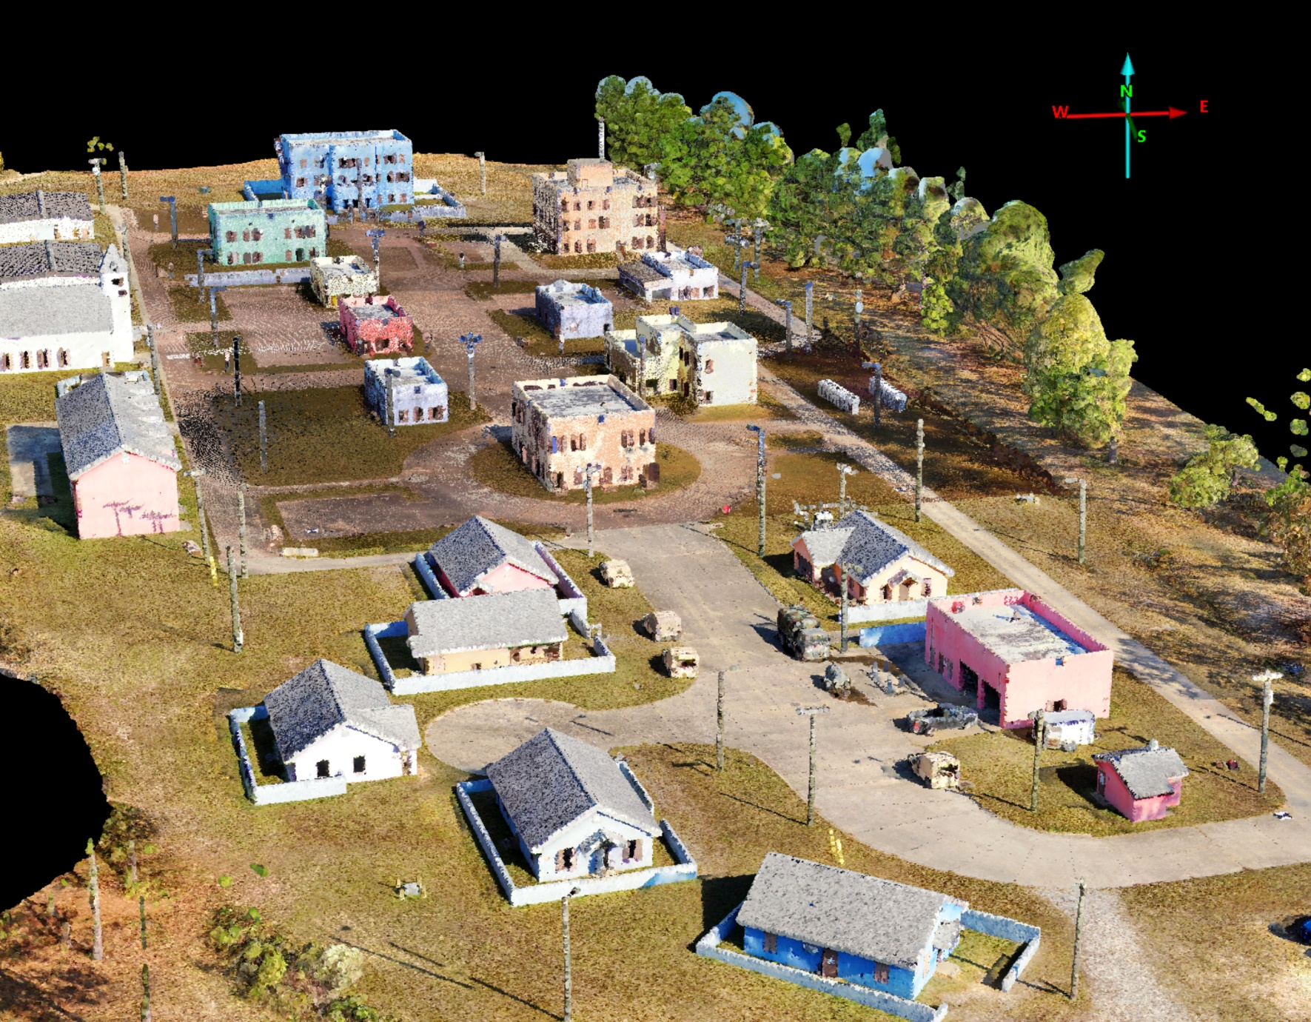
Motivation
Problem: Army has flown a sUAS-Photogrammetric Survey and we want to know the overall accuracy of the data.
AND we’d like to know the per-point error/uncertainty of the collected data.
Ft Moore/Selby CACTF sUAS-Photogrammetric (SkydioXD2) collected November, 2023

Slide 4
Errors Associated with 3D Data
Measured Errors
6 axis linear transformation to determine registration parameters
Registration Errors
Measurement Uncertainty
Input Point Cloud
Reference Point Cloud
Registered Input Point Cloud
Reference Point Cloud
Error ellipsoid around each point
difference
dX, dY, dZ, dθx, dθy, dθz,
Scale factor
Per Point Measurement error converted into Sigma-R, Sigma-Z
With reference data, an error ellipse can be calculated for each point (Per-Point-Error)

Slide 5

Can Predicted Errors can Approximate Measured Errors
Predicted Errors
Measured Errors
6 axis linear transformation to determine registration parameters
GPS Errors
Registration Errors
Measurement Uncertainty
GPS_{Base}
Bias_H, Bias_Z;
RMS_H, RMS_Z
Registered Input Point Cloud
Reference Point Cloud
Input Point Cloud
Reference Point Cloud
GCPs
RMS_H_{i} , RMS_Z_{i}
difference
Input Point Cloud
dX, dY, dZ, dθx, dθy, dθz,
Scale factor
Per Point Measurement error converted into Sigma-R, Sigma-Z
Reconstruction Errors
Assumption: no registration errors

Slide 6
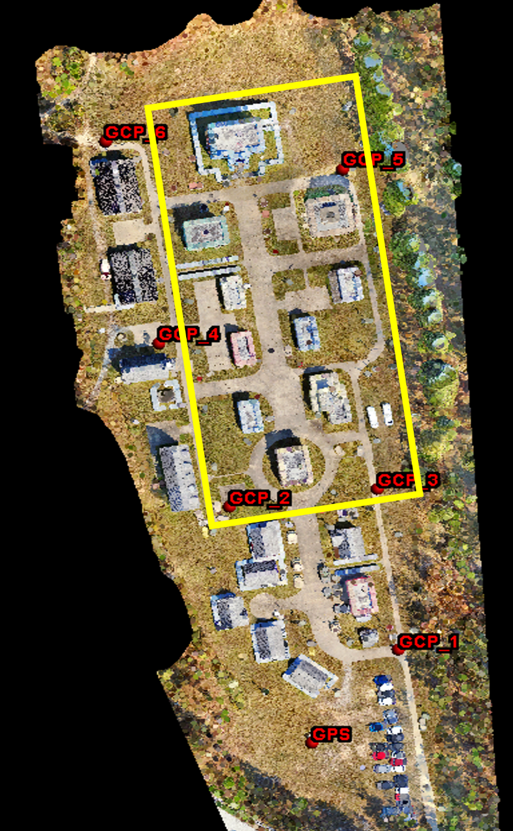
Collection Details
SkyDioX2D photogrammetric drone was flown over entire site
iTwin (Context Capture) was used to generate High Resolution Mesh from photographs
10 cm GSD point cloud was derived from High Resolution Mesh
Ground Control Points were used in this collection
Terrestrial Lidar Scanner (TLS) data were collected (yellow box) at the same time for data validation
Trimble RTX was used to collect 3D position information
Ft Moore/Selby CACTF sUAS-Photogrammetric (SkydioX2D) collected November, 2023

Slide 7
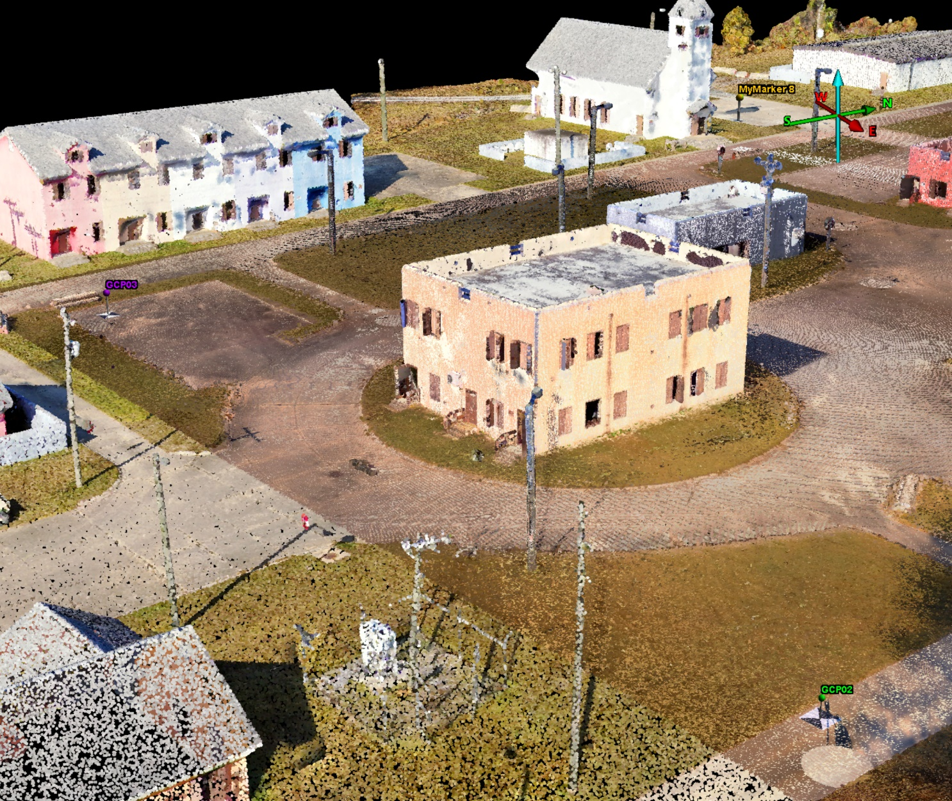
Importance of Controlled sUAS Collection
For a typical survey (~0.15 km2), we distribute 6 – 15 GCPs across the AOR.
Each GCP is 48” x 48” black and white tarp and the center XYZ location is surveyed with DGPS.
The computed mean and Standard Deviation registration errors (meters) of the Selby 3D data relative to GCPs
 | dX | dY | dH | dZ
without GCPs | -0.356 (0.398) | -0.794 (0.253) | 0.980 (0.139) | -8.656 (0.863)
with GCPs | -0.006 (0.045) | 0.023 (0.064) | 0.059 (0.056) | -0.075 (0.058)
Ft Moore/Selby MOUT sUAS-Photogrammetric (SkydioXD2) collected November, 2023

Slide 8
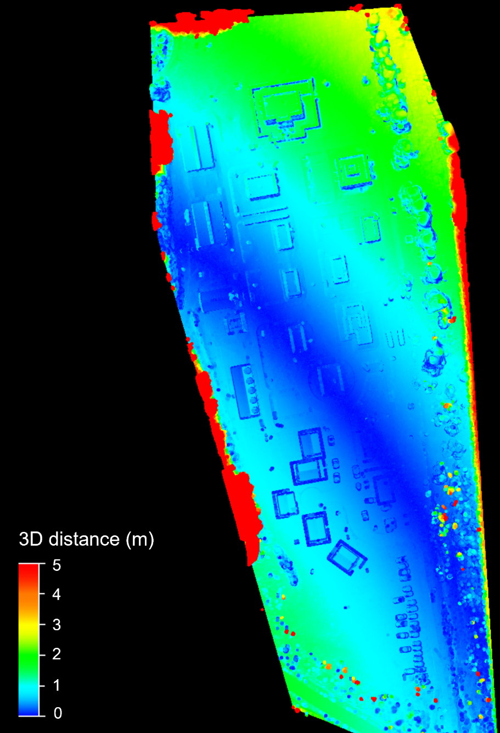
Importance of Controlled sUAS Collection
Using GCPs during a data collection is critical to minimize distortions and warping due to camera distortions and poor GPS information on photo tags
Absolute 3D error of data processed with and without GCPs

Slide 9
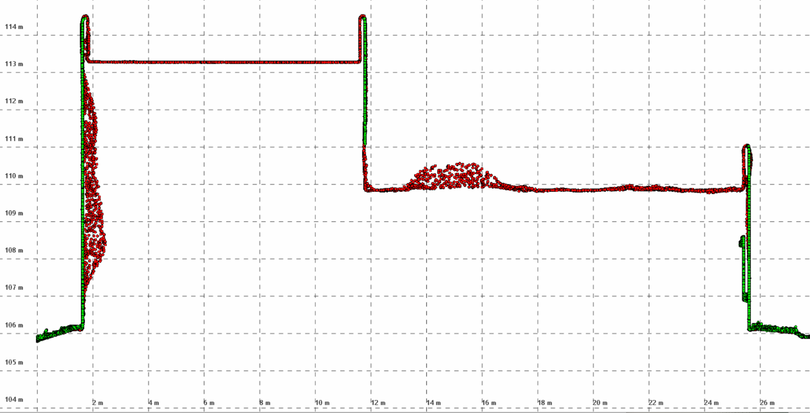
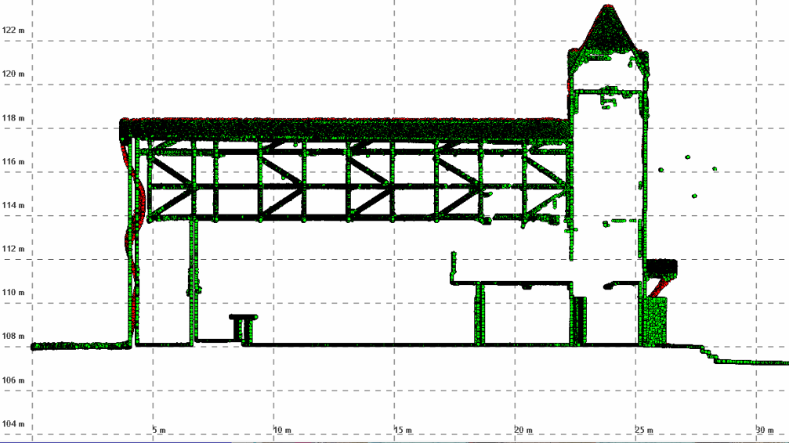
Examples of SfM Reconstruction Errors
UAS-EO
TLS
Reconstruction Errors

Slide 10
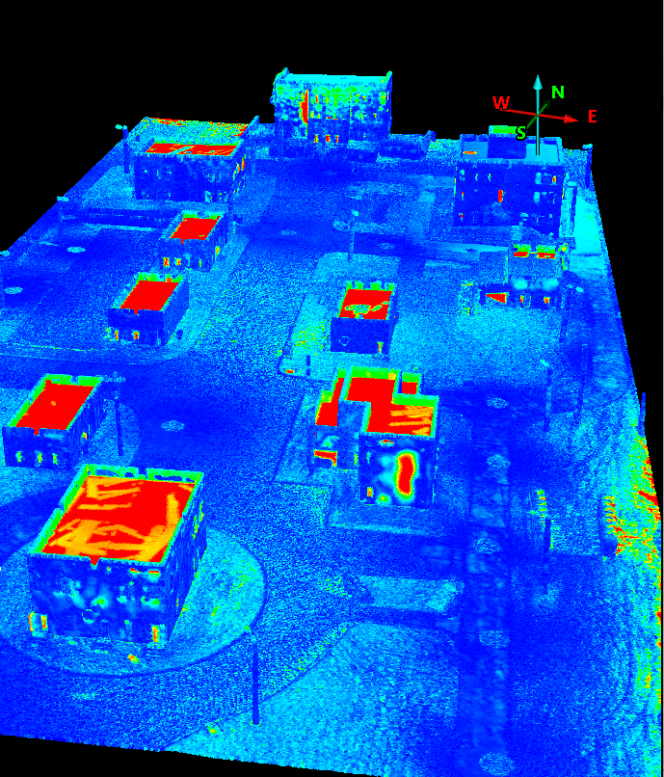

Calculating the Reconstruction Errors
Data Validation: Per-point Measurement Error
Difference of TLS – sUAS-Photogrammetric Point Clouds
Most of the reconstruction errors occur in doorways, window opening, beneath patio covering or along walls with low contrast between photos.
This 3D per-point measurement error along with the overall mean/RMSE errors provide a more complete representation of the actual errors/uncertainty for a sUAS collect.
3D Distance (m)
0.50
0.40
0.30
0.20
0.10
0.0

Slide 11
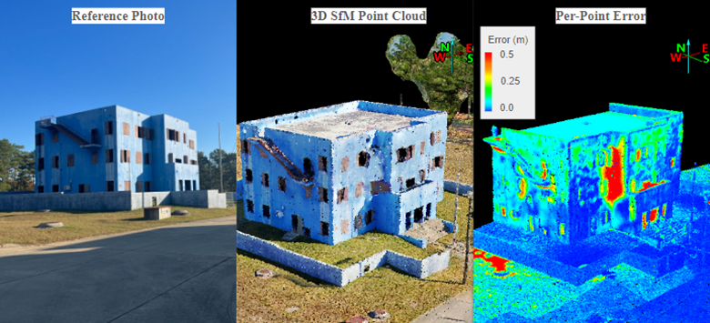
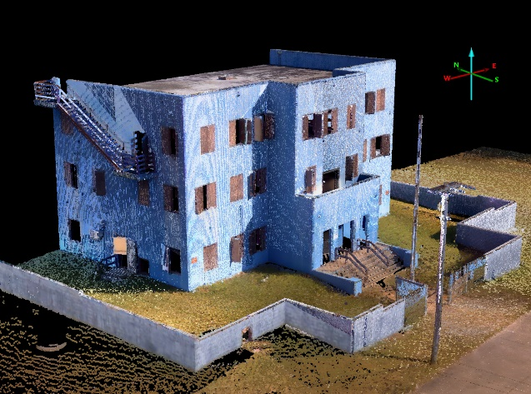
Calculating the Reconstruction Errors
3D TLS scan used as reference data

Slide 12
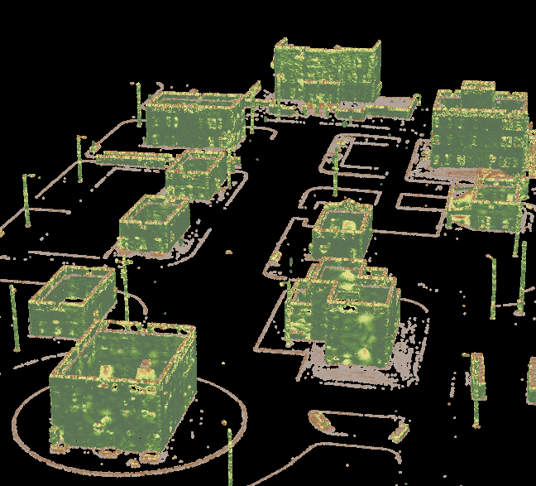
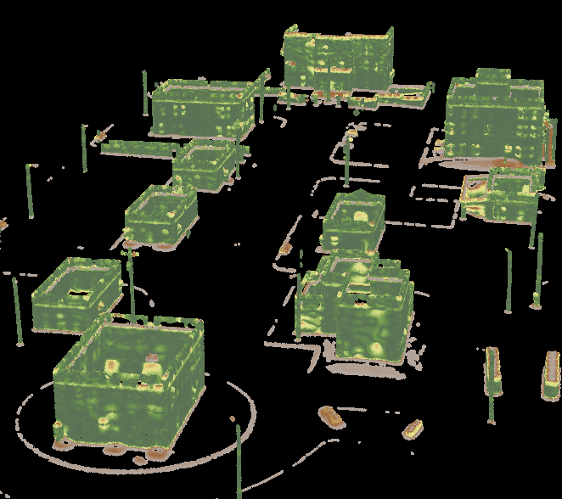

Building a Predicted Uncertainty Model
Measurement Error is what we want to predict
Generated “Features” from the input photogrammetric point cloud to predict against
Normal Vectors, 20 cm radius
Normal Vectors, 50 cm radius
angle (deg)
90
3D Distance (m)
0.50
0.40
45
0.30
0.20
0.10
0
0.0

Slide 13
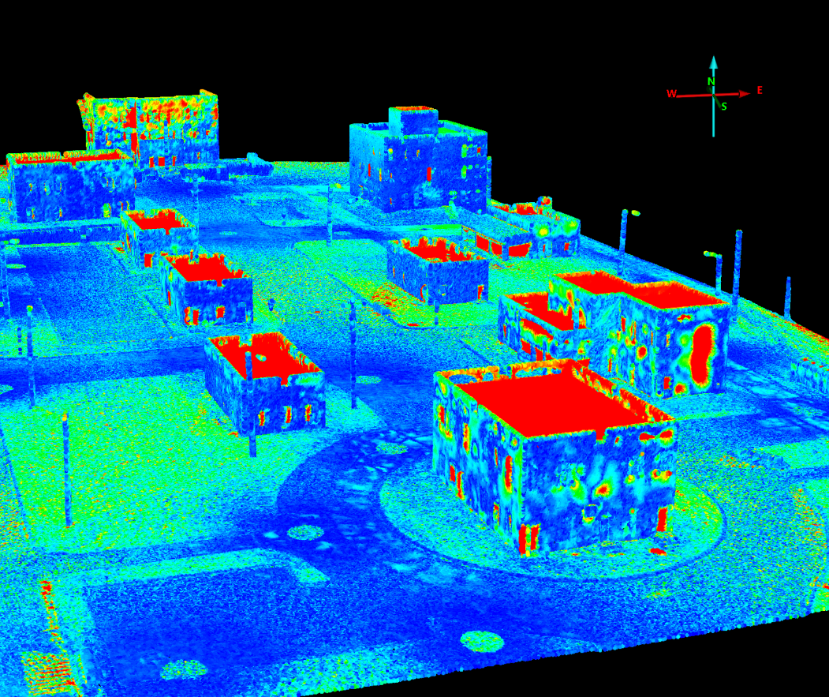
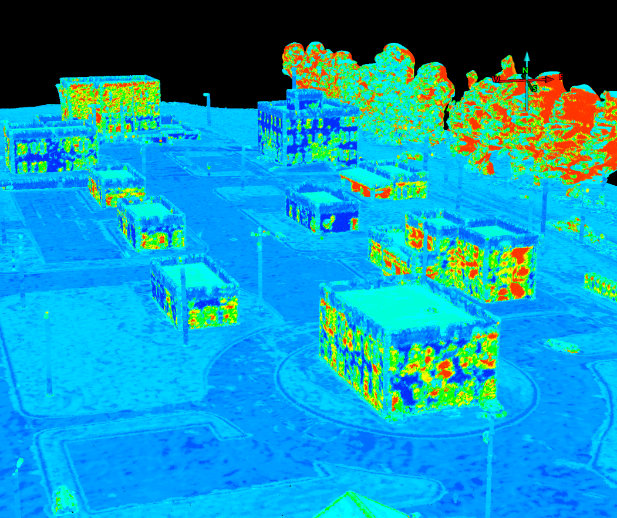

Prediction Error/Uncertainty Model
Measured Error
Predicted Error
cm
20
10
0
We used a Gradient Boosted Regression (GBR) model to predict our per-point-uncertainties.

Slide 14
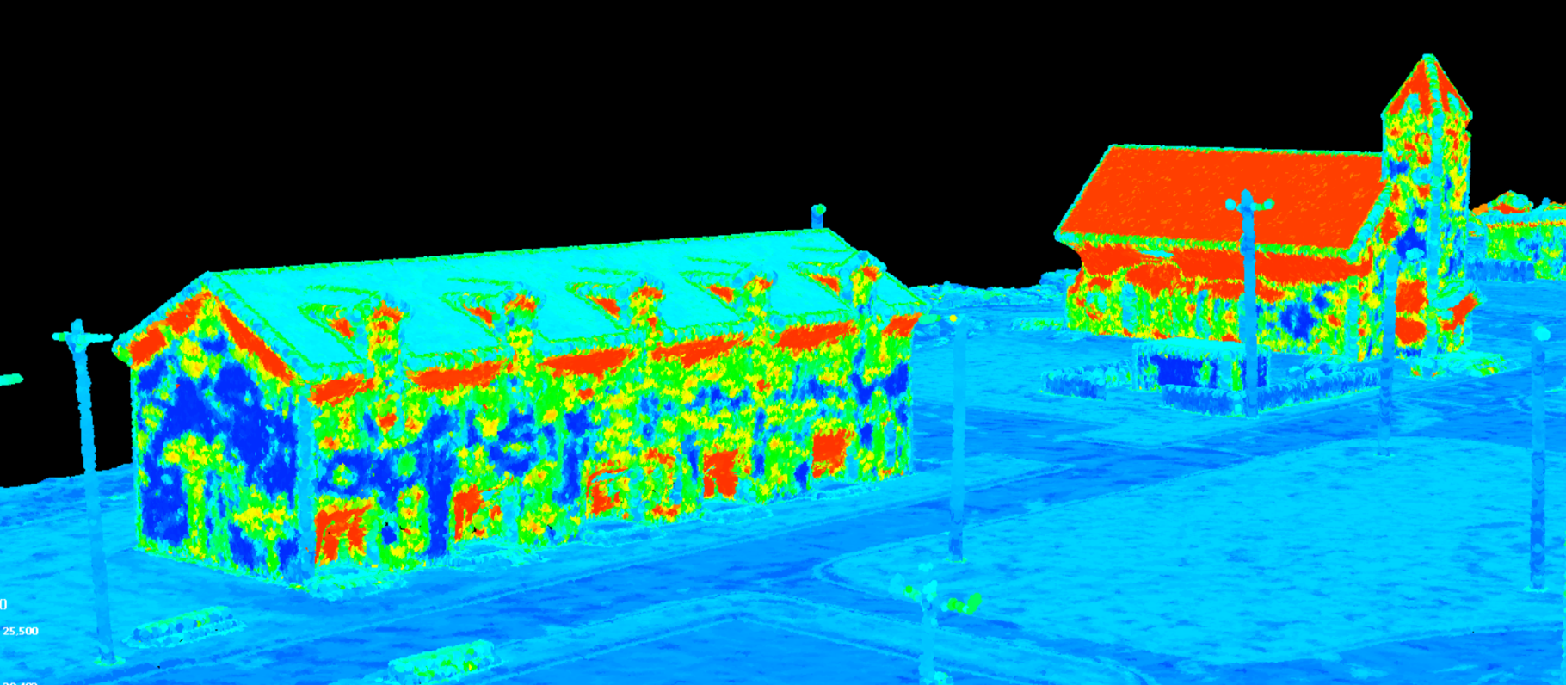
Prediction Error/Uncertainty Model
Highly pitched roof of church and steeple creates higher than desired uncertainty
Remedy: Need more representation in training data
Higher errors under eaves and in porch/entryways (as we expect)
cm
20
10
0
Predicted Error of photogrammetric 3D point cloud

Slide 15
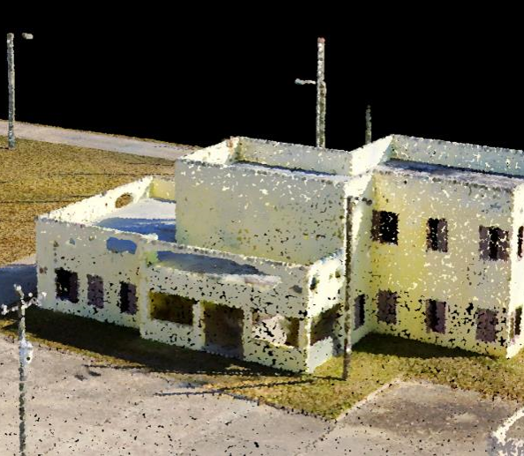
Limitations of the Model
Model currently applies only to open terrain and buildings.
  Vegetation has not been tested yet, but potentially could be included
  Terrain beneath vegetation is generally not visible in sUAS-Photogrammetric surveys
Need more data to improve model of reconstruction errors
Holes in reconstruction

Slide 16
Conclusions
Prediction Uncertainty Model was developed to create Per-Point-Errors (PPE) of sUAS Photogrammetric 3D data
  PPE informs data quality of sUAS survey
  PPE, combined with known and unknown errors contribute to the NGA Generic Point Cloud Model (GPM)
  Model currently consumes features from the input point cloud only
  Can be applied to ANY Photogrammetric point cloud
  Model assumes data is from a controlled Survey →No Registration Errors
Predicted Per-Point-Error

