Slide 1
Automated Radio Operator Utterance Recognition
for US Navy Training
Morgan Ulinski, Ph.D., Soar Technology, LLC
Ethan Medjuck, Soar Technology, LLC
Kellen Bixler, Soar Technology, LLC
Henry Phillips, Ph.D., Advanced Distributed Learning (ADL) Initiative

Slide 2
Introduction
Application: Navy shipboard radio operator training
Simulation of two-way radio communications
We will focus on using automated speech recognition (ASR) to grade the student utterance
Requirements:
Maintain at least 97% accuracy
No Internet connection
Limited computational power
Two types of grading for utterances (verbatim and non-verbatim)

Slide 3
Problem Details
Two types of grading for utterances (verbatim and non-verbatim)
Verbatim:
The exact text of the utterance is provided.
The student must repeat the text of the utterance word-for-word.
Any words that are mispronounced, skipped, inserted, or said out of order indicate failure on that utterance.
Non-verbatim:
Several keyword slots are provided as well as an expected communication as an example.
The student must correctly pronounce at least one word or phrase from each keyword slot.
If there is a keyword slot for a salutation, it must be spoken at the beginning of the utterance.
Other keywords may appear in any order, with unlimited extra words inserted in between.

Slide 4
Speech Recognition and Parsing
Problems with generally available ASR systems:
High-accuracy systems need large amounts of compute and/or connections to external servers
Not trained on specialized military domains
Fine-tuning requires many hours of audio recordings in intended domain
SpeechZero™
An all-in-one speech recognition and semantic parsing tool
Combines an off-the-shelf ASR system with a custom intent model to achieve high accuracy in specialized domains
Compatible with smaller ASR models that can run locally
Notes:
Classifies speech into speaker intentions via an intent model
Biases an off-the-shelf speech recognizer toward word patterns found in the intent model, increasing accuracy in specialized domains

Slide 5
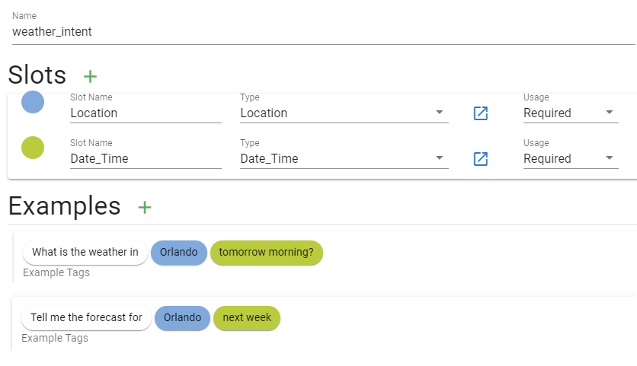
Speech Recognition and Parsing
What is an intent model?
A computer-interpretable model that translates speech into speaker intentions
Similar strings of words can have different intended meanings in different contexts
Similar meanings can be expressed using different combinations of words

Slide 6
Speech Recognition and Parsing
What is semantic parsing?
A process that converts natural language into a formal representation of its meaning that a machine can understand
Semantic
Parser
“Tell me the weather in New York City next week”
weather_intent {
Location=“New York City”,
Date_Time=“next week”
}

Slide 7


Speech Recognition and Parsing
Intent model
Intents
SpeechZero™
N-gram Generator
Grammar Generator
N-grams
Grammar
ASR Model
Parser
Semantic
parse
Grader
Text
N-gram model
Grammar model
Pass/Fail

Slide 8
Utterance Text Preprocessing
A list of 3,515 verbatim utterances and 1,093 non-verbatim utterances was provided
Utterances were preprocessed for consistency:
Correct misspellings and typos starboaord => starboard, accirdancewith => accordance with
Add spaces between acronym characters: MZD => M Z D
Convert numbers to English words: 27 => twenty seven
When appropriate, convert dashes to “tac” and letters to NATO alphabet: 5-4-0-W => five tac four tac zero tac whiskey
Remove duplicates
1,650 unique verbatim utterances and 553 unique non-verbatim utterances remained

Slide 9
Intent Model Construction
Intent models were constructed procedurally in a Python script
Each unique utterance in the list is considered an intent
Verbatim
Each utterance is split into words and short phrases. These are the required semantic slots for the intent.
Non-verbatim
The keyword slots are used as required semantic slots for the intent.

Slide 10
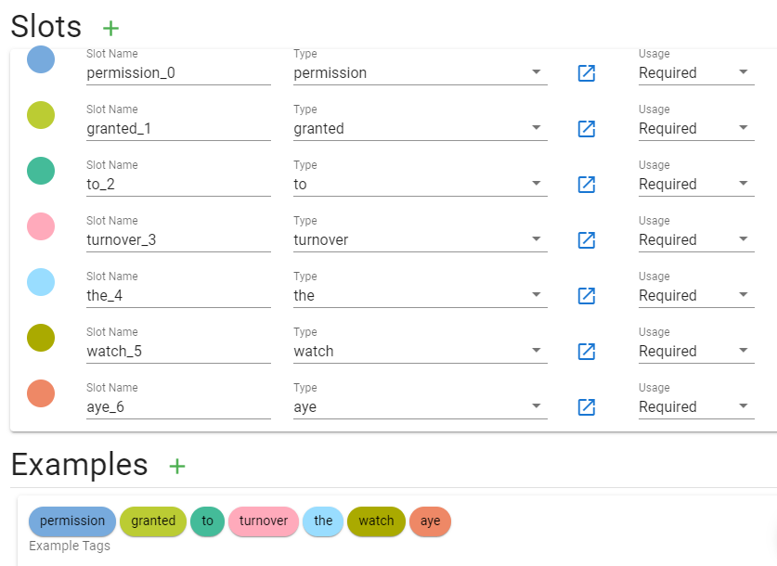
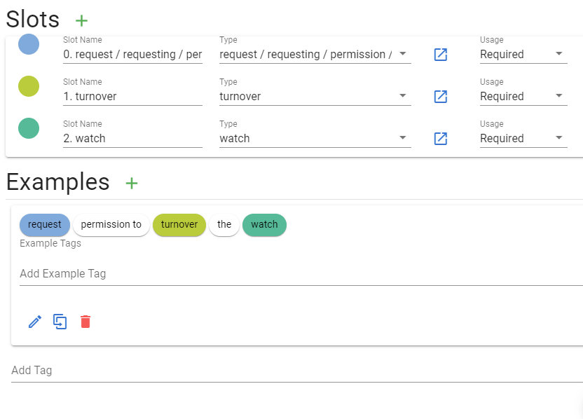
Intent Model Construction
Verbatim Intent
Non-Verbatim Intent

Slide 11
Audio Data Collection
13 speakers participated
Recordings obtained for both correct and incorrect versions of utterances
Pronunciation requirements for usable utterance recordings:
Cadence and enunciation reflecting some minimum and human-detectable pauses between words.
Human-perceptible breaks in speaking at utterance points containing commas or periods.
Human-perceptible distinction between syllables
Recording must be understandable by a human when played at normal volume.

Slide 12
Verbatim Utterance Recordings
Correct recordings:
Speakers read verbatim utterances as written
Incorrect recordings:
Incorrect examples produced by modifying verbatim utterance text:
1. Deletion: a random word or phrase was removed from the utterance
2. Substitution: a random word or phrase was replaced by a different word or phrase
3. Insertion: a random word or phrase was inserted at a random position in the utterance.
Speakers read incorrect examples as written
After filtering based on pronunciation requirements and adherence to written text:
3,310 correct audio recordings
1,646 incorrect audio recordings

Slide 13
Non-Verbatim Utterance Recordings
Correct recordings, expected communications:
Speakers read expected communication for utterance as written
1,632 recordings after filtering
Correct recordings, randomized:
Produced by randomly selecting one keyword from each keyword slot, shuffling these into a random order, and randomly inserting additional words between the selected keywords
Speakers read randomized text as written
2,208 recordings after filtering
Incorrect recordings, randomized:
Produced by randomly excluding one of the keyword slots, then following the same procedure as above
1,301 recordings after filtering

Slide 14
Grader Implementation
Output of SpeechZero™ is a semantic parse
A map from semantic slots to word index ranges in the recognized text
Any unfilled slots are mapped to null
Example
Grading algorithm:
If any semantic slot maps to null, return fail
If any word index is not referenced by a semantic slot, return fail
(Verbatim only) If the semantic slots are not in the correct order, return fail
Otherwise, return pass

Slide 15
Intent Model Iteration
Testing system on actual audio recordings revealed homophone errors
i vs. aye
too vs. to vs. two
lube oil vs. loo boil
turbine vs. turban
…
Adding alternatives to standard spellings improved accuracy

Slide 16
Hyperparameter Tuning
Hyperparameter definition:
A configuration variable used by a machine learning model
ASR engine has two hyperparameters of interest: Alpha and Beta
Alpha controls weighting the acoustic model vs. the language model
Beta provides a conciseness weighting
Alpha and Beta were tuned to achieve maximum accuracy on both correct and incorrect recordings

Slide 17
Results
Baseline Intent Model 1:
No alternative pronunciations or spellings
Baseline Intent Model 2:
One alternative spelling: allow i in place of aye
Final Intent Model:
All alternative pronunciations and spellings

Slide 18
Verbatim Results
Results on verbatim correct recordings
Intent model | Accuracy
Baseline 1 | 51.42%
Baseline 2 | 90.00%
Final model | 97.49%
Results on verbatim incorrect recordings
Intent model | Accuracy
Baseline 1 | 99.45%
Baseline 2 | 98.30%
Final model | 97.51%

Slide 19
Non-Verbatim Results
Results on non-verbatim correct (expected comms) recordings
Results on non-verbatim correct (randomized) recordings
Intent model | Accuracy
Baseline 1 | 89.77%
Baseline 2 | 89.71%
Final model | 98.16%
Intent model | Accuracy
Baseline 1 | 86.19%
Baseline 2 | 86.28%
Final model | 97.06%
Results on non-verbatim incorrect (randomized) recordings
Intent model | Accuracy
Baseline 1 | 99.31%
Baseline 2 | 99.23%
Final model | 99.15%
Notes:
We found that accuracy was lower on the randomized utterances than on the expected communications. One possible explanation for this is that the underlying ASR model was trained on grammatically spoken English and the randomized utterances did not follow this pattern. Another possible explanation is that the randomized utterances tended to be somewhat longer due to the number of extra words being inserted.

Slide 20
Word Error Rate Results
Word error rate (WER)
The number of recognition errors in an utterance divided by the total number of words.
Errors: substitution, insertion, or deletion of words
Slot error rate (SER)
Since insertion is legal for non-verbatim utterances, we also define SER which only counts deletion of words
Dataset | Result*
Verbatim Correct (WER) | 0.16%
Non-verbatim Expected Comms (SER) | 0.16%
Non-verbatim Randomized Correct (SER) | 0.28%
* For comparison, state-of-the-art WERs range from ~2% to ~15%.

Slide 21
Conclusion
The grading system met all the customer requirements:
Maintain at least 97% accuracy
No Internet connection required
Works with limited computational power
Two types of grading for utterances (verbatim and non-verbatim)
(Bonus) Word-error rates are highly competitive with current state-of-the-art
Future work
Automate additions of homophones and alternative spellings to the intent model
Apply grading methodology to other speech-based training systems

Slide 22
Questions?
Morgan Ulinski, Ph.D.
morgan.ulinski@soartech.com

