Slide 1

Soldier Centric Design of Mixed Reality Reconfigurable Virtual Collective Trainers
Dennis Joseph
Cole Engineering Services, Inc

Slide 2
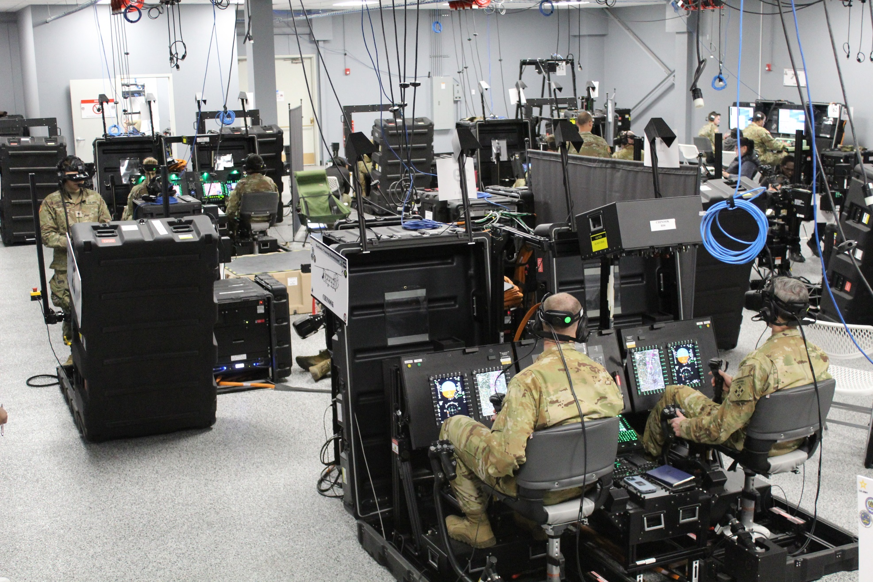
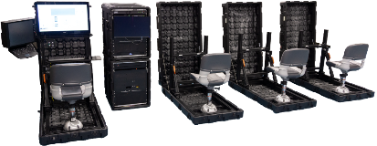
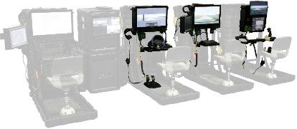
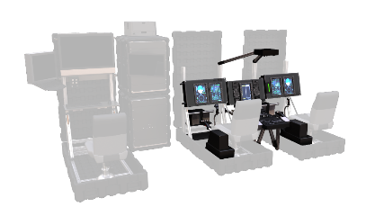
What is the Reconfigurable Vehicle Collective Trainer (RVCT)
Army’s new collective vehicle simulators developed for STE
Collective training simulator
Works with TSS/TMT
Reconfigurable and deployable
Setup by the Soldiers
Base Set
Ground
Vehicle Kit
Air Vehicle Kit
In operation
Reconfiguration

Slide 3
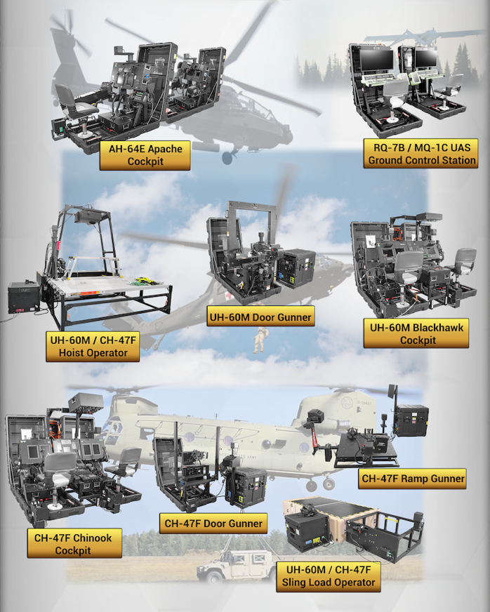
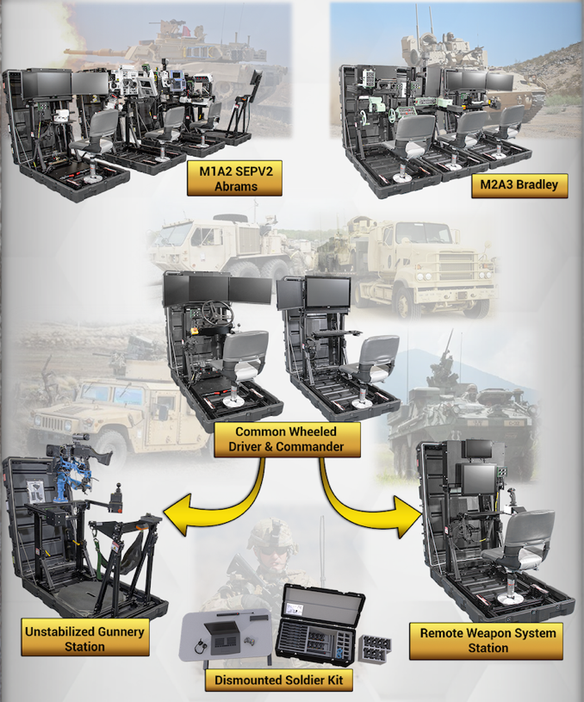
Current RVCT Vehicle Types

Slide 4
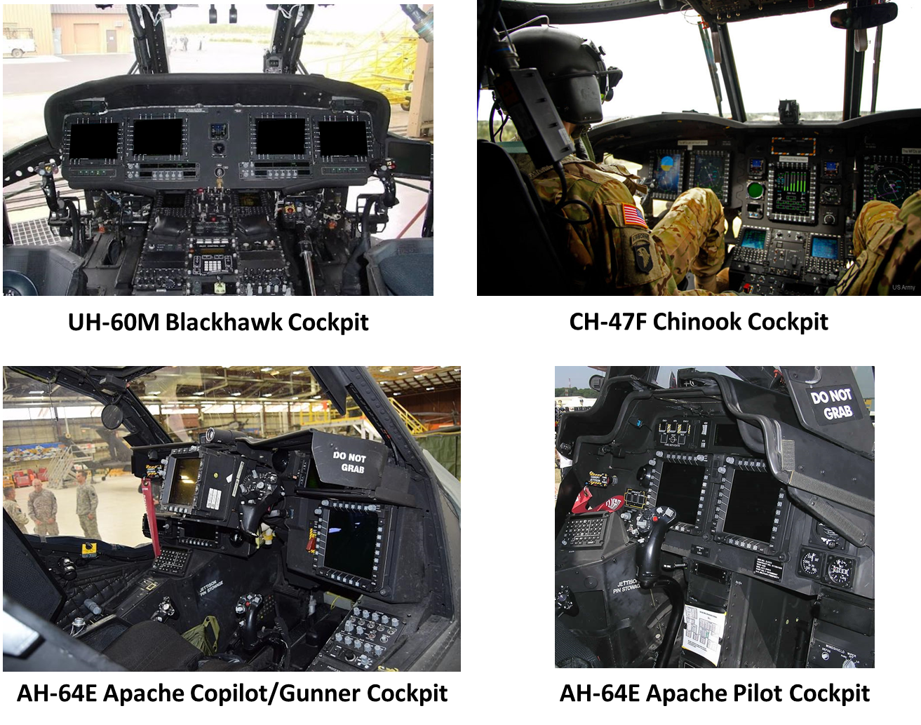
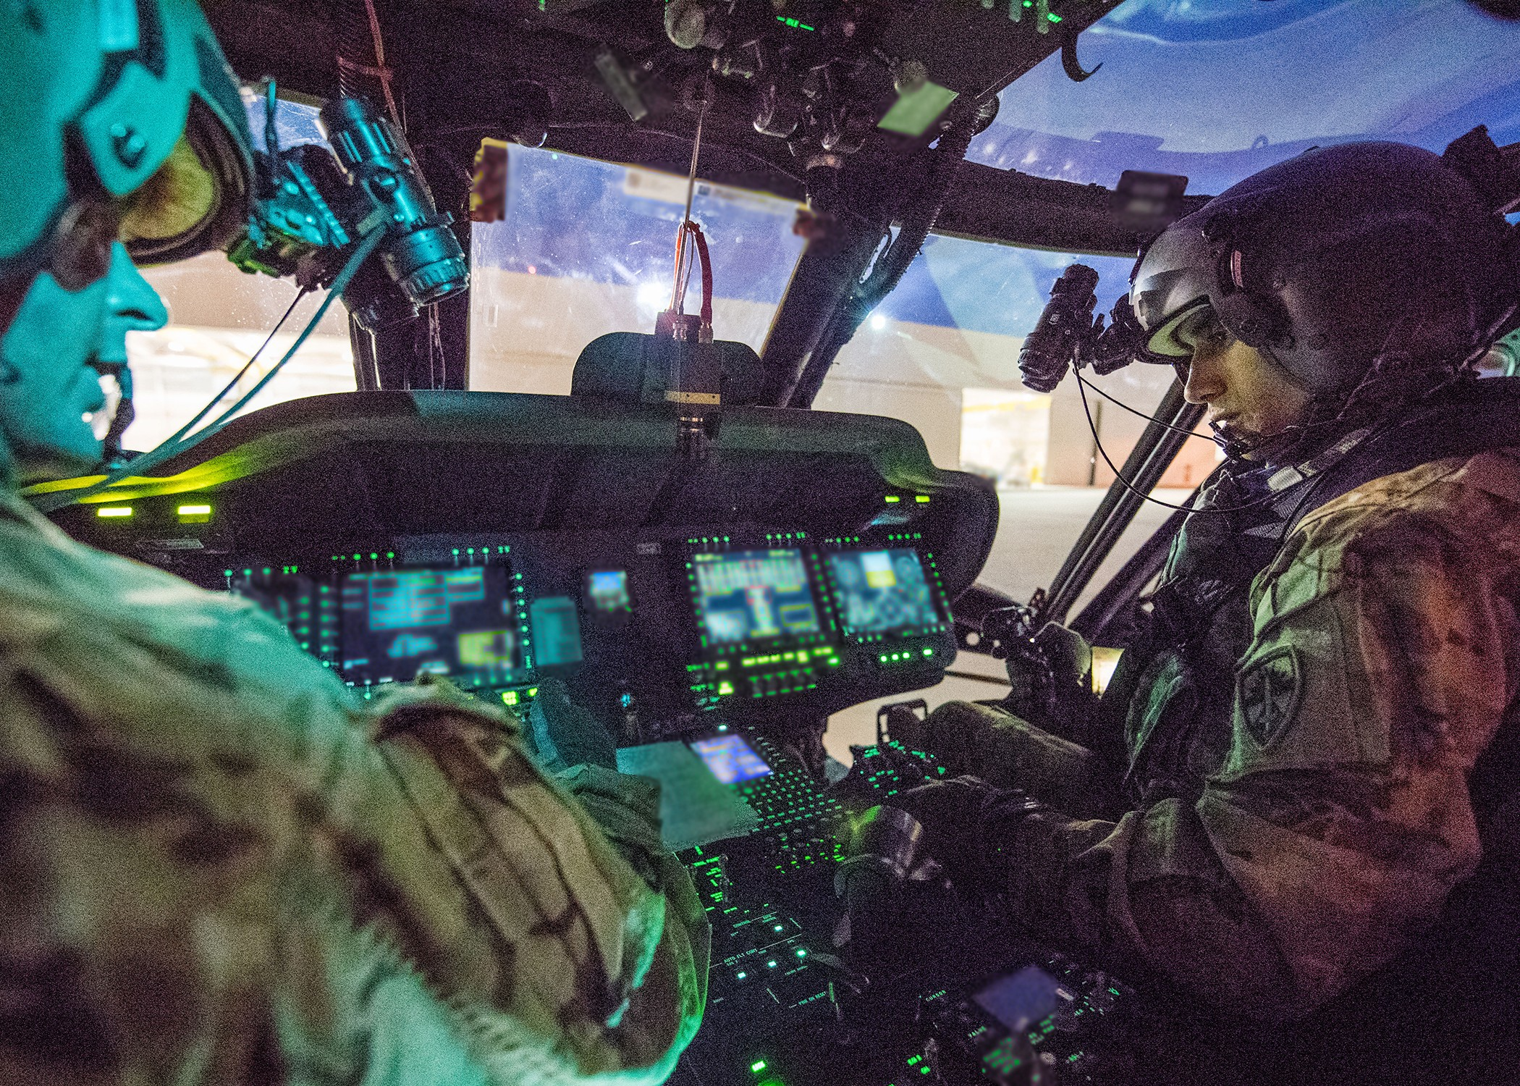
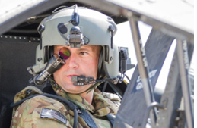
Current RVCT Air (Pilot/Copilot) Station Simulations
Including Night Vision Goggle (NVG) simulation
Including Integrated Helmet and Display Sight System (IHADS) simulation

Slide 5
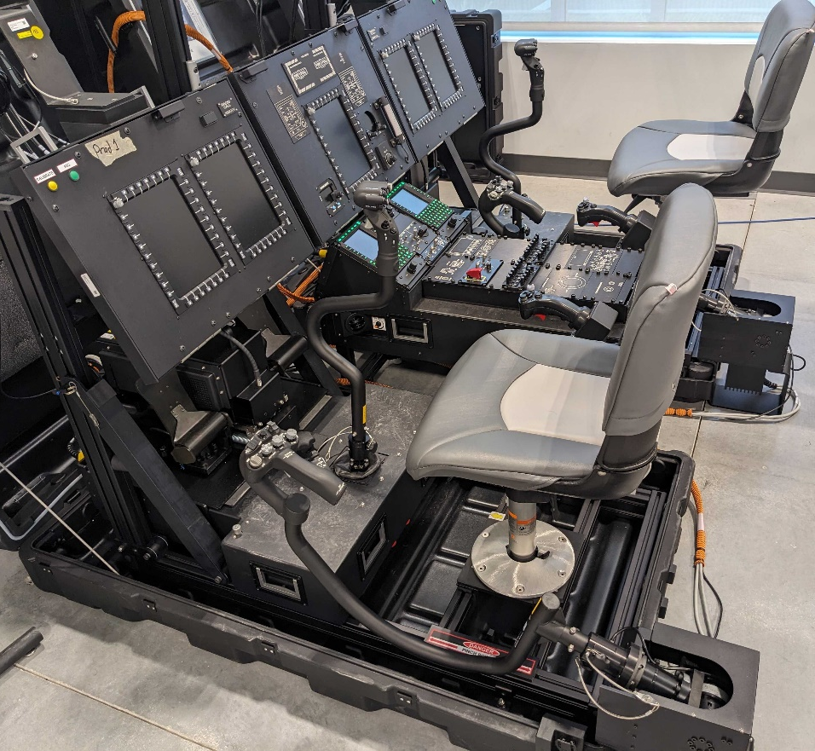
Introduction to the RVCT Air Stations
Collective Training - Pilots must be able to fly the aircraft and operate the systems with eyes-out of the aircraft as needed during live maneuvers
Instrument panels, center, side and overhead panels have full functional and physical fidelity
Cyclic, collective and pedals include electronic control loading with realistic flight models
Reconfigurable to each aircraft type
Powered by the Training System Software (TSS)

Slide 6
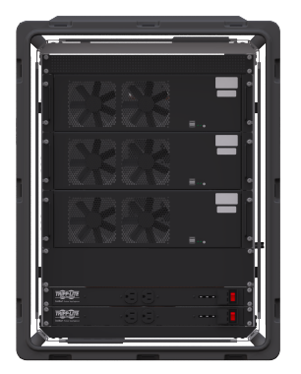

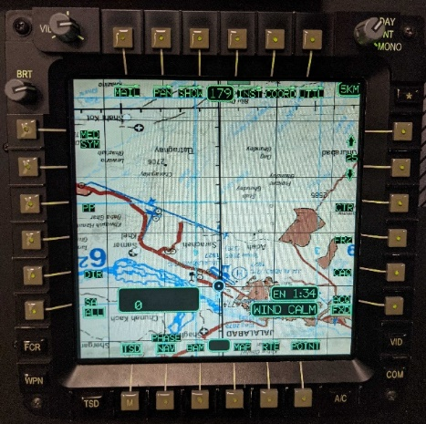
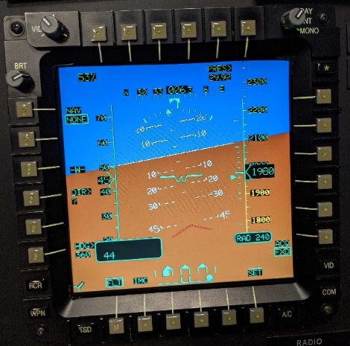
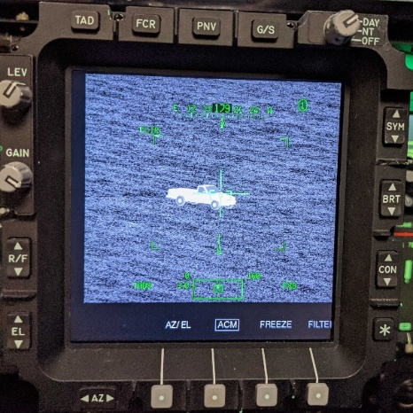
Key Challenges for RVCT Air Stations
Instrument Panel Display Challenges
Computational Challenges
Cockpit Display | Approx Viewing Distance | Display Size (HxV) | Pixels | Pixels per Inch | Pixels per Degree
CH-47F MPD | 36” | 6” x 8” | 480 x 640 | 80 | 50
UH-60M MFD | 36” | 8 x 6” | 640 x 480 | 80 | 50
AH-64E MPD | 36” | 6” x 6” | 768 x 768 | 128 | 80*
AH-64E TEDAC | 23” | 5” x 5” | 960 x 960 | 190 | 76*
One common compute kit per vehicle runs the pilot, copilot and sensor visual channels
Each platform must run off a single 20-amp circuit
*Visual acuity ~60 PPD (1 arc minute) for typical viewers
Deployment Challenges
Open room environments
No control of ambient lights
Must simulate all Day to Night conditions
Deployable by the soldiers
AH-64E TEDAC
AH-64E MPDs
High resolution sensor, map and symbology content must be clear through HMD

Slide 7
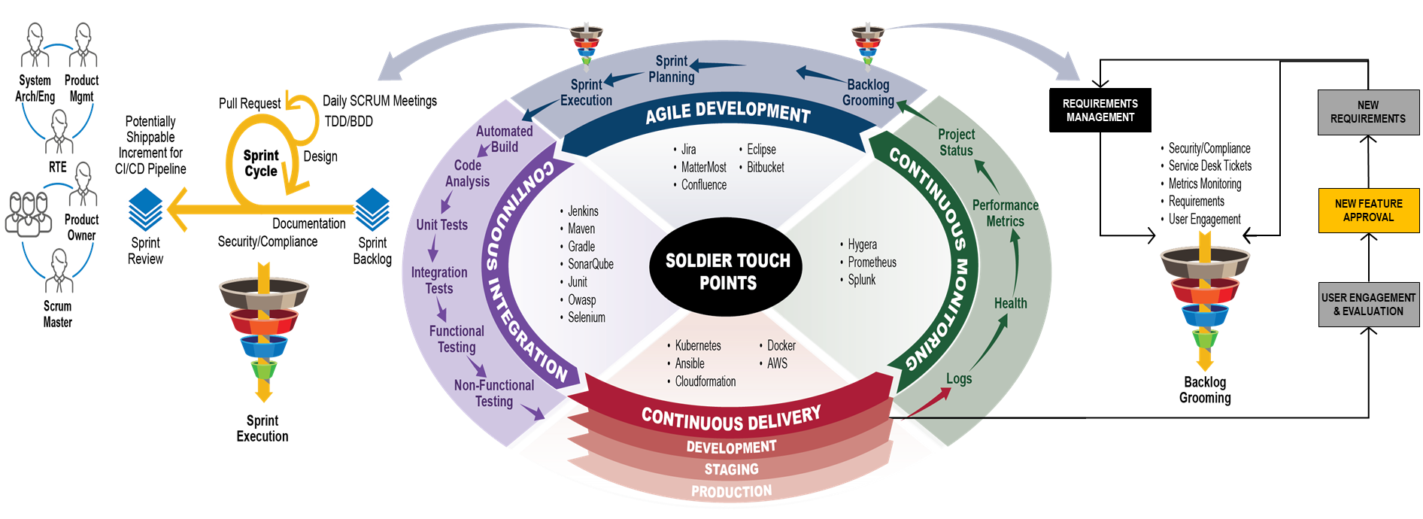
Soldier Centric Design Process
RVCT conducted over 60 soldier touchpoints to review and adjust the prototypes
Began with Fidelity Analysis developed with the users
Continuous iterative development and improvement of the initial capability by TSS
Development included three generations of RVCT Stations before production contract

Slide 8
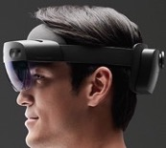
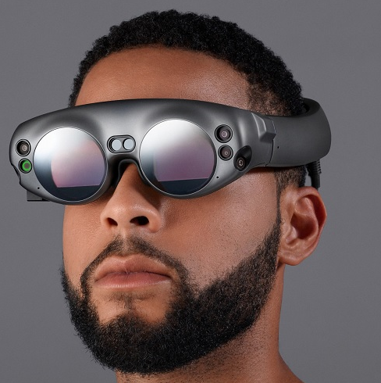
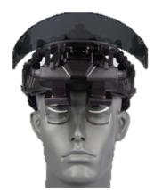
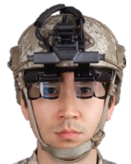
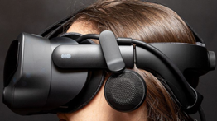
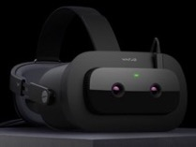
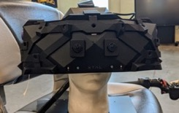
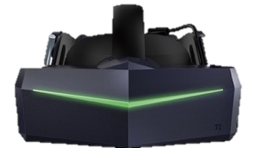
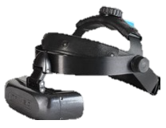
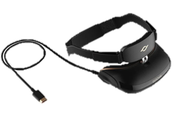
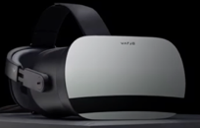
HMDs Evaluated at Program Startup (2019)
Optical Pass- Through (MR)
(AVCATT)
HoloLens 2
Magic Leap 1
SR-100A
SA-92
SA-147/S
Camera Pass- Through (MR)
Valve Index
Varjo XR-1
XTAL 5k w MR
Virtual Reality (VR) Only
PiMax Vision 8KX
Varjo VR-1
NVIS 106391
GOOVIS Pro (P2)

Slide 9
Application of VR-Only HMDs to RVCT Air Stations
Displays, instruments and panels are rendered as part of the VR scene
Physical controls / surfaces can still provide tactile feel
Reduces hardware, weight and cost
Provides isolation from exterior environment
Technical challenges
Realistic view of hands while working controls
Merging of high-resolution cockpit display content into the VR scenes
Alignment and stability of the VR with the physical surfaces with head motion
Solutions to the technical challenges were judged to be too high risk

Slide 10
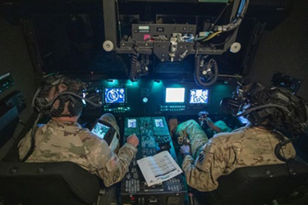
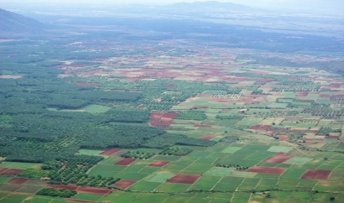

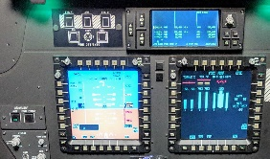


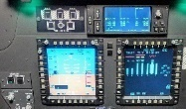

Optical Pass-Through / Legacy (AVCATT) Mixed Reality
VR scene is computed with black cockpit view
Black 3D
(Cockpit)
Mask
VR image reflects off beamsplitter, combiner, and back to eyepoint
VR Source (with mask)
Optics
Beam Splitter
Combined View
AVCATT Manned Module
(Head Mounted Displays Containerized in Trailer)
Eyepoint
Physical
View
Combiner
Element
Physical cockpit is seen through the beamsplitter and combiner
The Aviation Combined Arms Tactical Trainer (AVCATT) was the predecessor to RVCT Air
Full resolution of cockpit displays is preserved (Brightness attenuation only)

Slide 11
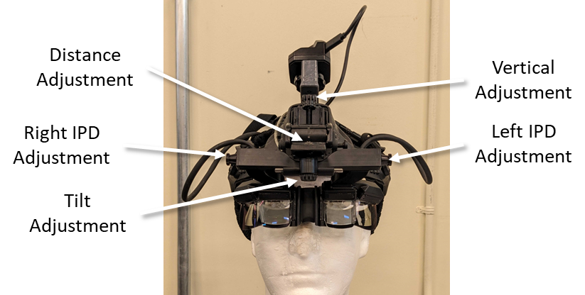
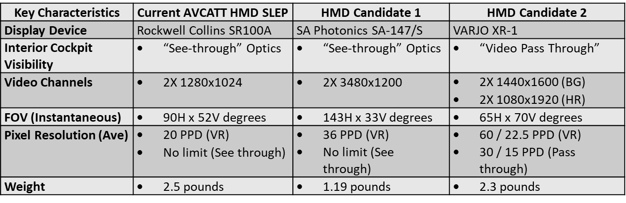
Initial RVCT Air Prototype (2020)
The SA-147S HMD was selected for the RVCT Air Prototype
See-through combiner (Same principle as AVCATT)
Resolution and weight enhancements over AVCATT
No adequate camera pass-through HMDs were available
Varjo XR-1 had insufficient pass-through resolution to clearly display the instrument panel display content
See-through combiner HMD limitations
Operation in an open room environment
Support for night simulation
SA-147/S

Slide 12
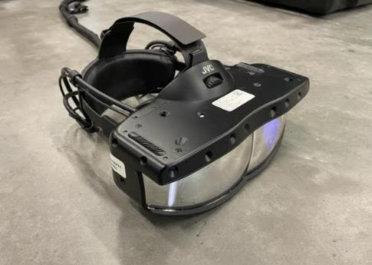
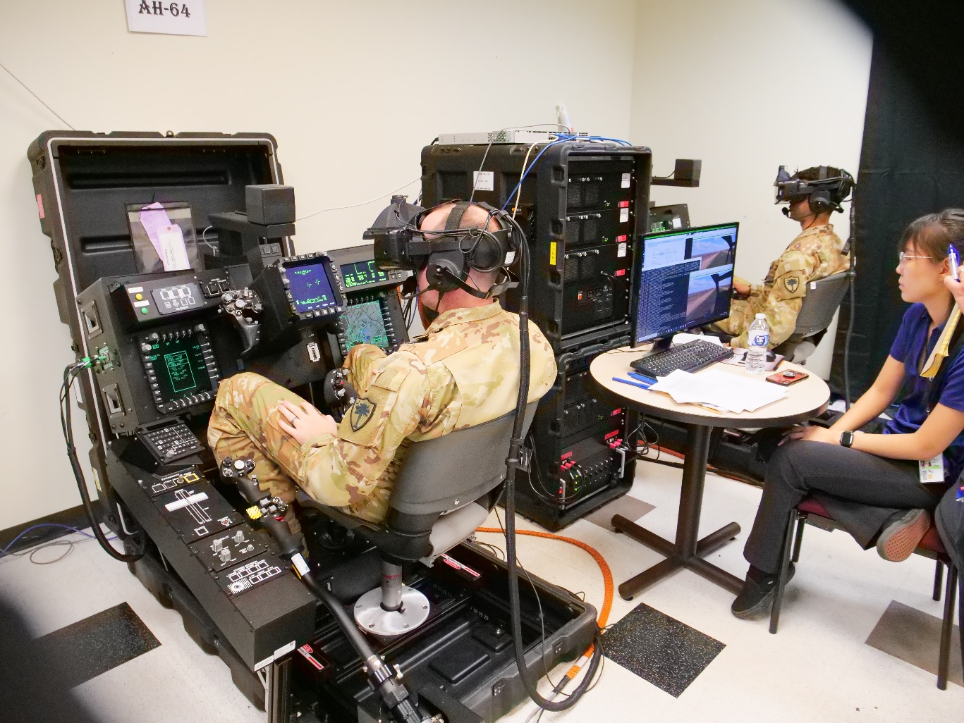
2nd Generation RVCT Air Prototype (2021)
Still a see-through combiner HMD subject to limitations
Operation in an open room environment
Support for night simulation
JVC VS-1W HMD
Became available April 2021
Non-pupil forming Eliminates user adjustments to align to pupils
120° H x 45° V FOV
32 PPD
Significant improvement of ease of use for the soldiers
JVC VS-1W at Soldier Touch Point
(With Polhemus Viper tracker / Integrated with TSS)

Slide 13
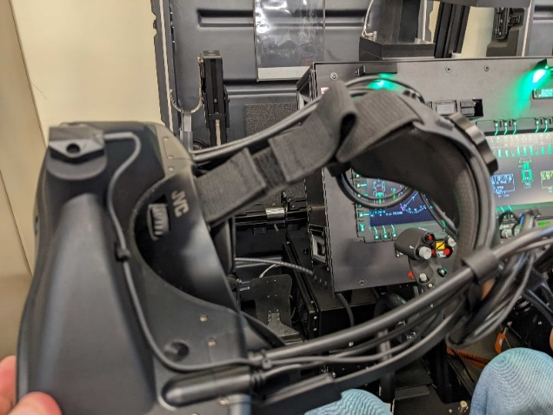
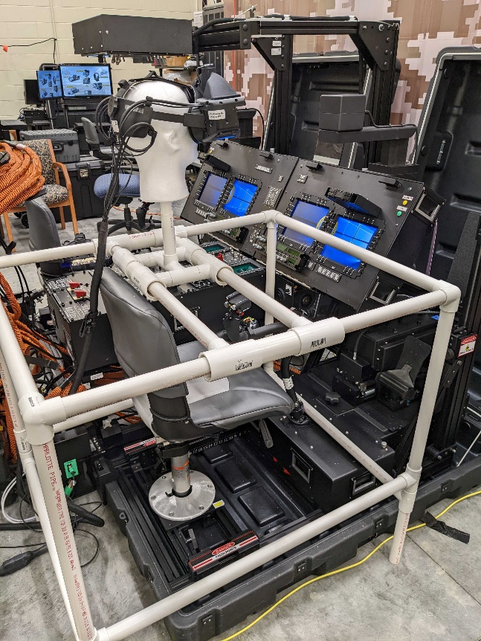
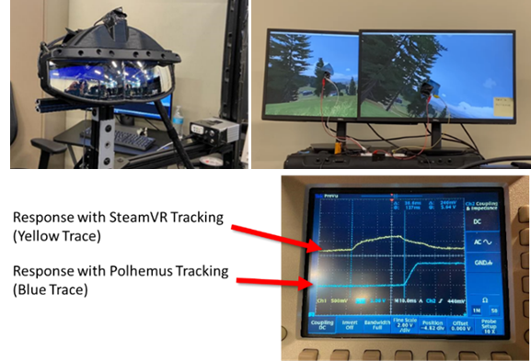
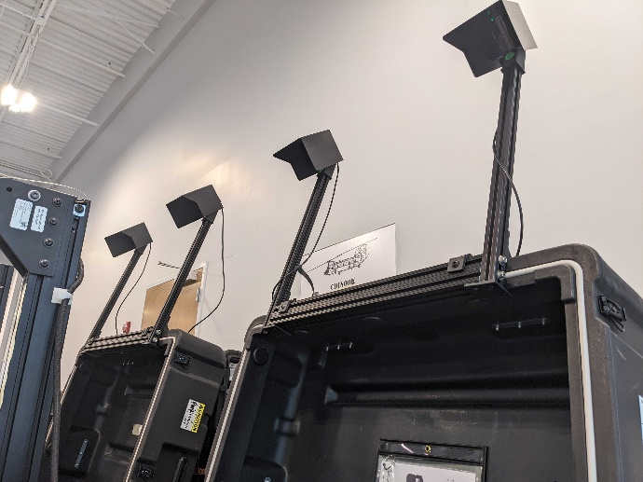
Evolution of Head Tracking on RVCT Air
Polhemus Viper (Common to all RVCT HMDs) was changed to SteamVR tracking on RVCT Air
EMI Induced Noise/Jitter
From HMD components
Resolved by offsetting sensor from HMD, reducing emitter distance, & filtering
Distortion of Tracker Space
Distortion of tracking space from metallic surfaces
Determined to be an issue
Mitigation by 6DOF mapping
Visual Latency
TSS measured latency of IG scene between Viper and SteamVR tracking
Major issue with soldiers
Could not be resolved
SteamVR Implementation
Four base stations per vehicle
Includes blinders to limit coverage to vicinity of the vehicle
Viper sensor “tierra” on JCV HMD
SteamVR Base Stations
Visual Latency Measurements
EMI, Distortion and Visual Latency issues were resolved by using SteamVR tracking
Distortion Measurement

Slide 14
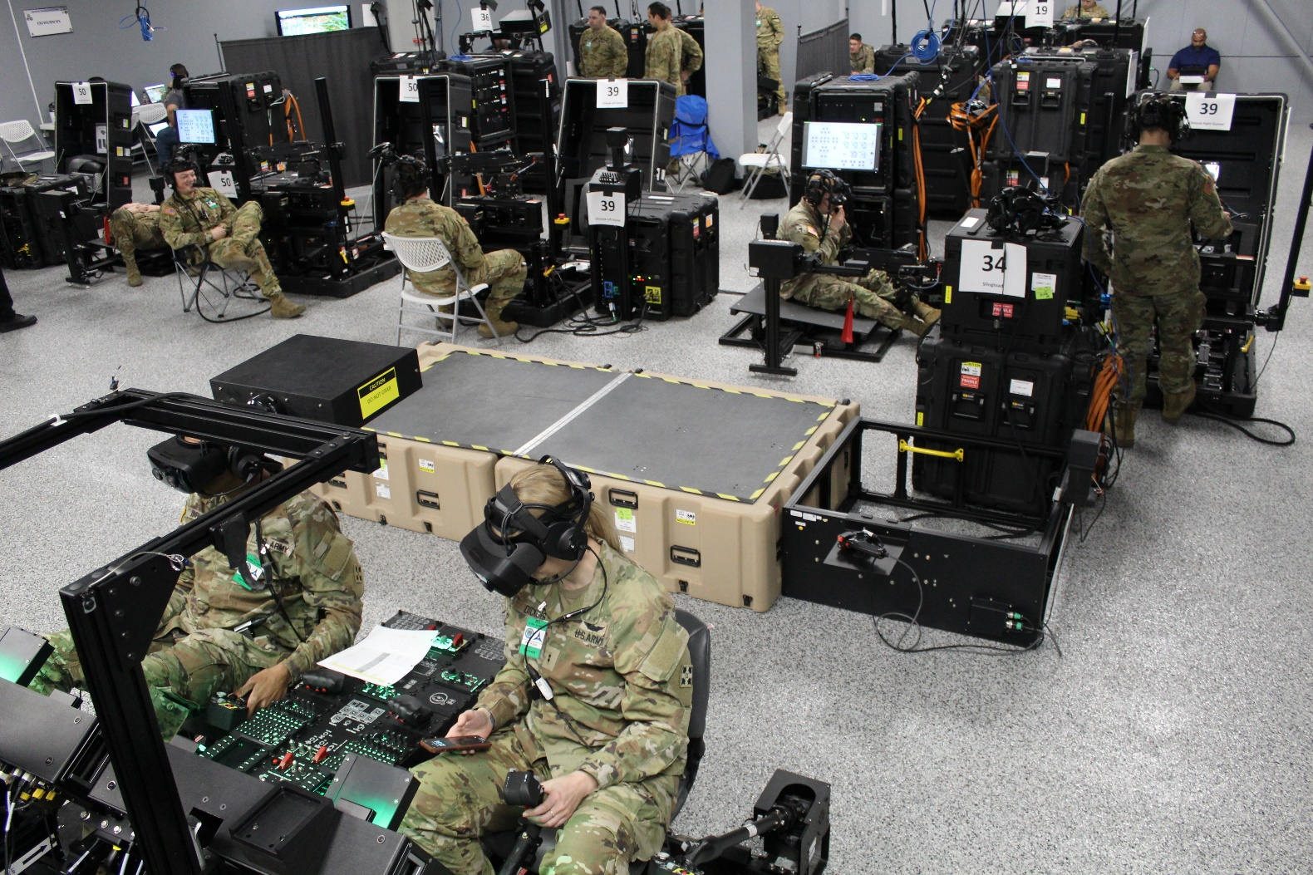
RVCT Issues Using See-Through Optics
RVCT operates in uncontrolled room environments
Multiple vehicles / No control of room lighting / ambient conditions
AVCATT utilized isolated / dark room environments
See-Through Optics Limitations
The room is visible through the optical combiner
Especially an issue for night simulation
Portable Tenting / Room Dividers Requires additional soldier setup, air flow and storage
Example of the RVCT “Open Room” environment

Slide 15
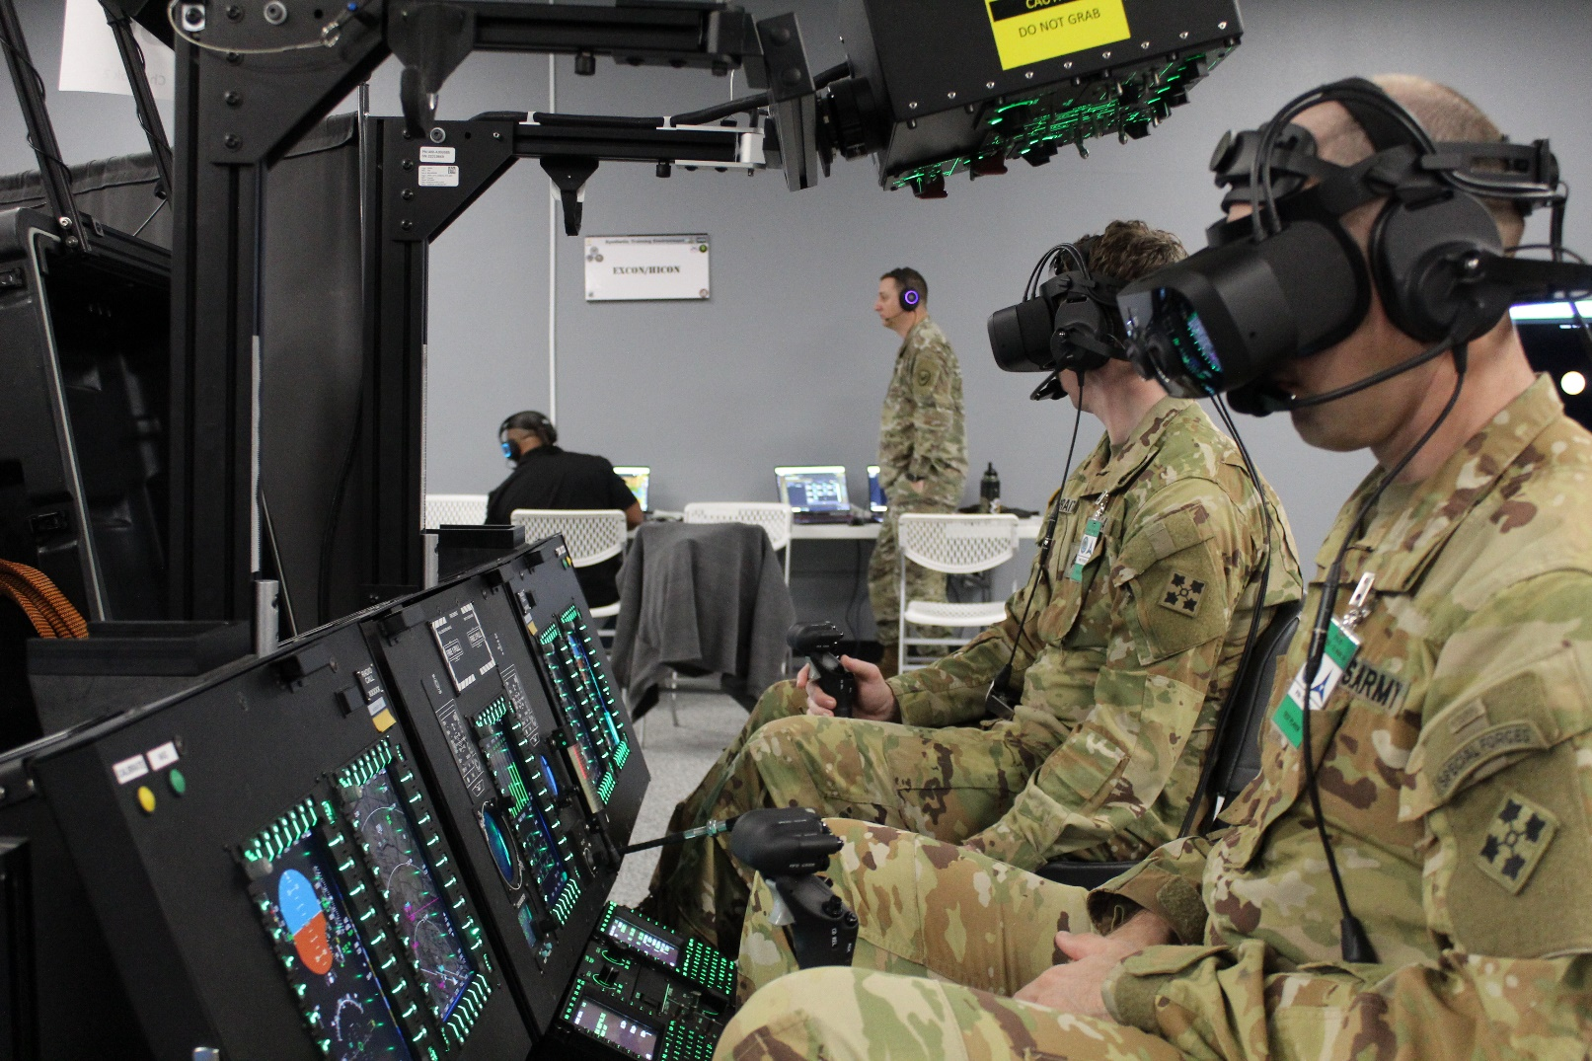
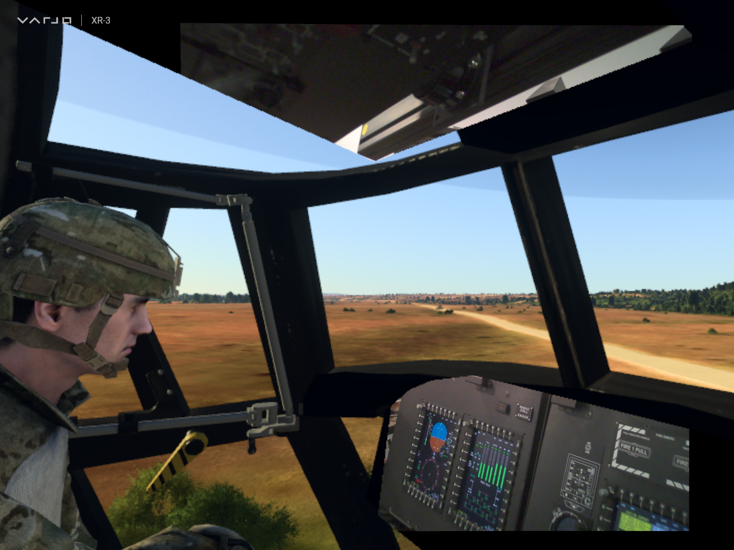
Key Advantage of Camera Pass-Through MR on RVCT
View of the Open Room
Pilot’s Mixed Reality View
VR View
Physical View
If done properly, the MR isolates the users from the external surroundings

Slide 16
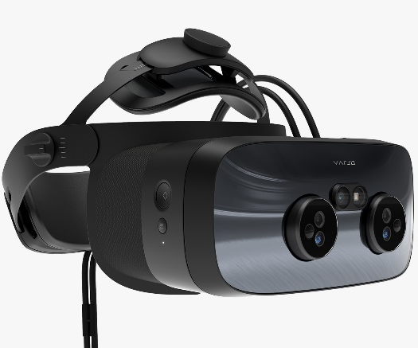
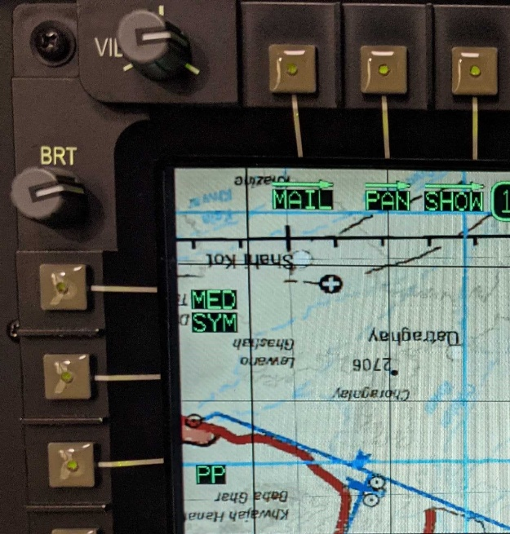
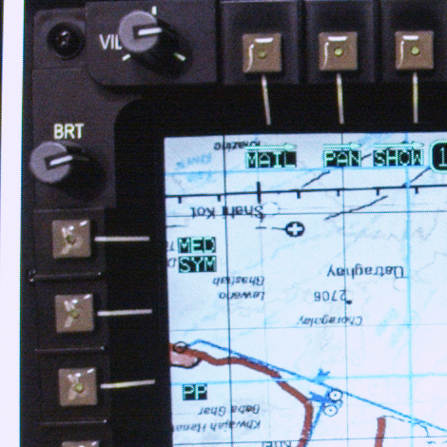
Pursuit of a Camera Pass-Through (MR) HMD
RVCT provided images of MFD content and viewing distances to assist HMD developers to understand what was needed
Varjo developed the “Vari-Focus” version of the XR-3
Achieved 49 PPD image quality for the camera pass-through
Traded-off reduction of the camera pass-through FOV
Also implemented variable focus distance based on LiDAR
Considered ready to demo to soldiers
XR-3 Vari-Focus
TEST RESULT IMAGE
Varjo HMD | Standard XR-3 | XR-3 Vari-Focus
Virtual Image | Foveated View 27° x 27° (70 PPD) Background View 106° x 90° (16 - 35 PPD) | Foveated View 27° x 27° (70 PPD) Background View 106° x 90° (16 - 35 PPD)
Video Pass-through | Foveated View 27° x 27° (35 PPD) Background View 106° x 90° (16 PPD) | Foveated View 27° x 27° (49 PPD) Background View 63° x 53° (16 PPD)
SOURCE IMAGE
XR-3 Vari-Focus

Slide 17
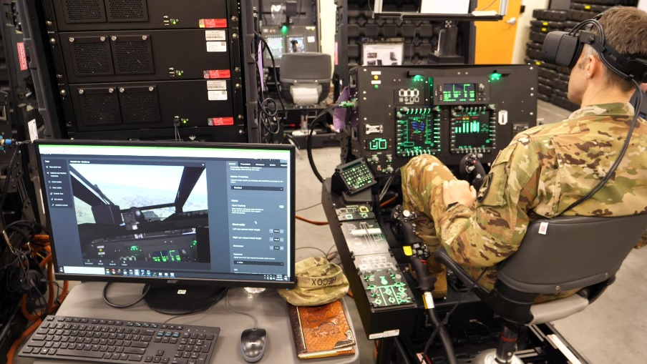
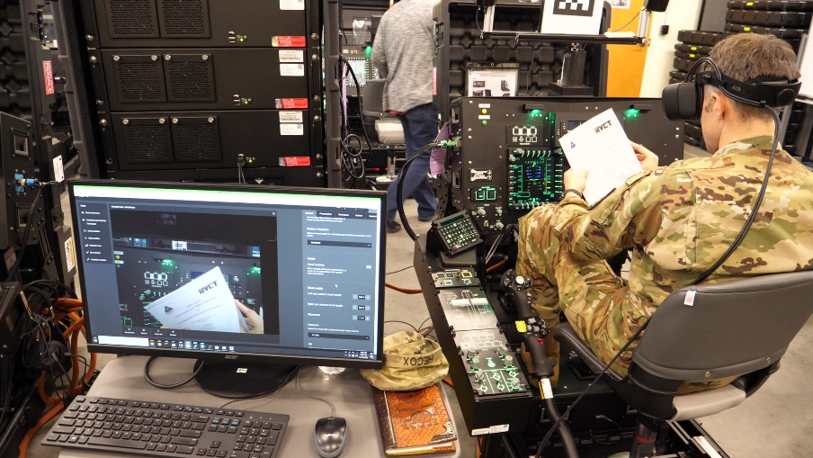

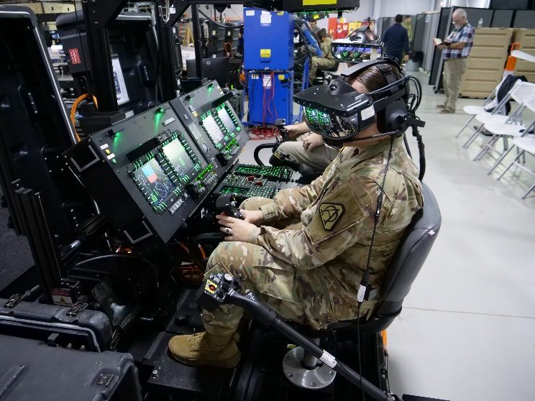
XR-3 Vari-Focus Evaluations & HMD Fly-Off
Initial XR-3 Vari-Focus touch point with DOS and USARNG demonstrated suitability of the HMD camera pass-through image quality (December 2022)
Pass-through camera quality was judged adequate to support training
Subsequent Flyoff between the JVC and Varjo “HMD Rodeo” demonstrated capabilities and limitations to support training scenarios (March 2023)
Key discriminator for the XR-3 “Vari-Focus” was ability to isolate the simulated environment from the exterior room
Soldier preference was the XR-3 Vari-Focus

Slide 18
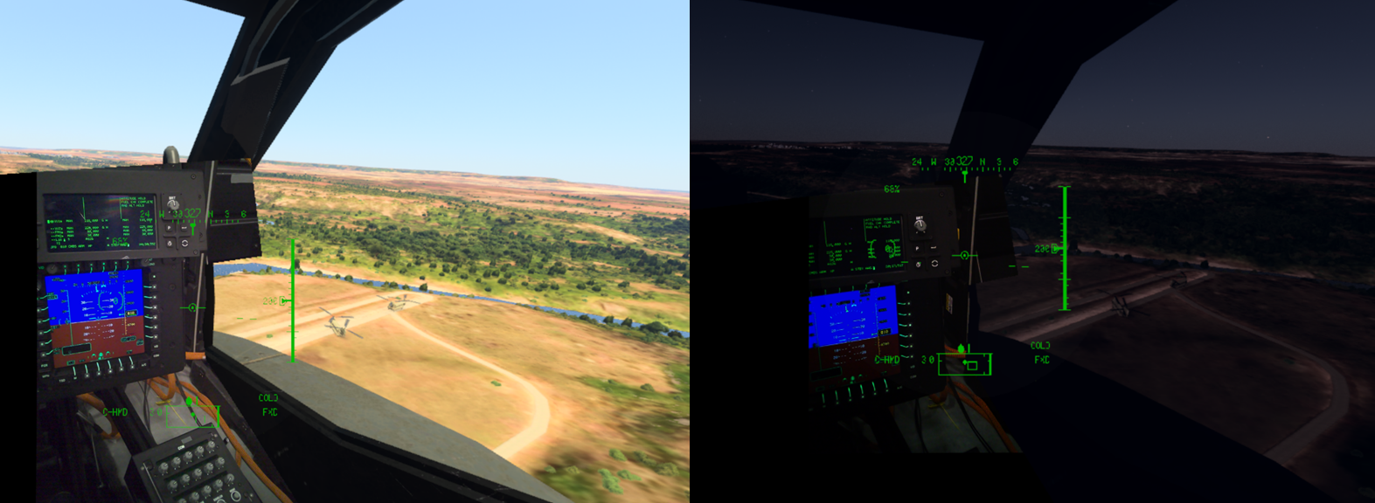
Mixed Reality Day/Night Simulation
Scenes with identical ambient room light conditions
The XR-3 Vari-Focus pass-through camera exposure and gamma settings are continuously adjusted for time-of-day

Slide 19
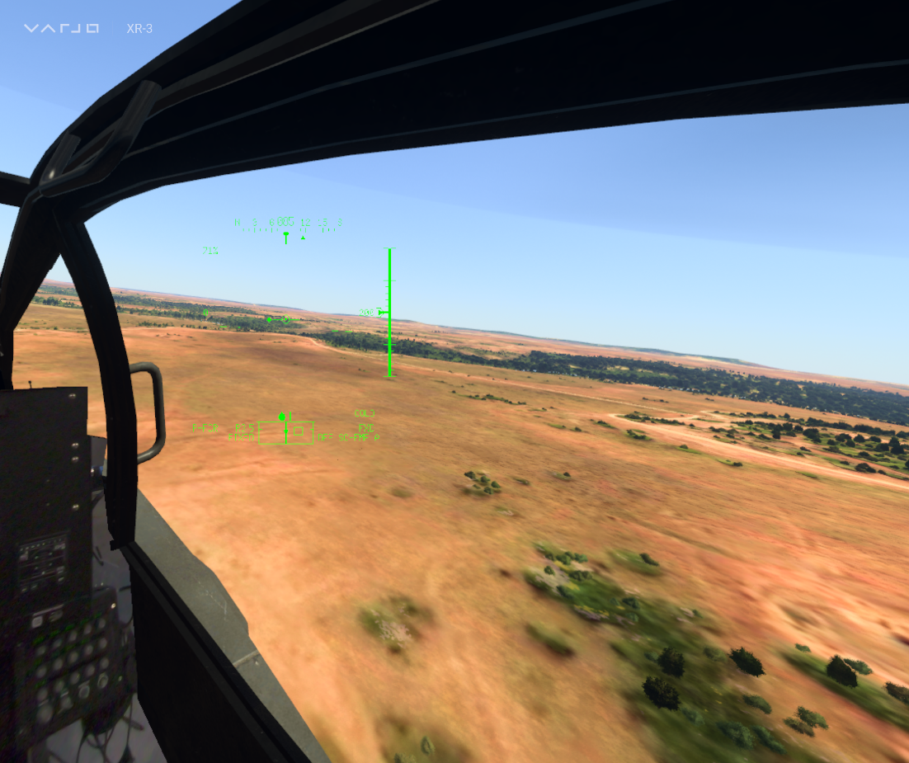
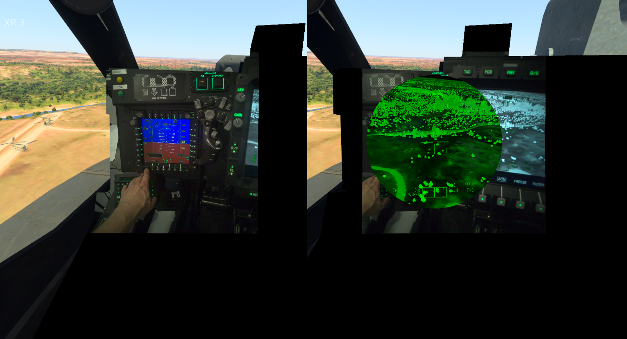
IHADSS and NVG Simulation
AH-64E Pilot Right Eye View (with IHADSS)
AH-64E Copilot/Gunner Left & Right Eye Views (IHADSS on Right Eye)
Aircraft head-worn display content is merged through Varjo’s multi-app interface by a fully-programmable TSS app

Slide 20

Crewmember Avatars
Pilots expressed the desire to see their copilot
Showing the actual pilot (using an accurate dynamic pass-through mask) was not within the current capabilities
Other crewmembers could be physically located remote from the pilot/copilot station
TSS leveraged head tracker data from the pilot/copilot and non-rated crew members (NRCM) to animate avatars in the VR scene
CH-47F Pilot View
Door Gunner Station
Door gunner avatar
Copilot avatar
Copilot

Slide 21




HMD Progression Summary
Initial Baseline Selection (2020)
2nd Prototype Baseline
Production Baseline
XR-1
Camera Pass-through
106°H x 90°V
60/30 PPD (VR/MR)
Ease of Use
Upgrade (2021)
Mixed Reality
Upgrade (2023)
XR-3 Vari-Focal
Camera Pass-Through
106°H x 90°V
39/49 PPD (VR/MR)
1.3 lb.
SR100A
See-Through Optics
90°H x 52°V
20 PPD / 2.5 lb.
SA-147/S
See-Through Optics
143°H x 33°V
36 PPD / 1.2 lb.
SA-147/S
See-Through Optics
120°H x 45°V
32 PPD / 1.4 lb.
Dark Room Only
Open Room Compatible
RVCT Baseline

Slide 22
Next Steps for RVCT Mixed Reality
RVCT Air
Varjo XR-4 (Planned for RVCT 2025 Production)
Varjo XR-4 Inside-Out tracking
RVCT Ground and NRCM
Deploy the MR concepts using Magic Leap 2 (leveraging ML2 segmented dimming)
Smaller form factor / less immersive
Continue to monitor new and emerging products and technologies

