Slide 1

Training ML Classification Models of Warfighter State with fNIRS
Olivia Fox Cotton, Aptima Inc.
Co-authors: Justin Morgan, Lisa Lucia, Will Dupree, Jordan Coker & Matthew Ewer; Aptima Inc.
CDR Joe Geeseman, Naval Air Systems Command

Slide 2
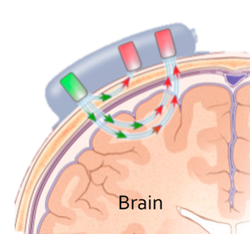
Background
Access to Warfighter state information could optimize the speed and quality of training for military personnel
Cognitive state, attentional arousal, workload, etc.
Physiological data provides objective and passive insight to operator state
Functional Near-Infrared Spectroscopy (fNIRS) is ideally suited to collect data which indicate a variety of executive functioning activities
Focus, inhibitory control, stress control, workload, fatigue, etc.

Slide 3
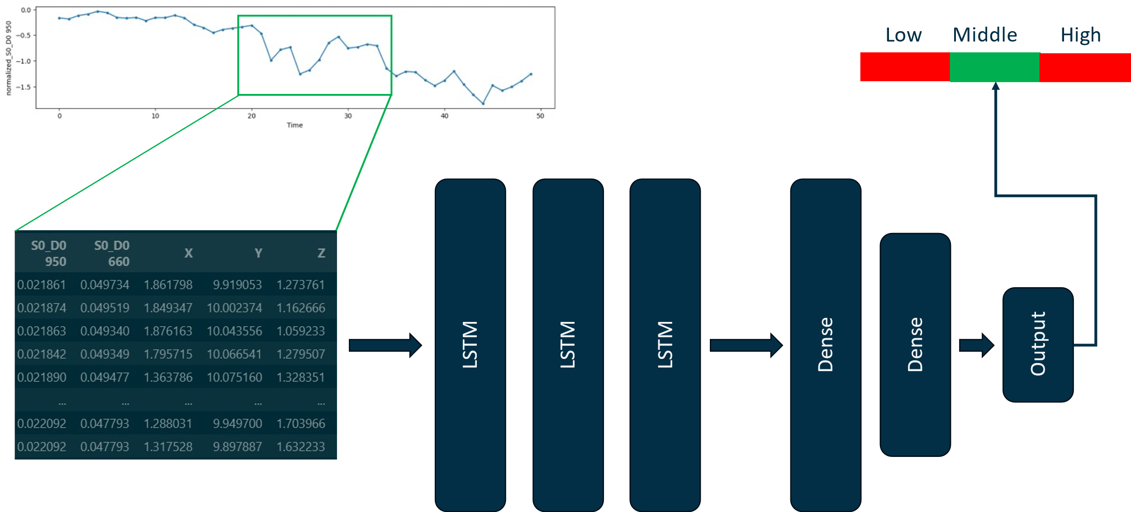
Background
Long-short term memory (LTSM) models are a type of recurrent neural network ideal for physiological timeseries data
Overcome vanishing gradient problem
Specialized cell state and series of gates are effective at capturing temporal patterns and dependencies
Maintain long-term memory
Sensitive to short-term and long-term patterns

Slide 4
Background
N-back has been successfully employed to quantify cognitive workload
N-back requires participants to view a sequence of stimuli, and for each stimulus, judge whether it matches the stimulus n stimuli ago
Varying the n induces differing demand conditions
Prefrontal cortex is critical for n-back
E
A
Time
E
2-back target
S
S
1-back target
E
3-back target

Slide 5
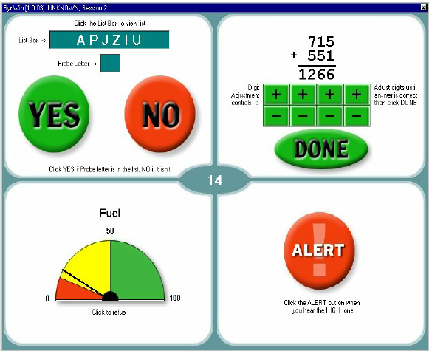
Background
More complex tasks can also be used to assess workload
Synthetic work environment (SynWin)
Four concurrent subtasks each imposing demands on different cognitive resources
Similar to Multi-Attribute Task Battery (MATB-II)

Slide 6
Goals of Present Study
Train individualized models of participant workload using standard task data
Test models on data from our contextualized version of SynWin, the Aviator SynWin
Assess physiological relationships with task performance and self-report workload
We expect:
Cerebral blood oxygenation will be negatively correlated with task performance
Cerebral blood oxygenation will be positively correlated with self-report workload

Slide 7
Participants & Study Design
Participants
N=17 (76% male)
Mean age=27 (SD=5.16)
Study Design: repeated measures
Both n-back and Aviator SynWin tasks contained 3 conditions varying in task difficulty
N-back contained 4 blocks per condition with brief rest periods between
Aviator SynWin contained a single 10-minute block per condition

Slide 8
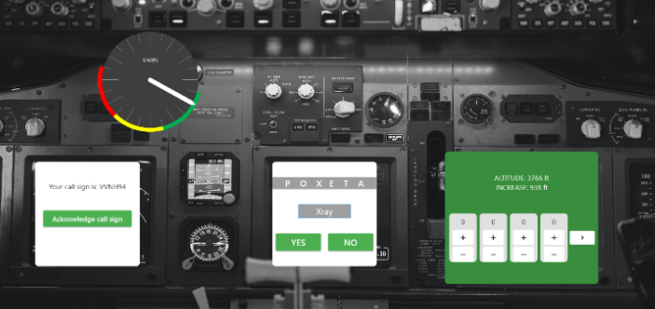
SynWin Task Environment
Participants must simultaneously attend to four concurrent subtasks:
Visual monitoring (upper left), auditory monitoring (lower left), memory recall (lower middle), and arithmetic (lower right)
Subtask event pacing increased with task difficulty, except for self-paced arithmetic

Slide 9
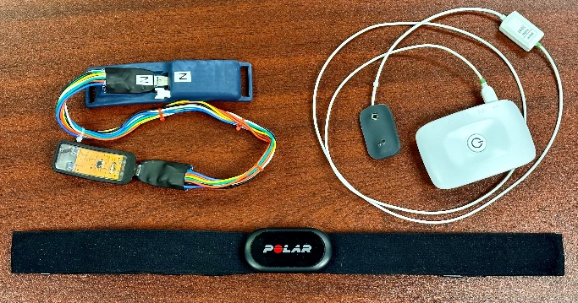
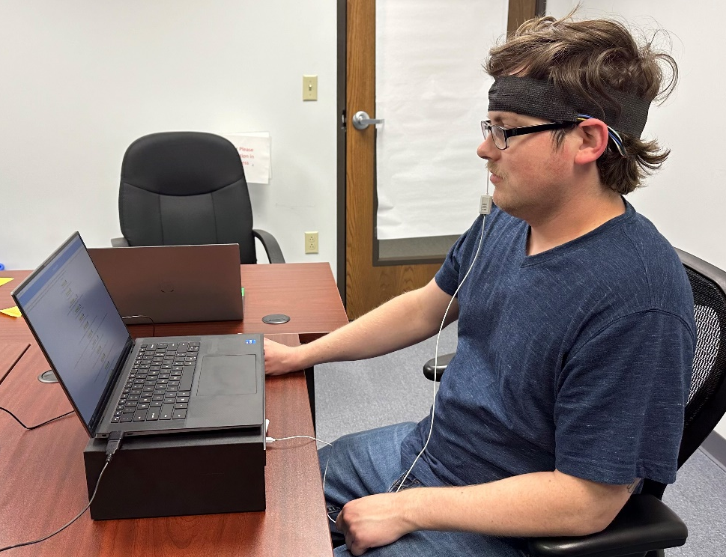
Equipment
Sensors:
Aptima MAVERIC fNIRS
Plux Pioneer fNIRS
Polar H10 heart rate monitor
Equipment:
Participant laptop & researcher laptop
Standard keyboard & mouse
Neuro-Behavioral Systems (NBS) Presentation
OpenSignals
Custom software (Aviator SynWin, data acquisition, survey tools)

Slide 10
Measures
N-back performance: d’
Aviator SynWin performance: composite score
Self-Report workload: NASA-TLX composite
Objective workload: cerebral oxygenation
Machine learning models: LSTMs
$$SynWin Composite=\frac{{d′}_{Aud}+{d′}_{Mem}+3\left(Z_{Math}\right)+3(Z_{Vis})}{4}$$

Slide 11
Procedure
Session 1
Baseline
N-back
1-, 2-, & 3-back
CPT
Flanker
Session 2
Baseline
Aviator SynWin Tutorial
Aviator SynWin
Low, medium, & high difficulty
Demographics & Self-reports
Following each n-back and Aviator SynWin condition, participants completed NASA-TLX
Notes:
N-back always first, but difficulty conditions were counterbalanced within the task
Order of CPT and Flanker was counterbalanced

Slide 12
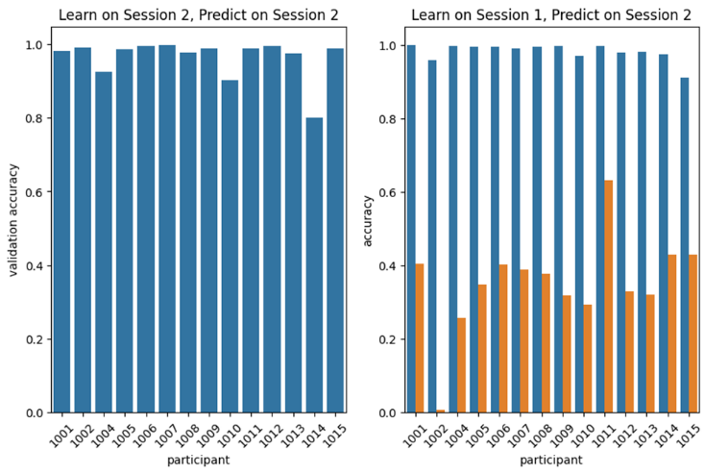

Results: Modeling
Trained LSTM models
Experiment 1: trained on 80% Session 2, validated on remaining 20% subset, no test set
Experiment 2: trained on 80% of Session 1 data, validated on remaining 20% subset, tested on Session 2
Learn on SynWin, Predict on SynWin
Learn on n-back, Predict on SynWin
Notes:
Replace session labels with task names

Slide 13
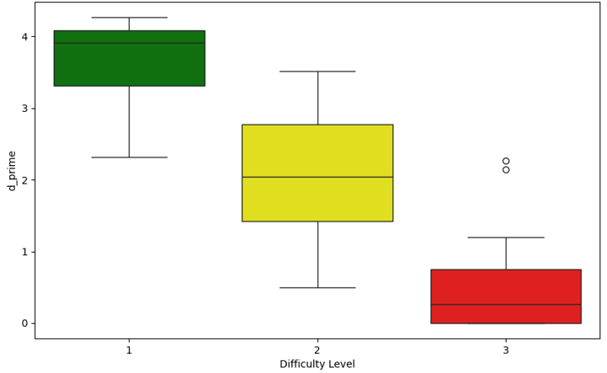
Results: N-back Behavioral Data
1-back and 1-back violated assumption of normality
Friedman test
χ²(2) = 32.12, p < 0.0001
Pairwise comparisons: Wilcoxon signed-rank test with Holm’s correction
1-back & 2-back: W=2.0 , p < 0.001
1-back & 3-back: W=0.0, p < 0.001
2-back & 3-back: W=2.0, p < 0.001
N-back performance data (d') across conditions
Condition | d’ | Accuracy | Hits | False Alarms
1-back | 3.67 (0.54) | 99.11 (1.03) | 38.18 (7.02) | 1.44 (0.86)
2-back | 2.05 (0.91) | 93.39 (4.44) | 34.65 (5.95) | 7.68 (5.59)
3-back | 0.54 (0.74) | 82.29 (5.78) | 24.36 (6.23) | 19.98 (10.57)

Slide 14
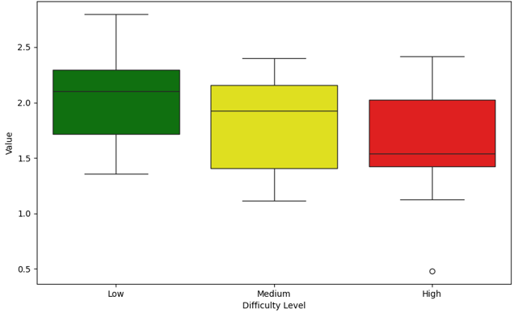
Results: Aviator SynWin Behavioral Data
Repeated measures ANOVA
F(2, 32) = 6.657, p = 0.0038
Pairwise comparisons: paired t tests with Bonferroni correction
Low & Medium: t(16)=2.62, p=0.06
Low & High: t(16)=-3.68, p<0.01
Medium & High: t(16)=-1.16, p=0.78
Aviator SynWin composite scores across conditions

Slide 15
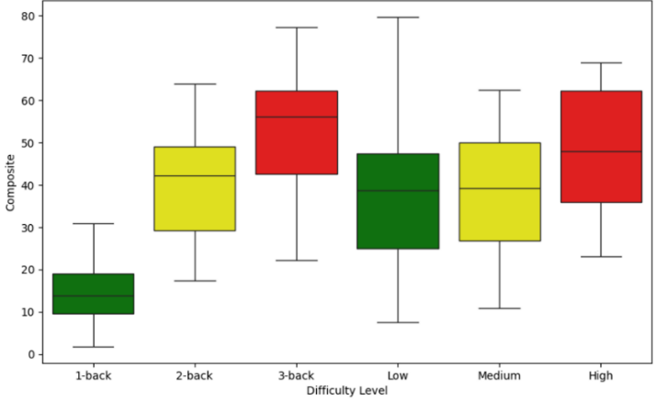
Results: Self-Report Workload
Repeated measures ANOVA
N-back: F(2,28)=57.98, p<0.001
Aviator SynWin: F(2,30)=9.22, p<0.001
Pairwise comparisons:
N-back
1-back & 2-back: t(14)=-6.12, p<0.001
1-back & 3-back: t(14)=-9.16, p<0.001
2-back & 3-back: t(14)=-5.91, p<0.001
Aviator SynWin
Low & Medium: t(15)=-0.15, p>0.05
Low & High: t(15)=4.26, p<0.01
Medium & High: t(15)=3.91, p<0.01
Average NASA-TLX composite across conditions for both n-back and Aviator SynWin tasks
Notes:
The expected pattern of results did emerge in the n-back data, but we didn’t see as much separation in the Syn Win data as we expected and we had way more variability in responses than what we might have liked to see. So this potentially suggests that we have some fine tuning to do with the Aviator Syn Win task.

Slide 16
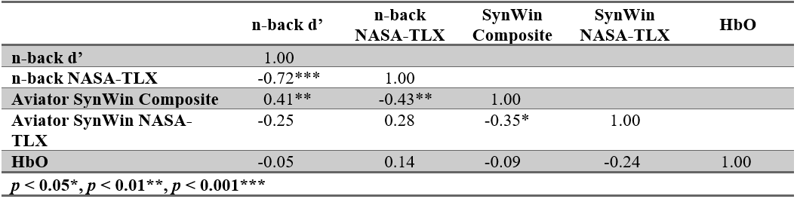
Results: Performance, Self-Report & Physio

Slide 17
Summary of Findings
LSTMs
Models performed well when trained and validated same task data
Models failed to generalize across tasks
Performance
Significant effect of task difficulty on both n-back d’ and Aviator SynWin composite
Self-Report Workload
Significant effect of task difficulty in both n-back and Aviator SynWin TLX ratings
Cerebral Oxygenation
No significant findings

Slide 18
Study Goals
Train individualized models of participant workload using standard task data
Test models on data from our contextualized version of SynWin, the Aviator SynWin
Assess physiological relationships with task performance and self-report workload
We expect:
Cerebral blood oxygenation will be negatively correlated with task performance
Cerebral blood oxygenation will be positively correlated with self-report workload

Slide 19
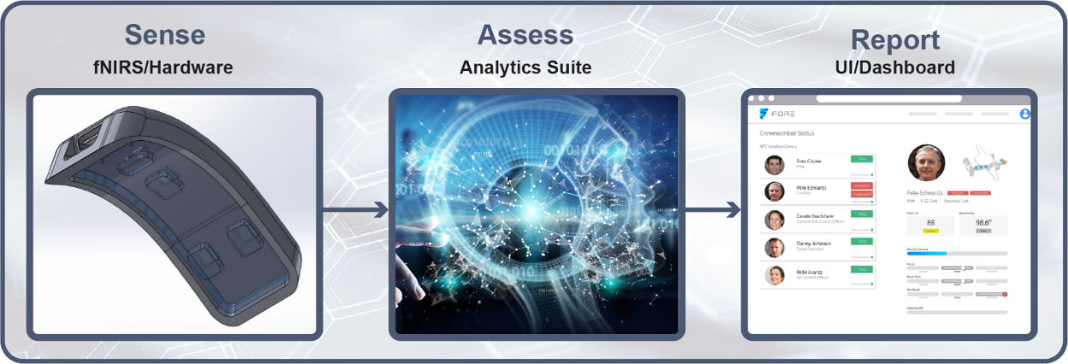
Summary of Findings
Limitations
Sample size & variability
Parameterization of Aviator SynWin
fNIRS data quality
Future Work
Additional data collection
Device development & validation
Conclusions
Developed contextualized task that is correlated with standard task
Successful development of reusable testbed for training research
Notes:
While alternative data exploration techniques could be pursued with the current data set, we also know it is limited by size and variability so our preference is to collect additional data

