Slide 1


Abstracting Geo-specific Terrains to Scale Up Reinforcement Learning
Volkan Ustun, Soham Hans, Rajay Kumar & Yunzhe Wang
Human-inspired Adaptive Teaming Systems (HATS) Group
USC Institute for Creative Technologies
The work depicted is sponsored by the U.S. Army Research Laboratory (ARL) under contract number W911NF-14-D-0005, and that the content of the information does not necessarily reflect the position or the policy of the Government, and no official endorsement should be inferred

Slide 2
General Motivation for Human-inspired Adaptive Teaming Systems Group
To develop cost-effective, challenging training experiences with reduced reliance on human participants and shortened development time

Slide 3
Multi-agent Reinforcement Learning (MARL)
Multiple agents learn by dynamically interacting with an environment and each other, providing a framework for evaluating competitive and collaborative dynamics
Need to leverage a fast simulation environment
Opportunities with MARL:
To train simulated enemies to become challenging opponents in interactive simulations
To devise interactive decision support systems to aid users in gaining decision advantage in adversarial scenarios.

Slide 4
Military Training Simulations
Military environments present significant challenges for MARL
Complex: There is a collaborative group of tasks to be performed by an agent rather than just a single task
Stochastic: The processes and the decisions made in these environments are non-deterministic
Multi-agent: Several agents are collaborating and competing against each other while acting in the environment
Partially-observable and continuous: There are a large number of moves available at any given simulation state and moves of one agent are not always observable to other agents
Non-stationary: The processes utilized by the agents and the environment itself may shift during the course of a simulation,
Doctrine-based: Conforming to military hierarchies and policies are essential.
Discovering good behavior patterns requires a lot of computation
Can we exploit prior bias (and knowledge) to support RL?

Slide 5
Speeding up RL
Observation: In traditional RL models in Unity, agents make movement decisions every frame (←↑→↓↺↻🛑)
Very fine-grained, moves 0.07 units per frame (1 unit ≈ 1 meter)
Decisions are too frequent
Movement is jittery
Longer decision horizons take too long to train
Perspective: Agents can make less frequent navigation decisions
E.g., Move towards a destination
Automate movements with pathfinding
Problem: Pathfinding algorithms like A* works fine at real-time but can have issues when running faster than real time, especially on geo-specific terrains
RL models need to train headless significantly faster than real time.
Pathfinding becomes a bottleneck

Slide 6
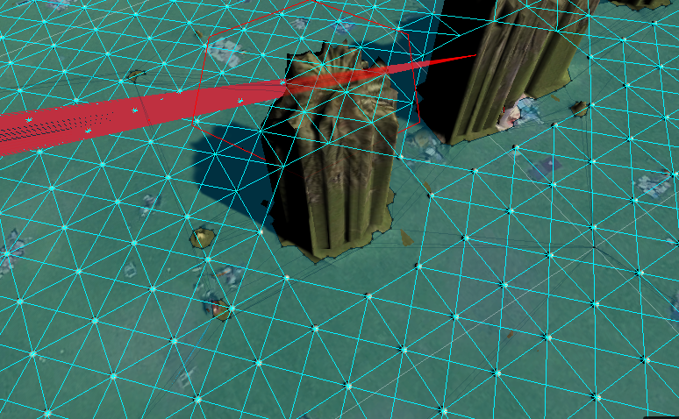
Key Perspective: Waypoint-based Navigation
The action space is now 8 potential adjacent waypoints to travel to. ​
Predefine a waypoint-based navigation graph for a given resolution
If the navmesh doesn’t exist in a specific direction or it takes too long to reach the next waypoint, no node/edge is created.
Move the entity on the edge with linear increments
No need for path finding algorithms -> faster execution (20-30x real time)

Slide 7
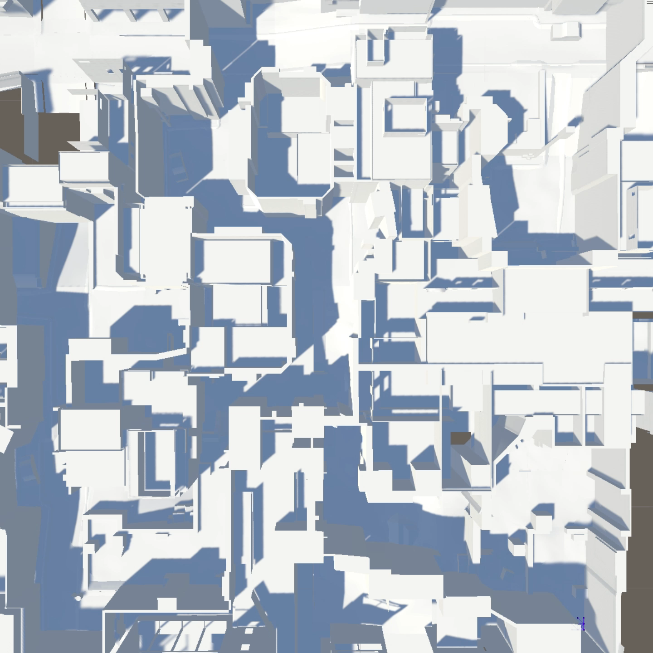
Counter Strike Global Offensive (CSGO) Dust 2 Map in Unity
Waypoint Generation

Slide 8
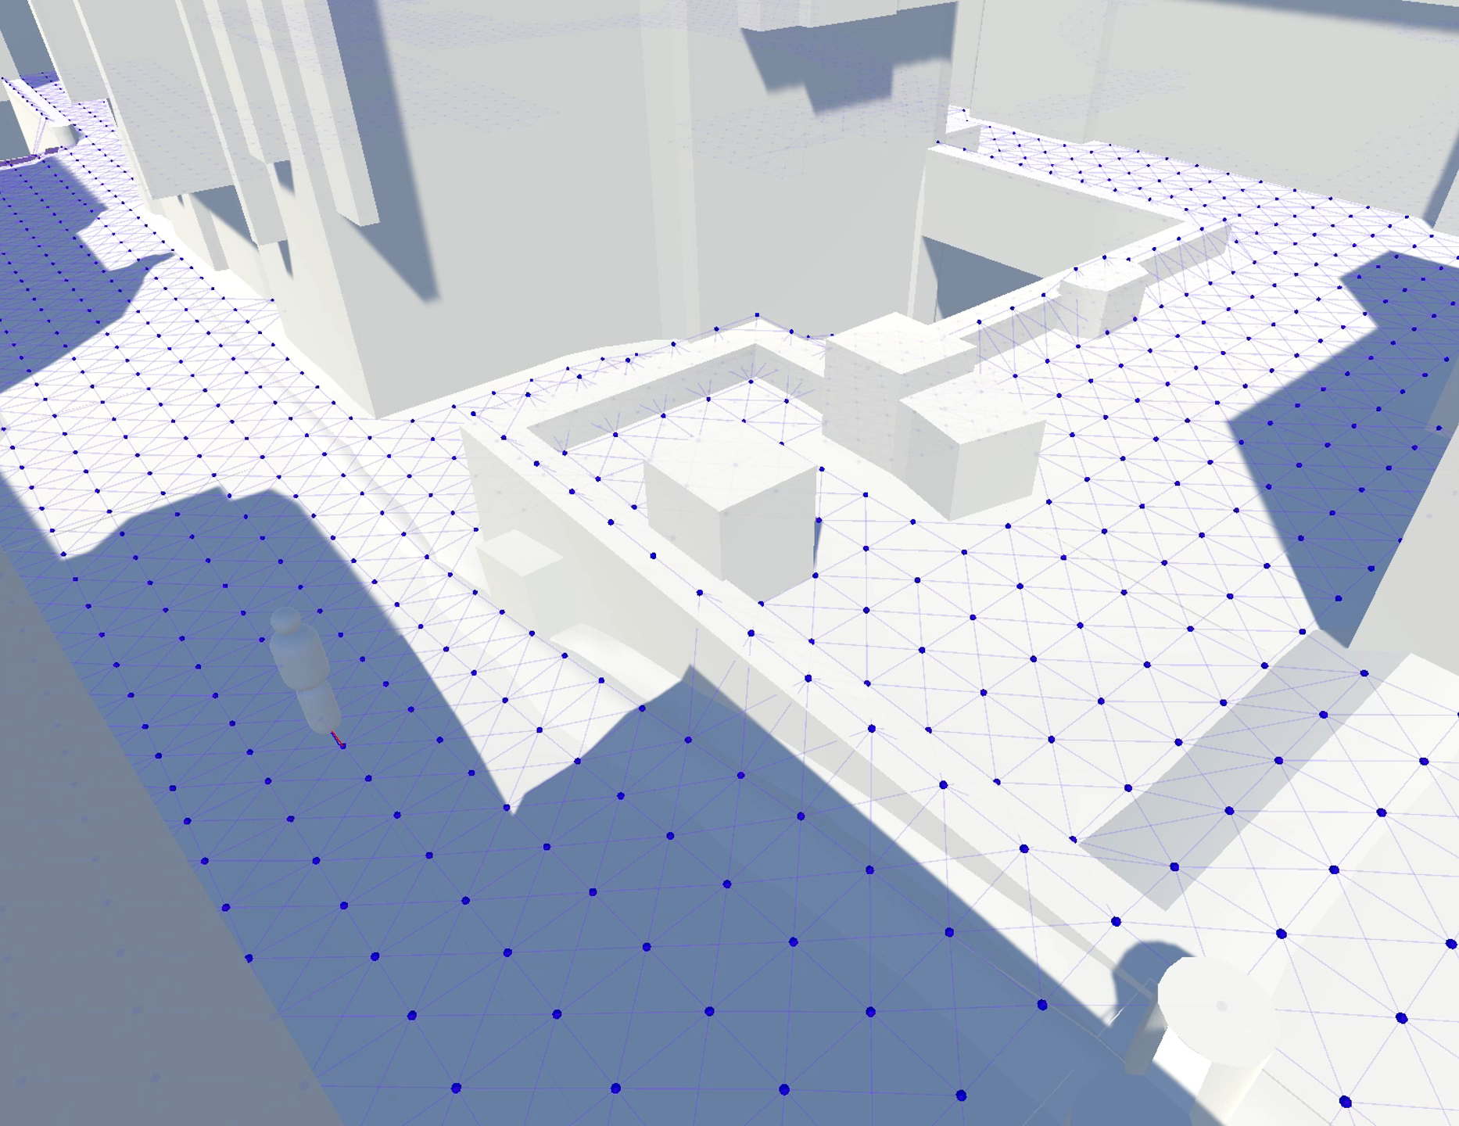
Waypoint-based Movement

Slide 9
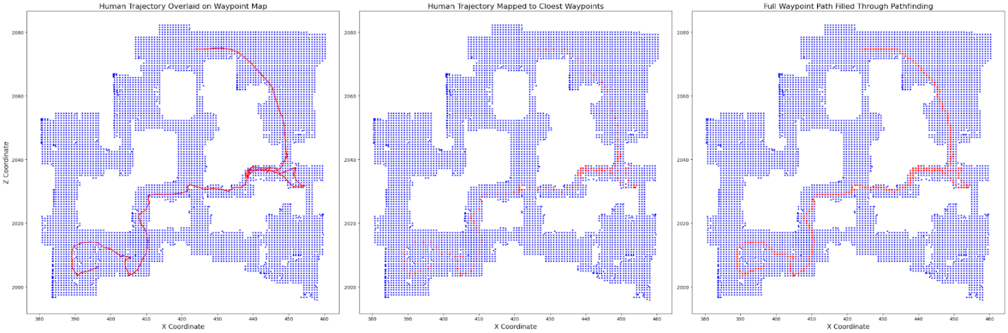
Waypoint-based Movement
Comparison of human trajectories with Waypoint-based movements
Dust2 map of CSGO, from T-spawn to A-Bombsite.
Human Trajectory
Closest Waypoints
Generated Path
Notes:
*Xenopoulos, P., Freeman, W. R., & Silva, C. (2022). Analyzing the differences between professional and amateur esports through win probability. In Proceedings of the ACM Web Conference 2022 (pp. 3418-3427).

Slide 10
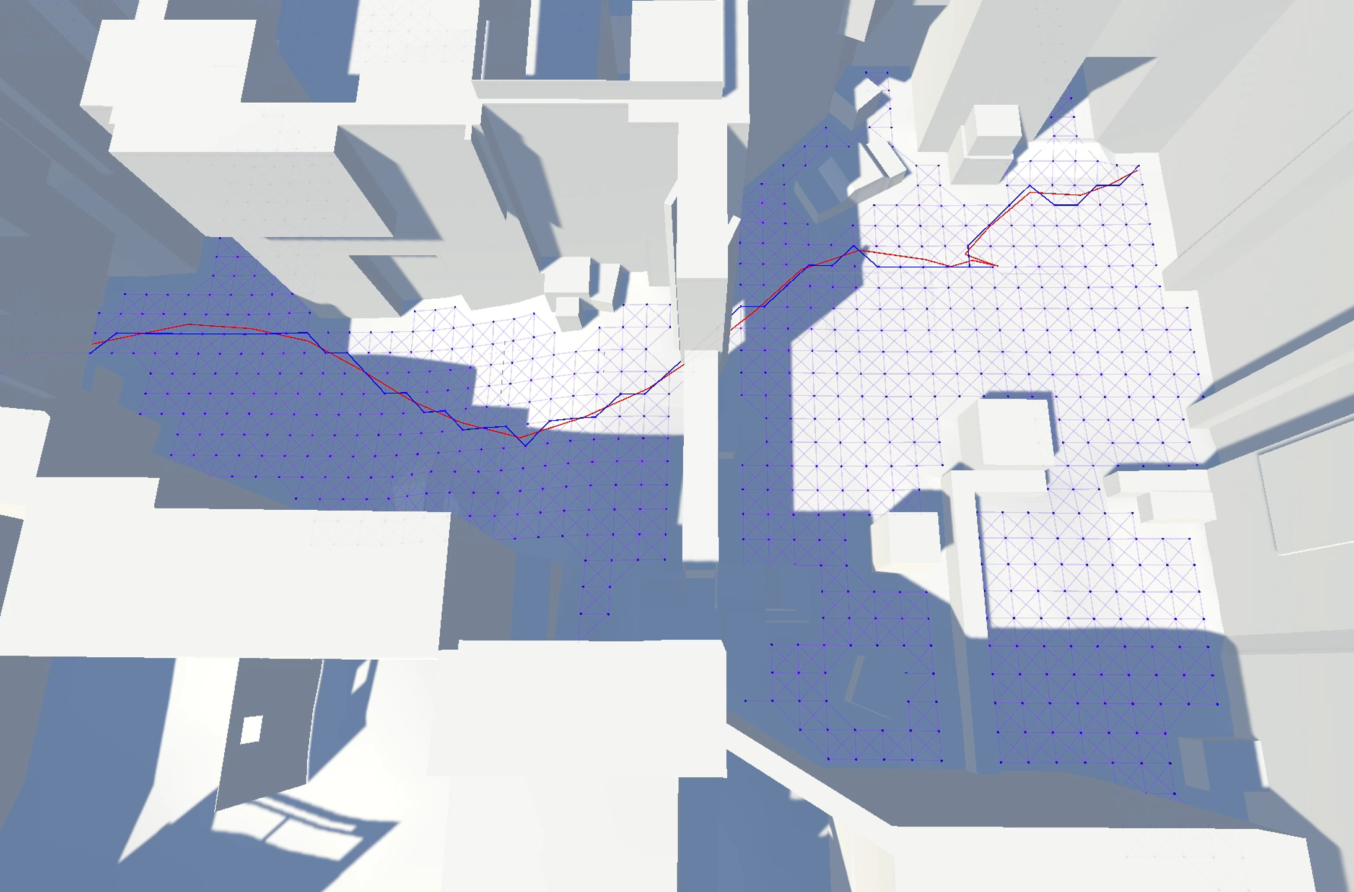
Waypoint-based Movement vs. Human Trajectories

Slide 11
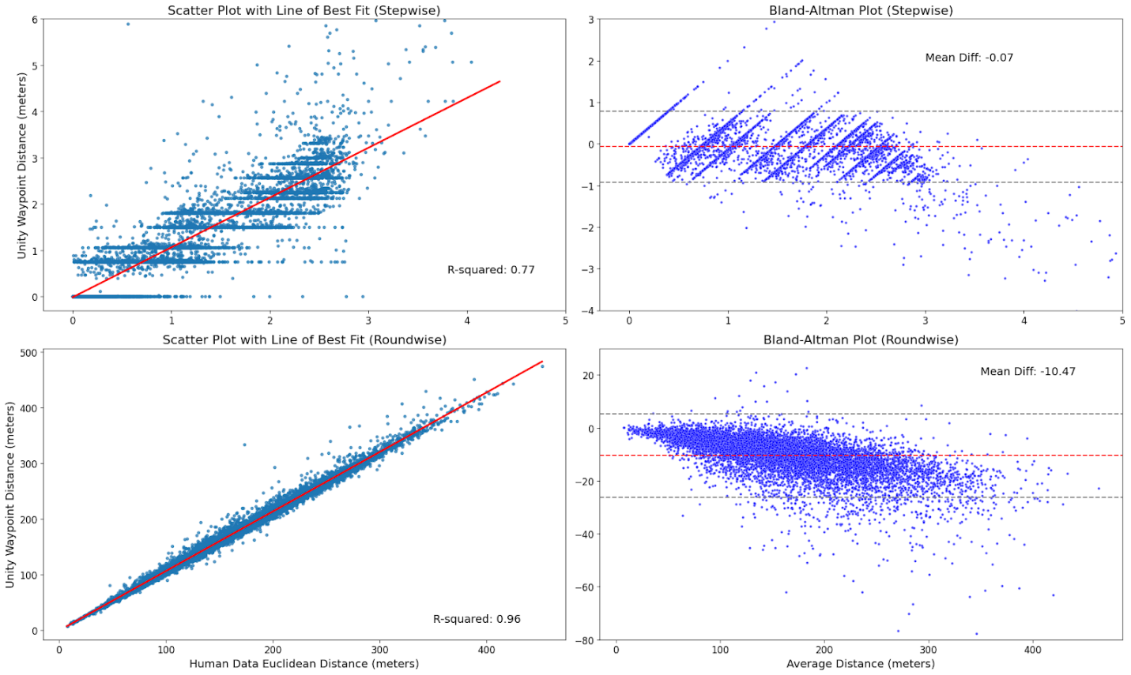
Accuracy of Waypoint-based Movements
Stepwise Assessment
R-squared=0.77
Roundwise Assessment
R-squared=0.96

Slide 12
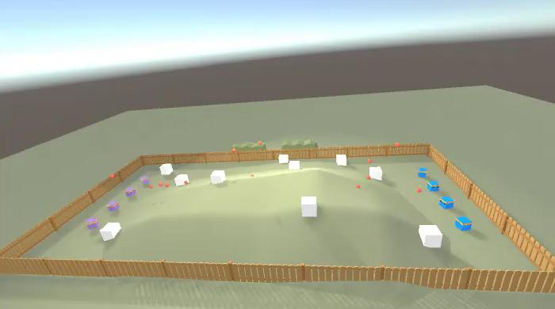
Simple Unity Environments
Extending the Dodge Ball Scenario
Introduce terrain features
Requires additional raycasts
Vertical shooting
Aim assist
Infinite ammunition

Slide 13
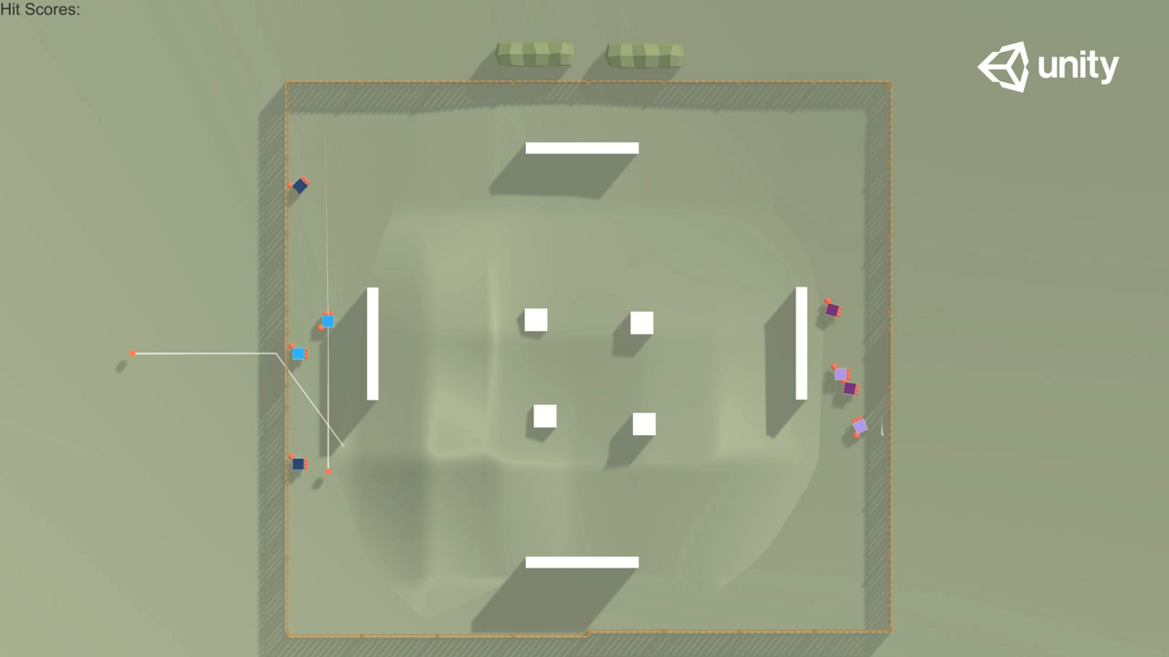
Head-to-Head Matches
Dark colored agents have double the range
Light colored agents have a higher fire rate rate
Dark colored agents learned to stay distant
Blue is trained with waypoints
Purple is trained with
fine-grained* movements
Significant improvement in time-between decisions ~700%
*Fine-grained movement: Decisions every frame (←↑→↓↺↻🛑)

Slide 14
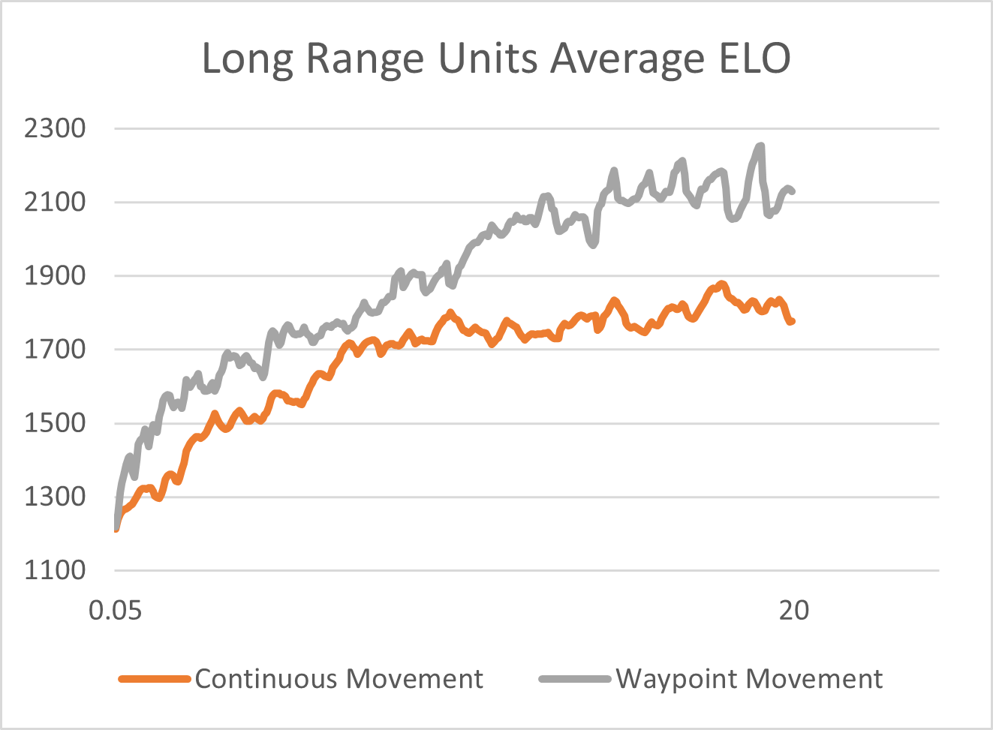
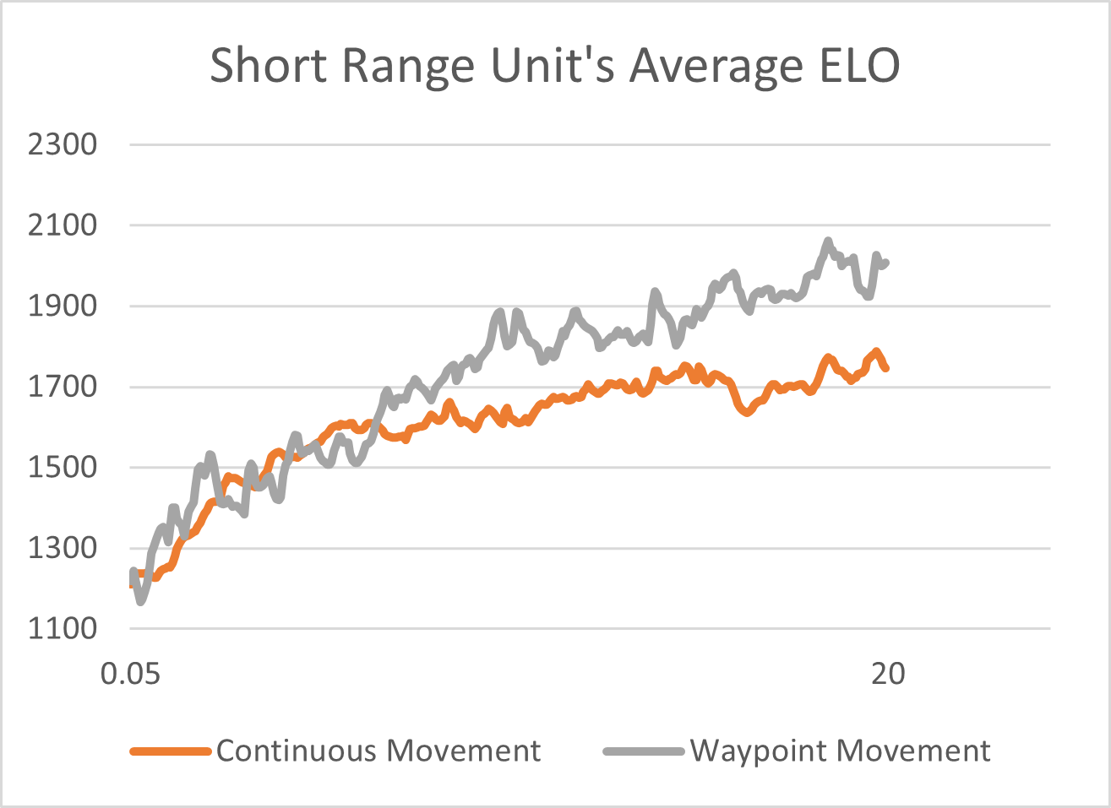
Waypoint vs. Fine-grained* Movement
*Fine-grained movement: Decisions every frame (←↑→↓↺↻🛑)

Slide 15
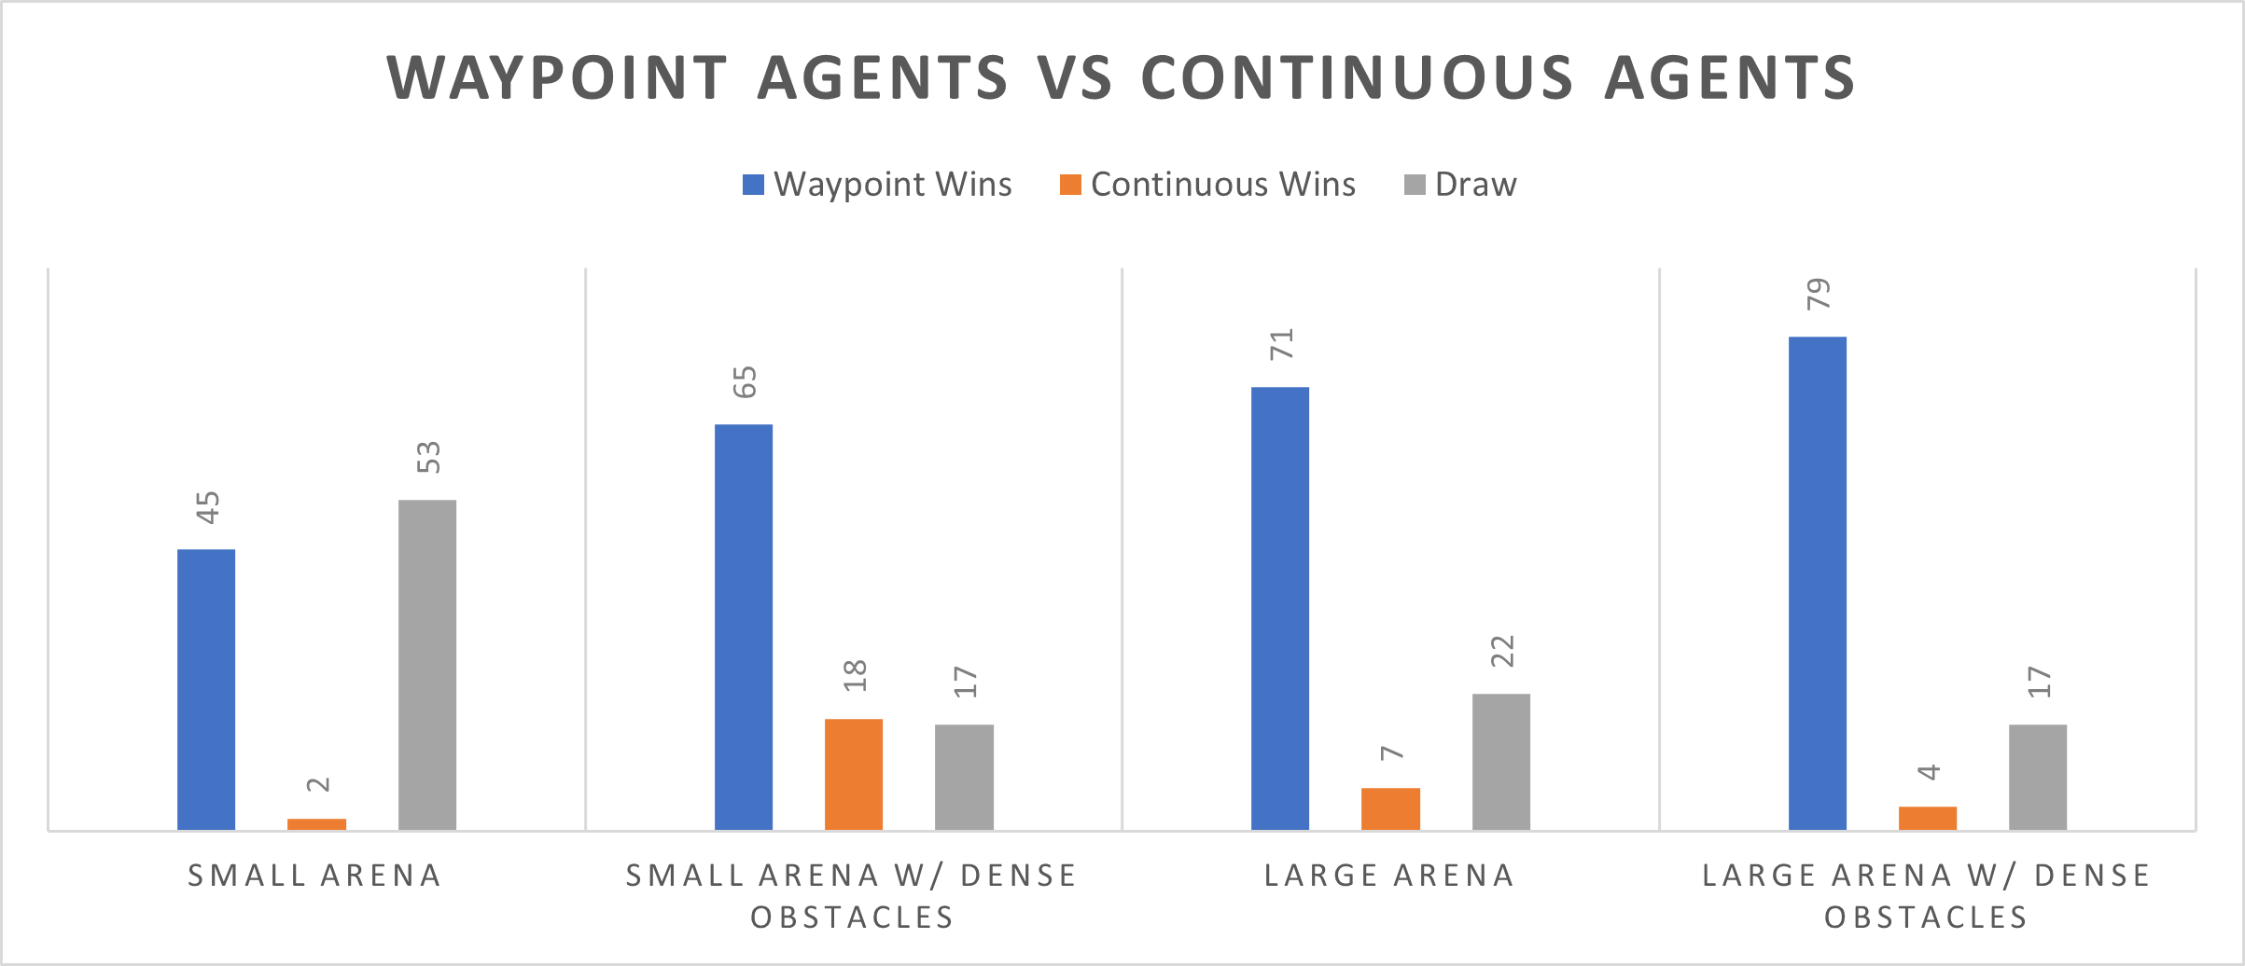
Waypoint vs. Fine-grained* Movement
*Fine-grained movement: Decisions every frame (←↑→↓↺↻🛑)

Slide 16
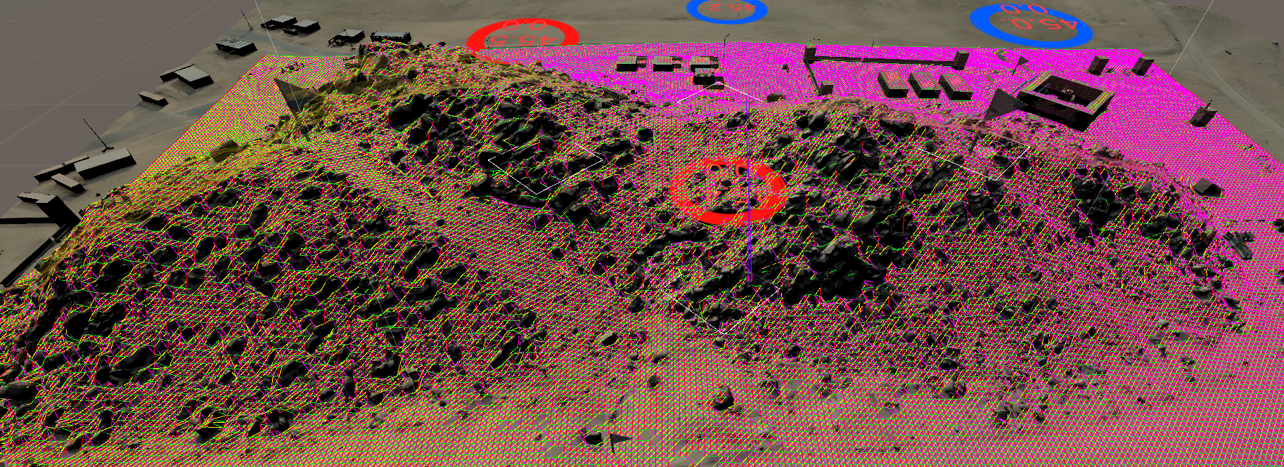
Geo-specific Terrains
Edges between waypoints specify the action space
Pre-generated waypoints provide a more efficient path finding framework
Edges are generated if there is a feasible path between waypoints
*Rock piles around Razish Village at National Training Center

Slide 17
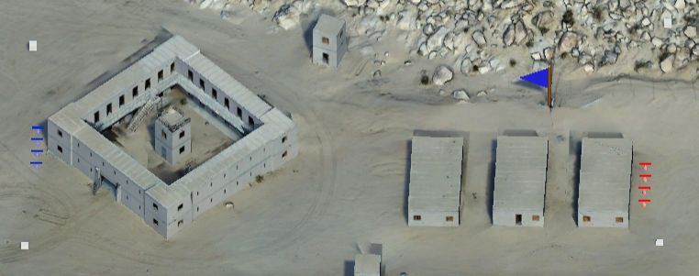
Flag Capture with Differing Objectives
Blue is trying to get close to the flag
Red is defending

Slide 18
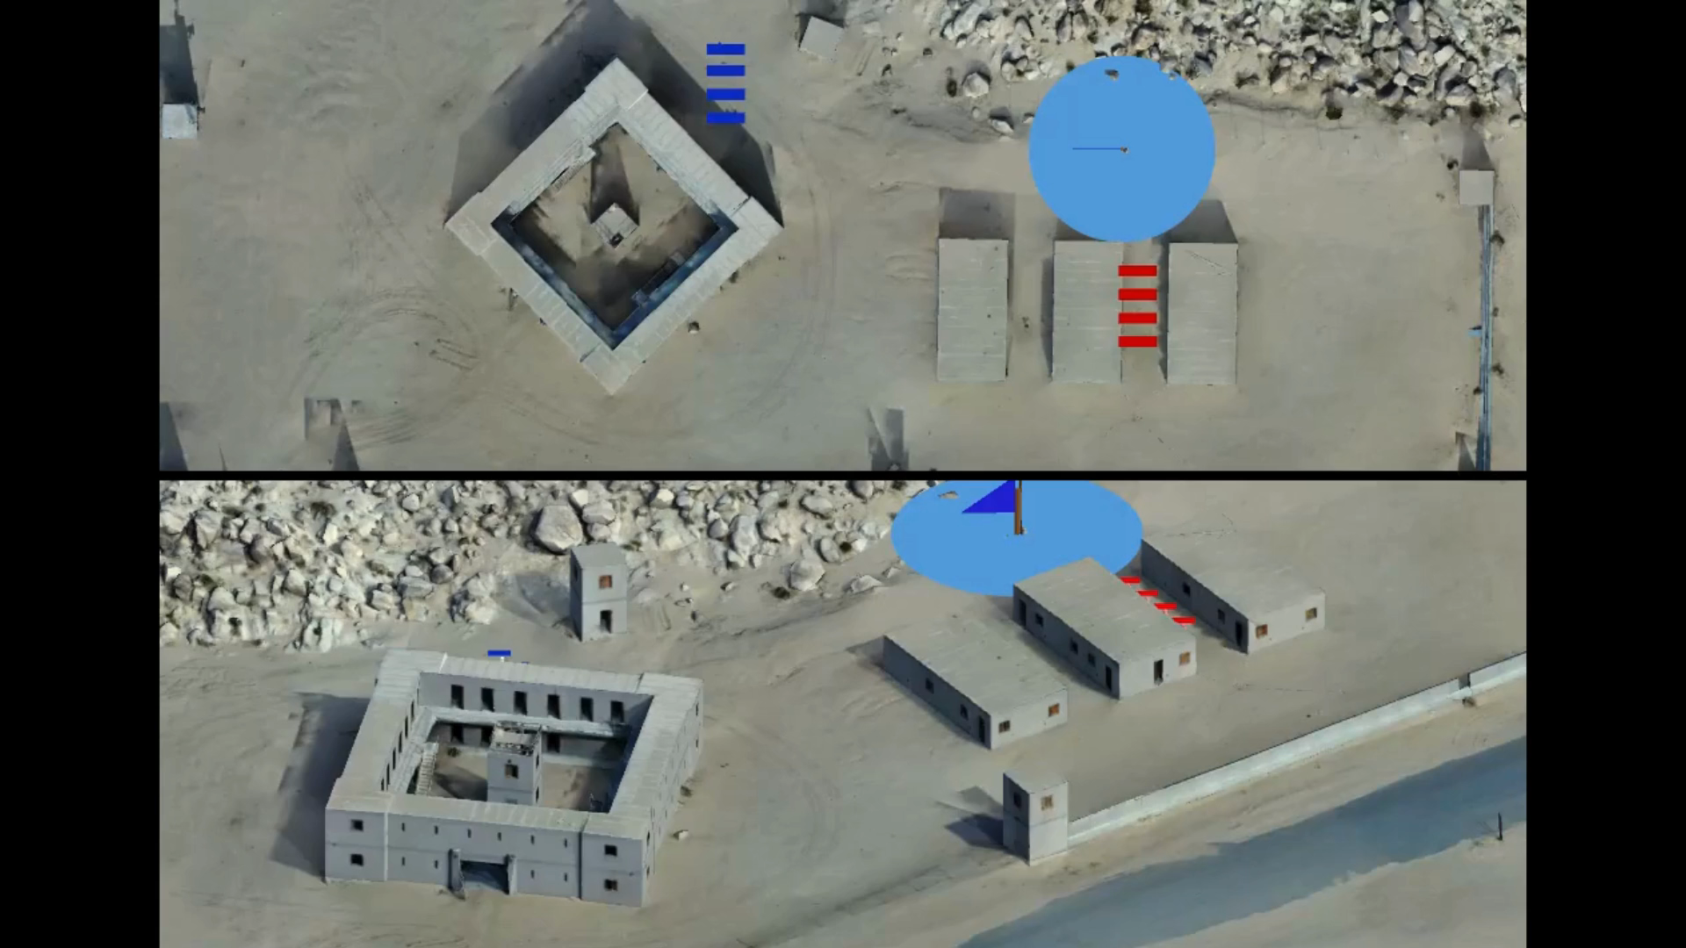
Sample Evaluation Run - 1
Blue utilizes waypoints
Red utilizes waypoints
Blue wins 70%
*Blue wins 55% when both use fine-grained movements
Notes:
Red waypoints model is quite aggressive and tries to come into blue's territory. However, blue has an inherently advantageous defensive structure and immediately uses that for cover. This allows blue team to outnumber red after some fighting. Blue then charges forward towards the destination, taking out any remaining red team members, and finally reaching the goal to end the game with a win.

Slide 19
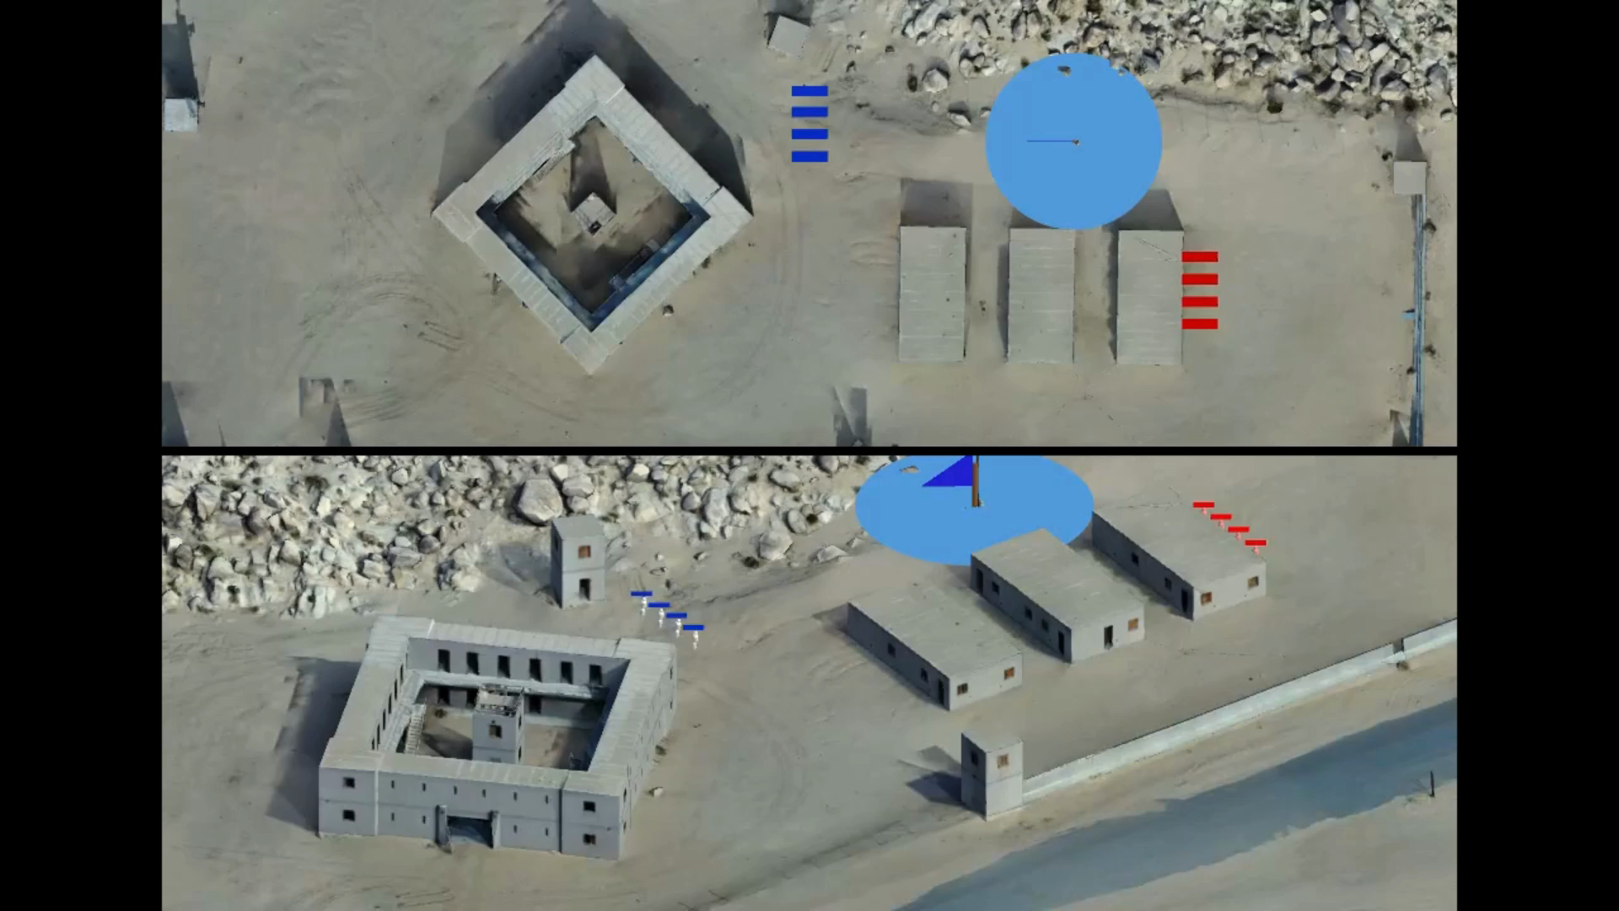
Sample Evaluation Run - 2
Blue utilizes waypoints
Red utilizes fine-grained movements
Blue wins 98%
Notes:
In this we see that blue initially takes cover behind the defensive structure in anticipation of early aggression from the red team, and waits there for a while without much action. This passive behavior can be attributed to the fact that since the blue waypoints model was trained against a more aggressive red waypoints model in the training phase, it learned that using its advantageous defensive position helps it win. However, the conventionally trained red team is not as aggressive and also takes a defensive stance. When blue notices that nothing is happening for some time, it then takes charge and starts moving towards the destination. Having a slightly better understanding of angles to take cover it is able to outnumber the enemy red. A blue team member is then able to reach the destination and win without even needing to eliminate all of the red team. (edited)

Slide 20
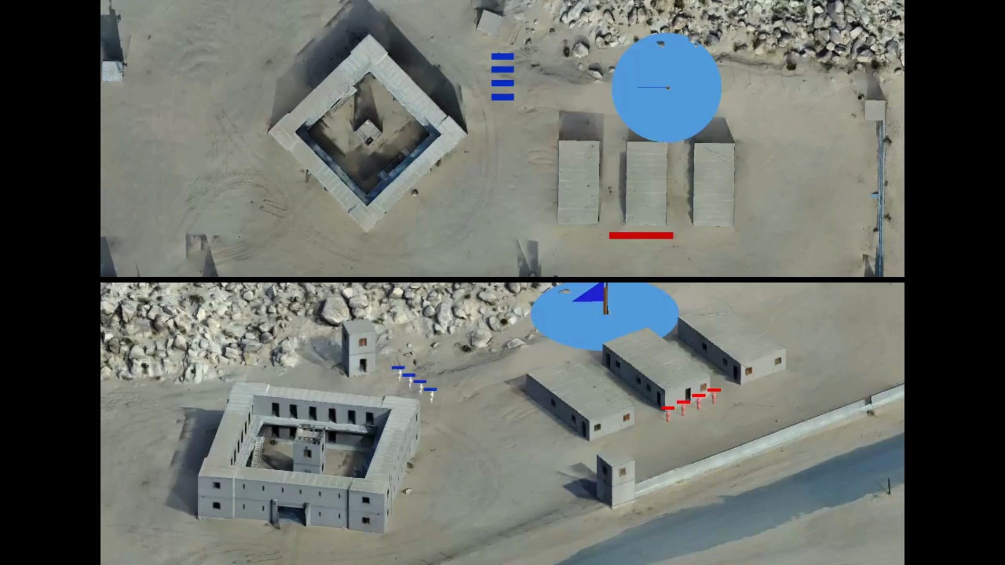
Sample Evaluation Run - 3
Blue utilizes fine-grained movements
Red utilizes waypoints
Red wins 88%
Notes:
In this, we see that the blue team doesn't take advantage of their advantageous map position, and decides to battle the aggressive waypoints based red team head on. The red team with waypoints is then able to use it's minor cover elements better to eliminate all the blue team members who don't have any cover. Resulting in a red team win.

Slide 21
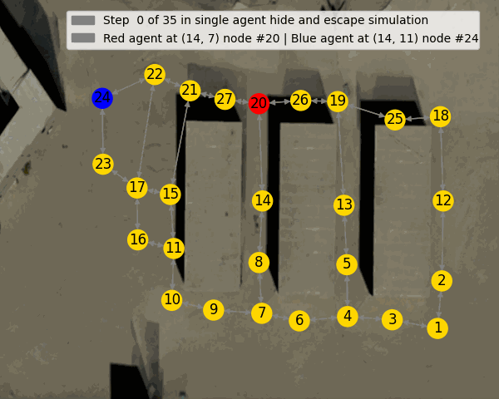
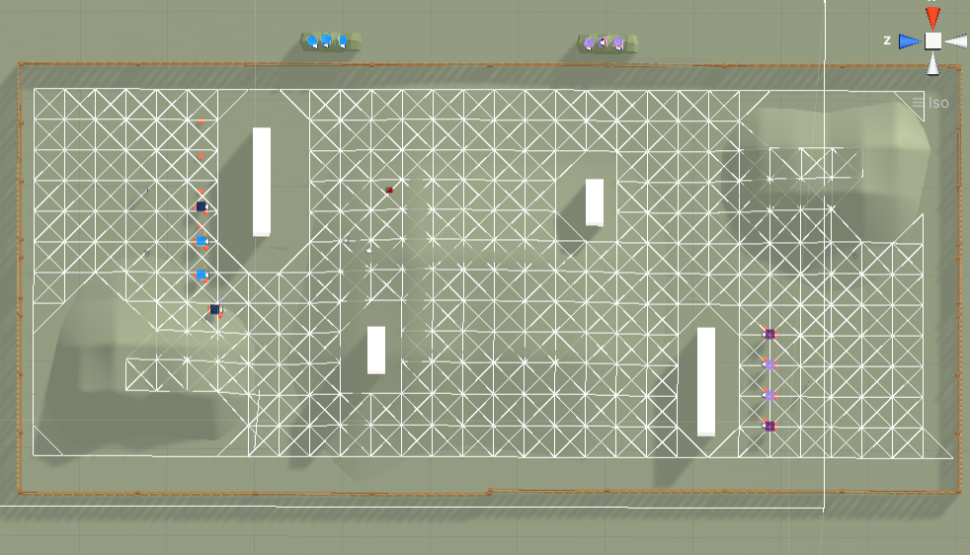
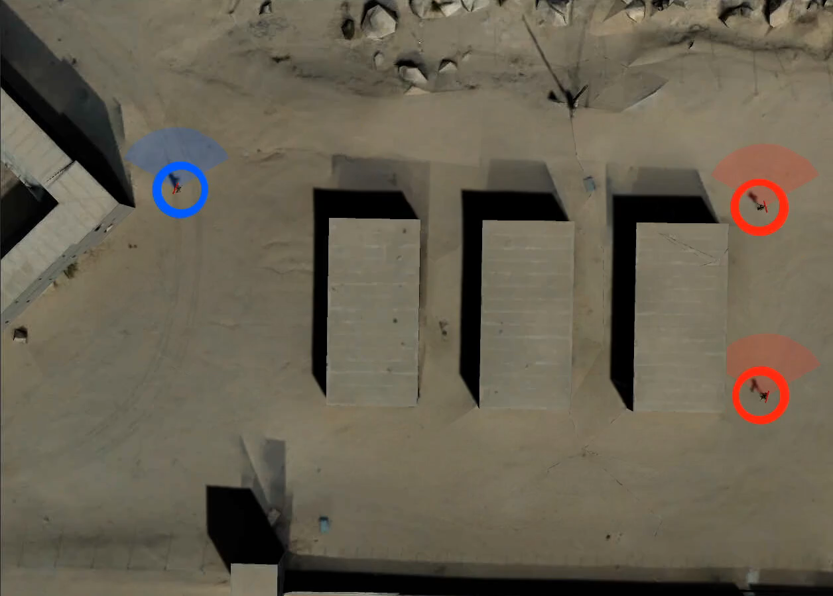
Waypoint Movements at Various Fidelity Levels
Low Fidelity
Mid Fidelity
Graph Based Simulation
Basic Unity Scenes
High Fidelity
Devise a graph sim env based on geo-specific waypoints
Emulate the real scene
Fastest
Approximate the geo-specific terrain
Leverage the game engine
Faster
Geo-specific terrain
Various resolutions based on distance between waypoints
Fast
We still need to fine-tune the models, but waypoints provide a structure for policy transfer

Slide 22
Summary
Waypoint-based movements significantly speed up RL experiments on geo-specific terrains
Less frequent decisions
Preprocessing eliminates the need for path finding -> Faster than real-time experiments
Waypoint-based movements approximate human trajectories
Resolution flexibility may assist to define different navigation graphs for different units operating on the same geo-specific terrain

