Slide 1



Top 10 DIS V8 Improvements
Lance Call, AFRL/CAEUSA
Bob Murray, SimPhonics, Inc.

Slide 2
Distributed Interactive Simulation (DIS) History
1980 – DARPA Simulator Networking (SIMNET)
1993 – DIS Version 2 (V2) – Stepping stone between SIMNET and DIS
1995 – DIS Version 5 (V5) – First widely implemented version
1998 – DIS Version 6 (V6) – Only added PDU’s to DIS Version 5, still in use
2012 – DIS Version 7 (V7)
Mostly compatible, because it only changed padding fields
New PDUs (SIMAN-R, Environmental Process, Point/Linear/Areal Objects, Live Entity)
Corrected errors and clarified rules
2025 – DIS Version 8 (V8)
Significant redesign based on 30+ years of experience
Replace Live Entity protocol with Compressed DIS

Slide 3
DIS V7 and V8 Compatibility
DIS V8 is not on the wire compatible with DIS V7
Different header and PDU format to support extensibility and other improvements
DIS V8 is Little Endian vs DIS V7 is Big Endian
Many of the same PDUs carry equivalent information to DIS V7 + new data
Some new PDUs in DIS V8 not available in DIS V7
DIS V7/V8 can be translated via a gateway
Translation can only support DIS V7 concepts and information
DIS V7
ALL INFO
Gateway
ALL INFO
DIS V8
SOME INFO
V8 INFO

Slide 4
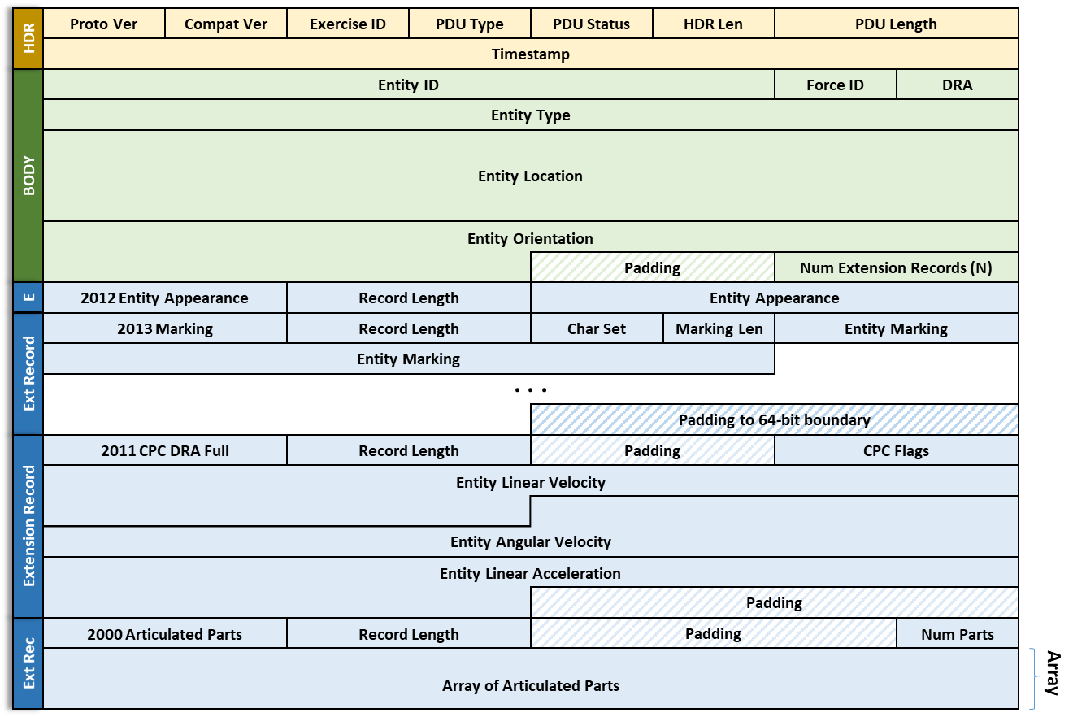
Improvement 1: Extensibility Through a New PDU Design
Fixed Header
Fixed Body
Variable
Extension
Records

Slide 5
Improvement 2: SISO-REF-030 Yearly Updates to Capability/Reusable Records
New document called SISO-REF-030 will be created to document new extension records
Managed like SISO-REF-010 enumerations are currently managed
Change requests, reviewed/modified by a support group, vote to accept/reject
Allows for periodic/yearly updates
Allows users to extend the DIS capabilities over time in a managed way
Encourages full definition of extension record data allowing for more reuse
Compressed versions of extension records will also be documented to allow use with the compressed version of DIS V8

Slide 6
Improvement 3: Improved RF Modeling of AESA Radar and Advanced Jammers
Advanced Radar and Jammer Tiger Team created 16 (12 new, 4 from existing data) extension records to model AESA Radar and Jammers
Initial design was based on conflicting and overlapping Combat Air Force Distributed Mission Operations (CAF DM0) and Battlespace Simulation Inc.(BSI) datums
Final design significantly expanded and unified the AESA and Jammer capabilities
See Advanced Radar and Jamming in DIS V8 (SISO paper 2023-SIW-001)

Slide 7
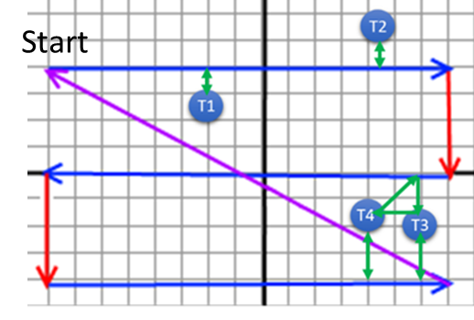
Beam Activity for the Pictured Scan

Slide 8
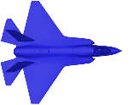
Improvement 4: Combined Parabolic Circular (CPC) Dead Reckoning Algorithm Reduces PDU Rates
Formulas
World = Parabolic
Body = Circular
Pos = Pos₀ + Vel*T + ½ Acel*T²
Pos = Pos₀ + [R₀]_{b->w}([R1]*Vel_{b} + [R2]*Acel_{b})
Most entities travel in a circular path when turning (except lifeforms/helicopters)
CPC algorithm picks most appropriate formula for Dead Reckoning
Result is fewer network updates required for the same accuracy while turning
CPC algorithm and math are documented in DIS V8
C (Java future) implementations of the algorithm available on sourceforge.com
See A Simpler Dead Reckoning Algorithm with Better Performance (SISO paper 2019-SIW-034).

Slide 9
Example - 500 Knots Turning Based on Math
This shows a 500 knot turning aircraft with 20 seconds of extrapolation
Parabolic has ~1200 meter error

Slide 10
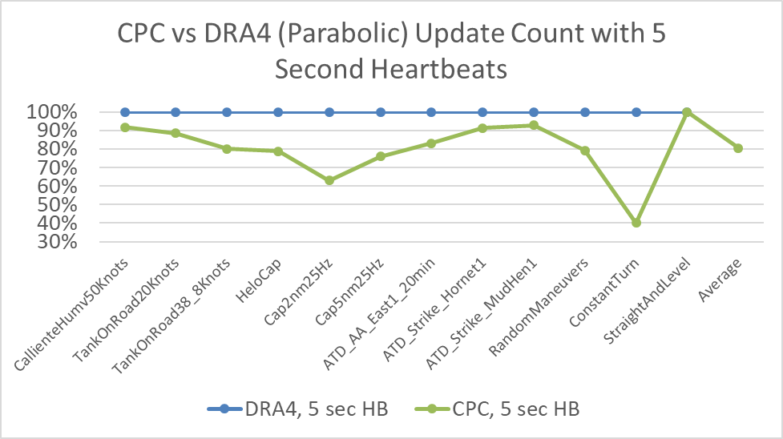
Combined Parabolic Circular Dead Reckoning Algorithm Reduces PDU Rates
60 % PDU reduction while turning
Average 18% PDU reduction overall

Slide 11
Improvement 5: Multiple Entity-Entity State PDU to Allow Higher Entity Counts
Number of Entities in a single Entity State PDU
Max PDU Size in bytes | Static Entities | Moving Entities | Accelerating Entities
1452 | 41 | 27 | 18
8144 | 251 | 167 | 111
Only a Single Entity Type allowed in a Multiple Entity Extension Record
Single PDU may have several Multiple Entity Extension Records
Especially good for background entities (People, Car Traffic, Parking Lots)
Might be good for Early Warning Radars & Surface-to-Air Missile sites

Slide 12
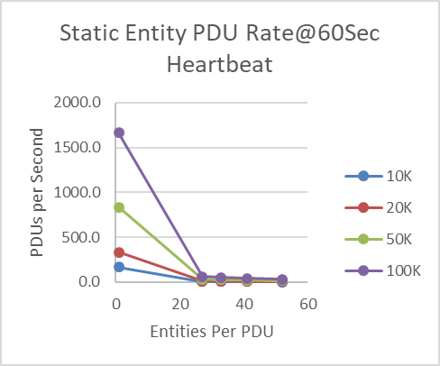
Multi Entity Example: 100K Static Entities
Assume a 60 second heartbeat
DIS V7 – 1 Static Entity per PDU
1666 PDUs/sec
240 Mbits/sec bandwidth
DIS V8 – 41 Static Entities per PDU
40 PDUs/sec
58 Mbits/sec bandwidth
DIS V7 takes
41X PDUs and 4X Bandwidth
100K Entities

Slide 13
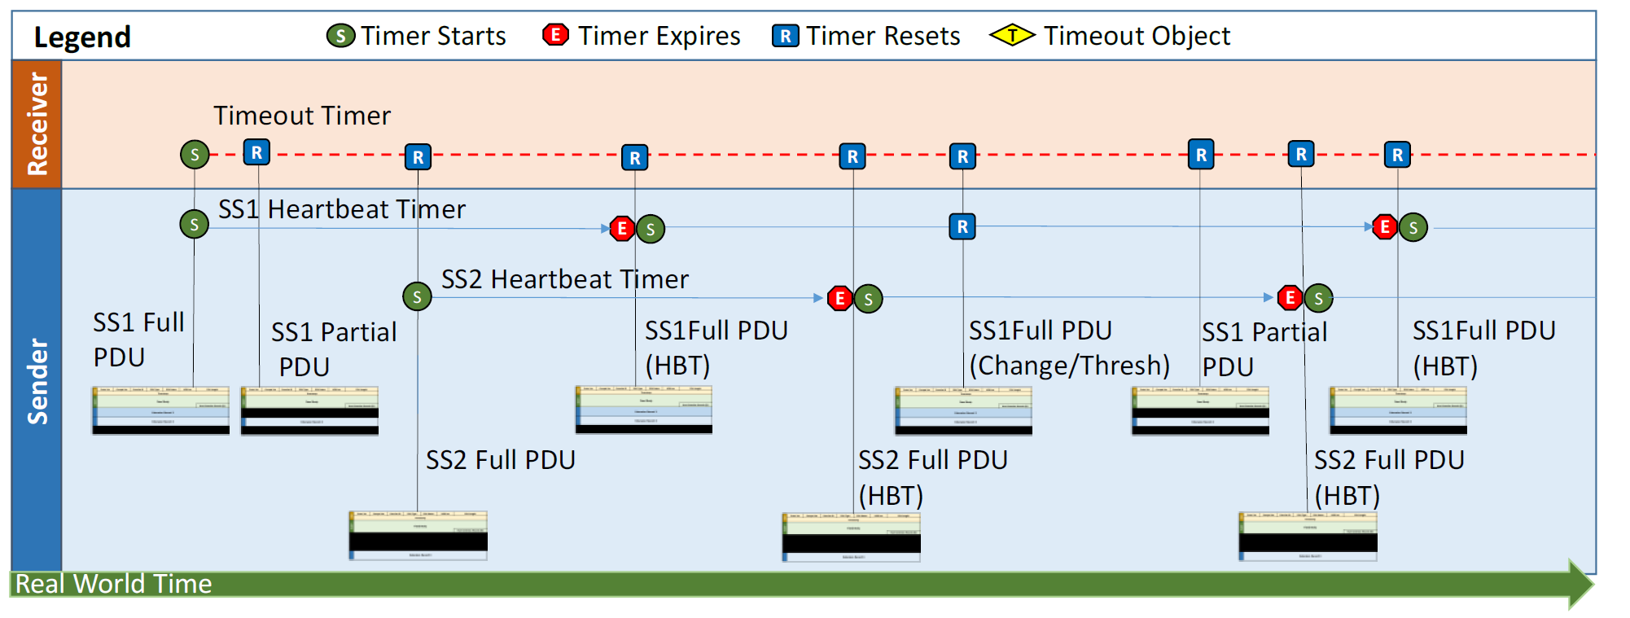
Improvement 6: Partial Updates/Split Modeling of Systems and Reliability
Heartbeat (HBT)
Subset (SS)
The same extension records are not required in every PDU update (Partial Update)
Extension records can have different heartbeats than the PDU
Can use multiple subsets of extension records (one set from each system)

Slide 14
Partial Updates/Split Modeling of Systems and Reliability
All SIMAN PDUs now support reliability with a single PDU type
No duplicate Data, Data-R etc. PDUs
15 Reliabilty “XXX-R” PDUs removed

Slide 15
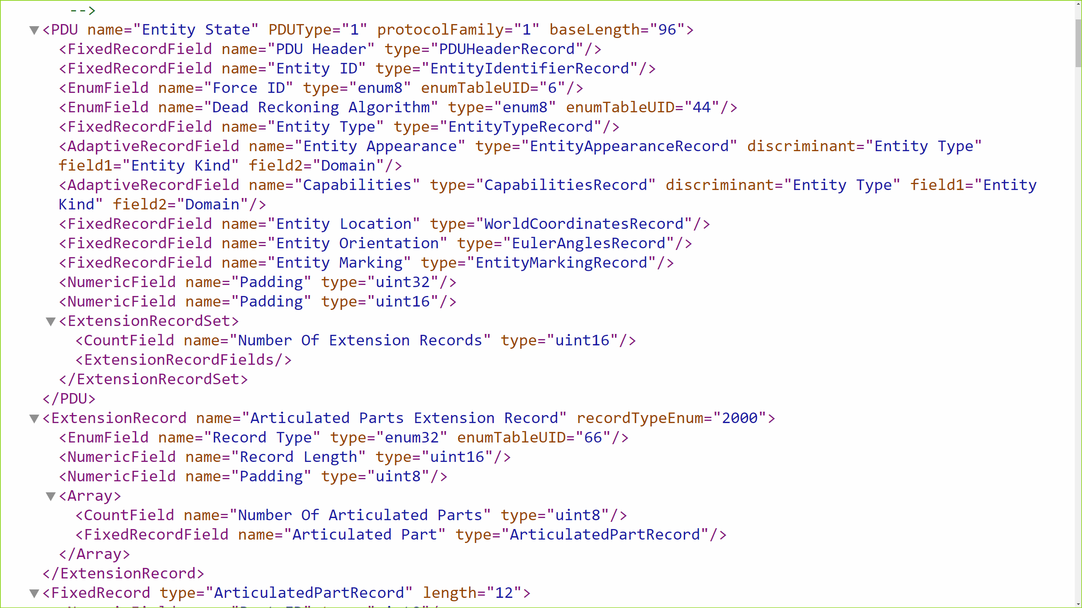
Improvement 7: XML Schema Supports Automated Marshalling/Wireshark Dissectors
Portion of an XML file that describes a PDU. (Separate schema not shown)

Slide 16
Improvement 8: New PDUs - Application Control, IFF-I
Application Control
Request control of an Application
Allocate simulations to exercise
Application Health monitoring
Control of simulators, gateways, and loggers
Identification Friend or Foe (IFF) - Interactive
Higher fidelity modeling of interrogation systems
Adds to existing IFF capabilities (doesn’t replace current IFF)

Slide 17
New PDUs - Laser, and Weather
Laser (Formerly Designator)
Laser Ranging and Jamming
Weapon Guidance and Target Illumination
Laser Pointer/Marker
Weather
Based on SISO-STD-013-2014 Common Image Generator Interface (CIGI) Standard
Messages condensed and reorganized for efficiency
Split Geometry (location information) from actual Weather Information (Temperature etc.)
Supports regions, vertical layers, clouds, rain, snow, sea state, waves, terrestrial surface etc.
Added new types of geometries (rectangular, circular, tubular, linear, polygon)
Added region groups, rotation, and velocities

Slide 18
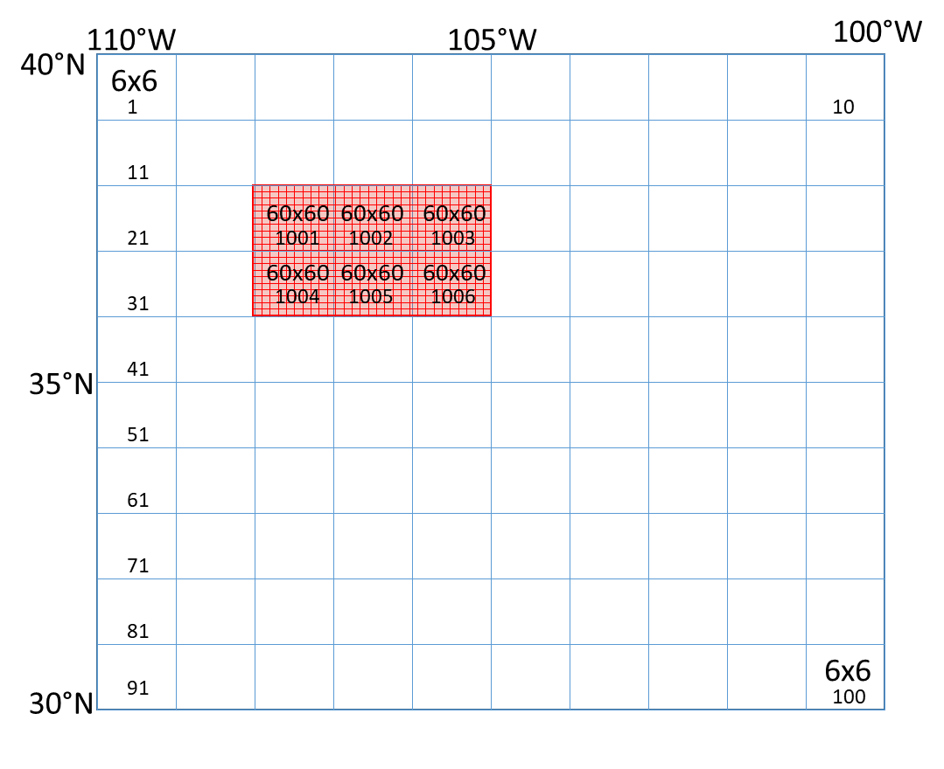
Improvement 9: Simplified Gridded Data PDU With Weather Support
Gridded data support
Able to mix high and low resolution data
PDU defines tile sizes both horizontally and vertically
Support for Wind, humidity, temperature, barometric pressure etc.
Can add parameters

Slide 19
Improvement 10: Miscellaneous Updates
Change from Big Endian (most to least significant byte) to Little Endian (least to most significant byte) order
Consistent with most modern hardware
Easier and slightly faster for most implementations
64-Bit timestamp
No clock “rollover” every hour
Includes date and time information for moon phase and ephemeris calculations
1µsec accuracy vs 107µsec in DIS V7
Common computer clock time
Point, Linear and Areal Objects are now Entities
Point, Linear and Areal Object PDUs are now extension records in Entity State

Slide 20
Conclusions
The extensibility of DIS V8 will allow for adding new capabilities to DIS without needing to modify the IEEE 1278.1 standard, which should lead to more innovation.
SISO-REF-030 will allow for faster updates of documented capabilities. This should lead to more reuse of existing extension records and increase the chances that updates will be interoperable.
DIS V8 will enable much better modeling of AESA radars and advanced jammers in a consistent, interoperable fashion.
The CPC dead reckoning algorithm will reduce network updates and reduce the size of network bandwidth peaks making better usage of available bandwidth.
The new multi-entity extension records will enable larger exercises with fewer PDUs and less bandwidth

Slide 21
Conclusions
General rules for partial updates for all PDUs improve bandwidth efficiency. Duplicate SIMAN PDUs are no longer required for reliability.
An XML machine-readable DIS syntax description enables significant automation of creating and processing DIS PDUs.
New PDUs add new capabilities and higher fidelity.
Simplified Gridded Data PDU with support for dynamic terrain and real-world weather data will allow users to use real-time weather or historical weather data to create more realistic training.
Miscellaneous updates for ease of use, faster computation, simplification, and less redundancy will provide better performance and make DIS V8 easier to understand, especially for new users.

Slide 22
Contact Info
Lance Call, Scientist, Systems and Software Engineer
711 HPW/RHAS; CAE USA
Phone 480-840-3944 ext. 102
Lance.call@us.af.mil
Bob Murray, Retired
Symphonics, Inc.
bobmurray222@gmail.com

