Slide 1





Spatial Accuracy Requirements for Visual Search Cues in Simulated Sparse and Dense Scenes
Colleen E. Gerrity, MAG Aerospace
John J. Graybeal, U.S. Army DEVCOM C5ISR Center
William Heath Sharp, Planned Systems International
Emily Lasko, CACI International, Inc.
Todd W. Du Bosq, U.S. Army DEVCOM C5ISR Center
Notes:
Good morning! Thank you for the introduction and thank you all for being here. Again, my name is Colleen Gerrity. I’m an Engineering Psychologist employed by MAG Aerospace, and I support the Army DEVCOM C5ISR Center in the Human Perception Laboratory. Before I begin, I’d like to acknowledge my co-authors, John Graybeal, Heath Sharp, Emily Lasko, and Todd Du Bosq.

Slide 2
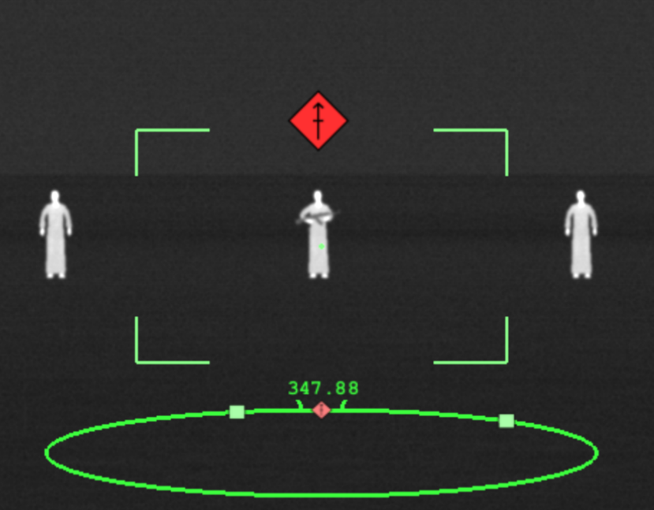
Introduction
The U.S. Army DEVCOM C5ISR Center is developing, evaluating, and integrating electro-optical and infrared (EO/IR) sensors to enhance the effectiveness and safety of Soldiers in the field
Augmented reality (AR) technologies attempt to enhance human sensory experiences by inserting digital information into the user’s experience of the “real world”
Notes:
Big picture, within the U.S. Army, a primary role of the C5ISR Center is developing, evaluating, and integrating state-of-the-art electro-optical and infrared sensors with the goal of enhancing the effectiveness and safety of Soldiers.
These sensors can then be implemented using augmented reality technologies, which attempt to enhance human sensory experiences by inserting digital information into the user’s experience of the real-world.
That’s where the role of us Engineering Psychologists comes into play – we can simulate these sensors and present them to Soldiers in a controlled environment to see how this information might translate to supporting them in the field.

Slide 3
Quality of Visual Cue Information
For AR technologies to be successful and for information to benefit Soldiers, it must be:
Perceivable
Comprehendible
Relevant
Timely
Accurate
If any of these dimensions are lacking, the information will not improve human operator performance and may even impair it
Simulation was used to systematically vary the quality of information to provide insight into how improvements or degradations affect operator performance
Notes:
Of course, that all sounds great, but for AR technologies to be successful and beneficial to Soldiers, the information presented must be perceivable, comprehendible, relevant, timely, and accurate.
If any of these dimensions are lacking, the information is not going to be as effective in improving human performance and it could even deter and impair performance.
At C5ISR, we use simulation to systematically vary the quality of information presented to the Soldier. Using simulation is a more cost-effective method to cleanly control the AR information to see how improvements or degradations affect operator performance.

Slide 4
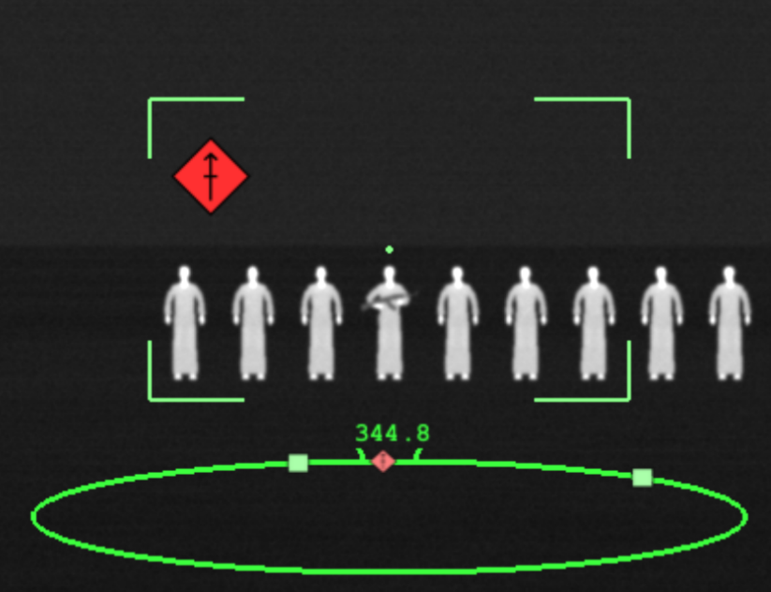
Quality of Visual Cue Information (cont.)
Visual cues are designed to support a variety of tasks, such as navigation and target detection, by orienting the operator’s attention in a way that supports task completion
Spatial registration of AR symbology remains a significant technical challenge
Potential sources of spatial error can cause a visual cue to be perceived in a location that is either slightly or severely different than its ideal or intended position
Example of AR symbology with spatial error
Notes:
In this experiment, we use the term “visual cue” to talk about the AR information presented to the Solider.
Visual cues are designed to support tasks, such as navigation and target detection, by orienting the operator’s attention in a way that supports task completion.
However, spatial registration of AR symbology remain a technical challenge, such that spatial error cause a visual cue to be perceived in a location that differs from its ideal or intended position.
This graphic shows a mild example of AR symbology with spatial error. In this task, we are searching for the human holding the weapon and the visual cue is intended to be positioned directly above the target. However, in this image, we can see it’s slightly off the left. This is a small amount of spatial error, so we also want to think about how the level of spatial error might affect task performance. More on that in moment.

Slide 5
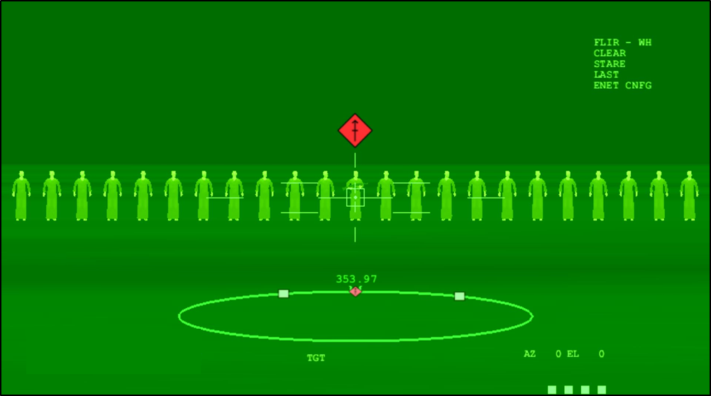
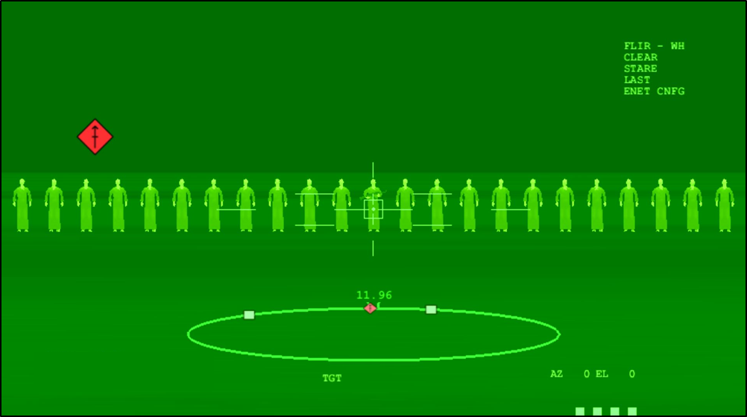
Previous Experiment (2019 I/ITSEC)
Examined impact of visual cue angular error on target acquisition performance as a function of range to target
Incremental errors in visual cue spatial accuracy produced impairments in performance
Even imperfect visual cues were beneficial in this experiment
(Graybeal et al., 2019b)
Perfect Visual Cue Imperfect Visual Cue
Notes:
The experiment that will be the focus of today’s talk is built upon our previous experiment, which was presented at the 2019 I/ITSEC and won Best Paper.
We looked at how the angular error of the visual cue impacted target acquisition performance at different ranges to target
On the left, we have a perfect visual cue – the cue is directly above the intended target. On the right, we have an example of an imperfect visual cue – the cue is placed with a degree of angular error, so it appears to not be above the intended target.
What we learned from this 2019 experiment is that incremental errors in visual cue spatial accuracy produced impairments in performance and that even imperfect visual cues were beneficial to performance. So, what that means is that some level of visual cue information does support performance compared to having no visual cue; however, performance is incrementally worse with incremental errors.

Slide 6
Current Experiment (2024 I/ITSEC)
Examined the additional impact that scene density has on the effects of visual cue angular error as a function of range to target
Our primary research questions explore how much visual cue accuracy in sparse and dense scenes is needed for visual cue information to:
Improve human performance
Harm human performance
Notes:
That brings us to the current experiment, which examined the additional impact of scene density on the effects of visual cue angular error as a function of range to target.
We explored explore how much visual cue accuracy in sparse and dense scenes is needed for visual cue information to improve human performance and to harm performance.
Essentially, at what level of scene density, visual cue angular error, and range provide benefit to human performance and at what point does it begin to harm human performance.

Slide 7
Experimental Design
Five visual cue conditions: No Visual Cue, Perfect Visual Cue, and Imperfect Visual Cue with 1°, 3°, and 5° of angular error between the visual cue and the true target
Three ranges: “Close,” “Intermediate,” and “Distant”
Five densities: 0.5 meter (m), 1 m, 5 m, 10 m, and 20 m
Denser Sparser
Notes:
Here’s our experimental design…
Please note that when talking about scene density, we’re talking in meters, so 0.5 is the densest scene and 20 and is the sparsest scene. I’ll try to call that out as we go through the results just to prevent any confusion.

Slide 8
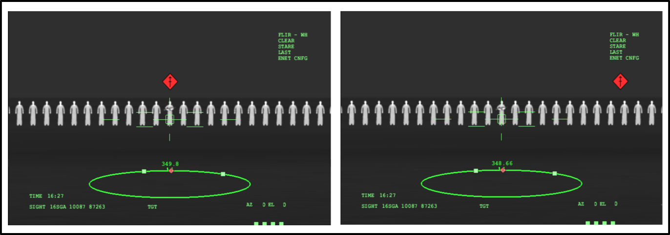
Sample Visual Cue Conditions
Perfect Visual Cue Imperfect Visual Cue
Notes:
Here are sample visual cue conditions. I’ll go into more detail in just a moment, but in this experiment, the target is the virtual human holding a weapon.
So, on the left is a Perfect Visual Cue – the visual cue is directly above the virtual human target holding the weapon.
On the right is an Imperfect Visual Cue – the visual cue has a degree of angular error, so it is not directly above the virtual human target holding the weapon.

Slide 9
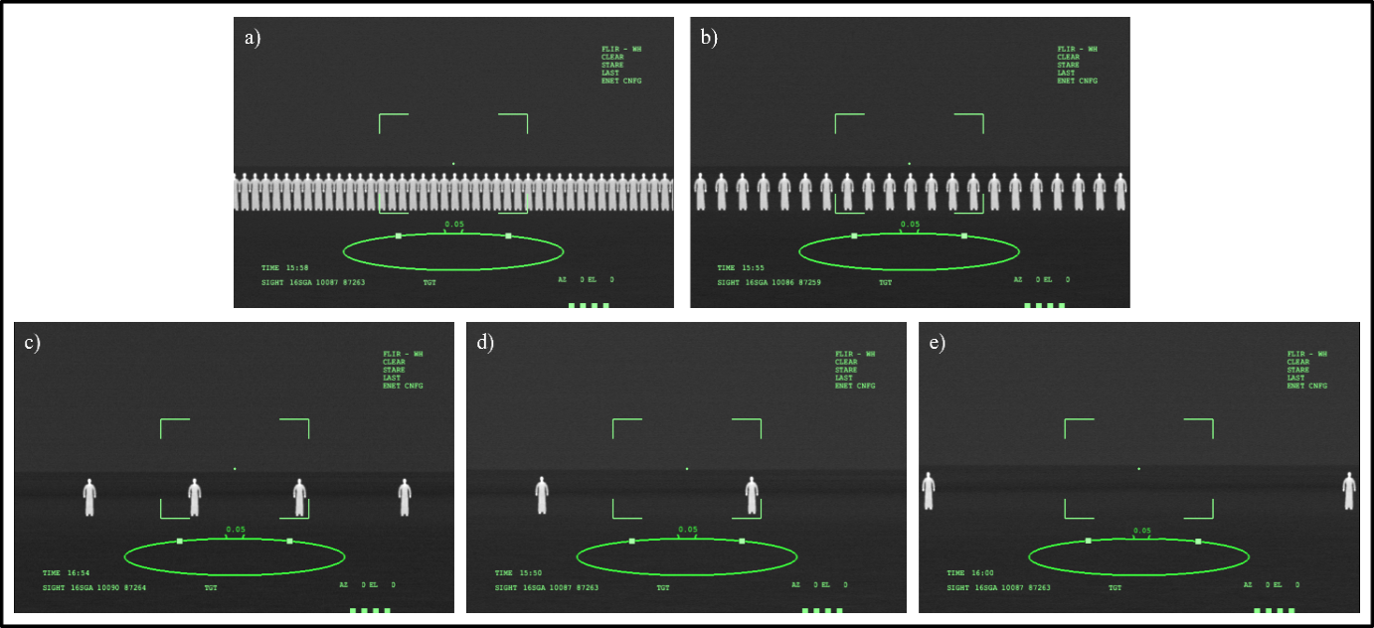
Densities
0.5 m
1 m
5 m
10 m
20 m
Notes:
Here are examples of our five densities…
Recall that 0.5 is the densest scene and 20 is the sparsest.

Slide 10
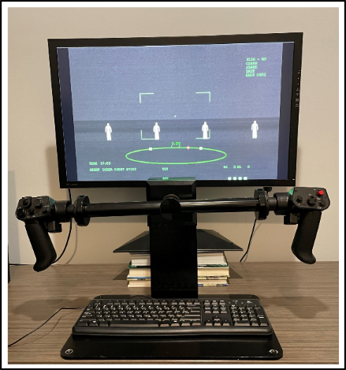
Scene Generation & Sensor Controls
Scenarios created using C5ISR Center’s in-house Night Vision Image Generator (NVIG) software to simulate an infrared sensor feed
Highly-realistic sensor grips
Pushing on grips rotated the sensor
Left/right, up/down
Optical zoom
Narrows the 8° field of view (FOV) to 2.7° FOV
Button on grips to designate target
Menu to confirm or cancel designation
Speed boost
Targeting reticle
Notes:
Our scenarios were created using C5ISR’s Night Vision Image Generator to simulate an infrared sensor.
On the right, you can see an image of our set-up. Participants used realistic sensor grips that rotated the sensor based on the physical movement of the grips, as well as housed all the button controls.
Participants had access to an optical zoom button that narrowed the 8-degree FOV to 2.7-degrees.
There, of course, was a button to designate the target, a speed boost button to accelerate their search speed, and a target reticle on-screen that was used to properly align and designate the target.

Slide 11
Situational Awareness Ring
Visual cue on the situational awareness ring assists the operator in gauging which direction and how far to rotate the sensor
Presented with same amount of fixed angular error as visual cue designating the target within the sensor feed
Visual Cue
Field of Regard
Notes:
On-screen, participants also had a visual cue on the situational awareness ring assists the operator in gauging which direction and how far to rotate the sensor, and it is presented with same amount of fixed angular error as the visual cue.

Slide 12
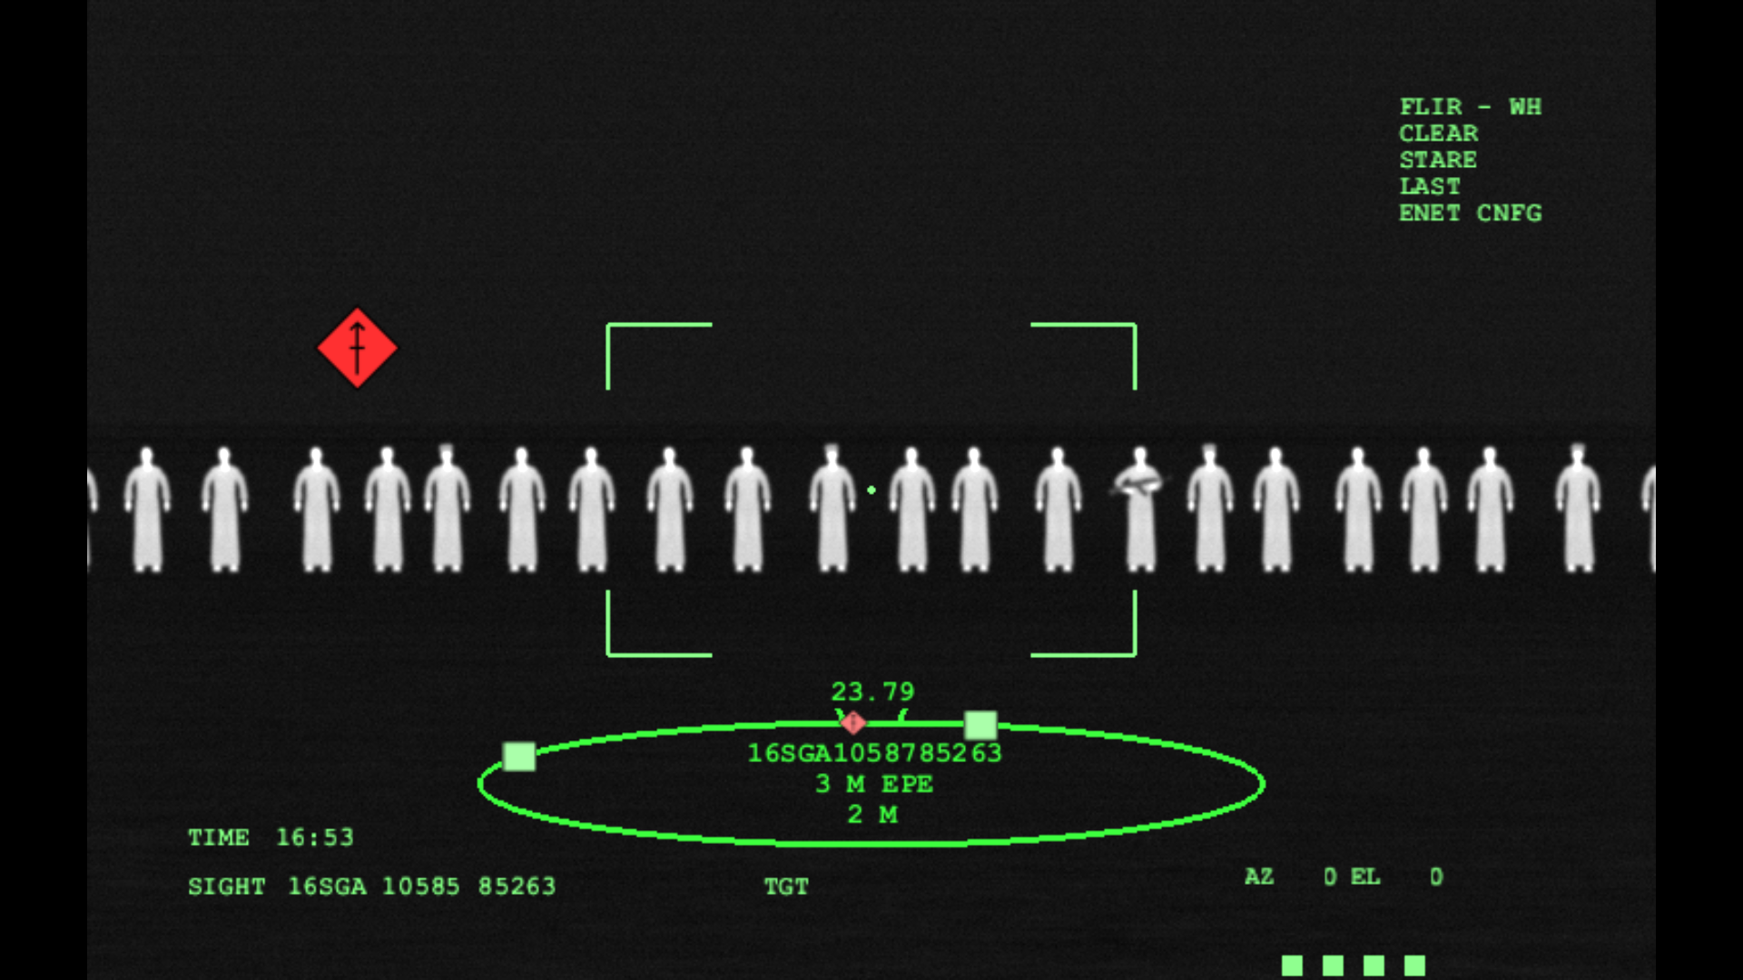
Participants & Procedure
30 U.S. Army Soldiers, recruited through Headquarters, Department of the Army
Final sample size was N = 29
Presented with training on the simulation instructions and sensor controls
Each scene contained only one human target holding a rifle, plus a varying number of non-target humans
At times, a visual cue would be present to help them during the task, but at varying levels of accuracy
Acquire the target as quickly as possible
Target
Non-Target
Notes:
Our participants were 30 U.S. Soldiers, and after conducting outlier analyses, our final sample size was 29.
As I mentioned, the targets in this experiment were a virtual human holding a rifle. There was only one human target per scene, plus a varying number of non-target humans. An example of both can be seen here.
Soldiers were instructed that, at times, a visual cue would be present to help them during the task, but at varying levels of accuracy, to acquire the target as quickly as possible.

Slide 13
Participants & Procedure (cont.)
Training Scenarios: 3 ranges × 3 visual cue conditions × 3 densities (27 trials)
No Visual Cue, Perfect Visual Cue, and Imperfect Visual Cue with 5° of angular error
Three densities (0.5 m, 5 m, and 20 m)
Covered the full spectrum of visual cue performance in the experimental trials
Experimental Scenarios: 150 trials, divided into 8 blocks
60 second time limit to acquire each target
Required to take a ten-minute break halfway through the experiment to alleviate fatigue
Notes:
Soldiers completed 27 training scenario trials that covered the full spectrum of visual cue performance that they would see in the experimental trials.
As for the experimental scenarios, there were 150 trials, divided into 8 blocks. Soldiers were given 60 seconds to acquire each target. They were encouraged to take breaks between blocks, but were required to take a 10-minute block halfway through to alleviate fatigue and eyestrain.

Slide 14
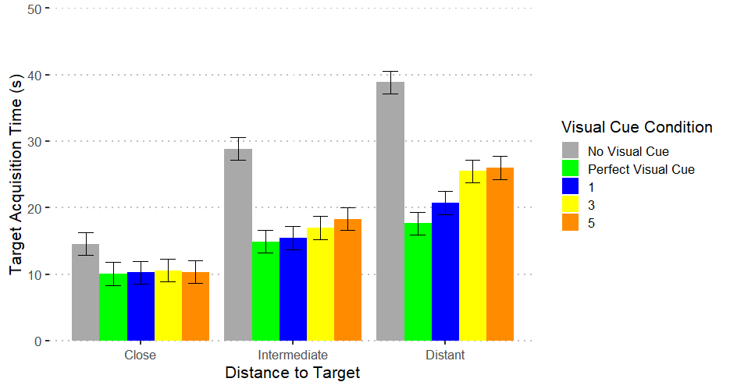
Results
Target Acquisition (TA) Times
Significant Main Effects:
Visual Cue Condition
Fastest TA times in Perfect Visual Cue Condition
TA times increased with greater amounts of angular error
Slowest TA times in No Visual Cue Condition
Range
TA times increased as range also increased
Significant Interactions:
Range and Visual Cue Condition
Compared to No Visual Cue Condition, visual cues provided improvements to TA times as the task became more difficult at further ranges
° Angular Error
° Angular Error
° Angular Error
Notes:
Now for the results. For this experiment, we looked at target acquisition time and target acquisition performance.
Starting with target acquisition time, we saw significant main effects of visual cue condition and range.
For visual cue condition, we saw…
For range, we saw…
There was also a significant interaction between range and visual cue condition, such that when…

Slide 15
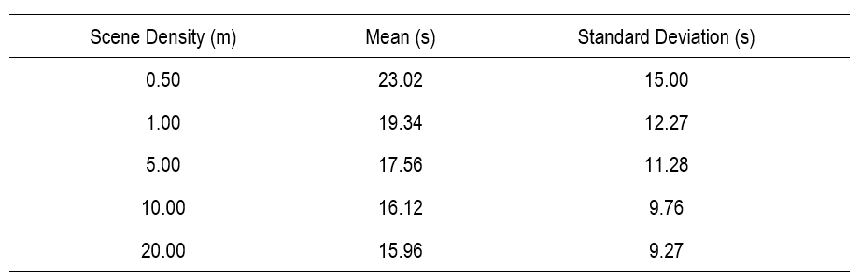
Results
Target Acquisition (TA) Times
Significant Main Effects:
Density
Slowest TA times in densest scenes (0.5 m)
TA times increased with greater amounts of density
Fastest TA times in sparsest scenes (20 m)
Average Target Acquisition Times by Scene Density
Densest
Sparsest
Notes:
We also saw a significant main effect of density on target acquisition times, such that we saw slowest target acquisition times in densest scenes and fastest target acquisition times in sparsest scenes.
So, we saw a trend of target acquisition times increasing with great amounts of scene density.

Slide 16
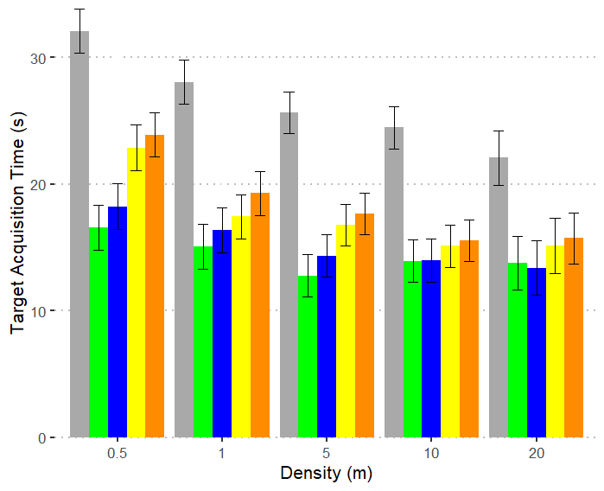
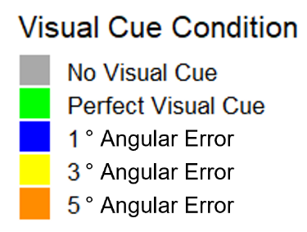
Results
Target Acquisition (TA) Times
Significant Interactions:
Density and Visual Cue Condition
Comparing No Visual Cue Condition to Perfect Visual Condition and 1° angular error, improvements to TA times were magnified as scene density increased
These increased benefits of visual cues in denser scenes were not significant at 3° and 5° of angular error
Interaction Trends:
Increased density and increased amounts of angular error generally increased TA times
Notes:
We also saw a significant interaction between density and visual cue condition, such that when we compared the no visual cue condition to the perfect visual cue condition and to 1-degree of angular error, we saw improvements to target acquisitions that were magnified as scene density increased.
This interaction was not significant at 3-degrees or 5-degress of angular error.
However, we did see an overall interaction trend of increased density and increased amounts of angular error generally associated with increased target acquisition times.

Slide 17
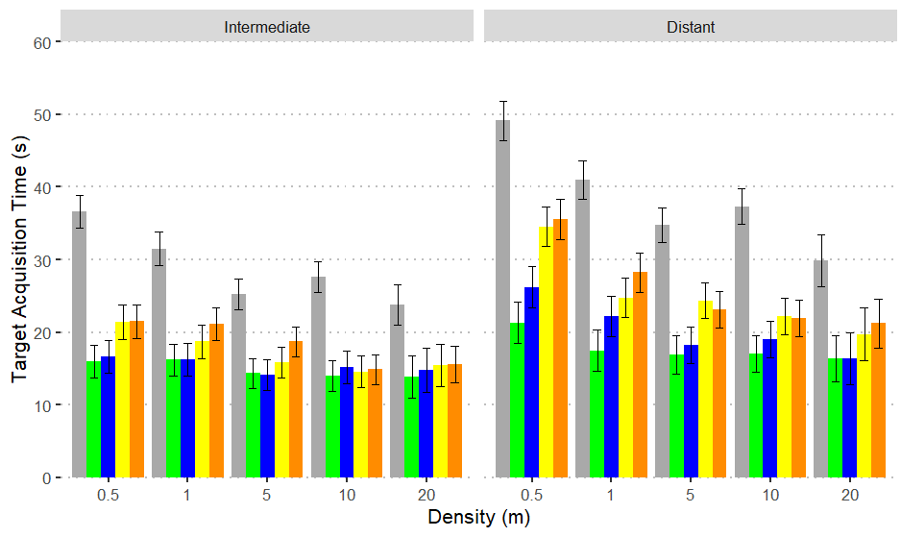

Results
Target Acquisition (TA) Times
Segmenting data by range:
Compared to No Visual Cue Condition, density had a significant effect on TA times with visual cues at Intermediate and Distant ranges
At Intermediate and Distant ranges, TA times for No Visual Cue Condition and most angular error conditions significantly increased as the density of the scene increased
Visual cues provided most benefit to TA times at more distant ranges
Notes:
For this analysis, we segmented the data by range to look at the effects of visual cue condition and density. Density had a significant effect on target acquisition times in conditions with visual cues for Intermediate and Distant ranges.
The big picture to take away from this slide is that visual cues provided most benefit to target acquisition times at more distant ranges, even if the visual cues were imperfect.

Slide 18
Accuracy Scoring
Response was scored as correct if the designated path and target were both within the sensor’s narrow FOV
Participant’s ability to finely control the grips and center the targeting reticle precisely on the target was not pertinent to our underlying research questions
Accuracy results in this task primarily reflect Soldiers’ attention to the task (i.e., Soldiers found the target before time ran out or they did not)
Notes:
Now we’ll switch gears to talk about target acquisition accuracy.
…
Thus, in this experiment, accuracy results reflect the Soldiers ATTENTION to this task, such that they either found the target before the 60-second time limit or they did not.

Slide 19
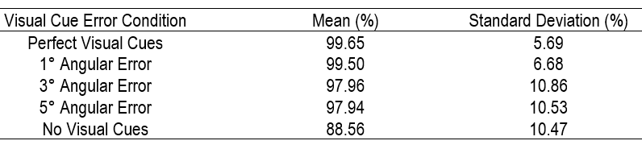
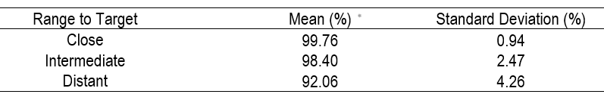
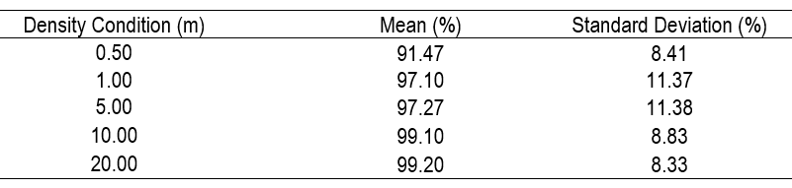
Results
Target Acquisition (TA) Accuracy
Significant Main Effects:
Visual Cue Condition
Lowest TA accuracy in No Visual Cue Condition, highest in Perfect Visual Cue Condition
TA accuracy incrementally decreased as angular error increased
Range
Nearly perfect TA accuracy at Close range
Progressively lower TA accuracy at Intermediate range and Distant range
Density
Lowest TA accuracy in densest scenes (0.5 m)
Generally, TA accuracy increased incrementally as scenes became sparser
Mean Accuracy Scores by Visual Cue Condition (All Ranges Combined)
Mean Accuracy Scores by Range
Mean Accuracy Scores by Density (All Ranges Combined)
Notes:
We saw significant main effects for all three of our independent variables.
Target acquisition accuracy incrementally decreased as angular error increased, such that we saw lowest TA accuracy in no visual cue condition and highest in perfect visual cue.
For range, TA accuracy was nearly perfect at close range, and progressively lowered at intermediate and distant ranges.
Finally, for density, we saw the lowest TA accuracy in the 0.5 m densest scenes, and generally saw improvement to TA accuracy as the scenes became sparser

Slide 20
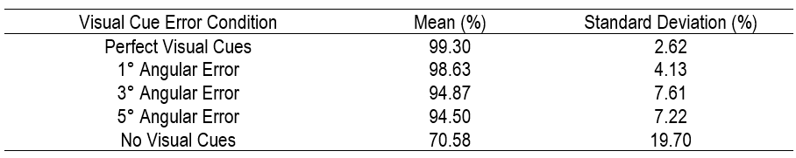
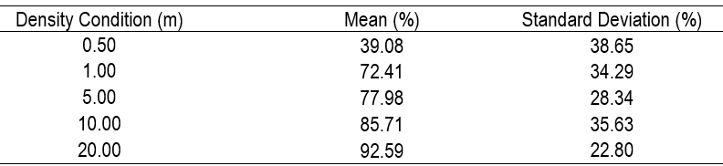
Results
Target Acquisition (TA) Accuracy
With No Visual Cue Condition as the reference group, there was significant improvement in TA accuracy for all visual cue conditions
Density had a significant impact on TA accuracy in No Visual Cue Condition
Least accurate in densest scenes (0.5 m) and most accurate in sparsest scenes (20 m)
TA accuracy increased as scene density decreased
Mean Accuracy Scores by Visual Cue Condition at the Distant Range
Mean Accuracy Scores by Density Condition at the Distant Range for Targets with No Visual Cue
Notes:
Looking deeper at TA accuracy at the Distant range, we see that compared to no visual cue condition, there was significant improvement in TA accuracy for all visual cue conditions.
Furthermore, density had a significant impact on TA accuracy in the no visual cue condition, such that Soldiers were the least accuracy in densest scenes and more accurate in the sparsest scenes. You can see the accuracy performance without any visual cues is really hindered at the densest scene.
No significant interactions between the visual cue conditions and density in terms of TA accuracy.

Slide 21
Discussion
Limitations
Highly-realistic sensor grips may have led to slower and less precise target designations due to gross motor skills required to use the grips
Accuracy scoring
Laboratory simulations do not encompass other influences related to Soldier performance, such as stress and fatigue present in battlefield conditions
Simulated scenarios did not contain any visual clutter outside of core objects that had to be searched
Notes:
In terms of the discussion and limitations of this study…
… That influenced our accuracy scoring because we felt there was a conflict between with the physical movement of the grips and getting a precise target designation.

Slide 22
Conclusion
Previous Experiment
Replicated results with respect to how range, angular error, and their interaction impact human performance
Effects of Density
Across visual cue conditions and ranges, target acquisition times increased as density increased
Density had a significant impact on observed gains in human performance when completing the task with and without visual cue information
Visual cue information, even imperfect, progressively benefitted performance
Target acquisition performance deteriorated as scene density, angular error, and range all increased
Performance was the worst when scenes were the densest and at the Distant range with no visual cue information
Visual cue accuracy requirements changed with increasing task difficulty when considering both range and density simultaneously
Notes:
To conclude, linking the current experiment with the past experiment, we replicated results with respect to how range, angular error, and their interaction impact human performance.
Unique to the current study are the effects of density. What we saw is that…

Slide 23
Thank You!
Colleen Gerrity
colleen.gerrity@mag.us

Slide 24
References
Bates, D., Maechler, M., Bolker, B., Walker, S., Christensen, R. H. B., & Singmann, H. (2015). lme4: Linear mixed- effects models using Eigen and S4, 2014. CRAN, 1(4).
Brunyé, T. T., Moran, J. M., Houck, L. A., Taylor, H. A., & Mahoney, C. R. (2016). Registration errors in beacon- based navigation guidance systems: Influences on path efficiency and user reliance. International Journal of Human-Computer Studies, 96, 1-11.
Chen, L., Liu, Y., Li, Y., Yu, L., Gao, B., Caon, M., ... & Liang, H. N. (2021). Effect of visual cues on pointing tasks in co-located augmented reality collaboration. In Proceedings of the 2021 ACM Symposium on Spatial User Interaction (pp. 1-12).
Dixon, B. J., Daly, M. J., Chan, H., Vescan, A. D., Witterick, I. J., & Irish, J. C. (2013). Surgeons blinded by enhanced navigation: the effect of augmented reality on attention. Surgical endoscopy, 27(2), 454-461.
Dunleavy, M., & Dede, C. (2014). Augmented reality teaching and learning. In M. Spector, M. Merrill, J. Ellen & M. Bishop (Eds.), Handbook of research on educational communications and technology (pp. 735-745). New York, NY: Springer.
Egly, R., Driver, J., & Rafal, R. D. (1994). Shifting visual attention between objects and locations: evidence from normal and parietal lesion subjects. Journal of Experimental Psychology: General, 123(2), 161.
Graybeal, J. J., Monfort, S. S., Du Bosq, T. W., & Familoni, B. O. (2018). Human perception testing methodology for evaluating EO/IR imaging systems. In Infrared Imaging Systems: Design, Analysis, Modeling, and Testing XXIX (Vol. 10625, p. 106250T). International Society for Optics and Photonics.
Graybeal, J. J., Nguyen, R. T., & Du Bosq, T. W. (2019). Simulating human vehicle identification performance with infrared imagery and augmented reality assistance. In Infrared Imaging Systems: Design, Analysis, Modeling, and Testing XXX (Vol. 11001, pp. 116-129). SPIE.
Graybeal, J. J., Nguyen, R. T. T., Du Bosq, T. W. (2019). Simulating Augmented Reality Spatial Accuracy Requirements for Target Acquisition Tasks. In Proc. of Interservice/Industry Training, Simulation and Education Conference.
Graybeal, J. J., Sharp, W. H., Lasko, E., Bagalkotkar, K., & Dang, J. (2023). Simulating the Impact of Navigation Waypoint Accuracy on Solider Performance. In Proc. of NATO MSG-207.
Harkrider, S., May, C., Paul, D., Osborn, W., Tran, V., & Anderson, D. (2011). A Successful Government Furnished Solution Use Case: The Night Vision Image Generator. In 2011 Meeting of the Military Sensing Symposia (MSS) Specialty Group on Passive Sensors, Battlefield Survivability & Discrimination, Detectors and Materials.
Kruijff, E., Swan, J. E., & Feiner, S. (2010). Perceptual issues in augmented reality revisited. In 2010 IEEE International Symposium on Mixed and Augmented Reality (pp. 3-12). IEEE.
May, C., Harkrider, S., Paul, D., Osborn, W., & Tran, V. (2011) Target IR Signature Creation Used in NVIG Sensor Simulation. In Proc. SimTecT, 31.
Monfort, S., Graybeal, J. & de Visser, E. & Du Bosq, T. (2018). Reliability requirements for augmented reality in visual search tasks. In Proc. of Interservice/Industry Training, Simulation and Education Conference.
Posner, M. I. & Cohen, Y. (1984). Components of visual orienting. Attention and Performance, 32, 531-556.
Radu, I. (2014). Augmented reality in education: a meta-review and cross-media analysis. Personal and Ubiquitous Computing, 18(6), 1533-1543.
Satterthwaite, F. E. (1946). An approximate distribution of estimates of variance components. Biometrics bulletin, 2(6), 110-114.
Tang, A., Owen, C., Biocca, F., & Mou, W. (2003, April). Comparative effectiveness of augmented reality in object assembly. Paper presented at the meeting of CHI, Ft. Lauderdale, Florida.
Wu, H. K., Lee, S. W. Y., Chang, H. Y., & Liang, J. C. (2013). Current status, opportunities and challenges of augmented reality in education. Computers & Education, 62, 41-49.

Slide 25
Supplemental Slides

Slide 26
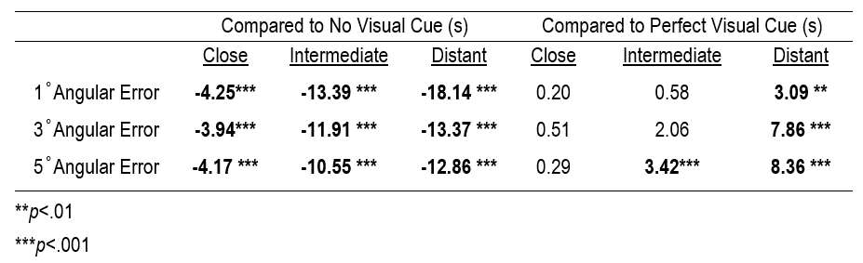
Results
Target Acquisition (TA) Times
Imperfect visual cue information dramatically improved average TA performance relative to No Visual Cue Condition
Benefits of having visual cue information, plus the detriments of angular error, became more impactful at longer ranges
Compared to Perfect Visual Cue Condition, TA times increased with any degree of angular error, and these increases were magnified as range to target also increased
Difference in Target Acquisition Times Between Imperfect Visual Cue Information and Control Conditions
Notes:
(Slide 16) As with angular error, variance in TA times also increased as the scene became denser

Slide 27
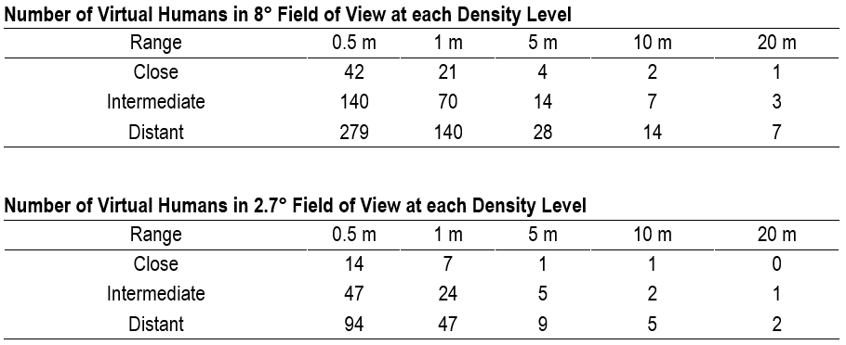
Appendix A

Slide 28
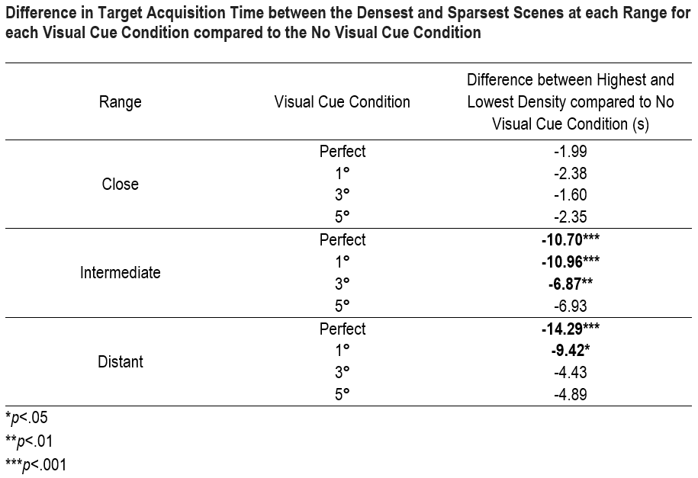
Appendix B

