Slide 1

Optimizing Readiness Through AI-Driven Analytics for Automated Training Insights
Presenting: Summer Rebensky
Co-Authors: Svitlana Volkova, Isabel Erickson, Louis Penafiel, Hsien-Te Kao

Slide 2

Goals
Pulling Insights from qualitative (open ended survey and interview data) is:
Time Intensive
Requires specialized skills
Long term around time
Often Subjective
Tools are not scalable
The DoD needs Actionable Informed Insights to improve training, make acquisition decisions, and track trends

Slide 3
Analysis Overview
Topic Analysis
Classis topic modeling using Latent Dirichlet Allocation (LDA) to automatically identify topics in instructor and student survey to draw the insights about training gaps and effectiveness.
Connotation Analysis
NLP technologies to extract insights about training gaps and effectiveness. Specifically, syntactic parsing and semantic role labeling combined with sentence-level embeddings clustering.
Insight Extraction
NLP capabilities to analyze targeted student opinions about training gaps and effectiveness.

Slide 4
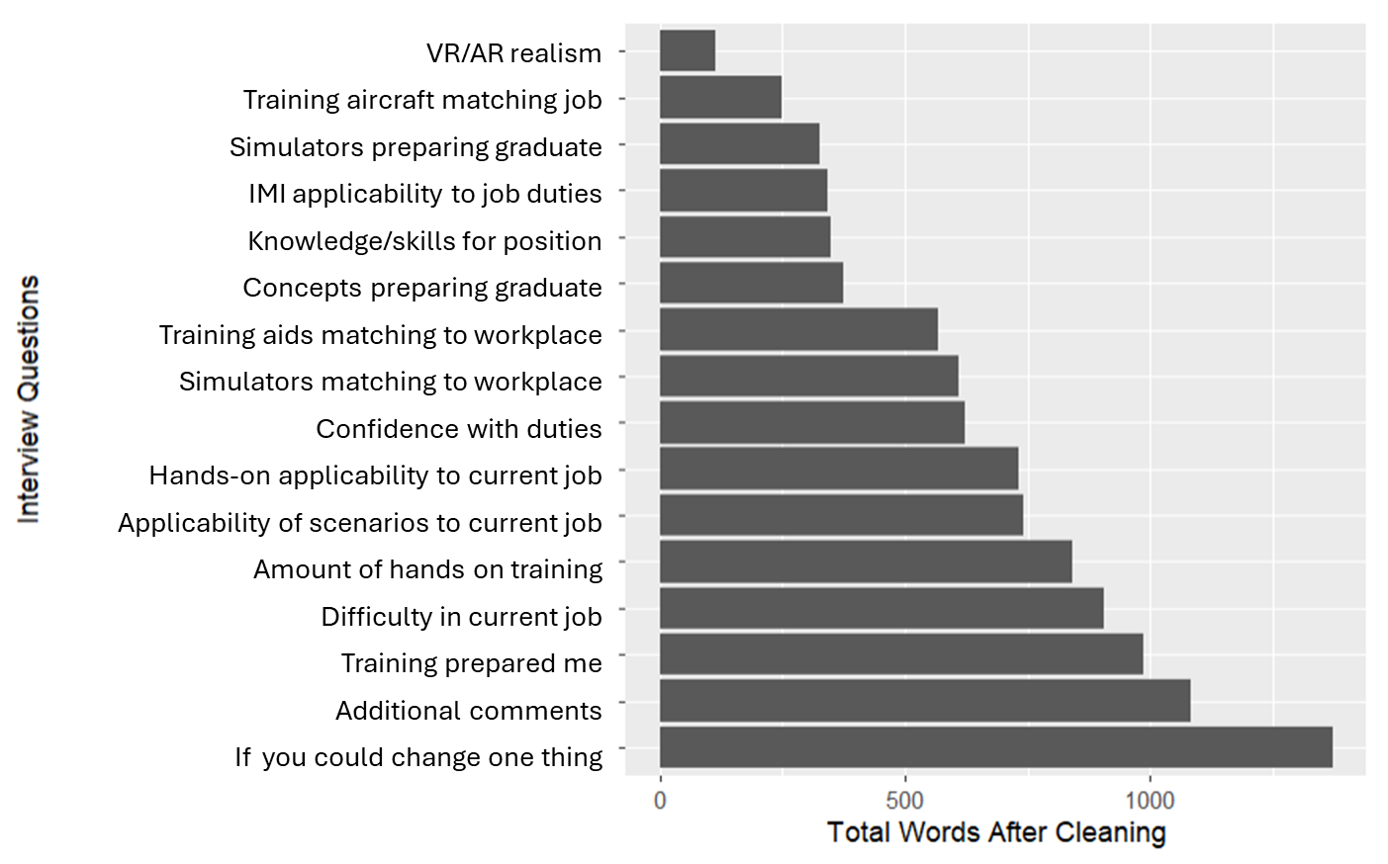
Topic Analysis
Utilizing Structural Topic Modeling (STM) and a Latent Dirichlet Allocation (LDA) variant
Analytical Approach Benefits
LDA is an unsupervised learning algorithm provides a distribution over words
STM goes one step further by utilizing metadata to improve the assignment of words

Slide 5
Topic Analysis
STM was applied to automatically identify themes related to training gaps and effectiveness issues across the survey responses
Survey Comment Benefits
Quickly identify questions worth additional NLP analyses
Understand which questions can be removed to reduce survey fatigue

Slide 6
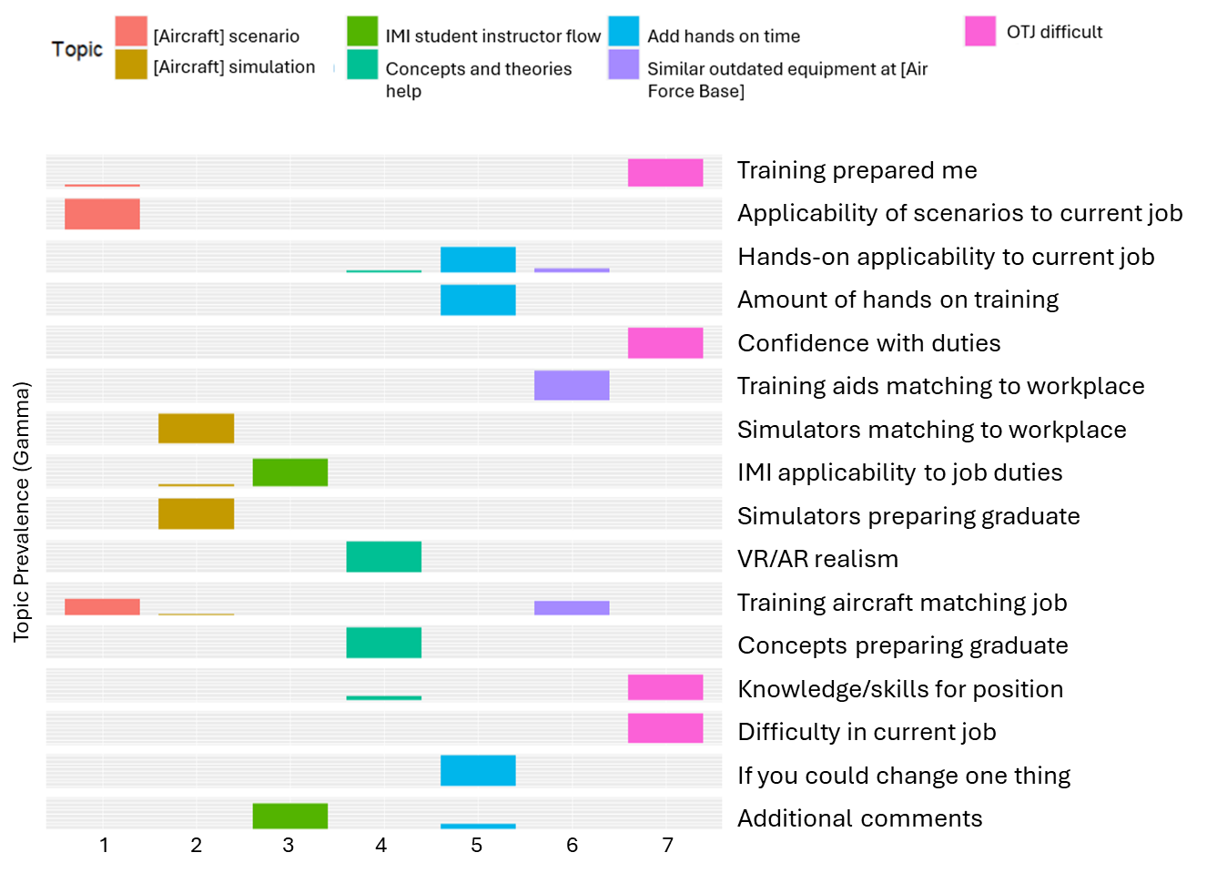
Topic Analysis
This topic analysis considers the probability of each word belonging to a specific topic based on the overall distribution of topics across the entire corpus.
Vertical Interpretation
Understand themes that are mentioned multiple times
On-the-job training difficulty was mentioned across multiple questions

Slide 7
Topic Analysis
Horizontal Interpretation
Understand frequency of themes of within a question
Simulators were a common issue noted for the question related to training aircraft matching the job
Takeaways
Potential training gaps or challenges that necessitate either future investigation or through funded improvements to training.
Some methods for qualitative analysis of themes are described in later slides

Slide 8
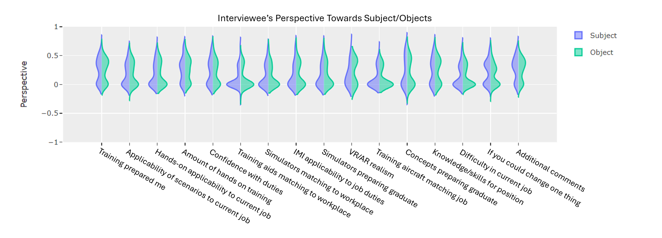
Connotation Analysis
Connotation frames were used to assess student opinions and experiences at scale
Questions that are wider at the bottom are interpreted more negatively, wider at the top more positively
Those that are taller may be interpreted as a mixed opinion; well suited for demographic splicing of info
When administered frequently responses may highlight perspectives growing positively or negatively over time

Slide 9
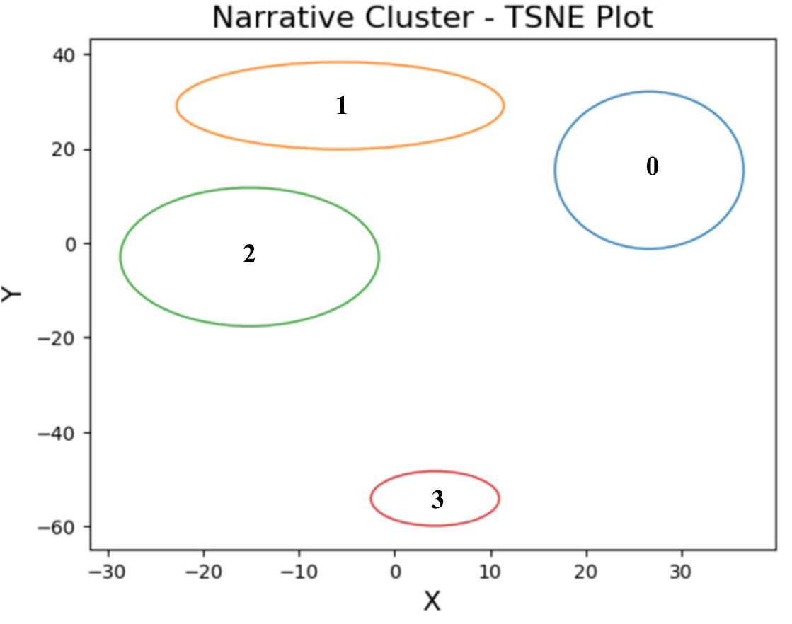
Insight Extraction
The methodology of insight extraction focused on extracting distinct thematic elements from comments based on word associations.
Analytical Approach Benefits
Considers each comment as containing multiple ideas. It addresses conflicting statements by parsing each comment into discrete subject-verb-object structures.
Clusters them based on semantic similarity, thereby preserving narrative coherence over a strict subject-verb-object interpretation.
Illustrating closely related, divergent, and sub-narrative themes.
Repetition and Hands-On Experience
Improving
Training Quality
More In Depth
Differences between training and operational equipment

Slide 10
Insight Extraction
Clusters also visualize how semantically similar or visually close the topics are to one another.
Cluster Takeaways
Hands-on training is a large concern and spoken to uniquely the orange and green cluster
Each cluster speaks to wanting more of something (the subject verb structure and purpose is similar).
However, the blue cluster is conveying graduates desire for more quality training related to courses
Red has a larger distance from the other clusters as the topic shifts from “wanting more” to “experiencing differences”.
Repetition and Hands-On Experience
Improving
Training Quality
More In Depth
Differences between training and operational equipment

Slide 11
Connotation Analysis
ChatGPT summarizations of the statements within a cluster can provide additional insights.
Could utilize the clustering to perform “pulse-checks” targeted surveys of each cluster topic.
Instructors could utilize this information to provide hands-on training more frequently within classes or pursue independent learning platforms so students can perform more hands-on training on their own schedule.
Cluster 0 | Improving Training Quality | It is necessary to maintain and improve quality control over existing courses. There needs to be more hands-on experience within these courses so students will understand what it takes to do their job when they graduate.
Cluster 1 | Repetition and Hands-On Experience | I like more. More repetition would help me feel comfortable and prepared for the course. Provide students with more opportunities or time in class that is handson/repetitive if they do.
Cluster 2 | More In-Depth | I think the (Interactive Multimedia Instruction) IMI should be more in depth
Cluster 3 | Differences between training and operational equipment | No hands-on training Not enough time with an assigned airframe. Most people learned on different models than their assignment, and there's a gap between general aviation fundamentals to modern systems and aircraft.

Slide 12
Future Areas and Recommendations
The automated AI-driven analytics presented in this paper have the potential to revolutionize training evaluation and improvement processes within the Department of Defense.
Traditional, manual analysis could take a team of full-time employees (FTEs) months to complete
NLP and ML techniques allows a single FTE to analyze the data within just hours.
These methods can significantly reduce the time and effort required for analyzing survey and interview data while providing more consistent, unbiased, and actionable insights.
Next Steps
Enhancing LLM summarization capabilities
Application of AI-driven analytics to other areas (e.g., personnel management and command climate) Integrate with test and evaluation processes to assess of training effectiveness and interventions
Development of modular, user-friendly dashboards for stakeholders
Exploring the integration of additional data sources, such as performance metrics
Investigating the use of real-time data collection methods (e.g., speech recognition and computer vision)
Establish best practices and guidelines for the ethical and responsible deployment of AI-driven analytics

Slide 13

Questions

