Slide 1

Leveraging MSaaS Concepts to Enable Mission Environments: Lessons Learned
Jay Freeman, CAE USA
Andreas Krupp, CAE Germany

Slide 2
Agenda
Problem Statement
MSaaS Technical Reference Architecture
Implementation of MSaaS Concept For Large Scale Exercises
C2SIM Utilization
MOSA Concepts and Performance
Metrics Collected
Lessons Learned
Summary

Slide 3
Problem Statement
Modular Open Systems Approach (MOSA) is an integral aspect to the concept of Integrated Deterrence to address challenges from near-peer adversaries who are increasingly hostile and threaten global stability
To achieve Integrated Deterrence within the Modeling and Simulation (M&S) community, the constraints of stove pipe training systems require transformation to ease the integration of the Allies and partners’ disparate systems.
Characteristics of stove pipe training systems include:
Designed and optimized for a specific domain (e.g., air, land, maritime, space, cyber)
Designed and optimized for a mission set (e.g., intelligence, surveillance, reconnaissance)
High-fidelity models are often restricted for global use because of security and intellectual property (IP) considerations
Is the NATO Modeling and Simulation as a Service (MSaaS) Reference Architecture a viable mechanism to build a MOSA M&S capability to meet integrated deterrence needs?

Slide 4
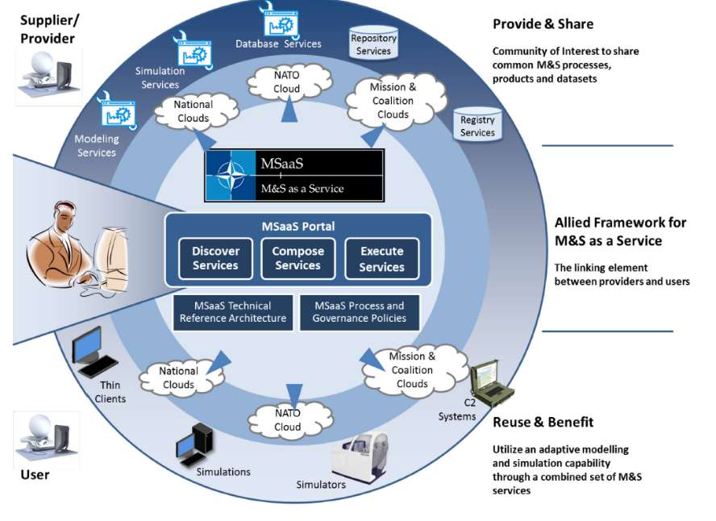
MSAAS TECHNICAL REFERENCE ARCHITECTURE
NATO MSG-136 published a Reference Architecture (RA) for a concept called Modeling and Simulation as a Service (MSaaS) in 2019
This initiative aimed to develop a cloud-based system that would provide on-demand access to simulated training environments
MSaaS RA is a layered architecture consisting of:
A static structure and a dynamic library of relevant Architectural Building Blocks (ABBs)
Architecture Patterns (APs)
Service Level Agreements to enable integration of capabilities

Slide 5
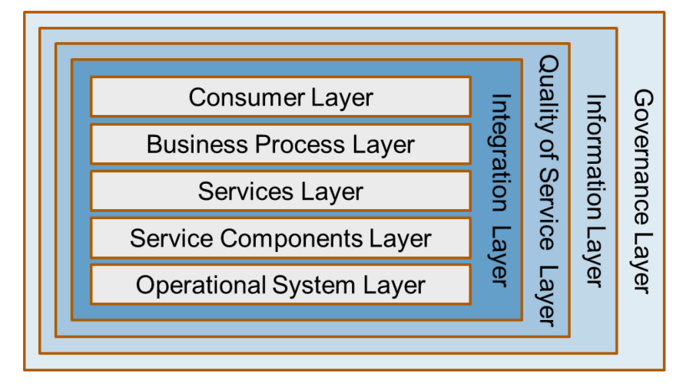
MSAAS TECHNICAL REFERENCE ARCHITECTURE
Layer | ABB
Governance | M&S Repository Services
Information | M&S Registry Services
Quality of Service | M&S Security Services M&S Certification Services
Integration | M&S Message-Oriented Middleware Services M&S Mediation Services
Consumer | Modelling Applications Simulation Applications
Business Process | Composed Simulation Services M&S Composition Services Simulation Control Services Simulation Scenario Services
Services | Modelling Services Simulation Services
Service Components | OA Platform Services
Operational Systems | Infrastructure Services Communication Services

Slide 6
IMPLEMENTATION OF MSaaS CONCEPT FOR LARGE SCALE EXERCISES
MSaaS Architecture Building Blocks (ABBs) | Description | Technologies Employed
Composed Simulation Services | Totality of Simulation Services | vSphere, K8, VR Forces, MACE, GESI, and STRIVE
Core, Communication and SOA Services | Range of functionality enable basic system support | GeoServer, PostgreSQL, KeyCloak, vSphere, K8S, API Gateway, LVC Gateway
M&S Certification Services | Verify compliance to interoperability standards | Apache Kafka + custom connector
M&S Composition Services | Compose and execute simulation services | API Gateway, vSphere, K8 and custom functionality
M&S Mediation Services | Transform/Translate data | Apache Kafka + custom connector
M&S Message-Oriented Middleware (MOM) Services | Efficient and time-coherent exchange of data | Apache Kafka
M&S Registry Services | Metadata for simulation resources | Not implemented yet

Slide 7
IMPLEMENTATION OF MSaaS CONCEPT FOR LARGE SCALE EXERCISES
MSaaS Architecture Building Blocks (ABBs) | Description | Technologies Employed
M&S Repository Services | Store, retrieve and manage simulation resources | Federated repositories and customer functionality
M&S Security Services | Enforcement of security | Keycloak + custom implementation for ZTA
Modeling Applications | Front-end functionality for accessing the Modeling Services | Thin client: OpenLayers & Cesium.js in Angular micro frontend architecture Thick client: SitaWare, Ridge, Prodigy
Modeling Services | Suite of tools needed to construct a Simulation Service | Not implemented yet
Scenario Services | Creation & management of scenarios | Custom C2SIM implementation
Simulation Applications | Front-end functionality enabling users to interact with Simulation Services and Composed Simulation Services | Thin client: OpenLayers & Cesium.js in Angular micro frontend architecture Thick client: SitaWare, Ridge, Prodigy
Simulation Control Services | Logging and input for simulation execution | Custom implementation
Simulation Services | Individual simulation engines | VR Forces, MACE, GESI, and STRIVE

Slide 8









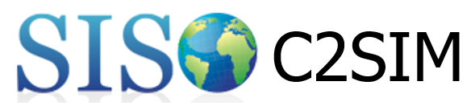



OUR TECHNOLOGY IMPLEMENTATION OF MSaaS
Front Ends
Microservices

Slide 9
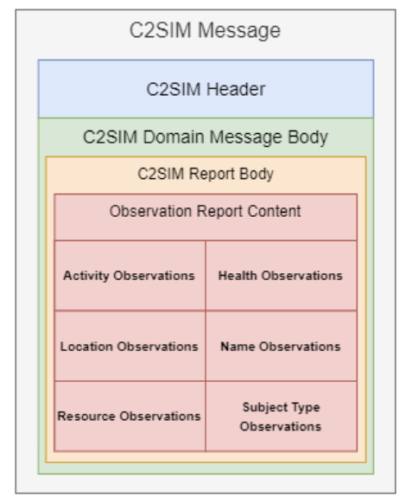
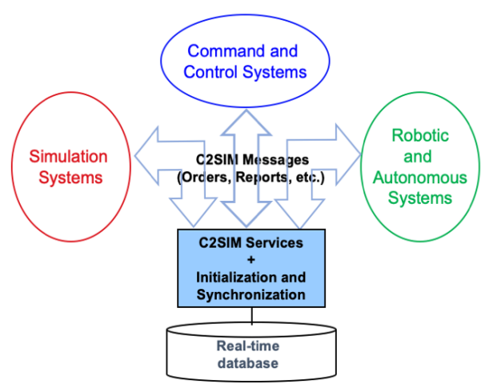
C2SIM Utilization
Why not DIS or HLA?
C2SIM geared to campaign-level exercises.
Built-in support for COA Analytics.
Ontology used contains extensions for granular control/entity events.
C2SIM XML schema used encapsulated in protobuf.

Slide 10
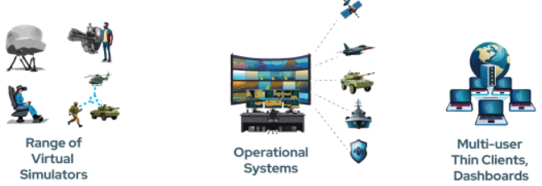

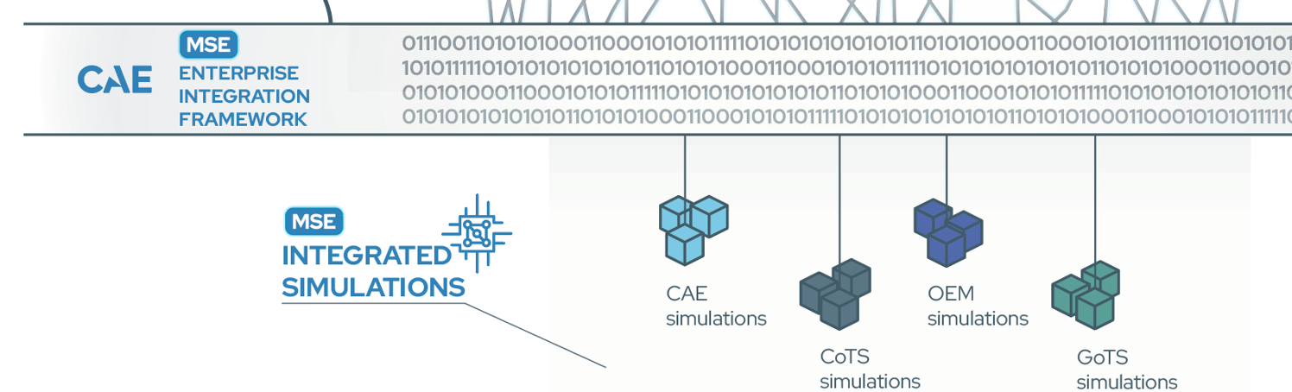
MOSA Concepts and Performance
We follow a MOSA concept by having clearly defined (modular) components with loose coupling and clearly defined interfaces.
Loose coupling however affects performance (processing overhead, latency).
Depending on the use case it may be required to strike a balance between MOSA / MSaaS and simulation performance.
Connector – Gateway
Translator – schema converter
Serializer – handler for binary format
Transport – Kafka consumer / producer
ENTERPRISE INTEGRATION FRAMEWORK
Messaging Middleware
Kafka + Common ICD + SDK

Slide 11
Metrics
Distributed simulation services exchange entity data via a high number of relatively small messages (data packages).
High message throughput and low latency are key!
Critical use case: Large-scale distributed live virtual constructive (LVC) exercises.
We assessed the feasibility and scalability of our approach with some initial trials:
Setup | Messages | Throughput | Entities | Latency
Laptop, Intel Core i7-10850H, 64GB RAM, Local network | C2SIM payload, 240 bytes on average | 750,000 messages per second, Single Kafka partition, Single consumer | ~1,500 @ 500 messages per second per entity Typical CGF service, e.g. MACE @ 8x speed | Network roundtrip: ~10ms Kafka: <1ms (150-800µs)

Slide 12
Lessons Learned
Topics | Description | Observation
Rapid Integration, Scaling and Extensibility | We used three different mechanisms to integrate Simulation Services: 1) VMs 2) containers and 3) using commodity technologies like Kafka, vSphere, and K8 to scale and integrate Simulation Services | Clear benefits of MSaaS!
Common Data | The cornerstones of interoperability in M&S are shared order of battle, scenarios, terrain, event exchange, and entity control | MSaaS is abstract in how these items are defined – the concrete implementation designs can lead to interoperability woes if the Service Level Agreements are weak
MOSA and Performance | The degree of coupling of the SOA Services and Simulation Services define performance | MSaaS is abstract in how these items are defined – significant risk a Simulation Service only works with a particular SOA Service
Native Zero Trust Architecture (ZTA) | MSaaS RA specifies abstract concepts for security within M&S Composition Services | Our implementation required more than the concepts in MSaaS to meet ZTA guidelines

Slide 13
Summary
MSaaS is a viable approach to implement MOSA concepts for the needs of Integrated Deterrence
MSaaS defines a logical separation of services with respect to desired MOSA concepts.
The MSaaS RA is an abstract architecture that requires concrete implementation.
The concrete implementation defines key design decisions directly impacting the underlying tenants of MSaaS.
M&S Services are at risk of becoming tightly coupled to the selected SOA Services.
The recommendation for future iterations of MSaaS is to consider provisions to ensure MSaaS implementations are agnostic with respect to SOA Services and better align to recent ZTA guidelines.

