Slide 1

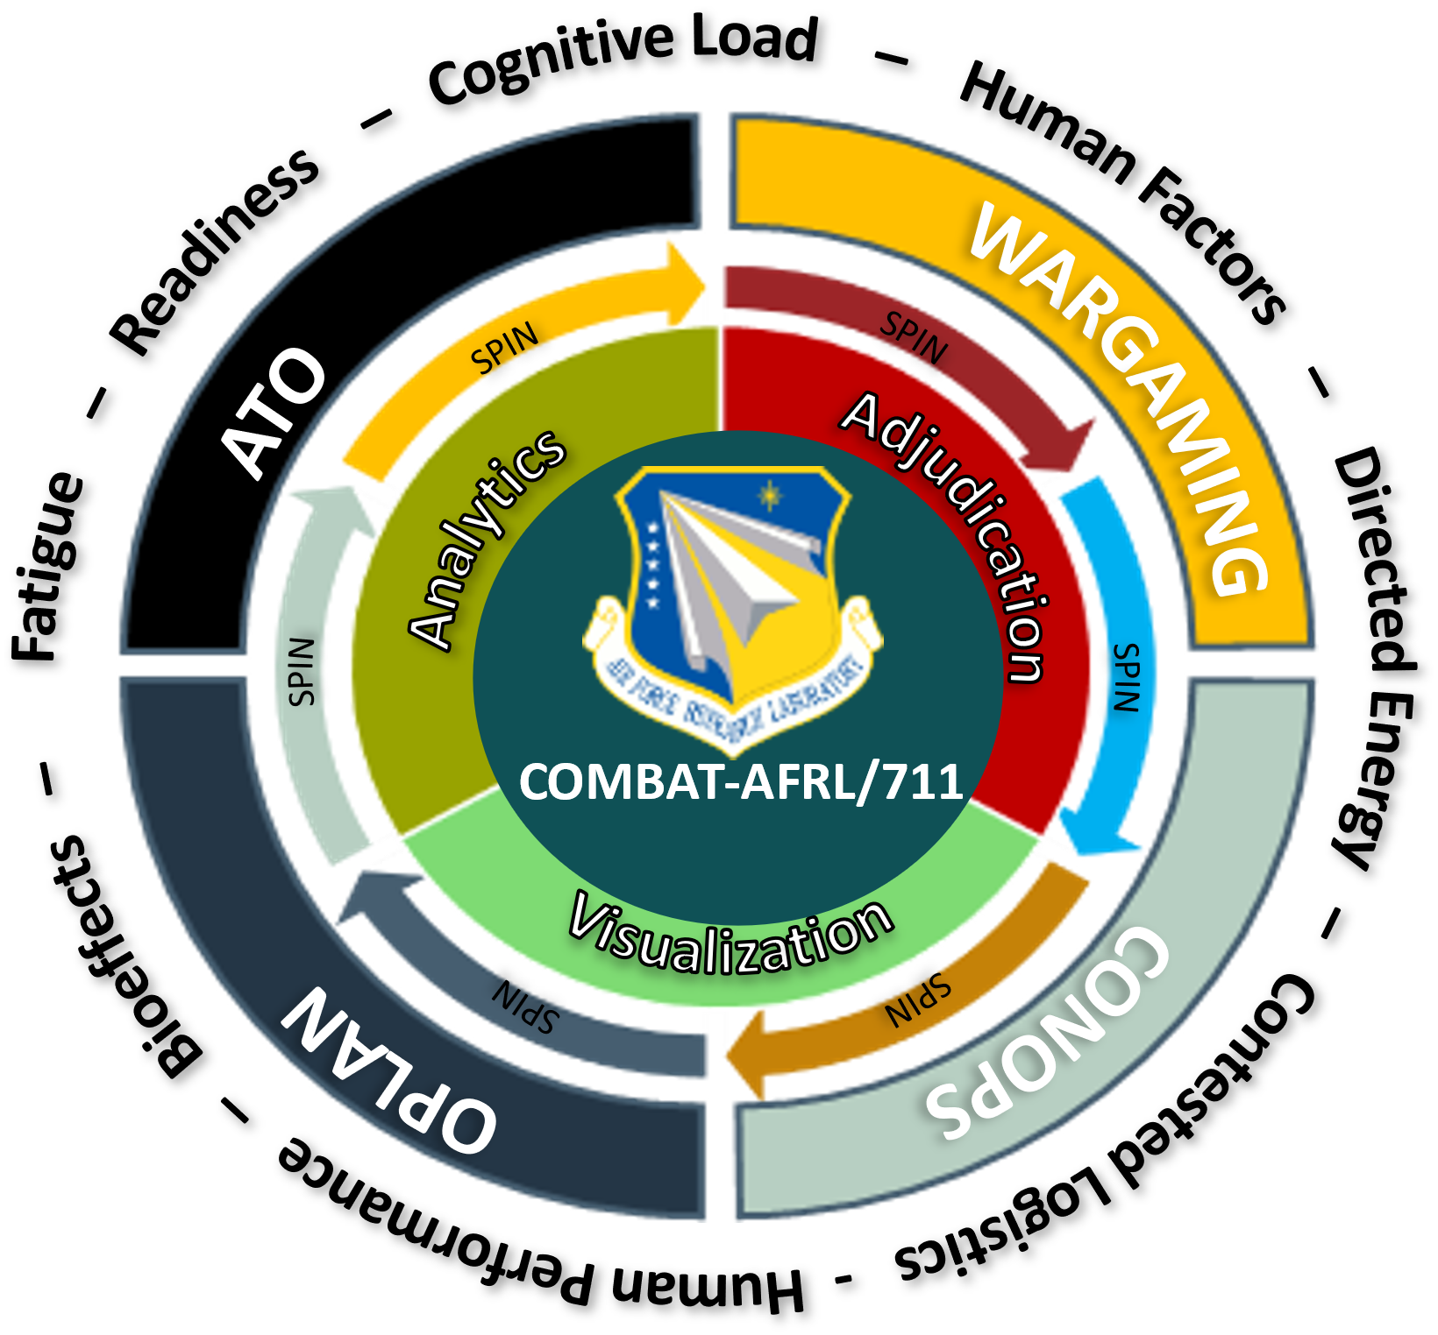
COMBAT-AFRL/711: A Tool for Integrating Human Factors into Wargames
Dr. Megan Morris, Air Force Research Laboratory
Dr. Christopher Stevens, Air Force Research Laboratory
Dr. Bella Veksler, Tier1 Performance Solutions
Ms. Emma Robin, Booz Allen Hamilton
Mr. Kevin Contreras, Booz Allen Hamilton

Slide 2
COMBAT-AFRL/711: a tool for integrating human factors into wargames
DR. MEGAN MORRIS¹, DR. Christopher Stevens¹, DR. BELLA VEKSLER², Ms. EMMA Robin³, MR. kevin contreras³
¹Human Effectiveness Directorate, ²TiER1 Performance Solutions, ³Booz allen Hamilton
The views expressed are those of the author and do not necessarily reflect the official policy or position of the Department of the Air Force, the Department of Defense, or the U.S. government. Unless otherwise noted, imagery in this document are property of the U.S. Air Force. Distribution A: Approved for public release; distribution unlimited. AFRL-2024-5565.

Slide 3
Overview
Background on Wargaming Human Factors Needs
COMBAT Software
Fatigue Modeling Capabilities
Laser Dazzle Modeling Capabilities
Method
Results
Discussion
  Limitations
  Future Directions

Slide 4
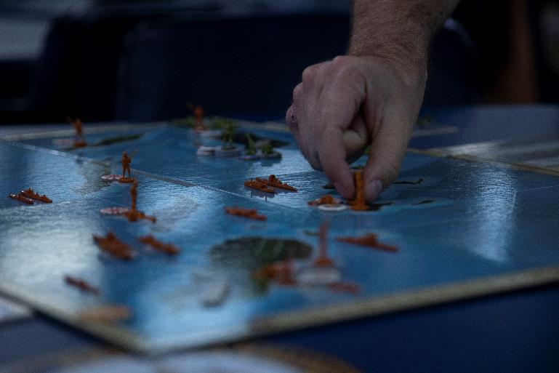
Wargaming
“Wargames are representations of conflict or competition in a synthetic environment, in which people make decisions and respond to the consequences of those decisions.” (Joint Planning, 2017)
Critical tool to aid in training and planning wartime strategy and maneuvers
Digital simulation capabilities have enhanced effectiveness of games (Applegate, 2021; Caffrey, 2000)
Photo by Cpl. Yvonna Guyette

Slide 5
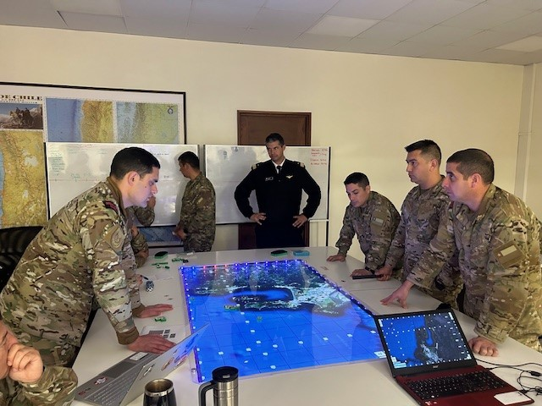
Wargaming (cont.)
Human resource and performance fidelity is lacking, decreasing the potential for these tools
  Cognitive fatigue is a pervasive issue in military communities (Caldwell, 2005; Miller et al., 2008)
  Laser dazzle is a common means to disrupt operations (Williamson & McLin, 2018)
Recent efforts are working to fill these gaps (e.g., Morris et al., 2022)
Current effort focuses on integrating human fatigue and directed energy modeling capabilities into wargaming tool
Photo by U.S. Marine Corps Forces, South

Slide 6
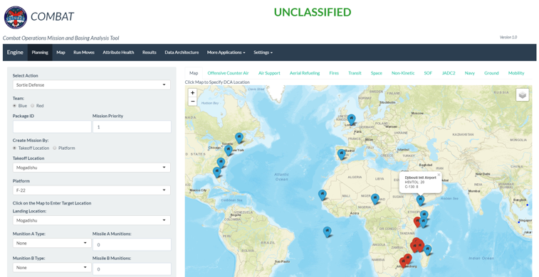
COMBAT
Combat Operations Mission and Basing Analysis Tool
Rapid simulation framework developed by Booz Allen to ‘digitize’ Title 10 wargames (campaign level conflict to mission-focused engagements)
Software is based on the open-source software environment R
Available at multi-level security as a stand-alone application or accessed via DAF cloud services
Blue laydown and Red threat data based on Title 10 Wargames (e.g., Futures Game and Global Engagement)
Image provided by Booz Allen

Slide 7
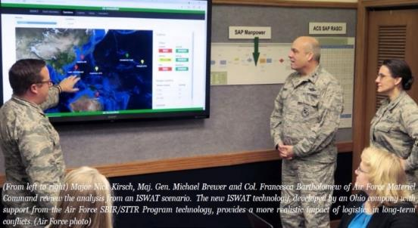
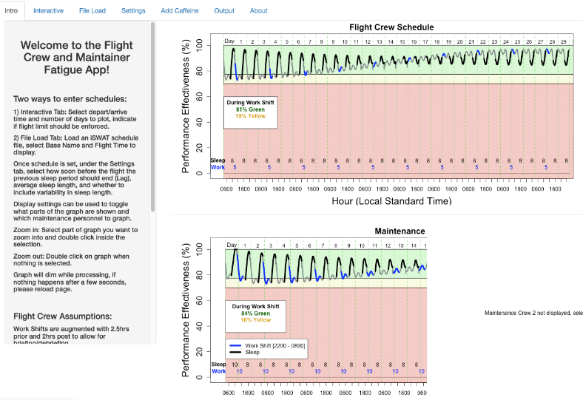
Fatigue Modeling
Wartime is especially fatiguing given extreme demands and operation tempo
  Increased reaction time, risk-taking behavior, errors of omission
  Degraded attention and decision-making (Lamond & Dawson, 1999; Miller & Melfi, 2006)
Critical to represent fatigue effects in wargaming scenarios to be more realistic from a resourcing and performance perspective
Initial effort integrated fatigue modeling with output from the Integrated Sustainment Wargaming and Analysis Toolkit (iSWAT) (Morris et al., 2022)
Using a mockup scenario, found that certain aircrews were experiencing high levels of fatigue, creating safety risks
Image by Dr. Bella Veksler

Slide 8
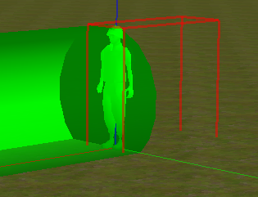
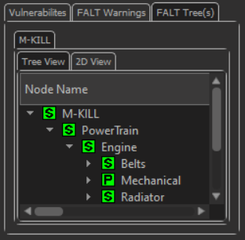
Laser Dazzle Modeling
Directed energy weapons – electromagnetic systems that convert electrical/chemical energy to focused, radiated energy (Hoffman, 2022)
Energy dispersed across retina causing damage (Williamson & McLin, 2018)
Important to model bioeffects of laser dazzle and impacts on human performance
AFRL researchers and collaborators have developed models of laser dazzle on human perception (e.g., Williamson et al., 2017)
Can be integrated into wargaming software to simulate effects on operations
Images of laser dazzle modeling software from 711 HPW/RHD

Slide 9
METHOD

Slide 10
Human Factors Modeling Integration
Leveraged original COMBAT software based on Future Games 2023 data fields and scenarios
Four mission types:
  Offensive Counter-Air (OCA)
  Defensive Counter-Air (DCA)
  Fires
  Aerial Refueling (AR)
Vehicle types: fighters, bombers, unmanned aircraft, tankers
COMBAT and fatigue modeling software both developed in R and RShiny

Slide 11
Human Factors Modeling Integration (cont.)
Fatigue Modeling
  Departure time, arrival time, location, type of aircraft, number of aircraft
  Work period = 2.5 hrs before mission + mission length + 2 hrs after mission
  Fatigue effects:
    No Fatigue – Performance effectiveness above 78% and mission launched
    Mild Fatigue – Performance effectiveness between 70% and 78%, mission flagged, and launch status is based on probability/user input
    Severe Fatigue – Performance effectiveness below 70%, mission does not launch, but user can override
    Maximum amount of fatigue during mission calculated and used to flag/display

Slide 12
Human Factors Modeling Integration (cont.)
Laser Dazzle Modeling
  Probabilistic baseline based on user input
  Laser dazzle effects:
    DE Impact – Pilot experienced directed energy dazzle while landing
    No DE Impact – Did not experience directed energy dazzle while landing
  Incapacitates pilot so they cannot perform next mission
Notional Table of User Inputs

Slide 13
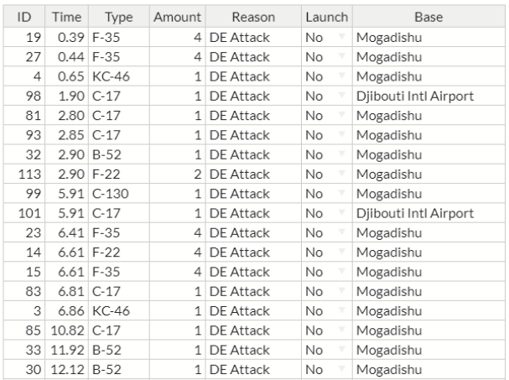
Human Factors Modeling Integration (cont.)
Modeling capabilities used own assumptions and thresholds
Thresholds crossed were marked accordingly in scenario
  Mission cancelations could be overruled through adjudicator
Validated output against baseline models
Interactive dashboard/map show campaign results, modeling outputs, and house data
DE Outputs and Adjudication Table
User Input to Update Results

Slide 14
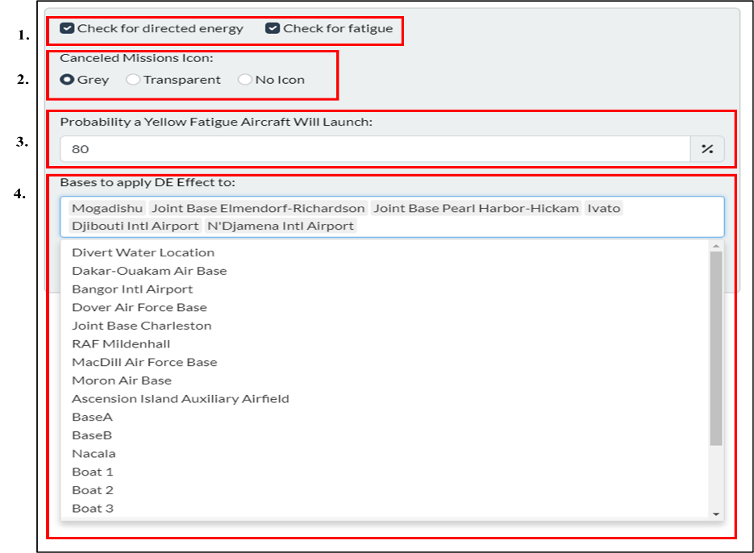
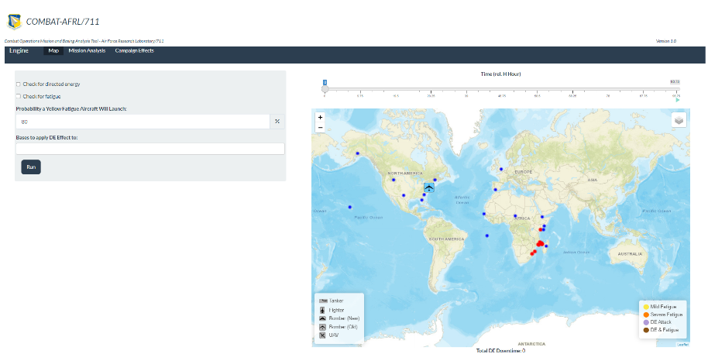
Configuration Panel
COMBAT-AFRL/711 Homepage
Configuration panel
  Select human performance parameters to customize
  Select indicator for canceled missions
  Change probability aircraft with Mild Fatigue will launch
COMBAT-AFRL/711 Configuration Panel
Select bases for directed energy

Slide 15
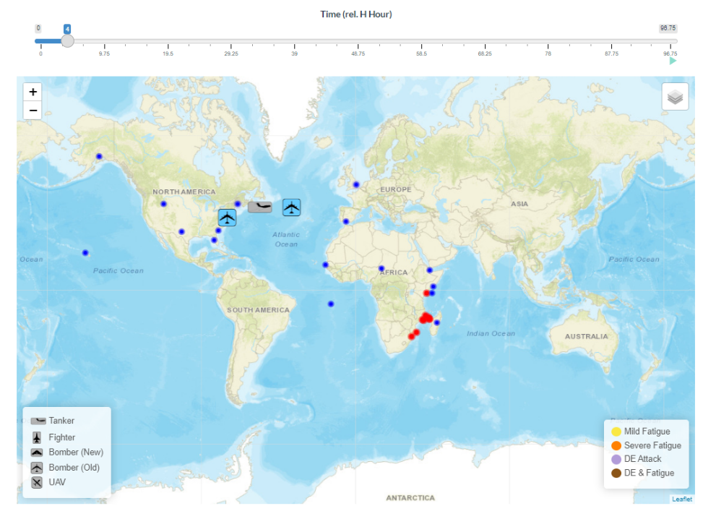
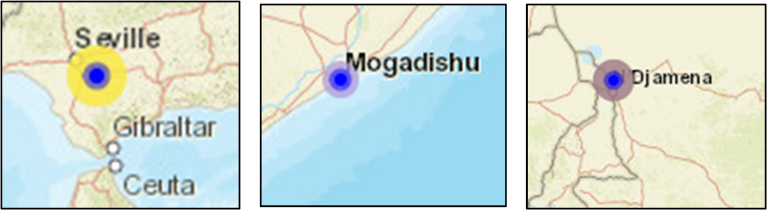
Map Panel
COMBAT-AFRL/711 Map Panel and Indicators
Map panel visualizes bases & aircraft
Aircraft color
  Canceled mission - Grey
Rings
  Mild Fatigue – Yellow
  Severe Fatigue – Orange
  DE Effect – Purple
  DE and Fatigue Effect – Brown
Canceled Mission

Slide 16
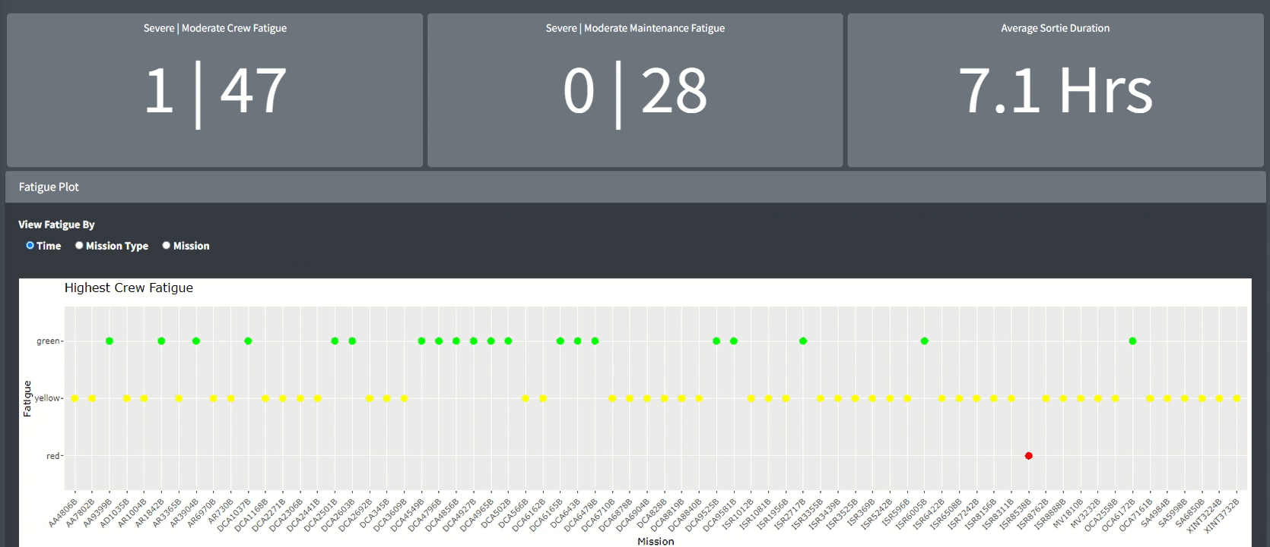
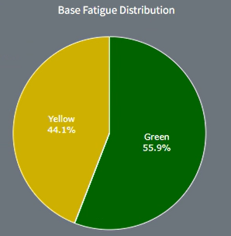
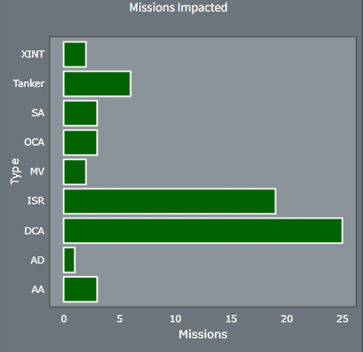
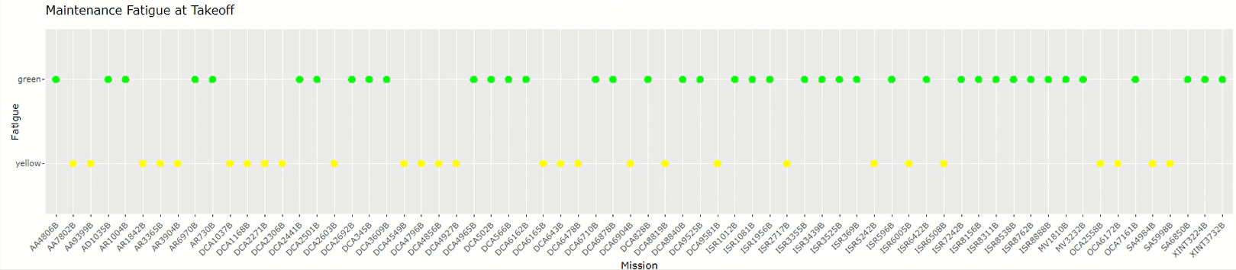
Interactive Plots and Graphs
Interactive scatter plot and graphs
  Mission types
  Bases
  Platforms
  Outputs

Slide 17
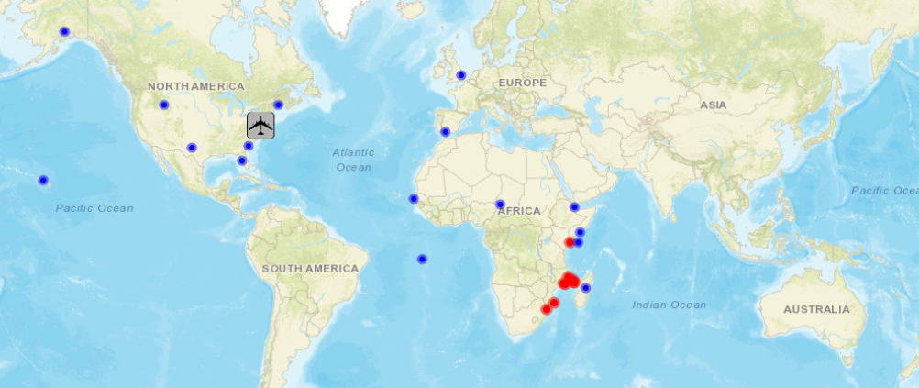
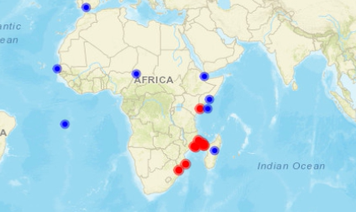
Wargaming Scenario
Synthetic scenario for unclassified discussion (actual COMBAT-AFRL/711 fatigue study used classified wargame data)
Fictional conflict with Blue forces in North America and Europe, Red forces centered in Africa
Mobility treadmill, bomber treadmill, DCA, and Fires
  Long duration missions with air refueling points
Blue main operating based defending island off coast of Madagascar
Red tried to cross channel to capture Madagascar
World View of Unclassified Synthetic Scenario
Main Operating Bases
Mogadishu
Red Ships Crossing Channel

Slide 18
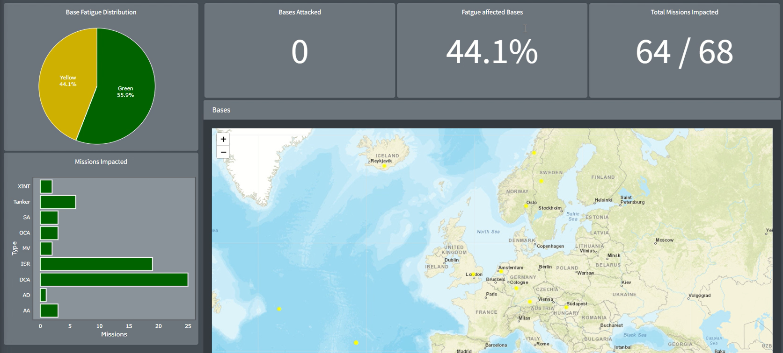
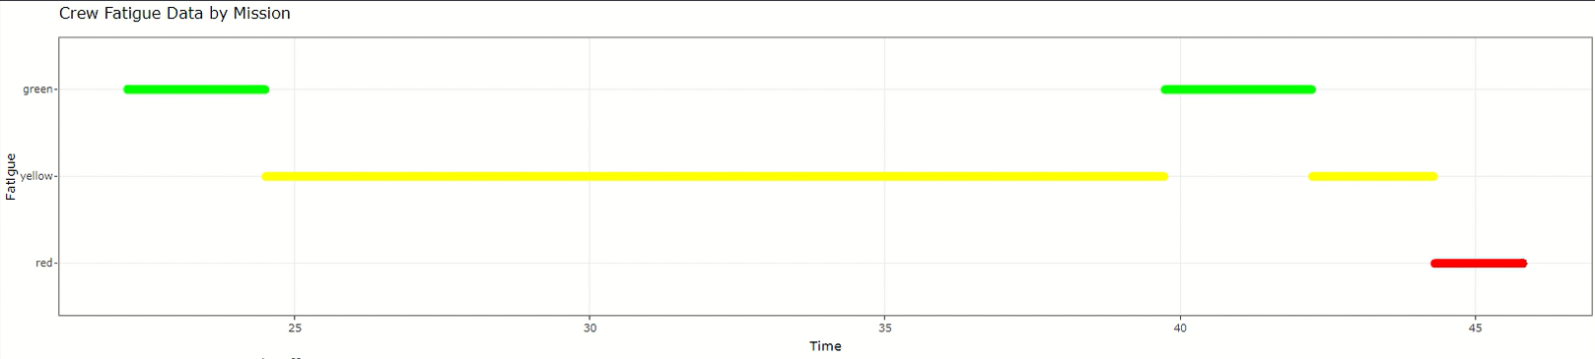
Scenario Analysis
Baseline of scenario with no human factors compared to implementation with human factors modeling
  Baseline – all missions launch and execute
Flags of fatigue and DE effects on missions used to calculate percentage of missions impacted and canceled
Cascading effects examined by quantifying mission types impacted by canceled missions
Plots and Graphs for Analysis

Slide 19
RESULTS

Slide 20
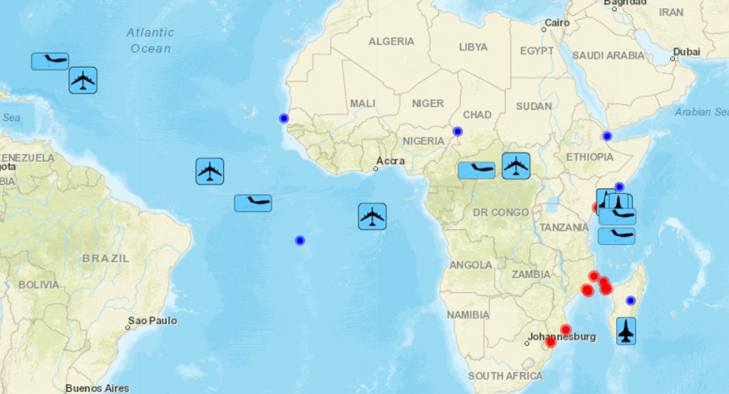
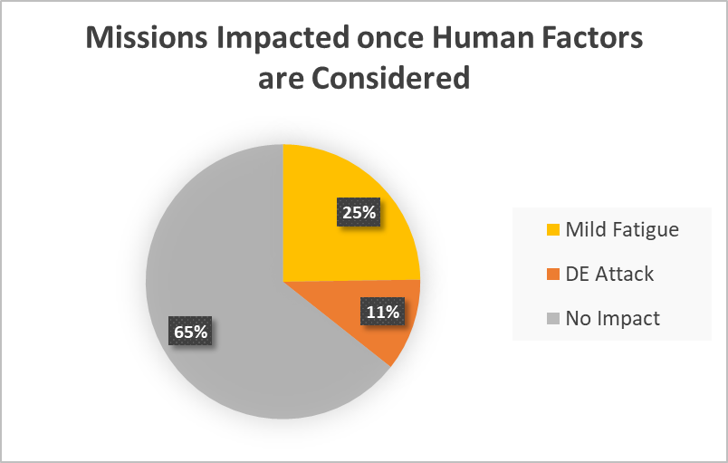
Results of Human Factors Integration
Baseline wargaming scenario
  100% of missions execute - no human factor effects considered
Initial impacts of human factors modeling
  25% of missions impacted with Mild Fatigue
  11% of missions canceled due to DE attack
  65% of missions launched without any impacts
Baseline Map with All Missions Launching

Slide 21
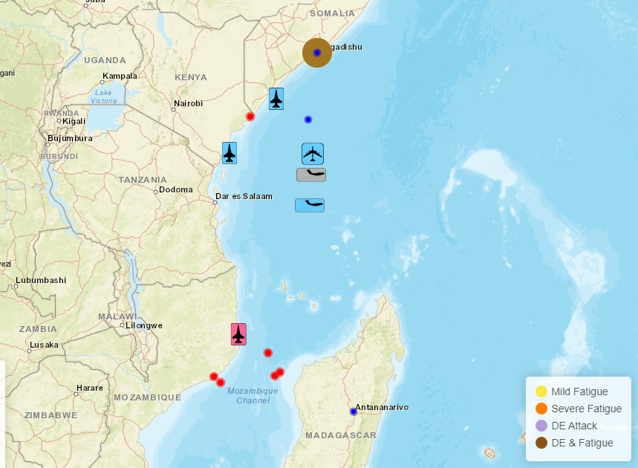
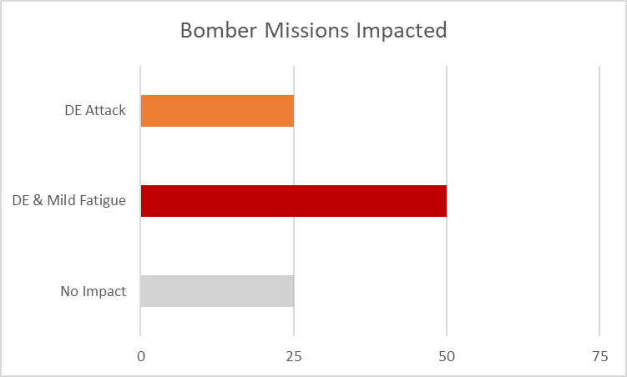
Results
Cascading Impacts
  25.5% of refueling missions impacted with Mild Fatigue
    9 tanker refueling points impacted (27% of tanker missions)
    2 bomber refueling points impacted (50% of bomber missions)
  15% missions canceled due to DE attack
    50% of bomber refueling missions canceled
  Overall, 75% of bomber missions impacted
Unsuccessful Refueling
Reduced Effect on Targets

Slide 22
DISCUSSION

Slide 23
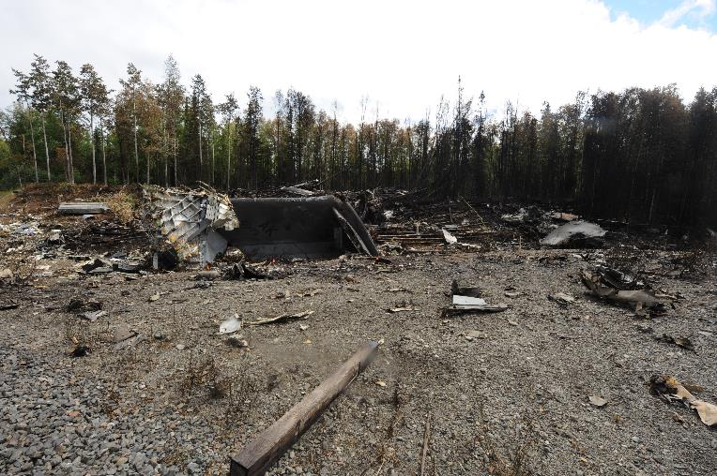
Discussion
Proof-of-concept demonstrating increase of human factors fidelity in wargaming tools and effects on decision-making
Degradations from fatigue and laser dazzle and cascading effects resulted in increased safety risk and decreased performance
  Degraded cognition from fatigue - if conditions are right, can lead to costly mishaps
  Incapacitation from laser dazzle – pilot resources need to be considered
Photo by Senior Airman Cynthia Spalding

Slide 24
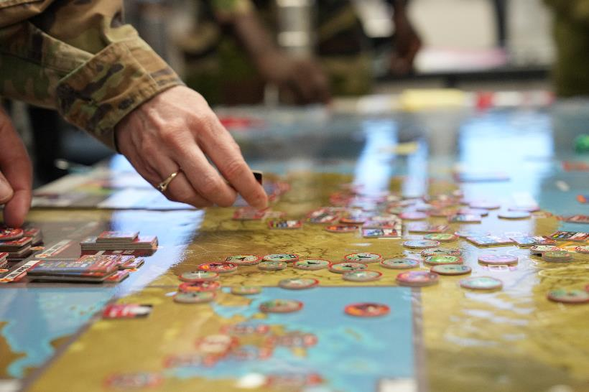
Discussion
Gives theory-driven mechanism to inject effects in plausible scenario to help with training and decision-making
Adjudicators can create more realistic and challenging scenarios to facilitate flexible and creative decision-making
Players must take these factors into consideration as wartime is fraught with human factors issues
Photo by Billy Blankenship

Slide 25
Limitations
Initial fatigue model does not account for missions over 24 hrs or that start before the campaign timeline
  Extend fatigue modeling to reflect these
DE effects only effect one pilot – possible other pilots are available at the base
  Ideally track missions by tail number
Modeling does not take tasks (e.g., take off, landing, aerial refueling, fires) into consideration
  Could explore prediction for specific mission tasks

Slide 26
Future Directions
Readiness modeling
  Includes elements of fatigue
  Other personnel factors (e.g., specialty codes, prior training)
Software usability
  Interface design
  Iconography
  Graphical representation
  User workflow

Slide 27
References
Appleget, J. (2021). An introduction to wargaming and modeling and simulation. In C. Turnitsa, C. Blais, & A. Tolk (Eds.), Simulation and Wargaming (pp. 1-22). https://doi.org/10.1177/15485129211073126
Caffrey, M. (2000). Toward a history-based doctrine for wargaming. Aerospace Power Journal, 14(3), 33-56. https://www.airuniversity.af.edu/Portals/10/ASPJ/journals/Chronicles/caffrey.pdf
Caldwell, J. A. (2005). Fatigue in aviation. Travel Medicine and Infectious Disease, 3(2), 85–96. https:// doi.org/10.1016/j.tmaid.2004.07.008
Hoffman, R. (2022). Directed Energy Weapons (DEW) High Power Microwave (HPM) 6.1 Programs FY22 Annual Report. (DCN# 0543-1375-23) Office of Naval Research Science & Technology. https://www.nre.navy.mil/media/document/directed-energy-weapons-dew-high-power-microwave-hpm-61-programs-fy22-annual-report
Joint Planning. (2017). Joint Publication 5-0. https://www.airforcespecialtactics.af.mil/Portals/80/prototype/assets/joint-pub-jpub-5-0-joint-planning.pdf
Lamond, N., & Dawson, D. (1999). Quantifying the performance impairment associated with fatigue. Journal of Sleep Research, 8, 255–262. https://doi.org/10.1046/j.1365-2869.1999.00167.x
Miller, N. L., Matsangas, P., & Shattuck, L. G. (2008). Fatigue and its effect on performance in military environments. In P. A. Hancock & Szalma, J. L. (Eds.), Performance under stress (pp. 231-249). Burlington, VT: Ashgate Publishing, Ltd.
Miller, J. C., & Melfi, M. L. (2006). Causes and effects of fatigue in experienced military aircrew (Report No. AFRL-HE-BR-TR-2006-0071). Air Force Research Laboratory. http://www.dtic.mil/get-tr-doc/pdf?AD=ADA462989
Morris, M. B., Veksler, B. Z., Noesen, B., Tuttle, J., Carpenter, B., Tran, P., & Gunzelmann, G. (2022). Human fatigue modeling in wargaming simulations. Proceedings of the 2022 Interservice/Industry Training, Simulation, and Education Conference, Paper No. 22331. https:// www.xcdsystem.com/iitsec/proceedings/index.cfm?Year=2022&AbID=112519&CID=944#View
Williamson, C. A., McLin, L. N., Rickman, J. M., Manka, M. A., Garcia, P. V., Kinerk, W. T., & Smith, P. A. (2017). Wavelength and ambient luminance dependence of laser eye dazzle. Applied Optics, 56(29), 8135-8147. https://doi.org/10.1364/AO.56.008135

Slide 28

QUESTIONS?
Contact: megan.morris.3@us.af.mil

