Slide 1



Technological Fluency: A First Step in Rethinking
Army Training
Presenter:
Julia Brown, Aptima, Inc.
The research described herein was sponsored by the U.S. Army Research Institute for the Behavioral and Social Sciences, Department of the Army (Contract No. W911NF-23-F-0026). The views expressed in this presentation are those of the author and do not reflect the official policy or position of the Department of the Army, DOD, or the U.S. Government.
Notes:
Good afternoon and thank you for being here.
My name is Julia Brown I’m a Senior Research Scientist at Aptima Inc.
I’m excited to present on the topic of Technological Fluency: A First Step in Rethinking Army Training
As a quick disclaimer,
This research was sponsored by The Army Research Institute.
The views expressed in this presentation are mine and my co-authors, and they do not reflect the official policy or positions of any government organization.

Slide 2
Acknowledgements
Co-Authors
Julia Brown (Aptima, Inc.)
Krista Ratwani, Ph.D. (Aptima, Inc.)
Werner Born, Ph.D. (Aptima, Inc.)
Michael Mackay, Ph.D. (HumRRO)
Nicole Stoneley (HumRRO)
Evan Good (HumRRO)
Andrew Naber, Ph.D. (U.S. Army Research Institute)
Margaret Toich, Ph.D. (U.S. Army Research Institute)
Kyle Benbow, Ph.D. (U.S. Army Research Institute)
Notes:
Before going into the presentation, I would first like to acknowledge my colleagues and co-authors.
This research was a joint effort between Aptima and HumRRO and we have been working closely with the Army Research Institute to set the foundation of a new research program.
We have a fantastic multi-disciplinary team represented here.
My background is in Industrial and Organizational, or IO Psychology where we study things like selection, training, leadership, and culture.
We also have researchers with backgrounds in mechanical engineering and other areas of social and cognitive psychology on the team.
Each of the individuals listed on this screen have provided unique contributions and this work would not have been possible without them.
Without further adieu, let’s get into the topic of today’s presentation.

Slide 3
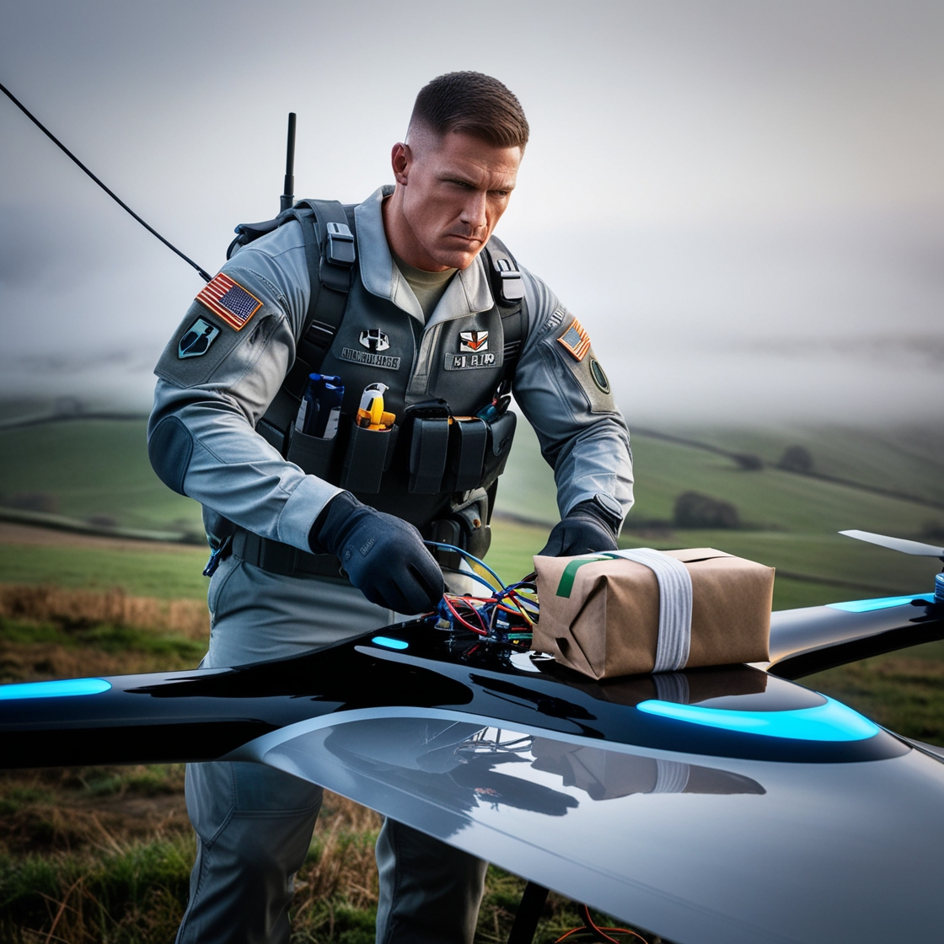
The Challenge
Image generated with Leonardo.AI
Notes:
The rapid evolution of technology in both civilian and military sectors presents a world of opportunities, but it also poses significant challenges to Army training.
Soldiers are required to operate increasingly complex systems, often with little time and resources for formal training.
By the time a new training course is developed, it quickly becomes outdated.
Furthermore, the battle space is becoming more complex, and Soldiers must leverage new technologies to accomplish a mission in critical, real-time operational environments with ever changing conditions.
This new battlespace requires innovation, adaptation, and leveraging of superior technologies to meet ever-changing demands.
To illustrate this, we can look at a recent example in the war in Ukraine where Ukrainian soldiers have used small commercially available drones to deliver small explosives. This use cases was enabled by the advancements in technology that made drones more cost-effective and widely available, but it was also critical that these drones were operated by people with the necessary skills and forethought to incorporate them into a mission in a way that they were not originally designed to be used.
Examples like this and the anticipated requirements of the future operating environment led to the creation of the T-SAVVY program, which is not the name of a rapper, but is a collaborative program between the Army Research Institute and Army Research Lab. This program highlights a necessary shift that is taking place from the focus on training specific technologies and operating procedures to general technical training and encouragement of innovative out-of-the-box thinking.
The purpose of this research is to develop and validate a model of technological fluency that will aim to help the Army make personnel decisions and train for this capability.

Slide 4
Foundational Concepts Defined
Technology pertains to any tool, technique, device, system, and/or process that
is operationally relevant and significant
has an interface that requires interaction by the end-user
requires acquisition of knowledge, skills, and/or abilities for effective or novel use
Technological Fluency (TF) is “a competency consisting of cognitive and noncognitive attributes that enable individuals to creatively use, synthesize, and adapt with evolving technologies to enhance performance”
Creativity
Adaptation
Synthesis
Tech Proficiency
Tech Fluency
Notes:
Before going into more detail, I wanted to first define some key terms.
For the purposes of this research, the term technology pertains to any tool, technique, device, system, and/or process that (1) is operationally relevant and significant; (2) has an interface that requires interaction by the end-user; and (3) requires acquisition of knowledge, skills, and/or abilities for effective or novel use.
Our operational definition of Technological Fluency is “a competency consisting of cognitive and noncognitive attributes that enable individuals to creatively use, synthesize, and adapt evolving technologies to enhance performance”
This definition was developed in the early stages of the project in a collaborative effort between ARI and ARL researchers.
It includes a few elements that I’d like to point out…
First, there’s the basic element of using the technologies. We refer to this as technological proficiency.
Then there’s the added elements of creativity, synthesis, and adaptation which really differentiate tech fluency from more traditional proficiency or the ability to use a technology in the way in which it was intended.
Taken together, these elements combine to create Technological Fluency

Slide 5
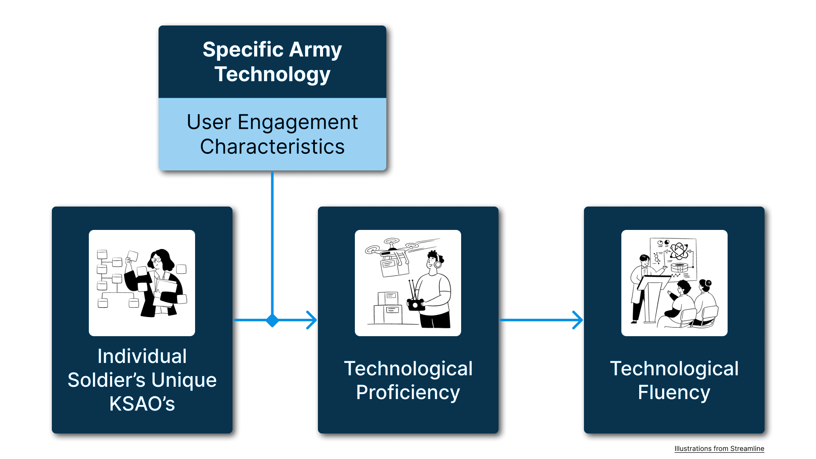
Overall Model: Integrating User Engagement Characteristics and TF Competencies
Notes:
Building off the last slide with the two components of the definition of tech fluency, this graphic is meant to show some of our proposed relationships
First, we have a Soldier’s unique KSAO profile leading into tech proficiency, which is necessary, but not sufficient to achieve tech fluency, because recall, there are those added elements of creativity, adaptation, and synthesis beyond tech proficiency.
However, moderating this relationship between the KSAOs and tech proficiency, are the characteristics of the technology itself.
These User Engagement Characteristics, or UECs as we will often refer to them, were developed as a part of this project in an attempt to account for both existing and future technology development.
This moderating relationship is included to portray that the weighting of the competencies needed to achieve technical proficiency will likely vary as a function of the characteristics of the technology.
So, for example, technologies that provide a high frequency of output may require more information evaluation, whereas technologies that provide a low frequency of output may draw more on memory or abstract thinking.
This slide is meant to provide a high-level overview, but we will go more into detail on each component, starting with the UECs.

Slide 6
User Engagement Characteristics (UECs)
UEC | Definition
Frequency of Technology Feedback | The degree to which the technology provides feedback to the user
Clarity of Technology Feedback | Feedback provided to the user is explicit/clearly defined vs. implicit/ambiguous
Physical Proximity | Location of technology relative to user (near vs. far)
Cognitive Workload | Degree of mental resources the technology requires of a person at any one time to interact with it
Technological Interdependence | Degree to which the technology is a standalone element vs. part of an integrated system of technologies
Degree of Collaboration | Degree to which technology can be operated by a single individual vs. requires team input/coordination
Frequency of User Input | How often user must provide input to the technology
Type of User Input | How input is communicated to the technology, e.g., number of inputs, sensitivity
Notes:
At the beginning of the project, we were challenged by the limits of our current knowledge, which included current technologies and applications.
Similar to the challenge the Army is facing technology is rapidly advancing, we knew that focusing on any specific technology put us at risk for becoming quickly outdated.
After observing some Army training with new technologies being tested, we noted how there were shared characteristics across technologies that require similar behaviors to utilize them. For example, the controller for operating the robot dog was like a drone controller, and also like an Xbox or PlayStation controller.
These observations sparked internal conversations among our team and ARI about the need to determine ways to describe and group technologies by their specific user interactions. The idea was that identifying shared behaviors required to control a piece of technology would result in identifying the shared competencies and KSAOs required to perform those behaviors. Considering the ever-evolving nature of technology development, approaching the problem from this perspective allows us to create a model that characterizes both current and new technologies.
What you see here is our ‘final’ list of UECs. This list was developed over several months. We started with a larger list and the attributes were refined through multiple rounds of review by subject matter experts (SMEs) both internal to our organizations, and from our partners at ARL.
Some of the criteria we used in our refinement were:
Is the UEC a KSAO?
Is the UEC redundant with other UECs?
Is the UEC a combination of other UECs?
Is the UEC outside of project scope (e.g., selection requirements)?
It’s worth noting that our list was not meant to be exhaustive; but rather to serve as a starting point for conceptualizing important elements of how users engage with technology for the purposes of this research.

Slide 7
Developing The Competency Model
Literature Review:
37 sources from military and civilian sectors
Initial identification of 211 KSAOs
O*NET Consultation:
Mapped KSAOs to relevant Army and civilian roles
Refinement Process:
Used natural language processing (NLP) to group KSAOs using cosine similarity
Reduced redundancy in paired statements
Thematic Grouping:
KSAOs organized into competencies & aligned with Army Talent Attribute Framework (ATAF)
Competencies grouped into 7 higher-order domains
Model Validation:
SME reviews and iterative refinements
Notes:
Next, I wanted to share an overview of the process for developing the competency model. I’ll note, this is a gross oversimplification of all of the work that went into this process, but I’ll do my best at providing a high-level overview. We actually did this whole process twice, first focusing on tech proficiency and then with a focus on the fluency aspects involved with creativity, adaptation, and synthesis of technology, but for the sake of clarity and time in this presentation I’m just going to cover it once.
The first step was to conduct an exploratory review of the literature related to TF. From this review, KSAOs were extracted, refined, and eventually organized into the competencies comprising the models.
We reviewed ONET for KSAOs by identifying civilian jobs that were equivalent to Army jobs that heavily relied on technology (e.g., Information Security Analyst)
The next step was to refine the 211 statements by identifying those items that were thematically similar to one another. We used natural language processing (paraphrase mining) to calculate the cosine similarity between every possible pair of 211 KSAO statements. (Cosine similarity captures the semantic relatedness between two statements – values are interpreted like correlation coefficients)
Researchers reviewed the pairings to determine overlap and whether statements should be removed.
The remaining KSAOs were reviewed to determine whether they were within project scope and of equivalent levels of specificity. Statements meeting these criteria would be retained as is or revised, whereas those that failed to meet the criteria would be removed.
Primary criteria for retaining statements:
Statements meaningfully differentiated performance and were not a requirement (often physical) to use the technology (“Ability to see long distances”, “Ability to lift 50 lbs”)
Statements also needed to be broad enough to apply to multiple groups of users across multiple types of technology, but not so broad that statements could apply to every user and every type of technology (“Skill in determining connectivity using Internet Control Message Protocol (GBS).” is too specific while ““Skill in controlling operations of equipment or systems.” is way too general)
Next we needed to wrangle the KSAO list into a meaningful grouping of competencies. We leveraged NLP, specifically “topic modeling”, as a first step to identify a foundational clustering of themes that we could use to begin to sort the statements. This was an iterative approach that was part exploratory at first and then more focused as we learned more through the NLP outputs.
For example, on the first run, we did not have a predetermined number of topics, which resulted in a five-topic model that touched on key areas, but all the topics were double-barreled.
We decided to introduce more specific commands by running 5, 7, 9, and 12-topic models
Researchers then combed the output for distinct constructs, which resulted in a preliminary list of competencies
The next step was to map the KSAOs onto these competencies.
The final step was to refine the list of competencies to address thematic overlaps, improve clarity of language, and ensure the KSAOs corresponding to each competency were sufficiently comprehensive.
We started first by combining or split competencies, however, the default was to avoid combining competencies so that important nuances in the model remained intact
Next we clarified competency labels and corresponding definitions to improve both clarity and comprehensiveness – Competency definitions were revised by first examining the list of KSAOs associated with each competency and then updating the definition to ensure it appropriately reflected the content of the KSAOs. Next, the team reviewed the labels in light of the definitions and worked to develop new labels that were more succinct and meaningful (e.g., Divergent Thinking [Anti-Functional Fixedness] was revised to Cognitive Flexibility).
Additionally, the team consulted the ATAF and replaced labels in the model with those used in the framework to ensure consistency of nomenclature (e.g., Anticipating Problems was revised to Problem Sensitivity)
We also created higher-order domains given the large number of competencies; this was mostly to help impose some structure on the model given the number of competencies was becoming rather large. Six domains were generated as a result of this exercise
Having updated the competencies and their definitions, we next revisited the KSAOs associated with each competency and identified a subset that would serve as “exemplars.” “Exemplars” were KSAOs that reflected integral parts of the competency and/or its definition. KSAOs that were too general, too specific, or were not reflective of the competency were removed. We also added KSAOs to capture any aspects of the competency that we felt were missing.
This process yielded a model with 7 domains, 33 competencies, and 1-7 KSAO statements per competency.

Slide 8
An Example
Problem Sensitivity
Identifies when something is wrong or is likely to go wrong. It does not involve solving the problem, only recognizing there is a problem.
Type | Statement
A | Ability to anticipate problems
A | Ability to understand the implications of new information
S | Skill in determining how changes in conditions, operations, and the environment will affect outcomes of a system
S | Skill in identifying measures or indicators of system performance, relative to the goals of the system
Notes:
Before showing the entire model, I wanted to show an example of what one of the competencies looks like.
This is for the competency Problem Sensitivity.
You can see we have a definition, and then exemplar statements underneath.
Type here refers to the type of statement, Knowledge, Skill, Ability, or other.
Then, we have the statements that make up the competency.

Slide 9
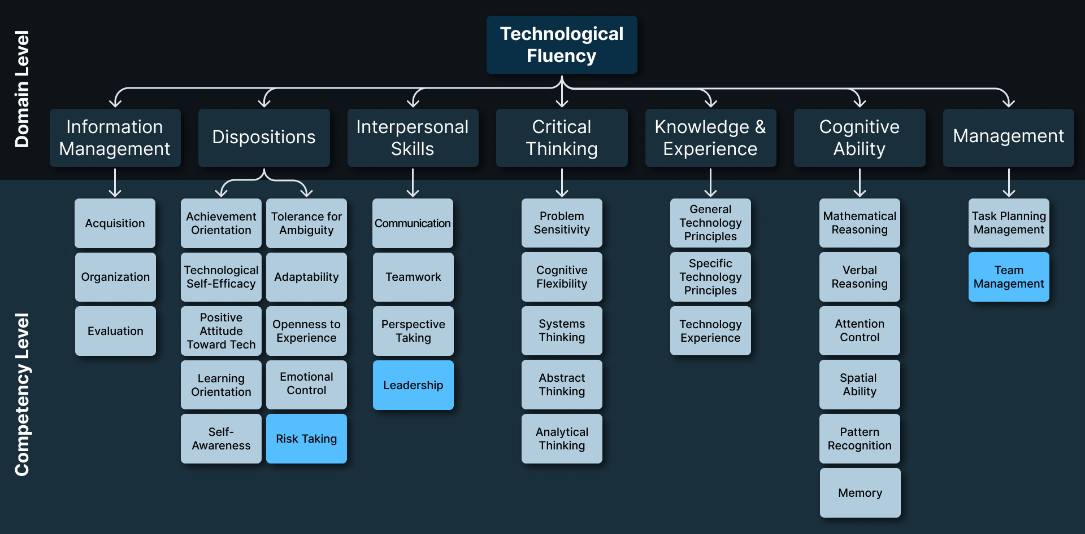
TF Competency Model
Notes:
Here is the TF Competency Model. It includes:
7 Domains: Information Management, Dispositions, Interpersonal Skills, Critical Thinking, Knowledge & Experience, Cognitive Ability, and Management
33 Competencies: 3 unique to TF: Risk Taking, Leadership, Team Management; 30 relevant to both
Because the TF model was built off the TP model, we wanted to combine them in a way that resulted in a two-layer model: the first layer is foundational and comprises the competencies/KSAOs relevant to TP, whereas the second layer comprises competencies/KSAOS unique to TF. In other words, all competencies and KSAOs in the final model are relevant for TF, but only a subset of those competencies and KSAOs are relevant for TP.
When focusing on the TF layer, we developed a process model that centered primarily around the development of innovative, tech-driven solutions to problems. We also identified contextual parameters and boundaries of the model such as:
1. Organizational support: Soldiers have the autonomy, opportunity, and freedom to engage in the TF process and/or be allowed to take the risks inherent in developing a possible solution. This is really critical, as literature has consistently pointed to organizational support and psychological safety as a precursor to creativity in organizational settings because creativity involves so much risk-taking, experimentation, and frequent failure
2. Model applies to single Soldier or informal team of 3 – 5 Soldiers; individuals that make up the team will likely be located close to the problem, either geographically or with respect to mission or work activities. Thus, seeking continuous input from an expert who is not close to the problem is outside of scope.
3. Time limitations: We assume Soldiers will have hours to several days, but unlikely more than one week, to innovate a solution. The primary implication of this is that there is usually insufficient time to formally organize, recruit personnel with specific expertise, or assign official roles when tackling a problem that crops up unexpectedly – we are not modeling research think tanks but rather “MacGyvers” in the field who are doing their best to fashion a solution to an immediate issue.
4. Individual/team requirements: We expect Soldiers to have the basic capabilities (whether tech-based, basic physical requirements, contextual awareness) to do their job effectively. These requirements are necessary and foundational in day-to-day performance so we assume this as the “bare minimum” of any Soldier going into a situation that would require them to be creative and innovative within that performance space.

Slide 10
Overall Model: Integrating UECs and TF Competencies
Notes:
Now that we’ve covered each of the elements, I thought it would be helpful to include this overview again. Again, this is meant to show how an individuals unique KSAOs lead to their ability to demonstrate technological proficiency, but the specific KSAOs and extent to which each is required is dependent on the characteristics of the technology itself.
Technological proficiency is a necessary, but insufficient prerequisite to technological fluency, which may require more or less proficiency on each of the competencies in the model, in addition to some unique competencies not required for proficiency.

Slide 11
Next Steps: Model Validation
Gather and analyze data from Soldiers
Focus Groups: Identify instances of TF in the Army
Survey: Soldiers rate User Engagement Characteristics (UECs) for their technology
Survey: Soldiers rate the extent to which each competency is required for tech use
Analyze: Identify gaps in the competency model
Outcome Goals
Understand where TF exists/should exist in the Army
Evidence of UEC profiles
Construct validity to ensure all components are covered
Evidence of competency clusters related to UEC profiles
Refine model based on feedback
Notes:
Now that we have an initial conceptualization of a model, our next steps are to validate it.
We are currently working to collect and analyze data from Soldiers.
As a first step, we are identifying critical incidents, which is an approach we use in IO psychology to help ground participants as to the important tasks of a job that we are asking them to think about.
This is important because Soldiers can have very different perceptions as to what it means to work with technology from one another.
For the validation of the tech proficiency layer, we ask them to think about a specific technology, rate that technology using the UECs, and then rate the importance of each of the competencies.
Then, we will provide the definition of tech fluency and the critical incidents to serve as a frame of reference, and ask about the importance of each of the competencies in relation to tech fluency.
Our goals for this effort are listed to the right. We are working to understand both where TF currently exists and where it should exist in the Army. As you can imagine, we recognize there is a time and place for innovation, and there is also a time and place for specific technical training and sticking with procedures.
We are also hoping to see evidence of UEC profiles that require shared competencies.
We will be using these data to refine the model over time and ensure all components are covered.

Slide 12
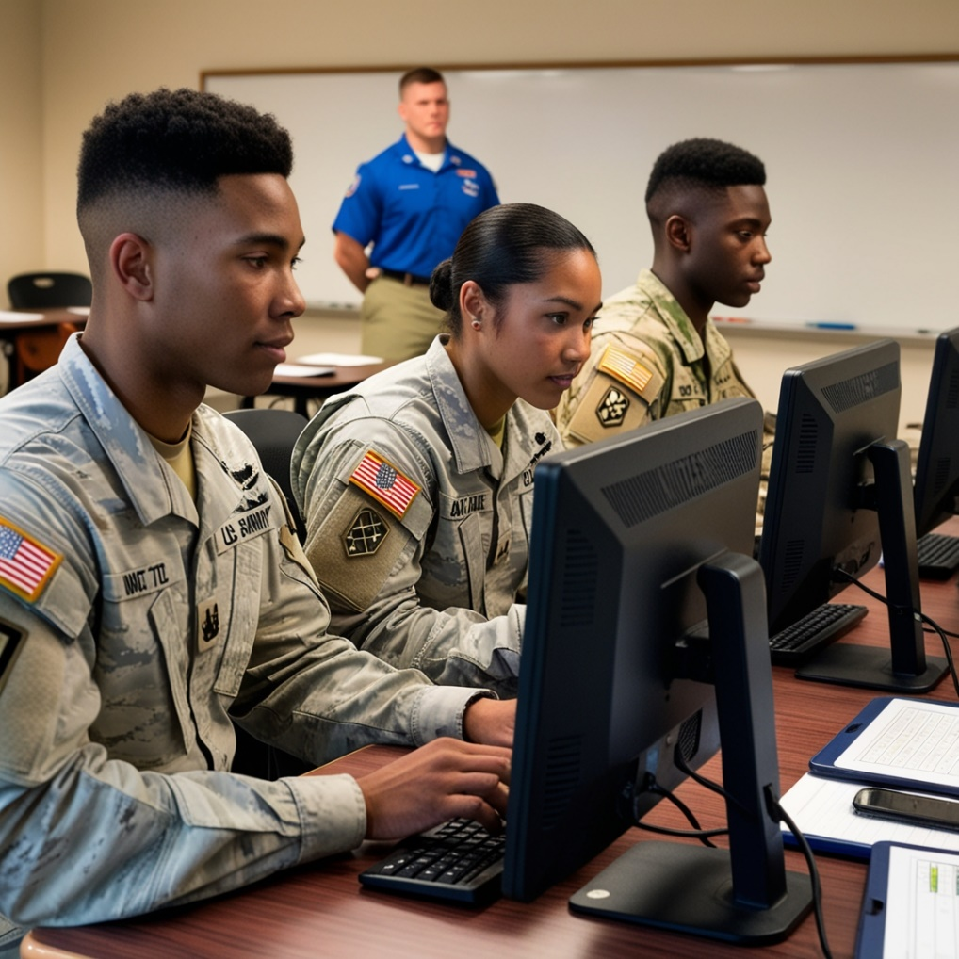
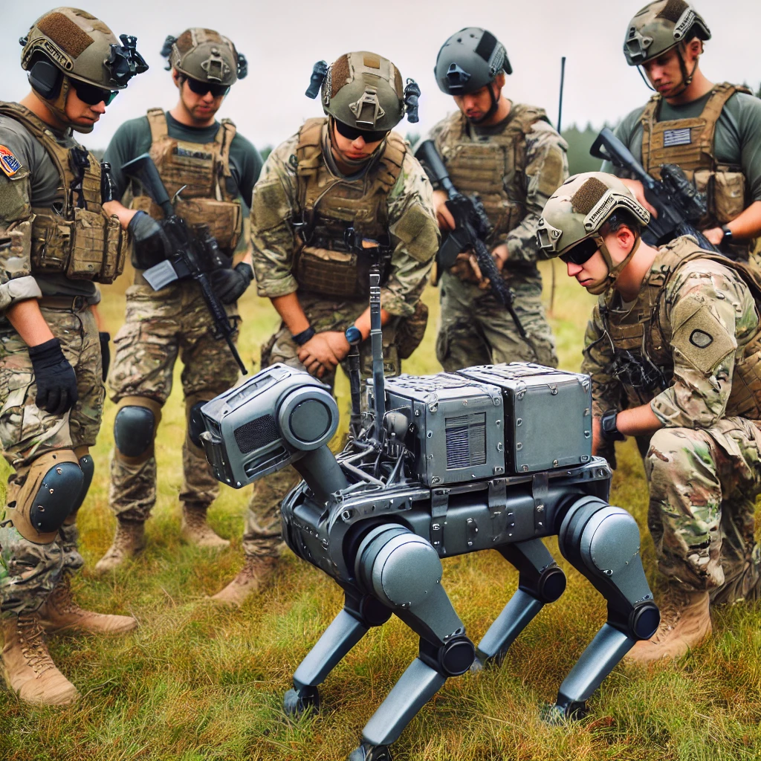
Applications
Classification
Training
Image generated with Leonardo.AI
Image generated with DALL-E
Notes:
In terms of future use of this competency model, we see two broad level applications in classification and in training.
One of the key applications of this model will be in Soldier assignments or classification. By identifying Soldiers with a high propensity for technological fluency, we can place them in roles where they can thrive and ensure future readiness. We have a team working on building assessments to assess Soldiers on each of the elements of the model.
We're also exploring ways to integrate technological fluency into training programs to ensure that Soldiers are continually developing these critical competencies throughout their careers. We are working to understand the best methods of training for each of the competencies within the model. Coupled with the UECs, if we can understand how best to train on technologies with a given UEC profile, as new technology emerges, we can incorporate these training methods into the programs of instruction.

Slide 13
Conclusion
Technological Fluency is and will be critical for maintaining superiority in a rapidly evolving battlefield
Need to consider both human and technology elements and how they interact
This work is a starting point for future applications (assignment to roles, training development, and continuous learning)
More work will be needed to understand how the current military services should adapt their current practices to encourage technological fluency
Notes:
In conclusion, Technological Fluency is and will be critical for maintaining superiority in a rapidly evolving battlefield
When thinking about tech fluency, we Need to consider both human and technology elements and how they interact
The work I’ve described today serves as a starting point for future applications
And more work will be needed to understand how the Army should adapt their current practices to encourage technological fluency
Thank you for your time, and I’m happy to take any questions.

Slide 14
Questions?
Julia Brown
jbrown@aptima.com
Andrew Naber
Andrew.M.Naber.civ@army.mil

