Slide 1


Multimodal Machine Learning Framework for
Soldier Fatigue Prediction
Louis Kim, The Charles Stark Draper Laboratory, Inc.
This material is based upon work supported by the US Army Contracting Command-APG, Natick Division, Natick, MA, under Contract No. W911QY-23-C0089. Any opinions findings and conclusions or recommendations expressed in this material are those of the author(s) and do not necessarily reflect the views of the US Army Contracting Command-APG, Natick Division, Natick, MA.

Slide 2





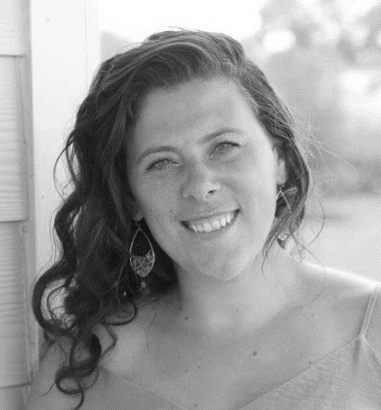
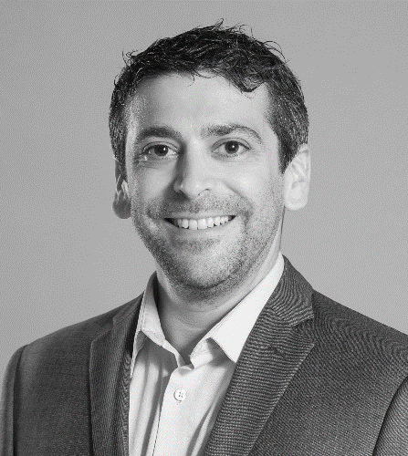

The Team
Draper
Louis Kim
Principal Scientist
Machine Learning
Connor Diehl
Senior Scientist
Software
Ryan Dougherty
Senior Scientist
Machine Learning
Dr. Kelly Hale
Principal Scientist
UX/Human Perf.
Dr. Andrea Webb
Chief Scientist
Human Centered Sol.
Johns Hopkins University
US Army DEVCOM Soldier Center
Hope Mango
Analyst
Modeling and Simulation
Dr. Seth Elkin-Frankston
Research Scientist
Cognitive Science
Victoria Bode
Research Scientist
Physiology

Slide 3
The Program
Measuring and Advancing Soldier Tactical Readiness and Effectiveness (MASTR-E)
Objective
US Army DEVCOM Soldier Center supported MASTR-E program develop groundbreaking capabilities to measure, predict, and enhance Soldier and Squad close combat performance.
Methods
Large scale data collection to enabling data-driven capability development to better understand, monitor, and predict Soldier performance.
Field study 200+ metrics from 150 Soldiers over 4 weeks
Lab study 50+ from 450 Soldiers over 30 weeks
Collaboration of 200+ subject matter experts from 15+ organization Industry, Academia, and Government

Slide 4
Problem & Motivation
Problem: Overuse injuries cost the Army over $3.7 billion a year*.
Majority (>2/3) of military injuries are overuse injuries
Most common causes are excessive running and marching
Challenge: Despite ongoing efforts to reduce the injuries, overuse injuries persists*.
While risk factors are better understood, the US Army has no standardized method for injury prevention.
Need: Tools to support better fatigue monitoring and prevention of injuries.
*References available in our paper, Multimodal Framework for Soldier Fatigue Prediction, I/ITSEC 2024

Slide 5
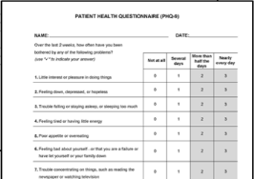
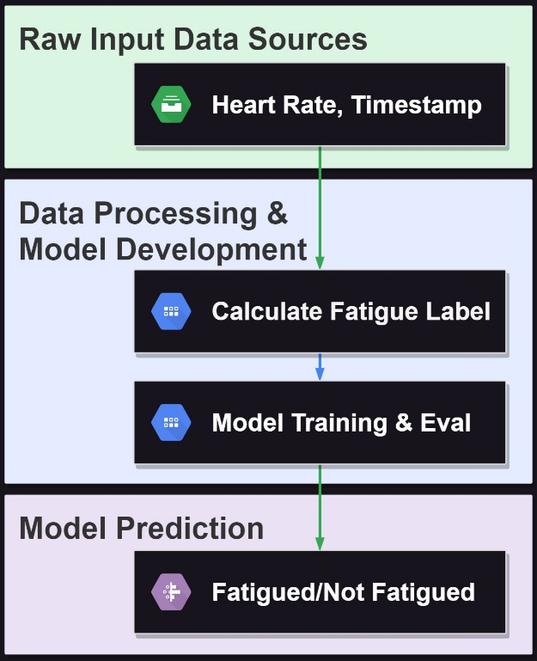
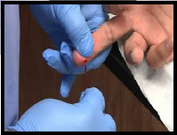
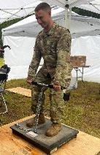

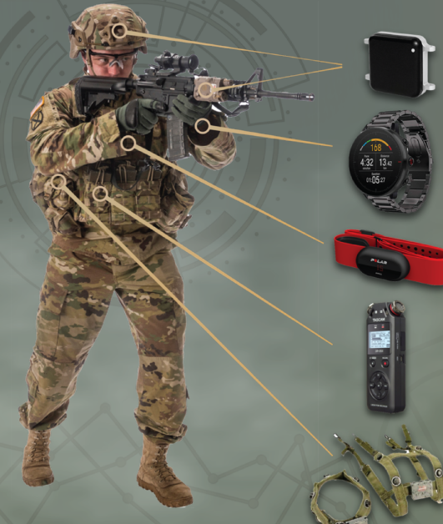
Proposed Solution
A machine learning framework that can leverage commercial-of-the-shelf wearable sensor data and other readily available sources of data to predict fatigue (excessive physical exertion)
Extensive multimodal soldier data
Data processing &
machine learning pipeline
Future fatigue prediction &
explainability
Baseline data
Excessive Fatigue
Overtraining / high risk of injury
In-field data
- High running cadence and speed
- High alcohol use
- Past injuries

Slide 6
Existing Solutions - Literature
Most* use machine learning models to predict current state of self-reported fatigue leveraging wearable sensor data, e.g. IMUs, GPS.
Key limitations:
Self-reported fatigue → inaccurate due to subjectivity and biases
Not predictive of future fatigue state → limited to reactive intervention
*References available in our paper, Multimodal Framework for Soldier Fatigue Prediction, I/ITSEC 2024

Slide 7
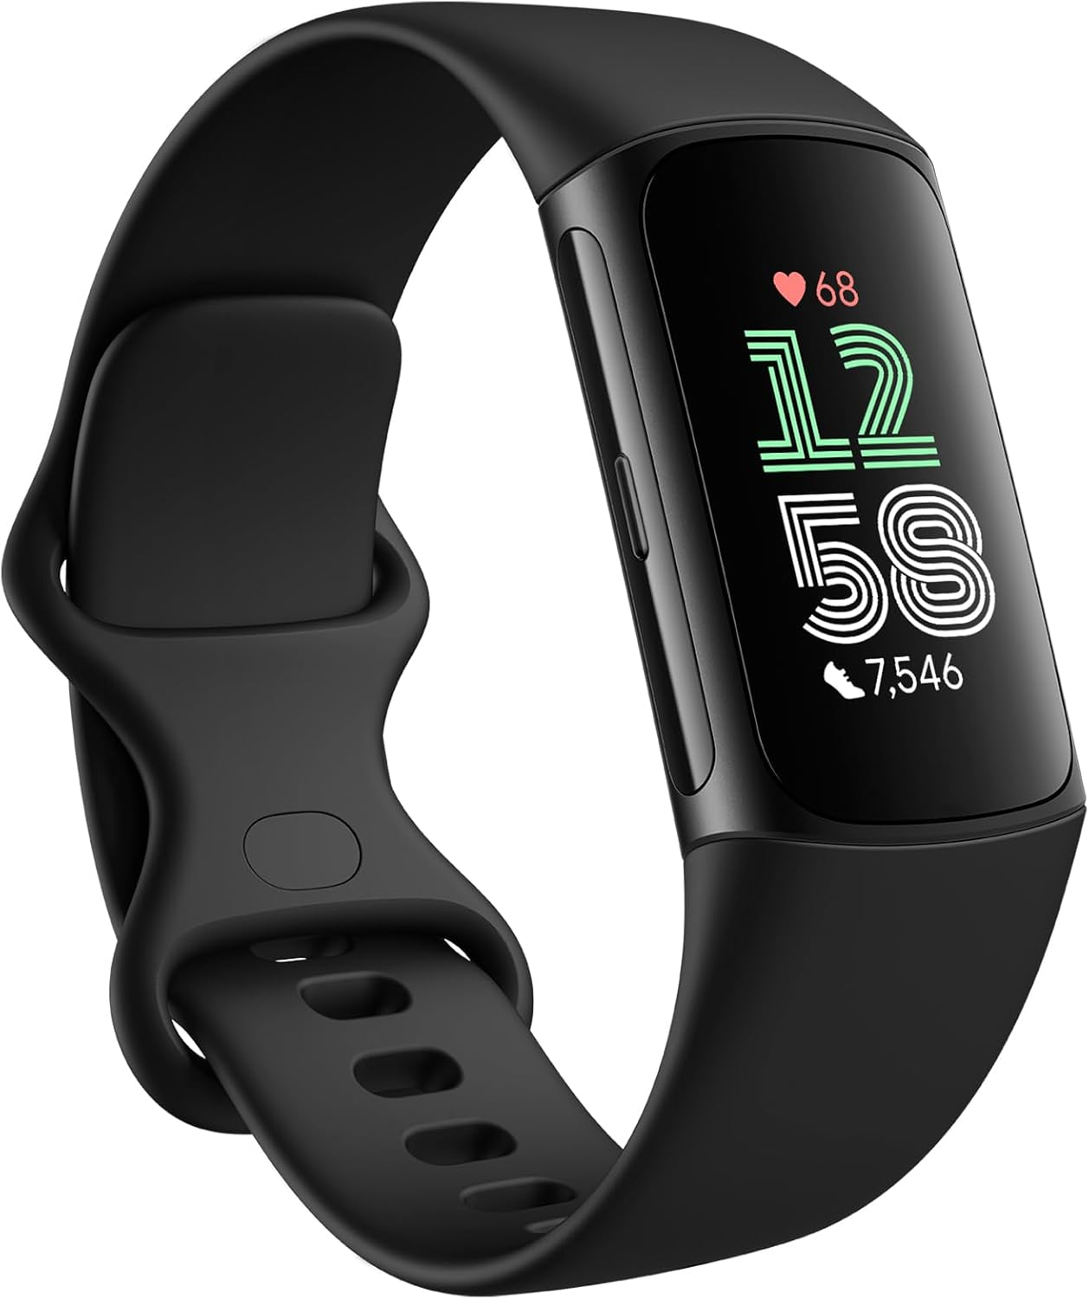
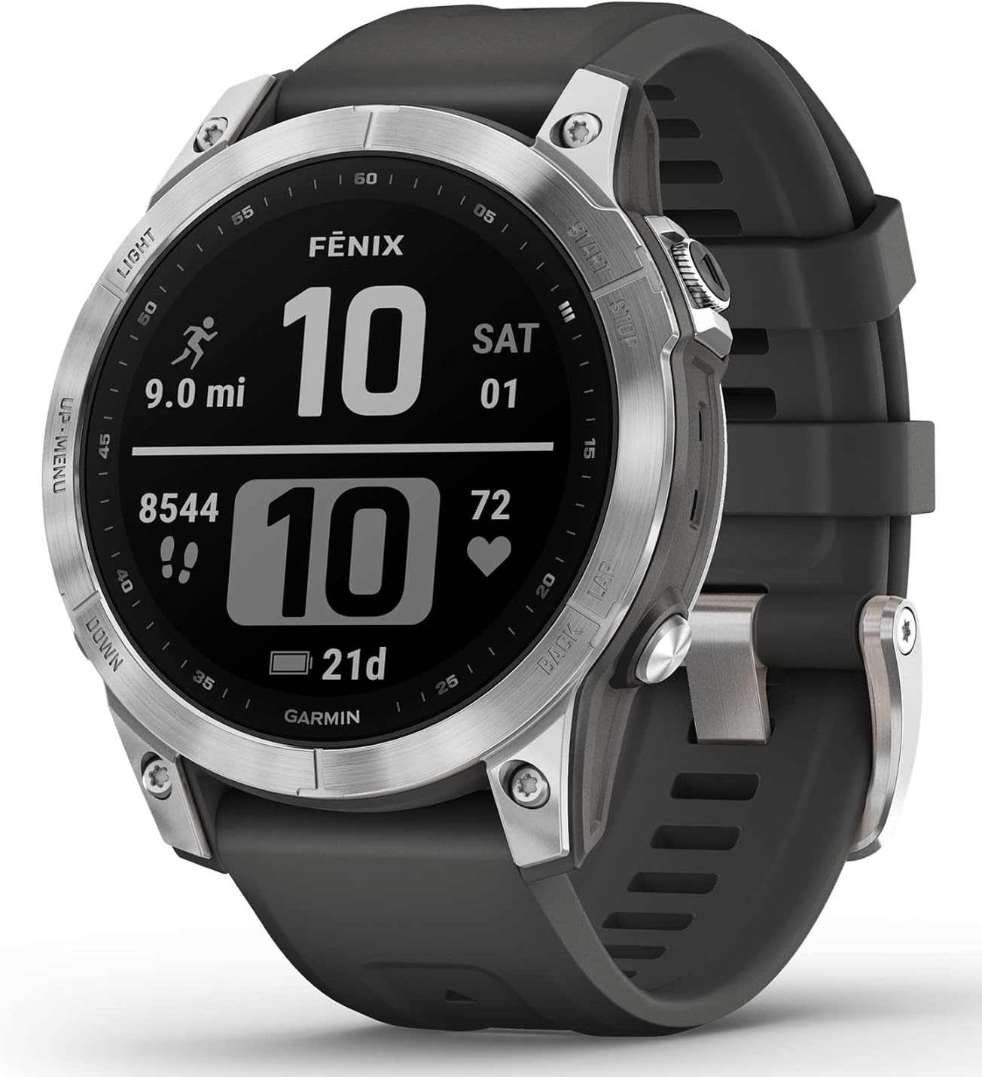
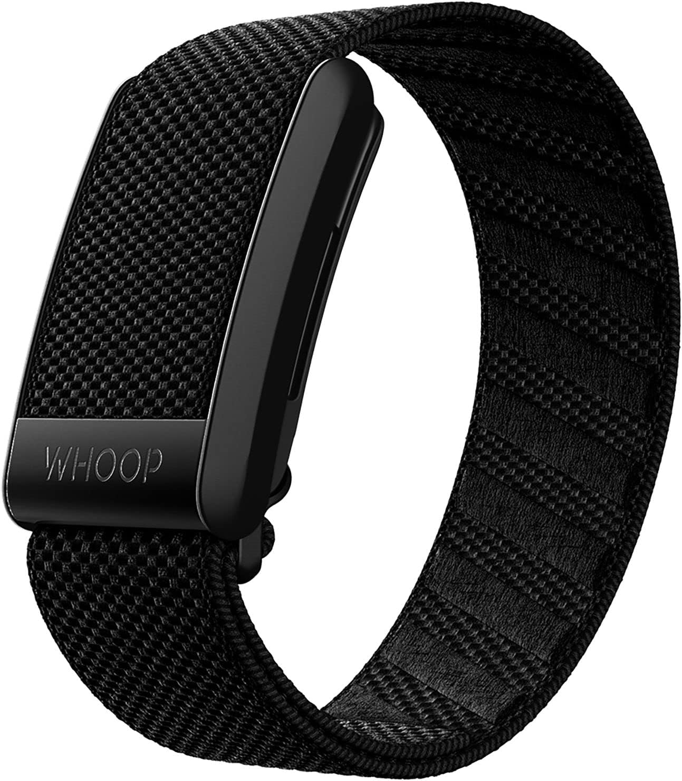
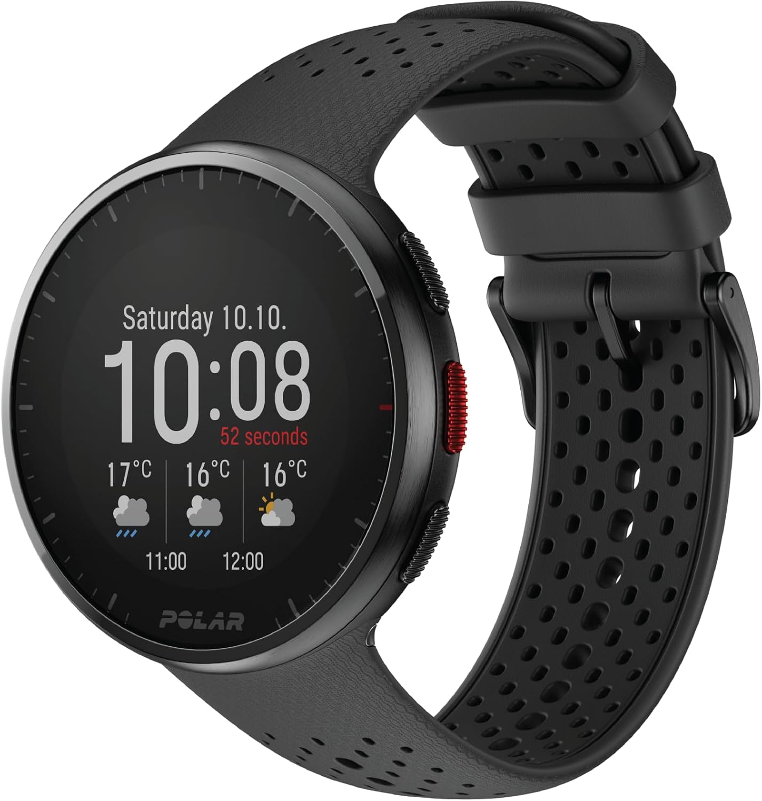
Existing Solutions – Commercial Products
Company | Fitbit | Garmin | WHOOP | Polar
Product | Charge 6 | Fenix 7 | 4.0 | Pacer Pro
HR monitoring | All offers optical heart rate monitoring
Fatigue assessment | Readiness Score | Body Battery | Strain | Recovery Status
Key limitations | Lack of transparency, accuracy, and interpretability → reliability issue Do not predict future fatigue state → limited to reactive intervention

Slide 8
How Our Proposed Solution Deals with the Limitations of the Existing Solutions
Limitations | Proposed Solution | Improvements
Self-reported fatigue as ground truth | Wearable sensor-driven generation of ground truth fatigue labels | More frequent and objective fatigue information
Current state estimation | Predict future fatigue state (up to 60 minutes) | Proactive intervention
Lack of transparency and interpretability | Explainable AI methods | Prediction interpretation and reasoning

Slide 9
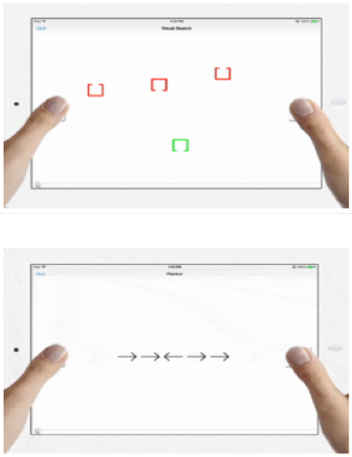
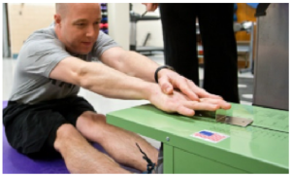
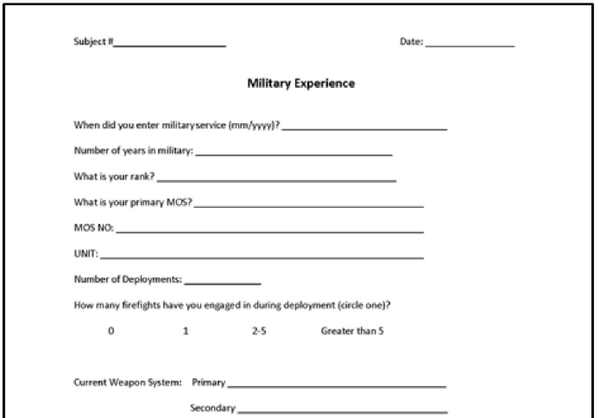
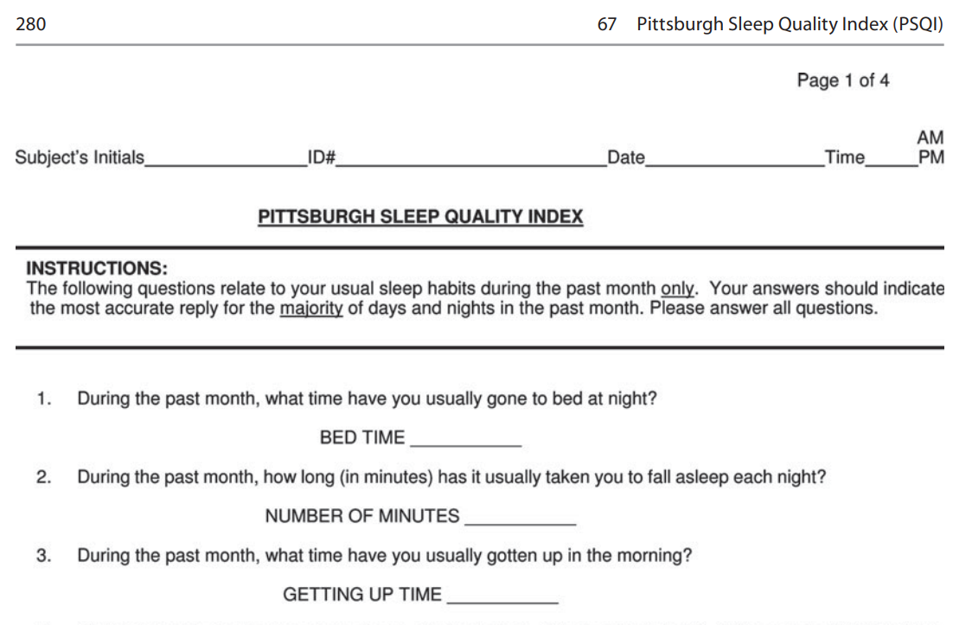
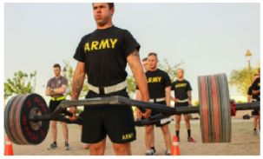
Data Collection - Overview
Baseline
(Fort Liberty, NC)
Field Study
(Fort Devens, MA)
Day 1
Day 2
Day 3
Day 4
Day 5
Day 6
Day 7
Day 8
Day 9
Cognitive metrics
Physical metrics
Lifestyle metrics
Health metrics
Questionnaires for:
Demographics
Military experience
Habits
Questionnaires for:
Eating behavior
Sleep quality
Activities

Slide 10
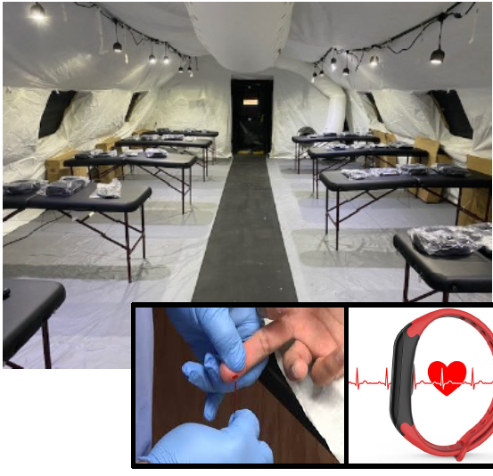
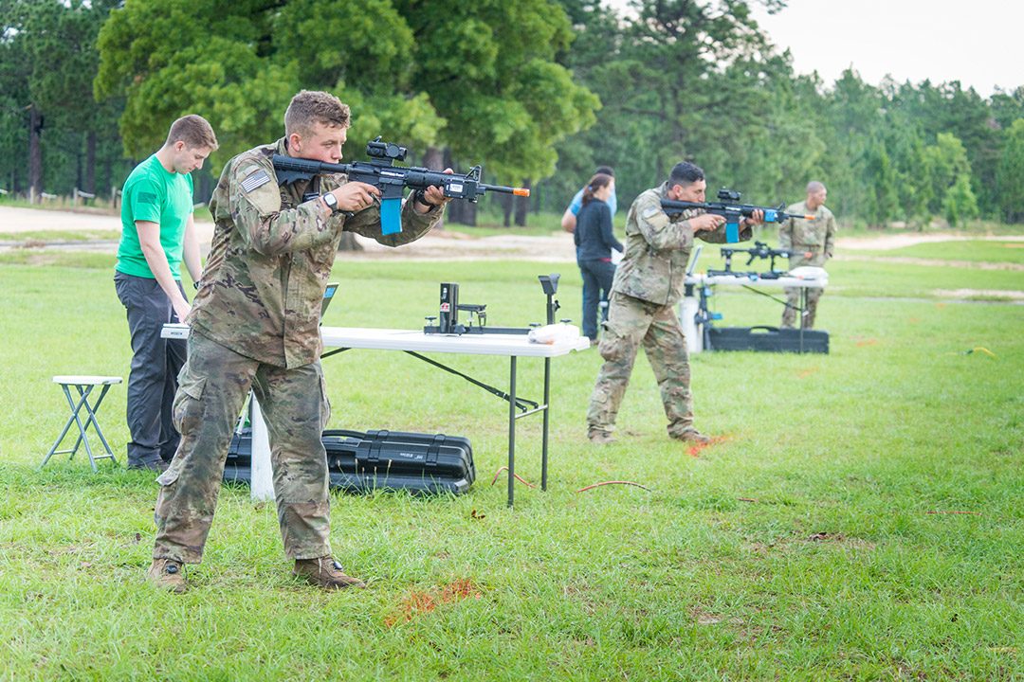
Data Collection - Overview
Baseline
(Fort Liberty, NC)
Field Study
(Fort Devens, MA)
Day 1
Day 2
Day 3
Day 4
Day 5
Day 6
Day 7
Day 8
Day 9
Pre-mission
Mission
Post-mission
Intake surveys
Biosamples collection
Wearable sensor data collected while performing:
Ruck marches (data used for this work)
Shooting scenarios (individual and team)
Reconnaissance
Raid / Building assault
Intake surveys
Biosamples collection

Slide 11
Data Collection – Summary
Event | Device / Collection Method | Frequency | Collected Information
Baseline data collection | Lifestyle and health metrics questionnaires | Once | Age Height Tobacco usage | Weight Years in military | Weight Years in military
 |  |  | Alcohol consumption Caffeinated beverages consumption Other drink consumption (soda, etc)
 | Physical tests | Once | ACFT (Army Combat Fitness Test) total score Total sprint time Sprint drag carry total
Pre- and Post-missions | Blood and saliva samples | Before and after mission | CREQ LACQ HISQ | UROQ CARQ COR-Q |  | EST-Q DHEA-Q TEST-Q
Wearables during mission event | Polar Pro | 10 Hz | Heart rate Speed Acceleration | Interbeat interval Distance Running cadence
 |  | 2 Hz | Heartbeat interval
 |  | 1 Hz | Latitude | Longitude
 | Opal IMU | 256 Hz | Torso lean ML (mediolateral) Torso lean AP (anterior-posterior)
 |  | 2 Hz | Step length Stride speed | Step width Foot yaw
 |  | 2 Hz | Toe off to heal strike time delta

Slide 12
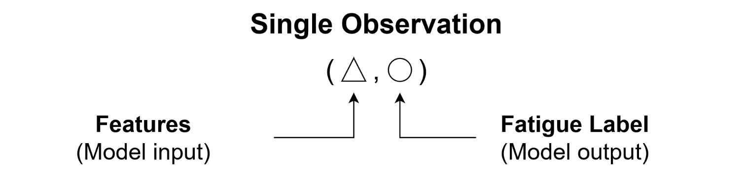
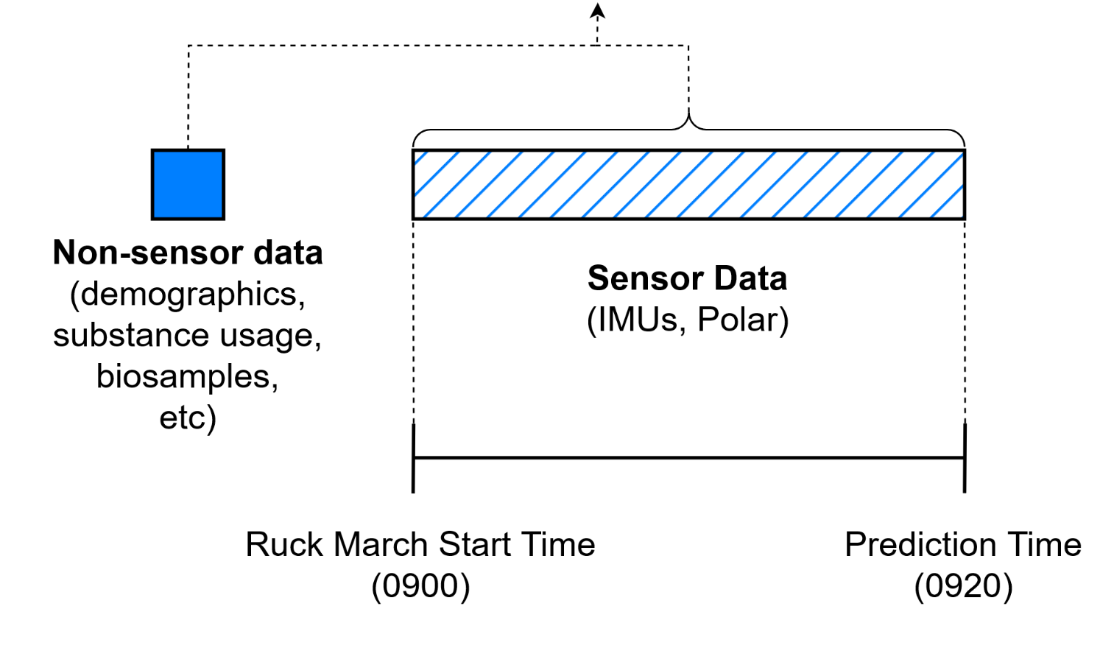
Method – ML Data Generation For Fatigue Prediction

Slide 13
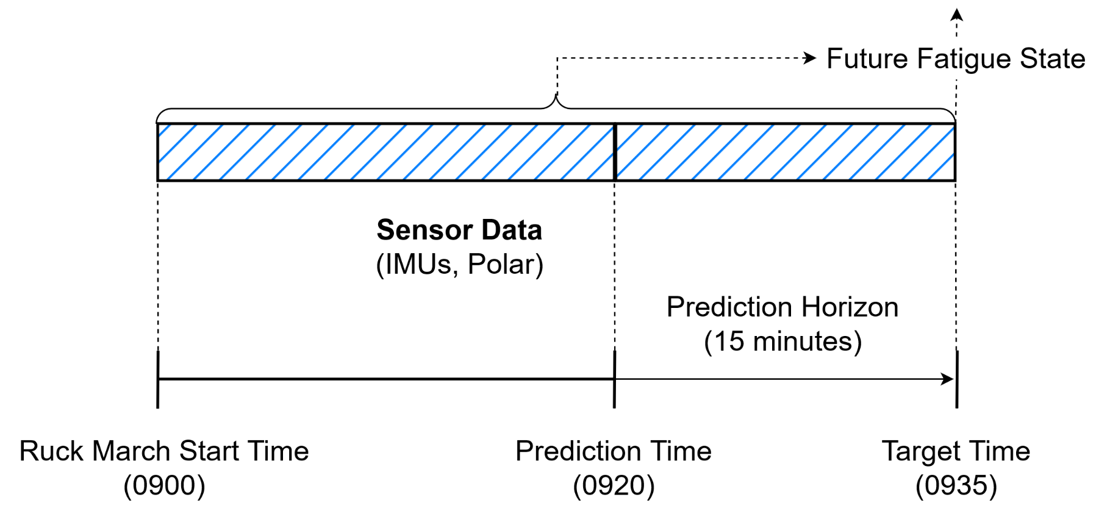
Method – ML Data Generation For Fatigue Prediction

Slide 14
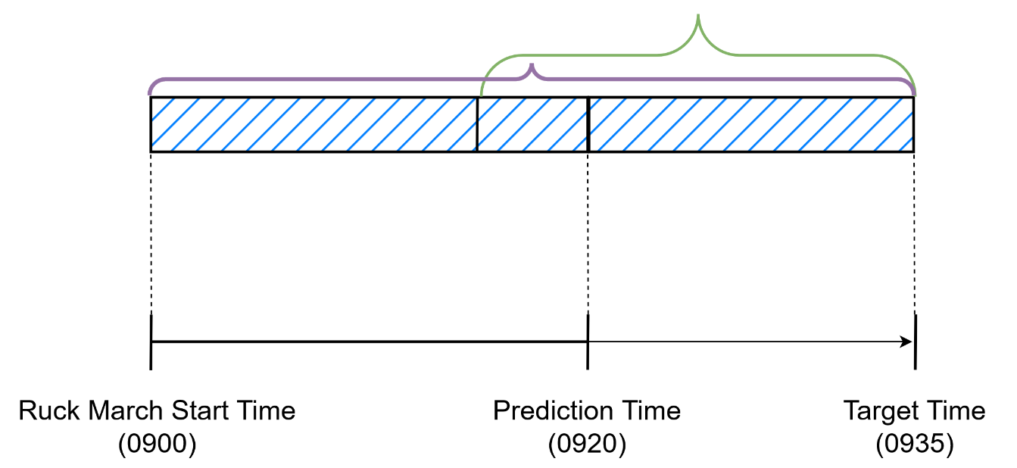




Method – Fatigue State Estimation
Current HR/Max HR
Constant used to estimate the lactate to heart rate ratios in men (y=1.92) and women (y=1.68)
Duration
$$TRIMP= \sum{(D×{HR}_{r}×{0.64e}^{y})}$$
(1)
$$Acute Workload= \sum_{past 20 min.}{TRIMP}$$
(2)
$$Acute to Chronic Workload Ratio (ACWR)=$$
$$Chronic Workload= \sum_{start to target time}{TRIMP}$$
$$Fatigue state=\left\{\begin{aligned}0, ACWR<1.3 \\ &1, ACWR≥1.3\end{aligned}\right.$$
Acute workload window
(3)
Chronic workload window
*References available in our paper, Multimodal Framework for Soldier Fatigue Prediction, I/ITSEC 2024

Slide 15
Processed Data Summary
Prediction Horizon | Number of Observations (from 33 participants)
 | Fatigued (%) | Not Fatigued (%)
5 minutes | 61 (4.4%) | 1329 (95.6%)
15 minutes | 78 (5.5%) | 1343 (94.5%)
30 minutes | 78 (6.1%) | 1211 (93.9%)
60 minutes | 93 (9.0%) | 938 (91.0%)
Removed over 70% of participants that did not experience fatigue at least once during the ruck from model training to reduce label imbalance.
Used 80/20 strategized split by participant separate train and test sets.

Slide 16
Results - Prediction Performance for Varying Time Horizons
Prediction Horizon | Accuracy* | Balanced Accuracy* | Recall* | Specificity*
5 minutes | 0.87 (± 0.01) | 0.84 (± 0.03) | 0.81 (± 0.05) | 0.87 (± 0.01)
15 minutes | 0.77 (± 0.02) | 0.74 (± 0.02) | 0.71 (± 0.05) | 0.78 (± 0.02)
30 minutes | 0.70 (± 0.02) | 0.70 (± 0.03) | 0.70 (± 0.06) | 0.70 (± 0.02)
60 minutes | 0.76 (± 0.02) | 0.67 (± 0.03) | 0.55 (± 0.06) | 0.78 (± 0.02)
*All measures +/- 95% Confidence Interval
Given the nature of the unbalanced dataset, balance accuracy was used as the main performance metric for the final model selection and evaluation.
Performance degrades quickly as the prediction horizon increases.

Slide 17
Results - Prediction Sensitivity to Input Data Types
Data Source(s) | Accuracy* | Balanced Accuracy* | Recall* | Specificity*
Wearable (Polar) | 0.73 (± 0.02) | 0.69 (± 0.03) | 0.64 (± 0.06) | 0.74 (± 0.02)
Wearables (IMUs) | 0.68 (± 0.02) | 0.67 (± 0.02) | 0.64 (± 0.06) | 0.69 (± 0.03)
Wearables (Polar, IMUs) | 0.60 (± 0.02) | 0.69 (± 0.02) | 0.80 (± 0.05) | 0.59 (± 0.02)
*All measures +/- 95% Confidence Interval Best performance in bold
Slight decrease (-1.4%) in balanced accuracy observed when using only wearable data (compared to 0.70 when using all data).
Using advanced movement data (walking posture and technique) from IMUs in addition to simple movement and physiology data from a fitness tracker improved predicting fatigue instances but did not improve balanced accuracy.

Slide 18
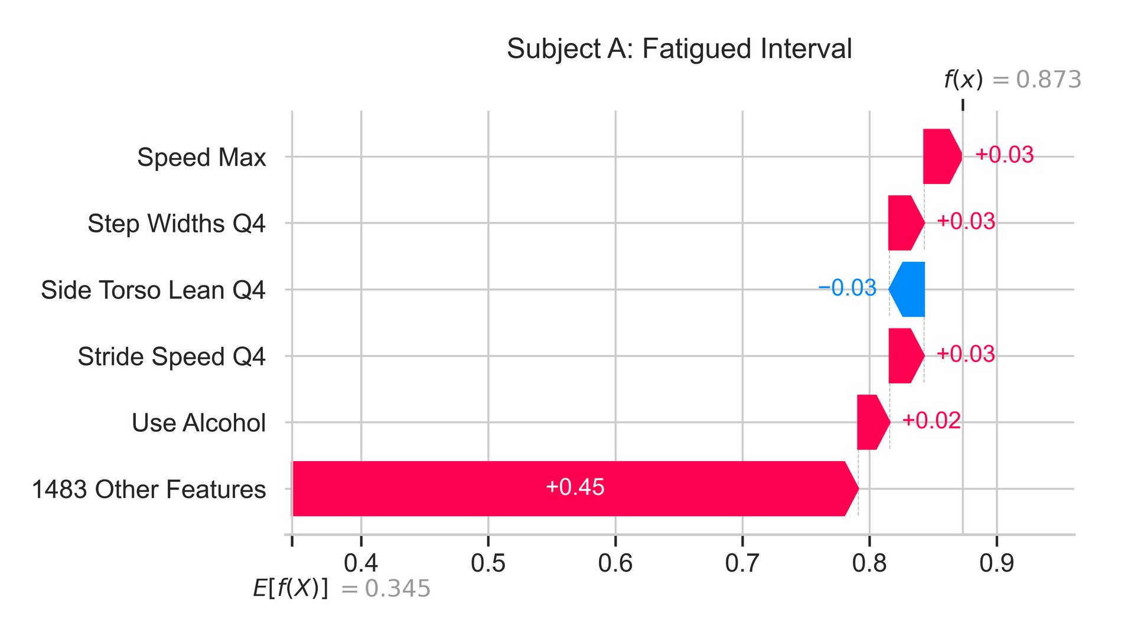
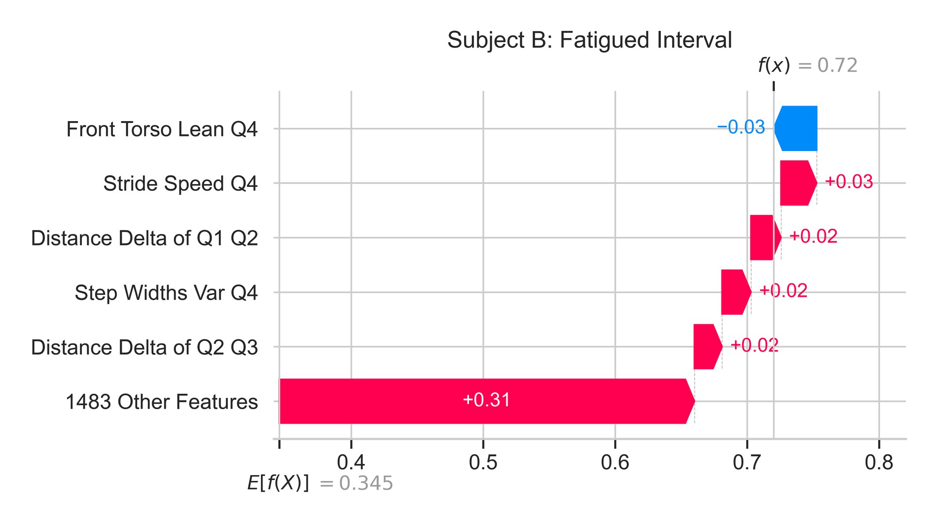
Results – Explainability via Shapley Values
Feature importance technique enables personalized
understanding of the prediction.

Slide 19
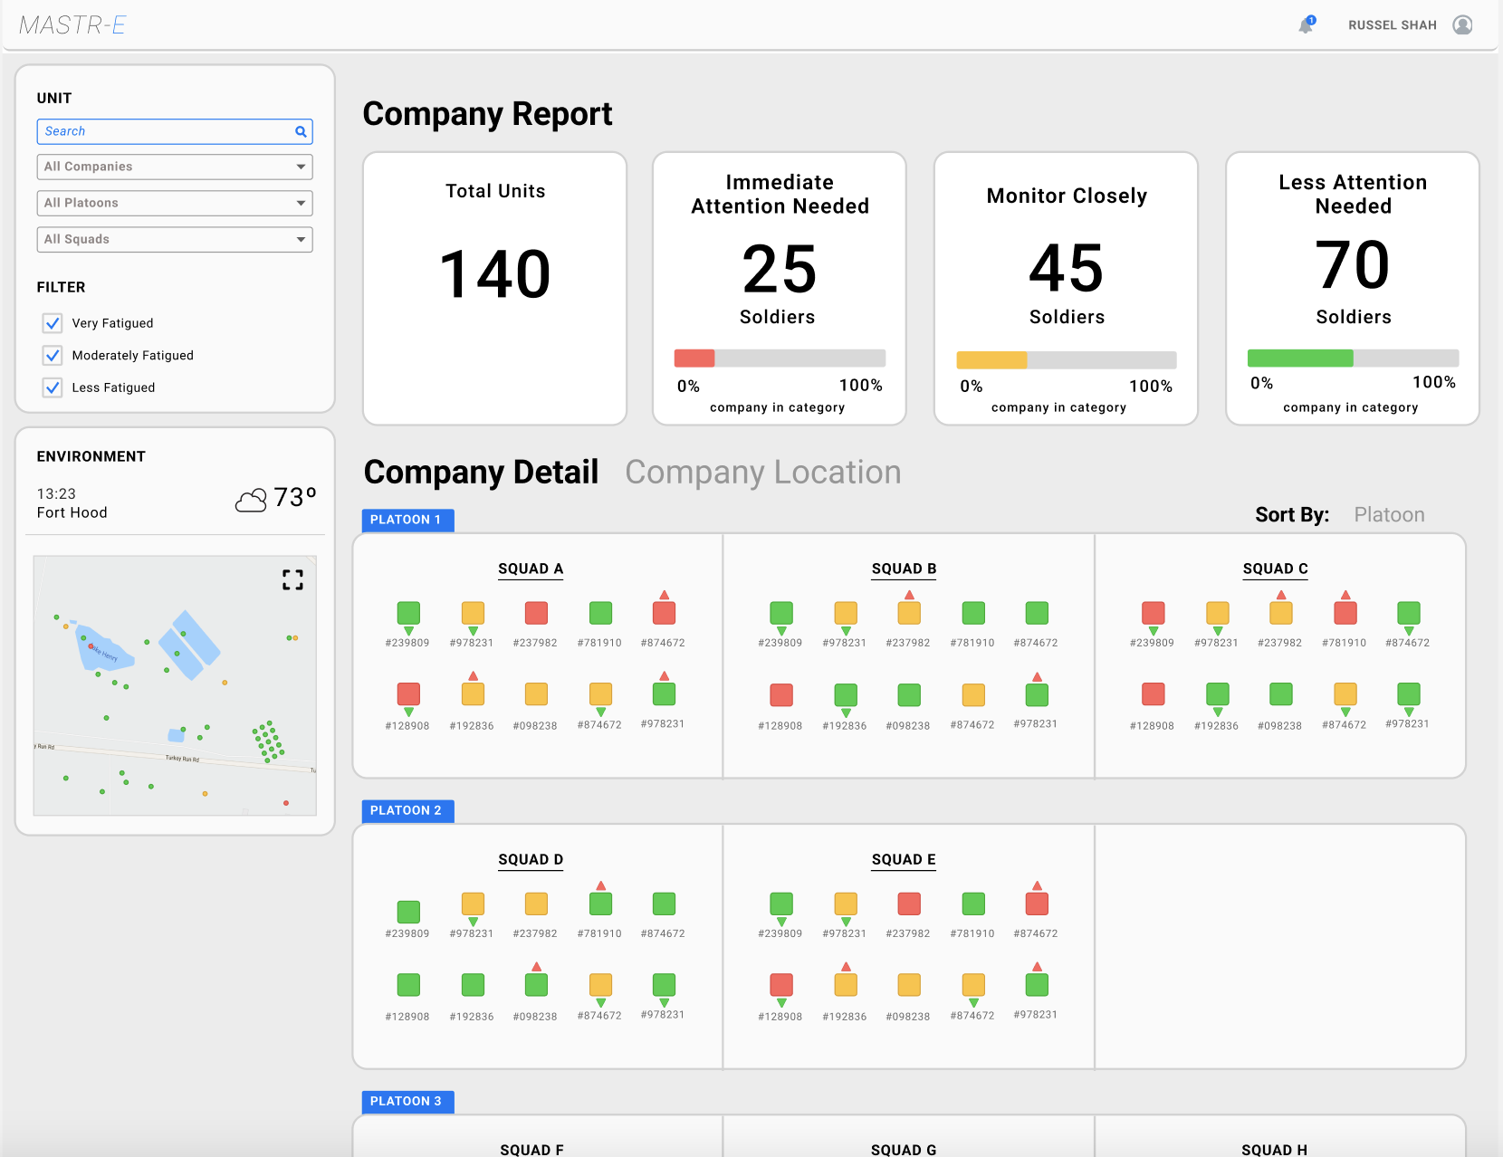
Use Case: Proof-of-Concept
Highlight ones that need immediate attention to reduce potential injuries
Overview of the soldier’s fatigue states

Slide 20
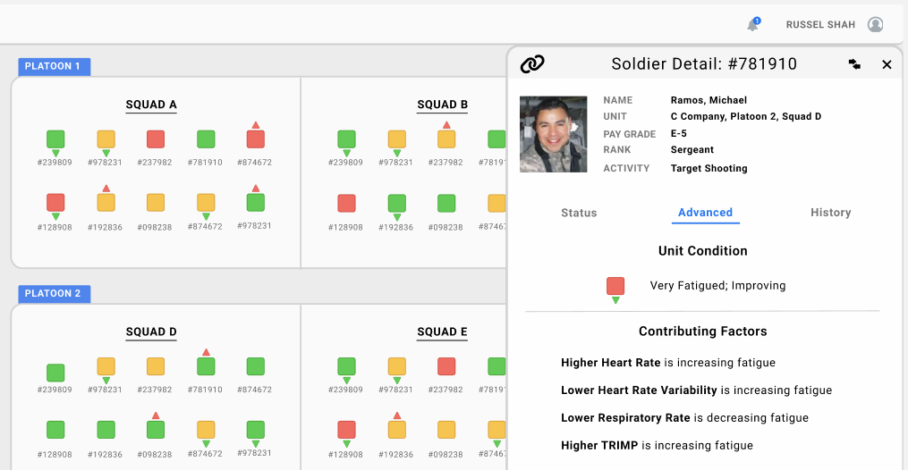

Use Case: Proof-of-Concept
John, Doe
Individual details panel can highlight contributing factors behind the prediction.

Slide 21
Summary
The framework for effectively predicting soldier fatigue offers a path towards implementing a data-driven decision support system to limit the injuries the Army is struggling with.
The proposed method for generating fatigue labels can automatically assess fatigue states using heart rate signals from wearables, ensuring both applicability and scalability

Slide 22
Path Forward
Continued communication and collaboration with the Army to incorporate research advancements into daily training scenarios and operations, aiming to minimize injuries and enhance soldier performance.
Continued data collection and research efforts to improve prediction performance.

