Slide 1

Learning to Learn II:
Evaluation of Learning Systems for Supporting
Competency Based Education (CBE)
Nathan Jones
Nate Ferrara

Slide 2

Contents
Need
Previous Research Summary
Purpose
Methodology
Limitations
Results
Discussion Points

Slide 3

Need for CBE Effective Programs
Critical need for comprehensive and proactive strategies to bridge the skill gaps and ensure workforce readiness in the face of rapidly changing job requirements.
44% of the skills required for employees to perform their roles effectively are undergoing significant transformation (Zahidi, et al 2020)
Back in 2021, 58% of the current workforce already required new skills to maintain their professional efficacy (Baker & Zuech)
Traditional education methods cannot fill the gaps

Slide 4

Impacts of Learning Management Systems on CBE Program Success
Challenges:
Failed to support open
Enrollment and flexible scheduling
Lack of technological adaptability
Successes:
Accommodating student schedules
Clear competency goals
Real-time, adaptable learning environments
Learning to Learn: The Trials and Tribulations of CBE Implementation in Technical Training," by Ferrara & Jones (2023)

Slide 5

Purpose
Research showed the negative impact the LMS selection and implementation can have on educational outcomes and learner experience.
Evaluate the readiness of Commercial Off-The-Shelf (COTS) LMS platforms in facilitating a modern CBE implementation within online learning environments.
Insights and tools for educators and administrators to optimize the selection and implementation of educational technologies in support of CBE initiatives.

Slide 6
Evaluation Criteria
Self-Paced Learning Adaptive Learning Interactive Content
PC Mobile 3D Access VR/AR Accessibility 360 Immersive Accessibility
Real Time 3D Accessibility Flexible Learning Paths Varied Assessment Strategies
Defined Learning Objectives Measure Learning Objectives Define Competencies
Measure Competency Robust Assessment Tools Competency Mapping
Student Communication Independent Learning Paths Discussion Forums
Chat Tools Collaboration Spaces Personalized Feedback
Personalized Instruction Tailored Learning Experience Personalized Learning Paths
Accessibility Features Progress Driven Registration Advanced Progress Tracking
Support Mini Milestones Open Enrollment Instructor Content Tools
Individual Contact Methods Contact Tracking Student Engagement Tools
Supports Blended Learning

Slide 7
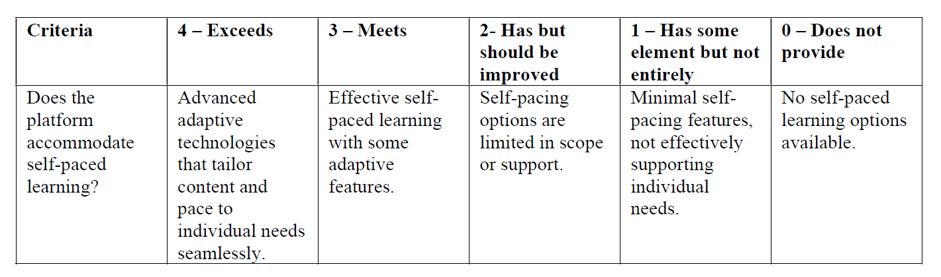
Measurement Definitions
35 evaluation criteria
175 score definitions
700 scores
The team collaboratively defined what meets the criteria as well as what was considered to exceed the criteria. For each score, the reason for the selected score was recorded into the scoring matrix along with the score assigned.

Slide 8
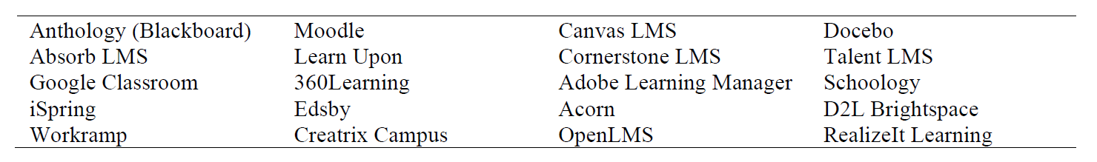
LMS Systems Market Sampling
Selection focus covered:
LMSs that were consistently recognized across sources
Held significant market share
Claimed to support CBE

Slide 9

Limitations
The intent is to look at trends.
Not include user experience studies
Not fully capture the customization capabilities of each platform
Based on documentation and standard features
Long-term engagement with these platforms might reveal strengths or weaknesses that are not apparent from documentation alone
The results are not intended to endorse any LMS over another.
Changing elements of selection criteria for an individual organization’s needs will likely change results.

Slide 10
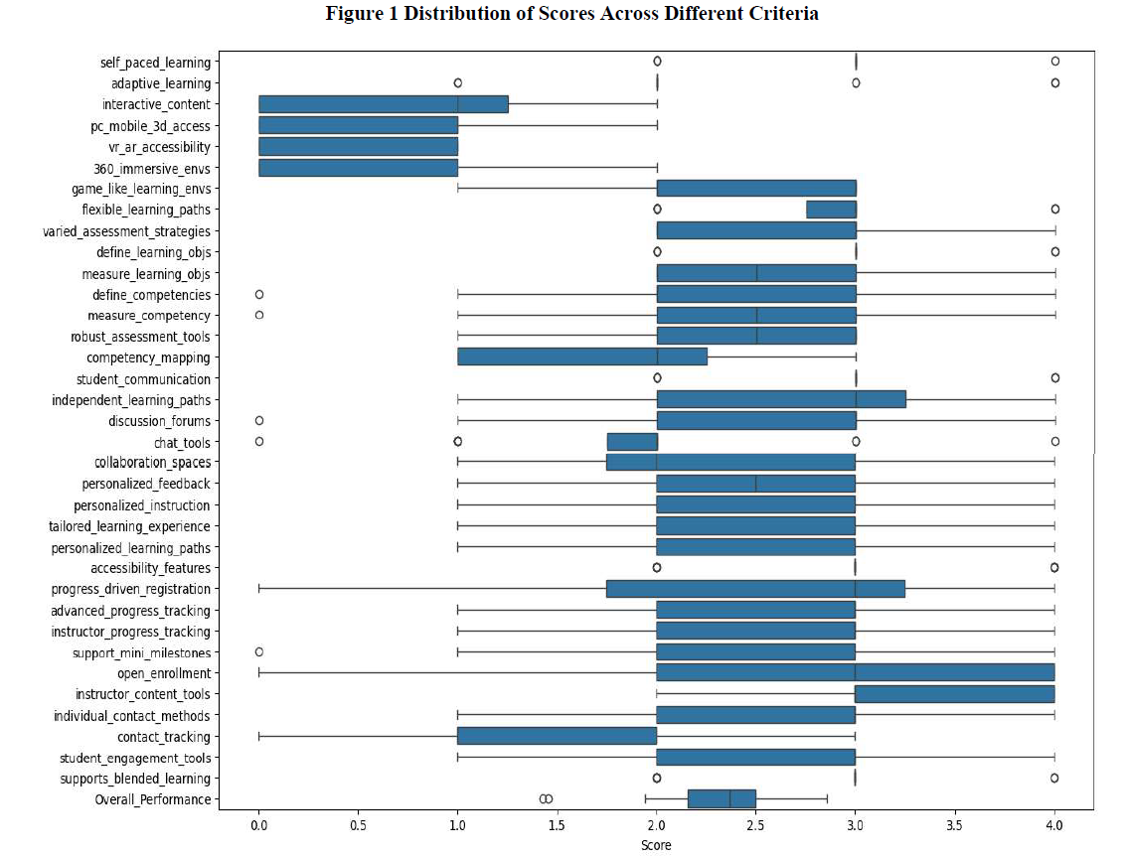
Distribution Evaluation
Least Coverage
Interactive Content
3D Content Access PC/Mobile
VR/AR Accessibility
360 Immersive Environments
Contact Tracking
Most Coverage
Instructor Content Tools
Open Enrollment (also most variance)
0
4
Notes:
Interactive Content defined as A platform would offer sophisticated 3D rendering that provides learners with an immersive and interactive experience. Such platforms might feature detailed, high-resolution models in courses related to architecture, biology, or engineering, where users can manipulate 3D objects or environments in real-time to explore different angles and scenarios.
Interactions with the 3D content are seamlessly integrated, affecting the learner's pathway with instant feedback, akin to interacting with a 3D model of a human heart on a mobile device with the same functionality as on a PC.
VR/AR modules that are deeply integrated into the curriculum and directly impact the learning path based on performance within the VR/AR environment.
Integration of 360 environments into the learning process, where interactions within these virtual spaces directly influence the course direction and outcomes.
Contact tracking – communication logging and might include integrated messaging systems, video calls, or the ability to schedule one-on-one meetings directly through the platform.

Slide 11
Deep Diving into Results
Potential Market Differentiators
(Most impact on unweighted score)
Open Enrollment
Personalized Feedback
Personalized Learning Paths
Student Engagement Tools
Mini-milestones
Self-paced Learning
Personalized Instruction
Interactive Content
Flexible Learning Pathways
Contact Tracking
Improvement Need Across Market Sampling
Scores most heavily influenced by shortfalls in direct access to:
interactive content
mobile 3D accessibility
VR/AR accessibility
360 immersive environments accessibility
The ability to provide immersive interactive environments for training is vital in CBE.
Notes:
creating a regression model focusing on selected features deemed most critical based on their individual correlation with the overall scores. This will provide understanding of what was most impactful to
the scores and could guide future development and improvement strategies. Based on preliminary correlation analysis, the top ten features most strongly correlated with overall scores were selected for further examination.

Slide 12
Effective CBE LMS Discussion Points
Immersive Content Accessibility
Modern learners expect seamless access to digital environments, analogous to the ease of logging into online gaming platforms and progressing through levels via immersive experience.
Personalization
Prioritizing the development of personalization and engagement features could strategically position educational institutions and enterprises at the leading edge of CBE supportive technology.
Development Priority Recommendations
Future student perspective and expectations vice historic administrative processes.
Educational experience could potentially rival the engagement and interactivity of online gaming, thereby transforming the traditional paradigms of educational delivery and engagement

Slide 13
QUESTIONS
Learning to Learn II:
Evaluation of Learning Systems for Supporting
Competency Based Education (CBE)
Nathan Jones, Nate Ferrara
Spinnaker Institute

