Slide 1
Preventing and Handling Offensive Behavior in Military Training
Experience from the Danish armed forces
Peter Sjoestedt,
Danish Ministry of Defence Acquisition and Logistics Organization
Ninette Fridahl,
Danish Ministry of Defence Acquisition and Logistics Organization
Notes:
About the authors
Introduction
Experiential learning
Method
General guidance from the Danish Ministry of Defence Personnel Organization
Guidelines and training from the Danish armed forces
Comparing the general guidelines and the local guidelines
The instructor's tasks, challenges, and resources
Conclusion / Perspectives for the future
Acknowledgements

Slide 2
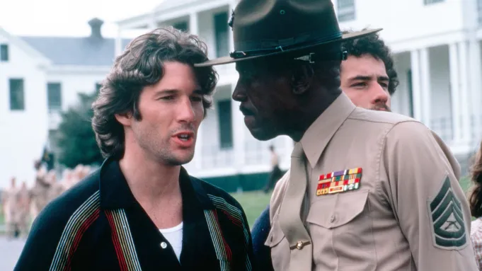

Good military training?
Notes:
To the left we see a photo from the film An Officer and a gentleman from 1982. Richard Gere as officer candidate Zack Mayo on his first day on the Aviation Officer Candidate School being disciplined by Louis Gosset Jr. as the hard-driving Marine Corps Gunnery Sergeant Emil Foley.
To the right we a photo from the film Top Gun from 1986. see Tom Cruise as Lieutenant Pete "Maverick" Mitchell, with his teacher astrophysicist and civilian Top Gun instructor, Charlotte "Charlie" Blackwood played by Kelly McGillis. When I first saw the movie in my teenage years I was chreing for the relationship to happen. Now being an expireinced professional I see some problems.
Looking back through history, offensive behavior has been an almost normal part of military training. Offensive behavior in military training invokes fascination as an iconic subject. Memoirs, literature and film describe it well in films like Top Gun, or An Officer and a Gentleman where we see offensive behavior unfolded as bullying between training participants, harassment by participants against instructors, and instructors who harass participants. The films portray offensive behavior as a natural and almost indispensable part of the military training environment. There seems to be a narrative of exceptionalism. It expresses that the military world is quite special and that the harsh tone and offensive behavior is a necessary and unavoidable part of the military culture and environment. (Bennike, Mohr & Sløk-Andersen 2018, Sløk-Andersen 2018), moreover, some members of the armed forces will argue that harsh language is an inherent part of the military operational environment, and therefore necessary in the training environment (Sjøstedt 2014).

Slide 3
Offensive behavior
Notes:
Figure 1. Distribution of Decisions (Single Incidents) on Offensive Behavior in 2023 (Figure adapted from Forsvarsministeriet, auditørkorpset 2024)
The overview includes both gender-based offensive behavior according to the Military Criminal Code §§ 18, 19, and 27 and the Penal Code §§ 232, 263, 264, and 264a, as well as other forms of offensive behavior, including offensive behavior under the Military Criminal Code §§ 13 and 27, and violence and threats under the Penal Code §§ 244 and 266.
Developments in military policy, e.g. Denmark and NATO (Forsvarsministeriets personalestyrelse 2021, NATO 2019) show that time has passed from this approach. Current policy demands a safe and respectful learning environment. However, a real showdown with tradition remains to be seen in the actual behavior in the organization (Forsvarskommandoen 2024). In a recent survey from the Danish ministry of defense personnel organization a large number of employees, and especially women, report having experienced offensive behavior: “The survey from 2023 show that 11, 8 percent within the Danish armed forces have experienced at least one incident of unwanted sexually oriented behavior and bullying within the last year. For men it is 8, 4 percent, whereas for women it is 32 percent” (Forsvarskommandoen 2024). Most report having experienced offensive behavior in the form of speech and bullying. A very small percentage - however present in the answers – report having experienced violence and rape: “In the severe category of rape or attempted rape, the answers indicate an increase. The Danish armed forces has knowledge of a number of cases, which coincide with the investigation period, which has been reported and/or has been subject to handling. Due to the serious nature, the Danish armed forces is investigating the cases further.” (Forsvarskommandoen 2024). It is relevant to point out that the number of cases of offensive behavior can be similar, or even greater, among civilian professions compared to the military. However, researchers emphasize that there is an increased responsibility and severity in the military world due to the operational environment, conscription, encampment and deployment on missions (Sløk-Andersen 2020, Muhr & Sløk-Andersen 2017).
The sanctions for offensive behavior can be severe. It is stated in the Danish armed forces that any physically offensive behavior may lead to termination of contract. In addition to this comes the legal consequences that could include fines and/or prison. The civilian court, the military legal system, or both judge the cases. Not all cases lead to a punishment or a verdict. Typically, this is because of lack of evidence or that the offended person does not wish to contribute to the resolution of the case (Forsvarsministeriet, auditørkorpset 2024).

Slide 4

Female conscription
Improved training environments need to be implemented to care for the female conscripts
Notes:
In April 2024, the Danish government agreed on a new law for conscription in the Danish armed forces that resulted in an increase in the number of conscripts. The normal conscription period also increased from 4 months to 11 months. In addition, the agreement open up for female conscription as an option to be decided on later by the Danish parlament (Forsvarsministeriet 2024). The intended benefit is to increase the recruitment of soldiers to stay beyond the conscription period, and potentially to have an element of conscribed personnel in the operational units. The increased conscription sharpens and actualizes the need to improve the training environment. Firstly, to benefit from the increased recruitment base and retain both male and female soldiers beyond their conscription military service. Secondly, in general to better care for the conscribed personnel who will now serve a longer time in the armed forces. However, and most importantly, improved training environments need to be implemented to care for the female conscripts who have an increased risk of experiencing offensive behavior in the armed forces.
With the ongoing war in Ukraine and the general development of conflict in the world, there is a focus on military training to be increasingly effective. The central agents in military training include the participants, the instructors, and their managers. These agents face the task of navigating military culture and participating in creating a modern training and learning environment that ensures effective learning, and that the training is carried out in a safe and respectful manner, to care for all involved, and to recruit and retain personnel. In the recent years, researchers have described offensive behavior in the military world in general (2018 Beate Sløk-Andersen). However, the research does not specifically focus on training and learning. There is a need to address training specifically because relationships in the training context can be more informal with unclear lines of command, employees meeting in new temporary contexts, and because a safe learning environment is crucial for learning and development (Sjøstedt 2014, Grønlund and Sjøstedt).

Slide 5
Experiential Learning
Active experimentation
Concrete experience
Reflective observation
Abstract conceptualization
David A. Kolb: Experiential learning. 1984.
Notes:
Research and experience show that effectiveness of training comes with a safe, respectful, professionally oriented educational environment, with a focus on experiential learning and empathetic communication and feedback (Hattie & Yates 2014, Sjøstedt & Grønlund 2017). Furthermore, research emphasizes real personal contact and commitment between learner and instructor as the most important motivation to learn (Illeris 2017). A modern, up-to-date, and effective educational environment facilitates the participant’s active experimentation and reflective observation (Kolb 1984) through task-based learning, including the use of simulation (Steehouver 2005, Van der Hulst 2008, Sjøstedt & Huglstad 2006). In an effective learning environment interaction between participants and instructor is paramount, as well as the interaction between participants as a valuable source of learning.
In an experiential learning environment, participants should be encouraged to be active, express their opinions, and even be personal. This is crucial as deep learning is rooted in the person and personal experiences (Illeris 2017).

Slide 6
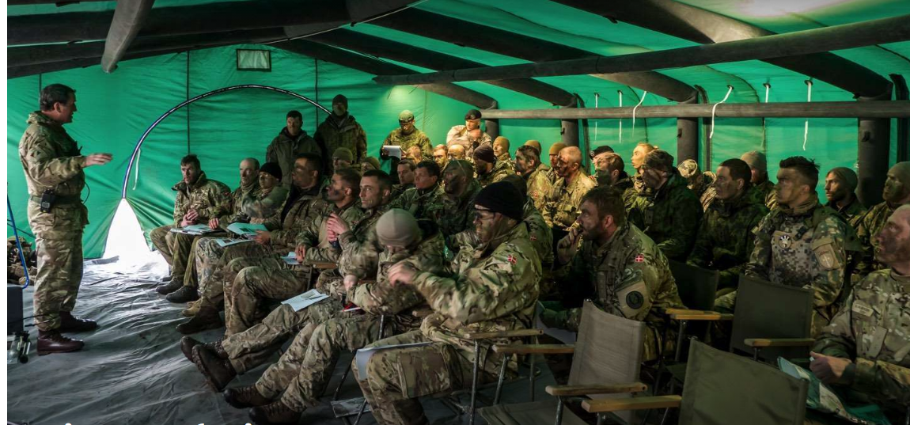
Value free feedback
Your communication followed the agreed procedure
Good!
Notes:
In the experiential and personalized learning environment, there is an inherent risk of conflicts and confrontation as well as misunderstandings in communication. Feedback can be challenging to receive and participants can understand well-intentioned feedback as unfair, disrespectful or even aggressive. Moreover, however well intended, feedback is often value-based. "It was a good performance" or "it was a bad performance" is a value-based statement that comes natural to most giving feedback. However, instructors or peers should avoid value-based feedback (Rosenberg 2003).
Value free feedback in a simulation-based exercise could be e.g., "The engine overheated, the consequence is that you cannot sail any further, alternatively you could have …”. Or, "you stayed within the zone marking as required, as consequence in the real world you would have a safe passage, as alternative you could have communicated to other traffic that you would need to leave the zone…” The instructor does not have to announce whether the observed behavior and its consequences is good or bad, even if intuitively it seems like the right thing. The value free knowledge oriented feedback is more helpful for learning (Hattie & Yates2014, Rosenberg 2003, Sjøstedt & Grønlund 2017, Sjøstedt 2014).

Slide 7
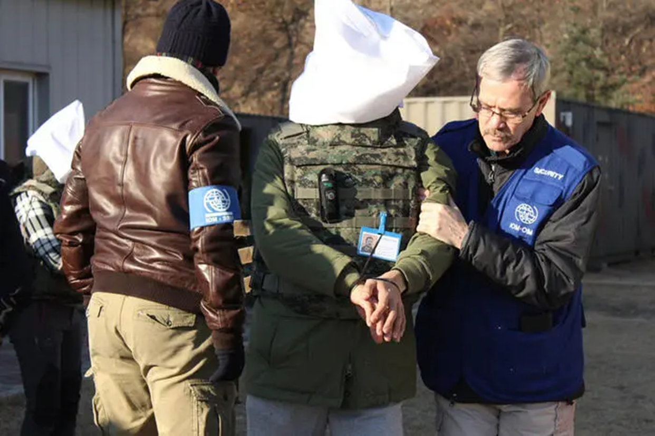
Risk management and learning
  Experiential
  Authentic
  Deep personalized
  Risk mitigated
  Vs
  Pre programmed
  Impersonal
  Risk aversive
Notes:
While we see experiential learning and the authentic and personalized learning environment as effective, it also poses risks and challenges to the participants and instructors. With the development in policy and the expectations to respectful behavior, the stakes are high, and conflicts, however unintended, can have fatal consequences for the involved parties. The solution should not be a risk averse and impersonal learning space where everyone simply uses preprogrammed standardized behavior because this does not create the necessary deep and personal learning. Instead, professionals need to examine policy and guidance to see how it supports the experiential learning environment in both supporting personal interaction and preventing and handling offensive behavior.
This picture shows a conduct after capture training. An area I know well from my experience as course leader and instructor from these courses. Here it is obvious that risk has to be managed and balanced with learning. The reisk mitigaitons around trainings like this is extensive and ranged from prevention of physical damage to prevention and handling of offensive behavior. The paradocs is that the participant have to be harassed and exposed to humiliating behaveour. However it needs to be within some limits that is decided through the general agrred SOP and the instructors expireince and communication.

Slide 8
Method
Qualitative sample
Terminology
Translation
Notes:
METHOD
The paper presents a qualitative sample of policies and material from the Danish military – and examines how the policies and material prevent and handle offensive behavior in military training; and how they at the same time support experiential learning. The policies are compared and the strengths and challenges are discussed. In recent years, researchers have described offensive behavior in the military world in general (2018 Beate Sløk-Andersen). However, the research does not specifically focus on training and learning. There is a need to address training specifically because relationships in the training context can be more informal with unclear line of command, employees often meet in new temporary contexts, and because a safe learning environment is crucial for learning and development (Sjøstedt 2014, Grønlund and Sjøstedt).
The focus is on the instructor in particular who has central position in the learning environment. The instructor is the primary agent for enforcing the safe learning environment, while at the same time, the instructor also has the potential to be subject to offensive behavior. Offensive behavior does not occur solely from instructors against participants, or participants against each other. Instructors can also experience offensive behavior from participants. The instructor may become a projection screen for the participants' emotions. In training and learning, the stakes are high, and participants and even their managers can direct emotions, opinions, and ambitions at the instructor. While the focus is on the instructor and their care for the participants, the guidance given to the managers of the participants and the instructors is also examined.
Throughout, the expression “offensive behavior,” is used as the general terminology for the sample of behavior in question in this paper. Included in this terminology is a large variety of behaviors, e.g. disrespectful language, sexism, bullying, violence. Where relevant, the specific behavior is named. Special attention is given to the diverse severities of the offensive behavior. The behavior ranges from remarks and tone of voice that individuals can perceive as offensive, to systemic, psychological bullying over a long period of time, and even rape and/or physical abuse. This diverse spectrum of behavior is both a challenge for understanding the problem and for guiding the individuals and organizations, and is an area where clear distinction can improve the handling and prevention of offensive behavior.

Slide 9
General guidance
"Offensive behavior is when one or more people severely or repeatedly expose other people to behavior that they perceive as offensive. Offensive behavior is a collective term for violence, bullying, gender-violating behavior and other ways in which offensive behavior can occur at work. There can be both active behavior and failure to act. Offensive behavior in relation to work include many different actions. It is irrelevant whether the actions are an expression of thoughtlessness or a definite desire to offend. It is the person's experience of the offending actions that is central.“
(Danish Ministry of Defence, Personel Agency 2021)
Notes:
"Offensive behavior is when one or more people severely or repeatedly expose other people to behavior that they perceive as offensive. Offensive behavior is a collective term for violence, bullying, gender-violating behavior and other ways in which offensive behavior can occur at work. There can be both active behavior and failure to act. Offensive behavior in relation to work include many different actions. It is irrelevant whether the actions are an expression of thoughtlessness or a definite desire to offend. It is the person's experience of the offending actions that is central."
(Forsvarsministeriet, personalestyrelsen 2021)
The entire Danish military is subject to a guide on prevention and handling of offensive behavior published by the Ministry of Defence Personnel Organization (Forsvarsministeriet, personalestyrelsen 2021). This guide sets the framework for the prevention and handling of offensive behavior. The guide has an introduction to offensive behavior in general and is divided subsequently into three appendices: 1) Gender oriented offensive behavior, 2) bullying, and 3) violence. The general introduction defines offensive behavior as follows:
The above is a very comprehensive definition that emphasizes the subjective experience of the offensive behavior while specifying that there must be gross conditions and/or repetitions. There is also an object-wise focus, where violations within gender-oriented offensive behavior, bullying and violence are particularly in focus. Finally, yet more importantly, it is emphasized that negligent behavior can also be offensive; it is the subjective perception that is decisive.
The guidance is primarily aimed at managers and states that they have a duty to act in relation to the prevention and handling of offensive behavior. The guidance is based on occupational health and safety legislation and is primarily an interpretation of this legislation to the military world. This also explains that it has status as a guide and not a military provision or actual law. The focus of the guide is to define offensive behavior as well as specify responsibility and support options. Thus, the guide highlights the manager as the primary agent and then mentions the working environment organization, the work committees and finally the OPRK organization, which is the Danish Ministry of Defence advisory and support unit pertaining to offensive behavior.
https://medarbejder.forsvaret.dk/da/ansaettelsesforhold/administration/oprk/
The guide specifies a number of tools that managers can use. Here, the statutory annual working environment assessment is central to uncovering the scope of the problem. In relation to prevention, the guide mentions is that guidelines or policies for good behavior can be published locally and discussions carried out. Last, but not least, it is stated that cases must be processed by both locally and if needed in the legal military and legal civilian legal systems. Punishment and sanction options are not specified; rather reference is made to the legal organizations. A campaign called "Respect each other" supplements the guidance. A website presents the content of the guide, and a number of presentations and dialogue tools are available for highlighting and discussing offensive behavior https://respektforhinanden.dk/.
Discussion
The published guide supports experiential learning in a number of ways. The guide encourages managers to have conversations with staff on offensive behavior. This is supportive to have discussions as an alternative to only presenting the legislation. It is also supportive and in line with an experiential learning environment, that cases and action cards to facilitate discussion are available on the web page connected to the guide. Lastly, the definition of offensive behavior, that emphasizes the subjective experience of offensive behavior, is in line with the underlying learning values of experiential learning. Neither the guidance nor the prepared campaign and material specifically mention the training environment in relation to cases or principled guidelines.
The definition of offensive behavior and availability of support options is applicable to the training environment. On the other hand, defined instructor's responsibilities and tasks is missing. In principle, this problem can be solved by deciding that the instructor has a managerial responsibility. However, this still contains the problem of when does this managerial responsibility end? The guidance should be that when a participant is registered for a training and taking part in learning activities, the instructor has managerial responsibility. Once participants leave the training, the instructor's managerial responsibility ceases but the instructor may be required to provide information if there is an ongoing case until the case is resolved. However, this definition cannot be extracted from the published guidance but must be determined locally.

Slide 10
Guidelines and training from Danish Armed Forces
"The idea is to kick-start a cultural change. It is a heavyweight ambition to invest so much in creating a new, inclusive culture that will transform a traditionally male-dominated organization into a workplace that is more attractive to be in in the long term for women and minorities in general,”
"We stand with an organization that values ​​community enormously, but it has historically been a community of men. It is very powerful to be part of that community, but it is also very powerfully exclusionary if you do not feel that you are part of it.”
Commander ILO, Vilhelm Holsting (Bach, 2024)
Notes:
"The idea is to kick-start a cultural change. It is a heavyweight ambition to invest so much in creating a new, inclusive culture that will transform a traditionally male-dominated organization into a workplace that is more attractive to be in in the long term for women and minorities in general,”
"We stand with an organization that values ​​community enormously, but it has historically been a community of men. It is very powerful to be part of that community, but it is also very powerfully exclusionary if you do not feel that you are part of it.”
Commander ILO, Vilhelm Holsting (Bach, 2024)
The Danish Armed Forces - as an entity under the Danish ministry of defence - has launched a training campaign, ending in mid-2025 named “Strong Work Communities” (Stærke arbejdsfællesskaber) to prevent and handle offensive behavior. All persons under the command of Danish Armed Forces must complete training once a year for three successive years. The training is organized as a cascade where trainers are trained first and then training is offered locally to all. Following the initial training campaign, the plan is to implement and include the content from the training into ordinary military training. The training is divided in 3 different batches according to rank. One for top managers and military commanders, one for mid-level civilian and military persons, and one for lower ranking civilian and military persons. The training has a generic content with the focus on identifying, preventing and handling offensive behavior. The training material is case oriented with a number of scenarios and questions for discussion. The training has a self-study online preparation that needs to be completed before engaging in the live trainings. The training is very detailed with many different sources of content: Text, audio and video. The material does not specifically include scenarios or text on how to prevent and handle offensive behavior as an instructor.
The campaign and trainings are developed by the Royal Danish Defence college Institute for Leadership and Organization (ILO). The rationale behind the trainings is to focus on inclusion and creating a community and to keep the offensive behavior and sanctions as background. The ambition is for all persons to see themselves as creating a positive work culture. Instead of a binary logic where all male are potential offenders and all women are potential victims.
The Danish defense as a whole is not subject to the training campaign. Only the armed forces. The Danish ministry of defense is currently considering including the Danish defence in general in the campaign and trainings (Forsvarsministeriet, Personalestyrelsen 2024).
Discussion
The campaign and trainings have a generic content and does not explicitly address the instructor and the training situation. Instructors need to be able to transfer the generic competencies to the specific training situation. Military trainers do often have managerial responsibility and military trainings are typically a part of the ordinary daily work. The transfer is therefore likely to be successful. However, for the instructors not being managers, and in cases where a mix of persons join a training, without the trainer having direct responsibility for the trainees, a transfer training could be considered. As well as clarification if the instructor have managerial responsibility while the training is ongoing. The approach facilitate to the need for a safe learning space. Both in terms of preventing and handling offensive behavior and in terms of keeping a focus on cooperation and creating a positive work community through discussions and learning.

Slide 11
Comparing the general guidelines and the local guidelines
Convergent between general and local
Focus on conversation
Baseline for unacceptable behavior
Didactics not addressed
Notes:
The general guidelines from FPS and the campaign and trainings from the armed forces are in line and cover the same aspects of preventing and handling offensive behavior. The armed forces show how a large scale training campaign can be designed. The general and the armed forces guidelines are convergent in the focus on conversation as a method of creating change, and in the common baseline for unacceptable behavior. They are also convergent in the generic approach where the instructor and the training situation is not addressed directly.

Slide 12
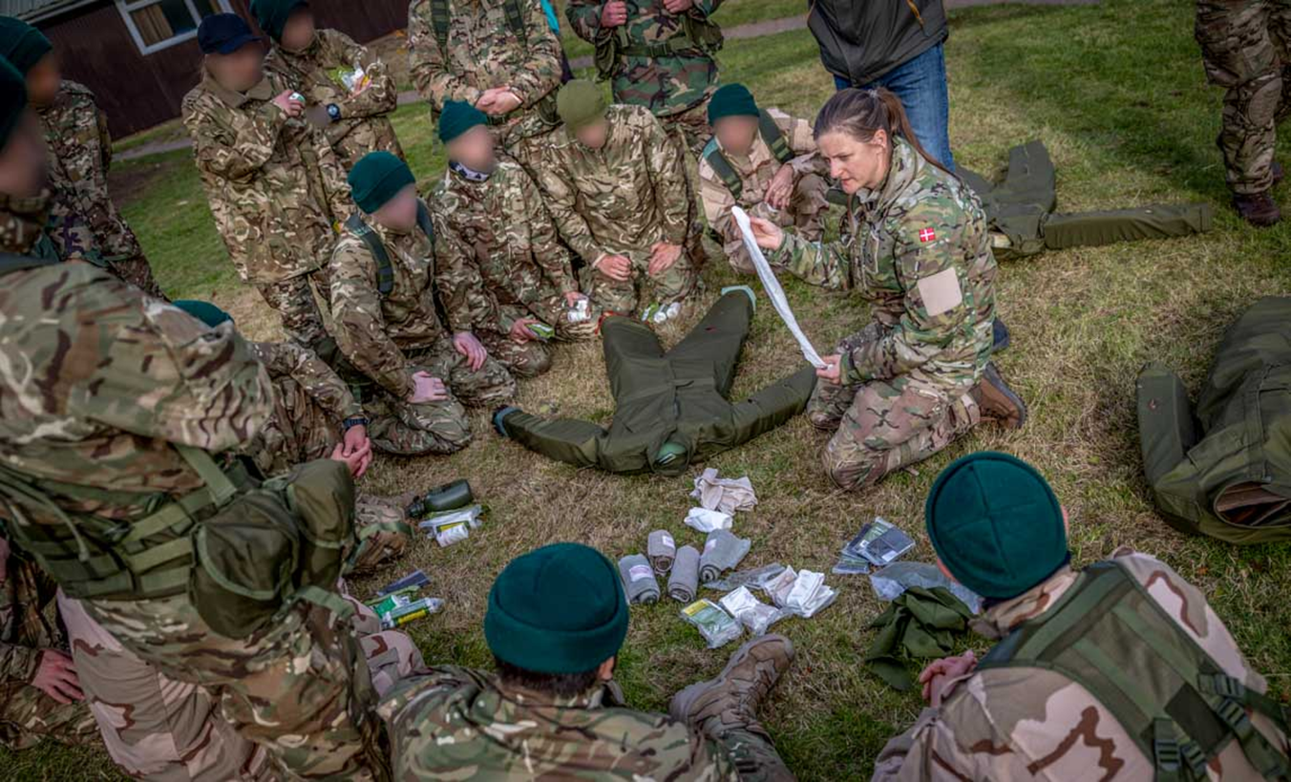
The instructor's tasks, challenges, and resources
Prevent and handle
Authority
Safe learning space for all (participants and instructor)
Transfer of skills
How can I interact
in a safe way?
Notes:
The previous text has shown that the military organization expect the training instructor to prevent and handle offensive behavior in military training. The guidelines does not directly give the task and responsibility to the instructor, but it becomes clear that the managerial responsibility for preventing and handling offensive behavior goes to the instructor when a training is ongoing and the instructor has the lead. It has also become clear from the guidelines - and the insight from research on experiential learning - that the instructor need to create and maintain a safe learning space. That is not only being safe from offensive behavior, but also safe to express ones opinions and engage in experiential behavior, and even being personal when engaging in learning and interacting with participant and instructors. The expectations created by military culture can be a challenge for the instructor when taking on the task and responsibility of creating a safe learning space. This goes for the expectations both from the environment as from oneself. As shown in the introduction, the military culture can include expectations of a harsh tone and hostile environment. Moreover, the perception of the instructor and participants can be that focus on wellbeing, emotions and cooperation is unwelcome.
Handling of offensive behavior can take many points of departure: Is there evidence for the claimed offensive behavior? Are there witnesses? Is it hearsay? Has there been a complaint? Did the instructor witness anything and how does the observed behavior resonate with all involved parties? Does all have the same perception of the behavior in question? In general, the instructors and the organization is new to this task and lack experience with handling offensive behavior. However, the instructor and organization alike has generic knowledge available to take on the task and responsibility. As shown in this text, research on experiential learning has produced guidance for the instructor. Web pages present tools for discussion and training of participants and managers alike. Moreover, support organizations are available with advice on prevention and assistance on handling offensive behavior. For an instructor, manager, and organization that are skillful, within the area of leadership and cooperative work, the learning the tools and preconditions to prevent and handle offensive behavior should be available.
Transferring the generic skills of leadership to specific skills on preventing and handling offensive behavior in military training could call for transfer training. In some cases the instructor does have neither generic leadership skills to transfer nor specific training oriented leadership skills and basic training could be relevant. Lastly, it becomes clear that the organization place implementation is on the individual staff and manager. To proceed forward clear expectations to implementation could be helpful. A top down process of prioritizing, and a concrete demand for resources allocated, could create clarity.

Slide 13
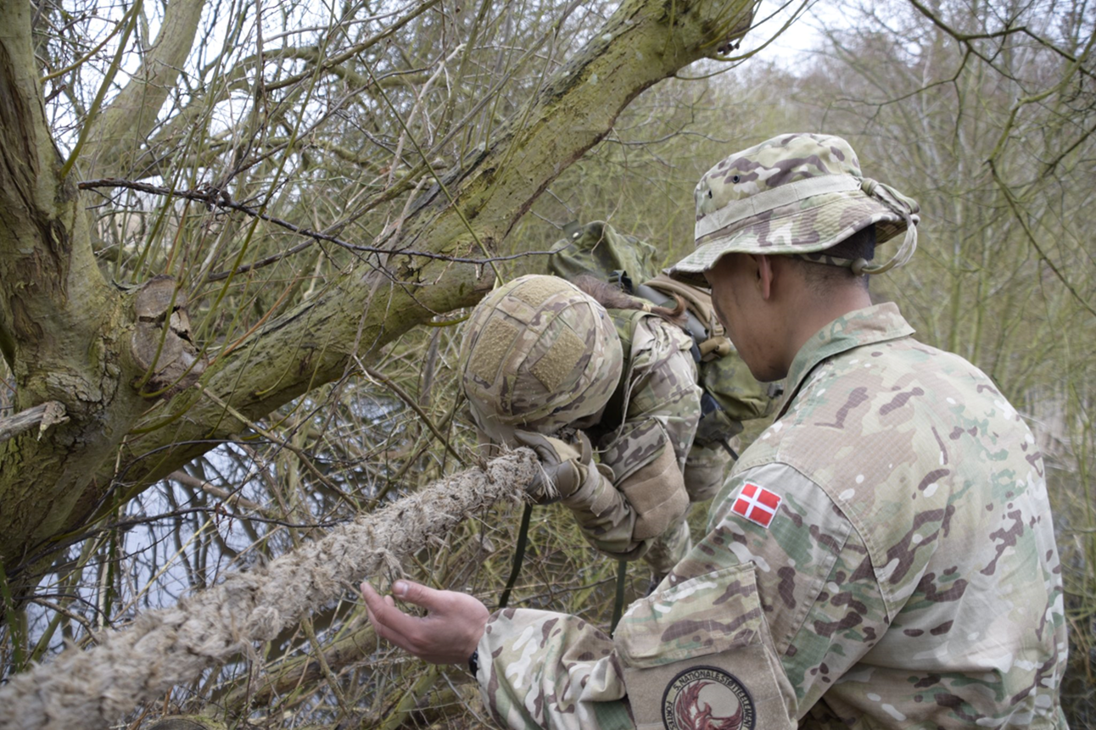
Conclusion
Must meet policy
Well being, retain and recruit
The instructor has responsibility
Balance: Risk management vs facilitate learning
Notes:
The military must live up to policy standards on preventing and handling offensive behavior to fulfill its responsibility for the well-being of training participants and staff, to recruit and retain personnel, and to secure that training investments yield the intended effects. In achieving this the military organization places responsibility on the instructor. Being a subject matter expert is not enough to be a good and safe instructor. The instructor needs knowledge about the demand to prevent and handle offensive behavior and leadership skills to facilitate cooperative work, dialogue, and take decisions and handle risk. Moreover, the instructor must be competent to create a safe and active learning space for all to be motivated, learn, and develop.
While some instructors can transfer generic leadership skills to the training environment, others need transfer training, and even more lack leadership skills and need soft skill training to be able to lead effectively in an experiential learning environment. The military organization places responsibility on the individual managers and instructors for achieving the objectives, however, a top-down process is needed, where the organization prioritizes training and allocates resources.

Slide 14
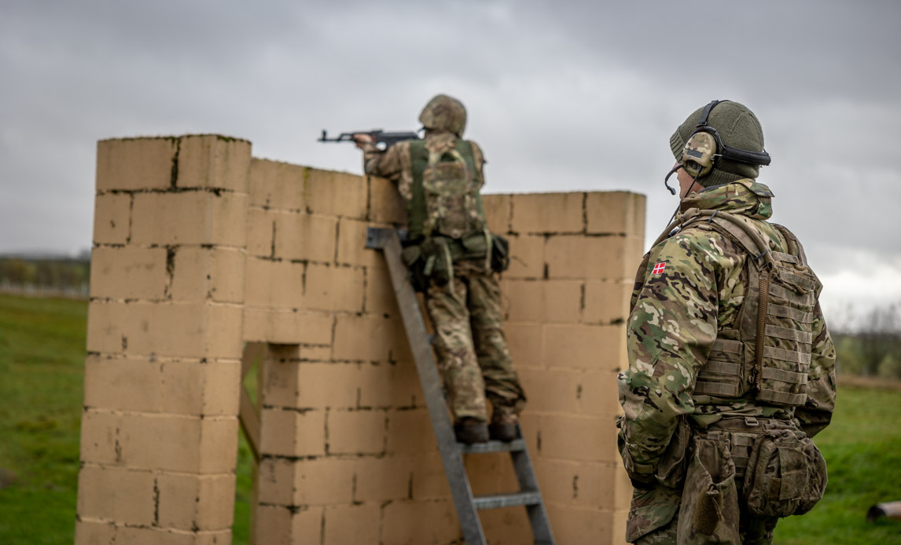
Perspectives for the future
Local guide
Awareness
Soft skill training for less experienced instructors
Notes:
Danish Acquisition and Logistics Organization (DALO) offer soft skill training for the Danish armed forces, typically within the administrative area. These are short courses lasting from a few hours to 4 days and the instructors can be subject matter experts without extensive training or experience in didactics or leadership. An incident, where a training participant experienced offensive behavior, initiated DALO's current work with preventing and handling offensive behavior in training. The instructor and his immediate manager handled the incident excellently in every way. It is a good example of how to handle a serious incident with investigative curiosity, empathy, firmness, determination and consistency. Nevertheless, the instructor and manager asked for feedback whether they had handled the case correctly and, not least, what their formal authority and responsibility were for the sanctions they had initiated.
DALO is preparing a local guide where the focus is on formal responsibility and sanction options, as well as expectations for the training environment. It is a summary and interpretation of the applicable regulations from FPS as well as the internal DALO regulations for training. The guide also highlights that training is required for the instructors to be able to create a safe learning space, and prevent and handle offensive behavior. Many DALO instructors are subject matter experts with no or only little training or experience in the didactics of experiential learning or in soft skills leadership. They carry a risk both for their own and the participant’s safety about preventing and handling offensive behavior. In the further development of the local DALO guide, it should be considered how to create a balance between prevention and handling offensive behavior and the desired behavior and the facilitation of experiential learning. Moreover, it is clear that soft skill leadership training is necessary concerning the instructors with no or little competence within this field.

Slide 15
Contact and acknowledgements
Please contact:
Peter Sjøstedt mail: fmi-uk-saa12@fiin.dk
Ninette Fridahl mail fmi-uk-saa11@fiin.dk
Danish Ministry of Defence Acquisition and Logistics Organization
Thank you to our bird dog Ed Jezisek ed.jezisek@saabinc.com

