Slide 1

When to Embrace Redundancy: Practical Guidance for Managing Digital Environment
Marwane Bahbaz, PEO STRI
Rowland Darbin, Steve Harvey, General Dynamics Mission Systems
Distribution Statement A. Approved for public release: distribution is unlimited

Slide 2
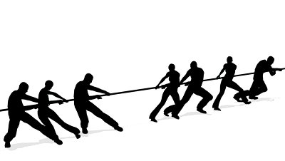
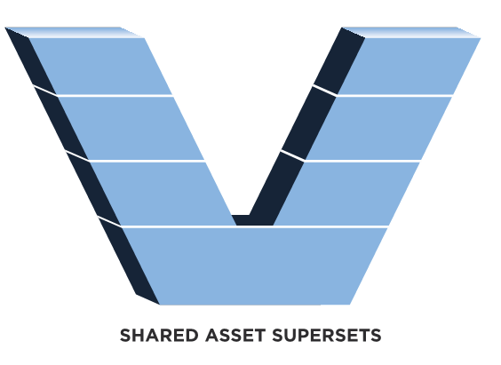
Introduction
Efficient use of resources is critical for any organization’s success
Total optimization is unachievable
Balance is achieved by empowering consolidation decisions at all levels within the organization
We analyzed decisions made within LT2 to understand the impacts to organizational value
Distribution Statement A. Approved for public release: distribution is unlimited

Slide 3
The Consolidation Problem
Lowest Portfolio Cost
Strategic Objectives
Balanced Portfolio
Individual Program Solutions
Shared Solutions
Program focused Execution
Clear value to program, clear path to objectives
Lowest Execution Cost
Distribution Statement A. Approved for public release: distribution is unlimited

Slide 4










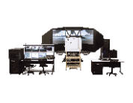
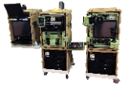

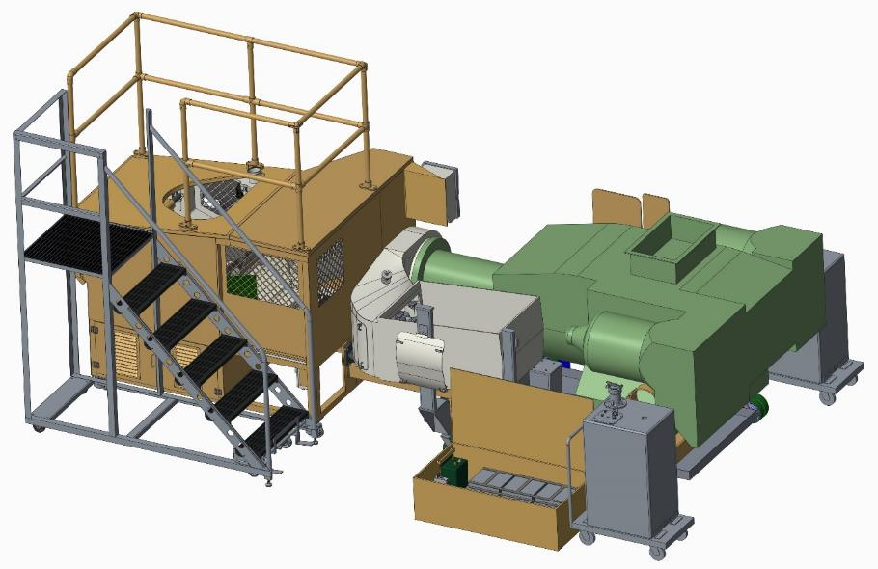
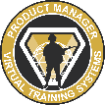

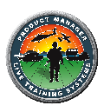

The LT2 Approach
PL FTS
Architectures
PLE
CPM Plus Oversight
LCPM Oversight
PdM VTS
Individual & Crew Skills
Driver, Operator, Gunnery, Maintainer Mobility, Lethality, Protection, Warrior Skills, Collective, Reconfigurable Virtual Collective Training
PdM CTIS
BDE Level Instrumentation; ExCon, Comms, MC, Data Mgmt & AAR; Instrumented Urban Operations; CTC and Home Station Instrumentation
PdM LTS
Combined Arms Engagement Pairing, Live Fire Ranges & Battlefield Effects, Force-on-Force, Force-on-Target,
OPFOR Threat Capabilities
PD FUTURE TRAINING SOLUTIONS
Product Line Management
TReX
Shared Assets & Architectures
Standards & Governance
Live STE
LT2/CPM Plus
Distribution Statement A. Approved for public release: distribution is unlimited

Slide 5
What is LT2
Live Training
600+ Ranges
At over
200 locations
$1 Billion
Cumulative cost avoidance for LT2
LT2 Products
22 Products
10.5M SLOC
Architectures
LTEC
CTIA 4
CTIA CN
FASIT
15 Labs
300+
Common Components and Services
4
5
Collaborative Development
300 Developers
Over 40
Agile Contracts (Delivery & Task Orders, OTAs and Independent Contracts)
OCONUS Developers
Korea
Germany
Hawaii
Alaska
Over 28
Contributor Organizations
Multiple physically connected locations
IDE (Primary Location)
Research Commons
Contractor Facilities and Labs
Distribution Statement A. Approved for public release: distribution is unlimited

Slide 6

Approach MOSA
Affordable & Adaptable
Open Systems
Principle 1
Principle 2
Principle 3
Principle 4
Principle 5
Establish Enabling
Environment
Employ Modular Design
Design
Key Interfaces
Use Open Standards
Certify Conformance
Establishing Supportive Requirements Strategies and Business Practices
Developing Architectures Based on Modular Design Tenants
Identifying Interfaces Impacting Performance, Cost, and Support
Using Consensus Based and Widely Supported Standards
Assuring Openness to Realize MOSA Benefits
Feasibility Analysis
Design for Change
Interface Management
Market Research
Verification & Validation
Well-Established MOSA Implementation Plan
NAVAIR’s Five Pillars of MOSA, the building blocks for affordable and adaptable open systems. (NAVAIR, 2023)
Standardized Systems Engineering Process
Integrated Product & Process Development
Distribution Statement A. Approved for public release: distribution is unlimited

Slide 7
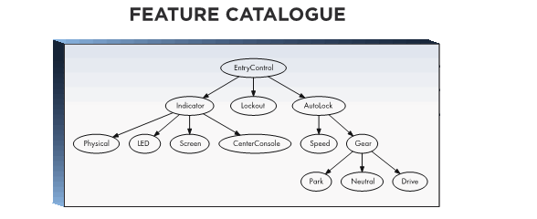
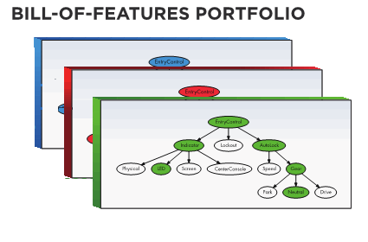
Approach Feature-Based (FB) Product Line Engineering (PLE)

Slide 8
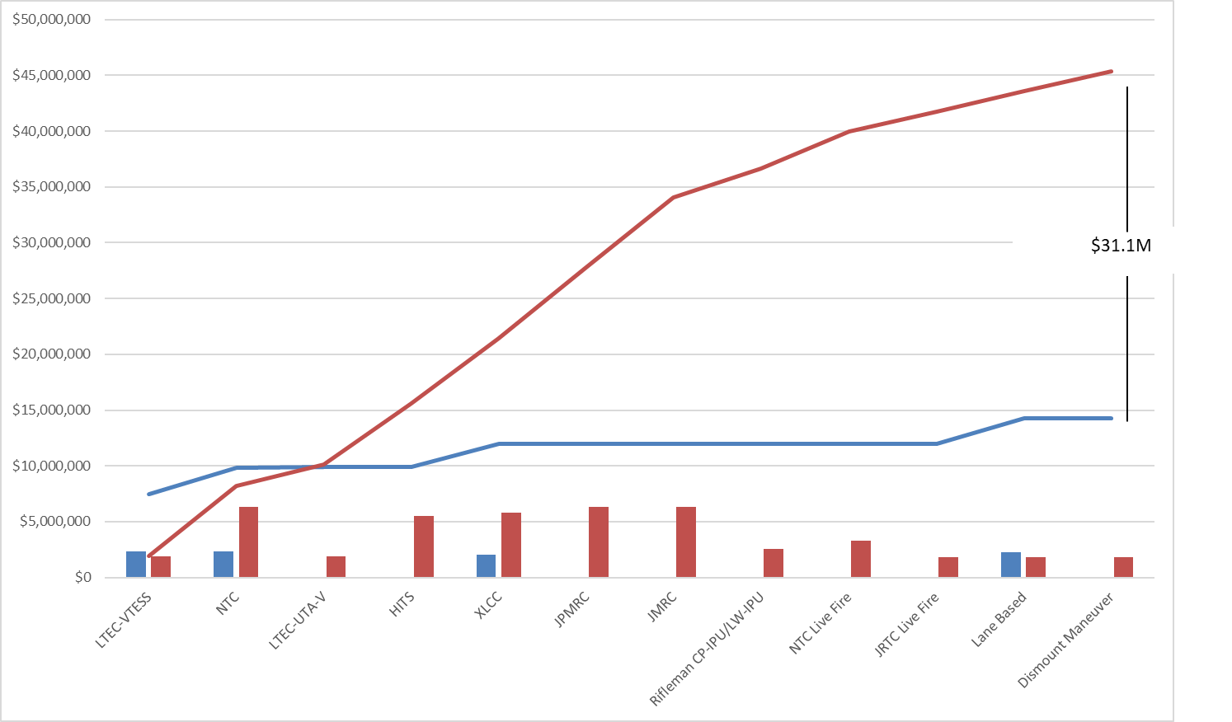
Measurement of Value
$31M PDSS Cost Avoidance
for fielded products in 2024
Distribution Statement A. Approved for public release: distribution is unlimited

Slide 9
Applying the Ansoff Matrix to Decision Making
New
MARKET DEVELOPMENT
DIVERSIFICATION
3
4
Test and Evaluation community
USMC Live Training
Markets
MARKET PENETRATION
PRODUCT DEVELOPMENT
Address obsolescence
New Features
1
2
Cyber Security
New Architecture
Fix Bugs
New Tools
Existing
Existing
Products
New
Distribution Statement A. Approved for public release: distribution is unlimited

Slide 10
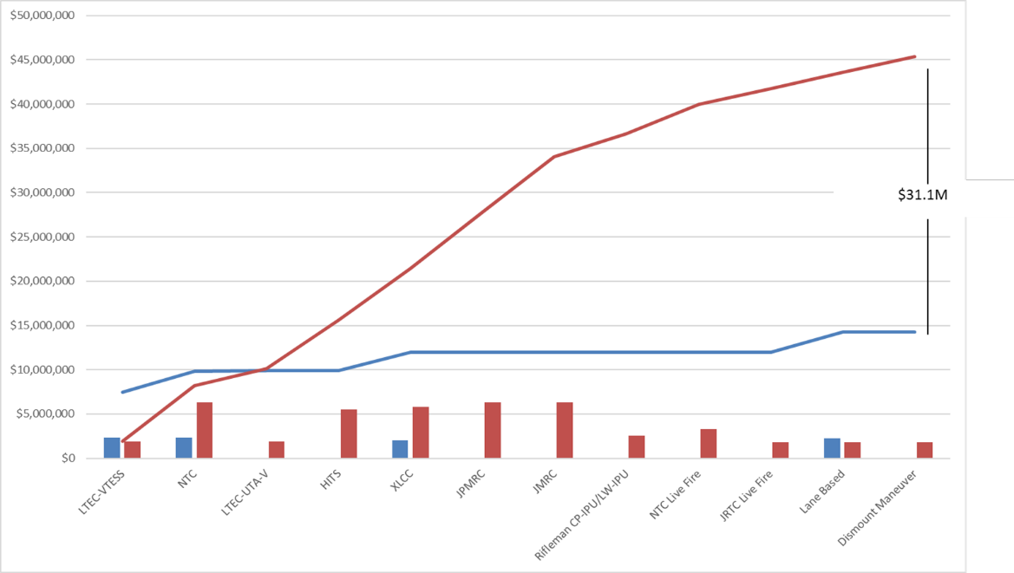
Evaluation Matrix
New
User
INVEST
IN USERS
AVOID
INVESTMENT
3
4
EXTREME VALUE
FB PLE
Markets
SUSTAIN
INVEST
IN TECH
1
2
Existing
User
Existing
Solution
New
Solution
Products
MOSA
Distribution Statement A. Approved for public release: distribution is unlimited

Slide 11

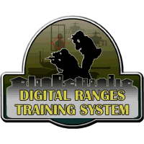

The Database Dilemma
HITS Team decision to replace Oracle RAC
Inputs from other teams influence design including recommendations to stay the course and use what works.
Collected needs form other teams for consideration when evaluating alternatives (performance, shared evolution needs, architecture changes).
Used PLE variation to isolate changes and permit concurrent database support by many services
Completion of PostgreSQL development
Communication to product line of results and deployment
Included recommendations for other teams if they wish to adopt the capacity with known gaps for other use cases.
Adoption by other teams
Expansion of shared capabilities to support new needs but at significantly reduced effort.
Already addressed some of the common need because of earlier discussions and feedback with HITS team.
4
3
1
2
Universal adoption – deprecate Oracle RAC
Included further development to meet larger use case, but at a fraction of the cost
Largest most complex use case (CTC) would likely have never justified the change due to risk, but after seeing results and feedback from the other products, the real risk was significantly lower than initially assessed.
Distribution Statement A. Approved for public release: distribution is unlimited

Slide 12
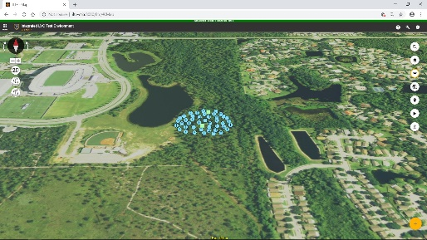
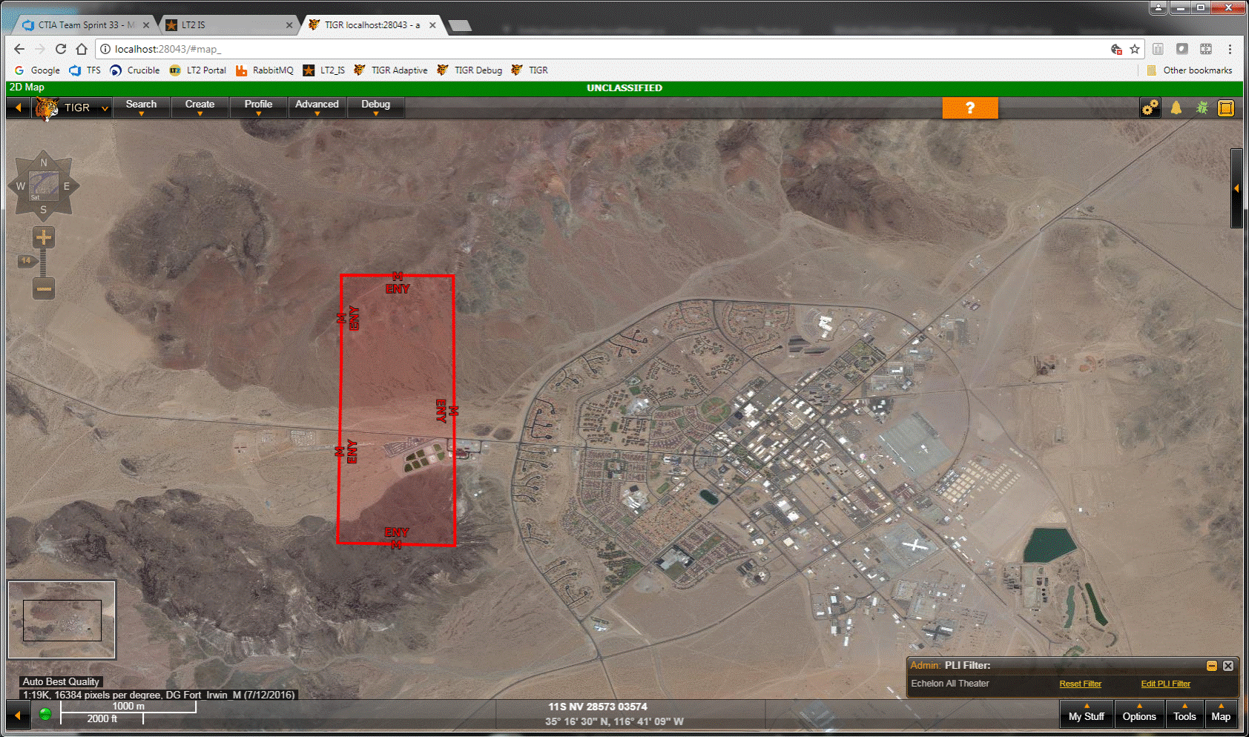
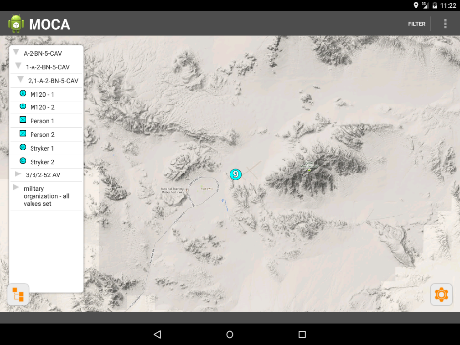
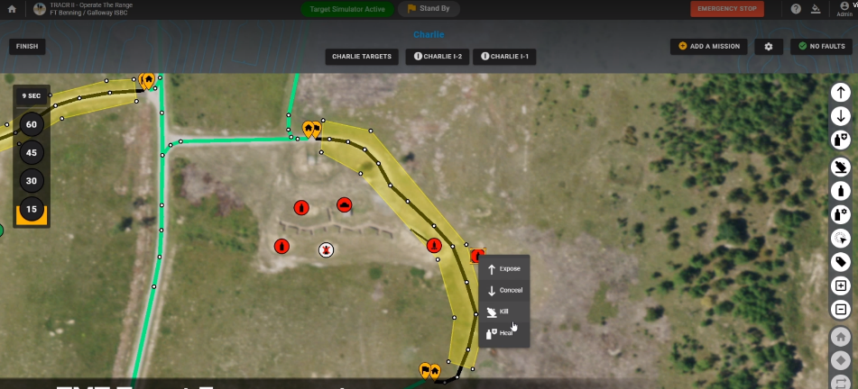
Geo-referenced Battlefield Map Viewers
EXCON Modernization
Edge Modernization
Frequent target for modernization
Multiple concurrent solutions are often supported in the product line
All users have an opinion about what right looks like
Highly context dependent, frequent change in small areas
Capabilities grow with continuous expansion and improvement based on user feedback. Creates a problem for replacing a large component with so many requirements.
The “Best” solution is often not the “right” solution for the product line
Doing “everything” is often different for the context of live training
Decomposed map into multiple smaller services to separate presentation from UI elements
Strategic decomposition for parallel development across teams
Allowed each team to field MVP of their individual needs that combined to support larger/more complex solutions with minimal extra effort (MVP were different on purpose)
Drove to extreme modularity in a single shared development environment and total visibility drives to solutions that are much closer to common while still maintaining unique product focus.
Falcon View
TCE
TIGR
MOCA
Canvas
NASA Web World Wind
GUI Framework
GUI Overlays
Decomposition
WWW 3D for CTC
Same
C2P0755
TIGR
MOCA
WWW 2D for FoT
Distribution Statement A. Approved for public release: distribution is unlimited

Slide 13
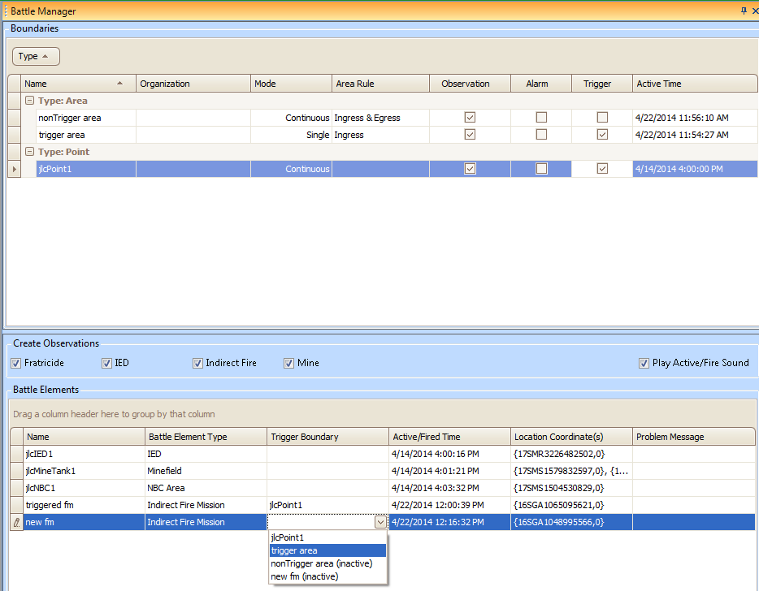
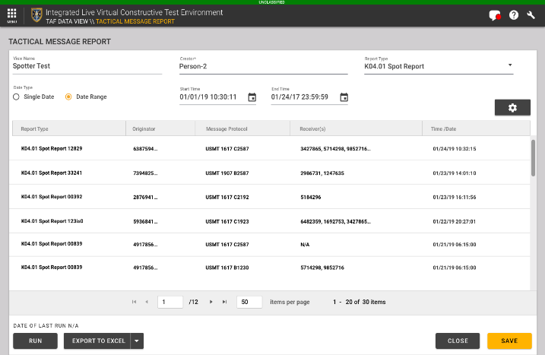
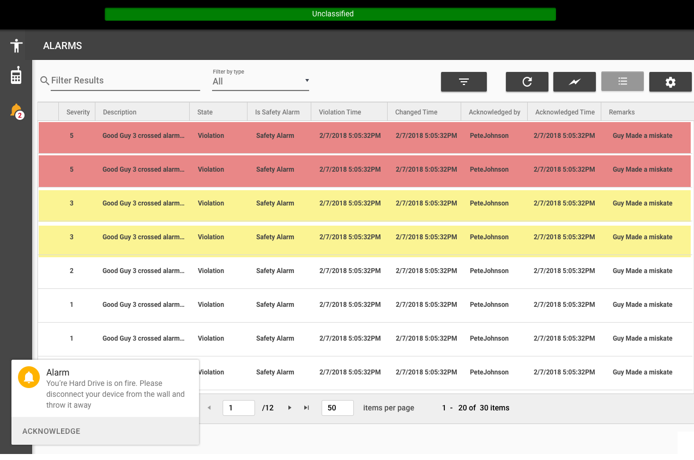
Alerts, Notifications, and Logs
One of many logging, alerts, alarms, troubleshooting tools
Commonality may not be evident until after it’s done and fielded
Especially true for bespoke engineering to satisfy unique user needs
Redundancy due to capabilities developed by programs to meet specific needs with no apparent overlap: event logging, safety alarms, entity location notifications, admin troubleshooting, historical database query tools
Growing usage of simple tools from engineering to admin and user tools
Capabilities expanded to support AAR artifact generation
Consolidation occurred during web-based service development
Genericized human readable, time based, logging and filtering tools
Started with a new MVP shared with the product line after analysis of current offerings
Expansion of capabilities improved usage after MVP based on individual product needs
There is value in allowing different users to deploy overlapping and redundant capabilities to satisfy user needs
Collaboration with full visibility of the portfolio and development efforts.
No team was forced into a solution, and all teams got what they wanted.
MVP
ARCH0485
Capability expansion by teams
Distribution Statement A. Approved for public release: distribution is unlimited

Slide 14
Conclusion
Err on the side innovation.
At best it will invite something needed at worst you gain experience
Change must be justified by a team with a need, so that development will be used by real users with real needs
Let success drive future adoption; do not mandate usage by others
Encourage open dialog between teams to broaden awareness before design/implementation
Innovative in manner that induces excitement and balances program risks
Decompose existing solutions to replacing them, and allow growth based on strategic investment, avoid “if you make it, they will come” type investments
Start with an MVP
Allow assets to grow over time
Gain consensus with the community early; foster co-developer support with shared objectives and goals
People want to help but they don’t want to be told what to do.
Give people choice and encourage them to bring innovative solutions that solve broader problems
Drive a culture of collaboration and inclusion to build on the work of others
Recognize that developers greatly over-estimate how much users will love their products
Distribution Statement A. Approved for public release: distribution is unlimited

