Slide 1



From Lab to Battlefield: Exploring the Relationship Between Military and Basic Science Tasks for Measuring Competencies
William (Liam) Stalker M.S., Summer Rebensky Ph.D.,
Ramisha Knight Ph.D., Shawn Turk, Samantha Perry Ph.D., Aptima, Inc.
Quintin Oliver, Winston “Wink” Bennett Ph.D., Air Force Research Laboratory
Notes:
Aptima and the GRILL logo comes from internally held files. AFRL logo comes from: https://spaceforcetechconnect.org/connections/afrl-afosr-funding-opportunities

Slide 2
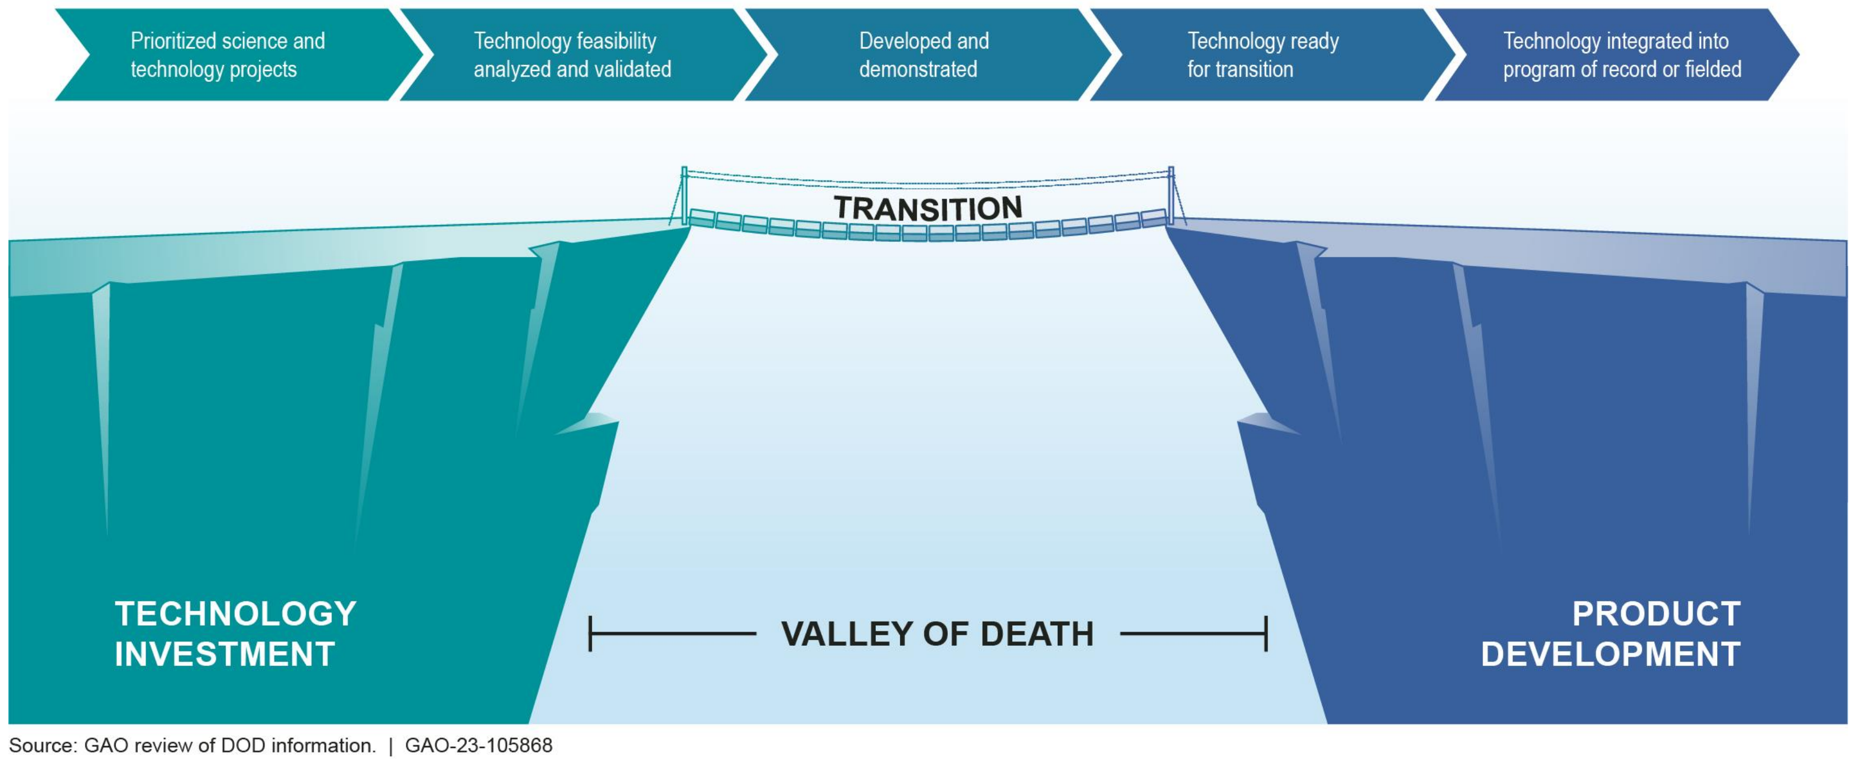
Valley of Death
As government and industry invests funding into developing training systems and competency measurement approaches, the importance of transferability of control study findings will be key to prevent the Valley of Death.
Notes:
Image obtained from:
https://www.gao.gov/assets/820/819139.pd
https://www.gao.gov/products/gao-23-105868f

Slide 3
Introduction
There is often difficulty translating results from basic laboratory research to an applied context.
Basic tasks, such as the n-back, do not often correlate closely to applied military cognitive tasks (Vine et al., 2020).
The present study:
Explores the transferability of a basic task, the n-back (Kirchner, 1958), to a domain relevant task dubbed Mission Relevant Audio Cue Task (MRACT).
Expands on an adaptive training system approach presented prior (Rebensky et al., 2022).
Further explores the relationship from basic science to military tasks for measuring cognitive constructs.

Slide 4
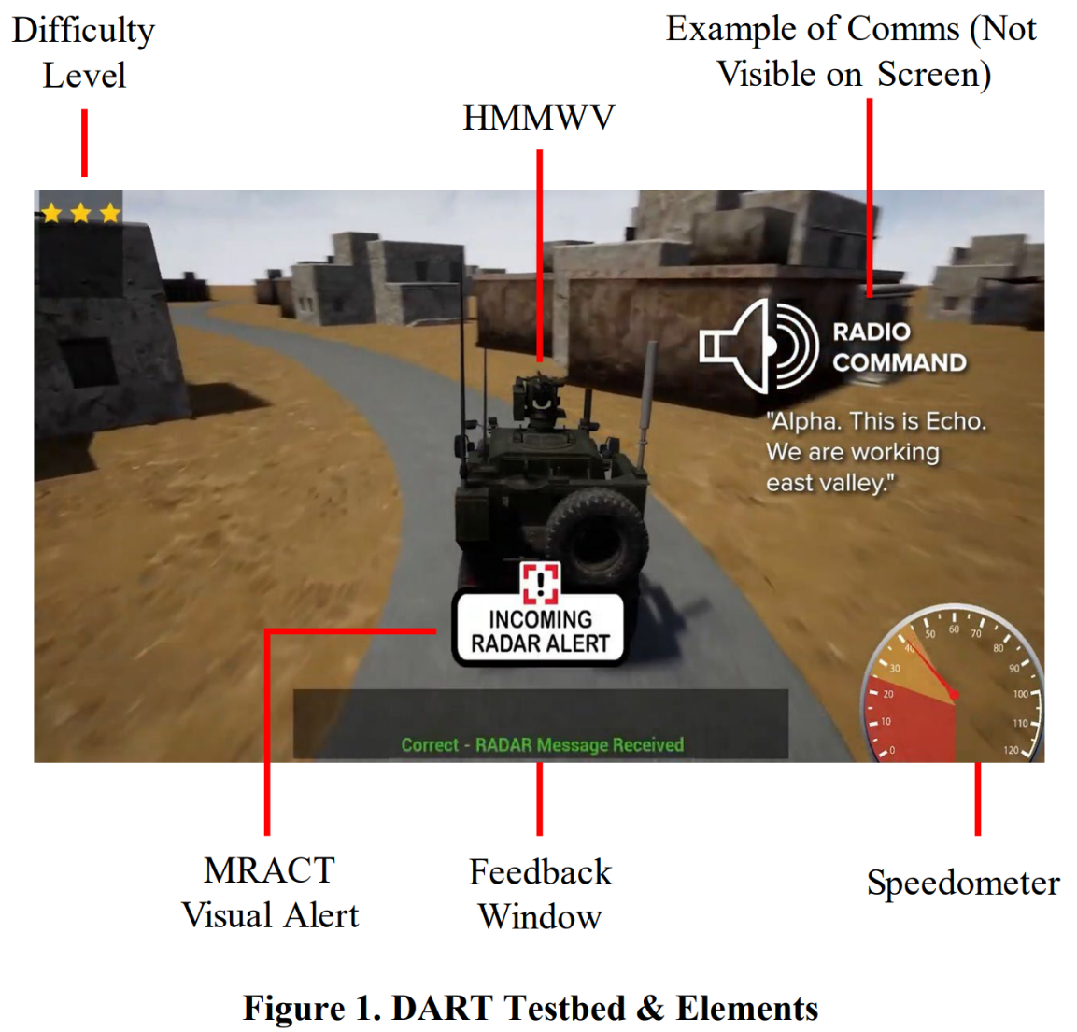
Experimental Testbed
Driving-based Adaptive Research Testbed (DART)
First theorized in Rebensky et al., 2022
Highlighted in Rebensky et al., 2023
Developed and hosted at the Gaming Research Integration for Learning Laboratory (GRILL®)
Adapts the difficulty of the task based on the user’s physiological state and their previous performance.
Notes:
Image is a screenshot of the simulator built for this research

Slide 5
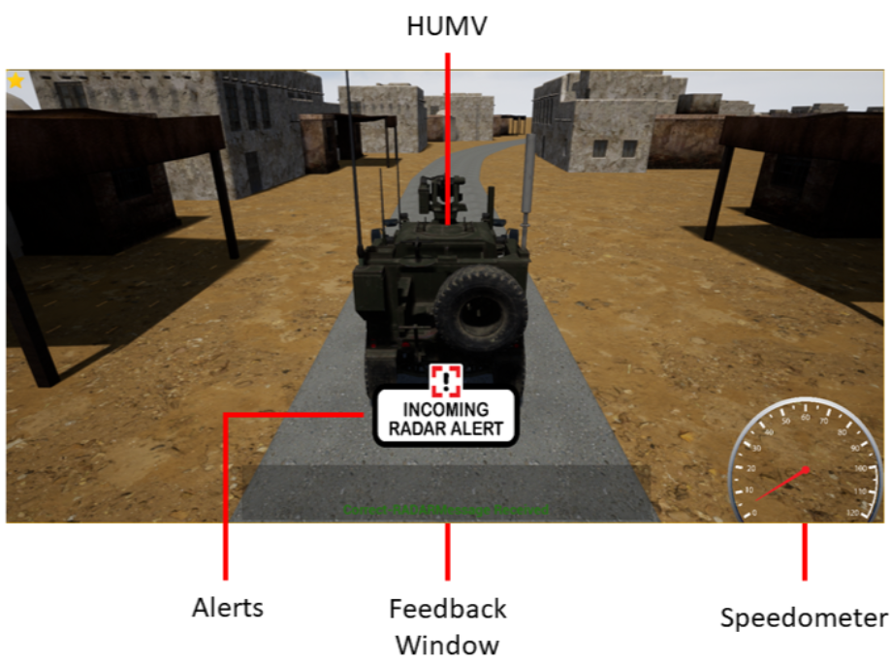
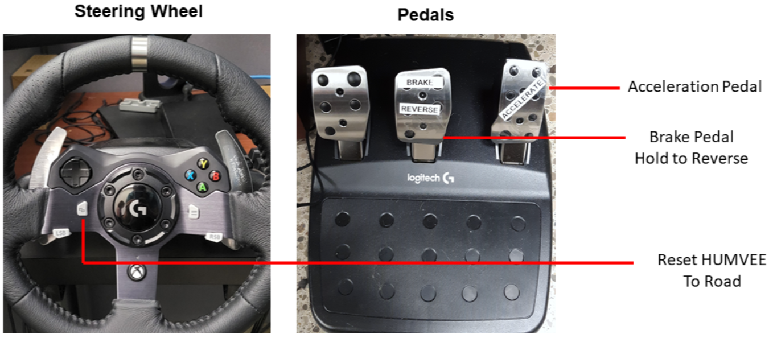
Methodology
Tasks Performed:
Driving: Maintain a moderate speed while staying on the road.
Notes:
Image is a screenshot of the simulator built for this research and the training materials used

Slide 6
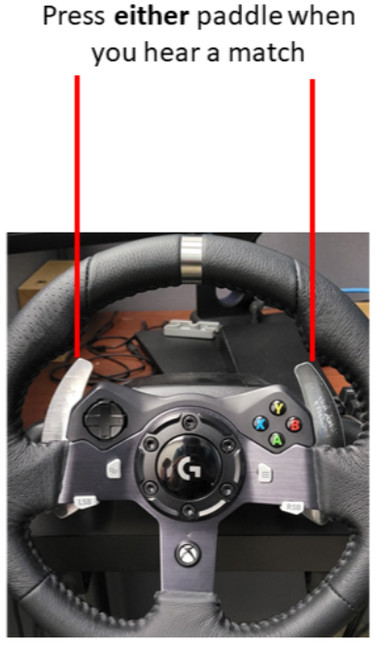
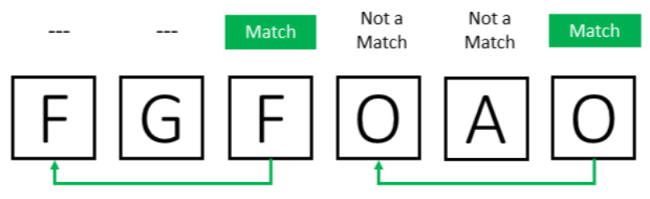
Methodology
Tasks Performed:
Auditory n-back: A working memory task where users indicate when the letter matches 2 letters back.
Letters: L, O, R, W, F, D, G, A, Q, Y
Feedback when you press a paddle:
When you miss a match: Miss – Letters were a match
When there was not a match: Wrong – Letters were not a match
When there is a match: Correct – Letters were a match
Notes:
Image is a screenshot of the training slides used in this research

Slide 7
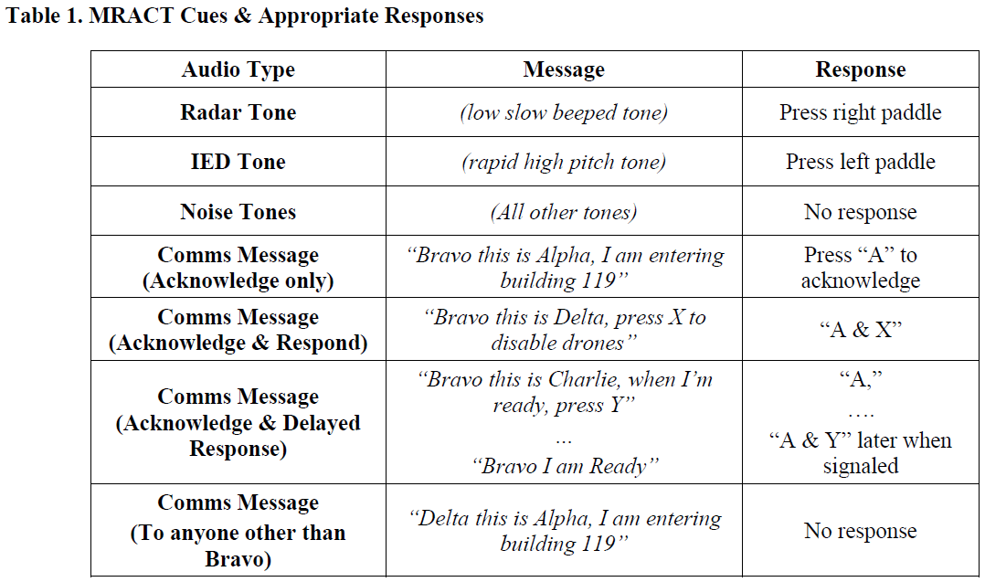
Methodology
Tasks Performed:
Mission Relevant Auditory Cues Task (MRACT): A working memory task where users are provided a mix of:
(a) Auditory Tones (beeps) that signaled that an immediate input was needed.
(b) Radio Communications that explicitly asked for an input, sometimes immediately or sometimes after a brief delay.

Slide 8
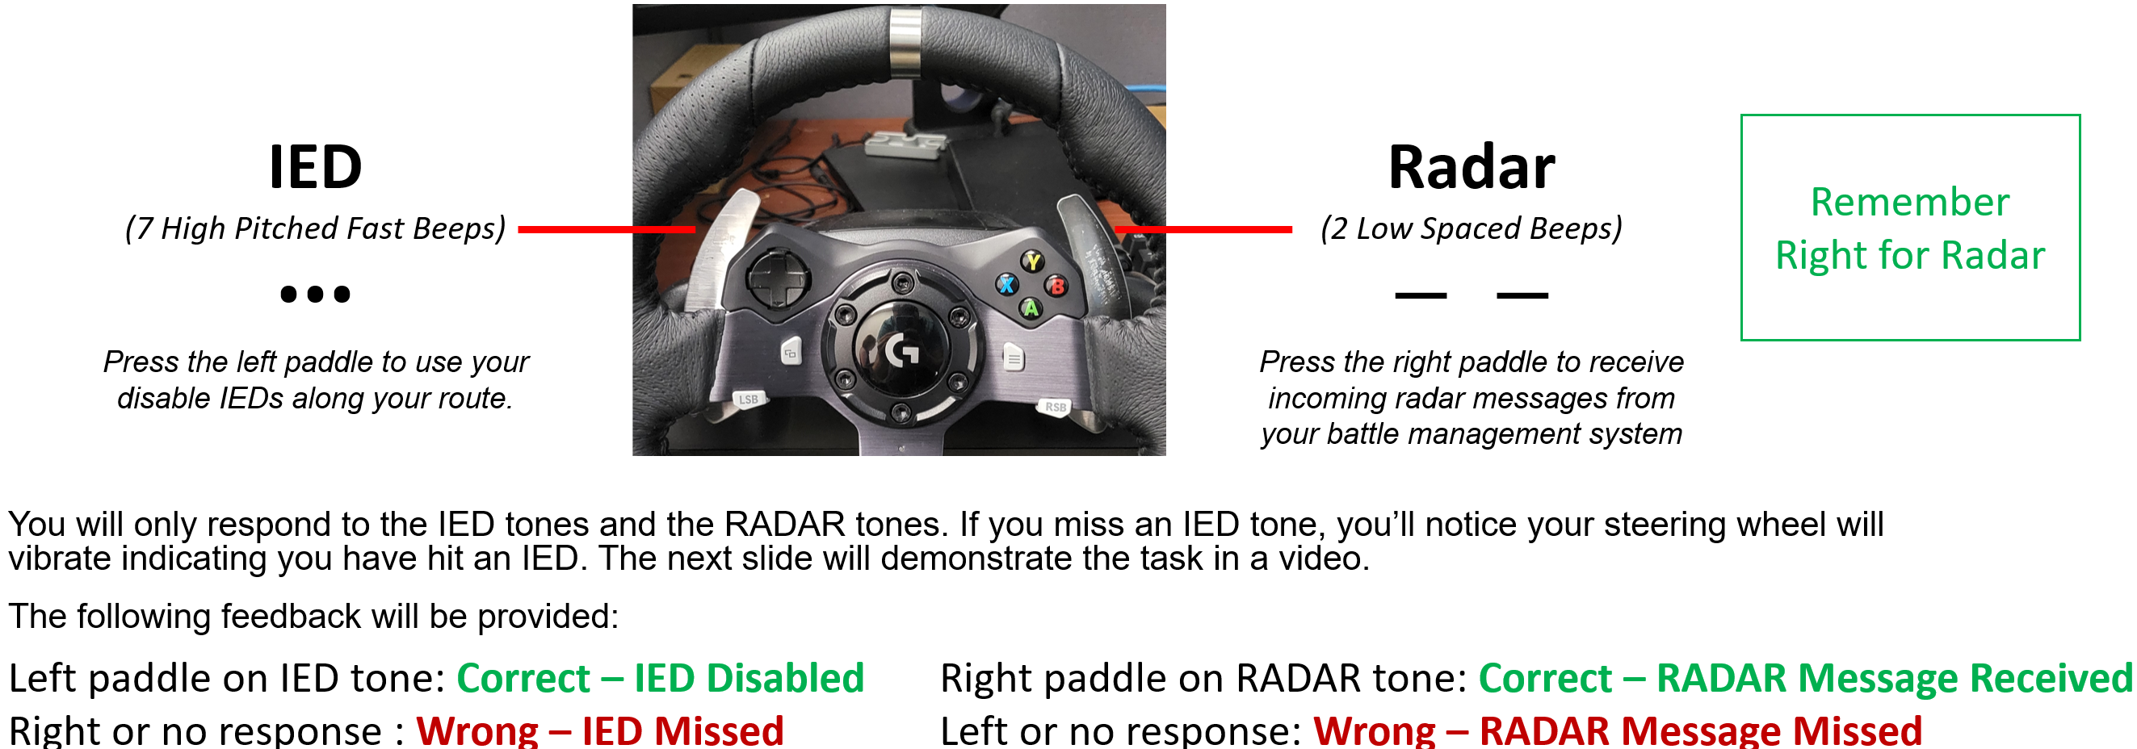
Methodology
Tasks Performed:
Mission Relevant Auditory Cues Task (MRACT): (a) Auditory Tones (beeps)
Notes:
Image is a screenshot of the training slides used in this research

Slide 9
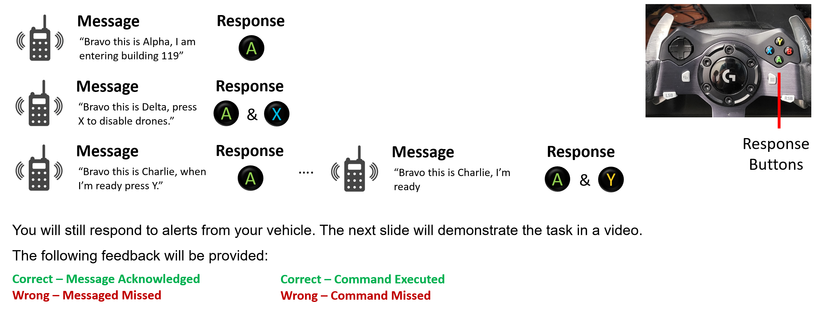
Methodology
Tasks Performed:
Mission Relevant Auditory Cues Task (MRACT): (b) Radio Communications
Notes:
Image is a screenshot of the training slides used in this research

Slide 10


Results
Analyses were conducted to determine the impact of task type (n-back vs MRACT) and level of difficulty (Easy, Medium, Hard) across:
Behavioral performance measures
Average MPH, Times Off Road, Resets, and Accuracy
Physiological measures
fNIRS HbO2, fNIRS HbD, Heart Rate
NASA-TLX
Task
Difficulty
Task + Difficulty

Slide 11
Results – Task
Multiple variables were significantly different related to task, meaning the variables differed between n-back and MRACT, including:
Average MPH
Times Off Road*
Number of Road Resets**
Percent Correct**
Polar HR
fNIRS HBD
fNIRS HBO2
NASA TLX*
**p < 0.05
**p < 0.001
Task

Slide 12
Results – Difficulty
Both fNIRS HBD and HBO2 were statistically significantly impacted by difficulty with no significant difference for task nor an interaction effect.
Polar HR
fNIRS HBD**
fNIRS HBO2**
TLX
Regarding behavioral performance measures, Average MPH and Times Off Road were also statistically significant related to difficulty.
Average MPH**
Times Off Road**
Road Resets
Percent Correct
**p < 0.05
**p < 0.001
Difficulty

Slide 13
Results – Task + Difficulty
Average MPH and Number of Resets both showed interaction effects between task and difficulty level
Average MPH*
Times Off Road
Road Resets*
Percent Correct
Polar HR
fNIRS HBD
fNIRS HBO2
TLX
Task + Difficulty
**p < 0.05
**p < 0.001

Slide 14
Discussion
The measures that are impacted by difficulty but not by task include fNIRS data and two of the selected behavioral performance measures (Average MPH & Times Off Road).
Task
Difficulty
Task + Difficulty
Average MPH Average MPH Average MPH
Times Off Road Times Off Road Times Off Road
Resets Resets Resets
Percent Correct Percent Correct Percent Correct
Polar HR Polar HR Polar HR
fNIRS HBD fNIRS HBD fNIRS HBD
fNIRS HBO2 fNIRS HBO2 fNIRS HBO2
NASA TLX NASA TLX NASA TLX
This suggests that fNIRS (HBD and HBO2) may be an ideal candidate that translates from the laboratory to an applied operational setting.

Slide 15








Discussion – Limitations
Multiple significant correlations with task and study design despite attempts to limit them.
NASA TLX, Percent Correct, Times Off Road, and number of Road Resets were statistically significantly impacted by the type of task due to:
Perceptions of difficulty
Tasks with more components are subjectively perceived as more difficult than tasks with less components even when performance is comparable.
Slight variations in the structure of task
How performance is scored
Response modality
Differences in adaptation interventions

Slide 16




Discussion – Limitations
HR was non-significant.
This finding conflicts with past research detailing a linked relationship between the construct of mental workload and various heart related measures (Mehler et al., 2009).
Heart rate is likely sensitive to these independent variables but is too diluted from noise caused by other factors.
Heart rate can be impacted by many different things including factors external to the experiment like outside clamor and prior stimulant use, and internal factors such as perceived stress and the shaking of the steering wheel.
Δ

Slide 17


Discussion – Our Future Directions
1. Exploring whether the significant measures continue to generalize:
Ex: fNIRS measures and select task environment measures
2. Investigating other physiological metrics:
Ex: More temporally sensitive heart rate measures, isolating the impact of extraneous factors on heart rate
3. Designing operationally relevant tasks and adaptations:
Ex: Incorporating realistic adaptations to operational missions (e.g., obstacles moving into the road)

Slide 18
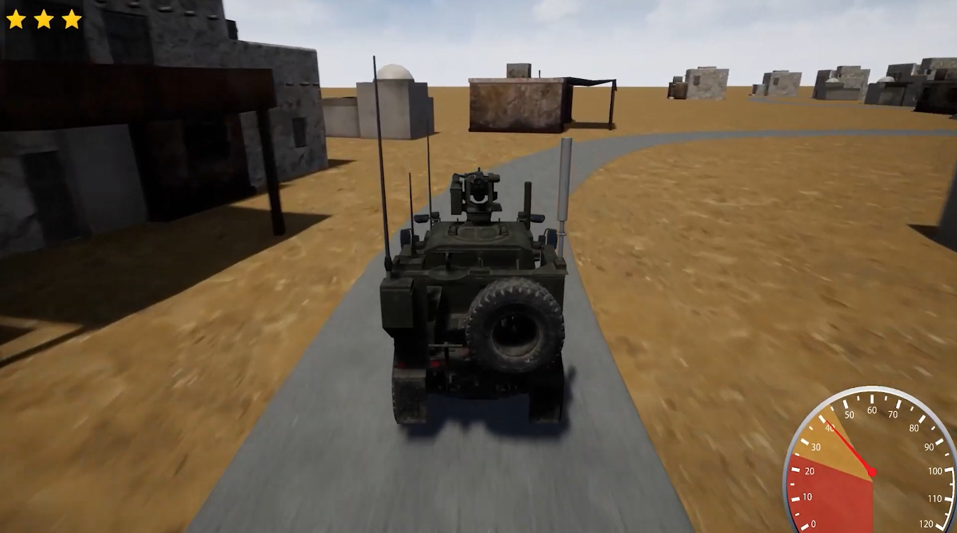
Conclusion & Takeaways
The transition from academic research to practical applications can be challenging due to the noticeable discrepancies between controlled laboratory experiments and real-world operational settings.
Physiological and behavioral measures showed value when transitioned from basic research tasks to more applied tasks.
However, many variables were impacted by the task designs themselves.
Notes:
Image is a screenshot of the simulator built for this research.

Slide 19


Implications
Industry Related Implications
An experimental task is unlikely to escape the Valley of Death if it is not designed with the real-world in mind.
Suggestion: Design mission relevant versions of basic lab tasks and conduct comparisons to help advocate for the value and principles of the founding approach.
DOD Related Implications
Be critical of solutions developed in unrepresentative environments.
Suggestion: Help industry shape representative tasks and datasets at unclassed levels to increase the likelihood of traversing the Valley of Death.

Slide 20

Questions?
Acknowledgement: This work was supported by the Air Force Research Laboratory (AFRL) 711th Human Performance Wing (HPW/RHW) Gaming Research Integration for Learning Laboratory (GRILL).

