Slide 1


Advancing Early Intervention Strategies
Leveraging Shorter xAPI Data Sequences with LSTM for At-Risk Student Detection
Presenters: Paul Jesukiewicz Powertrain Inc. Hyattsville, MD
James Bilitski, Ph.D., University of Pittsburgh at Johnstown, PA

Slide 2

Problem Statement
Managing large student populations in online education is challenging.
Detecting at-risk students early can improve outcomes.

Slide 3
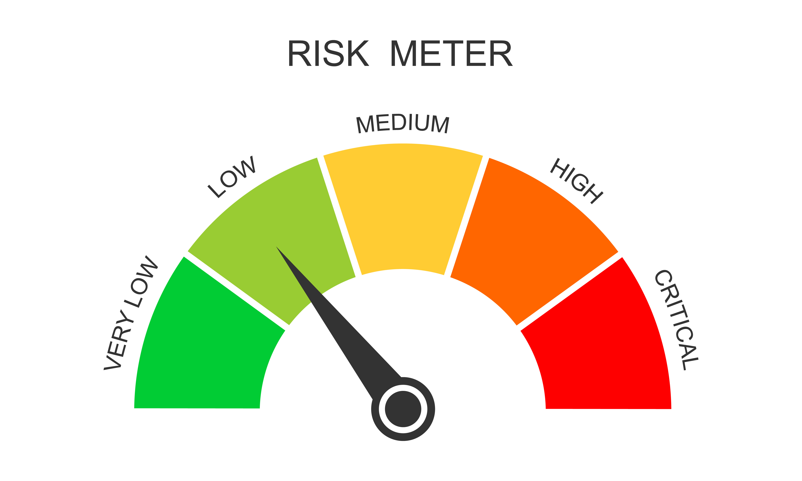
Objective
To enhance our previous model and enable earlier detection of student risk, allowing for quicker interventions.

Slide 4
Dataset Overview
Data Source:
Over 18 million xAPI statements from DCSA spanning 3 years.
Data Points:
Captures student interactions with Learning Management Systems (LMS), assessments, and online courses.
Key Terms
xAPI (Experience API): A data format that captures learning activities.
LSTM (Long Short-Term Memory): A type of neural network used for analyzing sequences of data.

Slide 5
xAPI Verb Examples
"Viewed": Looked at course material.
"Responded": Answered a question.
"Completed": Finished a task.
"Scored": Received a score.

Slide 6
Sequences
Student 1
Viewed, Viewed, Viewed, Responded, ……. Viewed, Completed, Scored
Student 2
Viewed, Viewed,, Responded, …….. Viewed, Completed, Scored
Sequence Length
Number of verbs between assessments.
Longer sequence lengths signify longer

Slide 7
Detect Risk and Intervene
Step 1: Detect Risk
Step 2: Intervene

Slide 8

Detect Risk

Slide 9

Detect Risk

Slide 10

Detect Risk

Slide 11

Detect Risk

Slide 12

Goal: Detect Risk Earlier

Slide 13
Detect Risk and Intervene
Step 1: Detect Risk
Step 2: Intervene

Slide 14
Challenges with Long Sequences
2023 Model: Used sequences of 100 xAPI events.
More data means more time to identify at-risk students.
Issue: Interventions may be too late if we wait for 100 interactions.
Goal: Can we predict risk with shorter sequences?

Slide 15
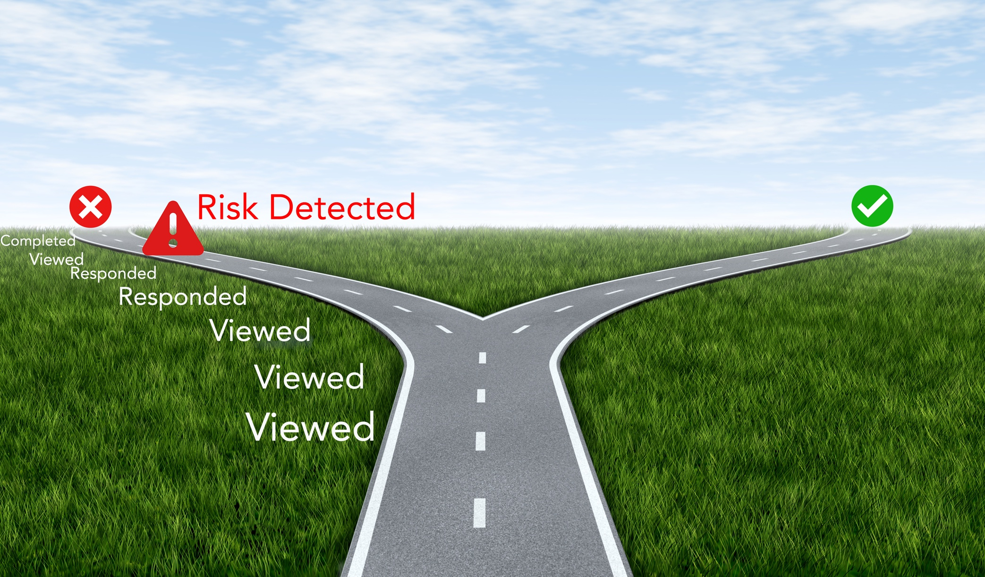
2023 Risk Detection Model

Slide 16
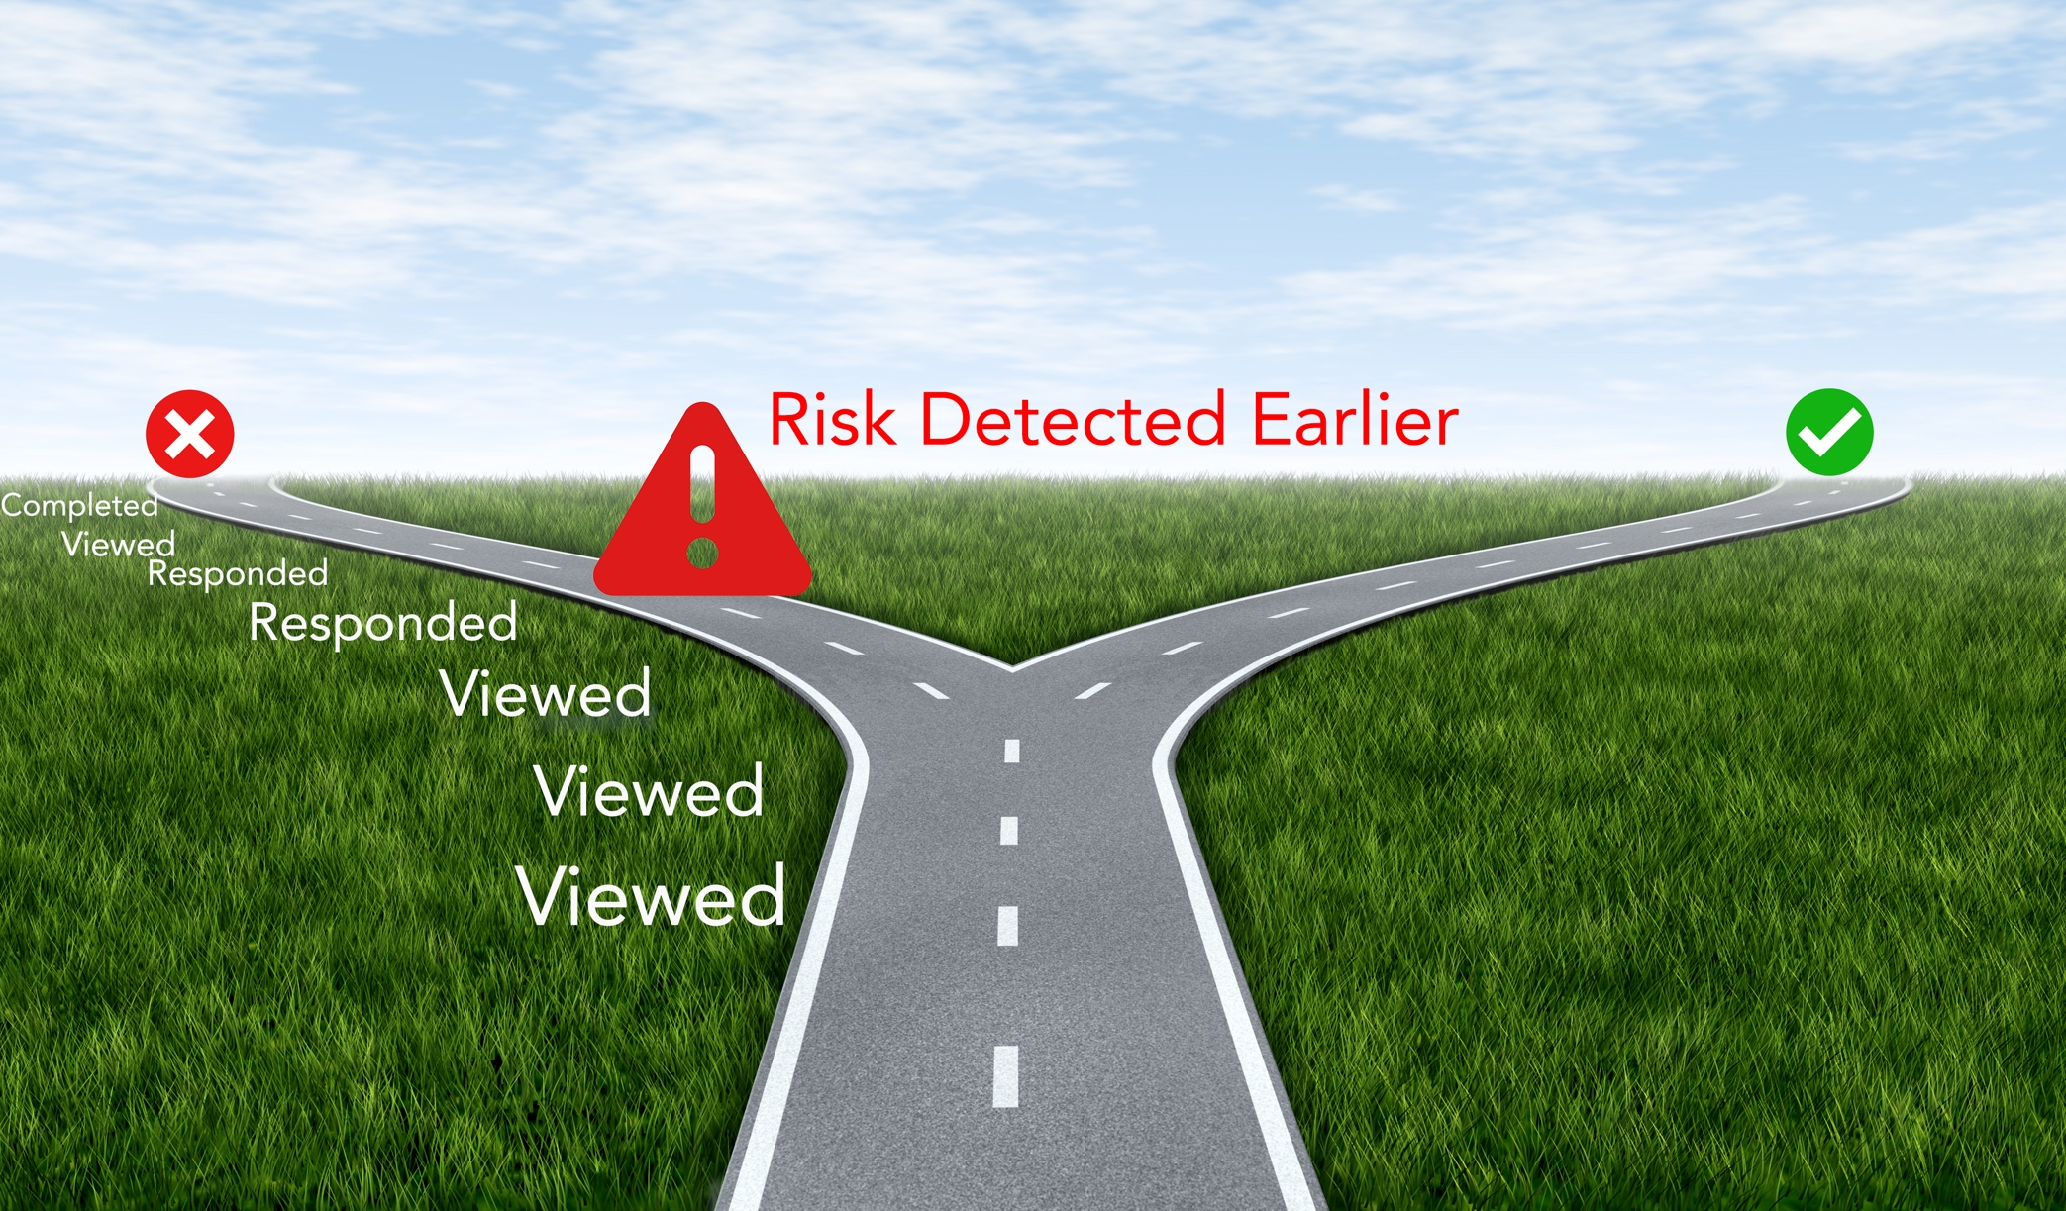
2024 Improved Risk Detection Model

Slide 17
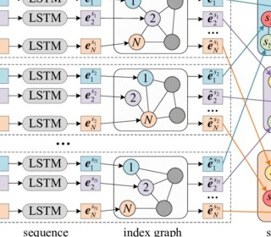
Model for Predicting Risk
Long Short-Term Memory (LSTM) networks are a type of neural network designed to handle sequences of data.
Ordered sequence of data: Initialized, Viewed, Viewed, Responded, …
The network “remembers” important events and patterns (like failing a quiz or logging in frequently) to predict student outcomes.

Slide 18
Risk Models
Our 2023 model introduced the model for prediction and showed feasibility in using a model of predicting risk.
Our 2024 model improved the performance and used shorter sequences allowing for earlier intervention.

Slide 19
2024 Model Design
Eight Hidden Layers of Size 50
Deeper networks with more layers allow for extracting complex features
Wider networks allow for capture complex relationship in the inputs
Experimentation: Vary sequence length and monitor learning behavior

Slide 20
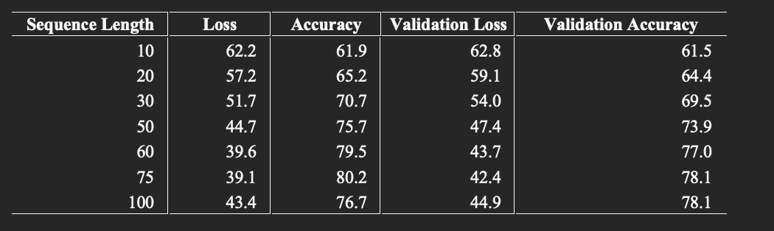
Improving with Shorter Sequences
Sequences as short as 60-75 xAPI events provide nearly the same accuracy (78%) as longer sequences.
Model shows ability to generalize without overfitting as training and validation data are similar.

Slide 21
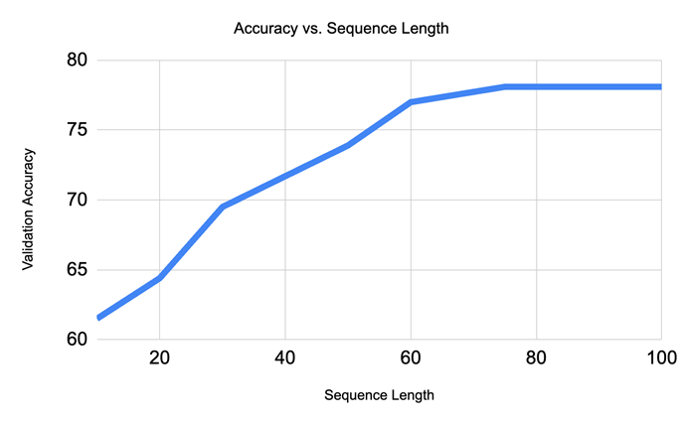
Detect Risk Sooner
Accuracy begins a stead decline around a length of 60.
Sequence length of 60 has similar accuracy to sequence length of 100
Detect risk 40% sooner than 2023 model

Slide 22
Real-World Impact
With shorter sequences, we can detect risk sooner and intervene faster.
This means better outcomes for students, who receive support before it’s too late.

Slide 23
Summary
Early Risk Detection: The model allows for earlier identification of at-risk students using shorter xAPI sequences, enabling timely interventions with minimal loss of accuracy.

Slide 24
Next Steps
Tested with Real Data: The model was evaluated using actual production data, ensuring its relevance in real-world settings.
No Simulated Data: Predictions are based on genuine student interactions, not hypothetical scenarios. Next Steps:
Integrate into Production: Successfully tested with real data, making the model suitable for deployment in production environments.
Immediate Impact: Start identifying at-risk students and supporting timely interventions right away.

