Slide 1


Mastering Digital Twins: Introducing ABoT for Cross-Disciplinary Simulation and Model-Based System Engineering
Scott James/Noblis
Pat Meharg/Noblis
Andrew Dudash/Noblis
Visit noblis.org

Slide 2
What is a Digital Twin?
Digital Twin Consortium:
A digital twin is a virtual representation of real-world entities and processes, synchronized at a specified frequency and fidelity. Digital twins are motivated by outcomes, tailored to use cases, powered by integration, built on data, and guided by domain knowledge
Rephrased:
Digital Twins are living companions to real systems whose primary purpose is to answer meaningful questions about the past, current and future functioning of their twinned, real-world system.

Slide 3
What is ABoT
The Authoritative Broker of Truth (ABoT) is a tool agnostic paradigm for building, maintaining, utilizing and evolving a Digital Twin

Slide 4
Why ABoT?
Wanted a paradigm which is
Simple
Tool Agnostic
Cross SME Domain
Used throughout full life cycle
… and by that we mean with a time horizon of forever, or at least as long lasting as the Real System

Slide 5
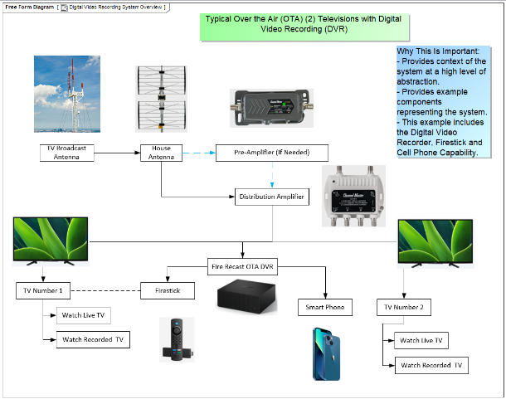
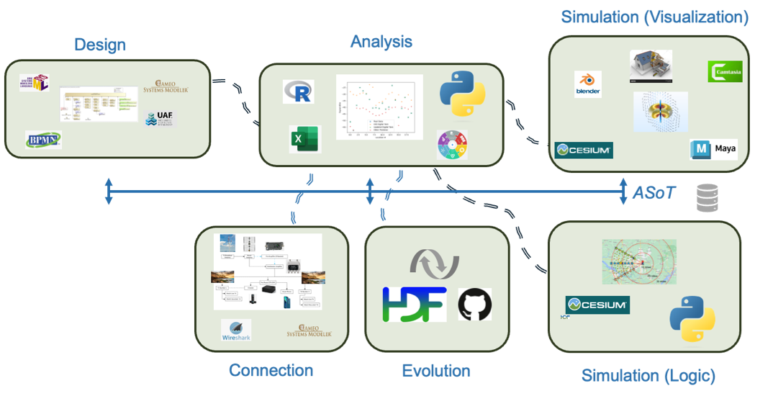
Use Case: Cut The Cord
Over-the-air television is available in most areas of the United States, providing free television through antennas.
Use ABoT to create a Digital Twin tracking RF reception for these OTA channels within a selected area

Slide 6
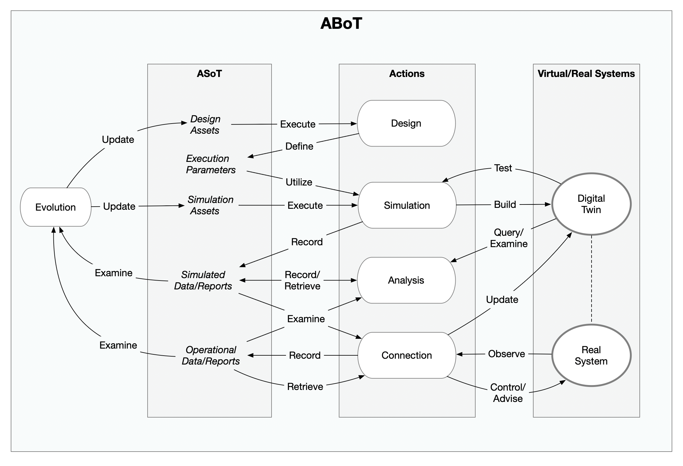
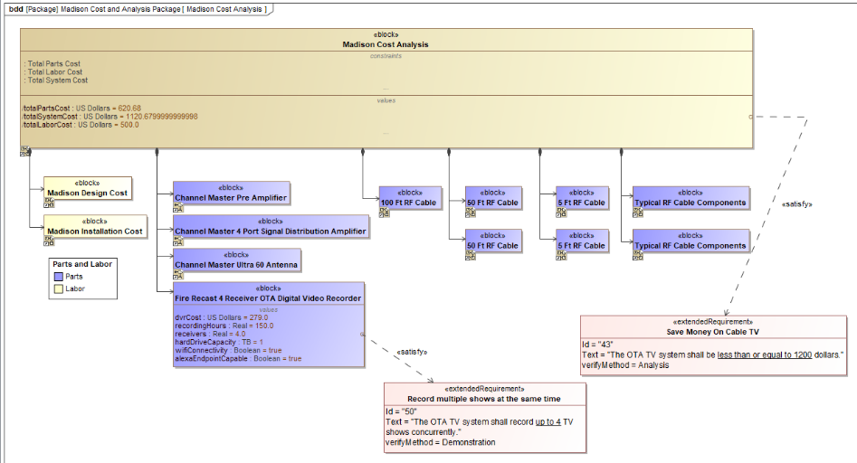
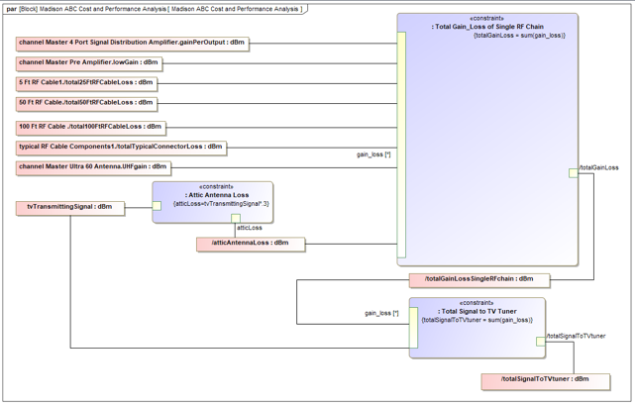
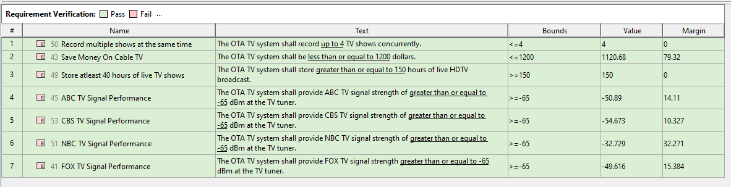
Design
BDD (Figure 10) was used to identify the components of the system including antennas
Design incorporated all nine diagrams of the SysML modeling language, including:
REQ: capture reason why the customer may be interested in an over-the-air TV antenna system
BDD: identify the components of the system, including antennas
PAR: predict the RF energy levels at geographical locations within the TV viewing area
Design provides parameters for the Simulation

Slide 7
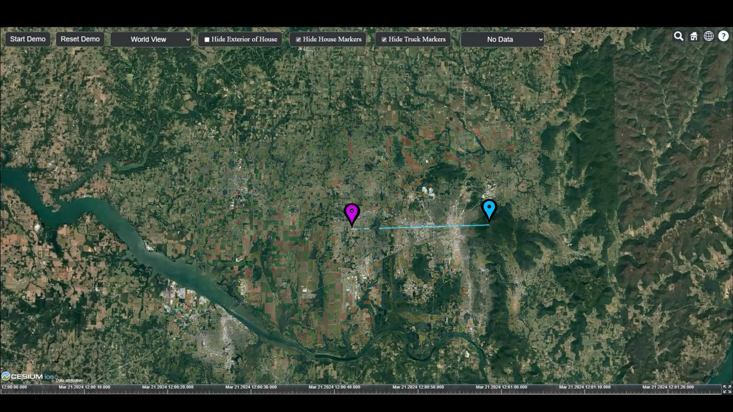
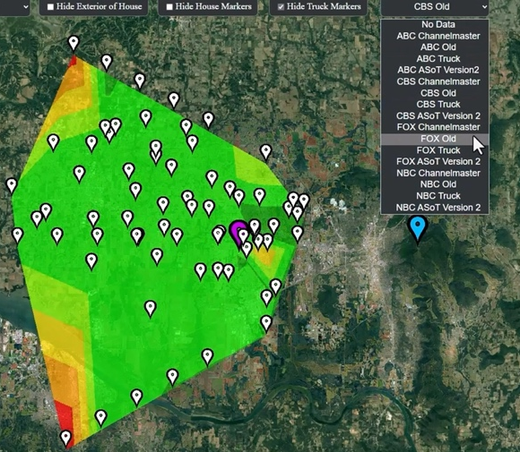
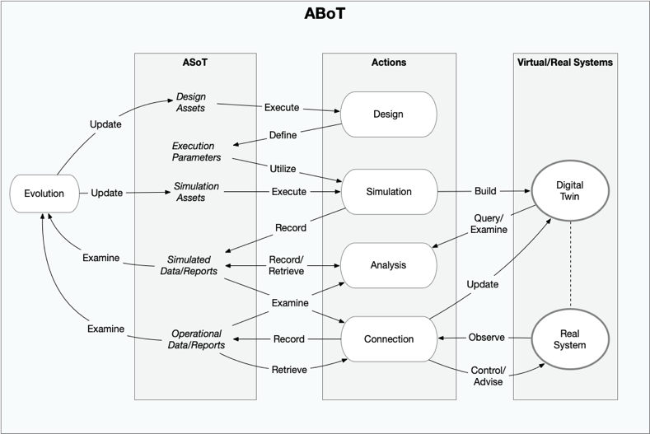
Simulation
From Design parameters generate signal strength map
Leverage Cesium to create an interactive display capable of browsing 2D/3D environment and filtering by reception channel

Slide 8
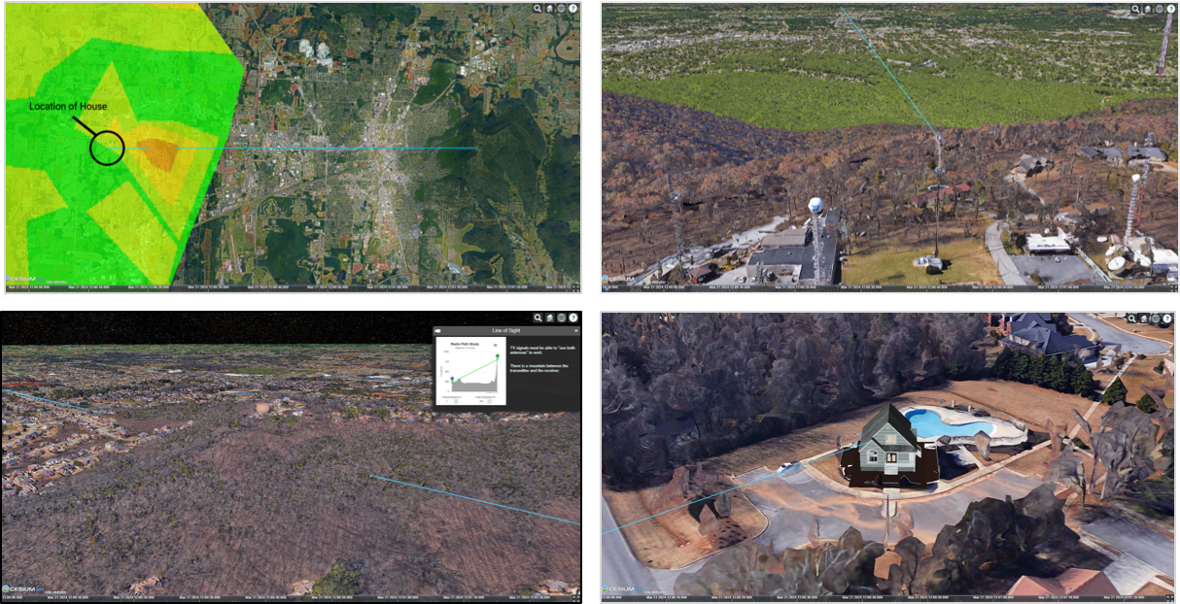
Analysis
A stakeholder in Huntsville, AL wants to determine if they can replace their cable television with television transmission
Entering their home coordinates, the stakeholder finds that the signal strength at their house is borderline
Exploring the area with the simulation application they discover that a mountain (Rainbow Mountain) blocked the line of sight between the transmitter and house
… but they would like to be convinced they really need extra hardware

Slide 9
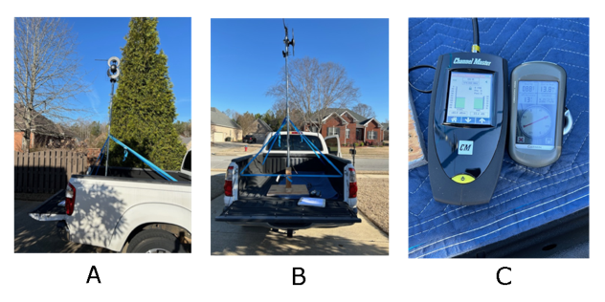
Connection
Collect additional RF data using
Mobile antenna platform
Hand-held GPS
Pickup truck
Drive test rig to different locations to obtain new measurements

Slide 10
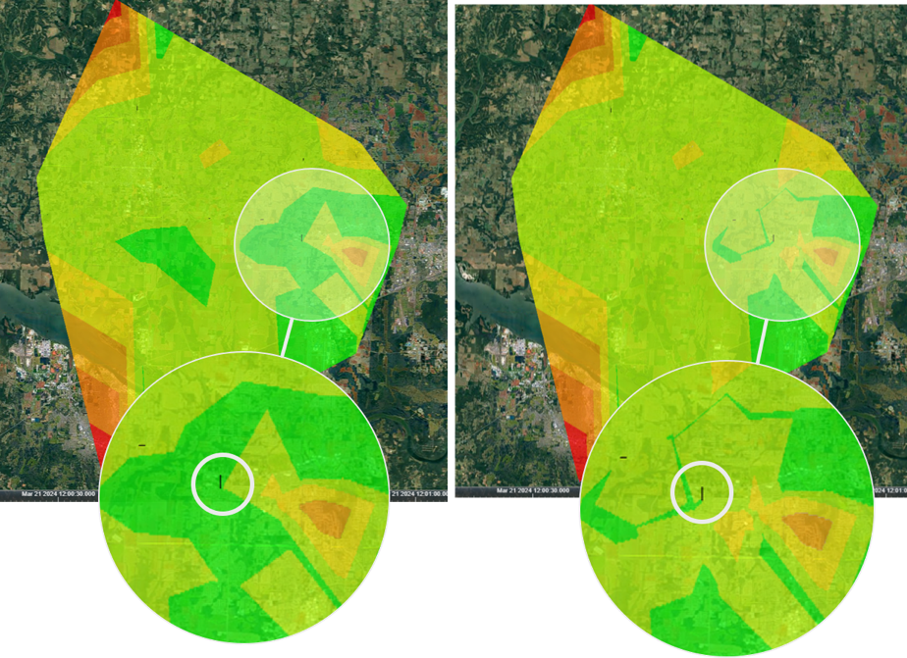
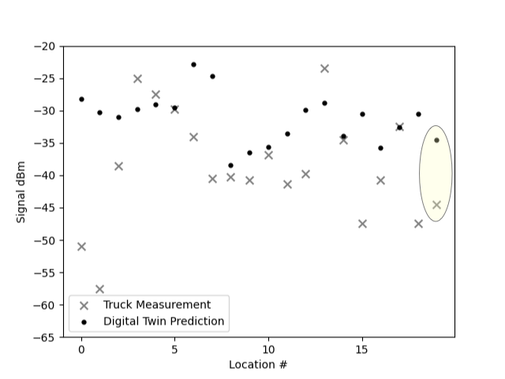
Evolution
Examining the physical RF measurement at the stakeholder’s house (yellow highlight) we see that the actual measurement was lower than predicted, thus confirming the need for an amplifier
The new physical measurements are added to the ASoT and incorporated as the basis for the simulation and the next version of the digital twin

Slide 11
Questions?

