Slide 1
Training in the future, and how to get there
Caroline Shawl, Defence Science and Technology Laboratory, UK
Daran Crush, QinetiQ, UK
The contents include material subject to © Crown copyright (2024), Dstl. This information is licensed under the Open Government Licence v3.0. To view this licence, visit https://www.nationalarchives.gov.uk/doc/open-government-licence/ . Where we have identified any third party copyright information you will need to obtain permission from the copyright holders concerned. Any enquiries regarding this publication should be sent to: Dstl.
Notes:
Caroline

Slide 2

So it begins
The challenge:
Defence is provided with evidence-based advice and recommendations that accelerate the adoption and use of emerging / radical / novel concepts and approaches that enable GAN Defence Learning approaches.
Notes:
Caroline

Slide 3

Predicting the Future
Future Learner | Future Operating Environment | Learning Ecosystem
Scenario Generation
Building on Research
Range of Futures
Potential Trajectories
Notes:
Caroline

Slide 4
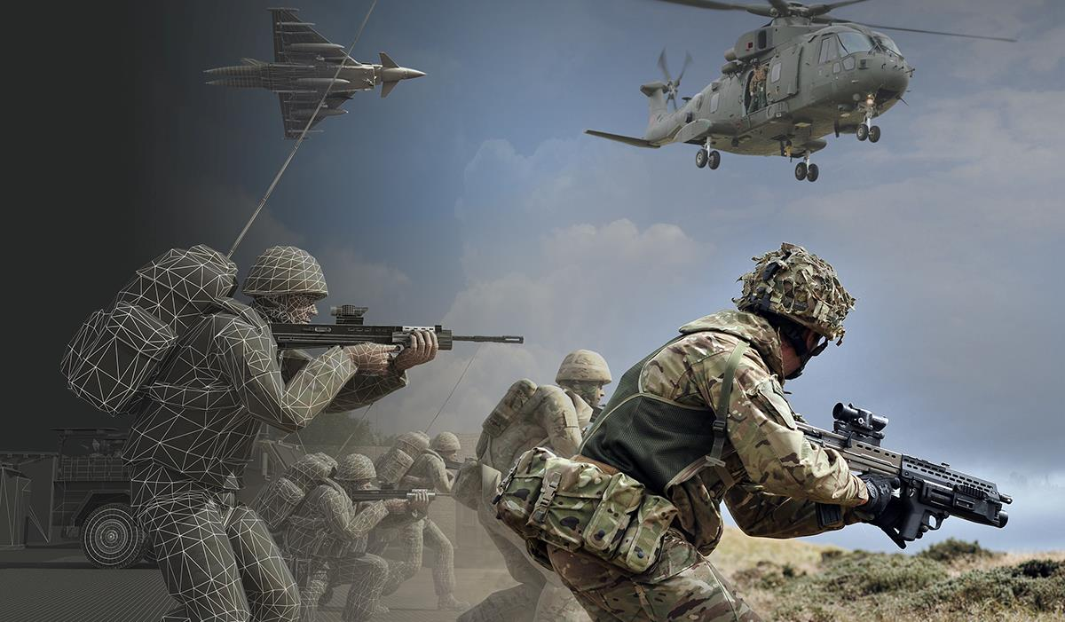



Teamwork
SSE52 Task61a Learning Futures
Learning Futures Development Scenarios (D61a-2)
QinetiQ
D3A Defence
Vedette
VEDETTE
Notes:
Caroline
My thanks must go to the team, who turned my vision into proper research!

Slide 5

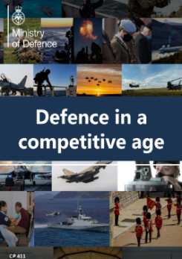


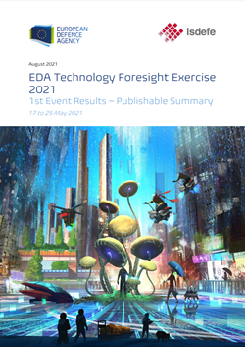



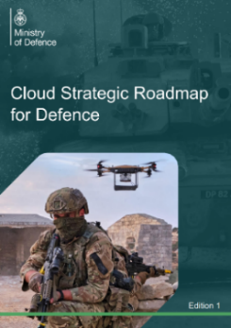
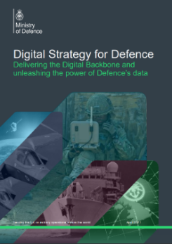
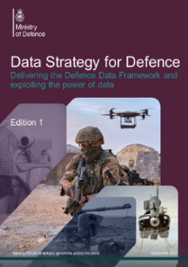
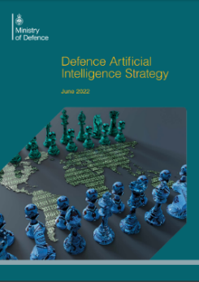
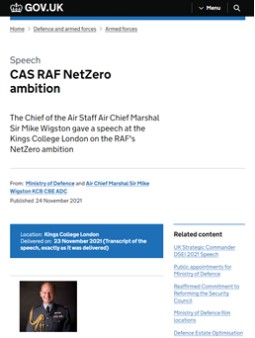
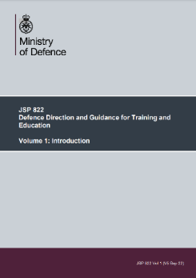
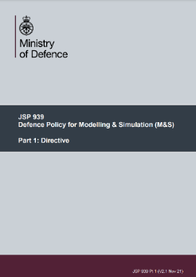
Key MOD sources
Notes:
Daran
So here are a few of the sources that were used in framing this research. I’d emphasising this, because what we haven’t done in this work is generate blue sky thinking, far-future scenarios. The underpinning base for this work was current understanding of future direction, planned and predicted Defence policies and positioning and this was used to provide guiderails for the scenario generation phase.

Slide 6
Scenario Generation
SME workshops create and refine scenarios
Notes:
Daran
Took those Strategic Inputs, combined them with horizon scanning and technology watch findings, compared this with trend predictions from futures community, and brought these together into a succession of workshops that initially created 37 scenarios of potential developments in future defence learning, which were developed into 21 scenarios

Slide 7
21 Scenarios to go…
No | TITLE | No | TITLE
1 | Data-Driven Learning | 12 | Green Learning
2 | Learning in the Age of Autonomy | 13 | I Think Therefore I Do
3 | AI Empowered Learning | 14 | XR for All Learning
4 | Recruit-Retain Centric Learning | 15 | Learning is Everywhere
5 | Just in Time Learning | 16 | Remote Tutors
6 | Competences for All | 17 | My Twin is Digital
7 | Learning for the Multi-Domain | 18 | Collaborate to Learn
8 | Turbo-Charged Learning | 19 | The classroom is History
9 | Every Barracks a Holodeck | 20 | Learning is a Game
10 | Learning in a Military Metaverse | 21 | Single Enterprise LVC Ecosystem
11 | Common Equipment Interfaces
Notes:
Daran
AI = Artificial Intelligence
XR = miXed Reality (AR, VR, MR)
LVC = Live Virtual Constructive
These scenarios were further matured, analysed, combined and refined iteratively, until we were left with 7 Learning Future Scenarios.

Slide 8
…down to 7 consolidated scenarios
 | NEW TITLE | Comprising
A | AI / Data | Data-Driven Learning, Learning in the Age of Autonomy, AI Empowered Learning, Recruit-Retain Centric Learning, My Twin is Digital.
B | XR / Metaverse / Holodeck | Every Barracks a Holodeck, Learning in a Military Metaverse, XR for All Learning.
C | Ubiquitous learning | Green Learning, Ubiquitous Learning, Remote Tutors.
D | Learner Centric | Recruit-Retain Centric Learning, Just in Time Learning, Ubiquitous Learning, Collaborate to Learn, The Classroom is History, Learning is a Game.
E | Brain Computer Interfaces (+ others) | Learning in the Age of Autonomy, Zero Learning Based Equipment, I Think Therefore I Do.
F | Live Virtual and Constructive Autonomy (LVC-A) Vision | Green Learning, Enterprise LVC Ecosystem.
G | Multi Domain Integration (MDI) | Competences for All, Learning for the Multi-Domain, Whole Force
Notes:
Daran

Slide 9
Fancy Names Club
AI Empowered Learning
Science Fiction becomes Science Fact
Expertise Everywhere all at once
Learners in the Spotlight
Interfacing with the future
The live digital matrix
Learning for the Military Multiverse
Notes:
Daran
Scenarios were renamed and developed further, with each written into a narrative.

Slide 10

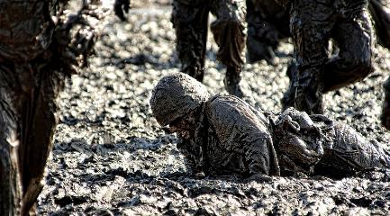
Scenario A: Artificial Intelligence-empowered learning
Use Case
A Sergeant based in Edinburgh is attending a Platoon Sergeant's training course, which is being run remotely from the Infantry Training Centre in Brecon. Each day, they begin by conducting physical training as directed by their AI tutor. The results of this session are recorded and uploaded to their digital twin, which helps to track any changes in physical ability or injuries.
After physical training, the Sergeant logs in to that day's learning event, which today is focused on Platoon Orders. They participate in a virtual classroom using an XR headset and learn about delivering Platoon Orders. To do this they will need to understand how each Platoon member’s Augmentation System functions, whether through a built-in Head Up Display (HUD) situational awareness display or input from their AI.
Next, the Sergeant conducts a training event in a virtual training environment, delivering orders to a Platoon made up of digital twins of their classmates. Each student will be conducting the same learning event at the same time. Their performance is monitored and evaluated by their AI tutor and feedback is provided to the human chief instructor.
The Sergeant’s training needs, and level of ability have been mapped out from selection onwards, and their career pathway has been planned from the time that they were recruited to ensure the best outcome for both the Sergeant and the Armed Forces.
Their potential has been identified from recruitment onwards, highlighting developmental areas before they become detrimental to the learner. Their performance data are streamlined to aid professional development, freeing up the instructors' workload, allowing them to intervene just in time when the learner needs their guidance and expertise the most.
Learners can also see exactly where they are in their learning journey since the continuous performance monitoring and their digital twin allows them to see historical data. This provides an understanding of why the AI tutor is suggesting one course or the other.
Notes:
Daran

Slide 11
Technology & Capability Super Bricks
Data Management
System Integration and Interoperability
Computer system Hardware, Software, OS, Applications & Web-based
Data and Information Storage
Artificial Intelligence and Associated Fields
Bio-technology
Communications and Networks
Materials Science
Enterprise Collaboration Technologies
Computer System Security and Cyber Security
Sensor Technologies
Quantum Technologies
Information and Knowledge Management
Computer System Architecture and Methodologies
Consumer Devices and Electronics
Human Machine Interface Technologies
Power Sources; Management and Efficiency
Robotics
Geolocation; Position, Navigation and Timing
Nano-technology
People
Process
Notes:
Daran
Once the scenarios had been finalised, the team turned to understanding what capabilities or technologies would be needed by defence in order to make each scenario possible.
Using an Industry technology taxonomy, we identified 303 individual technology bricks, which were mapped individually to each of the scenarios before being grouped into themed Super Bricks.
By

Slide 12
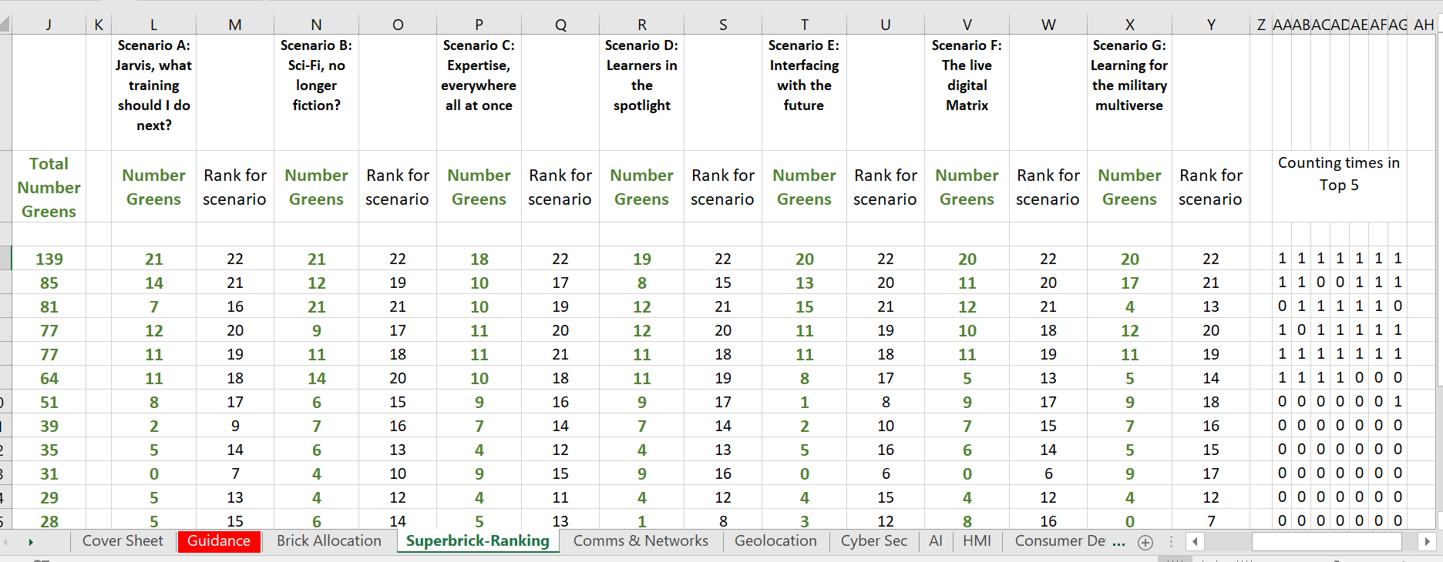
Lots of Data
Notes:
Daran

Slide 13
Technology & Capability Super Bricks
Scenario Critical Superbricks
Consumer Devices and Electronics
Sensor Technologies
Bio-technology
Human Machine Interface Technologies
Computer System Architecture and Methodologies
Computer system Hardware, Software, OS, Applications & Web-based
Computer System Security and Cyber Security
Quantum Technologies
Power Sources; Management and Efficiency
Universal Technology Foundation Superbricks
Data Management
Information and Knowledge Management
Data and Information Storage
Communications and Networks
Artificial Intelligence and Associated Fields
Critical Enablers
People
Process
Notes:
Daran

Slide 14
Technology & Capability Super Bricks
Scenario Critical Superbricks
Consumer Devices and Electronics
Sensor Technologies
Bio-technology
Human Machine Interface Technologies
Ubiquitous Computing Power
Data Management and Storage
Universal Technology Foundation Superbricks
Communications and Networks
Artificial Intelligence
Critical Enablers
People
Process
Notes:
Daran

Slide 15

Bringing the research to life
Notes:
Caroline
Video played in here

Slide 16

Notes:
Caroline
What is it?
This dashboard contains the results of an analysis aimed at identifying what are the potential implications of GAN tech and concepts. We brought together a team of Dstl and Industry SMEs to look at a series of inputs, such as Defence policy, strategies; learning trends within the wider education sector as well as horizon scanning techniques and using those we were able to distil down into a series of scenarios to allow us to imagine what the future may be like for Defence learning.
It forms a resource that will allow stakeholders to agree future directions for MOD learning (both military and civil service), and hopefully to start the synchronisation and coordination activities required if MOD is to successfully position itself to exploit opportunities as they arise.

Slide 17
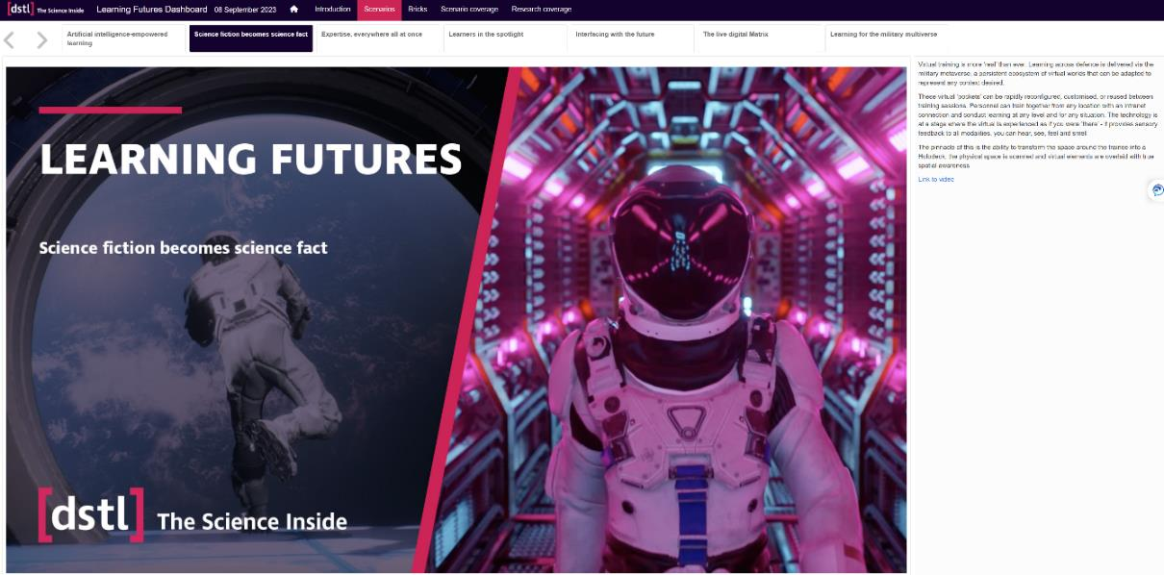
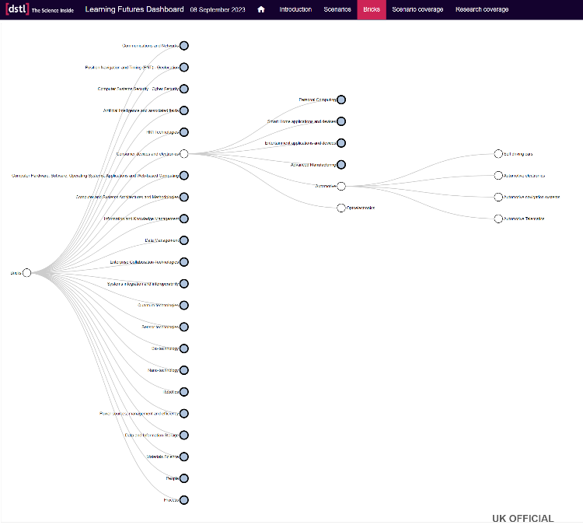
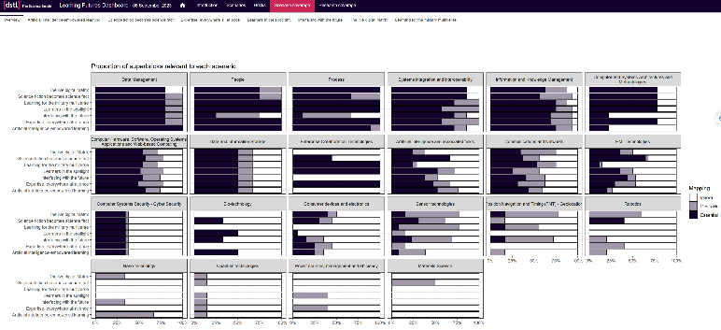
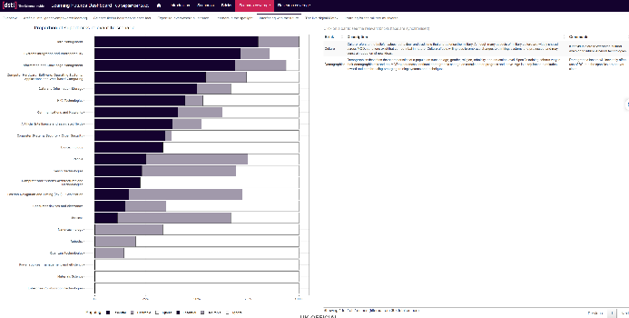
Dashboard
Notes:
Caroline
There are 7 possible future scenario for Defence learning. Each with a glossy video providing an overview. Building on that, the dashboard identifies four foundational capabilities that underpin all of the scenarios: AI, augmenting human cap, secure networking allowing pass of information freely and safely, and understanding data requirements, management and capture, and enhanced computing, delivering increase computational power at the point of need. On top of those foundational requirements, each scenario has its own specific capabilities that need to be in place in order for that future to be realised, such as robotics, nanotech, human machine interfaces, biosensor and with those we’re able to create a path that takes us from where we are now to where we need to be to manifest that future, built from the layers of these capability bricks. These roadmaps give us direction and steer the path that defence learning will take look at our current research programme, what’s happening externally in academia and industry and identify any gaps that will stop us from achieving the potential future.
We’re finalising that in-house and we’ll be making it available on our DLE site.

Slide 18
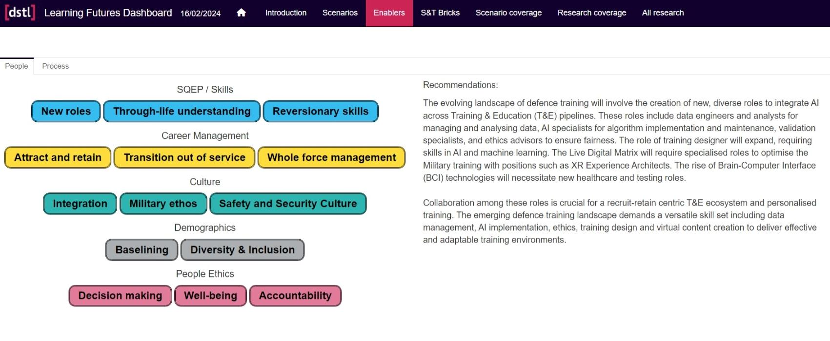
People
Notes:
Caroline

Slide 19
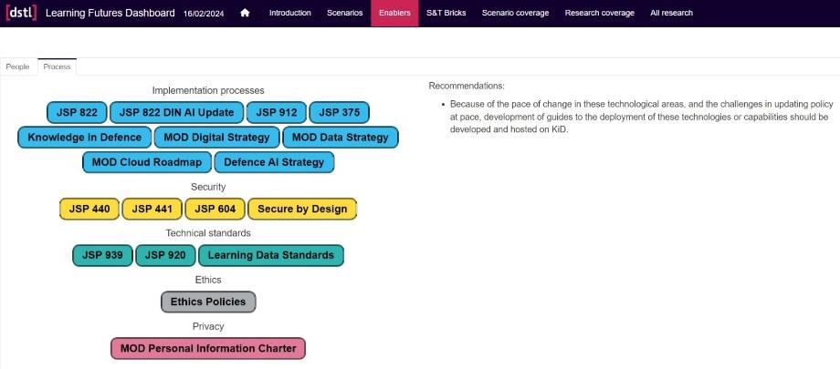
Policy
Notes:
Caroline

Slide 20
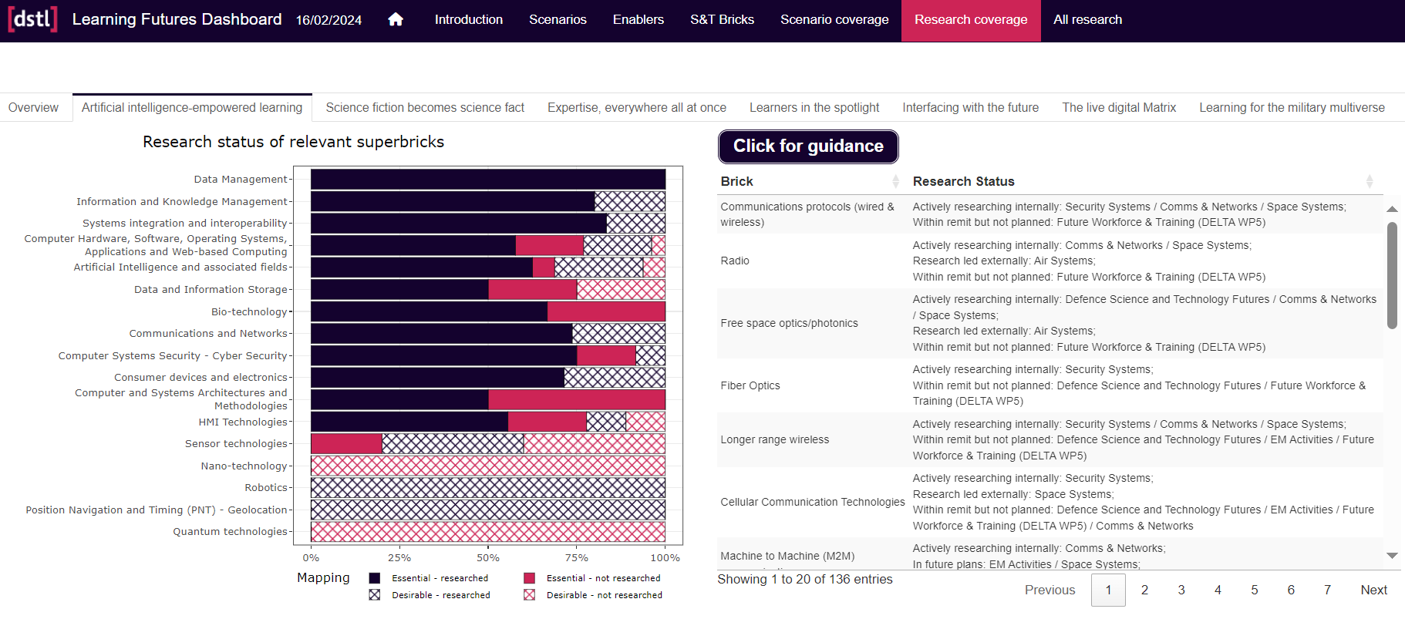
Research Alignment
Notes:
Caroline

Slide 21
Exploitation
Directing technology watch activities
Shared across Dstl and Commissioning Officers at DST
Using the scenarios to set context for planned and future research
Dashboard approach being adopted in several projects
Outcome met 3 years early, saving £s
“It is easier to invent the future than predict it”
Alan Kay
Notes:
Caroline

Slide 22
Training in the future, and how to get there
Caroline Shawl, cmshawl@dstl.gov.uk
Daran Crush, dfcrush@QinetiQ.com
The contents include material subject to © Crown copyright (2024), Dstl. This information is licensed under the Open Government Licence v3.0. To view this licence, visit https://www.nationalarchives.gov.uk/doc/open-government-licence/ . Where we have identified any third party copyright information you will need to obtain permission from the copyright holders concerned. Any enquiries regarding this publication should be sent to: Dstl.
Notes:
Caroline

