Slide 1
Flight Training Modernization: Applying Learning Engineering to Enhance F-35 Pilot Cognitive Capacity
JJ Walcutt, Ph.D., Patricia Bockleman, Ph.D., and Jay Spohn
SAIC

Slide 2
“In the last 20 years, the USAF was optimized for combat in a permissive environment that didn’t test the force. During that
same time, China was focused completely on the high-end fight,
and fighting us.”
USAF Air Combat Command’s General Mark D. Kelly in Tirpak, 2021
and
highlighted in Pilot Training Transformation: Transforming USAF
Pilot Training Curriculum to Meet 21st Century Challenges, 2022

Slide 3
Learning Engineering Methodology
Step 1: Capability Assessment
Step 2: Competency Modeling (USAF Handbook 36-2647)
Step 3: Instructional Technology and Resources Review
Step 4: Framework Design
Step 5: Recommendations
Step 6: Assessment and Personalization

Slide 4
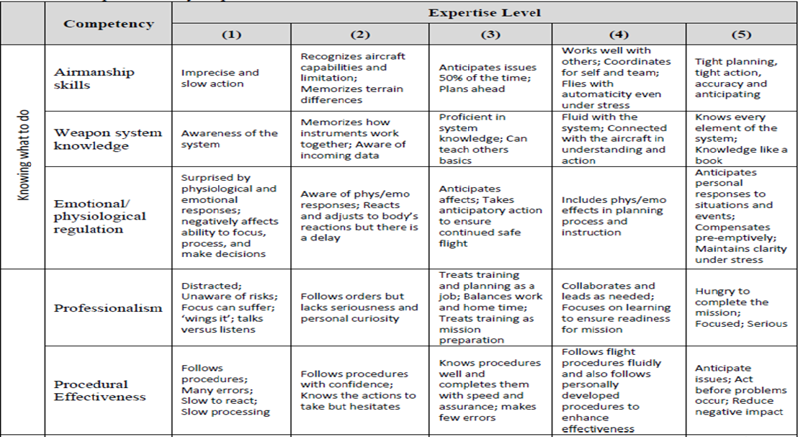
Step 2: MODEL

Slide 5
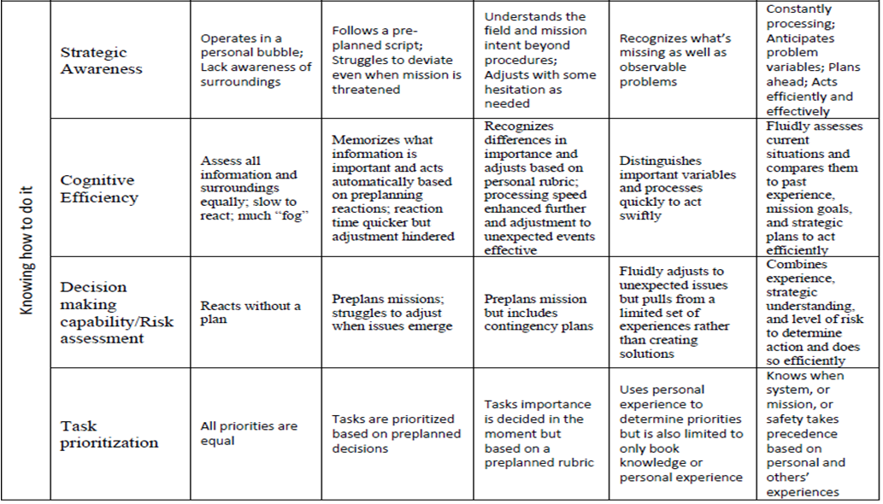
MODEL cont.

Slide 6
Step 3: Technology Review
Technology | Types | Most Effective Use
Mobile Devices | Micro learning (e.g., PeRLS) | Rapid memorization & Decision Making Practice
Desktop Computers | Distributed coursework (e.g., USAF MyLearning) | Professional Development
Tablet | Hyperlink-enabled eBook (e.b., PeBL) | Digesting & connecting dense learning material (e.g., 3-1 Manual)
Lightweight Simulators | AR, VR, XR, MR | Experiential Learning for mental model development
Full-scale Simulators | Immersive training | Experiential Learning for mental model assimilation
Full-scale Simulated Environments | Multi-platform training environment (TBD) | Experiential Learning for joint mental model assimilation & coordination
Digital-Data Highway | Open source, Open architecture streaming architecture for optimized analysis (e.g., TLA, MOTAR) | Real-time data collection and analysis for data-drive decision making, knowledge mgmt., & training personalization

Slide 7
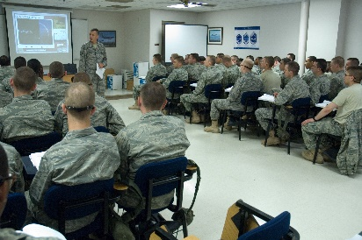

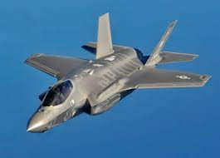
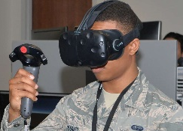
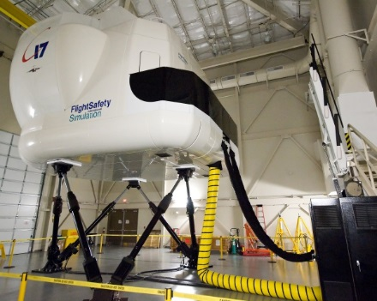

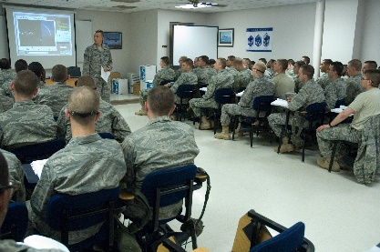
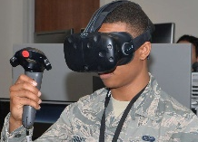
Step 4A: Framework
VTTC/ JSE
B Course
MQT
FLUG
IPUG
WIC
VTTC/ JSE
VTTC/ JSE
VTTC/ JSE
VTTC/ JSE
Notes:
Bullet 3 – tradeoff between synthetic and live fly? (Mr. Butcher) We’re not reducing live fly …. We’re enhancing (it) with synthetic.
-- Live fly needs to endure, or increase, as we bring more synthetic …. No tradeoffs!!

Slide 8
Step 4B: Pathway
Lesson Elements & Design
(1) Capability Gaps
Content
Strategy
Assessment
(2) KSAs
Technology
Next Lesson
(3) Knowledge Type
Learning Intervention
Lesson | Content | Competency | KSA | Knowledge Type | Lesson Elements | Strategy | Media Delivery | Learning Intervention | Assessment | Next Lesson

Slide 9
Step 5: Recommendations
STRATEGIC
Digital-Data Highway for optimized training: Combine efforts across USAF, OSD, Research, Technology, Data Analysis using Learning Engineering practices to create the DDH
Chief Training Officer: Science, Technology, Research, and Design Coordinator for training modernization

Slide 10
Step 5: Recommendations
TACTICAL
Syllabi Modernization: Organized by competencies and skills to support expertise development and prepare for data-driven measurement & training
3-1 Training Manual: Companion manual organized to promote memory, presented to reduce time to learn, and designed for increased comprehension
Lightweight Simulator: Created to target part-task training, reduce time to expertise, and increase practice, comprehension, and application
Micro-learning Tools: Inexpensive training tools to improve factual knowledge and decision making
Train-the-Trainer Course: Combining USAF, science, and other services’ products to create a course for the CAF

Slide 11
Step 6: Personalized Pathways
What will this enable?
Measurement of training experience, human performance, neurochemistry, physiology, capabilities, skill quality, and readiness levels at the individual and aggregate level
Data Analytics to support data-driven training and operational decisions beyond human ability
Training Recommendations and personalization to optimize experiences and expand human brain capabilities
Strategic Talent Management

Slide 12
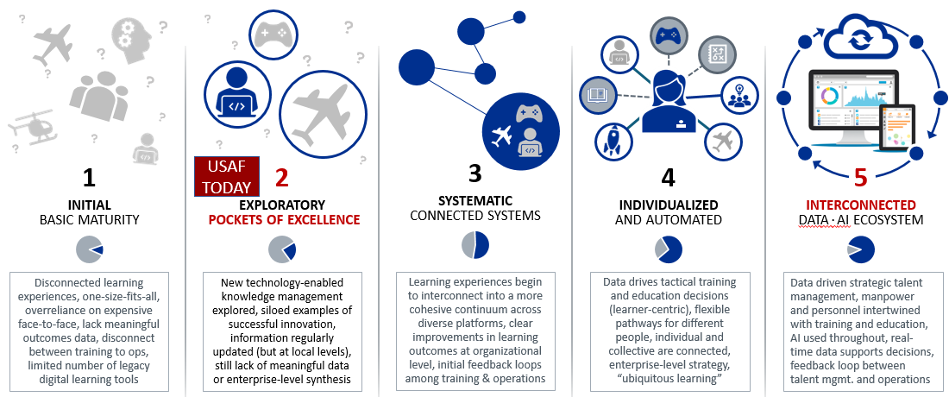
Digital-Data Highway
Linear training process
Limits how much can be learned
Lacks personalization
Designed for data-driven measurement & training
Allows for personalized, efficient, & effective training for multi-capabilities
Reduces time to develop expertise

Slide 13
Flight Training Modernization: Applying Learning Engineering to Enhance F-35 Pilot Cognitive Capacity
JJ Walcutt, Ph.D., Patricia Bockleman, Ph.D., and Jay Spohn
SAIC

