Slide 1

Analyzing visual fidelity in flight simulation software using Game Engine with Feature Mapping
Presented by: Rishabh Kaushik, Principal Software Engineer with Ankur Rathore, Principal Software Engineer
Notes:
Good morning! I hope everyone’s doing well. I’m Rishabh, and with my colleague Ankur, we’ll be discussing our approach to analyzing visual fidelity in flight simulation using feature mapping.

Slide 2
Content
Research Statement
Methodology
Feature Matching Overview
Comparative Analysis Approach
Results
Hill Air Force Base, Utah (KHIF) & Salt Lake City International Airport, Utah (KSLC)
Observations
Key Insights KHIF & KSLC
Technique Effectiveness and Accuracy Conclusion
Implications
Limitations
Conclusion
Notes:
Here’s a quick overview of what we’ll cover today.
We’ll start with our research goal and hypotheses, followed by an explanation of feature matching and how we used it in our analysis. Then, we’ll look at results from two datasets: Hill Air Force Base and Salt Lake City Airport in Utah. After that, we’ll discuss key observations, implications, and limitations of our approach, and wrap up with a conclusion.

Slide 3
Research Statement
Goal: Use Feature Matching principles to perform a comparative analysis between a simulation based on a Game Engine and real flight visual data
Objective: Conduct research without relying on pilot feedback
Hypothesis 1: Instances of visual objects belonging to specific classes are of utmost importance to a pilot
Hypothesis 2: Identify the visual objects using feature matching and group them semantically
Purpose: Identify these object classes and create a deterministic method for comparing image disparities
Notes:
We began with the goal of using a computer vision technique called Feature Matching to compare visuals from a game engine simulation and real flight data. While there's extensive research on cognitive and behavioral assessments, there’s minimal focus purely on visual fidelity-based techniques. Our aim was to create an Image Generator-agnostic method, avoiding reliance on pilot feedback.
We had two main hypotheses: First, that pilots rely on key visual objects belonging to specific classes in critical tasks like landing in low visibility. Second, that we can objectively identify these visual objects using feature matching.
By classifying these objects, we can develop a mathematical model to compare image disparities. Ultimately, we want to find out if simulated images can achieve “believability” through objective visual analysis.
------→ Next, Ankur is going to talk about feature matching and our methodology (**Hand to Ankur**).

Slide 4


Methodology – Feature Matching Overview
Keypoint Detection:
Keypoints are specific points or regions within an image that can be robustly detected and are distinctive
Notes:
So, what is Feature Matching? It can be defined in 4 main steps:
The first step is Keypoint Detection. Keypoints are specific points or areas within an image that can be reliably identified and are distinctive. In computer vision, keypoints are typically detected using methods such as Scale-Invariant Feature Transform (SIFT), Speeded Up Robust Features (SURF), Oriented FAST and Rotated BRIEF (ORB), and Features from Accelerated Segment Test (FAST).
We used ORB for our research.

Slide 5
Methodology – Feature Matching Overview
Feature Description:
Keypoint is described by a feature vector that captures its local appearance invariant to transformations such as rotation, scale, and changes in illumination
Notes:
The next step is Feature Description. After detecting keypoints, each keypoint is described by a feature vector that captures its local appearance. It's crucial that this description remains invariant to transformations such as rotation, scale, and changes in lighting. Descriptor algorithms such as SIFT, SURF, ORB, and others compute feature vectors based on gradient information, image intensities, or binary patterns.

Slide 6
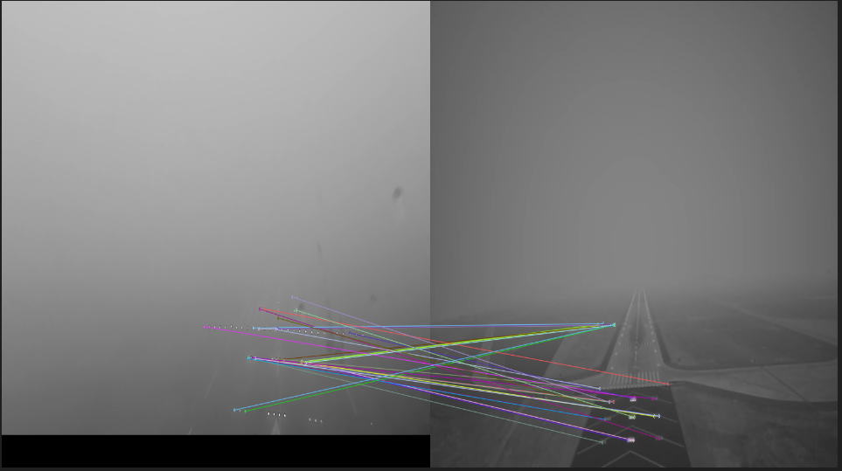
Methodology – Feature Matching Overview
Matching Keypoints: Feature matching compares keypoint descriptors from two images using metrics like Euclidean or Hamming distance to find corresponding points
Notes:
The next step is Matching Keypoints. Feature matching involves comparing the feature descriptors of keypoints from two images to identify corresponding points. Matching is generally performed by measuring the distance between feature vectors using metrics such as Euclidean distance or Hamming distance.
We used Hamming Distance for our research. In computer vision, the Hamming distance is used to measure the similarity between two binary strings. This metric calculates the minimum number of substitutions needed to transform one binary string into another.

Slide 7
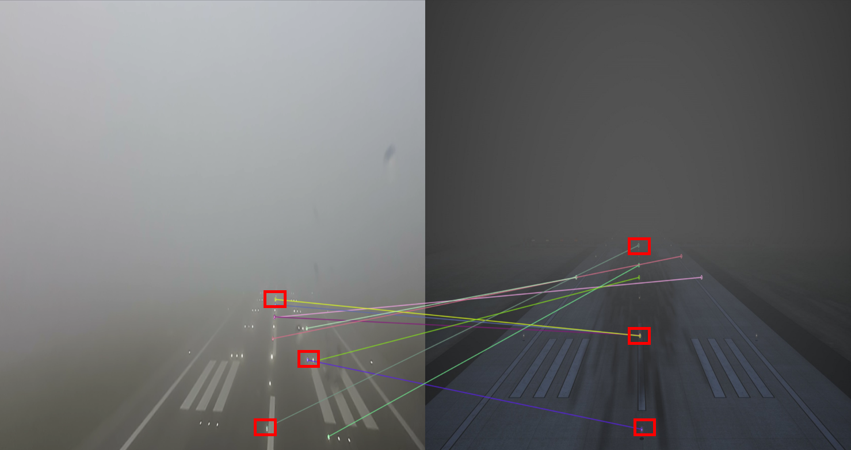
Methodology – Feature Matching Overview
Filtering Matches: Techniques like Random Sample Consensus (RANSAC) filter unreliable keypoint matches caused by occlusions or noise, estimating the transformation model between images
Notes:
The final step is Filtering Matches. Not all keypoints and their matches are reliable, as outliers may arise from occlusions, noise, or changes in viewpoint. Techniques such as Random Sample Consensus (RANSAC) are commonly used to eliminate outliers and estimate the transformation model between images.

Slide 8
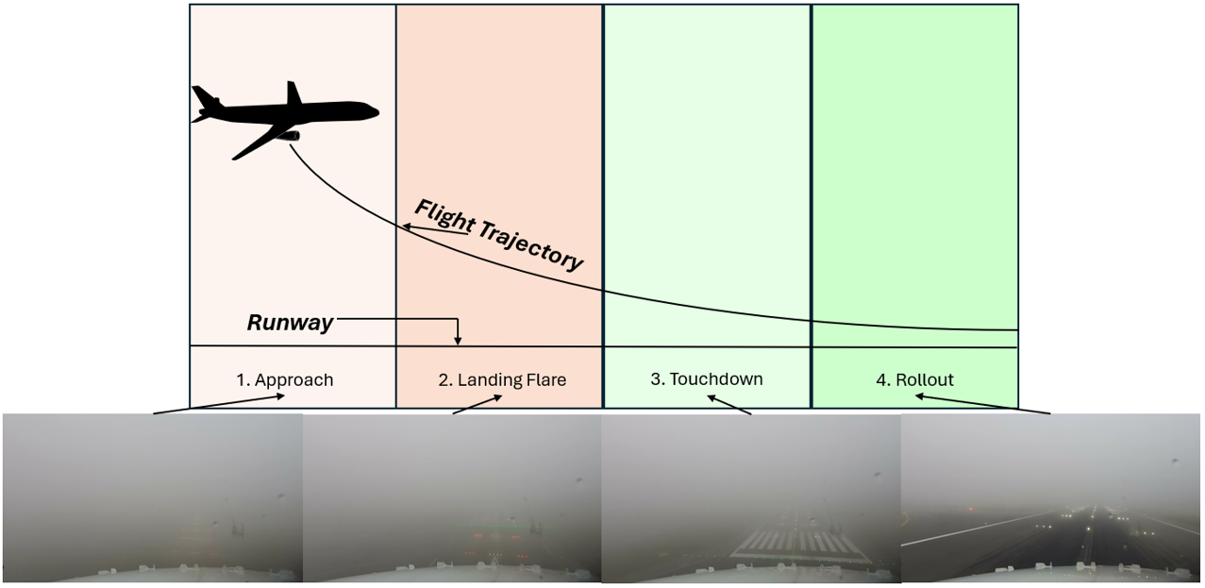
Methodology – Comparative Analysis Approach
Notes:
To explain our approach, we’ll show how it can be used to evaluate the consistency between real and simulated landing approaches.
Our primary aim was to deconstruct the process step by step, just like actual pilots would. This process is divided into four key phases, each involving a specific task that must be completed before moving to the next phase, as shown in this figure.
At Decision Height, a critical point during an instrument landing approach, the pilot decides whether to continue landing or perform a missed approach.
For simplicity, we consider the various types of light points positioned along the runway in our study as a collective entity referred to as ‘runway lights’. While each of these runway lights serves a distinct purpose in aiding the landing procedure, classifying these individual lights would require the use of an Object Detection technique based on Artificial Intelligence to assign metadata to the feature-mapped keypoints. However, due to time and resource constraints, we focused exclusively on Feature Matching.

Slide 9
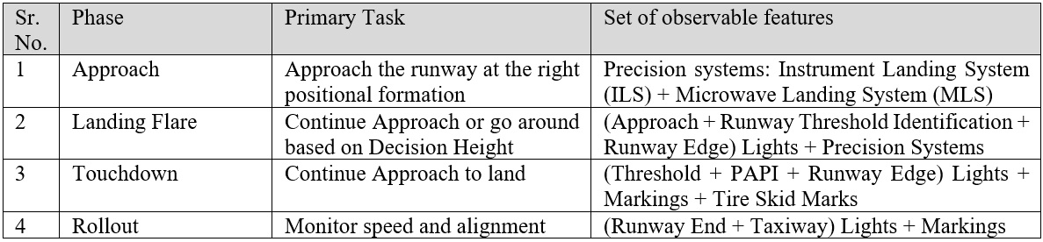


Methodology – Comparative Analysis Approach
Runway Edge Lights
PAPI Lights
Markings
Threshold Lights
Tire Skid Marks
Notes:
Here’s another way to visualize the breakdown of each phase. We will be focusing on the Touchdown phase. Notice the set of observable features in the rightmost column corresponding to this phase. It includes various types of lights, markings, and tire skid marks on the runway.
This research utilized images from an Adobe Stock video of a plane landing in fog, alongside images generated from a Game Engine-based Image Generator. This modern approach allowed for detailed simulations of landing conditions, creating two datasets—one for a military runway (Hill Air Force) and another for a commercial airport runway (Salt Lake City International). A large set of images were carefully curated to reflect real-world scenarios for effective feature mapping.

Slide 10
Results – Hill Air Force Runway, Utah
Notes:
After preparing two datasets for Feature Matching, we applied an algorithm to real-world and simulator-based images that visually resemble them. We analyzed the Hamming distance to measure similarity between the binary descriptors. We used ORB with Brute Force matching as our primary method for feature extraction and analysis.
What you see in this image is one of the feature matched results for Hill Air Force Base, Utah. On the right in a Game Engine based flight simulator, and a real-world correspondence on the left. Feature Matching produces numerous results, which are sorted by Hamming distance, with the top 10 selected for visualization here. We computed the average Hamming distances and recorded object classes to evaluate contextual accuracy, plotting the data throughout various stages of the pilot's task execution.
-----→ Rishabh is now going to walk us through the key findings and observations (**Hand to Rishabh**)
Thanks Ankur. Our study found that Feature Matching yielded significant outputs, with lines connecting corresponding keypoints between image pairs indicating successful matches. These lines allow for verification of the algorithm's accuracy, visually confirming the correspondence and quality of matches across different views. Different colors are used to distinguish between these matches, helping in visualizing the quality and distribution of matches. Red box here represents the class of runway light points.

Slide 11
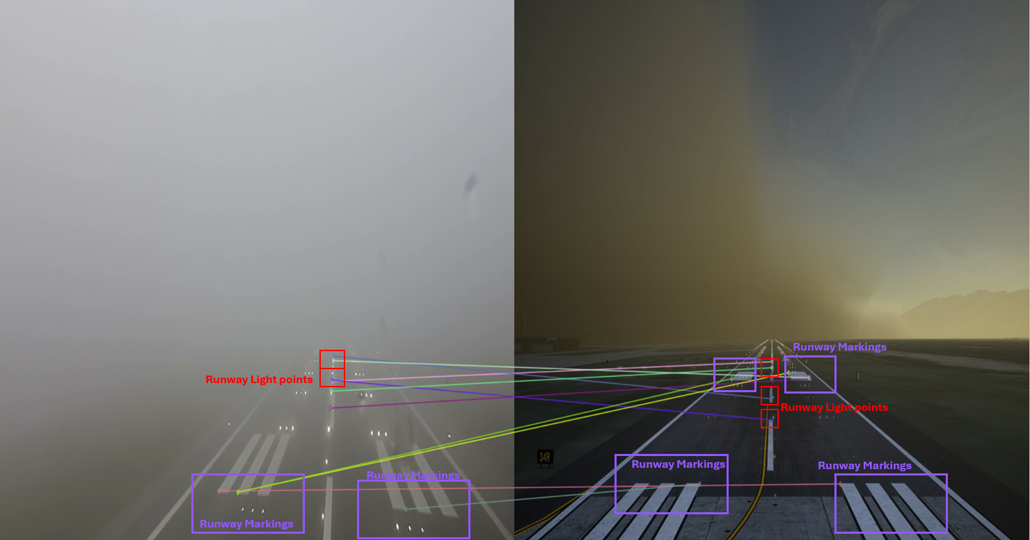
Results – Salt Lake City International Runway, Utah
Notes:
Here’s the results on the Salt Lake City International Airport database in Utah. Since the original video was of a commercial airport runway, our matched features started capturing additional classes which in this case is the Runway markings highlighted in violet boxes.

Slide 12
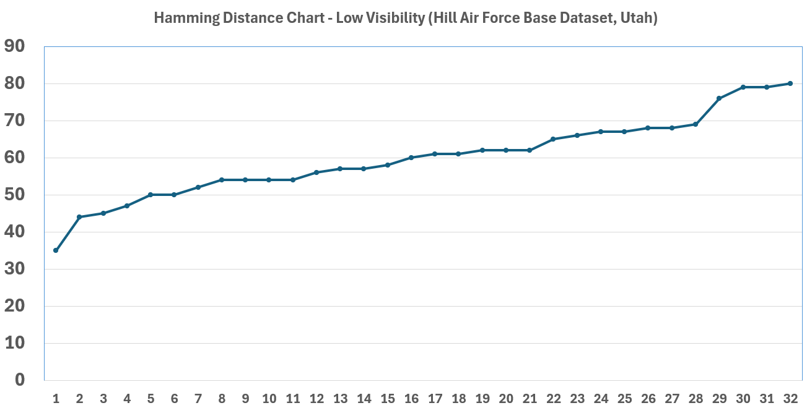
Observation - Key Insights Military Runway
Hamming Distance
Matched Datapoints
Notes:
This chart shows the average Hamming distance, comparing real-world data with the Hill Air Force Base military runway dataset during the Touchdown phase of a low-visibility landing. We identified 32 feature matches, with the top 10 results having Hamming distances below 55.

Slide 13
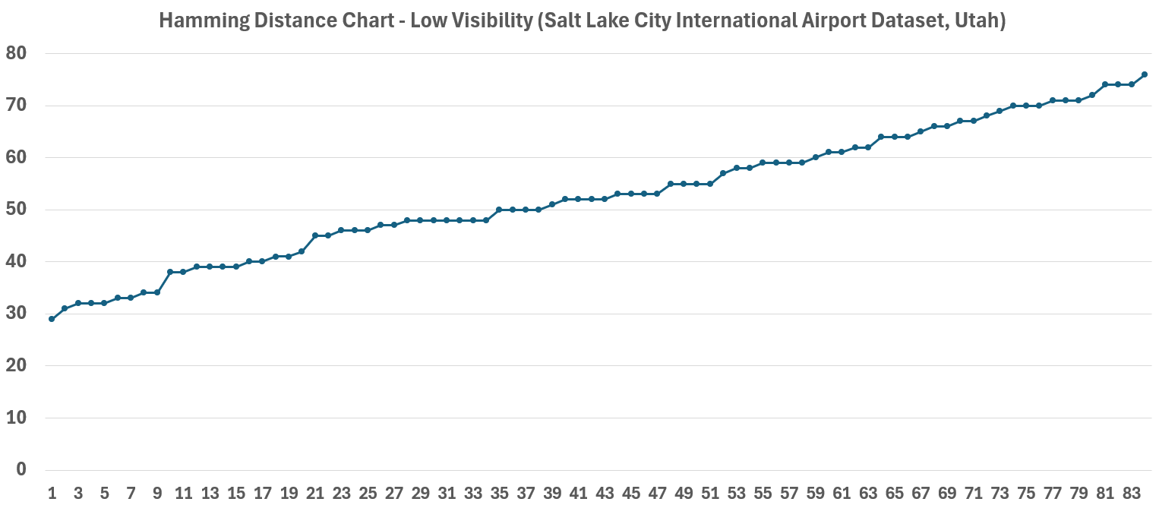
Observation – Key Insights Commercial Runway
Hamming Distance
Matched Datapoints
Notes:
This chart presents the average Hamming distance plot for 84 feature matches between the real-world sample set and the commercial runway dataset, with the top 10 results showing Hamming distances under 40 during the Touchdown phase in the same environment conditions.

Slide 14
Observation - Technique Effectiveness and Accuracy
Comparing the original landing video with the military runway dataset shows only 38% matched datapoints, while the simulated commercial runway dataset offers more matches
The Salt Lake City runway yielded a broader range of object classes, including runway markings, compared to the Hill Air Force runway, which only identified runway light points
Validating our hypotheses requires achieving a Hamming Distance threshold of 40 for optimal results during the Touchdown phase, indicating pilots rely on specific visual features
Feature Matching can mathematically translate observable features into distinct classes, but subtle aids like tire skid marks are overlooked in the analysis
Notes:
Let's dive into the observations and main takeaways from this work.
When we compared the original landing video to the military runway data, only 38% of the points matched, while the simulated commercial runway data had more matches.
The Salt Lake City runway had more top object classes, such as runway lights and markings, while the Hill Air Force runway primarily featured runway lights.
Integrating AI with object detection could improve accuracy in mapping features into semantic categories for low-visibility landings.
Our hypotheses were validated by achieving a Hamming Distance threshold unique to each phase, with a max of 40 during the Touchdown phase for optimal matches.
The first hypothesis shows that pilots depend on visible features like runway markings and lights, which was confirmed by feature matching during the Touchdown phase.
The second hypothesis suggests these features can be categorized using computer vision algorithms, supported by feature matching connections.
Using a support vector approach, we translated subjective visual assessments into measurable Hamming Distance values, confirming feature match accuracy with the top 10% matches.
Finally, while experienced pilots might use subtle cues like skid marks, Feature Matching didn't account for this class.

Slide 15

Implications
Problem: Visual inconsistencies cause virtual dissonance and cybersickness (nausea, dizziness), reducing immersion
Proposed Solution:
Identifies critical visual objects to reduce dissonance
Compares real-world and simulated visuals by detecting keypoints and matching features
Assesses terrain detail, landmark precision, texture, and lighting accuracy
Technical Benefits:
Quantitative assessment of simulation accuracy using feature matching
Improves terrain generation and texture mapping
Cost-effective validation method, reducing reliance on pilots or hardware
Supports FAA Level D certification with objective analysis
Notes:
Let’s talk about the implications of this technique. We’re addressing the problem of visual inconsistencies in Extended Reality flight simulations, which can cause virtual dissonance and cybersickness, leading to symptoms like nausea and dizziness. This further impacts immersion and limits the effectiveness of training.
Our solution focuses on identifying key visual objects to reduce dissonance and allows us to compare real-world and simulated scenes, focusing on important elements like terrain, landmarks, and lighting.
From a technical standpoint, we use feature matching for a quantitative assessment of simulation accuracy. This method improves terrain generation and texture mapping, offering a cost-effective solution without relying on pilots or expensive hardware. Additionally, this approach supports FAA Level D certification by providing objective analysis of visual accuracy.

Slide 16
Limitations
Computational Intensity: Feature Matching is resource-intensive, especially with high-resolution images, requiring powerful hardware for real-time applications
Sensitivity to Environmental Changes: Variations in lighting, weather, or reflections can impact keypoint detection and cause mismatches or false positives
Sensor and Image Quality: Low-resolution images, noise, or motion blur reduce Feature Matching accuracy, affecting keypoint detection and matching reliability
Geometric and Scale Variations: Significant geometric distortions or scale differences between scenes challenge precise feature matching
Occlusions and Dynamic Environments: Occluded keypoints or rapidly changing scenes hinder Feature Matching in dynamic or cluttered environments
Notes:
While Feature Matching is a powerful tool, it does come with some challenges. First, computational intensity is a concern, as it’s resource-heavy, especially with high-resolution images, and requires powerful hardware to achieve real-time results.
Second, it’s sensitive to environmental changes like lighting, weather, or reflections, which can lead to mismatches or false positives during keypoint detection.
Next, sensor and image quality play a big role. Low-resolution images or issues like noise and motion blur can reduce the accuracy of keypoint detection and matching.
Geometric and scale variations also present difficulties. Significant distortions or size differences between scenes make precise matching more challenging.
Finally, occlusions and dynamic environments can hinder Feature Matching, as blocked keypoints or rapidly changing scenes introduce complexity, especially in cluttered environments.

Slide 17

Conclusion
Challenges in Visual Fidelity:
Complex, non-linear observable space
Requires a focused, task-based approach
Segmenting tasks simplifies analysis
Inspire research independent of users and Image Generators
Machine learning enhances this framework using Feature Matching and AI-based Feature Maps
This study aims to aid the military, commercial aviation, and FAA in advancing Flight simulator certification methods
Notes:
In conclusion, Visual fidelity analysis is complex due to the vast and non-linear observable space. Unlike behavioral fidelity, visual fidelity requires a more focused, task-based approach. By segmenting tasks, we can simplify the analysis process.
This study also aims to inspire research that operates independently of users and Image Generators, allowing for more objective analysis.
Machine learning plays a key role in this framework, enhancing the process through Feature Matching and neural network-based Feature Maps.
Ultimately, this study is designed to support the military, commercial aviation, and the FAA in improving flight simulator certification methods, advancing how we assess and validate simulation environments.

Slide 18
Thank you!
Simulation and training team in Salt Lake City and Orlando.
Special Thanks - Dr. Angus L. M. Thom McLean, III, Senior Technical Fellow at Collins Aerospace
Questions?
Rishabh Kaushik, Principal Software Engineer | rishabh.kaushik@collins.com | +1 (801) 755-3733 Ankur Rathore, Principal Software Engineer | ankur.rathore1@collins.com | +1 (385) 528-7122
Notes:
We would like to thank our Simulation and Training team in Salt Lake City and Orlando for their support.
And with this, we now open the floor to your questions. Thank you!

