Slide 1
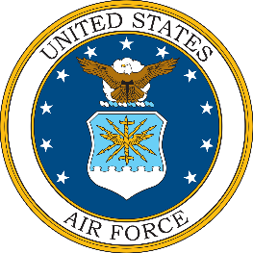
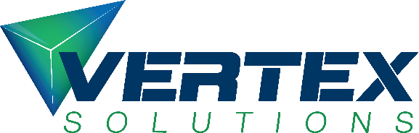
Beyond Illusions:
Navigating VR Fidelity in Undergraduate Pilot Training
A 3-Year Data Analysis
Ryan Pritchard, GS-12
United States Air Force
Dave "Cowboy" Urban
Vertex Solutions
vertexsolutions.com
Notes:
Ladies and gentlemen, my name is Dave Urban, I’m known by many as Cowboy. Welcome to Beyond Illusions where my coauthor, Ryan Pritchard, and I will be sharing with you some of the lessons we learned from studying the US Air Force’s integration of VR simulators into flight training.

Slide 2
Beyond Illusions
The Journey
Sim Theory
VR Device Details
The New Data
Notes:
The points in this presentation follow the path we took to fully appreciate what VR changed about flight instruction.

Slide 3
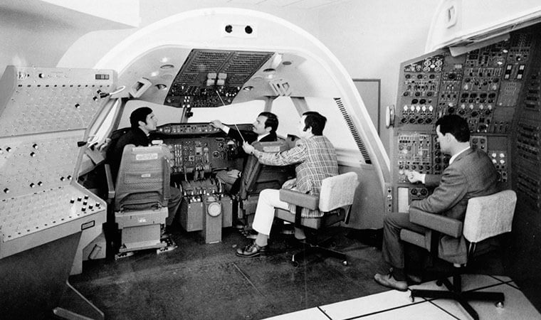
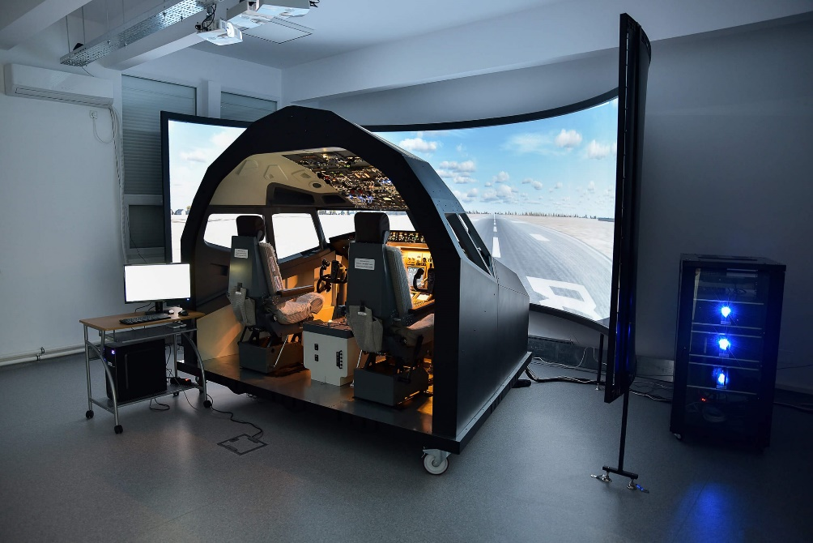
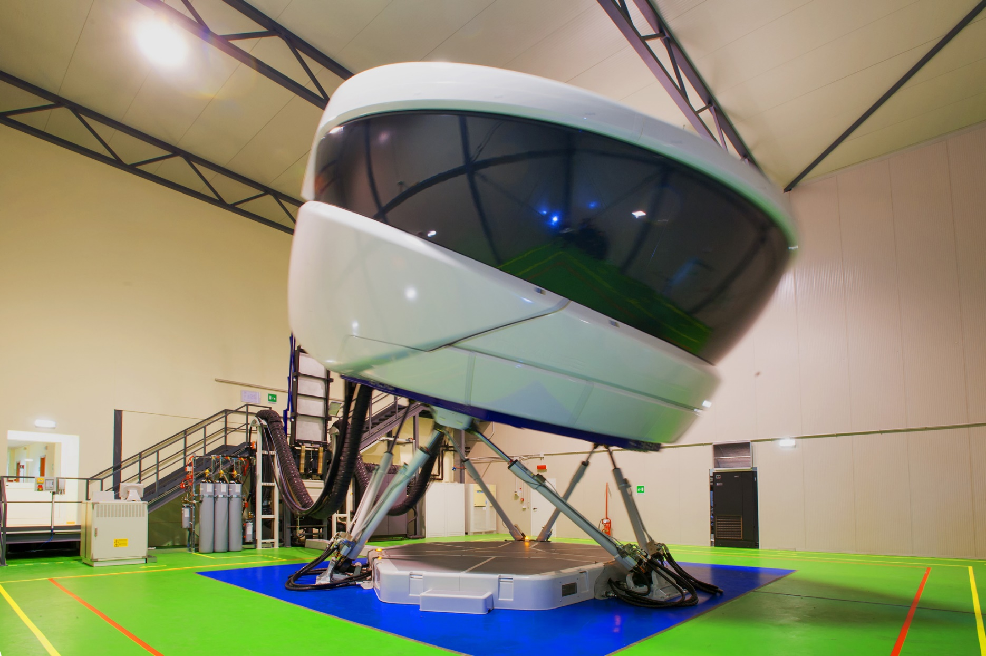
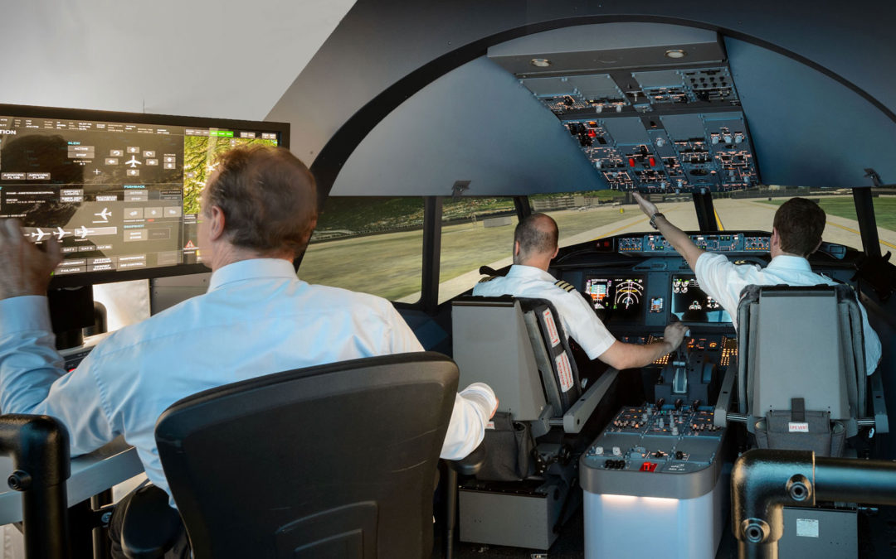
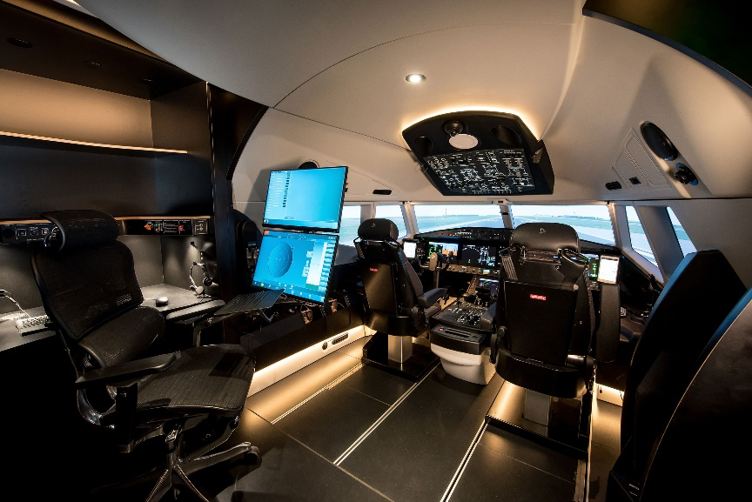
Beyond Illusions
Notes:
When we think of simulators, this is likely close to the image that comes to mind for most of us. A sleek pod on stilts, packed with high end computers and the latest in training models and software.
This vision may not resonate with military pilots. To those of you in the room, I can promise that this is a real image and not an AI deepfake. Civilians, they just get nicer toys.
But let’s not stop here, because there is more to see inside the pod.
>>
It turns out that underneath the modern shell, what the pilot sees has been functionally untouched for well over 50 years. At their heart, simulators are cockpits cut out of the plane and stuck in a box. The pilot experience has not been changed by decades of technological growth, instead we have seen new technology used to drive this cockpit in a pod concept even further.
This relentless refinement of an old concept is not an accident. Simulator design follows a training theory so ingrained that it is almost invisible.
So of course we need to take a look at it.

Slide 4
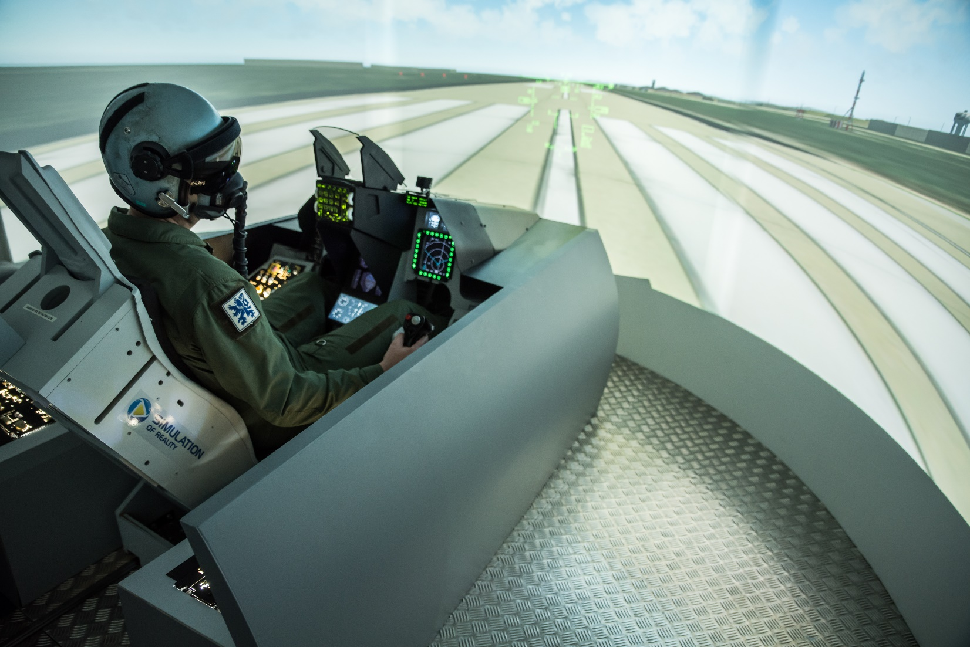
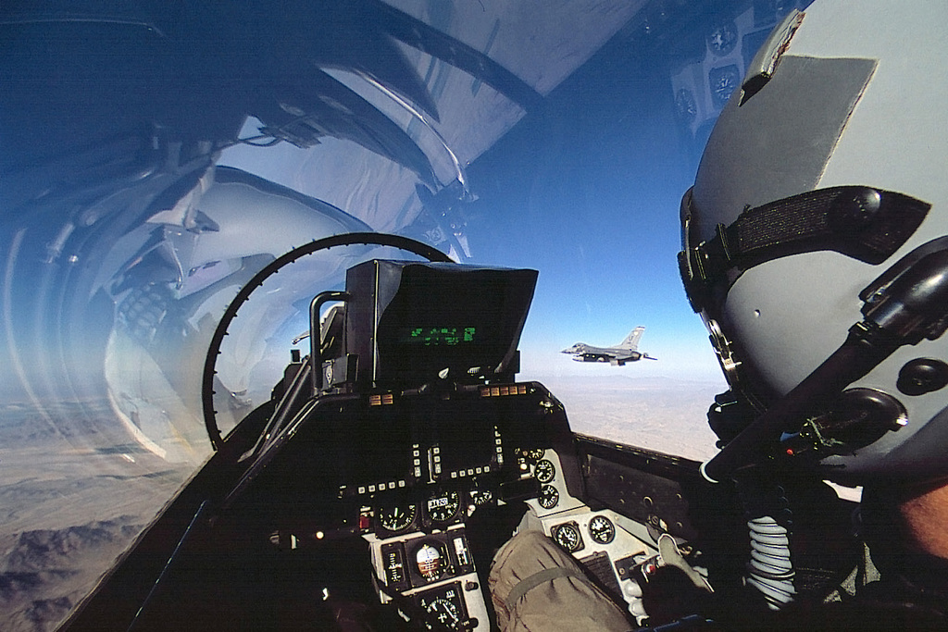

Beyond Illusions
What is the goal of Simulator Design?
Notes:
From the very beginning, simulators have been used to build skills that are inefficient or unsafe to learn in the air. This role is enabled by the fact that simulator hours are normally cheaper than flight.
To be useful for this role though, what a pilot learns in the simulator must be repeatable in the aircraft.
This repeatability makes good, transferable training the ultimate goal of simulator design. Every piece going into a simulator must answer to this goal. The stakes in flight are so high that failing to meet this goal is not an option.

Slide 5
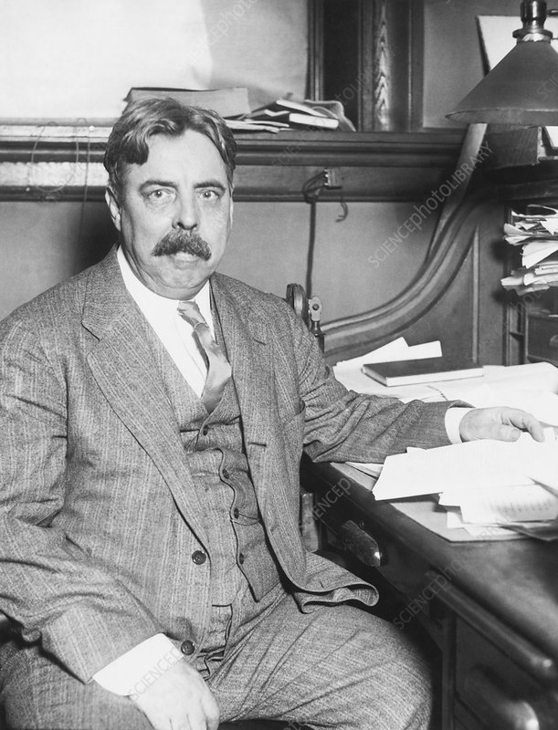
Beyond Illusions
Transfer only happens between identical elements.
E.L. Thorndike
Notes:
At the same time as the Wright brothers were unlocking the secrets of powered flight, Edward Thorndike was rising in fame as the founder of educational psychology. One of the things he is remembered for is his claim that far transfer does not exist.
He posited that a learned skill or task will only transfer between disciplines if the elements of transfer are identical. He kicked off over a century of debate in educational circles that still has not settled the question of the nature of transfer.
Aviation training, however, seems undisturbed by the long debate. Whatever other disciplines may say, transfer through identical elements has become the core of simulator design theory. Taking the form of physical replication requirements, it permeates through device and training design and is established in government certification regs.
It’s possible that this concept would not have taken such deep root without the second design principle, one which flight instructors often also associate with Thorndike.

Slide 6
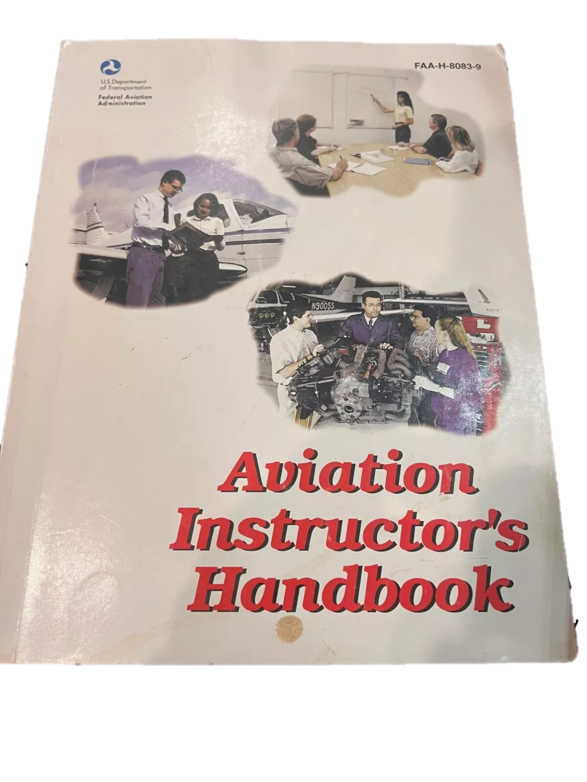
Beyond Illusions
“When an error occurs pouring a concrete foundation for a building, undoing and correcting the job becomes much more difficult than doing it right the first time. Primacy in teaching and learning, what is learned first, often creates a strong, almost unshakable impression and underlies the reason an instructor needs to teach correctly the first time.​”
Notes:
The laws of learning are well known in education. The original 3, Readiness, Exercise, and Effect came from Thorndike. But the ones we know as Primacy, Recency, and Intensity were added later by others.
What you see quoted on screen is the description of Primacy from the most recent edition of the FAA Flight Instructors’ Handbook. It’s here for two reasons. The first is that this law is often the first, sometimes only, law that flight instructors call to mind in the context of flight training.
The chief reason for this being that bad habits and negative training have cost countless lives, and preventing this is always an imperative.
A common term to describe what primacy seeks to avoid is Negative Transfer.
With simulators often being the first instruction a student receives for an aircraft, the desire to avoid Negative Transfer and teach correctly the first time combines with Thorndike’s identical elements to drive the creation of the most perfect simulators possible. Any mistakes or inaccuracies found in a device will often be treated as a training limit to prevent a primacy error.
The second reason it is here is this. I did months of research on training methods, and the flight community is the only place where this understanding of Primacy exists. And thus far the only source for the modern definition is here. The original 1977 aviation instructors handbook.

Slide 7
Beyond Illusions
Core Principles of Simulator Design
Physical Replication = Training Effectiveness = High Cost
First Instruction Must Be Correct = No Negative Transfer = Limited Value
= High Cost
= Limited Value
Notes:
And so here we are with a summary of the core principles of simulation design.
>>
The first is that physical replication is the primary prerequisite for training value.
>>
The second is that simulators must avoid negative transfer, so they must be correct to ensure that any instruction given on them is also correct.
At face value these are fully positive principles, but what does the impact of the principles look like in the real world?

Slide 8
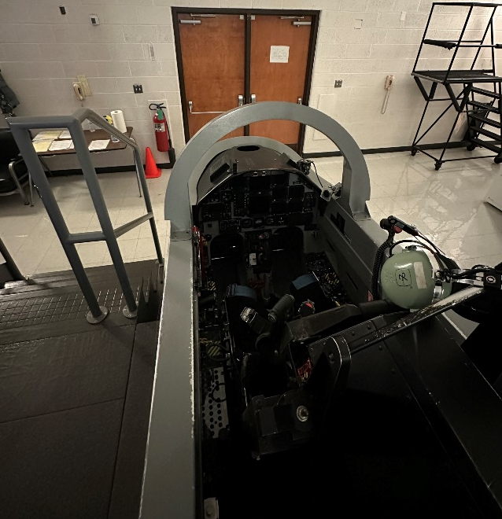
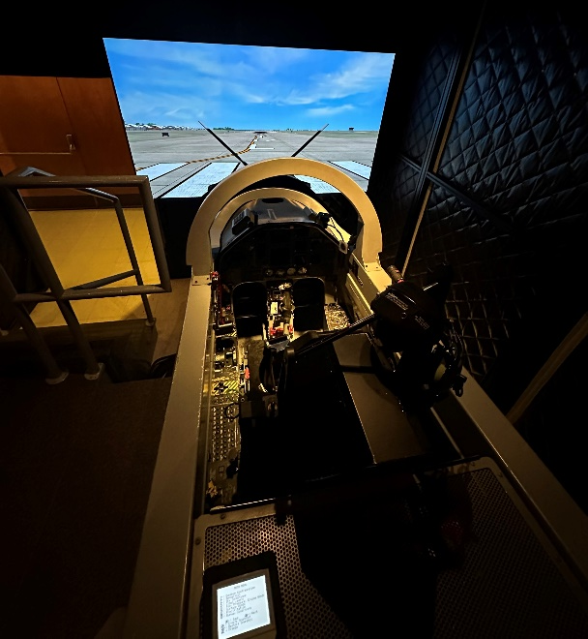
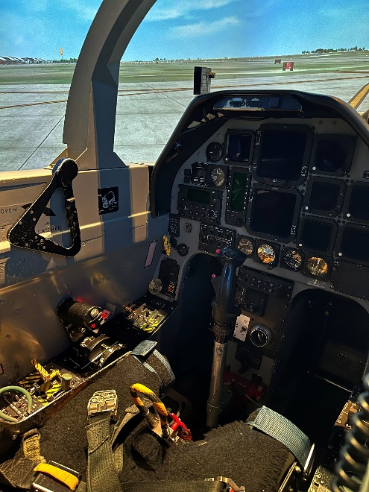
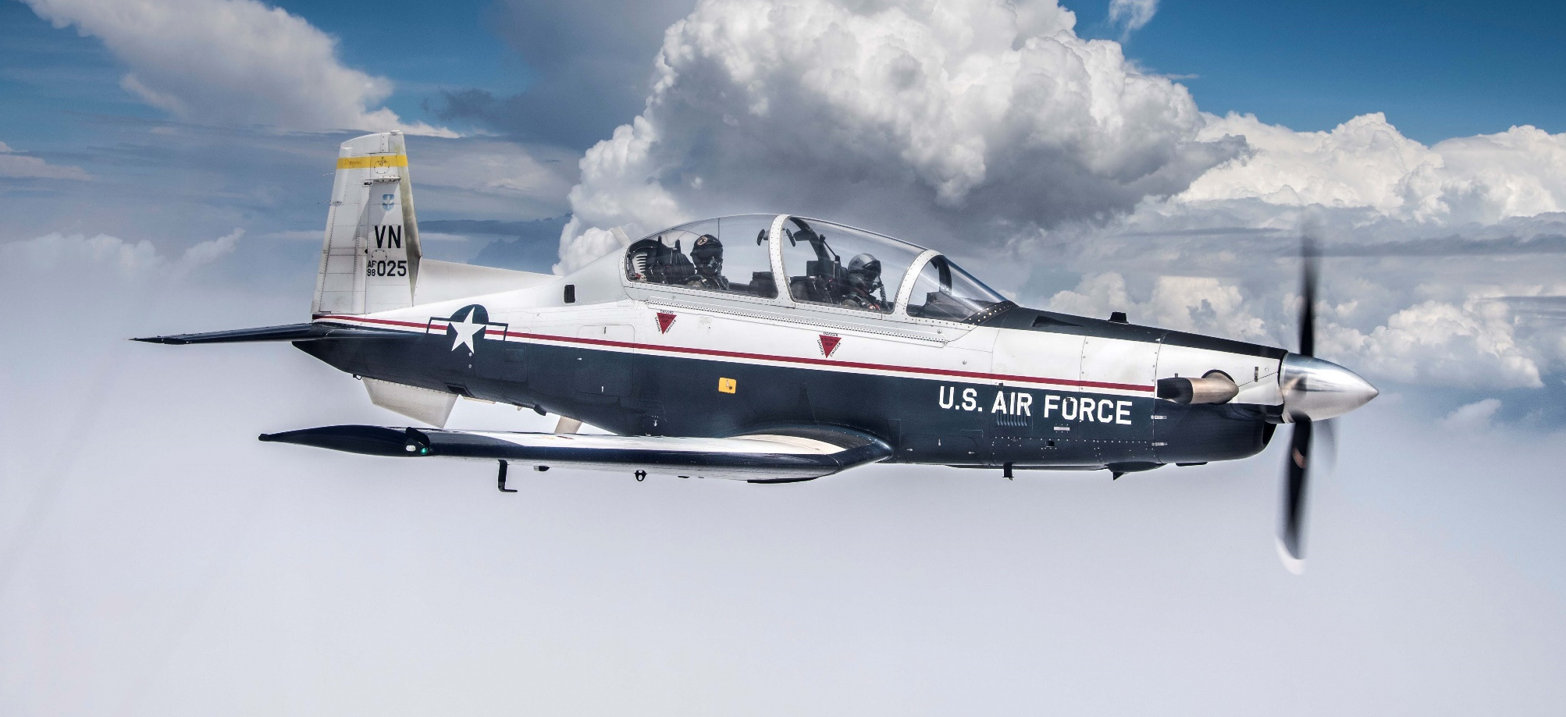
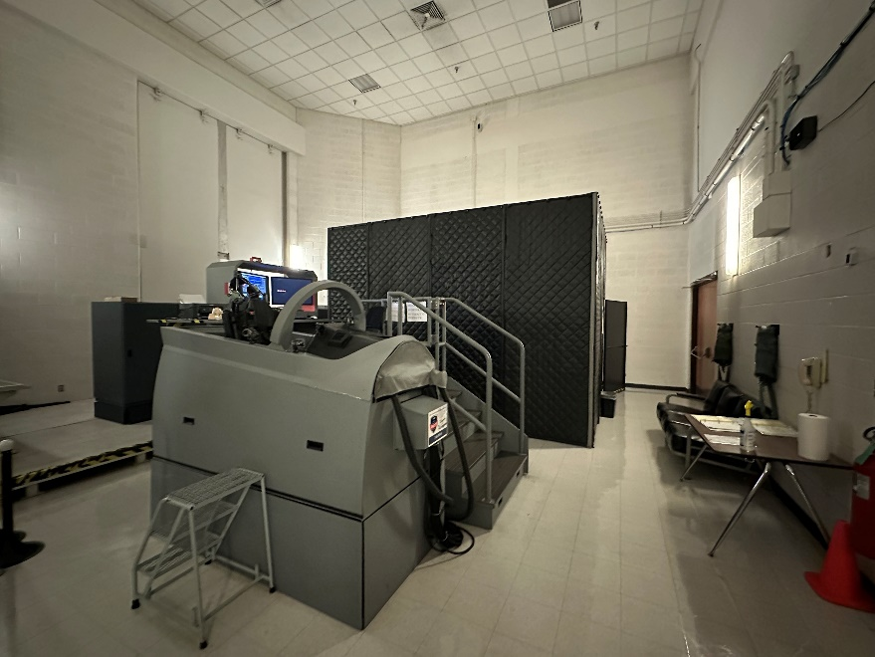
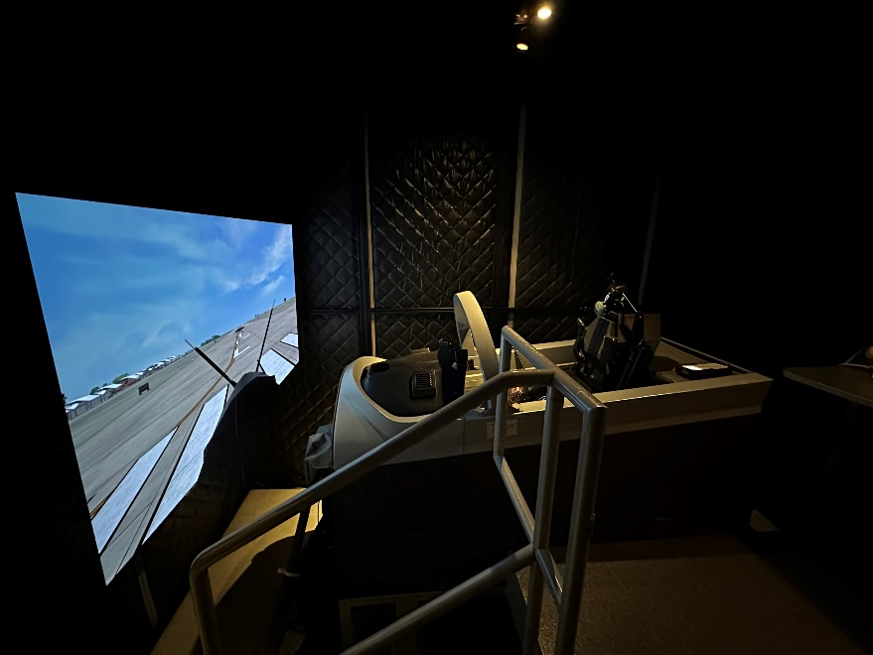
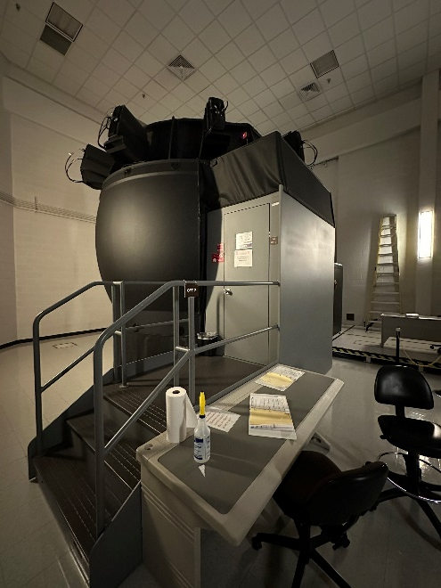
Beyond Illusions
T-6A = $5 Million
UTD = $1.2 Million
IFT = $1.6 Million
OFT = $3.8 Million
Notes:
The T-6A is the first aircraft every Air Force pilot flies in training.
There are 3 flight simulators which have been fully approved for T-6 training.
The lowest fidelity simulator is the Unit Training Device (UTD) which is an exact replica of the T-6 cockpit.
Instrument Flight Trainers (IFTs) are the same hardware as a UTD but add a front screen for external display.
The highest fidelity device is the Operational Flight Trainer (OFT) which puts a wraparound screen around the device. All this at only a fraction of the cost of an airplane.

Slide 9
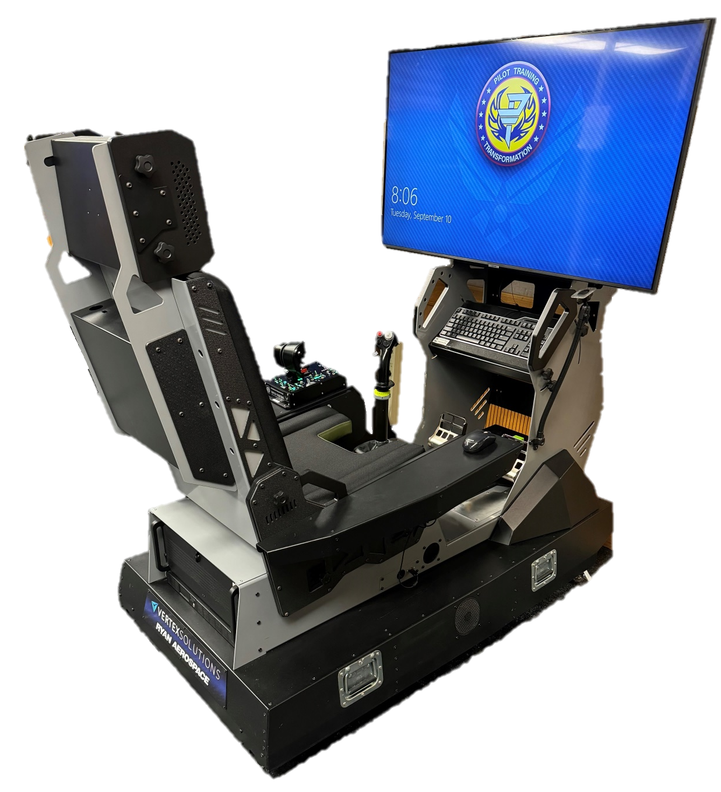
Beyond Illusions
ITD = $60,000
Notes:
The Immersive Training Devices or ITDs capitalize on the value of mental immersion and are only augmented by the fundamental physical controls providing an orders of magnitude lower cost.

Slide 10
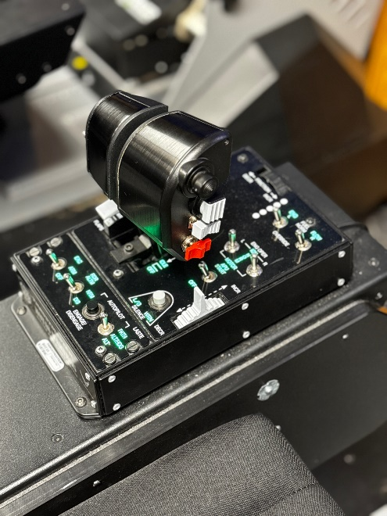
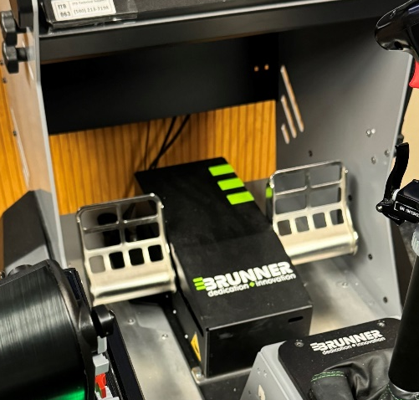
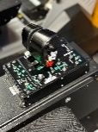

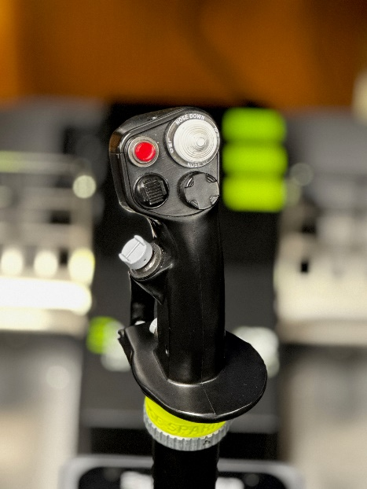

Beyond Illusions
Landing Gear
Flaps
Notes:
This ITD was developed intentionally with the use of readily available COTS simulator components.
It has a set of generic Brunner rudder pedals,
A stick from an F-16,
And the throttle is from the A-10.
Even more, the landing gear is a switch rather than a handle,
And there are 2 flap switches, only 1 of them similar to the aircraft.
The only true replication on the device happens virtually inside the headset.

Slide 11
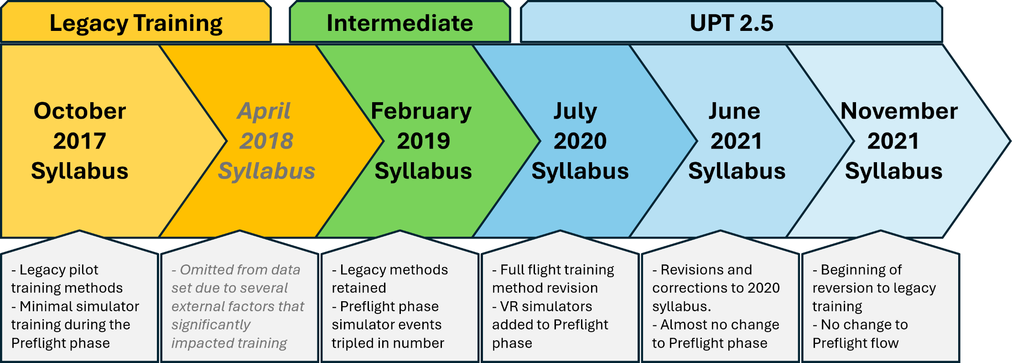
Beyond Illusions
UPT Syllabus Evolution
Notes:
Here are the major syllabus revisions in the last several years.
For anyone like us in the room who went through UPT, the Legacy syllabus will look familiar. Preflight training was historically reserved for academics, and there were very few simulator events prior to flight.
That changed with the intermediate syllabus, where production pressures led to moving 13 simulator events into the preflight phase to ease scheduling concerns. This major movement of devices did not change the overall training mindset, but it did give students better practice before they started flying.
UPT 2.5 was the first rethinking of training methods in decades, and it brought with it a shuffling of the preflight training. While the academic and simulator training was effectively retained, the addition of ITDs enabled the shuffling of which devices were required for each training event.

Slide 12
Beyond Illusions
Preflight Training Comparison
Syllabus | Legacy Simulator Events |  |  | ITD (VR Simulator) Events
 | UTD | IFT | OFT
Legacy* | 3* | 2* | 1* | 0*
Intermediate | 5 | 7 | 7 | 0
UPT 2.5 | 3 | 11 | 4 | 27
* Numbers shown for reference
Notes:
As we look at the number of preflight simulator events across syllabi, you can see the shifts in training device requirements we mentioned in the last slide. The intermediate syllabus added 13 events to the preflight phase with a majority occurring in the highest fidelity devices. The addition of VR devices in UPT 2.5 allowed us to adjust the fidelity requirements for several legacy training events.
…What needs to be pointed out is that these new ITD events were not randomly scattered throughout training. There was an intentional method to their placement in the training flow.

Slide 13
Beyond Illusions
Law of Primacy?
Legacy Sims
Academics
VR Sims
Aircraft
Notes:
VR is most effective for mental rehearsal. Because of this, a learning flow was created in UPT 2.5. For each maneuver a student learned, they first had a classroom or computer lesson describing the maneuver, next they got their first introduction and practice in the VR simulator. This applied not just to single maneuvers but went all the way up to full flight rehearsals. It was only after VR training that students moved to the legacy sims to refine their skills. But not always. In a few cases students skipped legacy training entirely, going directly from VR training to the aircraft.
It is entirely correct to say that we poured the entire student flying foundation in VR.

Slide 14
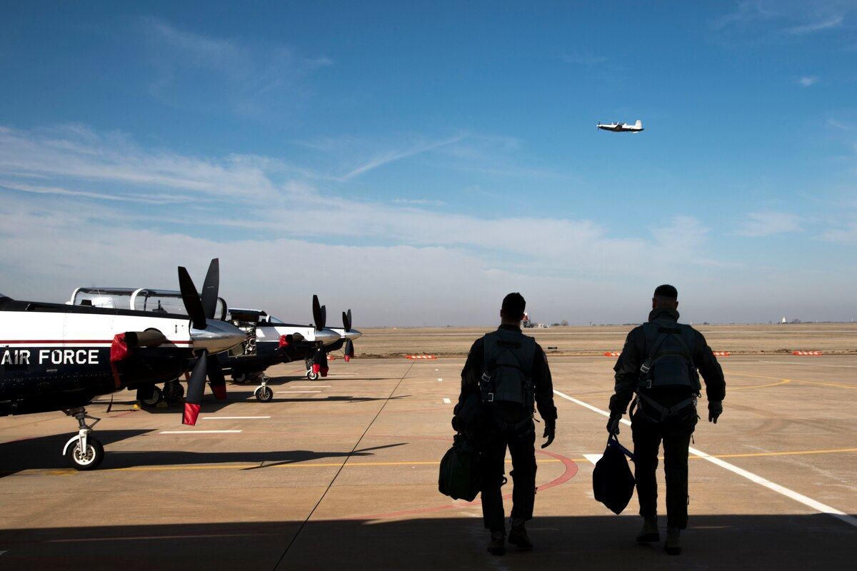
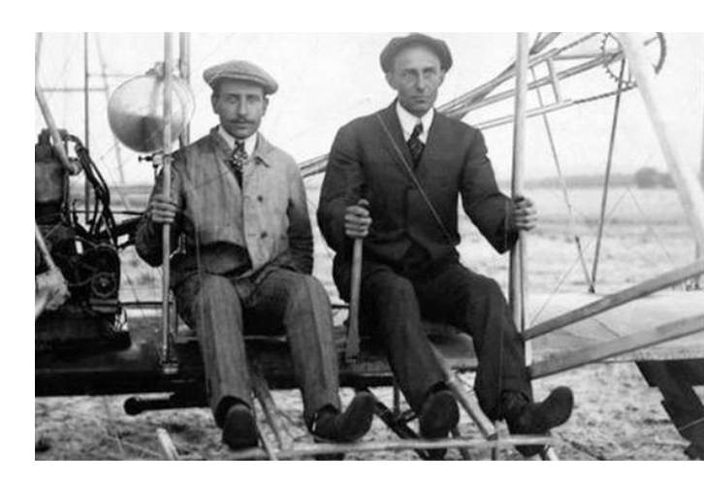
Beyond Illusions
Why the Dollar Ride?
Notes:
To test that foundation, we took advantage of one of aviation’s oldest traditions.
For those not familiar, the first time a student flies in a plane is more or less a freebie. The only expectations is that the student will spend the flight trying to break the plane with the instructor saying no. Since nothing in life is free, the student would pay the instructor a dollar after the flight.
The dollar ride does serve two training purposes. It is an orientation to the aircraft and the flying environment for the student. More importantly for us, it is a low-to-no stakes evaluation of the student’s training baseline.
What that means is that the instructor will give the student as many opportunities as conditions allow to attempt maneuvers, and then grade them objectively, with no outside pressure to make the student better or massage their scores. When an instructor finds a student incapable of a maneuver they will often demonstrate it, and then mark that in the grades. In short, it is likely the most completely and objectively graded sortie a student will fly.
This flight has been conducted in the same manner going back to the Wright brothers. The tradition is deeply ingrained in a way that has allowed it to survive intact up to and through the recent transitions in UPT. Because of that it serves as a perfect point of convergence for our survey. It is the moment where preflight training changes are most evident, and is before any changes in flightline training can impact results.

Slide 15
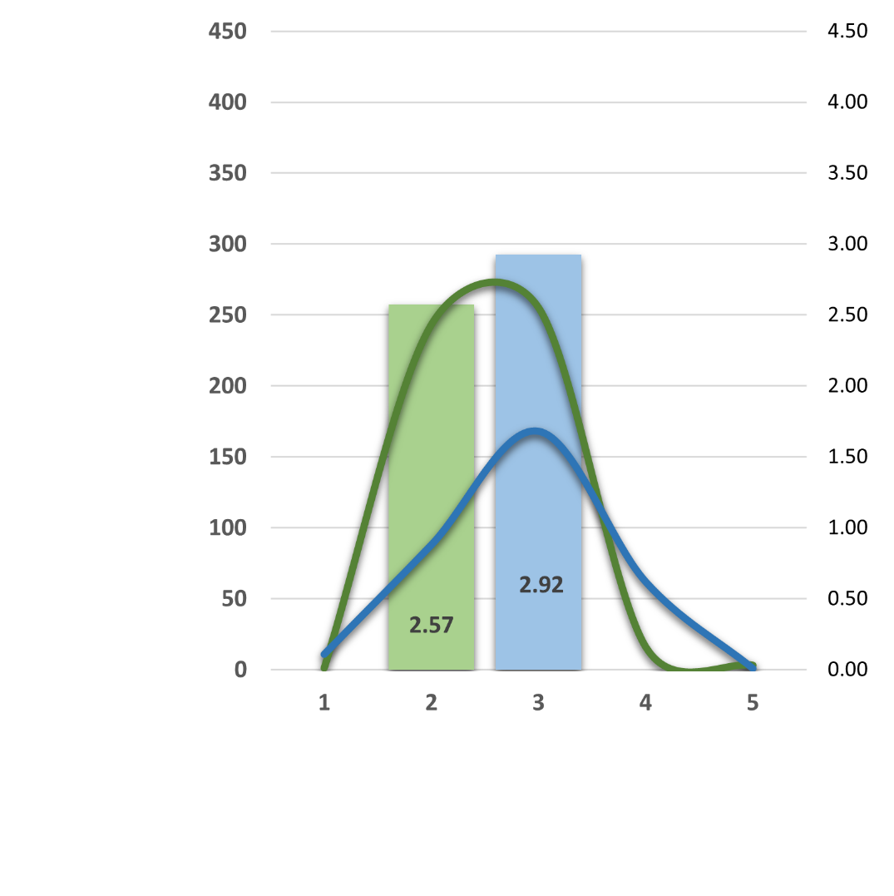
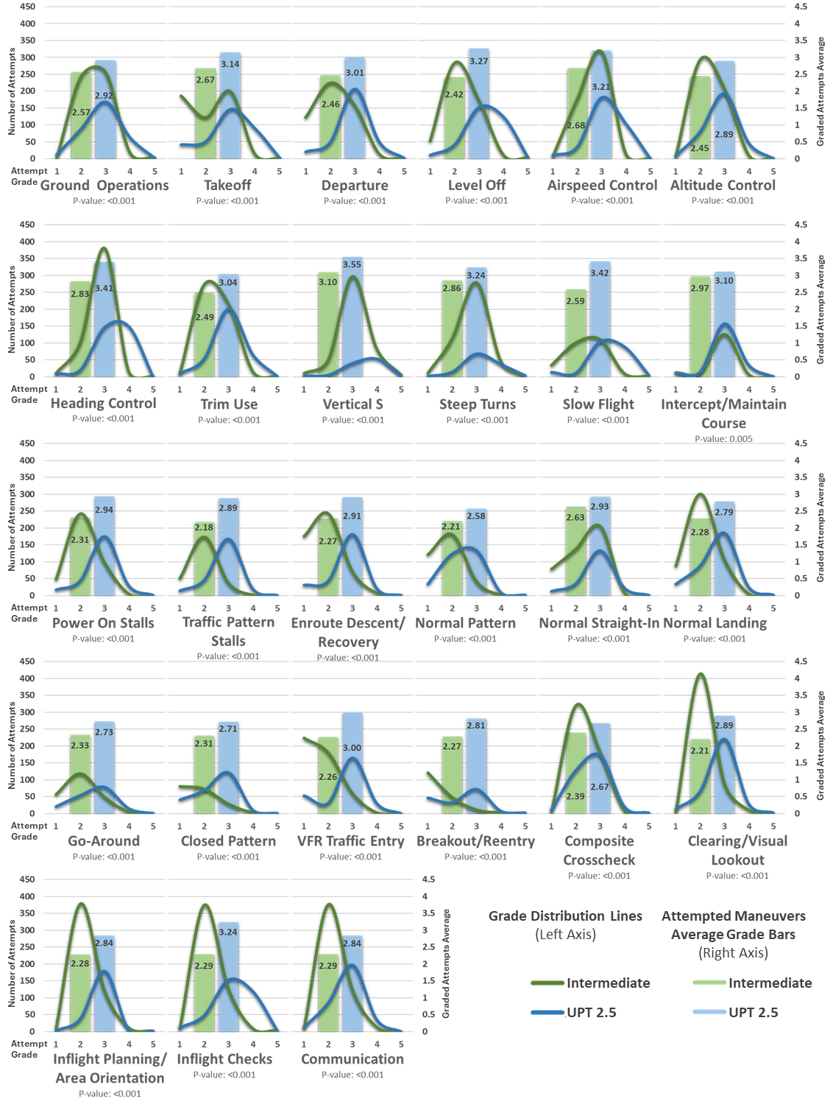
Beyond Illusions
The Graphs
Total Gradesheets
Intermediate | UPT 2.5
535 | 330
Notes:
So we pulled every dollar ride gradesheet at Vance AFB from the last version of the intermediate syllabus, and from the first of UPT 2.5. That gave us close to 900 flights to analyze. From those gradesheets we found every flight maneuver that was allowed in both versions, coming out to 40 directly comparable maneuvers.
I’ll give you a quick graph overview before we show everything. Data from the intermediate syllabus is always green, UPT 2.5 is shaded blue. Each maneuver is separated out and shown in two ways. The line graphs show the distribution curve of every recorded maneuver instance. Importantly, the grade of 1 on the bottom axis represents when an instructor demoed the maneuver with no student attempt. We found this grade to be relevant for program comparison because it captures how often a student was unable even to try a maneuver on the first flight.
The bar graphs show the average of all student maneuver attempt grades. Instructor demo grades were scrubbed from these so we could show the cleanest comparison of student performance.
Let’s jump in

Slide 16
Beyond Illusions
Notes:
Here is the first set of maneuvers. We have them shown a bit larger to allow you to get a sense of what we found.
Notable here is that we have grades from all phases of flight represented. You will see that even more on the next slide.
What you see across all phases of flight is a consistent positive shift in grade distributions for every measured maneuver after VR training.
This is also shown in the jump in average student grades. Many of them significant.

Slide 17
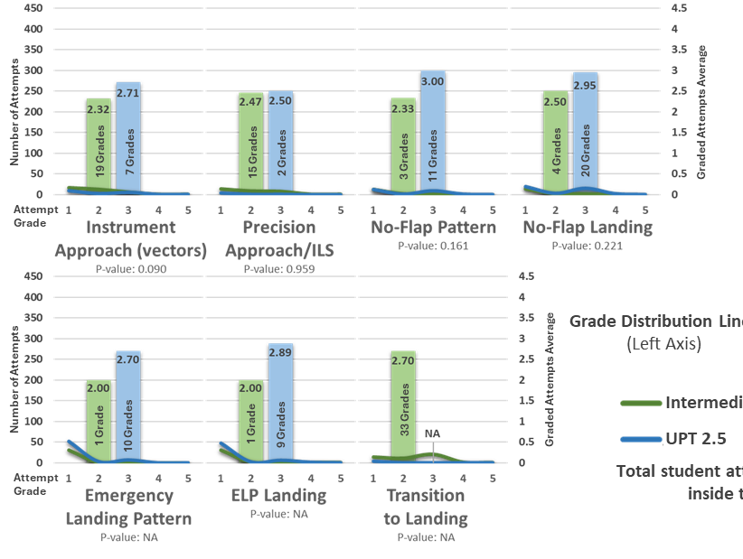
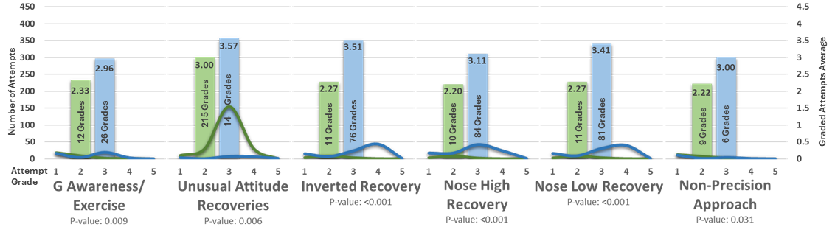
Beyond Illusions
Notes:
Here are the remaining graphs. The story doesn’t change. There are some details to point out though.
On the right side are maneuvers that did not have enough recorded student attempts for statistical significance in the results. These maneuvers have very little training value to attempt on a dollar ride, so this is not surprising.
The bottom middle are maneuvers we called out because the number of attempts shown was well below the rest of the data set. They all showed statistically significant improvement after VR, but it felt intellectually disingenuous to not show them. Notably, there are still more data points available for those maneuvers than many other published studies had for their entire test population.

Slide 18
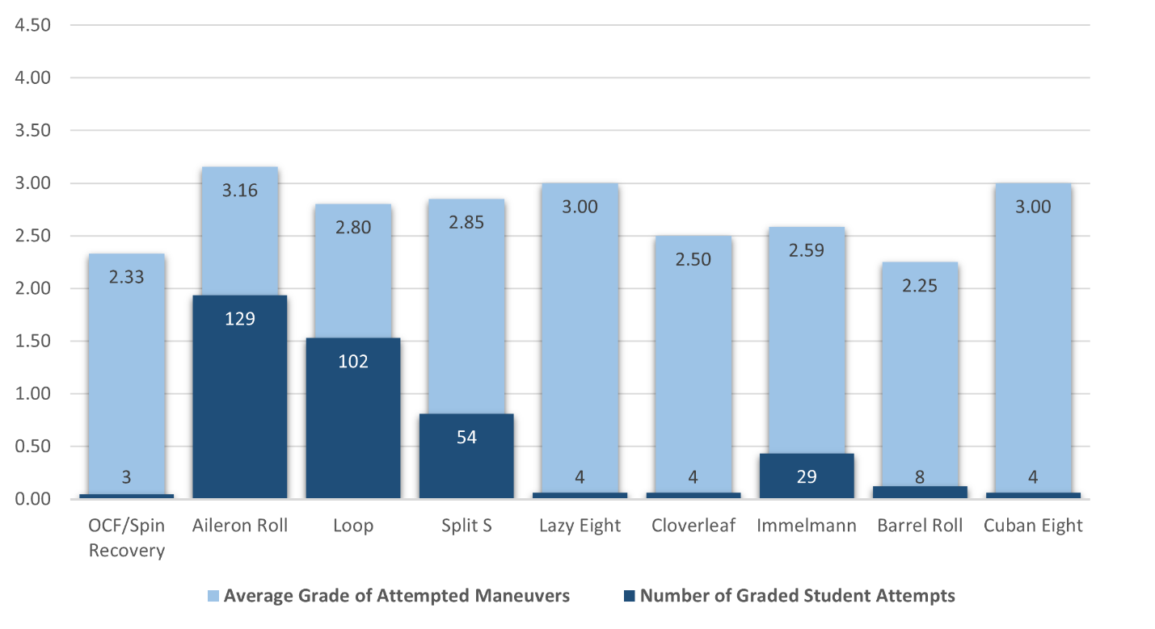
Beyond Illusions
Aerobatics
Notes:
Aerobatics are shown separately here, firstly because they were not allowed before UPT 2.5, so there is nothing to compare these results to.
Second, and even more interesting, these are all maneuvers that students only saw and practiced in VR prior to their dollar rides. Aerobatics were initially going to be left out of preflight training entirely because the prevailing wisdom was that aerobatic training was not possible in VR. But the choice was made to let the students try and prove prevailing wisdom wrong.
Doing well on aileron rolls is a given. It’s probably the easiest thing you can do in a T-6, easier than flying level. But what caught our attention was how many of the more complex maneuvers were being graded highly.

Slide 19
Beyond Illusions
Sim Theory cannot account for these results
Positive Transfer ≠ Physical Replication
Good Foundational Training ≠ Law of Primacy*
* As defined by the FAA Instructor Handbook
Notes:
So there it is. I’ll be honest, the results in the data surprised even us. Both of us were trained under conventional sim theory, and we expected to see it hold up in at least a few grades. But it didn’t.
>>
Positive transfer occurred in every graded maneuver, including ones that should have been negative because of the incorrect switch placements or missing physical controls.
>>
We also saw a strong counter to prevailing understanding of the law of Primacy. At least one of the 40 maneuvers evaluated should have reflected the use of wrong controls for first exposure. And we didn’t even discuss the fact that several of the VR events were self-guided with no instructor present to make corrections.

Slide 20
Beyond Illusions
How much is enough?
Notes:
After considering the data, we present to you that we have been asking the wrong questions about physical replication in simulators. Instead of chasing for as much as we can get, it would better for us to ask, how how much is enough?

Slide 21
Beyond Illusions
Header
  Bullet
    Sub-Buller
  Bullet
NT+OP=VEOP

