Slide 1
Separating Buzz from Method: The AI Revolution in Military Training
Cutting through the hype with a methodical approach to development and implementation of AI Strategies
Jenna Tuck, Bohemia Interactive Simulations (BISim)
Notes:
Thank you for joining me today. I'm excited to share insights on how we can bridge the gap between AI's buzz and its practical applications in military training. The goal is to separate the hype from meaningful use cases

Slide 2
Agenda
Current State of Affairs: AI in Military Training
Understanding AI Terminology: Moving Beyond the Buzzwords
Bridging AI and Data Strategies: The Iceberg Model
Method in Action: Case Studies
  Large Language Models to Increase Training Asset Utilization
Future Roadmap and Recommendations
Final Thoughts
Notes:
Brief intro and context
Importance of AI in military training
Acknowledgment of the audience
Acknowledgment of time limits; focus will not be on presenting on the paper, but diving deeper into the concepts outlined/discussed in the paper and providing case-study examples of these methods in practice

Slide 3

Current State of Affairs: AI In Military Training
AI History Overview:
  Began in 1950 with Alan Turing and the Turing Test
AI Winters and Resurgence in 1997
Emergence of AI in everyday life with Robots, Siri, & Alexa
Modern AI Boom (2022-present)
Ultimate Goal: Future of AI & Trying to Get There
Future of AI
Today: Challenges in the Current AI Environment:
  Limited Result
  ‘Sprinkle AI’ Trend
  Undefined Requirements
  Buzzword Over Substance
  Misunderstanding
But Why?
1950
Notes:
Bullet Points (Notes Section)
AI History Overview:
Began in 1950 with Alan Turing and the Turing Test, sparking early excitement around AI.
1956: Term "Artificial Intelligence" was coined.
1959: First industrial robot emerged.
1964: Introduction of the first natural language processing system.
1966: Creation of the first chatbot, dubbed the "electronic person."
AI Winters and Resurgence:
1980s-90s: "AI winters" due to Cold War and stalled progress.
1997: Resurgence of interest when Deep Blue defeated chess champion Garry Kasparov.
Commercial Integration and Recent Developments:
Emergence of AI in everyday life with robotic cleaners, Siri, and Alexa.
COVID-19 led to a temporary slump, with a refocus on big data afterward.
Modern AI Boom (2022-present):
2022: Explosion in AI interest with public availability of AI like ChatGPT.
Today: Yet another wave of excitement around AI’s potential in training applications.
Challenges in the Current AI Environment:
Limited Results: Despite all the excitement, many applications deliver limited results.
‘Sprinkle AI’ Trend: Too often, AI is added to projects without a clear purpose.
Undefined Requirements: AI requirements are often vague and poorly defined.
Buzzword Over Substance: Procurement and marketing efforts tend to focus on mentioning AI rather than understanding its true value
BUT WHY – what is it that is stopping us from achieving the next step in our large-scale realization of AI driving training benefits?
I would assert that in large part it is due to a fundamental misunderstanding of AI’s, when and how AI can provide benefit(s), and respective limitations.

Slide 4
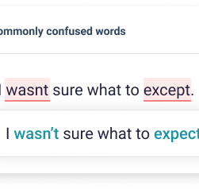
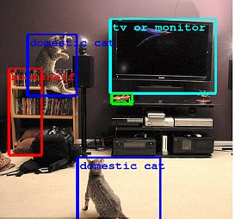



Foundational Understanding: Demystifying AI
AI Defined
AI Juxtaposition:
  What the Market Needs vs. What the Market Offers
Sliding Scale of AI
Less Complex
More Complex
Spell Checkers
Image Recognition Tools
Recommendation Engines
Expert Models
Notes:
AI is a term that’s quickly become a buzzword, thrown around everywhere in technology and defense. But what exactly is AI? According to the Institute of Data, it’s simply 'the simulation of human intelligence in machines that can perform tasks usually requiring human intellect.' Now, that’s a pretty broad statement, and it’s where the confusion starts.
For instance, an 'expert model' that follows a set of programmed rules is fundamentally different from a 'machine learning' algorithm that learns from data, yet both fall under the umbrella of AI. And that’s technically correct.
But here’s the thing—most AI that we interact with on a daily basis is simply a rule-based system behaving exactly as it was defined. If you dig beneath the surface of what’s called 'AI' in a video game, for example, you’ll often find that it’s just an algorithm following a hierarchical behavior tree.
This is the essence of the AI juxtaposition: marketing has created a facade of what AI is, and companies have rushed to conform to that image by labeling nearly anything as 'AI.' While they may technically be right, it doesn’t necessarily bring us any closer to achieving meaningful, AI-driven outcomes.
One helpful way to think about AI is on a sliding scale of complexity, from basic algorithms and rule-based systems all the way up to more sophisticated, adaptive approaches

Slide 5
Understanding the AI Terminology : Beyond the Buzzwords
AI Categorization
Categorized by Capability
Artificial Narrow Intelligence (ANI) or Weak AI
Artificial General Intelligence (AGI) or General AI
Artificial Superintelligence (ASI) or Super AI
More Simple
Categorized by Functionality
More Complex
Reactive Machines
Limited Memory Machines
Theory of Mind
Self-Aware AI
Categorized by Functionality Type
Descriptive AI
Diagnostic AI
Predictive AI
Prescriptive AI
Cognitive AI
Generative AI
Notes:
My paper goes into these categories in much more detail, but given the time we have today, I won’t dive too deep into each one. Instead, let's look at the big picture. When we think about AI, there are many types, and it can feel overwhelming. So, just as we can think of current AI technologies on a sliding scale, its helpful to think of things on that same sliding scale of complexity when we talk about the ways to categorize AI.
To bring this all together, I'll provide a high-level overview, breaking down these categories to help us understand how AI fits into military training applications without getting lost in the jargon. The key is to keep things simple and focus on the core concepts that matter
At one end, we have basic systems that follow simple rules, and at the other end, there are more advanced, theoretical forms of AI that push the boundaries of what’s possible. We can further categorize AI in different ways: by its capabilities, its functionalities, and the types of problems it addresses.

Slide 6
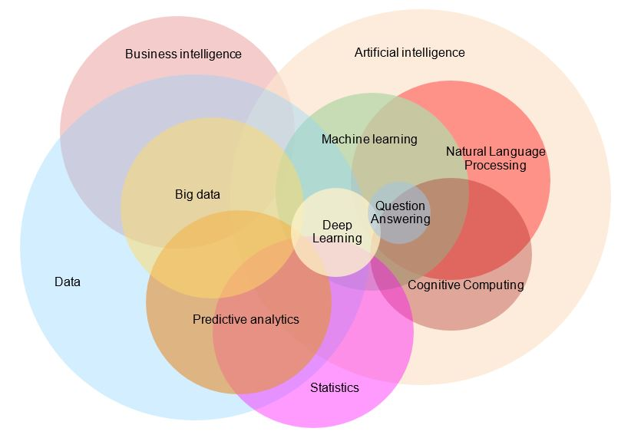
Understanding the AI Terminology : Beyond the Buzzwords
AI Categorization: By Technology
Notes:
Yet another way to categorize AI – but more importantly terms within AI that are absolutely critical to understand if you are to fully understand what AI can do and how you can use it is to categorize AI based on technology, and these are less of a clean c;hart and more of a very messy diagram – like for example this one from the imperial college of London.
There are many other ways of classifying AI such as; by learning type (supervised/unsupervised/semi-supervised/reinforcement); by model of interaction (human in the loop/on the loop/out of the loop); automated vs. autonomous; and by so on—But, possessing a baseline understanding of AI as it relates to capability, functionality type, functionality, and technology provides the fundamental understanding necessary to look at how AI can be used in application to harness AI in meaningful ways—even if those ways are minimal at first.

Slide 7
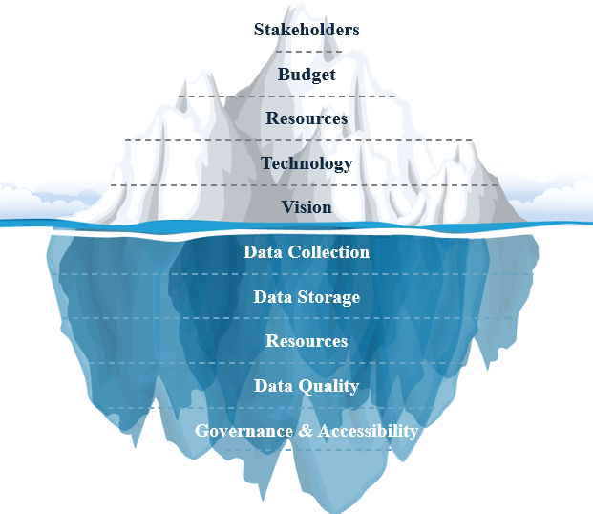
Building on AI Fundamentals
Moving from understanding AI capabilities to implementation
The Iceberg Model
  Starting with a clear vision
  The Importance of understanding:
    Available resources
    Limitations
    Stakeholders
  The role of data strategy
  Remaining agile but purposeful
Notes:
Now that we’ve clarified what AI can and cannot do, it’s time to talk about how we start applying it in meaningful ways within military training. Understanding AI's capabilities and limitations provides the foundation—but knowing the technology isn’t enough on its own. We need to align this understanding with a structured approach that starts with a strong strategy.
Think of it like an iceberg. What you see above the water—the AI strategy—are the tools, algorithms, and systems we use to enhance training. But underneath the surface lies the data strategy, which supports everything else. This hidden part is where the real work happens, making sure the AI has the right data, that the data is high-quality, and that it’s accessible when needed. Without a robust data strategy, the AI initiative is at risk of falling into what we call the 'Valley of Death,' where projects stagnate because they lack a solid foundation.
To start applying AI successfully, we need to align both strategies from the very beginning. It starts with having a clear vision: understanding the specific training outcomes we aim to achieve and ensuring that both our AI and data strategies support those goals. From there, we must focus on data quality and accessibility, which means collecting the right data, ensuring consistency, and breaking down silos to make data usable across the organization. We also need to allocate the right resources, including personnel, infrastructure, and budget, to support these strategies. And lastly, stakeholder alignment is key—everyone from leadership to data custodians needs to understand their roles in making the initiative successful.
By taking these steps, we can move from knowing what AI is capable of to actually leveraging it to deliver real, measurable benefits in military training
Key Takeaway:
Now that we understand AI's potential and limitations, a well-aligned AI and data strategy is crucial for starting practical implementations and avoiding common pitfalls.

Slide 8
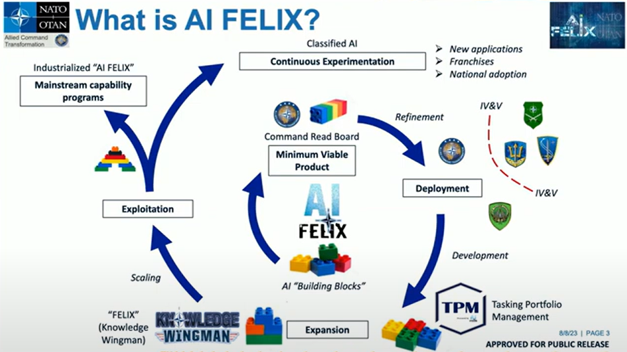
Case Study 1: AI FELIX; Cognitive Overload
  Technology: Web application, NLP Algorithms, meta data extraction
  Resources: Seed funding
  Stakeholders; further buy in due to actionable/quantifiable value
    Served as the ‘building block’ for future capabilities (see graphic)
Results:
  reduced processing time by 80%
Vision: Do more with less; Human ON the loop
Notes:
Problem Statement:
NATO Allied Command Transformation (ACT) faced a common challenge in the data-saturated environment:
Too much information to process, not enough time, and difficulty finding relevant data.
Example scenario: Sailor Juan Felix Williams at ACT received daily emails and official correspondence from the entire NATO enterprise.
He had to manually download PDFs, upload them to SharePoint, and transfer metadata (title, keywords, etc.)—a time-consuming process.
Vision:
The goal was to shift from having a human in the loop to a human on the loop.
Instead of manual processing, the system would automate the heavy lifting, allowing humans to oversee and intervene only when necessary.
Approach and Implementation:
Won "Innovation Idea" seed funding to develop the solution.
Built an AI-powered web application with Natural Language Processing (NLP) algorithms.
The AI engine read documents, extracted metadata, and performed automated data handling.
Results and Impact:
Reduced processing time by 80%, significantly increasing efficiency.
Enabled personnel to focus on higher-value tasks rather than manual data management.
Key Takeaway: NATO ACT's solution demonstrates the power of AI to automate tedious tasks, reducing workload and processing time while allowing human operators to stay "on the loop" for oversight (short term) and also paved the way for many more AI capabilities

Slide 9
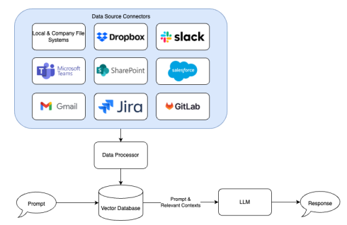
Case Study 2: JOI; Secured AI Assistant
Vision: Individualized AI Assistant
  Technology: Retrieval Augmented Generation (RAG)s
  Resources: Limited
  Stakeholders:
Results:
  Unified data access
  Contextualized Insights
Notes:
Challenge:
A small defense startup recognized the potential of AI assistants like ChatGPT but was concerned about data security.
Utilizing these tools typically requires sharing sensitive data, which posed significant security risks.
Opportunity with RAG (Retrieval-Augmented Generation):
The emergence of RAG technology offered a way to harness AI without compromising data security.
This led to the idea for JOI, a solution that could provide AI-powered insights while keeping data secure.
Strategic Approach for a Startup:
Recognizing limited resources, the founders aimed for a manageable initial capability that would deliver high value.
Focused on creating a scalable solution to secure early wins, which could then fund future development and iterative improvements.
Stakeholder Alignment:
As a startup, ensuring alignment with industry needs was critical for success.
The solution was designed to cater specifically to the defense community's unique requirements for data security and insights.
Results and Value Delivered:
Unified data access enabled secure retrieval of information without moving the data.
RAG technology provided real-time analysis, generating valuable insights based on user queries while maintaining data integrity.
Key Takeaway: This case study highlights the importance of starting small, focusing on high-impact solutions, and aligning with stakeholder needs to build a scalable and sustainable AI capability.

Slide 10

Case Study 3: Project CanDLE; Adaptive Learning
Vision: Adaptive Individualized Training for Computer based Systems
  Technology: Predictive Analytics, Virtual Assistant, Q&As, RAGs
  Resources: Limited
  Stakeholders:
Results:
  Multiple singular AI applications
    Ask questions of training content
    Insights of performance
    Suggested training on performance
    Performance trends and analytics
  Iterative improvements
    Insights based on all users
Notes:
Challenge:
The more complex and capable a simulation system (like VBS), the longer the onboarding process for users.
Both trainees and instructors face significant learning curves before they can effectively utilize the system for training.
Approach with Expanded Resources:
This project had more resources available, enabling the integration of multiple technologies to enhance the system's capabilities.
Leveraged expertise across various technology types to create a comprehensive solution that addressed multiple needs within the training process.
Stakeholder Composition:
The project's stakeholders included a diverse mix of salespeople, end-users, and technical experts, reflecting its broad impact.
This diverse input helped shape the solution to be both user-friendly and aligned with the needs of different groups involved in the training.
Outcome and Value:
Reduced onboarding time by streamlining the system interface and making it more intuitive for new users.
Enabled faster transition from learning the system to actual training, maximizing the time spent on developing practical skills.
Integrated capabilities improved training efficiency by allowing users to access multiple functionalities from a single platform.
Key Takeaway: This case study demonstrates the importance of simplifying complex systems to reduce onboarding time, leveraging multi-technology expertise, and ensuring diverse stakeholder alignment for comprehensive solutions.

Slide 11

Turning Understanding into Action
Practical Steps for AI Implementation
  Start Small and Scale Up
  Prioritize Measurable Outcomes
  Learn from Case Studies
  Align AI with Your Overall Vision
  Embrace Incremental Change
Notes:
Start Small and Scale Up: Focus on manageable, high-impact projects
first begin with pilot programs that address specific, well-defined problems
Use these small wins to build confidence and gather data for future scaling
Prioritize Measurable Outcomes: Don’t just implement AI for the sake of it
Define clear objectives with measurable success criteria
Avoid "AI for AI's sake" by ensuring every project has a tangible benefit
Learn from Case Studies: Adapt the principles from earlier examples (and SO MANY MORE)
Apply targeted, adaptive training like in the marksmanship case study
Leverage rapid experimentation for innovative strategies, as in wargaming
Align AI with Your Overall Vision: have a clear vision:
Make sure your data strategy supports your AI initiatives
Secure stakeholder buy-in and clearly define roles for everyone involved
Embrace Incremental Change: Limitations and challenges are part of the process
Address limitations gradually by refining your data and AI strategies
Focus on iterative improvements rather than trying to solve everything at once

