Slide 1



Towards a Cognitive Framework for Assessing Students and Adapting Interventions in Extended Reality (XR)
Gregory McGowin, University of Central Florida
Gregory McGowin¹, Joseph Cohn², Georges Potworowski³, Tarah Daly³, J.T Folsom-Kovarik², Stephen M. Fiore¹, and Jenni Phillips³
¹University of Central Florida, ²Soar Tech, ³Cognitive Performance Group

Slide 2


Background & Objective
Background
Problem
Adaptive XR T&E development:
does not leverage the full potential of XR affordances
does not integrate XR in a blended classroom
is slow and expensive, so not scalable
CNO's priority is to prepare Sailors to “operate in uncertain, complex, and rapidly changing environments.”
Immersive extended reality (XR) has the potential to deliver a paradigm shift in training and education (T&E).
XR affordances extend and complement learning in classroom instruction.
XR has instructional and design limitations.
Adaptive training improves T&E outcomes by tailoring learning to each Sailor.
Adaptive instruction has not yet been deeply integrated in XR.
Objective
Provide a framework that is grounded in the learning sciences, leverages the affordances of XR, integrates methodologies of adaptive training, accounts for the needs of blended learning in order to provide a scalable, effective and efficient solution for enhancing learning outcomes, personalizing instruction, and improving skill acquisition in immersive training environments.

Slide 3
Current Approach and Limitations
Current Approach
Limitations
Development of XR for training and education (T&E) draws heavily on the computer-based training literature.
XR T&E is typically developed as one-off modules or courses.
XR T&E is generally as effective as conventional T&E methods for transfer and shows positive impacts on learning gains, self-efficacy, and engagement¹.
XR’s full potential not leveraged:
XR T&E design often neglects the interdisciplinary literature relevant to XR that could provide evidence-informed design options.
One-off XR modules not scalable:
They are expensive and slow to develop and adapt, so offer no potential gains in efficiency through re-use.
Limited instructor monitoring of XR:
No solution exists for instructors to monitor multiple students' performance in real-time on XR modules in the class to select XR or in-person adaptations..
Notes. ¹ Kaplan et al., 2021; Radianti et al., 2020; Hamilton et al., 2021

Slide 4
ACTIVE Framework
Framework Elements |  | What the Element Does
A. 4E Cognition Embodied Enactive |  | Philosophical and cognitive theory to inform an adaptive XR framework¹
B. XR Affordances Interactivity Presence |  | Framework to inform design of user-centered, effective XR instructional systems²
C. Learning Objectives Knowledge Comprehension |  | Desired objectives or outcomes of learning in XR
D. Training Interventions |  | Instructional manipulations that produce effective training³
E. Measures Accuracy Fluidity |  | Student behaviors and performance suggestive of current level of proficiency
Embedded
Extended
Immersion
…
Application
…
Deliberate practice
Scaffolding
Cueing
…
Speed
…
Notes. ¹ Clark, 2008; Varela et al., 1991; ² McGowin et al., 2023; ³ e.g., Van Buskirk, et al., 2009; Schatz et al., 2012

Slide 5


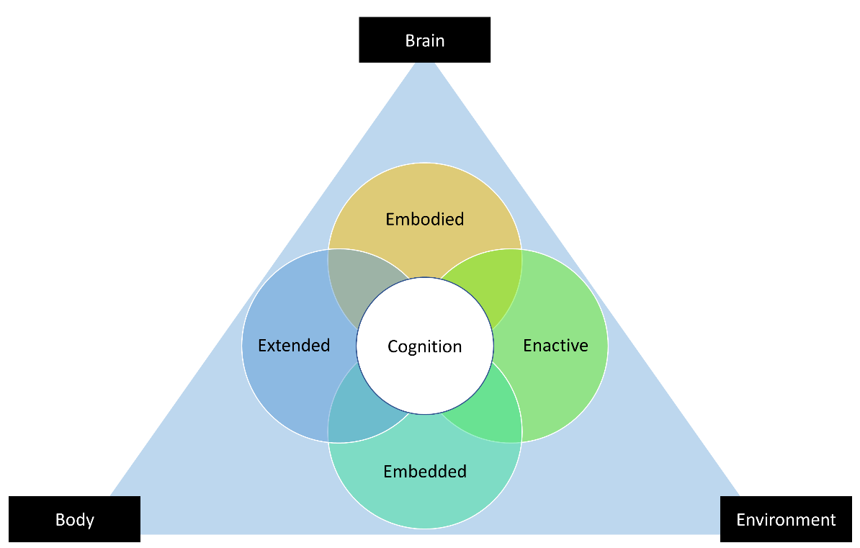

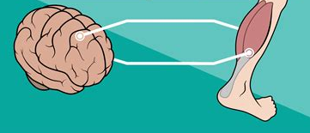

What is 4E Cognition?
Embodied
Extended
Enactive
Embedded

Slide 6
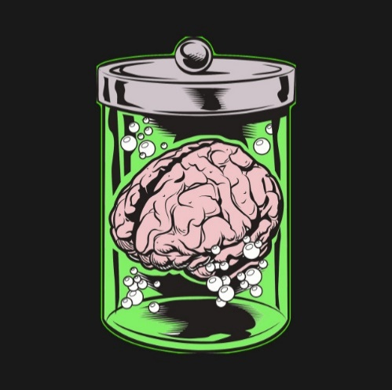
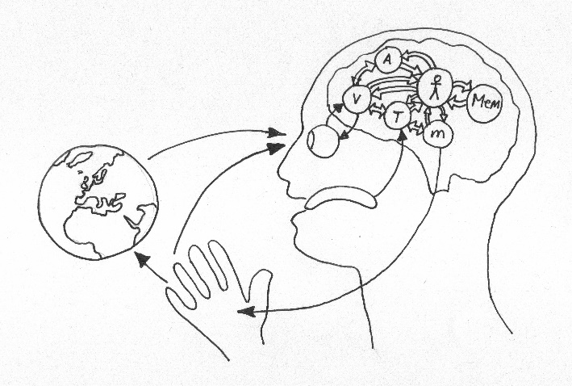



What is 4E Cognition?
Embodied Cognition: More than abstract mental processes. Involves the entire body of the living system (brain and body).
Extended Cognition: can be offloaded into biological beings and non-biological devices.
Embedded Cognition: Not separated from the agent’s ecological niche. Contains layers of co-determination with physical, social, and cultural aspects of the world.
Enactive Cognition : are a set of meaningful relationships determined by an adaptive two-way exchange between creatures and the environments they inhabit and actively shape

Slide 7

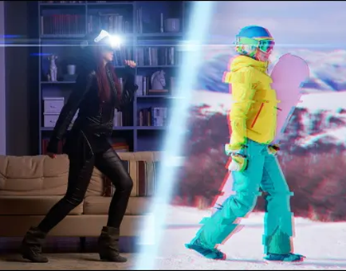
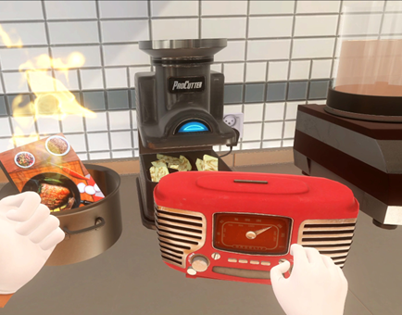

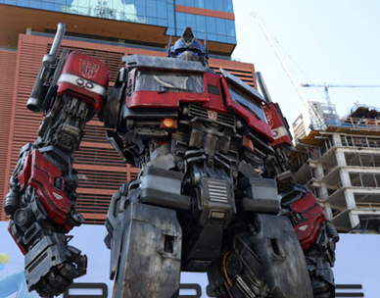



Learning Affordances
Immersion
Presence
Interactivity
Agency
Transforming the Abstract to the Concrete
Doing Rather than Only Observing
Infeasible or Impossible Becomes Practical
Exploring Manipulations of Reality and Beyond

Slide 8
Adaptive Training
Standardized learning often fails to accommodate individual differences and the varying levels of scaffolding needed.
Applying learning science theories in real-world educational settings requires technical approaches to translate them into practice.
A generalized approach to transform these theories into practical technical solutions is needed.
Adaptive training (AT) offers solutions to translate theoretical insights into educational practices to foster learning in virtual environments that are both adaptive and effective.

Slide 9
Adaptive Training
At its core, AT creates customized learning journeys (i.e., individualized learning) to meet the specific needs and performance levels of each learner.
Numerous approaches for implementing adaptive training (e.g., rule-based, machine learning algorithms, AI driven cognitive tutors) exist.
General approaches can be supplemented by additional monitoring technologies such as EKG, EDR, ET (physiological), EEG and fNIRS (neurological), as well as accelerometers and gyroscopes (physical movement).

Slide 10
Proposed Adaptive Training Architecture
AR/VR SIM
Monitor
Learner
Activity
Assess Competency
Learner
Activities Log
Competency
Model
Learner
Micro-Adaption
Recommend Need for Adaptation
Adaptive
Strategy Model
Instructor: In the Loop or On the Loop
Instructor
Feedback to
Student
Deliver Adaptations
Sim
Instance Data
Adaptive Training
System
Macro-
Adaptation,
Progression
Dashboard

Slide 11
Linking It All Together
XR + AT does not simply simulate reality; it offers several advantages over real-world learning:
  it enables learning in environments that are dangerous, rare, or hard to recreate in real life;
  it can turn abstract concepts into tangible first-hand embodied experiences;
  it can scale interactivity cost-effectively;
  it can provide on-demand scaffolding;
  offers both traditional and novel methods for capturing learner progression
  it can adapt to support individual learning paths to optimize learning gains (e.g., learner state, difficulty)
The ACTIVE framework bridges these together

Slide 12
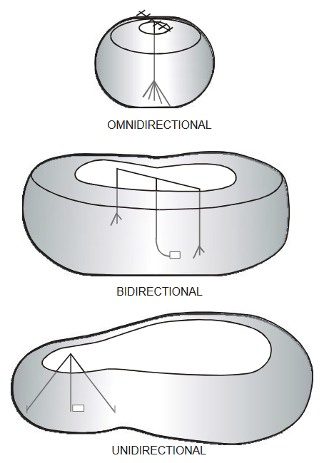
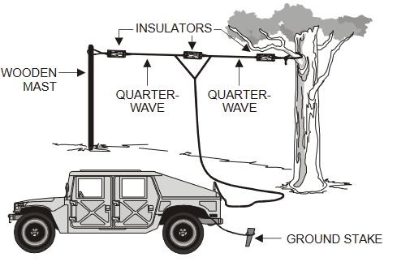

Case Study: Antenna Basics
Antenna Array
Construction Tools
Antenna Radiation Patterns

Slide 13
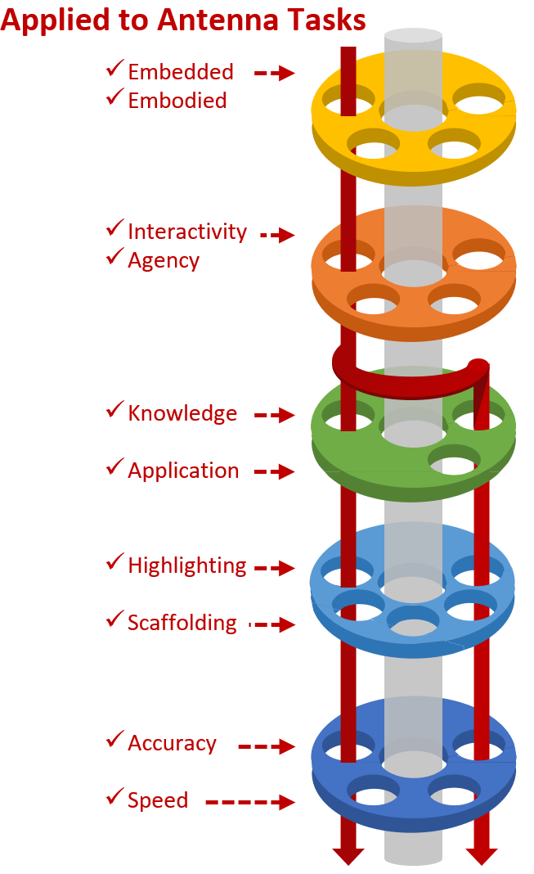
Water Through the Pipes
4E Cognition Embodied Enactive Embedded Extended
XR Affordances Presence Agency Interactivity …
Learning Objectives Comprehension Analysis …
Training Interventions Cueing/hinting Deliberate practice …
Measures Accuracy Speed …
Example of Content
Embedded: Requires a level of authenticity Embodied: Requires self-representation/avatar within the environment
Interactivity Levels: Level I: Review basic content (embedded) Level II: Provide new similar content through JIT’s (extended) Agency: Allows learners to choose how to approach tasks
Knowledge: Identify components and their functions Application: Construct an antenna array based on location factors
Highlighting: Compare and contrast features Scaffolding: Construct simple to complex circuits
Accuracy: % of correct connections between components Speed: time to complete task

Slide 14
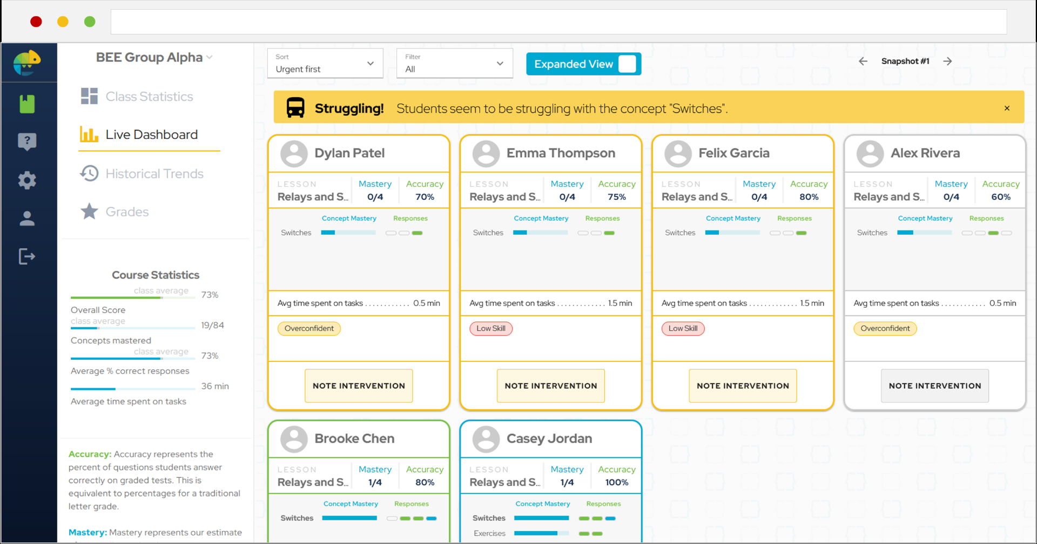
Instructor Dashboard

Slide 15
Challenges and Path Forward
Blending XR with Traditional Methods:
  The integration of traditional and XR-based instruction was only touched on. Future work needs to explore how blended learning can be optimized within the ACTIVE framework to combine the strengths of both approaches.
Aligning Learning Objectives with XR Interventions:
  We aim to develop a Training Intervention Matrix to ensure that learning objectives are better aligned with specific XR-based training interventions. This will help us match the right instructional strategies with the desired learning outcomes.
Establishing Clear Metrics for Learning:
  We are working towards defining metrics (both traditional and novel) that can capture learning and skill acquisition in XR environments. This will allow for tracking learners through their progression along the novice -> expert continuum, while also mapping onto the affordances that XR systems provides.

