Slide 1



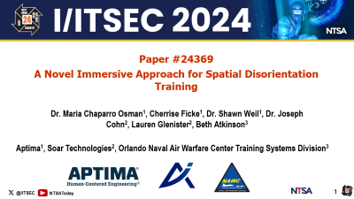
Paper #24369
A Novel Immersive Approach for Spatial Disorientation Training
Dr. Maria Chaparro Osman¹, Cherrise Ficke¹, Dr. Shawn Weil¹, Dr. Joseph Cohn², Lauren Glenister², Beth Atkinson³
Aptima¹, Soar Technologies², Orlando Naval Air Warfare Center Training Systems Division³
Notes:
24369
Soar Technologies Inc., Orlando Naval Air Warfare Center Training Systems Division

Slide 2
Introduction
Spatial Disorientation: Occurs when a pilot's perception of direction, altitude, or position is incorrect due to conflicting sensory inputs
Spatial disorientation (SD) is a critical challenge for military pilots
Leading cause of Class A mishaps in aviation (Lonner et al., 2024)
From 1990-1999, the USAF experienced 36 SD-related Class A mishaps costing a total of $557M and the loss of 44 aircrew (Heinle & Ercoline, 2002).
Continuous SD training is recognized as an effective method to help pilots respond to SD (Pennings et al., 2020)
Notes:
Spatial disorientation has been a persistent challenge
SD has the leading cause of Class A mishaps
SD definition
To mitigate disorientation mishaps….several solutions have been implemented
Synthetic vision systems…computer-generated imagery that provide pilots with a clear view of any obstacles, or runway layouts in low visibility conditions. This help pilots maintain awareness of their environment. However, pilots can still experience doubt or misjudgement of these systems-especially under stress
CRM less applicable….(F-16, F-22, F-35)
While these solutions can be highly effective in certain scenarios, they alone are not enough to fully address the challenges of SD.
This is why continuous SD training ….

Slide 3
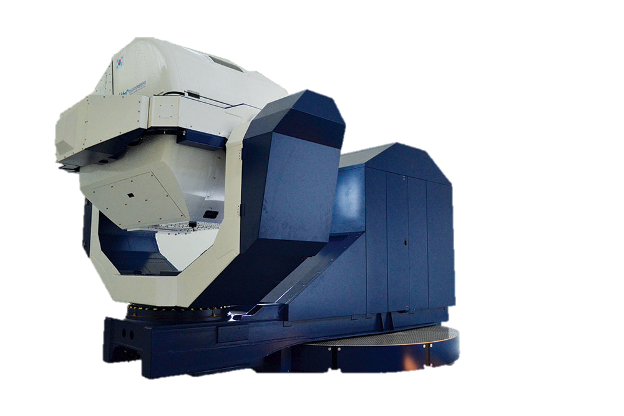
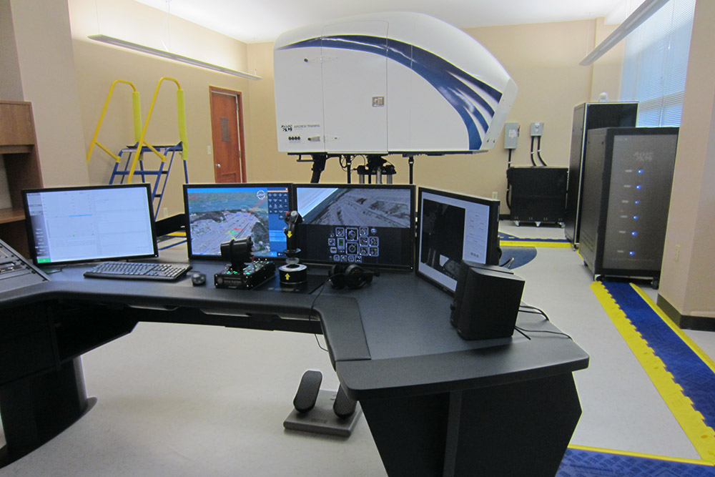
Introduction
Limitations on current training methods
Resource-intensive
Lack of immersivity
Limited portability
Inability for instructors to update
Need for an innovative SD training method
Cost-effective
High levels of immersivity
Portable solution
Rigorous SD measures
GYROLAB GL-4000
GYROLAB IPT-II
Notes:
However, Implementing continuous training poses challenges
Existing SD training methods typically fulfill only one of these requirements…need an efficient SD training approach, meets all criteria
Propose a multi-method training approach……integrates VR, GVS, array of objective and subjective metrics

Slide 4
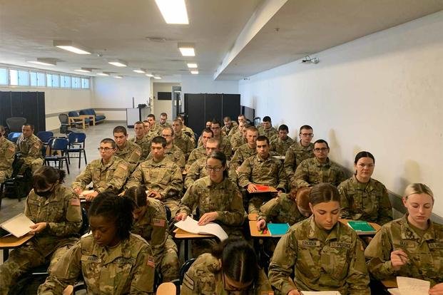
Existing Training Approaches
Traditional Classroom Instruction
Structured and theoretical approach to SD knowledge
Facilitate interaction and discussion
Ability to share experiences and learn from each other
Benefits
Covers a wide range of topics
Cost effective
Low Risk
Limitations
Lack of engagement
Limited instructor availability
No individualized instruction
Notes:
Before we talk about our approach….
Traditional Classroom instruction
Students will learn the military definition for SD
Benefits
Limitations
Lower engagement → lead students ….ill equipped to combat spatial disorientation in an operational environment

Slide 5
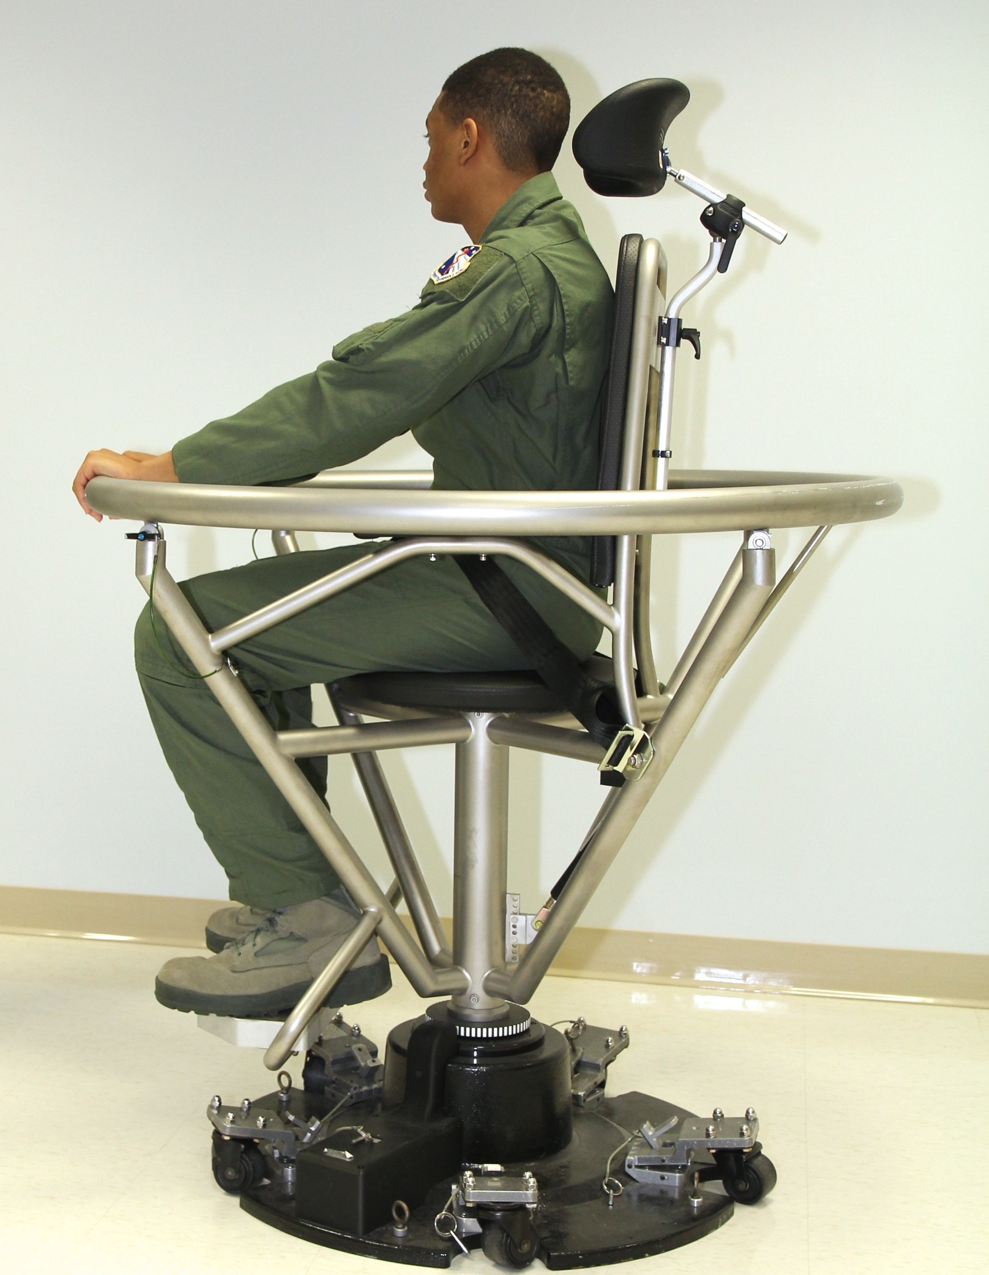
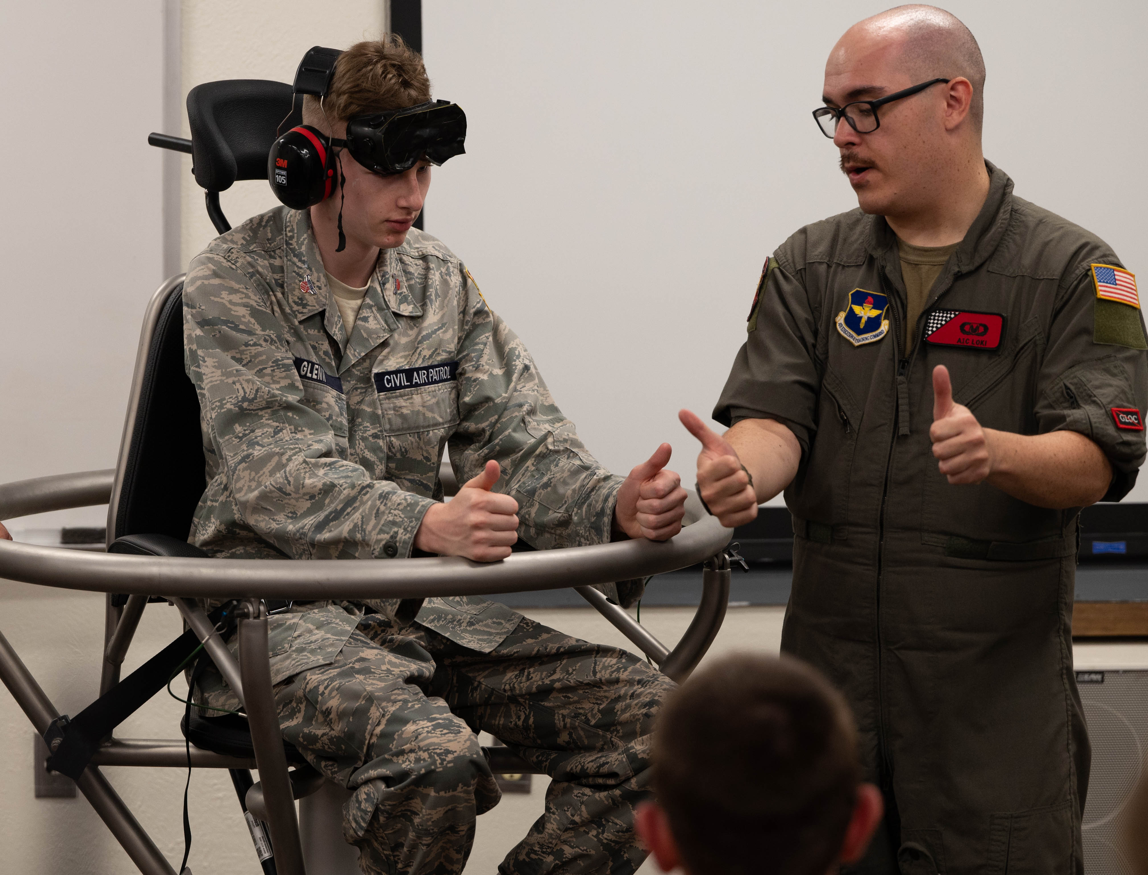
Existing Training Approaches
Vestibular Rehabilitation Therapy (VRT)
Compensate for imbalance and improve Vestibular function
Barany Chair: stimulates vestibular responses by rotating occupants
Benefits
Cost effective compared to other SD training
Highly Engaging
Low Risk
Limitations
Not a stand-alone training approach
Low transportability
Barany Chair
Barany Chair, Peterson
SFB
Notes:
VRT involves specific exercises….head movement to stabilize gaze and gait
Help the body adapt to imbalances + improve vestibular function
Barany chair …. Moving fluids in the inner ear
Widely used to train pilots and astronauts to handle disorientation and motion sickness
Benefits
Limitations
Does not provide…. full range of SD conditions and sensations
SD can be induced through visual cues…. vestibular cues
Important for pilots to learn about visual illusions through other approaches
Next we have vestibular rehabilitation therapy, which is designed to address dizziness and balance problems caused by vestibular disorders. VRT involves specific exercises, like head movements, to stabilize gaze and gait. These exercises help the body adapt to imbalances and improve vestibular function
One common form of VRT is sensory organization training. This method improves the ability to balance by integrating information from the vestibular system, vision, and proprioception. It often includes exercises like balancing on unstable surfaces or keeping balance with eyes closed to simulate challenging sensory conditions.
The most popular form of VRT is the Baranay chair-for you military folks, this may look pretty familiar to you. As shown in the pictures on the right, this chair rotates the occupant to stimulate vestibular responses by moving the fluids in the inner ear. It’s widely used to train pilots and astronauts to handle disorientation and motion sickness.
The Barany chair has several benefits: it’s cost-effective, engaging, and allows trainees to experience and adapt to vestibular responses in a safe, controlled environment like a classroom. It’s a low-risk way to improve balance and resilience to motion disturbances without posing a real threat of SD.
Limitations of VRT include its inability to provide a full range of conditions and sensations experience. For example, SD in flight isn’t just vestibular cues, we should also take visual cues into account. Visual illusions such as the black hole illusion, aren’t accounted for in this form of training. Another limitation is transportability. The Barany chair, as shown, is bolted to the floor and not portable, making it less accessible for training if a facility lacks one.
In summary, while VRT is a valuable tool, it should be part of a broader training program, complemented by other methods like traditional classroom instruction, to provide a more comprehensive approach to handling SD.
Barany chair: https://www.wpafb.af.mil/News/Article-Display/Article/818570/aerospace-physiology-key-to-af-missions/
https://www.petersonschriever.spaceforce.mil/Newsroom/Graphics/igphoto/2003539097/

Slide 6
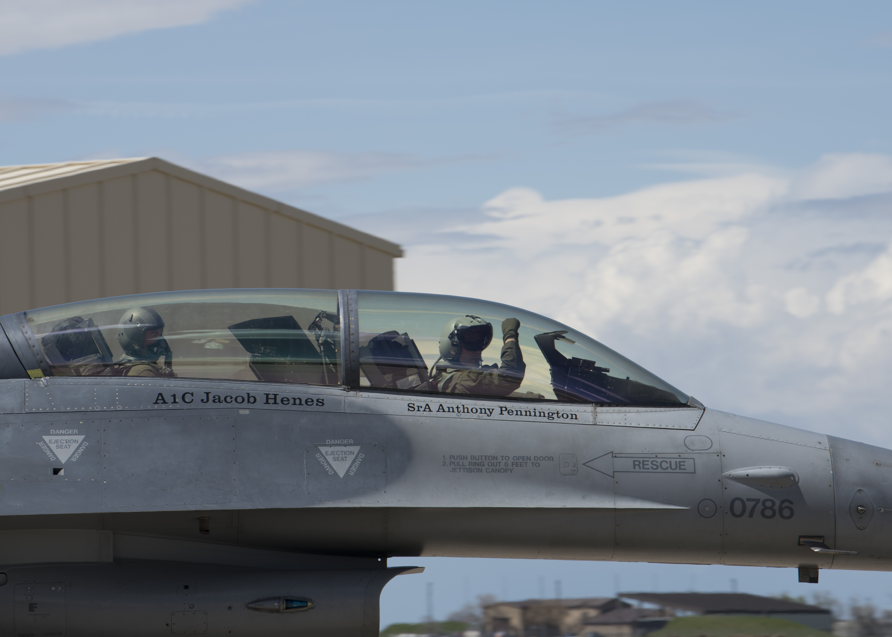
Existing Training Approaches
Controlled Live Training
Hands-on SD experience in a live flight with a flight instructor
Benefits
Highly immersive and engaging
Limitations
High risk
Limited instructor and aircraft availability
Expensive
Holloman AFB
Notes:
Benefits
Understand what it feels like and how to respond effectively
Limitations
Flight environments are unpredictable
Always a potential for accidents, even with an experienced instructor present
No one is completely immune to its effects in dynamic flight conditions
Scheduling challenges
Fuel and maintenance costs
Due to these limitations, this training method does not effectively support pilots in receiving continuous SD training. Important for pilots to receive more consistent and ongoing training through other avenues
Photo: https://www.holloman.af.mil/Art/igphoto/2002131690/
Other photo options: https://www.reddit.com/r/WarplanePorn/comments/138kba5/pakistan_air_force_f16b_with_killmark_in/

Slide 7
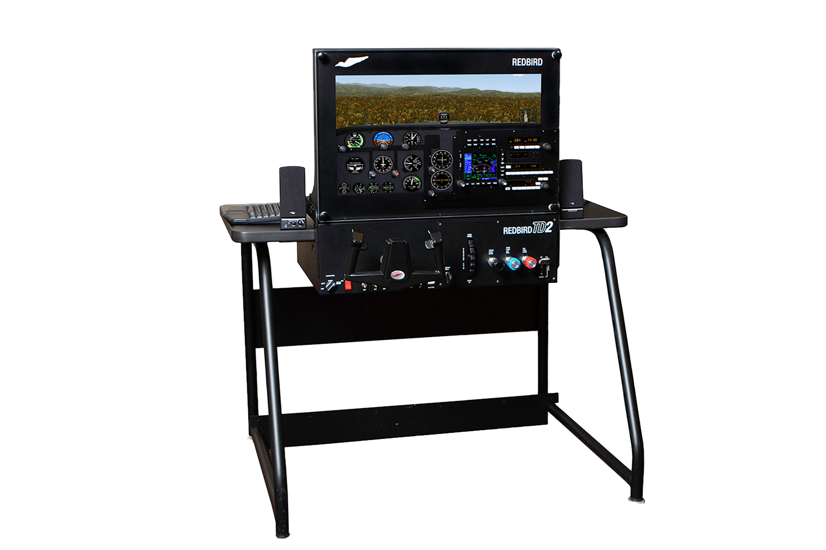
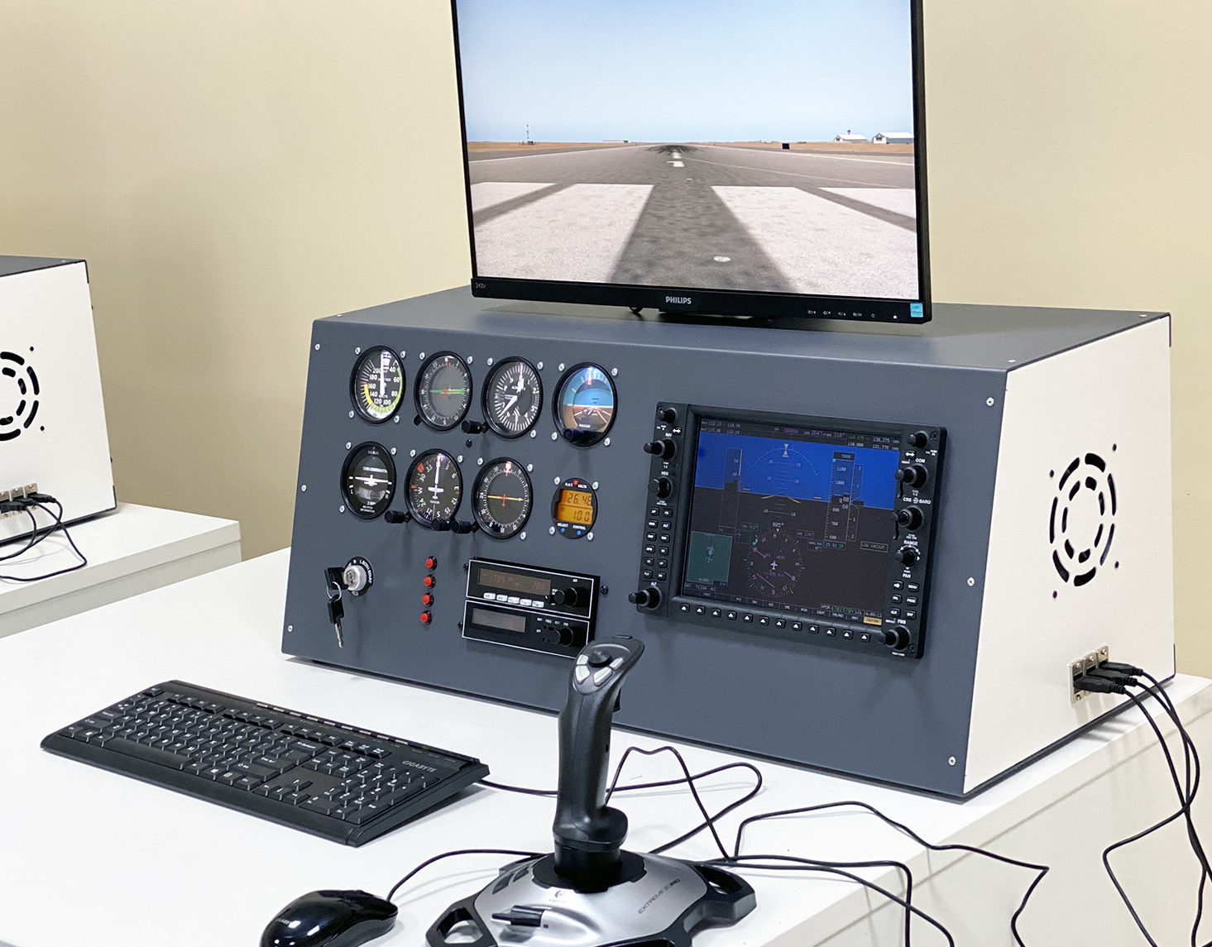
Existing Training Approaches
Low-Fidelity Simulated Trainers
Desktop simulators
Benefits
Cost effective
Transportable
Resource efficient
Low risk
Limitations
Low immersion and engagement
Redbird Flight Desktop Simulation
TRC Simulator
Notes:
Trade-off between affordability and immersion
Reduced realism → less engaging → affect how well trainees acquire and retain skills
Creates a gap between training experience and real world application, leaves pilots less prepared

Slide 8
Existing Training Approaches
High-Fidelity Simulators
360° simulators
Benefits
Highly immersive and engaging
Low risk
Limitations
Expensive
Lack of transportability
GYROLAB GL-4000
GYROLAB IPT-II
Notes:
Great for effective and engaging SD training
Expensive to purchase and maintain
Difficult to implement high-fidelity simulation training on a wide scale, especially in regions with limited resources or available space for advanced equipment

Slide 9
Existing SD Training Approaches
Table 1. Comparison of Existing SD Training Approaches
 | Cost Effective | Immersiveness and Engagement | Resource Efficient | Transportable | Low Risk
Traditional Classroom Instruction | ✔ |  |  |  | ✔
Vestibular Rehabilitation Therapy (i.e., Barany Chair) | ✔ | ✔** |  |  | ✔
Controlled Live Training |  | ✔
Low Fidelity Simulated Trainers | ✔ |  | ✔ | ✔ | ✔
High Fidelity Simulated Trainers |  | ✔ |  |  | ✔
**only provides vestibular cues associated with SD illusions
Notes:
So to summarize benefits and limitations…..
Illustrates gaps for each training method
None of the existing training methods checks all the boxes. Poses the question “How can we develop an existing SD training approach that checks off all these boxes to better prepare our warfighters to combat SD?”
To answer that question….explore specific device....mimics feelings of SD….will be a part of our proposed SD training approach

Slide 10
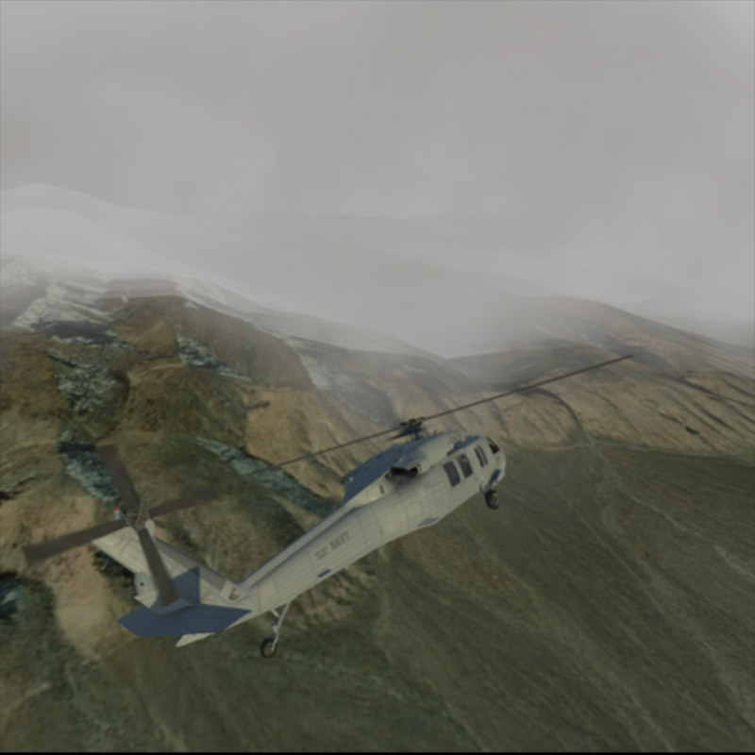
WingMAN System
WingMAN: Playback system developed to visually create flight events from multiple perspectives
Playback videos
Edit existing SD illusions
Create new SD illusions
Allows instructors to give better trainee feedback
Snapshot from WingMAN scenario
Notes:
WingMAN
Ability for instructors to give better trainee feedback
Creates first-person visual flight experience through manual construction or via flight data import

Slide 11
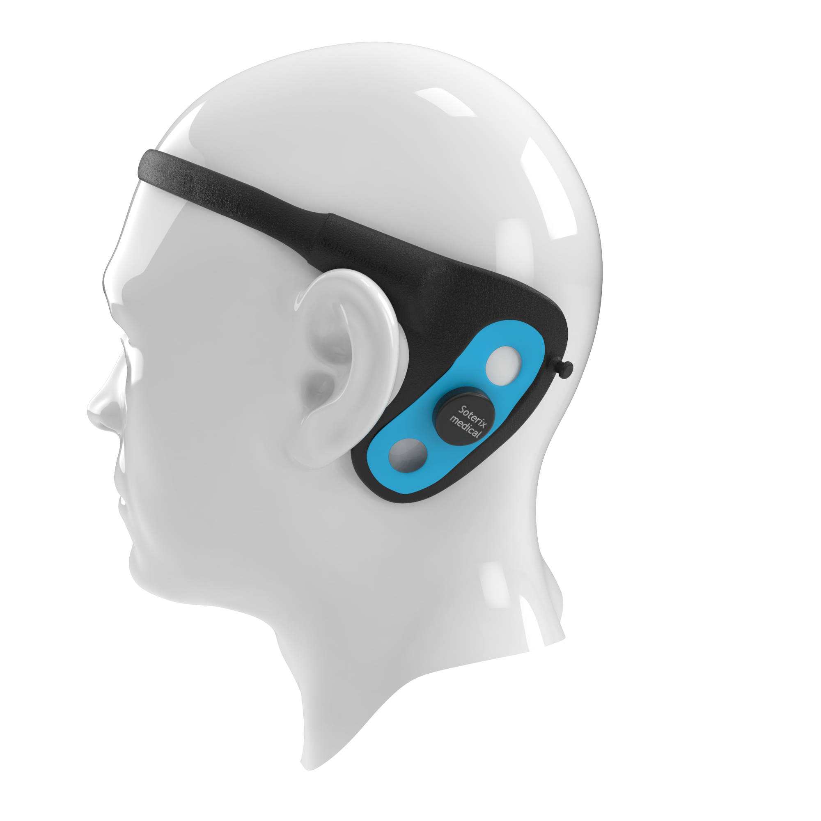
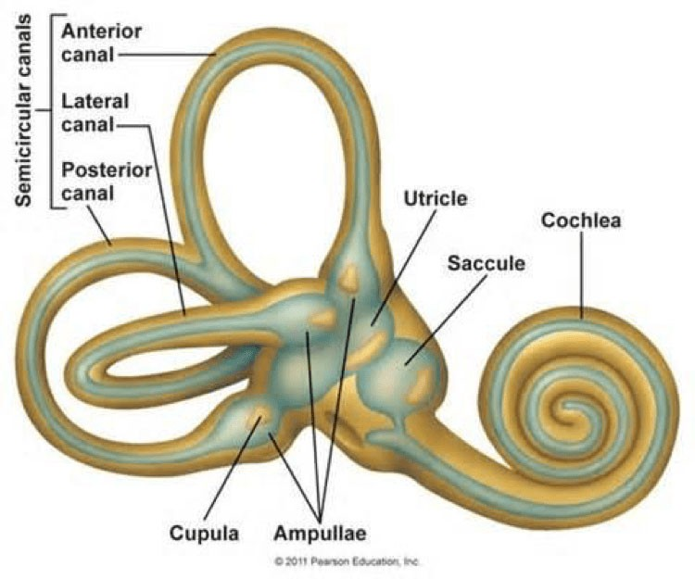
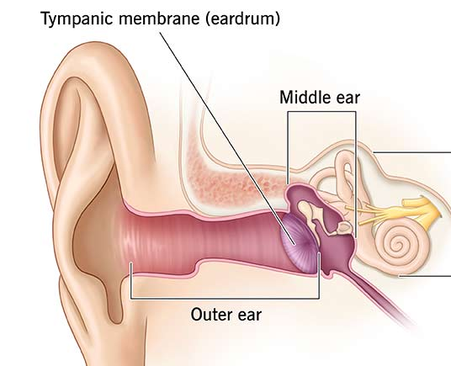
Galvanic Vestibular Stimulation (GVS)
Galvanic Vestibular Stimulation (GVS)
Non-invasive method of inducing SD
Low-level electric currents to stimulate the vestibular system
Mimics signals sent by vestibular system
GVS device by Soterix

Slide 12
Galvanic Vestibular Stimulation (GVS)
Table 2. Types of Spatial Disorientation
Common Illusions | Primary Responsible Organ Modalities | Illusory Perception
Graveyard Spiral | Semicircular Canals¹ | Yaw³ Rotation
Coriolis Illusion | Semicircular Canals | Multi-axis Rotations
False Pitch Angle | Otoliths² | Pitch⁴ Tilt
The Leans | Semicircular Canals and Otoliths | Persistent Roll⁵ Tilt
Notes. ¹Semicircular canals: Located within the inner ear and are responsible for detecting angular acceleration of the head; ²Otoliths: Located within the inner ear and responsible for detecting linear acceleration of the head. ³Yaw: Movement of the aircraft along its vertical axis, causing side-to-side motion; ⁴Roll: Movement of the aircraft along its longitudinal axis, causing aircraft's banking motion. ⁵Pitch: Movement of the aircraft along its lateral axis, resulting in the aircraft's nose moving up and down.

Slide 13
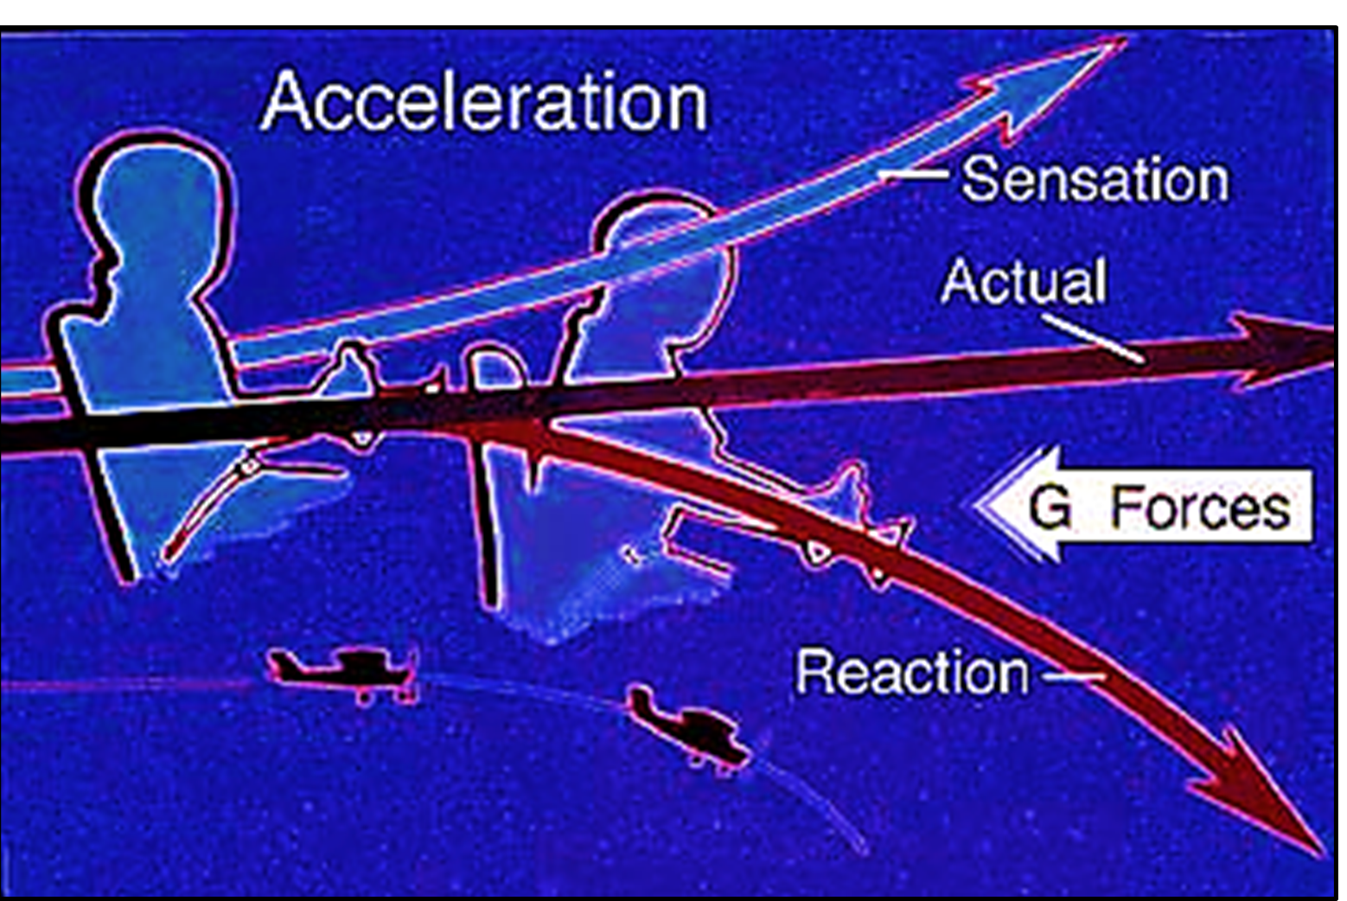
Galvanic Vestibular Stimulation (GVS) in Action
Table 2. Types of Spatial Disorientation
Common Illusions | Primary Responsible Organ Modalities | Illusory Perception
Graveyard Spiral | Semicircular Canals | Yaw Rotation
Coriolis Illusion | Semicircular Canals | Multi-axis Rotations
False Pitch Angle | Otoliths | Pitch Tilt
The Leans | Semicircular Canals and Otoliths | Persistent Roll Tilt
Federal Aviation Administration (FAA), 2003
Notes:
Reference: https://www.faa.gov/pilots/safety/pilotsafetybrochures/media/spatiald.pdf

Slide 14
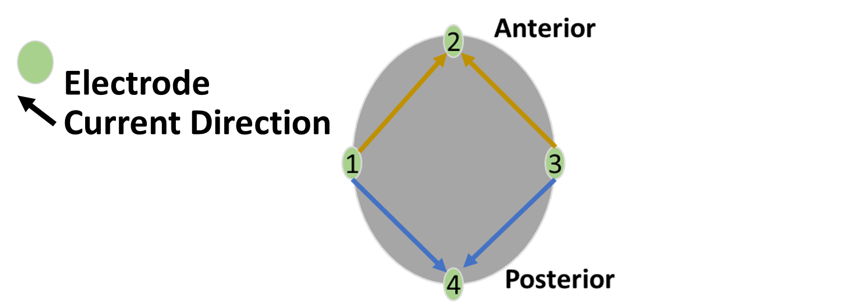
Galvanic Vestibular Stimulation (GVS) in Action
 | Current Direction
Pitch Forward | Electrode 1 → 2 OR Electrode 3 → 2
Pitch Backward | Electrode 2 → 1 OR Electrode 2 → 3
Federal Aviation Administration (FAA), 2003
Notes:
Reference: https://www.faa.gov/pilots/safety/pilotsafetybrochures/media/spatiald.pdf

Slide 15
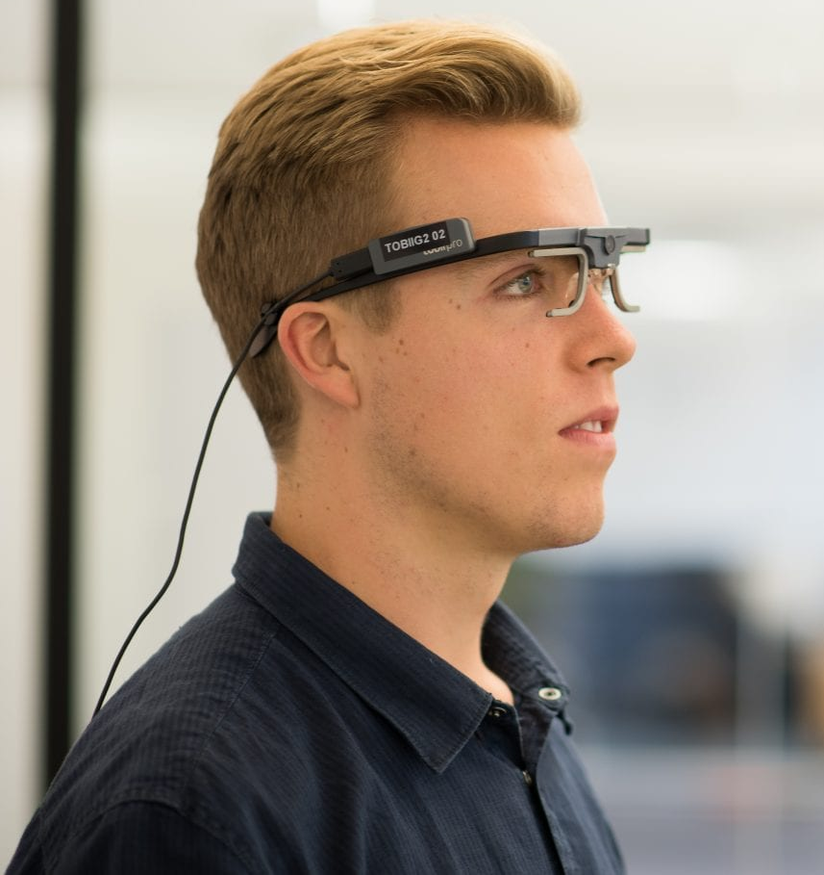
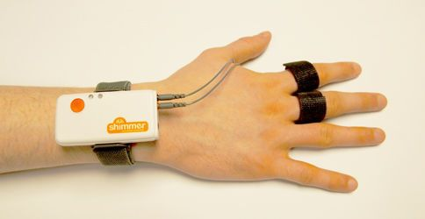
Measuring Spatial Disorientation (SD)
Physiological Measures
Electrodermal activity (EDA), heart rate variability (HRV), eye tracking
Benefits
High temporal resolution (e.g., second by second data)
High objectivity
High sensitivity
Limitations
Data meaning can be ambiguous
Difficult to analyze
Devices may be intrusive
Tobii Pro Glasses
EDA device by Shimmer
Notes:
Just discussed how to induce SD through GVS, equally important to have reliable methods for measuring SD
Crucial for both instructors and students, these measurements provide insights into how SD fluctuates, highlight specific areas where difficulties occurred
Benefits
limitations
Complex and elusive construct…spike in physio data → may reflect stress or external distractions rather than SD itself
Highlights importance of integrating multiple methods for accurate interpretation

Slide 16
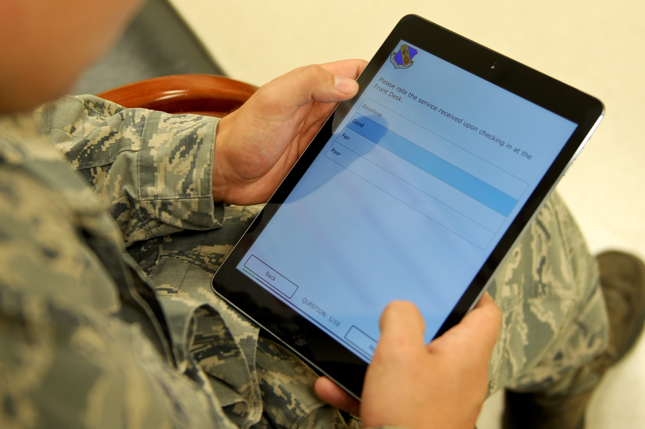
Measuring Spatial Disorientation (SD)
Self-report Measures
Simulation Sickness Questionnaire (SSQ), Perceived Stress Questionnaire (PSQ)
Benefits
Widely available
Easy to analyze
Limitations
Subjective
Intrusive
Notes:
Benefits
Limitations
Subjective: Reflect the subjective interpretation of a trainee’s SD experiences, leading to subjective responses
Unrealistic to fill out survey in the middle of SD training session
Middle of training would disrupt performance
Important to schedule self report measures at the beginning and end of training sessions allows for less obtrusive assessment

Slide 17
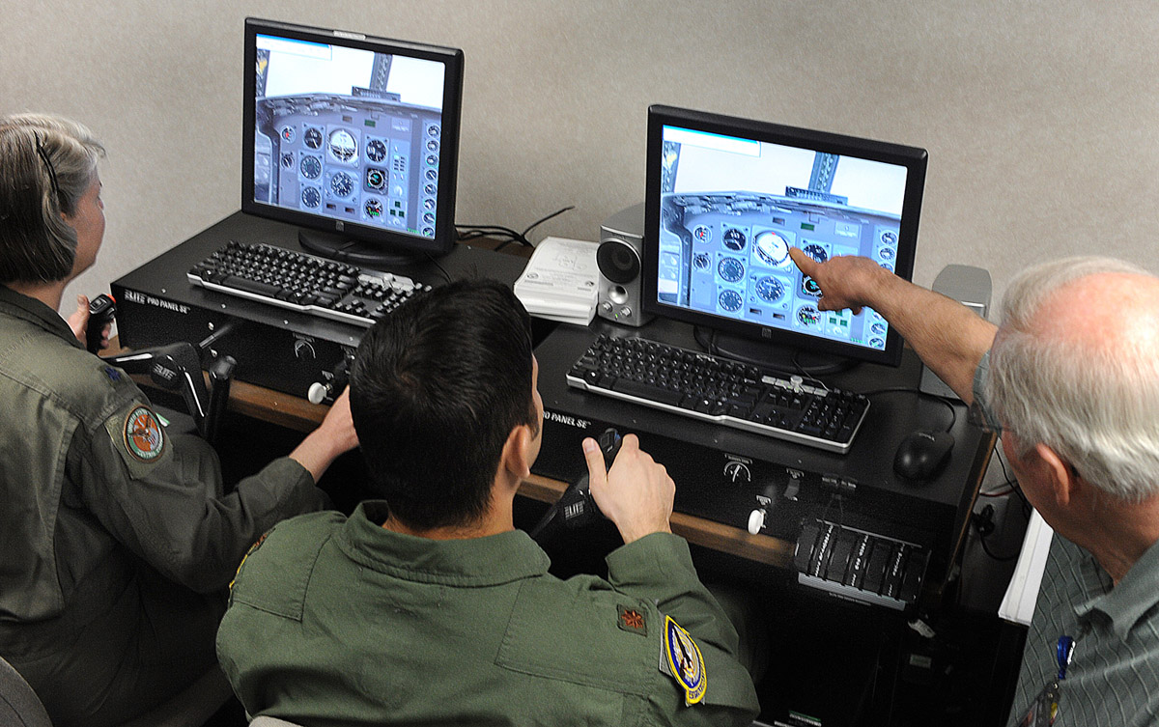
Measuring Spatial Disorientation (SD)
Behavioral measures
Reaction time, flight performance data (i.e., heading or altitude deviation)
Benefits
Unobtrusive data gathering
Monitor changes over time
Easy to observe and collect
Limitations
Supporting measure-not a stand-alone measure
Can create difficulty in assigning meaning
Notes:
Benefits
Limitations
Shouldn’t be used in isolation → don’t provide the full picture for SD
By integrating multiple methods to assess SD...researchers and instructors can identify specific challenges trainees face…more targeted and effective training

Slide 18



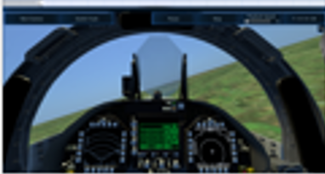



Proposed SD Training Approach
Galvanic Vestibular Stimulation (GVS)
Virtual Reality
(VR)
Multi-method approach
Virtual Reality (VR)
Immersive environment delivery
Physiological Tools
Cardiovascular data
Galvanic Skin Response (GSR) data
Self-report Survey
Simulation Sickness Questionnaire (SSQ)
Cardiovascular
Galvanic
Skin Response
(GSR)
Survey
Notes:
For our proposed training approach…we plan to use
Important to use a combination of different types of data to get a clear understanding on whether or not trainees are undergoing SD
Triangulation helps us see the bigger picture of how SD develops and affects trainees

Slide 19
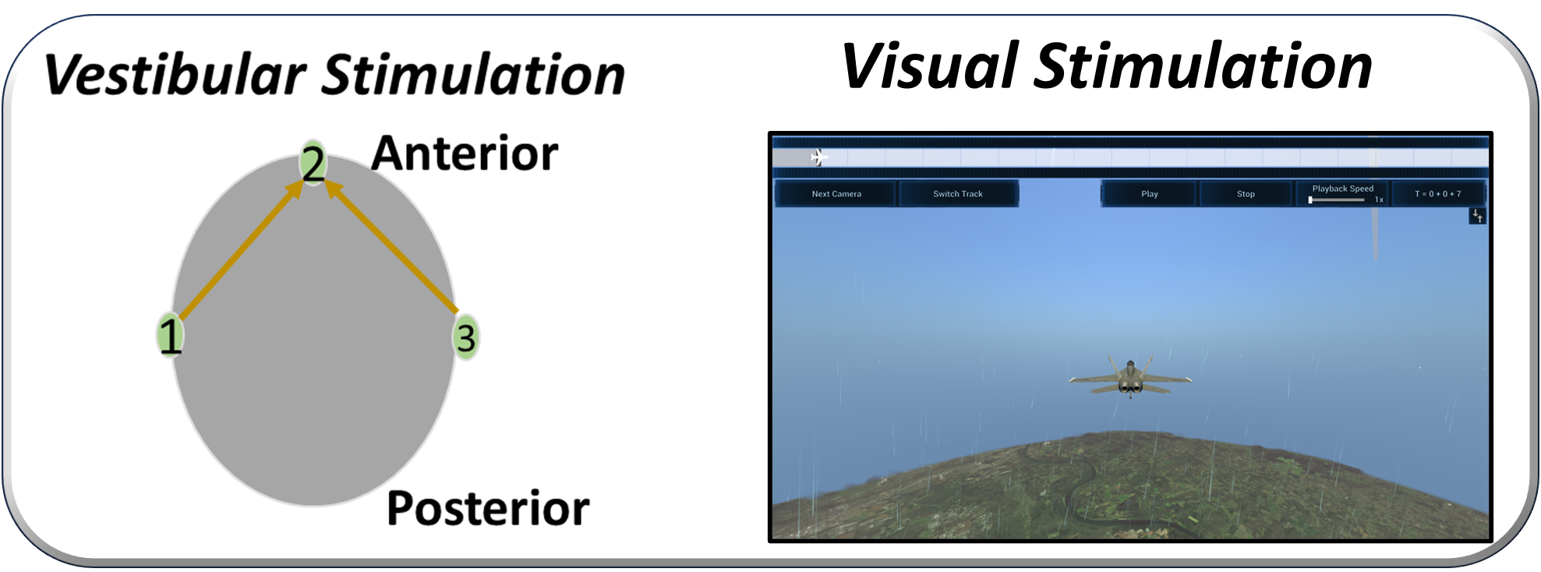

Proposed SD Training Approach
Galvanic Vestibular
Stimulation (GVS)
Virtual Reality
(VR)
Cardiovascular
Survey
Galvanic
Skin Response
(GSR)
Integrate GVS with custom flight simulation testbed to assess SD illusion induction
 | Cost Effective | Immersiveness and Engagement | Resource Efficient | Transportable | Low Risk
Proposed SD Training Approach | ✔ | ✔ | ✔ | ✔ | ✔
Notes:
At the start of this presentation….showed a table…..emphasized the need for a solution that addresses each of these gaps.
Now, as this table demonstrates….approach…..checks all boxes
In all, approach…..promising insights on how to improve SD training for warfighters
Cost-Effective and Resource efficient: More affordable …… Means we can train more people with less money.
Immersive Experience: Combining wingman with GVS
Transportable: Our system is easy to set up and move → can fit into a small case along with the VR headsets and sensors

Slide 20
Future Work
Evaluate and determine physiological devices for proposed physiological measures based on literature review
Integrate SD Training System
Sensor Integration
Galvanic Vestibular Stimulation (GVS) device
Virtual Reality (VR) system
Conduct a Human Subjects Study with the SD System
Participants will be asked to (1) share experience with the system and (2) compare training to the SD training
Notes:
In all, we are excited for the promising insights this approach may offer-as this could greatly improve how flight students and experienced pilots alike prepare for SD

