Slide 1
Behavior Envelopes for Defining Performance
Metrics in Complex Scenarios
Henry Phillips¹, Randolph Jones², Jeff Craighead², Michael Charlton³,
CDR Joseph Geeseman⁴, Joseph Cohn², Lorraine Barghetti⁵
¹Advanced Distributed Learning (ADL) Initiative
²Soar Technology LLC
³2 Circle, Inc
⁴Naval Air Systems Command
⁵Air Force Research Laboratory
I/ITSEC Submission 24368

Slide 2
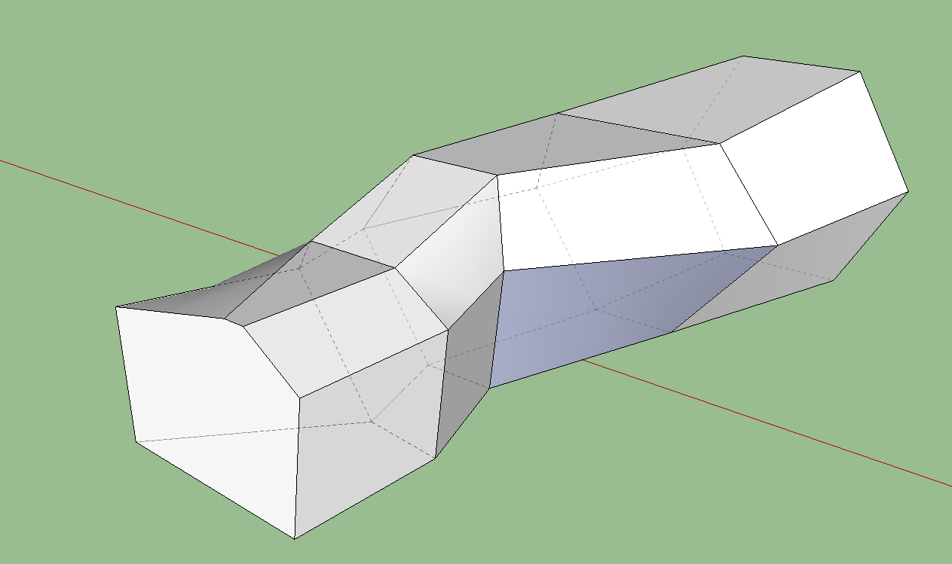
Complex Missions Make Metrics and Causal Attribution Difficult
Problem: Evaluation of decisions made in complex, multi-entity scenarios is extremely difficult
  Defining the goals and metrics for evaluation of an entity/entities’ decisions and actions
  Not always clear right or wrong classification for any decision or even chain of decisions
Solution: Behavior envelopes (BEs) are a tool that can be used to define the window of variation around which a set of goals or behaviors can be interpreted to have been met or to have occurred
Behavioral Envelope (BE) Components:
Situational context defining observable features of a situation, as well as unobservable features describing the internal state of the target being evaluated
Expectation constraints the behavior should meet in situations where the behavior context applies
Scoring/fit function that evaluates how well the behavior being observed conforms to the expectation constraints (non-binary)
Jones, R. M. et al. (2015). Automated monitoring and validation of synthetic intelligent behavior. International Conference on Artificial Intelligence (ICAI ’15).
Notes:
Analogous to property-based validation in software engineering
“Assert: X should equal 5.0 at this point”
Key differences
Intelligent systems are parallel and distributed, so there is no fixed “at this point”
True/false evaluations are less useful. For intelligent systems, it is more realistic to evaluate “How close is the system coming to ideal behavior?”
In many cases, intelligent systems are dealing with conflicting tradeoffs, so there is no “ideal behavior”

Slide 3
Why do we need BEs for evaluation?
Need: A debrief system that captures and annotates such occurrences can automate a portion of the root cause analysis (RCA) process for SMEs, reducing the time and workload required to generate these insights.
Solution:
Apply BEs to the use case of multi-entity performance and decision evaluation in complex aviation scenarios,
corpus of non-deterministic, high iteration count synthetic, labeled SAF mission iterations
BEs serve as the basis for understanding the causes of collective mission success or failure, beyond what TTP adherence can tell us
BEs can help explain causal antecedents, in conjunction with expert analysis
Benefit:
Behavior envelopes can improve consistency and objectivity of evaluations across groups of evaluators.
Critical task for debriefs/AAR is the development of root cause analyses (RCA) of mission outcomes.
Building these RCAs requires SMEs or systems to implicitly use and rely on the information captured in multi-entity BEs.

Slide 4
What makes BEs appropriate for evaluation?
Useful when “incomplete”
  BEs can be specified as precisely as they need to be, and no further
  Reduce the workload associated with defining requirements and metrics
  BE metric libraries do not need to be complete to be useful
  requirements-definition work required to improve them can be focused where needed to yield improved evaluations
Scalable
  Mission complexity
  Number of targets being evaluated
Bingo defined as sufficient fuel at any point to RTB with >350 lbs fuel
Blue 1 fuel reaches Bingo
Context
If Blue 1 fuel reaches Bingo prior to mission objectives, RTB
If Blue 1 fuel reaches Bingo after achieving mission objectives, RTB
Expectation
Outcome Score
Blue 1 turns back at Bingo prior to MO + 10
Blue 1 turns back at Bingo post MO + 10

Slide 5
The Point
Capturing what happened is increasingly insufficient as scenario complexity increases
BEs providing insight as to why it happened enables:
Root Cause Analysis as the driver of AAR for Complex Missions
Algorithmic Scoring or Contribution to Mission Evaluation

Slide 6
Sample Scenario: Time-Fuel-Weapons (TFW) Management
Narrative/Brief:
Blue 1-3 are to employ weapons against known SA threats
Blue 4 expected to engage Target after the SA threats have been neutralized
When Blue 1-3 expend weapons and/or reach Bingo fuel, they should retire
Blue 4 expected to have sufficient weapons and fuel to neutralize the target and RTB
TFW Definition
TFW management important for effective operation, mission sustainment, and ability to respond to changing conditions
Time: operational efficiency
Fuel: logistics and consumption
Weapons: weapons systems and ammunition
Blue 2
SA-C
Blue 4
Blue 1
SA-B
Target
Blue 3
SA-A

Slide 7
Time-Fuel-Weapons (TFW) Management Scenario
Failure to predict adversary behavior/intel failure can cause mission failure even with no individual TTP violations.
Blue 2
SA-C
Blue 1-3 employ weapons against known SA threats
Blue 1
SA-B
Target
Blue 4
Blue 3
SA-A
Timepoint A
Blue 1-4 can each execute perfectly in these circumstances and yet the mission can still fail due to the issue at Timepoint B where significant Red aircraft are now present after Blue 1-3 have retired.
Timepoint B
Blue 4 task is destruction of Target
Red 1
SA-C
Blue 4
Red 2
SA-B
Target
Blue 1
Blue 3
Red 3
SA-A
Blue 2
Red 1-3 emerge after Timepoint A
Blue 1-3 weapons/fuel exhausted
Individual TTP cannot compensate for a bad game plan.

Slide 8
Envelope for Evaluation of TFW Management:
Individual Example
Scoring scales listed here are continuous and arbitrary
Blue 2
SA-C
Blue 4
SA-B
Context
Expectation
Outcome Score
TFW Mgt Implications
Blue 1
Blue 3
SA-A
Mission briefing accounted for all known threats
Blue force pursues red SA threats and ground target
Blue 1-3 expend all fuel and weapons necessary to accomplish objectives
Continue route +10
One subset of blue (1-3) engages known SA threats
One subset of blue (4) in reserve to engage Target
TFW mgt a contributor to mission success
Blue 1-3 threat picture has not changed between continuation assessment and decision points
Blue 1-3 evade or neutralize SA threats
Blue 4 destroys mission target
Threat Destruction +10
Alt 1
Target Destruction +10
No additional threats emerge during the mission
Alt 2
Additional threats emerge during the mission after Blue 1-3 decision points
Blue 1-3 expend all fuel and weapons necessary to accomplish objectives
Blue 1-3 maintain original route and timing
Blue 1-3 neutralize SA threats
Threat Destruction +10
Remaining capable blue assets (Blue 4) face superior red force
Alt 2A
TFW mgt a contributor to mission failure
Blue 4 retires from engagement
Decision to retire +10
Alt 2B
Blue 4 engages red force and is destroyed
Decision to engage -10
!?
SA-C
Red 1
!?
Continue original plan -30
Blue 2
Blue 1
Blue 4
Red 2
SA-B
Blue 3
Target
Blue 4
Red 3
SA-A
Blue 1-3 weapons/fuel exhausted

Slide 9
Envelope for Evaluation of TFW Management:
Collective Example
Context
Expectation
Outcome Score
TFW Mgt Implications
At timepoint A, available blue assets are engaged against a specific subset of red threats/targets
Blue decisions to expend TFW early result in remaining threats
TFW mgt a contributor to mission failure
Mismatch of blue force capability against red force capability at different timepoints
Blue decisions to expend TFW late allow penetrating threats
At timepoint B, the ideal subset and positioning of committed blue assets matched to targets may look different
Blue decisions to expend TFW at correct increments yields good results
TFW mgt a contributor to mission success
Timepoint A
Timepoint B
Course of Action C
Blue 2
SA-C
Red 1
SA-C
Red 1
SA-C
Blue 2
Blue 4
SA-B
Blue 4
SA-B
Blue 4
Red 2
SA-B
Blue 1
Target
Blue 1
Red 2
Target
Blue 3
Target
Blue 3
SA-A
Blue 3
Red 3
SA-A
Blue 1
Red 3
SA-A
Blue 2

Slide 10
Time-Fuel-Weapons (TFW) Management Scenario
Failure to predict adversary behavior/intel failure can cause mission failure even with no individual TTP violations.
Blue 2
SA-C
Blue 1-3 employ weapons against known SA threats
Blue 1
SA-B
Target
Blue 4
Blue 3
SA-A
Timepoint A
Blue 1-4 can each execute perfectly in these circumstances and yet the mission can still fail due to the issue at Timepoint B where significant Red aircraft are now present after Blue 1-3 have retired.
Timepoint B
Blue 4 task is destruction of Target
Red 1
SA-C
Blue 4
Red 2
SA-B
Target
Blue 1
Blue 3
Red 3
SA-A
Blue 2
Red 1-3 emerge after Timepoint A
Blue 1-3 weapons/fuel exhausted
Individual TTP cannot compensate for a bad game plan.

Slide 11
Sample Criteria for Defining Broadly Applicable Scoring Conditions
Definition
Proximal Scores
Antecedent Scores
Degree to which blue asset capabilities across timeline are deployed to match red threat across timeline
Blue NKE exposure score is proximity of blue NKE assets to uncountered red assets
Blue NKE vulnerability score for every red threat based on proximity
Power Management
Blue NKE risk management score: degree to which blue NKE proximity to red assets is mitigated by proximity to blue escorts
Blue asset exposure score is proximity of blue assets to uncountered red assets
Blue asset vulnerability score for every red threat based on proximity
Time-Fuel-Weapons Management
Red threat coverage score is match of proximity of blue weaps fired ACROSS ALL BLUE ASSETS to red asset vulnerability
Blue weap utilization score is match of blue weapons fired ACROSS ALL BLUE ASSETS to red asset vulnerability
Red asset vulnerability score for every blue asset based on proximity
Blue weap match score for all blue weapons ACROSS BLUE ASSETS against red threat library
Degree to which the POE and ingress route selected were matched to the threat and the environment
Route Plan: Did the planned route minimize net risk to blue assets?
Route Selection
Course of Action C
Use TFW Shaping
Degree to which blue assets are deployed in an optimal order and timeline to neutralize threats as encountered
Asset Plan Score: Were the blue assets equipped to handle threats expected on route?
SA-C
Red 1
Coordination of Assets
Degree to which TFW assets are expended efficiently to maximize mission effectiveness
Blue 4
Red 2
SA-B
Blue 3
Target
Blue 1
Red 3
SA-A
Blue 2
Notes:
How close did we come to achieving the mission?

Slide 12
The Point
Capturing what happened is increasingly insufficient as scenario complexity increases
BEs providing insight as to why it happened enables:
Root Cause Analysis as the driver of AAR for Complex Missions
Algorithmic Scoring or Contribution to Mission Evaluation

Slide 13
BACKUP

Slide 14

Behavior Envelope Use Cases
Planning – Describe boundary of acceptable goals and generated plans so that the plans stay within the given bounds.
Pedagogy – Describe boundary of acceptable to optimal learning for students and/or synthetic forces.
Execution – Execute plans or generate behavior within the scope of specific priorities and tradeoffs.
Prediction – Compute bounds of possible/probable future behavior with respect to current situation assessment (context).
Characterization – Assess in which contexts a human or synthetic performer operates well or poorly
Evaluation – Assess how well observed behavior falls within or close to optimal/acceptable paths through behavior envelopes over time.

Slide 15
Examples of Tactical Domain Scoring Functions
Individual Assets:
When achieving racetrack point, aircraft should come to outbound racetrack heading within N seconds
Closing velocity to the current route waypoint should be between V1 and V2
After being given a directive to deliver ordnance on a target, closing velocity to the target should be between V1 and V2 within N1 seconds, and ordnance should be released with N2 seconds
When climbing after takeoff, velocity should be between V1 and V2, climb rate should be between R1 and R2, and altitude should be within A1 and A2 within N seconds
When commit criteria for a target have been achieved, aircraft should be within D degrees of collision course within N seconds
When intercepting a target, missile launch should occur within N seconds of achieving launch acceptability region
After missile launch, aircraft heading should hold a target aspect between T1 and T2 for a duration of N seconds
Notes:
When a bogey has been detected, a message reporting the bogey should be sent within N seconds

Slide 16
Domain-Independent Scoring Functions
Correlation coefficient between context and expectation values
Nearness of an expectation value to a mean or median value
Statistical tests on expectation values (T-test, ANOVA, etc.)
Bayesian/conditional relationships between context and expectations
  “Odds we should see Expectation E given we are in Context C?”
  “Odds we should NOT see Expectation E given we are in Context C?”
Timing/duration functions
  “Never stay in a particular context for an unreasonably long time.” (e.g., Time > X given Context Y)
Complex functions from Deep Learning Networks trained on observed data

Slide 17
BE for Evaluation of a Continuation Decision by a Single Entity
This approach works even when we only have a tiny proportion of the possible event context library defined
Simple examples listed here deal with a single decision by a single non-kinetic entity (Blue 4) under different context and expectation levels, along with possible scoring criteria for the individual decision and the relevant mission outcome
Scoring scales listed here are continuous and arbitrary
Scenario scoring
Decision scoring
Expectation
Context
Blue 4 continue to target
Escorts act to protect NKE
Blue 4 exposure to red threat SAM-B under escort
NKE attrition -15
Target destroyed + 20
Continue +10
NKE survival priority 95/100
Mission success priority 75/100
NKE attrition -15
Target destroyed + 20
Blue 4 take evasive maneuvers
Blue 4 exposure to red threat SAM-B without escort
Continue +10
NKE survival priority 95/100
Mission success priority 75/100
NKE attrition -5
Target destroyed + 20
Blue 4 continue to target
Escorts act to protect NKE
Blue 4 exposure to red threat SAM-B under escort
Continue +20
NKE survival priority 25/100
Mission success priority 95/100
Red threat danger is catastrophic
Blue 4 exposure to red threat SAM-B without escort
NKE attrition -5
Target destroyed + 20
Blue 4 continue to target on original ingress route
Red threat danger is catastrophic
Alternative ingress available that reduces threats to blue 4 but increases time to target
Continue -10
NKE survival priority 25/100
Mission success priority 95/100
NKE attrition -5
Target destroyed + 20
Blue 4 continue to target
Blue 4 exposure to red threat SAM-B without escort
Continue +20
Priority that at least one NKE survive
NKE 2 survival priority 10/100
Mission success priority 75/100
Red threat danger is catastrophic
Only one ingress route available
Strike package includes 2 NKEs
As BE models become more complex (more assets, more context and expectation constraints), their diagnostic value increases

