Slide 1
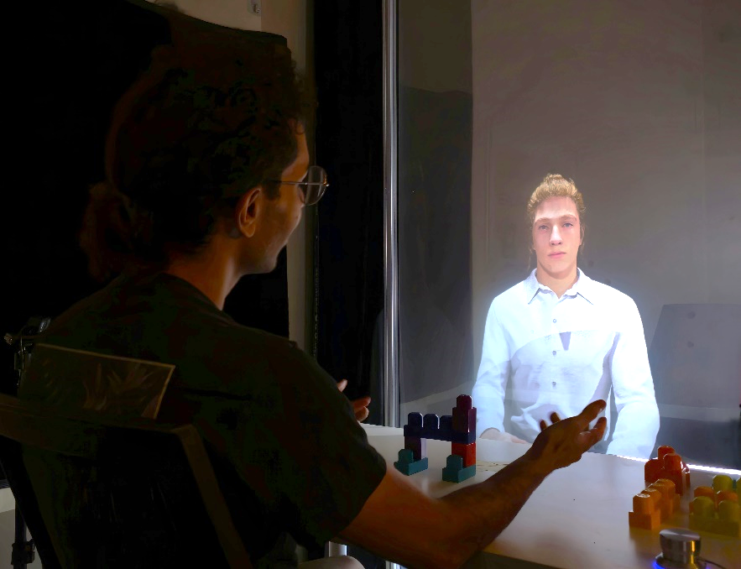

A Human Digital Twin Architecture
for
Knowledge-based Interactions
and
Context-Aware Conversations
Abdul Mannan Mohammed, Azhar Ali Mohammad, Jason A. Ortiz, Carsten Neumann, Grace Bochenek, Dirk Reiners, Carolina Cruz-Neira
University of Central Florida
Orlando, Florida

Slide 2
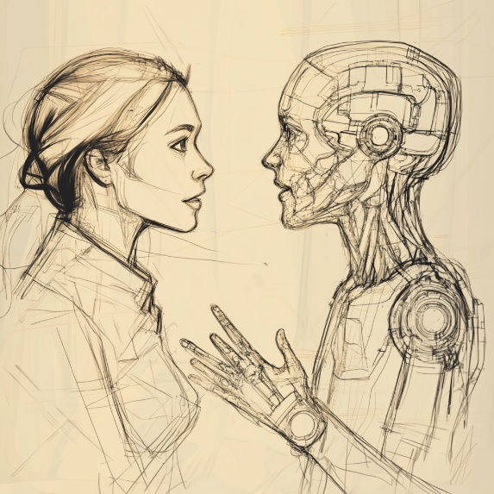
Introduction
Human-Autonomy Teams (HATs):
  Collaboration between humans and intelligent autonomous agents
  Challenges: Trust, control, shared situational awareness:
    AI systems obtain and analyze contextual data
    Human interaction is key to verify and improve AI insights to ensure relevance and correctness
Addressing human-AI and coordination:
  Interdependence through continuous learning and adaptation to enhance team performance
  AI can perform cognitive tasks: Learning, problem-solving, decision-making
  In certain contexts, the autonomous assets need to provide a sense of physical presence with a look and feel resembling a real human for better acceptance, trust, and interactions

Slide 3

Human Digital Twins (HDTs)
Human Digital Twins (HDTs)
  Typically, HDT = a digital recreation of a human from a physical/ergonomic approach
  HDTs must also become cognitive and emotional beings:
    Interact with other HDTs, humans and their surrounding environment
    Have appealing personality traits to improve bonding and relationships
    Have roles in the different situations and contexts they encounter
    Communicate with other humans around them
    Develop many types of relationships
Notes:
Verbally mention that most applications are either for medical diagnosis and treatments and for manufacturing ergonomic analysis and human-centered design.

Slide 4
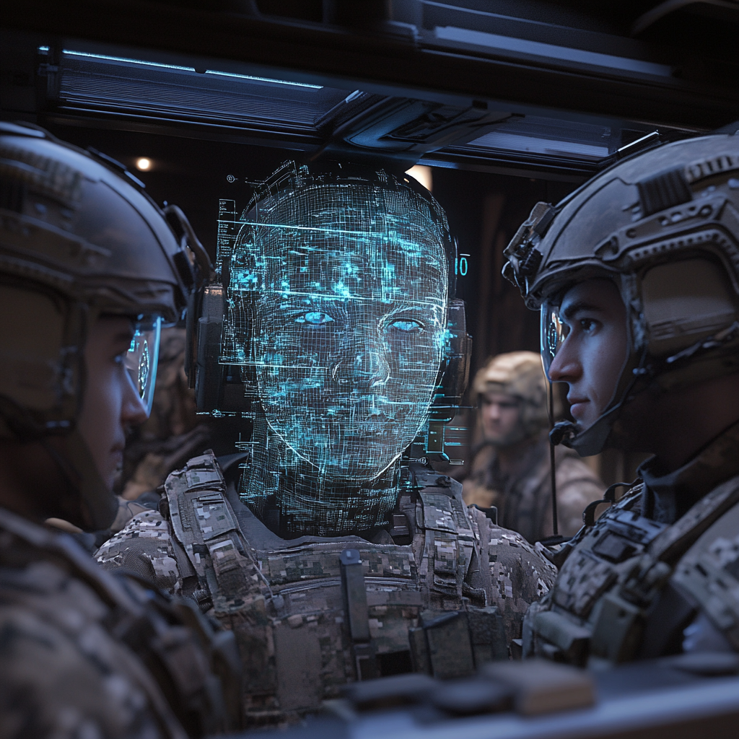
Motivation
Addressing growing demand for HDTs capable to acquire information, process it, and use it for problem solving
HDT incorporating cognitive, emotional, and mental capabilities
For defense and national security applications
Research Focus
  Open software architecture
  Integrates LLMs for conversational inter
  Life-like human embodiment for improved trust and interaction
  Cognitive and emotional aspects in HDTs
  Metacognitive AI to understand mental states and needs
  Multimodal data for real-time, context-aware interactions

Slide 5
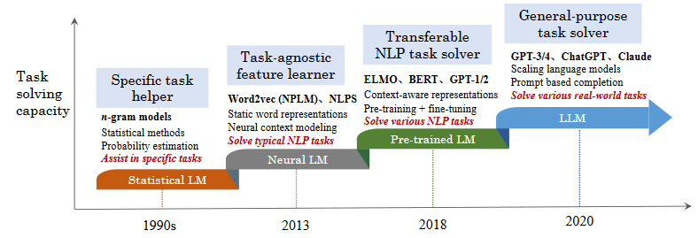
Related Work
Conversational Agents
  Evolution from rule-based systems to LLMs (GPT-3, GPT-4)
  Virtual Humans (VHs) incorporating LLMs for realistic, emotional interactions
  Affective computing for human-like emotional recognition and responses
Generative Pre-training Transformer (GPT)
  GPT models outperform manual information searches in speed and accuracy
  GPT-4Vision: Multimodal capabilities for real-time visual input interpretation
Notes:
Figure 3: Depicts the evolution of language models (LM) over four generations in terms of task solving capacity. (Zhao et al., 2023)
https://arxiv.org/abs/2303.18223

Slide 6
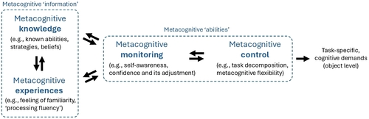
Related Work
Metacognitive AI
  Metacognition enhances usability and trust in GenAI systems
  Supports better context-aware and emotionally sensitive interactions
Personality, Memory, and Behavior in HDTs
  LLMs programmed with personality traits for relatable interactions
  Memory retention to maintain consistent personality across sessions
Notes:
Figure 4: Depicts a simplified descriptive framework for metacognition. (Tankelevitch et al., 2024)
https://doi.org/10.1145/3613904.3642902

Slide 7
HDT System Design
Main Components
  Visual Interface
  AI Module
Visual Interface
  Multiple modes: monitor, VR, holographic display
  Real-time rendering of human form (expressions, lip sync, etc.)
  Prototype: Unreal Engine 5.2.1 & Metahuman personas
  Key Modules:
    Speech-to-Text: Converts speech to text (Windows Speech API)
    Animation: Coordinates movements and lip sync
    Text-to-Speech: Converts text to voice
    Visual Input: Analyzes visual cues for context

Slide 8


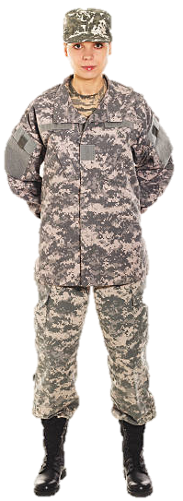
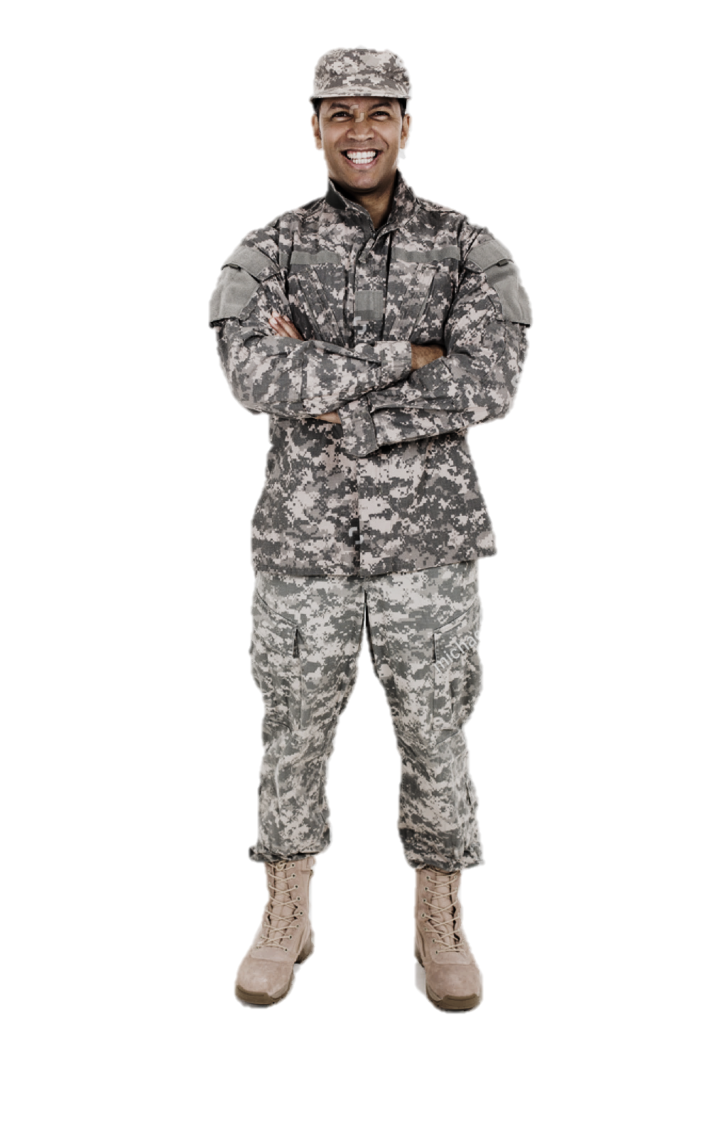
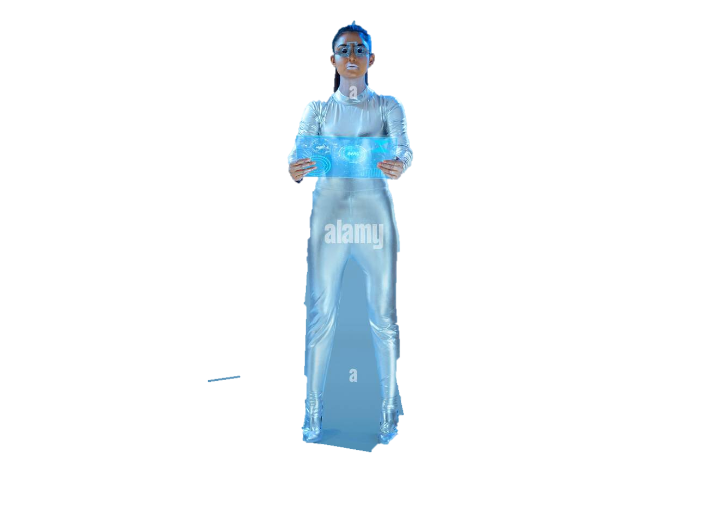

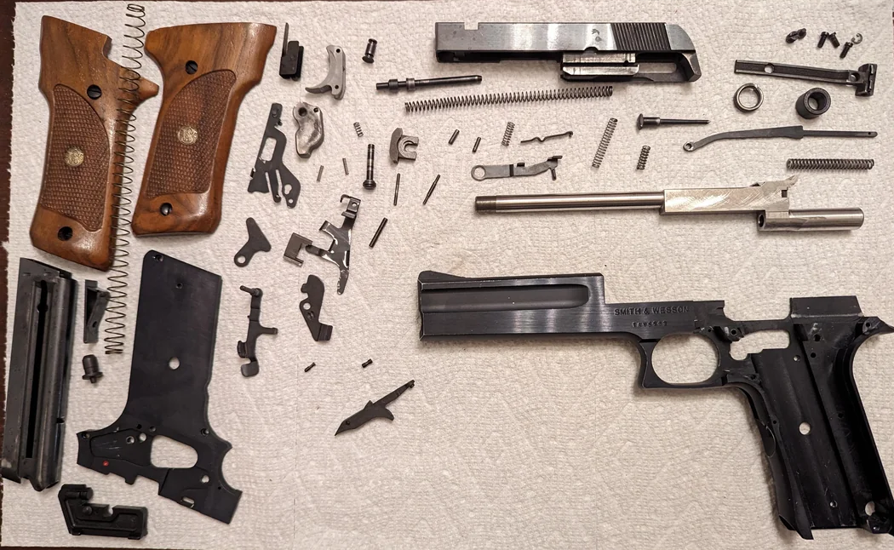
HDT SYSTEM
AI Sub-System
Crew Member UI Sub-System
System Prompt
Conversation History
Speech to Text
Construct Prompt
Response Generation:
Objects
In-context
Emotions
Process Visual Input
Text to Speech
Embodiment:
Lip Sync
3D body animation
Voice
HDT Representation Sub-System

Slide 9
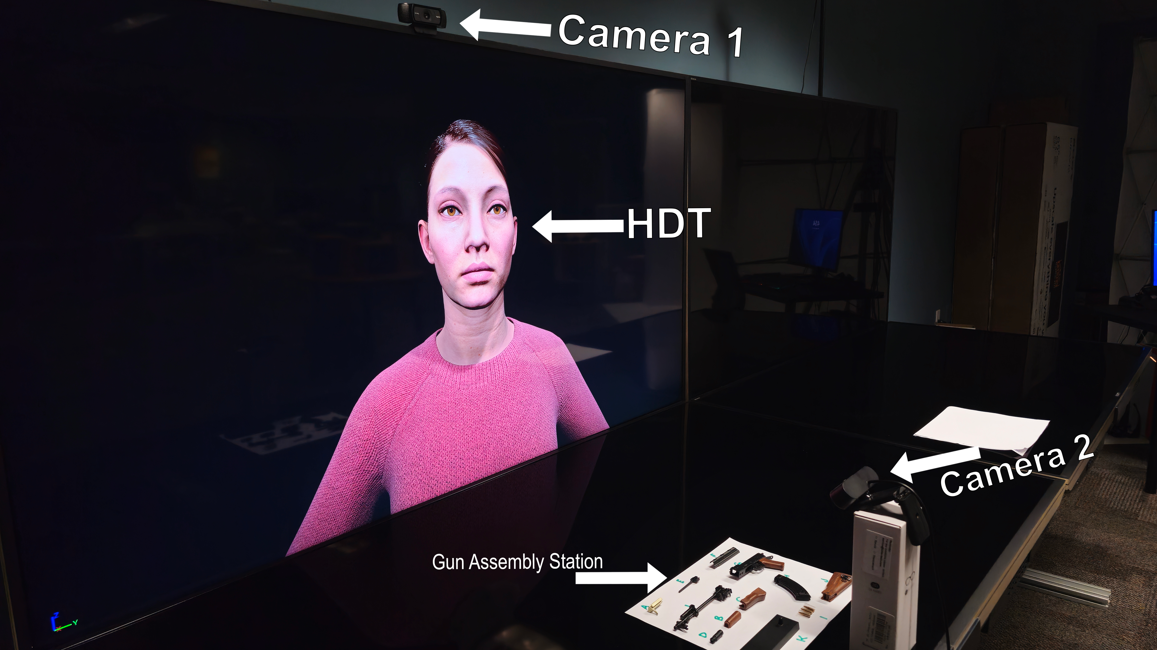
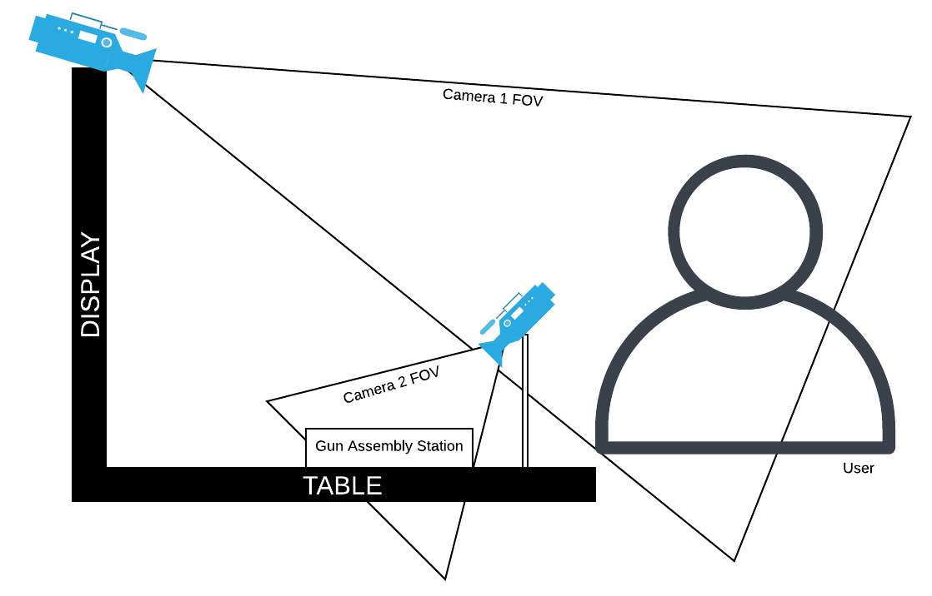
HDT System Performance Analysis Setup
Task: Guided gun assembly in a controlled environment
Goal: Assess HDT’s ability to talk with trainee to detect issues and provide feedback
Setup:
  55" autostereoscopic display with microphones, speakers, and cameras
  HDT preloaded with assembly instructions and real-time visual input

Slide 10
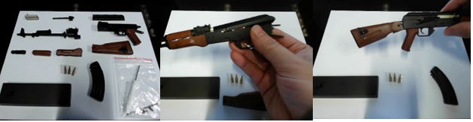
HDT Assessment Phases
Phase 1: Verify parts and identify components
Phase 2: Provide step-by-step assembly guidance
Phase 3: Offer solutions for mistakes and issues
Phase 4: Detect emotions and offer encouragement
Phase 5: Verify correct assembly and completion

Slide 11
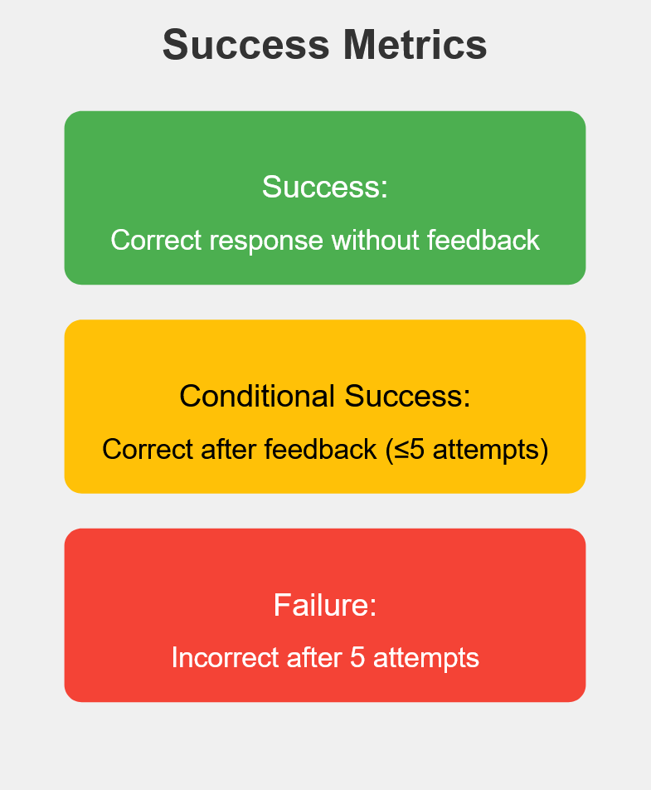
Results

Slide 12
Results - I
PHASE | # Scenarios | Success | Conditional | Failure
1.1 Pre-Check | 10 | 5 | 5 | 0
1.2 Identification | 10 | 10 | 0 | 0
2. Instructional Guidance | 7 | 7 | 0 | 0
3. Recommendations/Solutions | 10 | 10 | 0 | 0
Notes:
Phase 1: Pre-Assembly
Verified all parts; 5 successes, 5 conditional successes
Required feedback for missing parts detection
Phase 2: Instructional Guidance
100% success in 7 scenarios, clear step-by-step instructions
Phase 3: Recommendations & Solutions
100% success in providing corrective actions and alternatives

Slide 13
Results - II
PHASE | # Scenarios | Success | Conditional | Failure
4. Emotional Support | 11 | 11 | 0 | 0
5. Assembly Verification | 6 | 3 | 3 | 0
Notes:
Phase 1: Pre-Assembly
Verified all parts; 5 successes, 5 conditional successes
Required feedback for missing parts detection
Phase 2: Instructional Guidance
100% success in 7 scenarios, clear step-by-step instructions
Phase 3: Recommendations & Solutions
100% success in providing corrective actions and alternatives

Slide 14
Results - Performance Dynamics
 | Processing time (seconds)
 | Speech Recognition | Image Capture | LLM Response | TTS Generation | Total Interaction
Min | 0.9 | 1.7 | 4.7 | 0.7 | 20.2
Mean | 1.3 | 2.1 | 9.7 | 0.9 | 28.0
Max | 1.9 | 2.9 | 14.7 | 1.4 | 40.9
Notes:
Processing Times:
Speech Recognition: Avg. 1.3 seconds
Image Capture: Avg. 2.13 seconds
LLM Response: Avg. 9.72 seconds, 99th percentile at 14.68 seconds
Total Interaction Time: Avg. 27.96 seconds, 99th percentile at 40.86 seconds

Slide 15
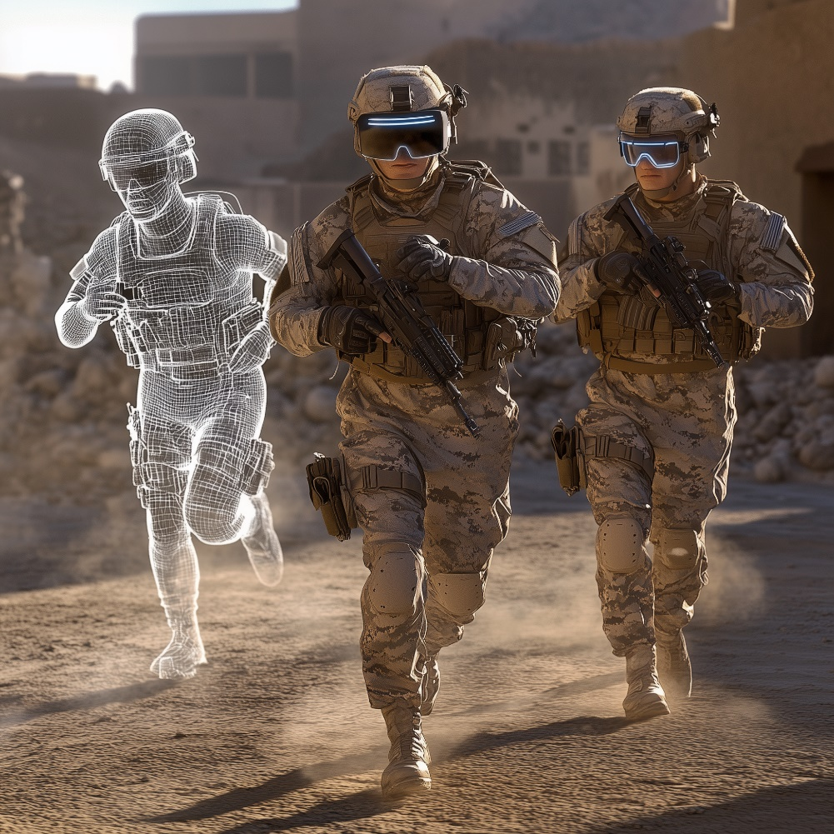
Future Work
System Optimization
  Improve processing times and explore custom domain-specific LLMs
  Explore self-contained systems for classified/restricted domains
  Integrate Metacognition for personalized learning
User Studies
  Test system usability and trust with diverse participants in HATs
Data Privacy & Security
  Implement privacy measures and content filtering
  Ensure compliance with data protection standards

Slide 16


Q&A
Come to interact and chat with our HDT at the UCF Booth in the Exhibit Hall
abdulmannan.mohammed@ucf.edu
carolina@ucf.edu

Slide 19
Results – II
PHASE | # Scenarios | Success | Conditional | Failure
Pre-Check | 10 | 5 | 5 | 0
Identification | 10 | 10 | 0 | 0
Instructional Guidance | 7 | 7 | 0 | 0
Recommendations/Solutions | 10 | 10 | 0 | 0
Emotional Support | 11 | 11 | 0 | 0
Assembly Verification | 6 | 3 | 3 | 0
Table 1: Summary of HDT System Task Performance
Notes:
Phase 4: Emotional Support
100% success in 11 scenarios, effectively managing user emotions
Phase 5: Assembly Verification
3 successes, 3 conditional successes; verified correct assembly with minimal feedback

