Slide 1
A Suite of Devices:
Applying the Immersive Flow Learning Outcome Framework to Training Program Immersive Device Acquisitions
Major Victoria Snow, United States Air Force
Dr./Lt Col Andrew Clayton, United States Air Force Reserve

Slide 2
A Suite of Devices
The Problem
The Solution – I-FLO Framework
Conceptual Theories
  Flow Theory
  CAMIL
  Taxonomy for Immersive Experience Design
Immersive Flow Learning Outcome (I-FLO) Framework
  5 Step Process
  Cost Considerations
  Example Application

Slide 3
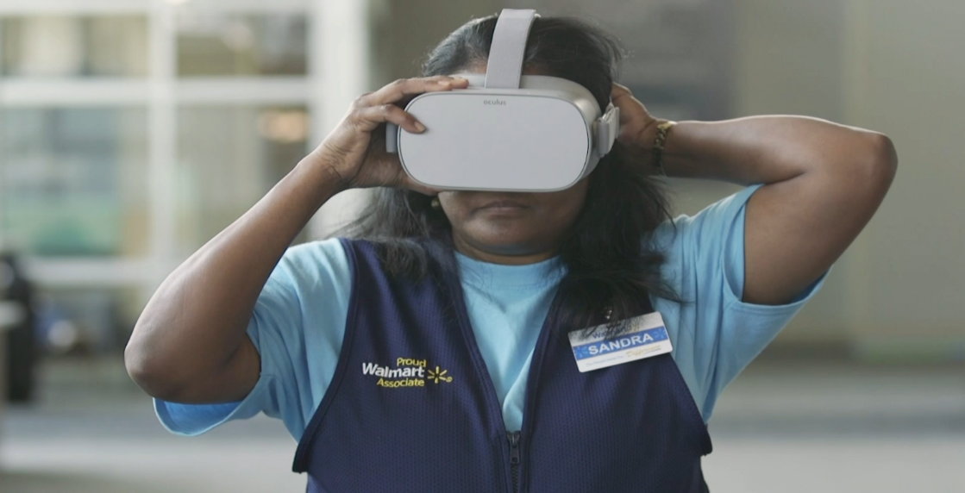
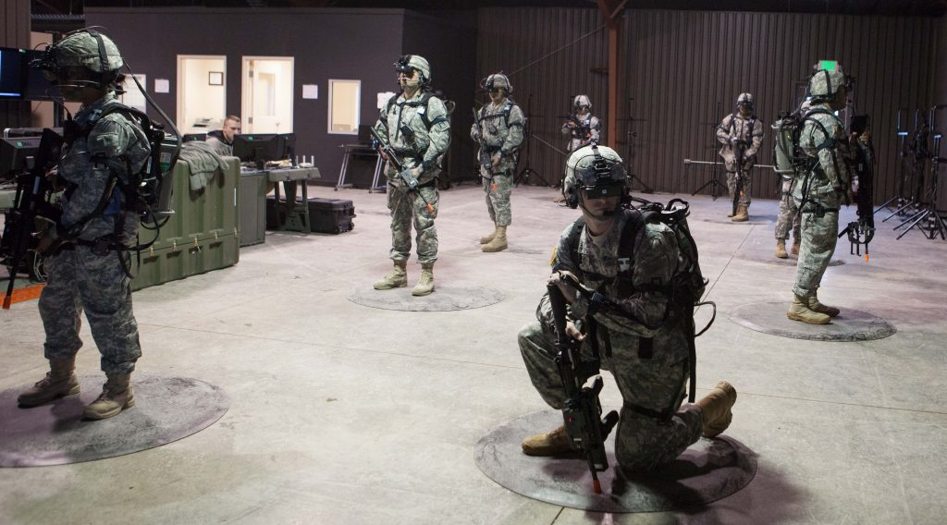

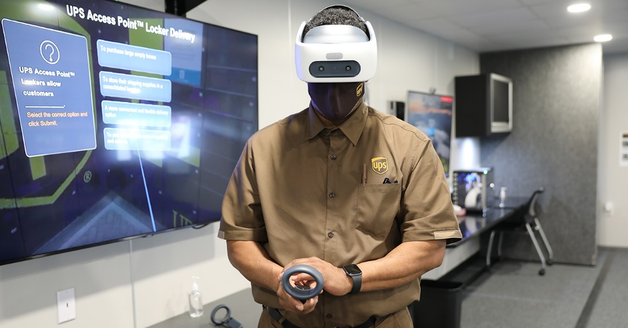
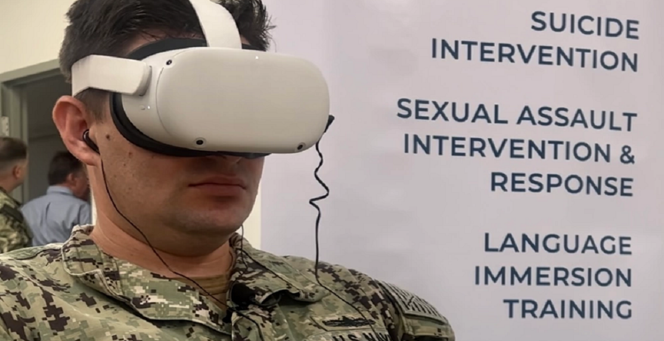
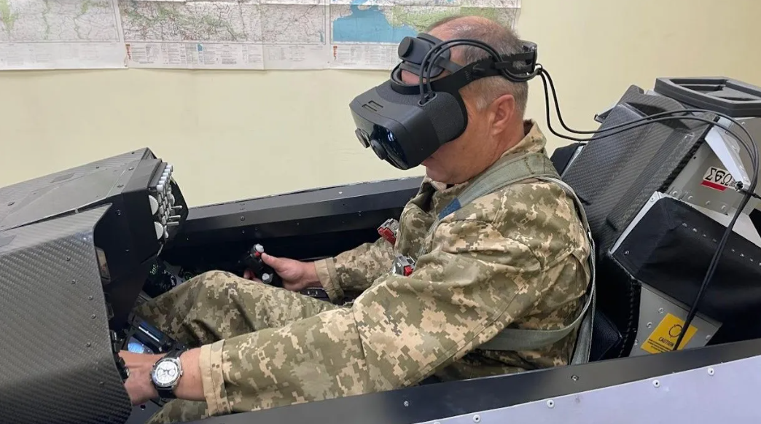
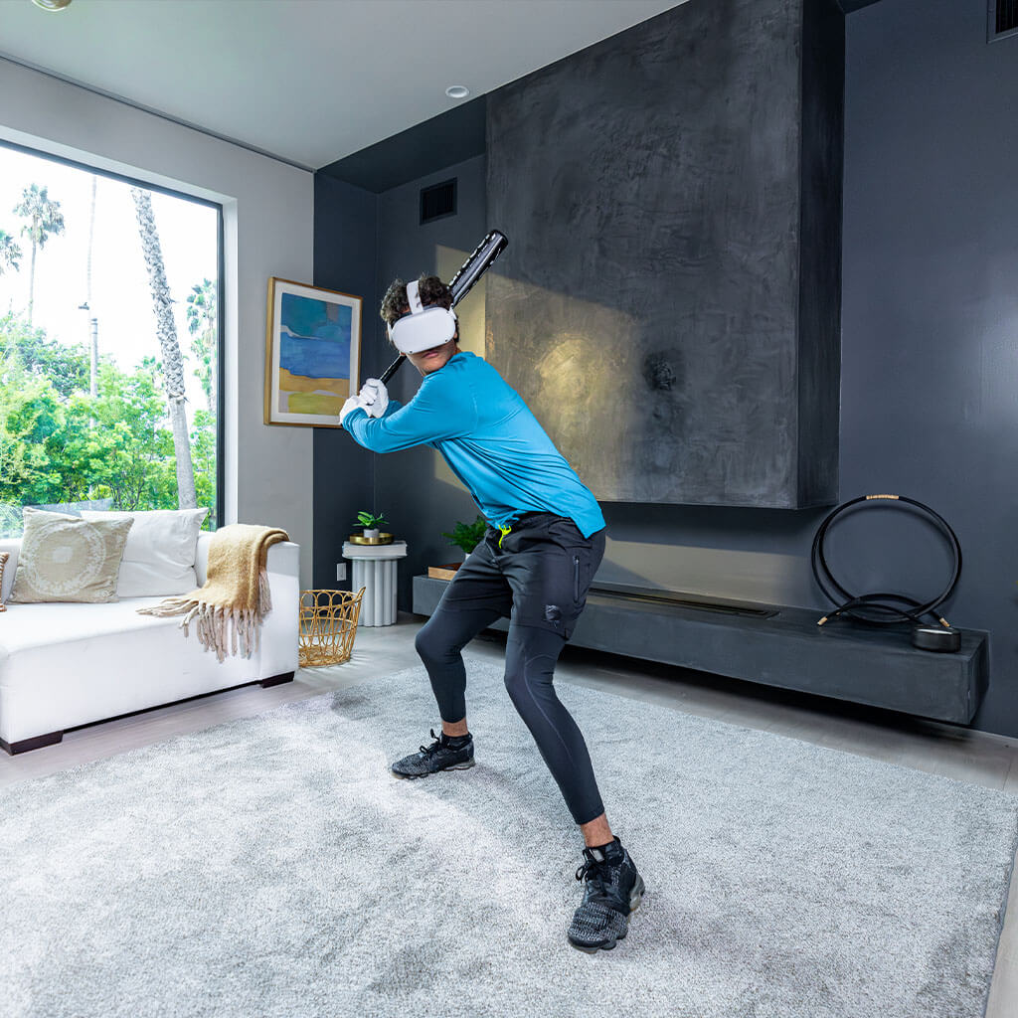
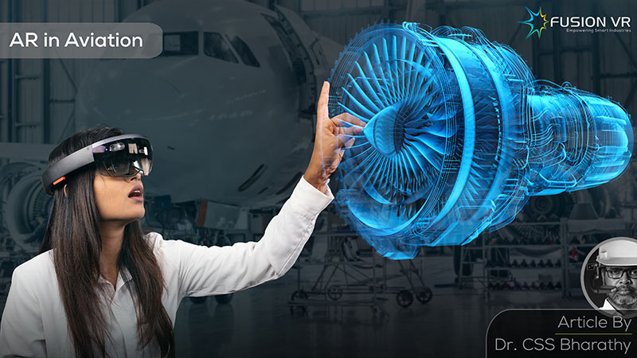
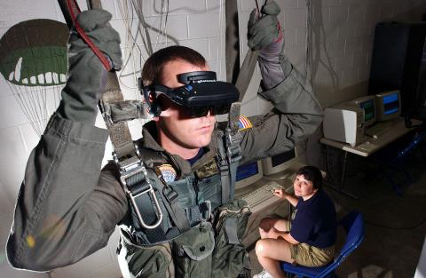
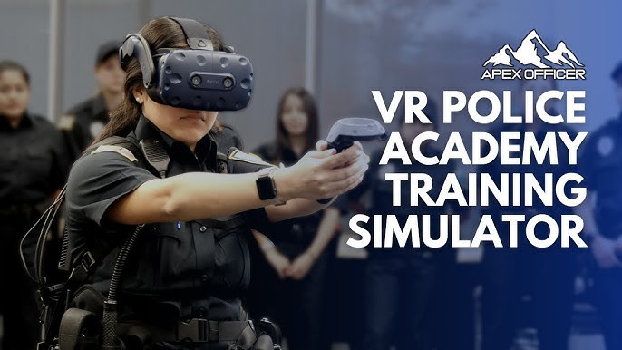
The Problem
Notes:
Walmart VR training - How VR is Transforming the Way We Train Associates (walmart.com)
UPS VR training - Virtual reality helping to create safety for UPS drivers | About UPS
WIN Reality - WIN Reality | Virtual Reality Baseball & Softball Training
APEX VR Police Academy – Apex Officer - Virtual Reality Police Training Simulator
Varjo XR-3 headset – Ukraine F-16 pilot - VR Headset Used To Train Ukranian Pilots To Fly F-16s (uploadvr.com)
Medical VR training - (7) Virtual Reality (VR) in Healthcare: Current & Future Uses | LinkedIn
Army VR training - Virtual Training Will Save Real Army Lives: Close Combat Task Force - Breaking Defense
Parachute Training - VR Parachute Trainer | Daly Realism
Engine Maintenance Training - AR in Aviation, in the process of shaping the future (fusionvr.in)
Soft Skills Training - US Navy Uses VR To Train Sailors On Suicide And Sexual Assault Prevention - BeyondGames.biz

Slide 4

The Problem
What process, steps, or framework did each industry use to determine the appropriate device?
How do you determine the “right” device for a training or education program?
Why do different industries or training programs acquire different types of devices to meet their specific requirements?

Slide 5
The Solution – I-FLO Framework
Guides device requirements based on desired learning outcomes within a training program
A five-step process that applies immersive learning efficiencies and challenges presented by the Cognitive Affective Model of Immersive Learning (CAMIL) and Flow Theory model of effective learning
Leverages immersive element concepts presented by the Taxonomy for Immersive Experience design
Provides leaders a tool to aid in selecting the most effective and efficient immersive devices for diverse training programs

Slide 6
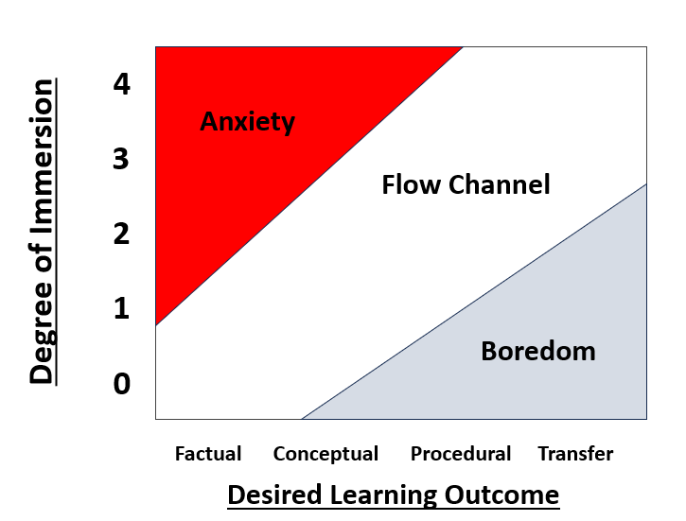
Why I-FLO?
I-FLO Answers 3 Questions:
1. What level of learning outcome best supports an optimal flow state of learning?
2. How can immersive technology create the optimal flow state for the user?
3. What level of immersion is needed to meet the user’s requirements?
I-FLO defines the optimum training experience

Slide 7
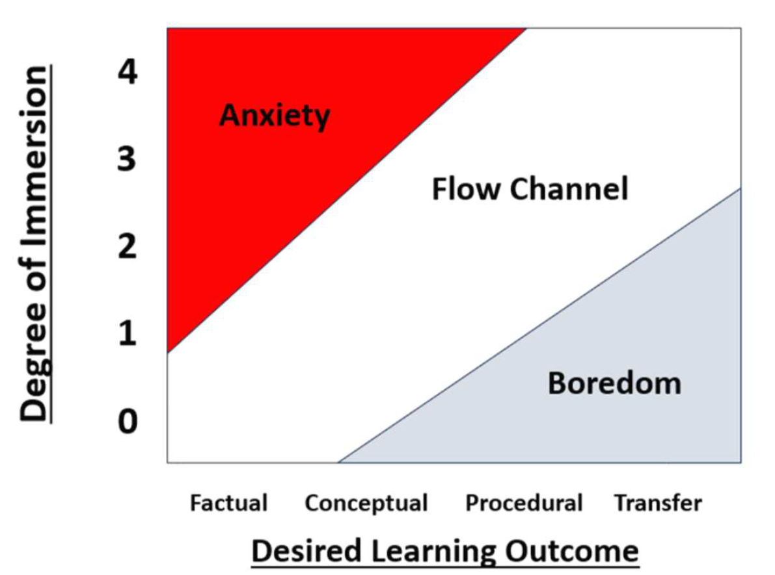
I-FLO Overview
Flow Theory
CAMIL Model
Taxonomy for Immersive Experiences
Notes:
Retrieved from ChaptGPT 4.0 search

Slide 8
I-FLO
Flow Theory
Flow Theory
CAMIL Model
Taxonomy for Immersive Experiences
Notes:
Retrieved from ChaptGPT 4.0 search

Slide 9
Flow Theory
Flow Theory presents a concept for achieving and sustaining optimal learning and performance by considering the learner’s affective state.
“To motivate a student so that [they] perform learning activities with complete immersion, it is necessary that [their] affective state provide an optimal experience.
This affective state is denominated flow, and it is a mental state of operation characterized by a feeling of energized focus, full involvement, and success in the task being performed” (Csikszentmihalyi, 2013).
Challenge
HIGH
AROUSAL
Anxiety
Flow State
Increasing
Skills
Decreasing
Challenge
Increasing
Challenge
Less
Demanding
Skills
Boredom
LOW
AROUSAL
Skill
LOW EFFICACY
HIGH EFFICACY

Slide 10
I-FLO
CAMIL
Flow Theory
CAMIL Model
Taxonomy for Immersive Experiences
Notes:
Retrieved from ChaptGPT 4.0 search

Slide 11
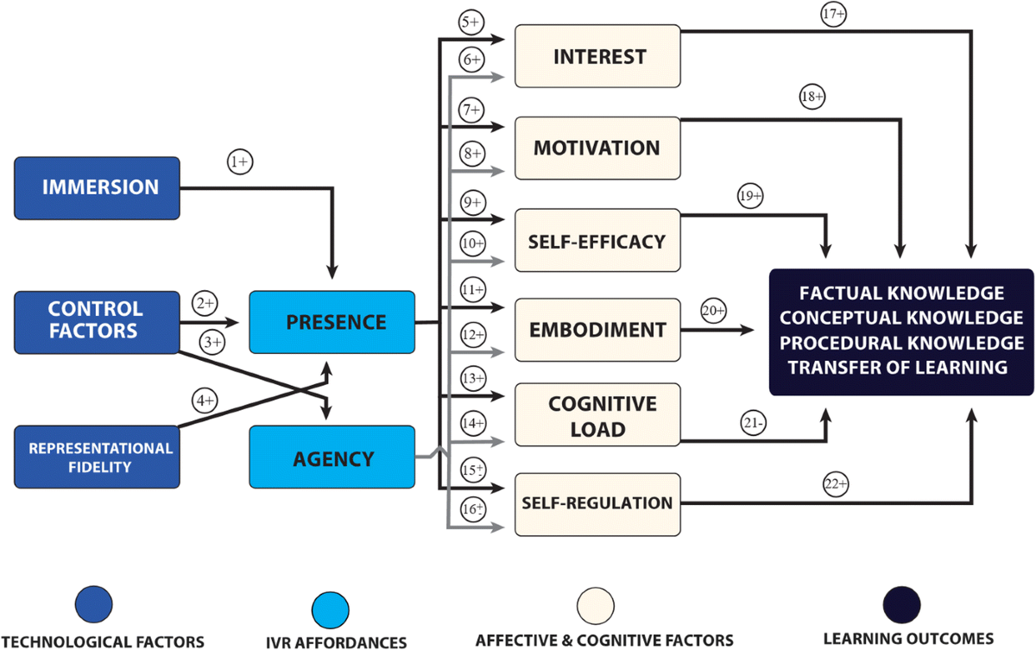
CAMIL

Slide 12
CAMIL
Learning methods (the types of immersion) affect learning
The general affordances of learning in IVR are presence and agency – how well the instruction design utilizes the advantages of presence and agency affects the learning outcomes
Predicts how presence and agency relate to the relationship between both Cognitive and Affective learning outcomes
Quality and Artistry have a tremendous impact on the learning outcome of an IVR
Notes:
The general affordances of learning in IVR are presence and agency – how well the instruction design utilizes the advantages of presence and agency affects the learning outcomes
Predicts how presence and agency relate to the relationship between both Cognitive and Affective learning outcomes

Slide 13
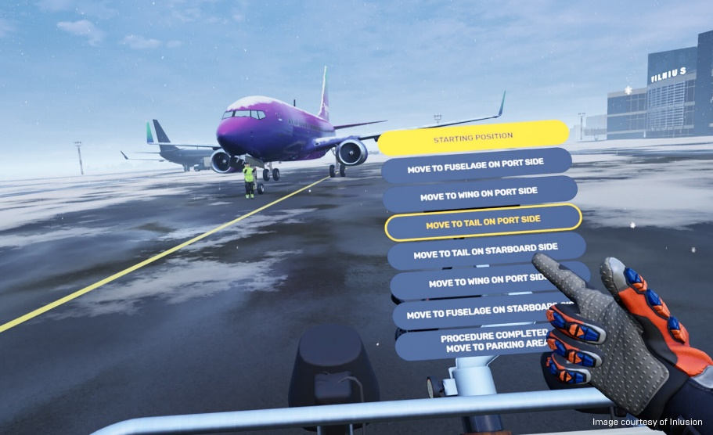
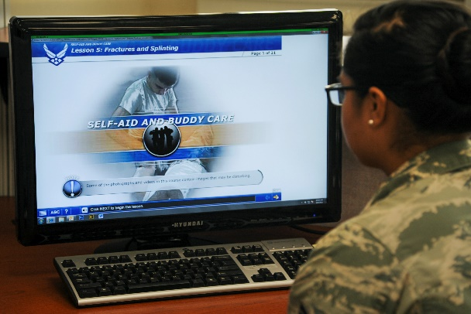
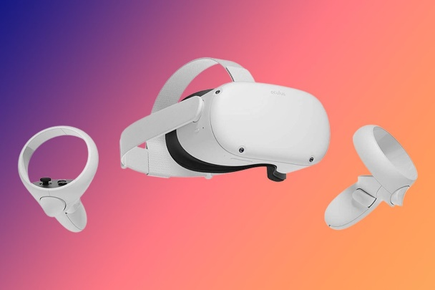
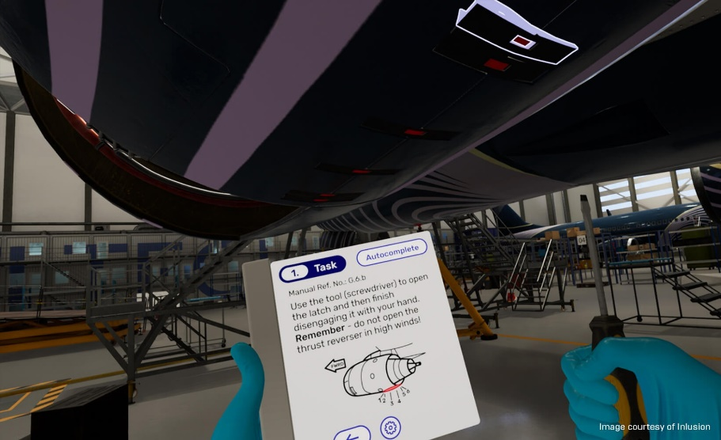
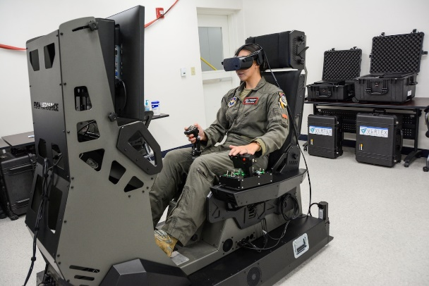
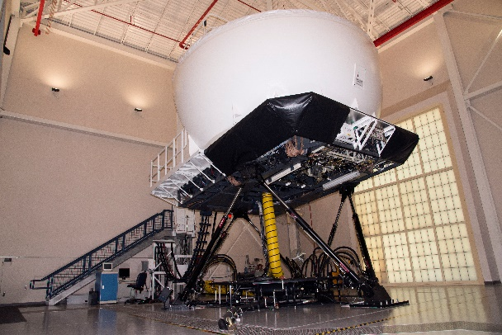
CAMIL
Instructional Design
Medium
>
Notes:
Provides a theory of change that describes how it is not the medium of immersive virtual experiences (IVR) that creates the learning moment, but the instructional method applied within the IVR and specifically how effective the technique facilitates the unique affordances of the medium (elements of immersion).
https://www.unrealengine.com/en-US/spotlights/beyond-the-manual-vr-training-on-aircraft-maintenance
https://www.aetc.af.mil/News/Article-Display/Article/1462008/80th-ftw-leadership-try-out-mixed-reality-simulator/
https://www.macdill.af.mil/News/Features/Display/Article/1609979/headed-to-the-sim-safer-stronger-warfighter-readiness/
https://www.google.com/url?sa=i&url=https%3A%2F%2Fwww.littlerock.af.mil%2FNews%2FArticle-Display%2FArticle%2F764538%2Flife-saving-skills-101%2F&psig=AOvVaw0yOQJbt0XES3qL2mvRd5BS&ust=1728069306200000&source=images&cd=vfe&opi=89978449&ved=0CBcQjhxqFwoTCKCmzPz18ogDFQAAAAAdAAAAABAE
https://www.315aw.afrc.af.mil/News/Article-Display/Article/2440443/ultra-low-cost-simulation-program-augments-pilot-training/

Slide 14
I-FLO
Taxonomy for Immersive Experiences
Flow Theory
CAMIL Model
Taxonomy for Immersive Experiences
Notes:
Retrieved from ChaptGPT 4.0 search

Slide 15
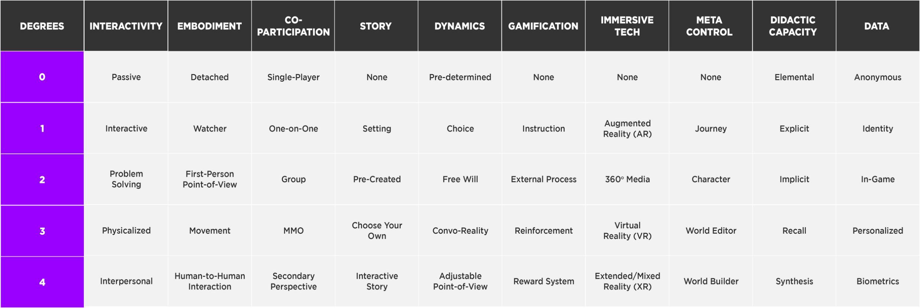
Taxonomy for Immersive Experiences
Ten (10) elements that contribute to the effectiveness of an IVR
Five (5) Dimensional levels of immersion
Describes the interplay between CAMIL’s model of Immersion and Presence
Allows for the mapping of the DNA of an immersive experience (IVR)

Slide 16

Taxonomy for Immersive Experiences
Immersion and Presence have a tremendous impact on the learning outcome of an IVR
Quality and Artistry have a tremendous impact on the learning outcome of an IVR

Slide 17
I-FLO

Slide 18
I-FLO
5 Step Process
Step 1: Identify Desired Learning Outcome(s)
Step 2: Identify Degree of Immersion Range(s)
Step 3: Identify Elements of Immersion
Step 4: Apply cost optimization strategies
Step 5: Draft requirements

Slide 19
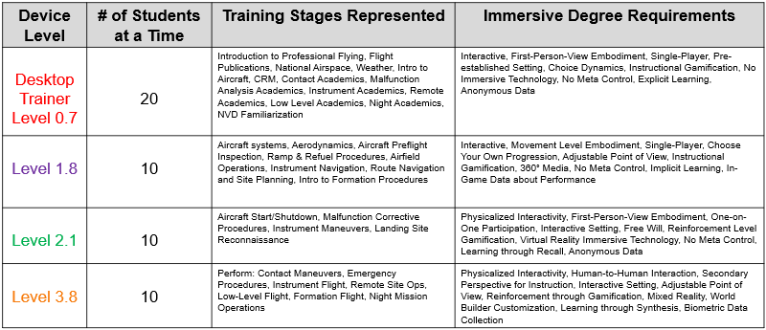
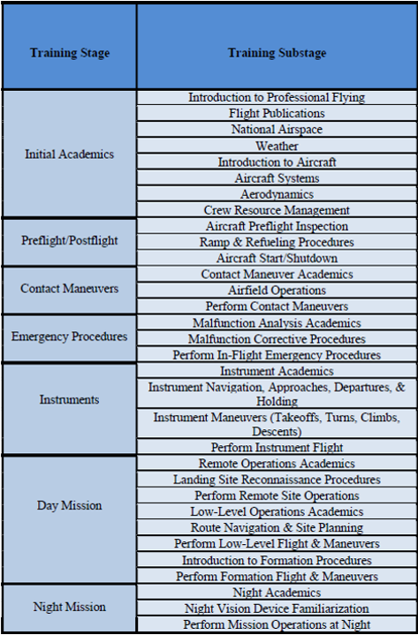
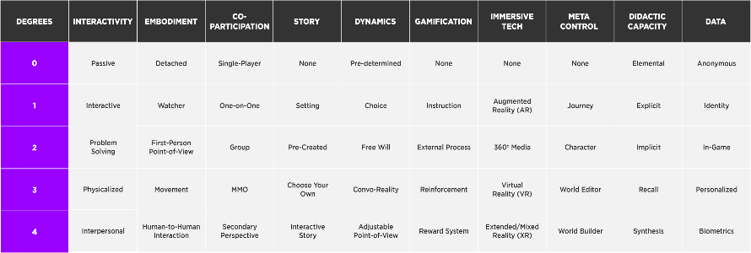
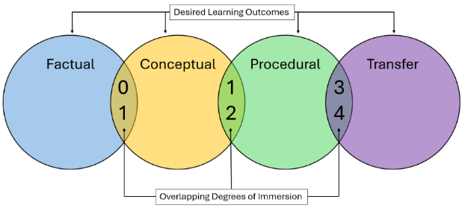
Pilot Training Example
  USAF Undergraduate Helicopter Pilot Training

Slide 20
Pilot Training Example – Step 1
Step 1: Identify the Desired Learning Outcome for targeted stage of training
Procedural

Slide 21
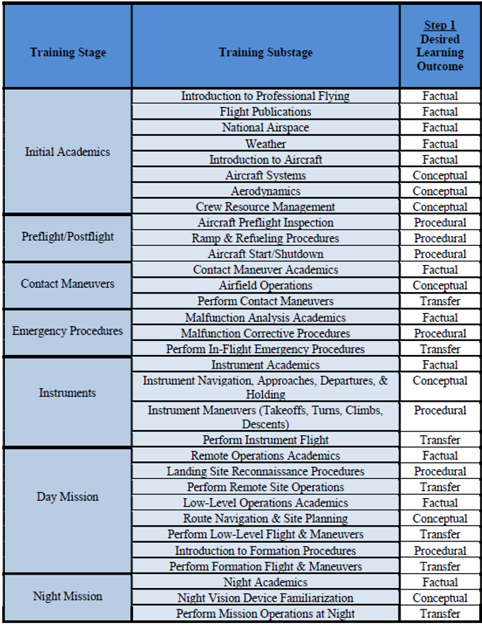
Pilot Training Example – Step 2
Step 2: Identify Degree of Immersion Range
1-4

Slide 22
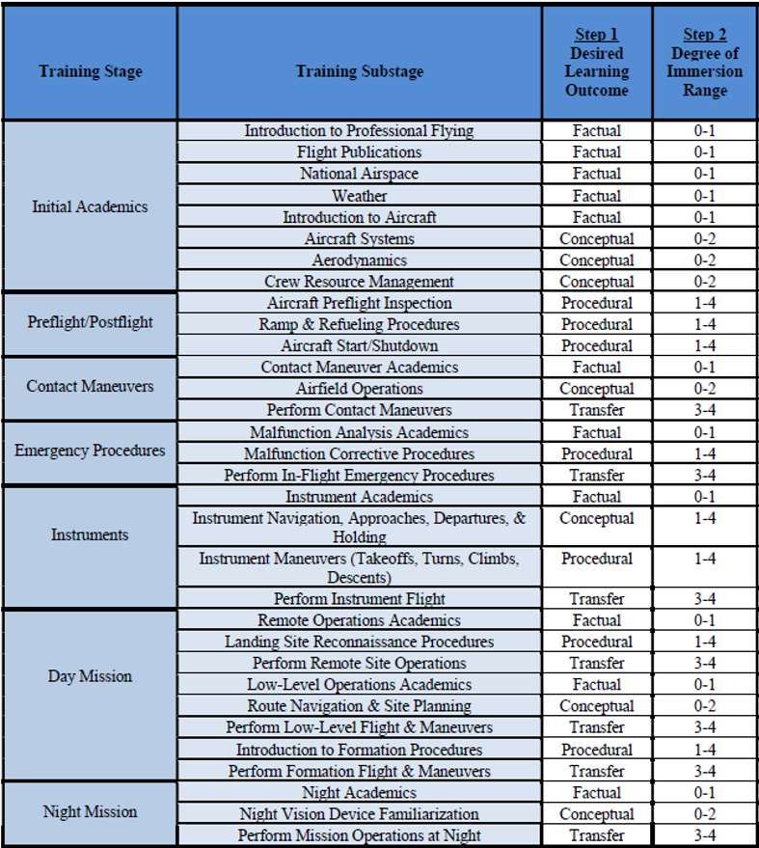
Pilot Training Example – Step 2
Perform Step 1 & 2 for all stages of training

Slide 23
Pilot Training Example – Step 3
Step 3: Identify Elements of Immersion on Taxonomy for Immersive Experience Design
Degree of Immersion
3
3
0
1
2
3
3
0
4
2
21
Average Degree of Immersion (DoI) = DoI Total / # of Elements
= 21 /10
ADoI = 2.1

Slide 24
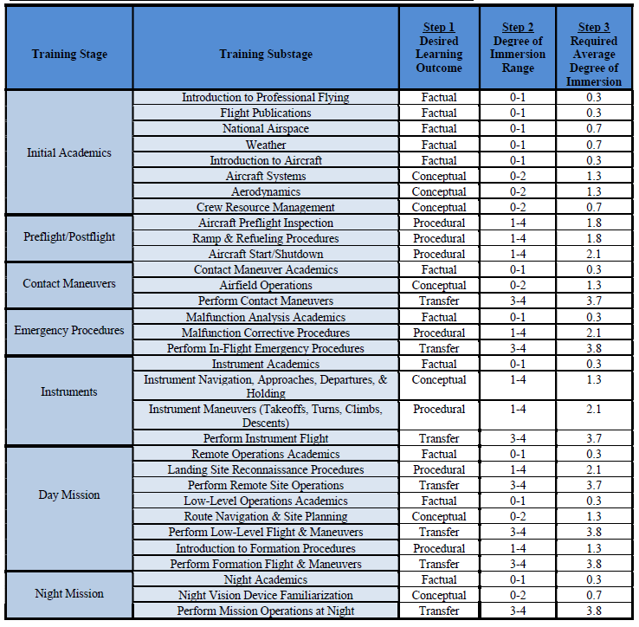
Pilot Training Example – Step 3
Perform Step 3 for all stages of training

Slide 25
Pilot Training Example – Step 4
Step 4: Analyze cost optimization and device consolidation strategies
  1) Different stages, same desired learning outcomes
  Example: Procedural training device can be utilized for 7 different stages of training
  Useful for training programs with major cost limitations & low variation in DLOs

Slide 26
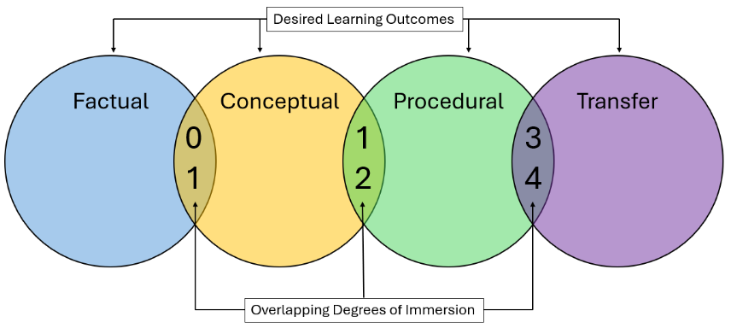
Pilot Training Example – Step 4
Step 4: Analyze cost optimization and device consolidation strategies
2) Overlapping degrees of immersion

Slide 27
Pilot Training Example – Step 4
2) Overlapping degrees of immersion
Step 3 results must be utilized to determine feasibility of overlap
  Bad: Trying to consolidate training into one device based only on Step 2 results
  Good: Utilizing one device for conceptual and procedural DLOs requiring 1.3 - 1.8 ADOIs based on Step 3 results

Slide 28
Pilot Training Example – Step 4
13 Stages
0.3 – 0.7 ADOI
ADOI Level 0.7 Desktop Trainer
8 Stages
1.3 – 1.8 ADOI
ADOI Level 1.8 Device
4 Stages
2.1 ADOI
ADOI Level 2.1 Device
4 Stages
3.7 – 3.8 ADOI
ADOI Level 3.8 Device

Slide 29
Pilot Training Example – Step 5
Step 5: Draft Requirements
Use Taxonomy to Draft Specific Immersion Requirements for:
Level 0.7 Desktop Trainer
Level 1.8 Immersive Device
Level 2.1 Immersive Device
Level 3.8 Immersive Device

Slide 30
Pilot Training Example – Step 5
Step 5: Draft Requirements
Use immersive taxonomy to frame requirements in verbiage industry will understand

Slide 31
Pilot Training Example – Final Results
Device Level | # of Students at a Time | Training Stages Represented | Immersive Degree Requirements
Desktop Trainer Level 0.7 | 20 | Introduction to Professional Flying, Flight Publications, National Airspace, Weather, Intro to Aircraft, CRM, Contact Academics, Malfunction Analysis Academics, Instrument Academics, Remote Academics, Low Level Academics, Night Academics, NVD Familiarization | Interactive, First-Person-View Embodiment, Single-Player, Pre-established Setting, Choice Dynamics, Instructional Gamification, No Immersive Technology, No Meta Control, Explicit Learning, Anonymous Data
Level 1.8 | 10 | Aircraft systems, Aerodynamics, Aircraft Preflight Inspection, Ramp & Refuel Procedures, Airfield Operations, Instrument Navigation, Route Navigation and Site Planning, Intro to Formation Procedures | Interactive, Movement Level Embodiment, Single-Player, Choose Your Own Progression, Adjustable Point of View, Instructional Gamification, 360° Media, No Meta Control, Implicit Learning, In-Game Data about Performance
Level 2.1 | 10 | Aircraft Start/Shutdown, Malfunction Corrective Procedures, Instrument Maneuvers, Landing Site Reconnaissance | Physicalized Interactivity, First-Person-View Embodiment, One-on-One Participation, Interactive Setting, Free Will, Reinforcement Level Gamification, Virtual Reality Immersive Technology, No Meta Control, Learning through Recall, Anonymous Data
Level 3.8 | 10 | Perform: Contact Maneuvers, Emergency Procedures, Instrument Flight, Remote Site Ops, Low-Level Flight, Formation Flight, Night Mission Operations | Physicalized Interactivity, Human-to-Human Interaction, Secondary Perspective for Instruction, Interactive Setting, Adjustable Point of View, Reinforcement through Gamification, Mixed Reality, World Builder Customization, Learning through Synthesis, Biometric Data Collection

Slide 32
Conclusion
As educators integrate immersive learning devices into training programs, consideration must be given to how students effectively learn within immersive environments.

Slide 33
Questions?

