Slide 1

Behavior-Based Performance Optimization in Emerging Training Environments
Audrey Zlatkin, Ph.D., Design Interactive, Inc.
Costas Koufogazos, Design Interactive, Inc.
Gwen Campbell, Ph.D., Design Interactive, Inc.
William Rivera, Ph.D., Design Interactive, Inc.

Slide 2

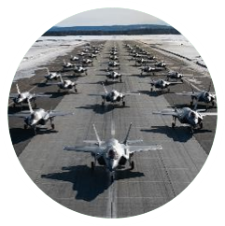
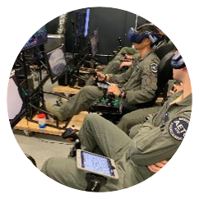
Introduction
Tomorrow’s Airmen must be:
Organized, trained, & equipped to succeed for high end combat
Transform learning across all facets of DoD education & training curricula
Influx of emerging training technologies
Performance Assessment methods have remained largely static
Manual, Subjective, Generalized

Slide 3





Benefits of Virtual & Simulation-Based Training
Immersive, repeatable training for both cognitive and psychomotor skills
Reduces costs for training, assessment, performance tracking
Adaptive feedback helps transfer skills to real-world operations
Potential to leverage data for AI enabled analytics and performance modeling
Design Interactive’s team of researchers have evaluated the usage of such technologies & have determined a reduced time to skill proficiency & performance gains between 30-34%
Notes:
Virtual, augmented, and mixed reality technologies present the DoD with a remarkable opportunity to make fundamental changes to how pilots and aircrews are trained
The technologies provide immersive, rapidly repeatable, experiential training that is more cost effect and capable of effectively training important cognitive and psychomotor skills for complex domains (Singhal et al., 2012, Lee, 2012)
Technology expansion for training, must be accompanied with innovation in instructional strategies through personalization of learning experiences and action-oriented feedback
Adaptive training with feedback and assessment has been demonstrated as critical to learning, and more to transfer of skill to real-world operations (Hattie & Timperly, 2007; Butler & Winne, 1995)
Advanced technology can provide the emerging DAF XR ecosystem (virtual, augmented, and mixed reality training solutions) with a solution for conducting automated performance evaluation through integration of AI for data analytics & performance modeling
AI provides opportunity to effectively profile expertise & execute analytics on trainee results for rapid comparison
Direct, personalized feedback on performance will provide more accurate readiness assessment

Slide 4
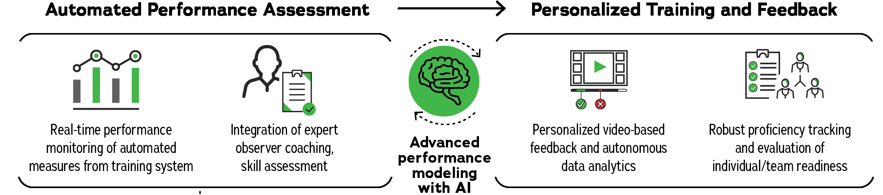
Research Approach
The use of advanced technology is expected to improve USAF human performance by:
Supporting consistent, standardized assessment
Reducing bias and demand on the human instructor
Increasing training capacity and performance tracking enterprise wide
Integration of research-based learning techniques with an adaptive performance algorithm can provide:
A comprehensive picture of a trainee’s knowledge, skills, & cognitive state

Slide 5
Research Approach
Research-based training interventions
Video Self-Modeling (VSM)
Personalized, elaborative feedback
ML techniques
Behaviorally Anchored Rating Scales (BARS)
Competency-based skill development
Increased inter/intra-rater reliability
Diagnose proficiency levels / skill gaps
Notes:
This competency-based skill approach enables rapid and efficient skill development, helping diagnose proficiency levels and identify performance gaps for learners, instructors, and exercise developers. Training that promotes individual trainee awareness and regulation of their own thinking, behaviors, biases, and competencies has been shown to enhance the perception and understanding of critical cues (Ford et al., 1998), the acquisition of higher-order conceptual knowledge (Fiorella & Vogel-Walcutt, 2011), and the development of appropriate mental models and behaviors within a domain (Wu & Looi, 2012).

Slide 6
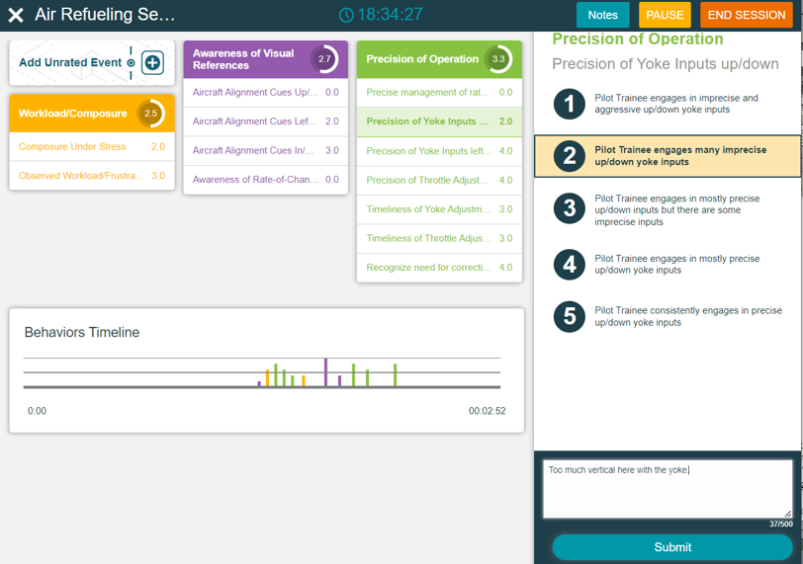
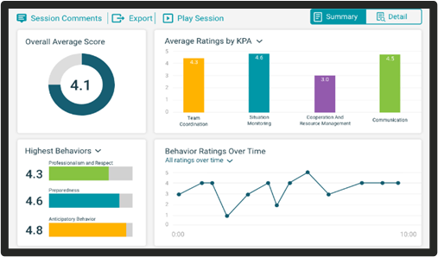
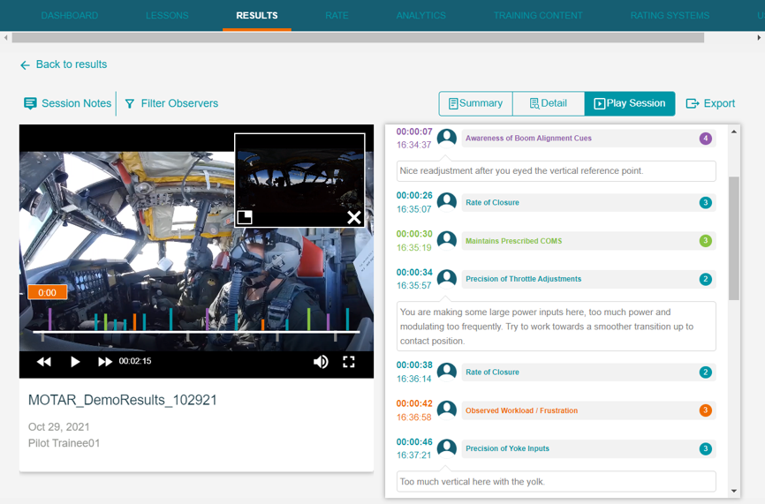
Method
Structured Performance Assessment
Integrate instructor expertise with automated data sources
Standardized, competency-based training and assessment platform
Customized rubrics
Real-time or video performance review
Results dashboards & analytics
Adaptive feedback & self-guided learning
6

Slide 7
Method
Use Case: B-52 Air Refueling
SME interviews
Identify and define Air Refueling performance outcomes and indicators
Refine assessment rubric with KPAs and Behaviors
KPAs | Behaviors
Awareness of Visual References | Aircraft Alignment Cues Up/Down Aircraft Alignment Cues Left/Right Aircraft Alignment Cues In/Out Awareness of Rate-of-Change in Position
Precision of Operation | Precise Management of Rate-of-Closure from Pre-Contact to Contact Precision of Yolk Inputs Up/Down Precision of Yolk Inputs Left/Right Precision of Throttle Adjustments Timeliness of Yolk Adjustments Timeliness of Throttle Adjustments Recognize Need for Corrective action/disconnect
Workload/ Composure | Composure Under Stress Observed Workload / Frustration

Slide 8
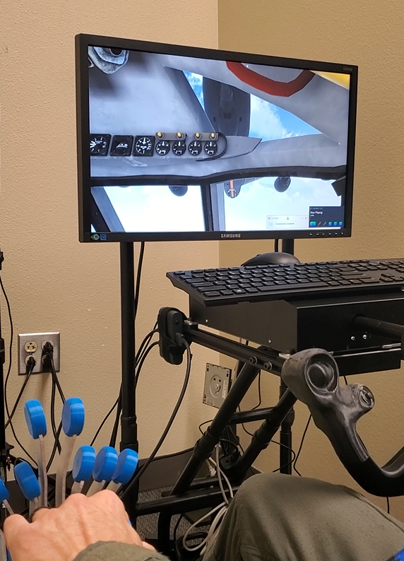
Method
Automated Performance Metrics
Variable | Type
Time in precontact | Timestamp data/ duration
# of contacts | Frequency counts
Position of contacts | Positional/vector data
Time in contact | Timestamp data/ duration
# of disconnects | Frequency counts
Position of disconnects | Positional/vector data

Slide 9
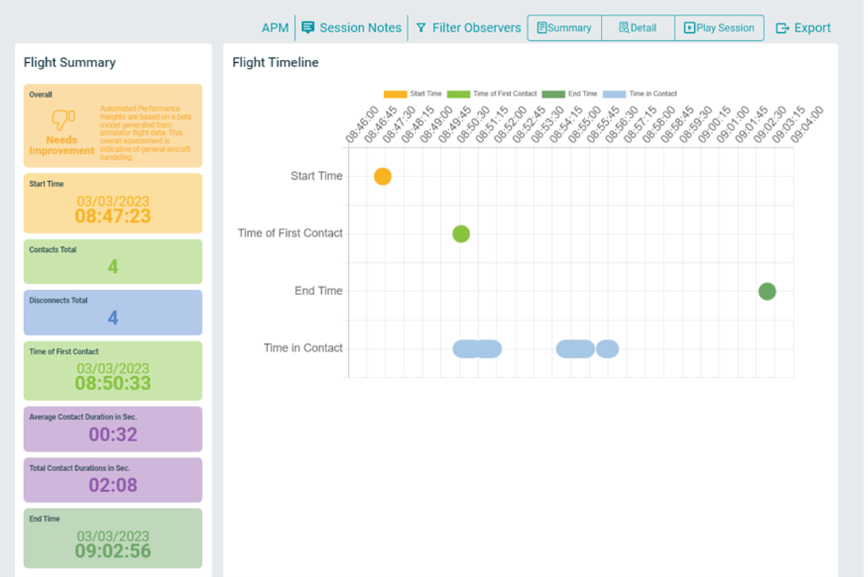
Automated Performance Metrics
Simulator training data presented:
Flight summary and Flight timeline
Highlight timestamped events and variables of interest
Automated Performance Assessment
Qualify as good or needs improvement based on aircraft handeling data from simulator
Notes:
These updates include updates to the date/time format, renaming the components to Flight Summary and Flight Timeline (from Accumulation Metrics and Timeline Metrics) (Figure 5) and most notably the addition of 3D models to the spatial view to support faster comprehension and localization of disconnects. The 3D model provides visual reference of both the boom and aircraft nose to aid better spatialization. This 3D model is also paired with a legend indicating the mechanisms for manipulating the model (zooming, rotating, etc.) as well as short cut buttons that allow the user to snap to the 2D side and front views.

Slide 10
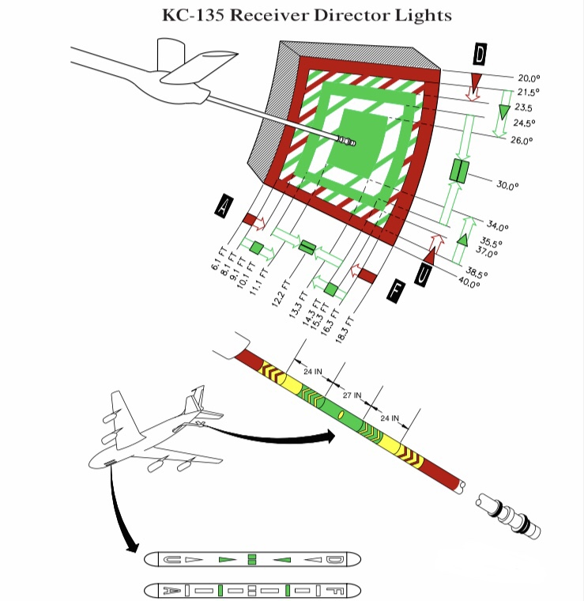
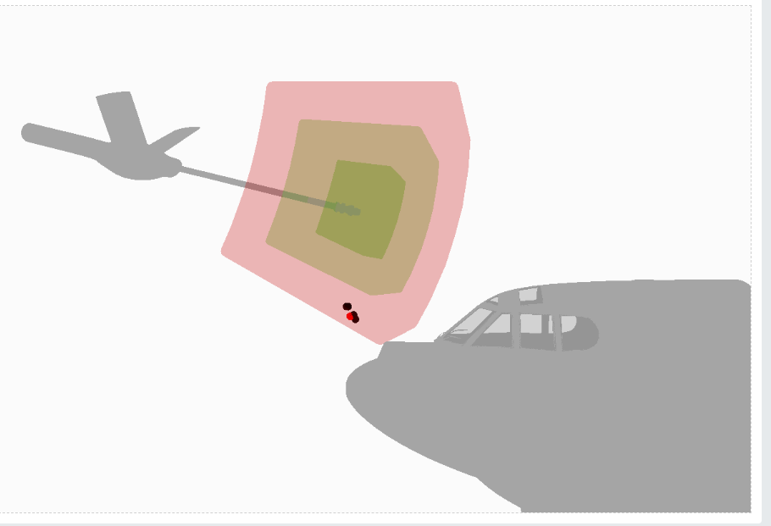
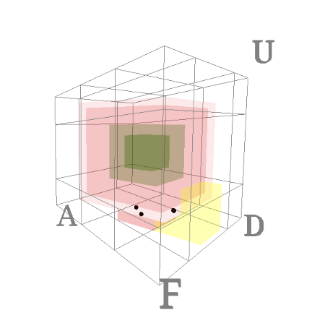
Automated Performance Metrics
3D mapping of Disconnects:
Faster comprehension and localization of errors
Visual reference of boom and aircraft
10
Notes:
Due to continued delays on Specular Theories side of things, we ended up rescoping the development during the second stage prototype to focus less on the automated performance algorithm and pivot to explore a 3D results visualization for disconnects. This is a concept that was developed by working closely with our GSC stakeholders, specifically Russ Mathers, our 2nd TPOC who remains an active stakeholder and advocate for the system. Here are the preliminary versions of this feature that we have since built out based on SME review and usability testing.
In our previous milestone meeting, Maj Wolf expressed concerns about making sure we are addressing the ‘why’ leading up to maladaptive training behaviors. What is causing the disconnect. We have a few idea on how to leverage the existing output data to better tell that sequence of events and we wanted to talk through that here.
Opportunity to take advantage of the hover tool tips to provide insight leading up to the disconnect. Ex: throttle input level at time of disconnect

Slide 11



Integrated After-Action Review
Summary:
Snapshot of overall performance
Highlight individual performance gaps
Detail:
Identify problem areas for individual/team
Utilize charts/graphs to:
Pinpoint when performance breakdown occurs
Compare performance across key areas and low-level behaviors
Video AAR:
Direct links from data to video of performance
Can observe what was happening during the session when ratings were made
Structured performance assessment paired with objective training data for a wholistic after-action review

Slide 12
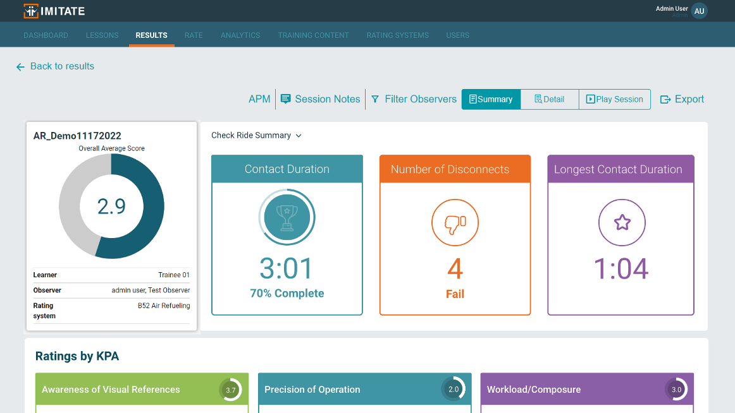
Integrated After-Action Review
Check Ride Summary
Automated Performance Assessment based on Check Ride Criteria
Based on number and duration of contacts during training simulation session
Contact Duration PR

Slide 13
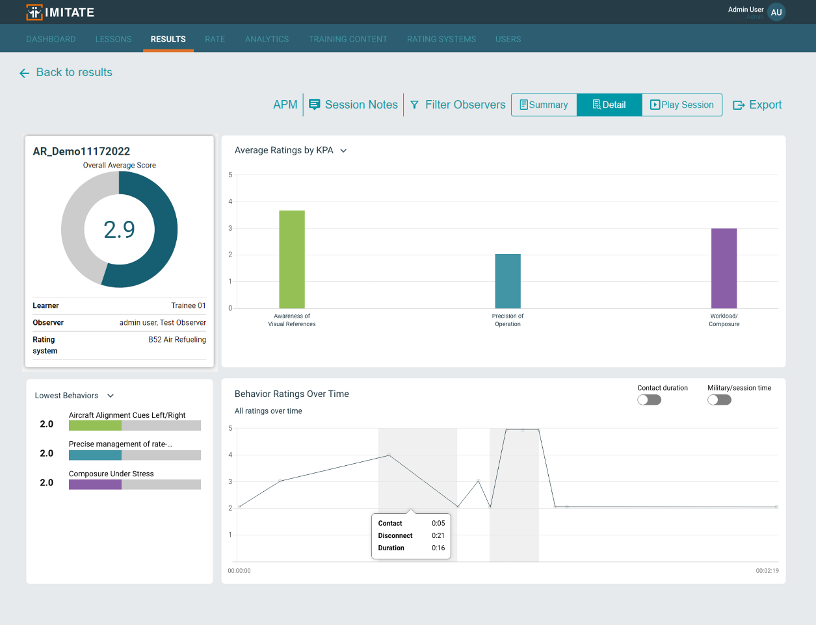
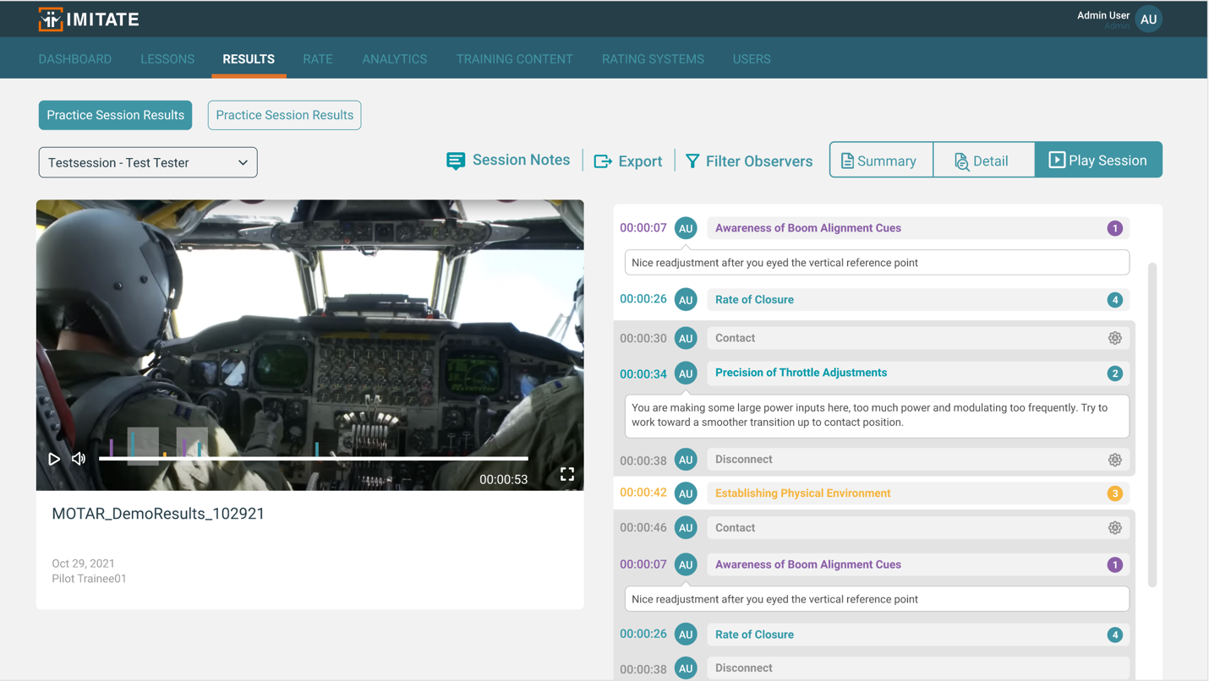
Integrated After-Action Review
Contact
Automated training data
Disconnect
Contact
Disconnect
Behavior ratings over time
Performance Ratings

Slide 14
Modeling Approach
Collect representative data
10 virtual air refueling training sessions
5 Novice – Student Pilots
5 Expert – Instructor Pilots
SME evaluated performance
Utilizing the Air Refueling Rubric
Identify instances of ‘good’ and ‘bad’ performance
Map SME rated behavioral data to automated data from the virtual trainer

Slide 15
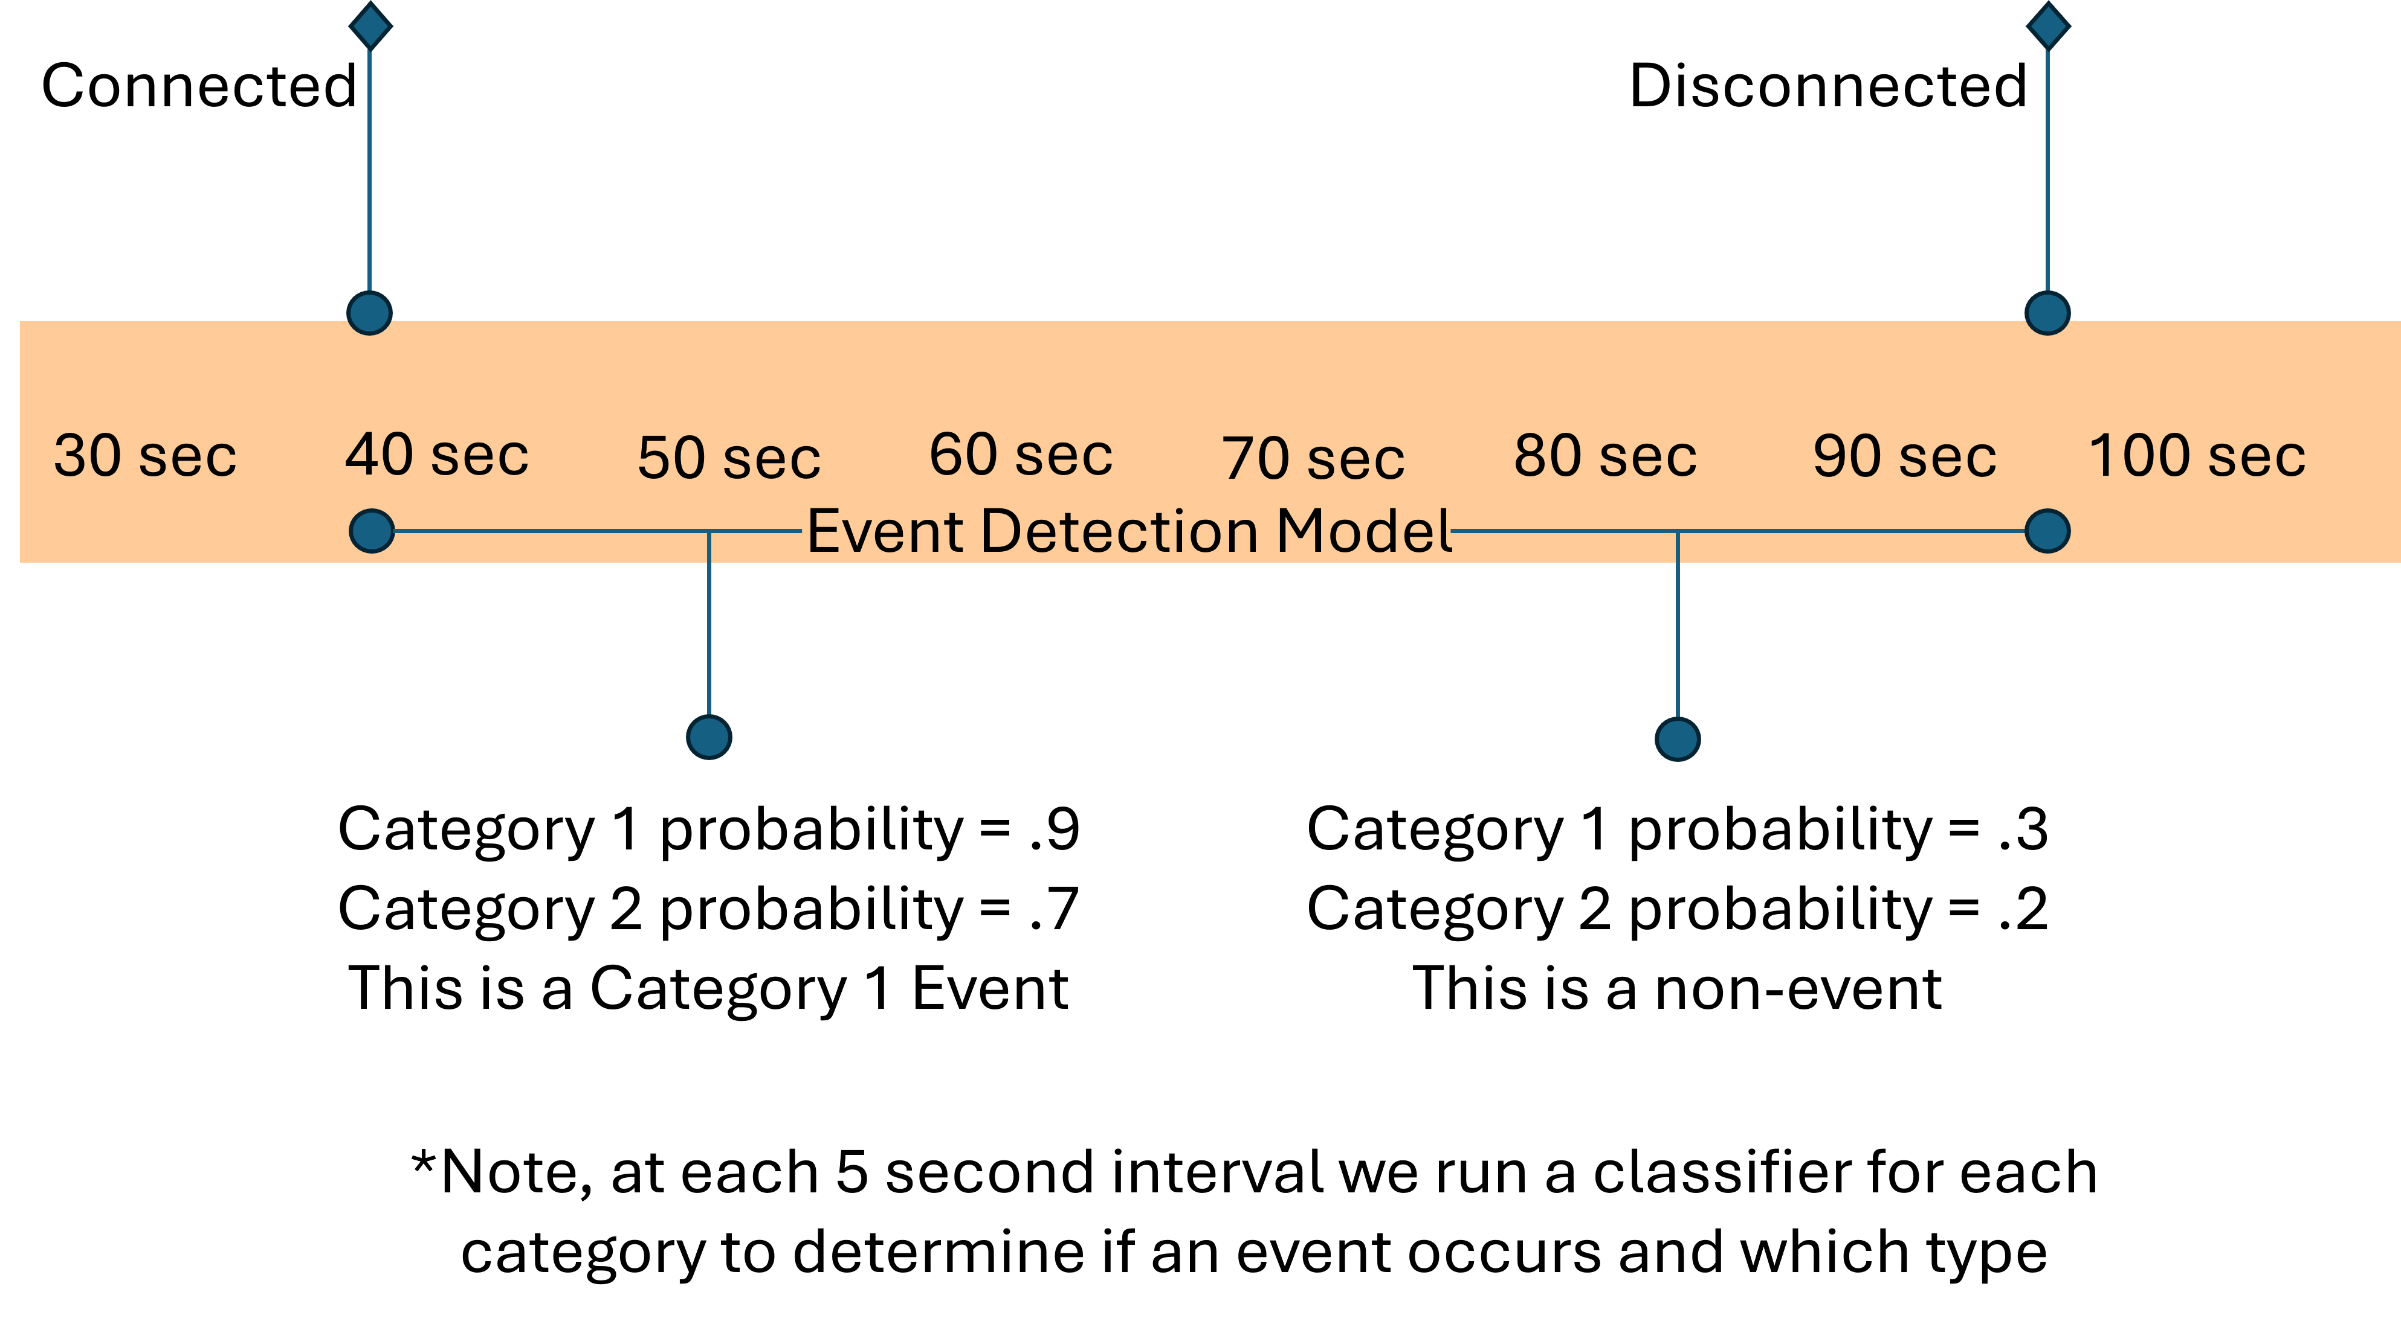
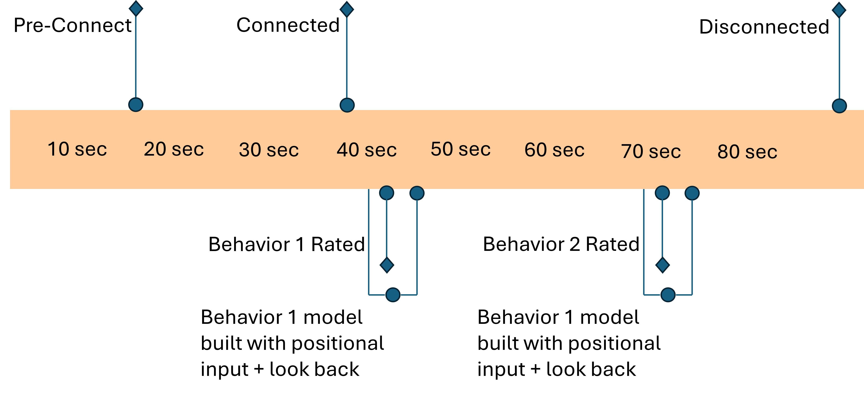
Modeling Outcomes
Explored models to determine performance ratings from aircraft data
Ranking Model
70-94% accurate at rate that event
Event Triggering Model
Unable to successfully predict when an event would occur despite being able to accurately

Slide 16
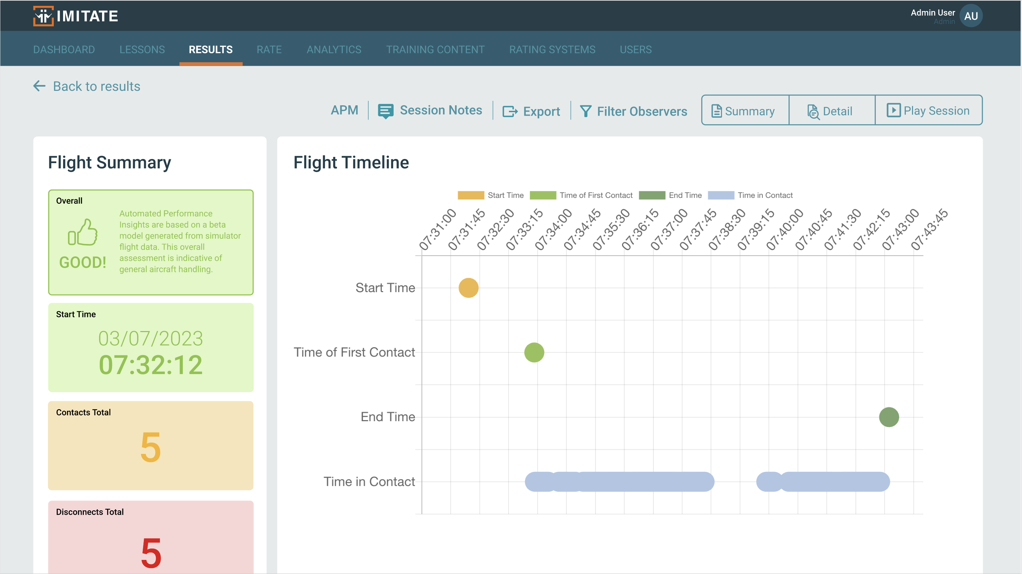
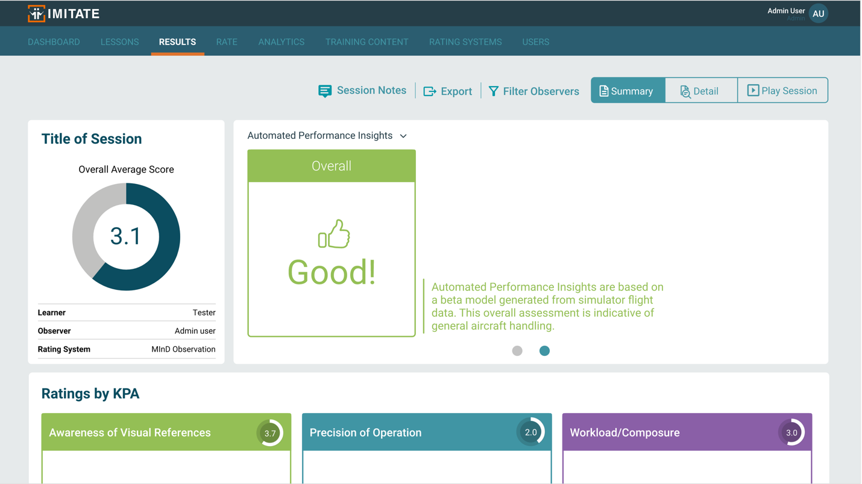
Modeling Approach
Aggregated data for whole session
Min, max, mean and variance measures across raw flight data to identify relationships with ratings
Generalize above and below 2.5 threshold
Not sufficient to determine satisfactory individual KPA/ behavior rating
Categorize sessions as either ‘good’ or ‘needs improvement’
Potential to provide automated evaluation in the absence of instructor ratings.

Slide 17
Future Opportunities
Integration within an AF training environment
Continue building out Air Refueling use case and sharing data with vendors
Enhanced Features
Continue developing AAR capabilities
Refined Automated Performance Model
Accommodate new and enhanced use cases / trainers
More robust performance qualifications/ratings
Central data repository
Automated/real-time streaming of trainer data and videos
Integrate organizational analytics and leaderboards

Slide 18

Questions

