Slide 1
Improving Training and Education Supply Chains by Harnessing Data Pipeline Observers
Brent Smith, ADL Initiative (SETA)
Erica Dretzka, DoD Chief Digital and AI Office (CDAO)
Jordan Gottlieb, DoD CIO Zero Trust PfMO

Slide 2
Agenda
Supply Chain Risk Management: The Training and Education SCRM
Application: Supporting Microservices with Use Case
Privacy, Security, and Observers
Next Steps

Slide 3
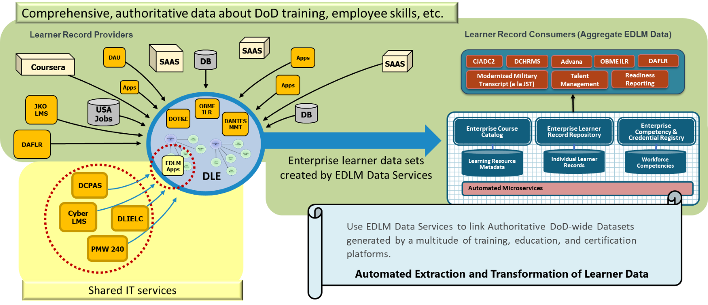
The Training and Education Supply Chain
Data scales insights into Readiness Reporting, CJADC2, cross-Service Talent Management initiatives
Digitalization of learner records requires data privacy and security measures

Slide 4
Human-Machine Skillsets
Industry 4.0
Industry 5.0
Integration of automation and data exchange in manufacturing technologies, including:
Cyber-physical systems
Internet of Things (IoT)
Cloud Computing
Shift towards "Smart" factories
Emphasizes human-machine collaboration
Create sustainable, more human-centric industries
More automation and interconnections
Improve Interoperability of Information
Growing need for a workforce skilled in digital, technical, and collaborative competencies
Data infrastructure supporting development curricula addressing these skillsets
Zero Trust security and privacy principles
DoDI 1400.25 established 28 Functional Communities (FCs) with labor frameworks, career roadmaps, etc
DoD's Enterprise Learning Data Management (EDLM) is working with CDAO and CIO Zero Trust PfMO to accomplish this

Slide 5
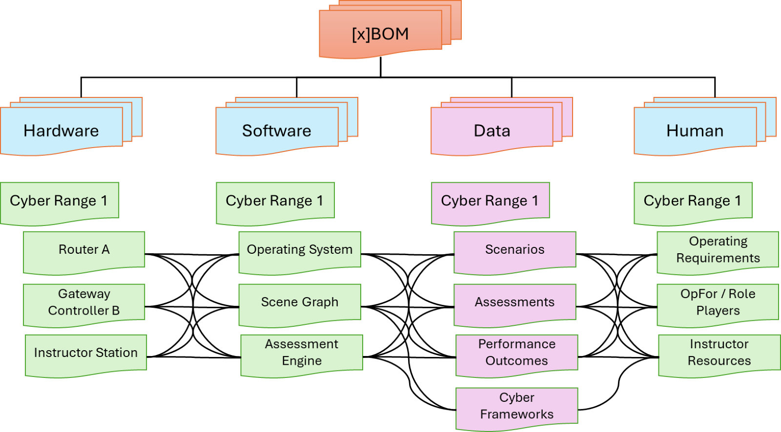
Digitizing Functional Communities
Challenges
Different Information Technologies, tools, and data formats, both internal and external to DoD, to describe the competencies, credentials, assessments, and learning resources required to support their workforce elements, work roles, and KSATs
There are about 250 types of cybersecurity frameworks and standards in use globally
Many companies use more than one standard
xBOMs improve Supply Chain transparency
Provide inventory for training and supporting technology stacks
Example: [x]BOM decomposition of the cyber range into its atomic services and the required resources for each platform’s hardware, software, data, and human components required to operate and maintain the software lifecycle.

Slide 6
Supporting Microservices
xBOMs empower DoD to track individual learner progress, tailor educational experiences, optimize training
Ensure learner data can be seamlessly shared, exchanged, understood, protected, and utilized across systems and communities by:
Pre-mediated structuring of different formats and standards of learner data
Facilitating semantic interoperability across FCs and learner providers
Identifying nuances of each organization and different learning platforms into machine-readable content
Preserve meaning and context of learner data at the atomic level since it is tagged and categorized at the lowest level
Data Pipeline Observers continuously monitor to detect anomalies indicating potential security or integrity breaches
Act as watchdogs which automate a layer of protection by:
Continuously scanning data pipeline
Validating data consistency, accuracy, and completeness by comparing against the xBOM
Detecting anomalies, outliers, or deviated patterns
Microservice infrastructure of small, self-contained programs ties capabilities together while remaining agnostic to individual environment configurations, allowing for legacy systems to interoperate with more modern systems.
Canonical Controlled Vocabulary
Pattern-ize terminology
xBOMs
Manage, integrate disparate data and data assemblies
Unique Identifiers
Tag elements at lowest atomic level
+
+

Slide 7
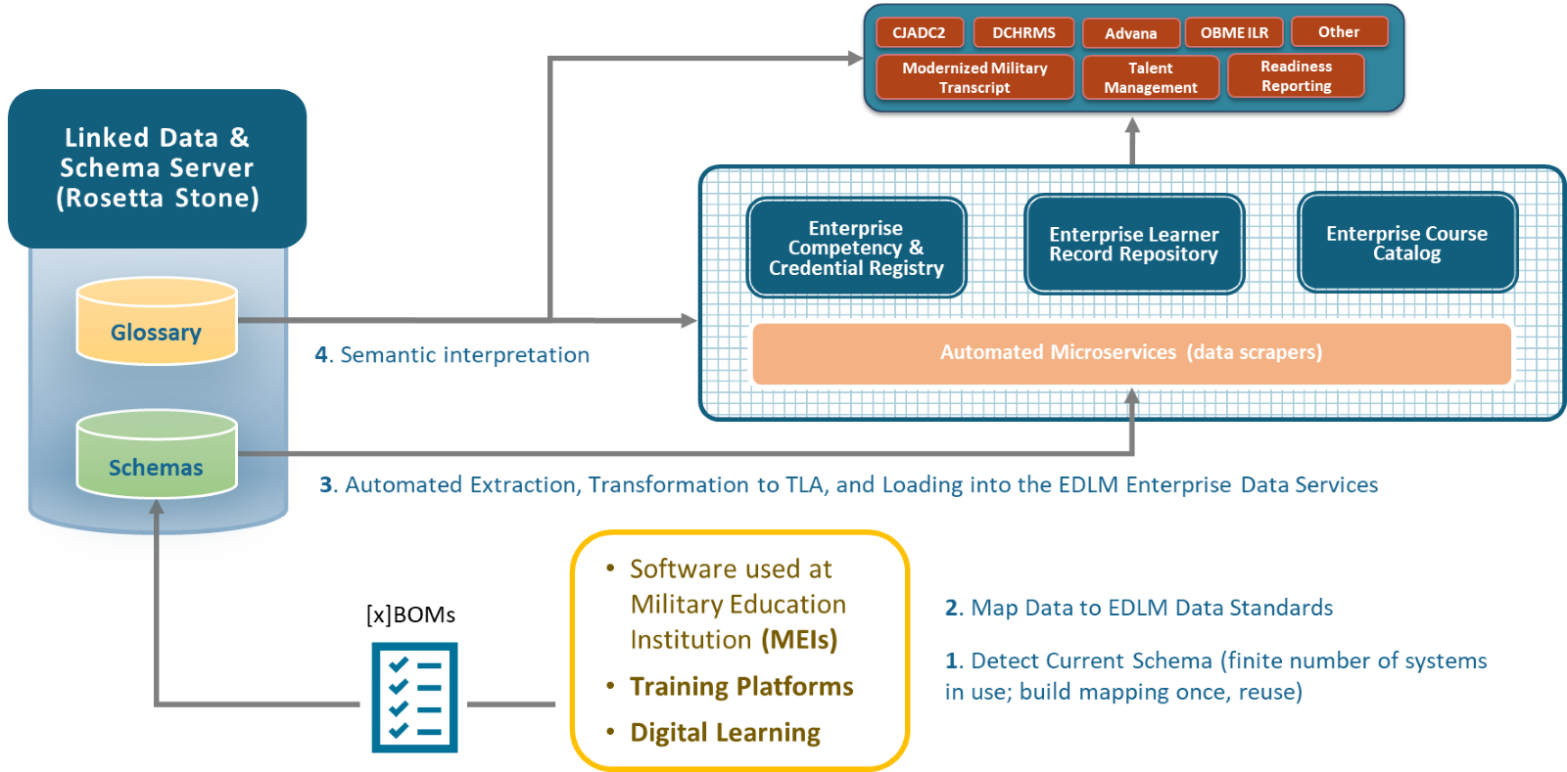
EDLM xBOM Framework Use Case
Software: xBOM fabric enables all sBOM formats by promoting interoperability at the atomic level
Hardware: hBOM contains information on maintenance, replacement parts, logistics, etc
Manpower & Resources: contains instructors, administrators, and learners; includes roles, responsibilities, interactions, etc
Data: dBOM contains learner records, performance metrics, curriculum
Note: EDLM is choosing to use data-xBOMs to hold information on AI/ML models
Tools and technologies managing the design, development, and delivery of instruction must work harmoniously.
The xBOM is the blueprint, detailing how the environment's elements interconnect and interoperate within the larger ecosystem

Slide 8
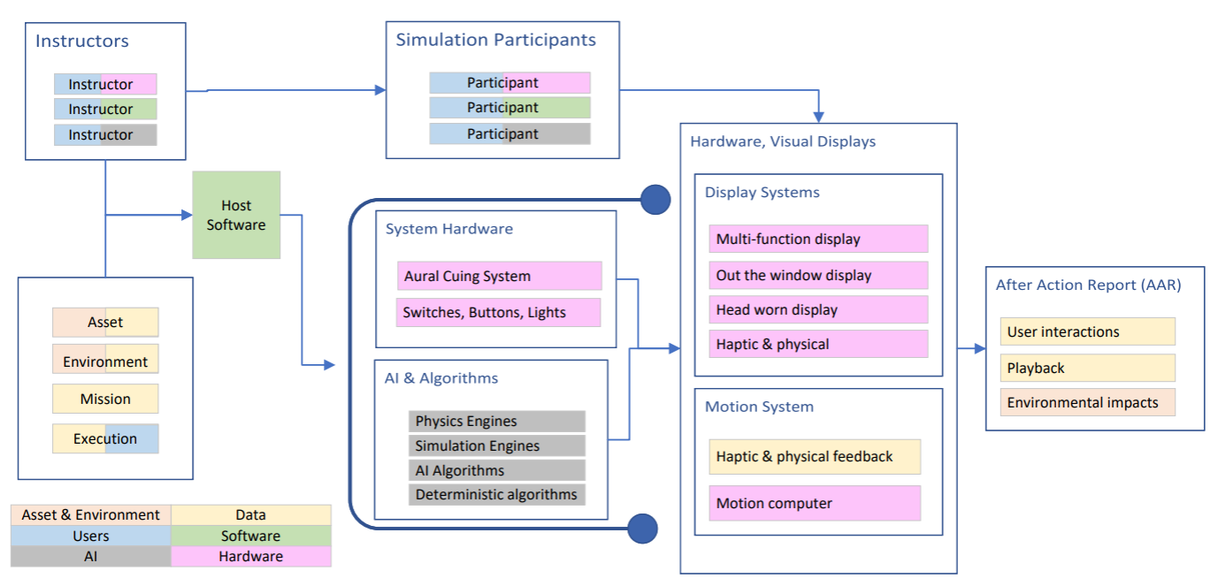
Sample Training Simulator Elements

Slide 9
Privacy & Security
Zero Trust (ZT)
The DoD-wide approach using logic rules to control and manage identity, credentialing, and access to physical and digital systems.
+
Policy-Based Access Control (PBAC)
Governed by predefined policies controlling who can view or modify each data element.
Identity (IBAC): affirms authorized Actors (Person and non-person entities) [DoD ICAM services]
+ Role (RBAC): defines clear access boundaries based on roles
+ Attribute (ABAC): allows dynamic access decisions based on attributes that can change over time
=
Positively controlled environment
As a result, xBOMs facilitate automated secure and compliant use of resources and contribute to governance oversight​

Slide 10
Data Pipeline Observers for SCRM
XBOMs capture the data necessary for Supply Chain Risk Management (SCRM)
Capture componentry of any object
Are machine readable
Use UIDs to track items across different xBOMs, entities, and across time
Use CCVs to mediate different semantic interpretations across different xBOMs, entities, and time
Data Pipeline Observers monitor and analyze the flow of data among systems
Continuously scan data being generated
Look for patterns, anomalies, outliers, aberrations, potential misuse
Act as side-car containers running alongside the primary microservice containers
Are a lightweight observer
Detect configuration shift for identically named sourcing

Slide 11
Next Steps
EDLM to establish data sharing agreements and authorities to connect different systems via xBOMs
DoD to establish DoD requirements for UIDs and CCVs, build supporting microservices

Slide 12
Contacts
Erica L. Dretzka Chief Digital and AI Office (CDAO), Chief Technology Office (CTO) Washington, DC erica.l.dretzka.civ@mail.mil Brent Smith ADL Initiative RD&E Principal (SETA) Orlando, FL Brent.smith.ctr@adlnet.gov | Dr. Kenneth Brown Chief Digital and AI Office (CDAO), Professor at National Defense University Washington, DC kenneth.b.brown8.civ@mail.mil Jordan Gottlieb DoD CIO ZT PfMO , SME (SETA) Washington, DC jordan.gottlieb.ctr@mal.mil

