Slide 1
Training through Simulation of Border Patrol Incidents
Nick Vlahopoulos – University of Michigan
Geng Zhang – Michigan Engineering Services
Nathan Murray, Robert Montemayor – Booz Allen Hamilton
Syed Mohammad – DHS Science and Technology
Paper 24348

Slide 2
Presentation Outline
Scope of Work
Main Elements
Examples
Summary

Slide 3
Scope of Work
Visualization driver for incidents
Parallel probabilistic calculations using an Attack-Defense Tree (ADTree) structure
Flexibility in defining any scenario that considers multiple threats, paths, defense elements, and targets
Outcome depends on relative strength between the threats and the defensive structure
Calibration of probabilistic modeling using available data
Risk tolerance vs. providing additional resources

Slide 4
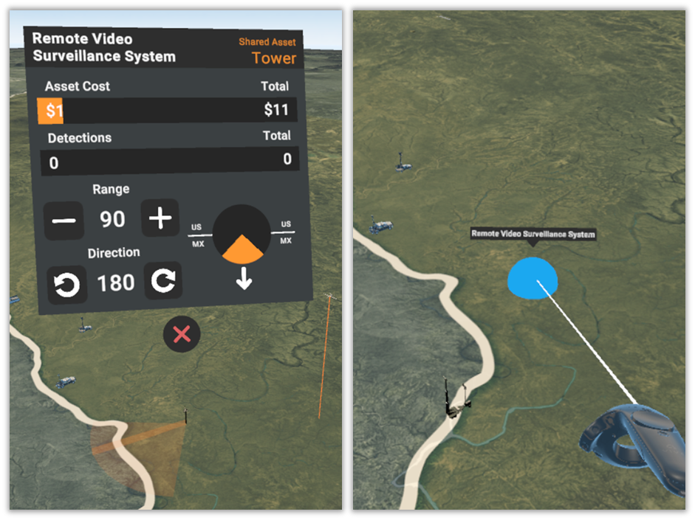
Main Elements
Visualization driver for incidents
Representative definition of an asset
Representative visualization during a simulation

Slide 5
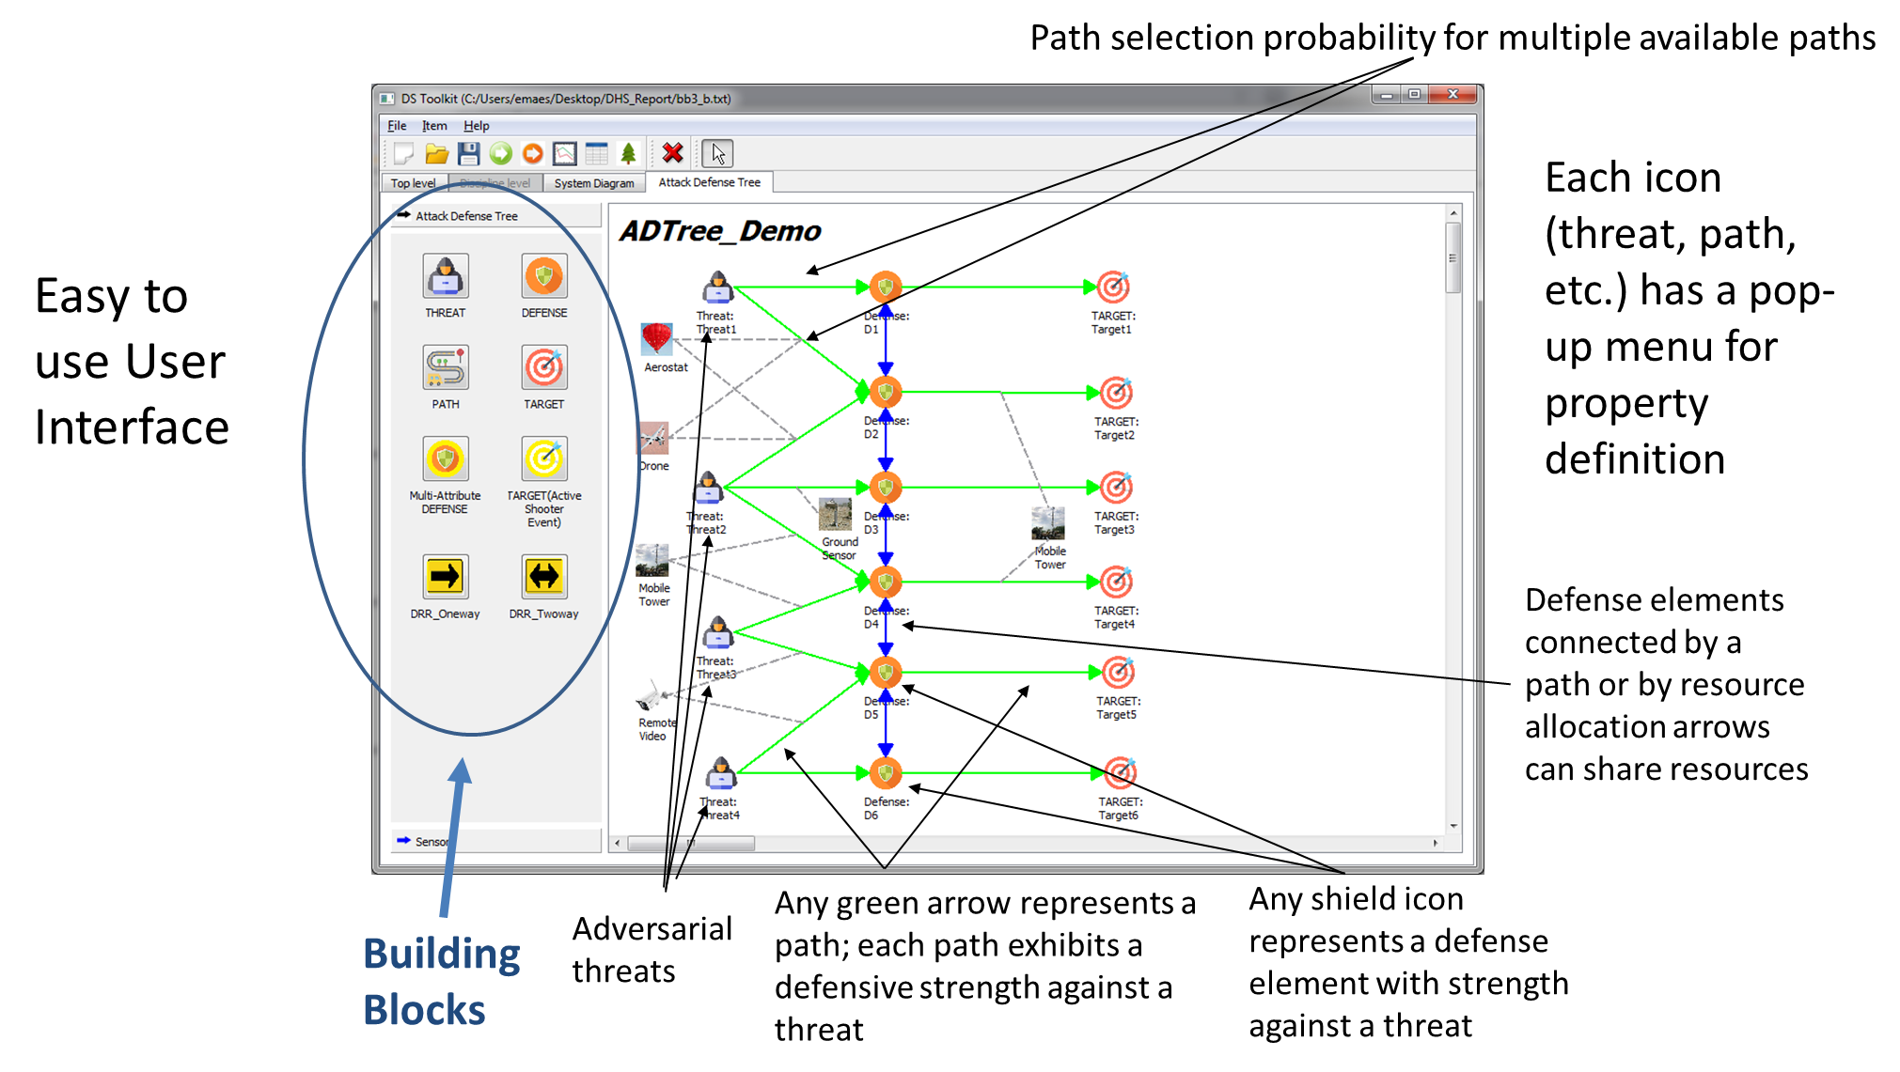
Main Elements
ADTree
5

Slide 6
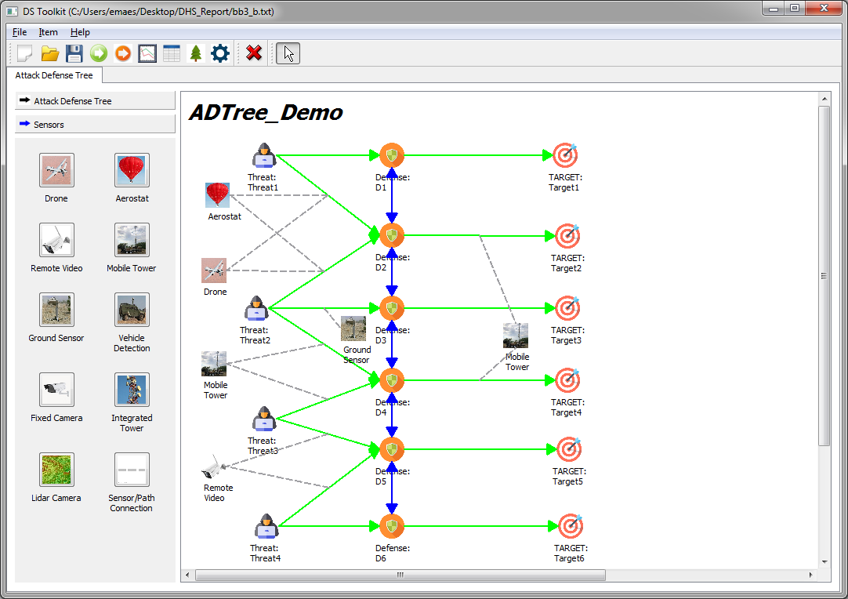
Main Elements
ADTree
Sensors that can be included in the ADTree for increasing the hardness of paths

Slide 7
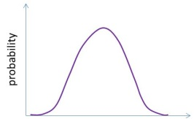

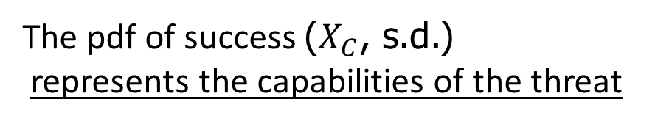
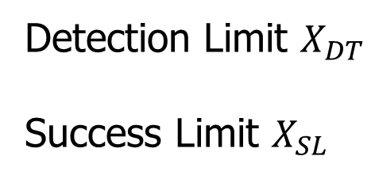
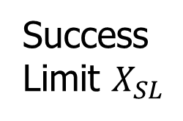

Main Elements
Detection
Limit $X_{DT}$
Success
Limit $X_{SL}$
pdf of
success
$$X_{C}$$
Probabilistic calculations at each path element and at each defense element
Standard deviation
The pdf of success ($X_{C}$, s.d.)
represents the capabilities of the threat
Probability of success without detection
X variable
Total probability of success
Detection Limit $X_{DT}$
Success Limit $X_{SL}$
Represent the hardness of the defense

Slide 8
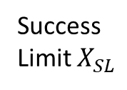



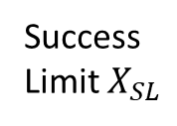

Main Elements
Detection
Limit $X_{DT}$
Offensive/Defensive matchup
Detection
Limit $X_{DT}$
$$X_{C}$$
$$X_{C}$$
pdf of
success
Success
Limit $X_{SL}$
pdf of
success
Success
Limit $X_{SL}$
Standard deviation
Standard deviation
Probability of success without detection
X variable
Probability of success without detection
X variable
Total probability of success
Total probability of success
When the threat has better capabilities than the defense the pdf of success moves to the left
When the threat has worse capabilities than the defense the pdf of success moves to the right

Slide 9
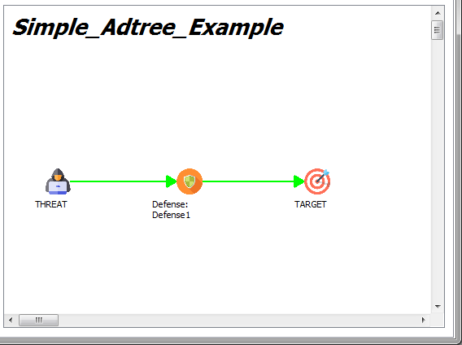
















Main Elements
Simple Example of Calculations
$$p_{31}$$
$$p_{11}∗p_{21}∗p_{31}$$
+
$$p_{21}$$
$$p_{32}$$
$$p_{11}∗p_{21}∗p_{32}$$
Defense 1
+
$$p_{11}$$
$$p_{22}$$
$$p_{33}$$
$$p_{11}∗p_{22}∗p_{33}$$
Path 1
Path 2
+
Threat
$$p_{12}$$
$$p_{23}$$
$$p_{33}$$
$$p_{12}∗p_{23}∗p_{33}$$
Path 1
Defense 1
Path 2
Target
$$p_{i1}$$
Threat is successful at the i^{th} element without been detected
$$p_{i2}$$
Threat is successful at the i^{th} element but it has been detected
$$p_{i3}$$
Threat is successful at the i^{th} element while it was detected at a previous element

Slide 10
Examples
Representative visualization during a simulation
Associated ADTree
36% probability of success for the threat
Out of 100 attempts to breach the defense 64 are apprehended and 36 become getaways
Low strengths 2 out of 5 assigned to defense elements
Relatively high strength assigned to threat 4/5
Presence of Aerostat hardens the defense

Slide 11
Examples – Dynamic Simulation
Dynamic Simulation (coordination between threats; allocation of resources between defense elements)
Threats engage by a user defined order.
Two aspects of the dynamic simulation: threats cooperation (leading and following threats) and defense resource reallocation.
When a threat encounters either weak or strong paths and defenses, it will advise following threats either to follow the same path or to avoid the path/defense element, by adjusting the path selection probabilities.
When a defense faces a threat with stronger strength, it calls for reinforcement from backup units (second line defenses) to match the strength of the threat.

Slide 12
Examples – Dynamic Simulation/Adjusting Probability Distribution & Strengths
Baseline
Threat # | Description | Probability of Route | Probability of Success
1 | Through D11, D12 | 1.0 | 0.0021
2 | Through D21, D22 | 1.0 | 0.6895
3 | Through D31, D32, D33 | 1.0 | 0.0538
Too uneven results

Slide 13
Examples – Dynamic Simulation/Adjusting Probability Distribution & Strengths
Threat / Defense Interaction: baseline probability distribution
 | D5 | D4 | D3 | D2 | D1
T5 | 0.84 | 0.99 | 1.0 | 1.0 | 1.0
T4 | 0.16 | 0.84 | 0.99 | 1.0 | 1.0
T3 | 0.01 | 0.16 | 0.84 | 0.99 | 1.0
T2 | 0.0 | 0.01 | 0.16 | 0.84 | 0.99
T1 | 0.0 | 0.0 | 0.01 | 0.16 | 0.84
Baseline
Threat / Defense Interaction: adjusted probability distribution
 | D5 | D4 | D3 | D2 | D1
T5 | 0.46 | 0.82 | 0.97 | 1.0 | 1.0
T4 | 0.14 | 0.46 | 0.82 | 0.97 | 1.0
T3 | 0.02 | 0.14 | 0.46 | 0.82 | 0.97
T2 | 0.0 | 0.02 | 0.14 | 0.46 | 0.82
T1 | 0.0 | 0.0 | 0.02 | 0.14 | 0.46
Adjusted

Slide 14
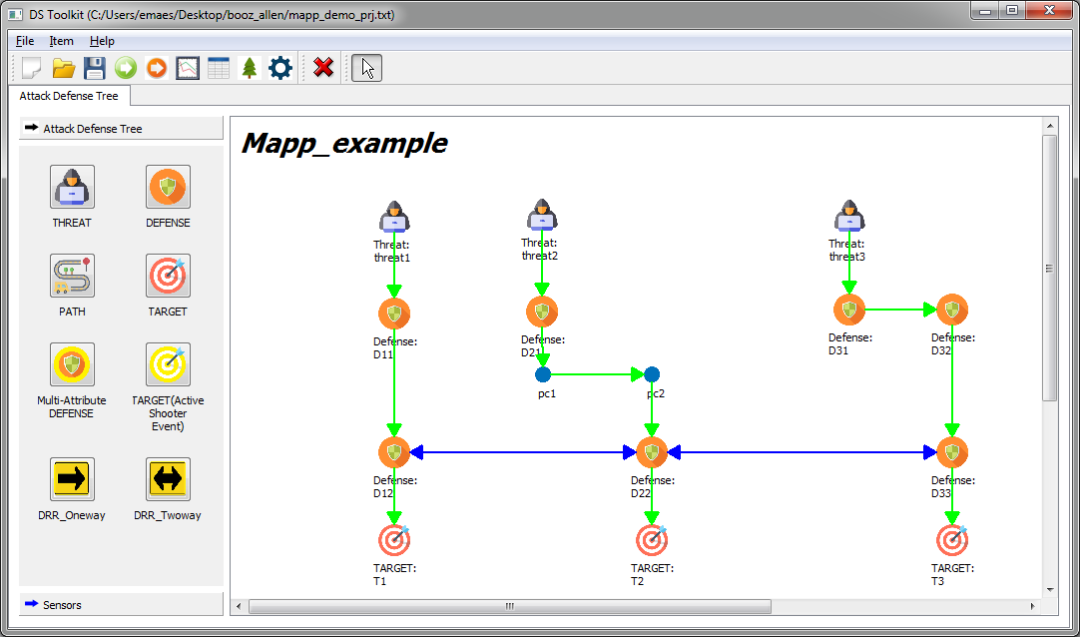
Examples – Dynamic Simulation/Adjusting Probability Distribution & Strengths
4
4
4
1
2
3
3
4
3
2
1
Adjusted
2
4
1
3
2
1
3
1
1
1
1
Threat # | Description | Probability of Route | Probability of Success
1 | Through D11, D12 | 1.0 | 0.2392
2 | Through D21, D22 | 1.0 | 0.2650
3 | Through D31, D32, D33 | 1.0 | 0.2400
More even results

Slide 15
Examples – Dynamic Simulation/Processing Results

Slide 16
Examples – Dynamic Simulation/Processing Results

Slide 17
Summary
Combining visualization driver with probabilistic calculations
Relationship between resources and strength of defense
Flexibility for calibrating the probabilistic modeling based on available data
Processing results from probabilistic calculations for estimating getaways

