Slide 1
Elements of Unsupervised Testing for Software Systems of Autonomous Vehicles
Sean Hickey, Nickolas Vlahopoulos, University of Michigan
Geng Zhang, Michigan Engineering Services
Jonathon M. Smereka, US Army DEVCOM GVSC
Paper 24346

Slide 2
Outline
Overall Scope
Establishing a simulation harness at UM
Intercepting messages and changing data flow
Running a simulation multiple times automatically and monitoring termination
Using a lightweight simulator to implement and test new features
Next steps

Slide 3
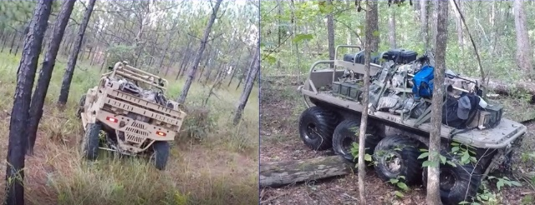
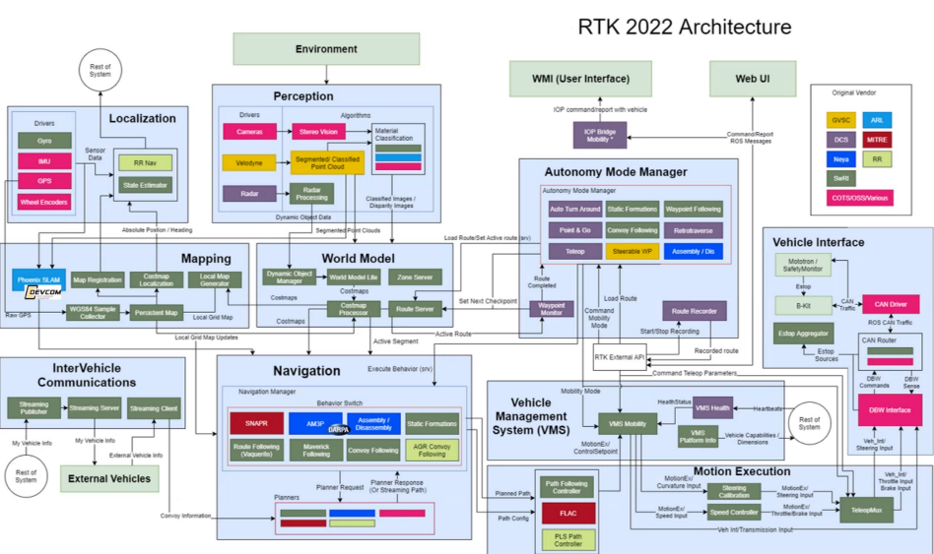
Overall Scope
From ARC 2023 meeting
Type of faults:
Implementation errors
Errors in logic
Notes:
Make clear: node interception, monitoring of errors, automatically launch multiple runs -> properly formulate fitness function and run GA
These are the main developments in the first 9 months of the project.

Slide 4
Research Questions
How effective is an unsupervised process in testing autonomy-focused software systems?
How can the automated process generate diverse input selections and discovered faults?
How much more efficient is a genetic algorithm in discovering faults compared to random search?

Slide 5
Outline
Overall Scope
Establishing a simulation harness at UM
Intercepting messages and changing data flow
Running a simulation multiple times automatically and monitoring termination
Using a lightweight simulator to implement and test new features
Next steps

Slide 6
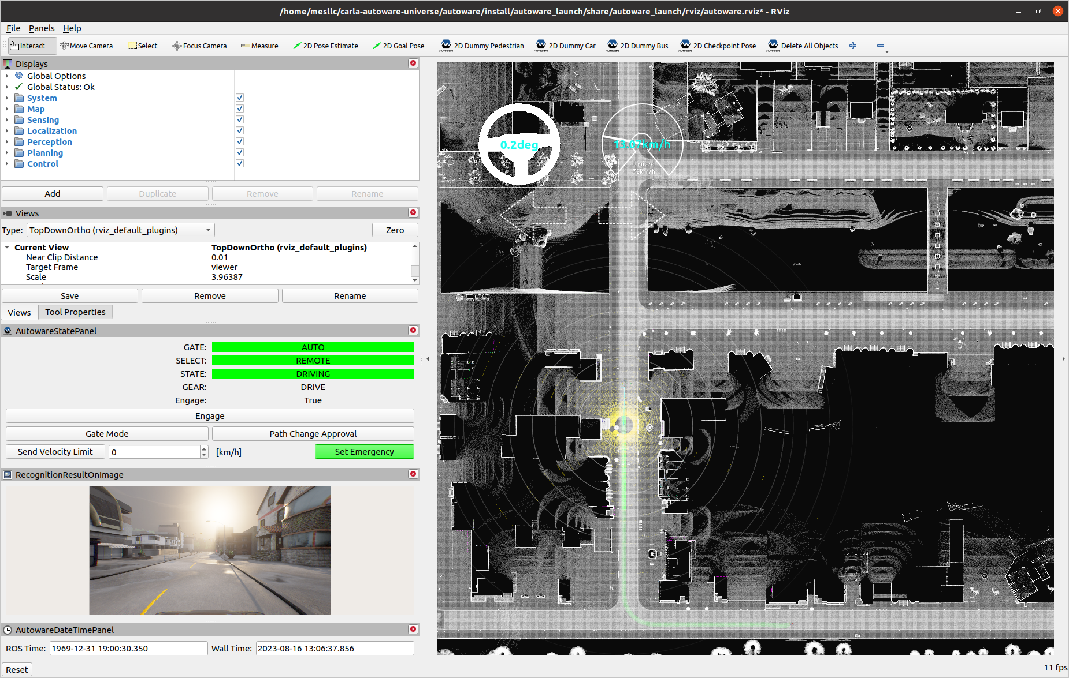
Establishing a Simulation Harness at UM
Autoware Universe (ROS2)

Slide 7

High-Level RTK/ARCS Architecture

Slide 8
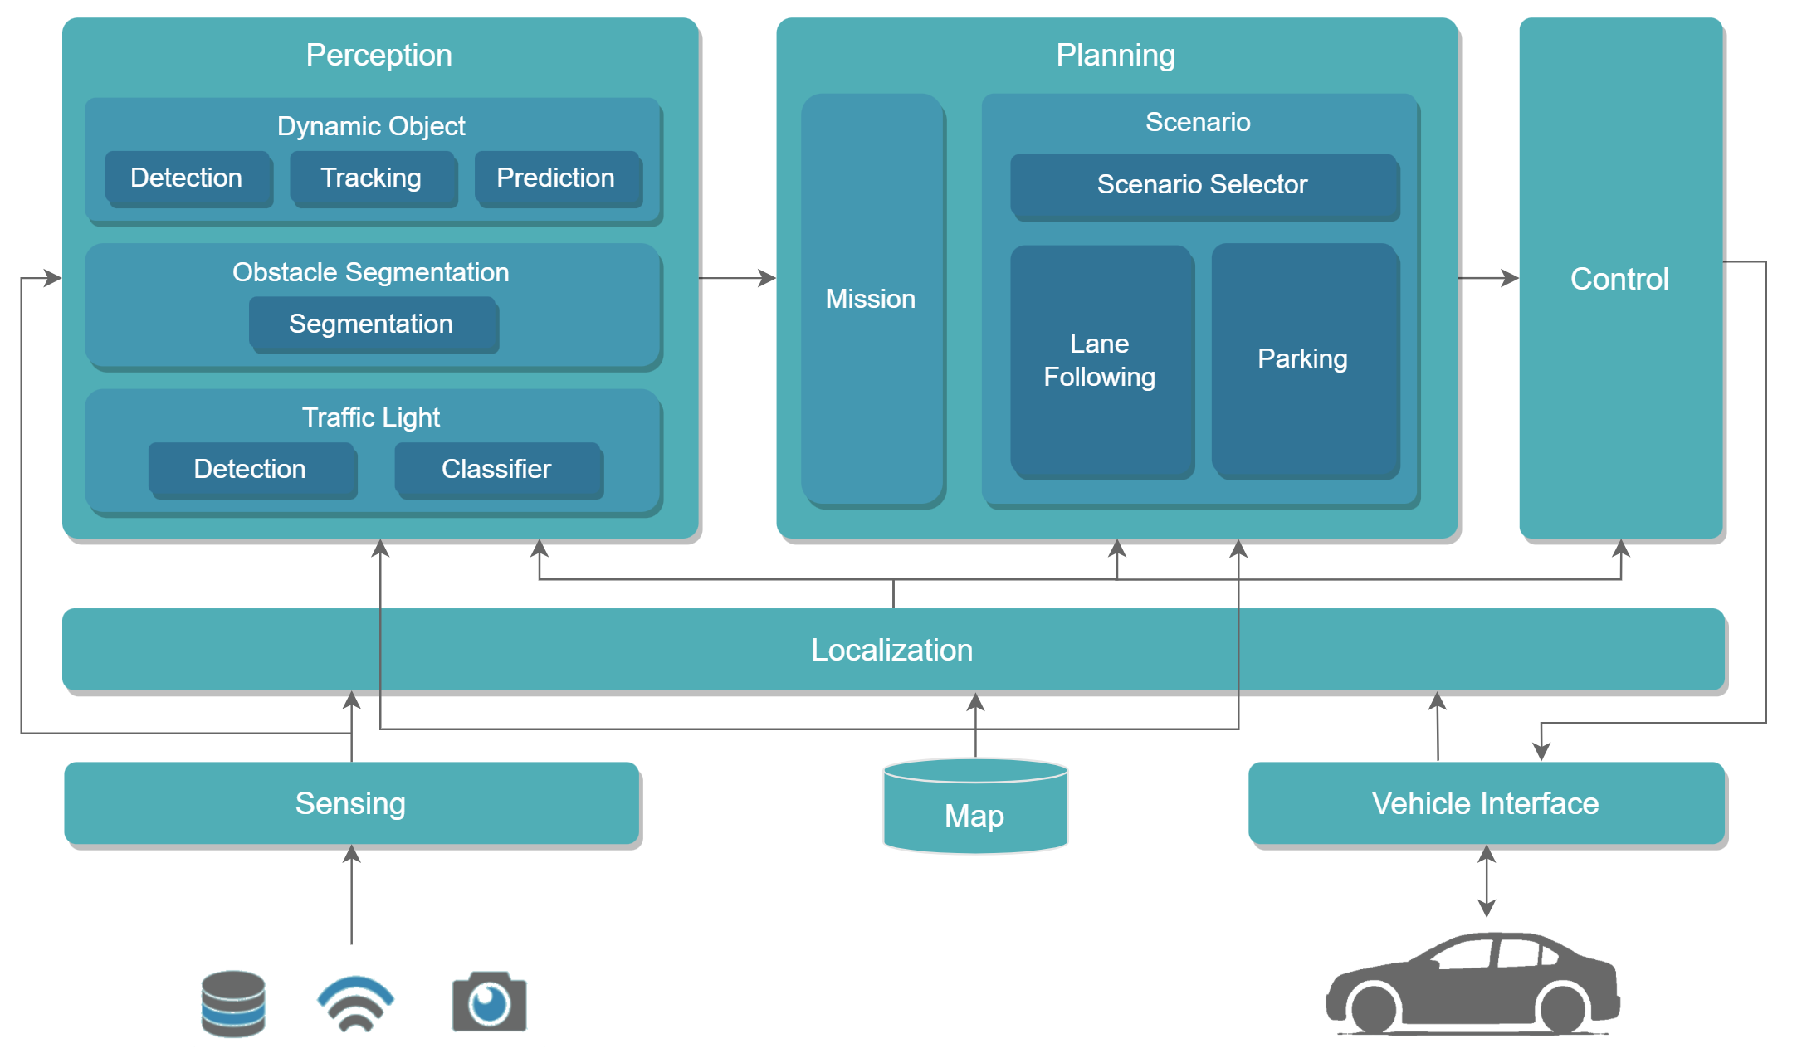
High-Level Autoware Architecture

Slide 9
Outline
Overall Scope
Establishing a simulation harness at UM
Intercepting messages and changing data flow
Running a simulation multiple times automatically and monitoring termination
Using a lightweight simulator to implement and test new features
Next steps

Slide 10
Mapping Data Flow
Using ROS2 commands we can do the following:
  List subscribers, publishers, services, actions for a target node, along with message type of each
  Analyze message types to understand information that can be intercepted
  Perform topic remapping to alter communication pathways

Slide 11
ROS2 Message Interception
Original Message Flow
Publisher Node
Subscriber Node
Modified Msg
Interceptor Node
Original Msg
Modified Message Flow

Slide 12
Interception Strategy for a ROS2-Based Code
Choose the topics to manipulate and intercept these by modifying launch files
Automatically generate an input file to specify messages to drop or modify
Use a single interceptor node to read inputs and apply modifications at specified times
* Unmodified messages are sent through interceptor node without changing the behavior of the system

Slide 13
Message Modifications
Types of modifications:
  Message dropping
  Modified data
Specified by:
  When the modification should start
  How long it should last
  Modified message (if modifying data)
Notes:
Message dropping – sensor not operating properly
Modifies data – errors in communication system
Generally sensor malfunctions

Slide 14
ROS2 Message Interception Example
Shift Decider Node
Control Execution Node
Modified Command Msg
Trajectory Follower Node
Control Command Msg
Interceptor Node
Vehicle Command Gate Node

Slide 15
Outline
Overall Scope
Establishing a simulation harness at UM
Intercepting messages and changing data flow
Running a simulation multiple times automatically and monitoring termination
Using a lightweight simulator to implement and test new features
Next steps

Slide 16
Running an Autoware Simulation Automatically
Manual Run
Automatic Run
Launch Autoware in terminal window
Launch Autoware by shell command
Define initial pose in Rviz window
Define initial pose by command
Define target pose in Rviz window
Define target pose by command
Set engagement in Rviz window
Set engagement by command
Stop Autoware by ctrl_c in terminal window
Stop Autoware by process killing command

Slide 17
Termination of an Autoware Simulation
Process alive?
No
Crushed
Simulation
Self-terminated
Yes
Yes
Success
Target achieved?
No
Zero speed for extended period?
Yes
Hung
*Terminate simulation
No
Total time exceeds limit?
Yes
Other issues
No
Ongoing
Continue simulation
*Simulation termination command: kill –SIGINT process_id

Slide 18
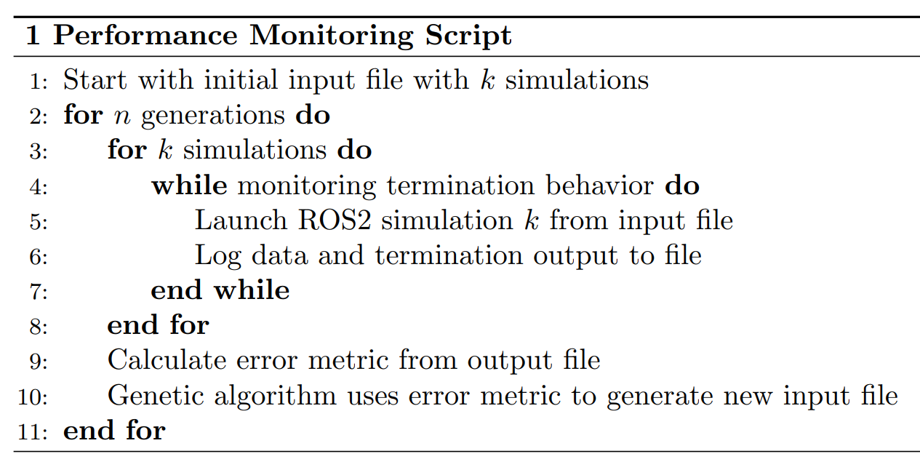
Automating Multiple Runs of Autoware

Slide 19
Outline
Overall Scope
Establishing a simulation harness at UM
Intercepting messages and changing data flow
Running a simulation multiple times automatically and monitoring termination
Using a lightweight simulator to implement and test new features
Next steps

Slide 20
Lightweight Simulator
Emulates Autoware control module
ROS2 environment for accelerated development
Simpler and faster simulations
Ability to insert intentional bugs to test detection performance

Slide 21
Genetic Algorithm
NSGA-II algorithm for non-dominated multi-objective optimization
Generates fault-causing test cases using fitness function
  Fault severity
  Input diversity
  Fault diversity
Discovers vehicle collisions, system crashes, and timeout faults

Slide 22
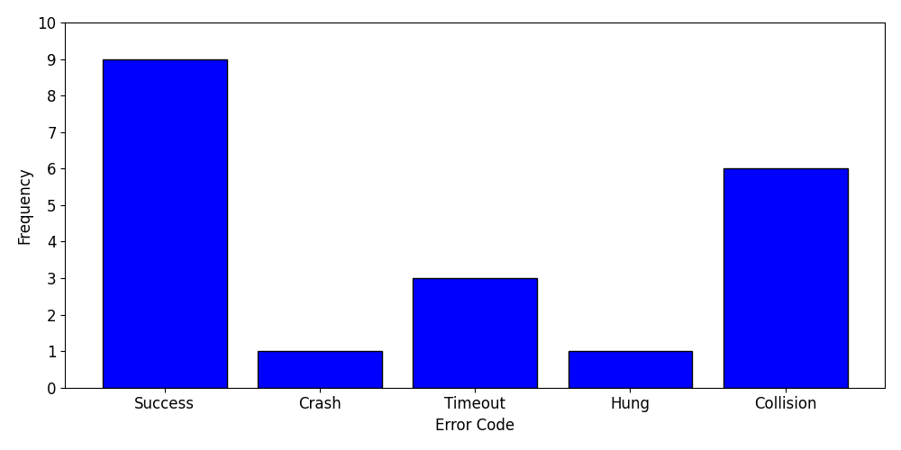
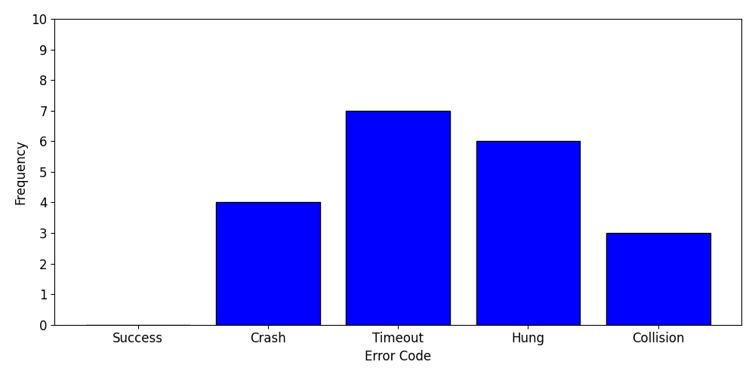
Genetic Algorithm Results
Initial Generation (Random Search)
Final Generation (After GA)
Population size = 20, Generations = 15
Notes:
Have initial successful results. Focus on future is refining objective function to gain better performance. Adding a term to encourage instability in results

Slide 23
Outline
Overall Scope
Establishing a simulation harness at UM
Intercepting messages and changing data flow
Running a simulation multiple times automatically and monitoring termination
Using a lightweight simulator to implement and test new features
Next steps

Slide 24
Next Steps
GA: custom selection and crossover methods
Working with the Army Ground Vehicle Systems Center to get involved in related projects
Duplicate node interception, automated execution, and error detection in ARCS and Project GL

Slide 25
Questions

