Slide 1

AI-Driven Course of Action (COA) Generation Using Neuro-symbolic Methods
Presented By: Kevin Golan
Authors: Michael Harradon, Kevin Golan, Oliver Daniels-Koch, Avi Pfeffer, and Robert Hyland

Slide 2
Agenda
Problem Overview
Experimental Approach
Neural Program Policy (NPP) Technical Approach
Evaluation and Results
Contributions
Notes:
Promise: During this talk you will learn about powerful AI approaches that you may not have been tracking, and you will lean how our neuro-symbolic AI approach advances the state of the art across multiple dimensions.

Slide 3
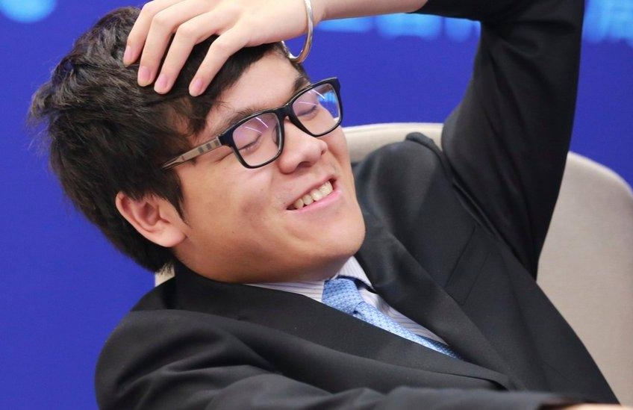
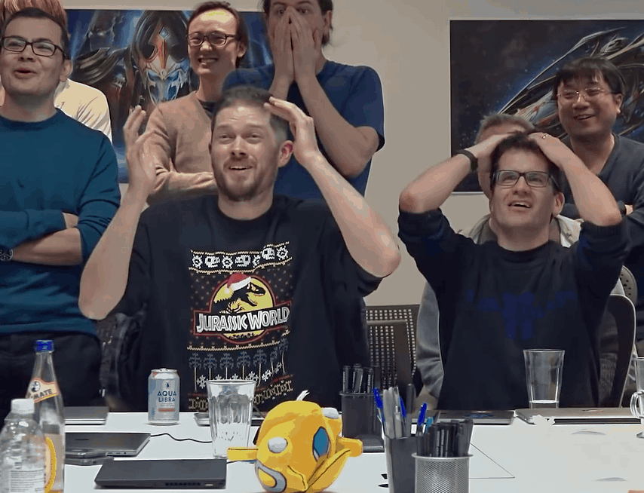
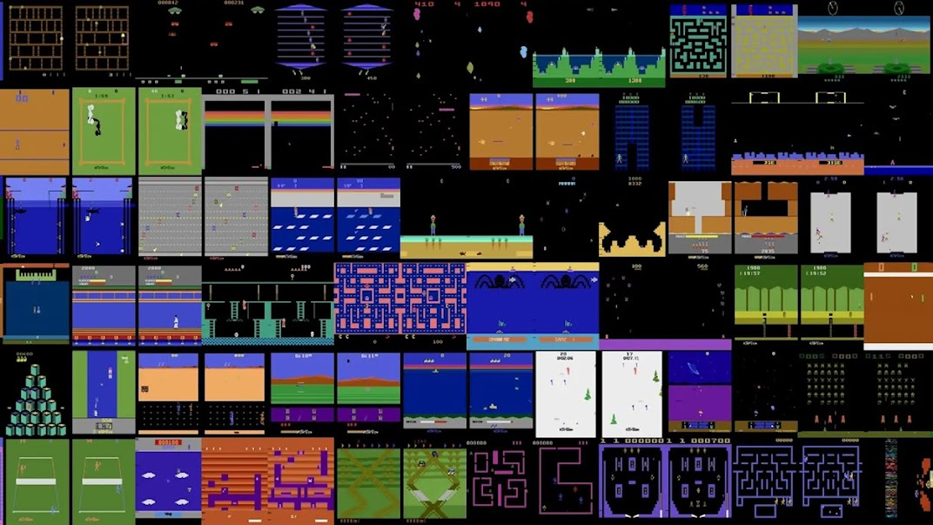


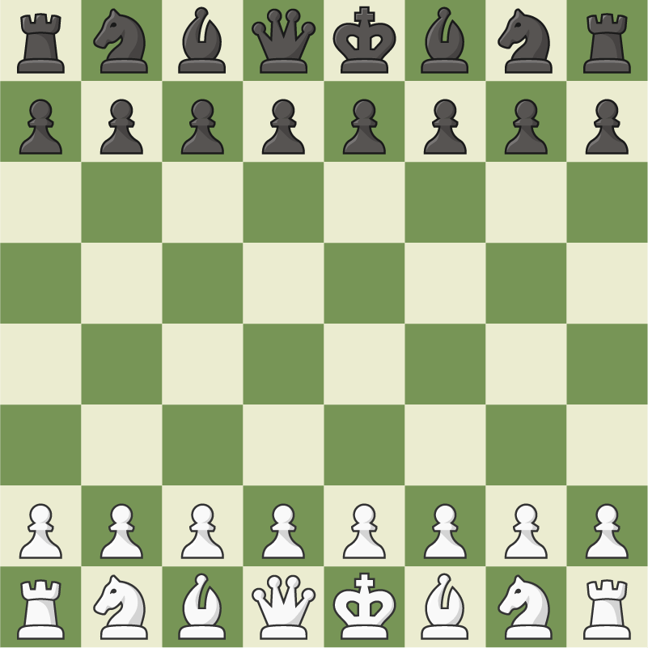

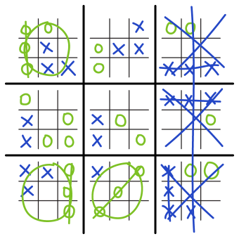
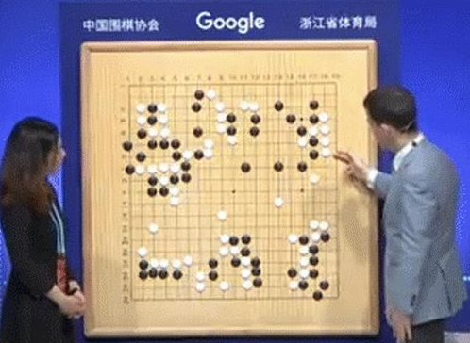

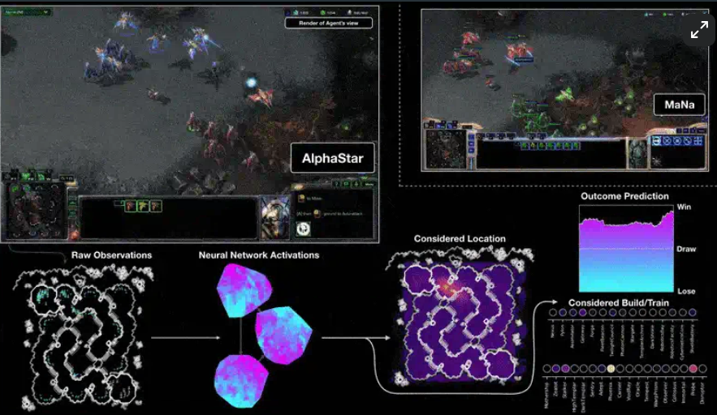

Problem Overview AI Has Defeated Human Strategy Games
Board Games
Retro Video Games
Real-Time strategy Games
Can AI Support More Real-World Planning?
Expert level creative play for ~15 minute games
$3M
Takes months to train at expert level
Deepmind’s AlphaGo
StarCraft Grandmaster
Uses limited actions across a few domains
Deepmind’s AlphaStar
Can’t explain what it knows to support human planning
** Images from Google DeepMind “Outperforming the human Atari benchmark” https://deepmind.google/discover/blog/agent57-outperforming-the-human-atari-benchmark/
*** Images from AI and Games “How AlphaStar Became a StarCraft Grandmaster” https://www.aiandgames.com/p/alphastar
* Images from BBC “Google AI defeats human Go champion” https://www.bbc.com/news/technology-40042581
Notes:
AI has defeated every strategic game we’ve thrown at it. The question is, can agents be applied to assist real-world human planning, a long-standing challenge for AI. <Click> . This is an attractive prospect, as DRL agents have achieved expert-level play in SC2, though the 15 min games would have to be scaled up to longer time horizons. <click> Training to reach this expertise is expensive, it takes months of computing on exquisite HPC parallel distributed processing. In the case of AlphaStar, this training equated to 200 years of the equivalent of SC2 play <click> and this costed over $3M if you wanted to do this training yourself, at the time. <Click> …finish with the last two scaling challenges.
. Citations:
DeepMind’s AlphaStar reached grandmaster-level performance in StarCraft II (Vinyals et al., 2019)
[1] Vinyals, O., et al. (2019). “Grandmaster level in StarCraft II using multi-agent reinforcement learning.” Nature, 575, 350–354.
Massive training requirements
AlphaStar 600 agents , each trained with an equivalent of 200 years of SC2 play time (including a massive set of anonymized real player games, ie, supervised learning)- trained 600 agents in the league for 14 days using Googles distib proprietary TPU compute nodes
AlphaStar Final — trained with battlenet players. Trained for 44 days (over 384 TPUs), $73,728/day, $3.2M in total
Why AlphaStar Does Not Solve Gaming's AI Problems | Design Dive
https://youtu.be/84VVFxHAdSY?si=8Oe4PqdHLmwl-Led

Slide 4
Can We Construct AI Agents with Planning Capabilities to Support Human Staffs?
Can AI Support More Real-World Planning?
Still using games as our benchmark and simulation environment, can we design a deep reinforcement learning (DRL) system to generate COAs that assists human planning staffs with:
Constructing more high-quality, long-duration plans,
Analyzing plan strengths and weaknesses more deeply, and
Exploring a larger number of plan alternatives in a fixed planning time
Requires new approach and technical performance to:
Learn a vastly reduced action space to lower training time
Incorporate domain-specific knowledge into machine learning (ML) methods to scale to large, long-duration scenarios
Reason over open-structure problems to manage uncertainty and interconnections among multiple domains
Explain what is learned and support human planning processes
Achieve expert level creative play for days/weeks-long games
$1K
Take hours to train at expert level
Handle massive action space from more, interconnected domains
Explain what it knows to support human planning
Notes:
<transition words from the last slide>> At Charles River Analytics, we conducted a work program to address these challenges.
Intro the title and then Explain first paragraph, and add an example:
Such a capability is extraordinarily valuable to any company that engages in high-stake, $B strategic planning and complex plan execution. For Example, UPS strategic planning team might use this for stress test a series of operational management plans over a series of weeks. Then as the plan is being rolled out, they could use this for 24hour execution and planning cycles, where the COA/plan updates need to be stress testing in a matter of hours. <click>
So to solve this problem, our solution would have to achieve new SoA benchmarks to address real-world planning to support human planning staffs. <click>
The technical problems require a new approach and new performance to : … quickly talk to the 4 bullets

Slide 5
Defining Key Terms for AI-Driven COA Generation
COA = A time-phased or situation-dependent plan that features effective strategies to achieve human-specified and multi-domain objectives with dynamic uncertainty.
Multi-Domain = Space, Air, Land, Sea, and Undersea capabilities and actions all with interacting phenomenon and effects
AI-Driven COA Generation = AI-agent generates COA traces
AI agents can be thought to generate COAs if they output multiple action traces (i.e., “execution” paths recorded during simulation runs with respect to agent-chosen actions) that achieve the human-specified objectives through sequenced strategies and tactics

Slide 6




Experimental Approach
Physical Domains:
Experimental Concept
Multi-domain Game Environment
A Large-Scale Challenge Scenario Requiring Novel Solutions
Generation of COAs Faster than Human Planners
Presentation of Human-Understandable Winning Insights
General Operation
Inputs:
Processing:
Analyze plan strengths and weaknesses more deeply
Explore a larger number of plan alternatives in fixed planning time (<24hr)
Outputs:
Air
Land
Sea
Undersea
Support Functions:
Resource Management
Communication
Heavily Modified Version of StarCraft II
Heavily Modified Version of StarCraft II
Scenario Details
Sensors
BLUE COA
Scale:
RED Force
Laydown
+
+
Blue Improvements
1,000’s of multi-domain units
Days/Week’s long scenarios
AI-agent
Sim runs
Scenario:
Blue: Stronger Force, Plan defined by Human Expert Team
Winning Insights
For Red & Blue
Red COA Traces
Red COA
Red COA
Red COA
Red: Weaker Force, AI-generated plan/COA trace
Red COA Traces
Red COA
Red COA
AI-generated >>
Rank >>
Analyze >>
Best winning COAs
Notes:
<click> right before you explain the “Heavily mod’d version of SC2” to run an over-the-top animation, when you explain there are significant modifications and in a few slides you will characterize the expanded game state space (and how our handles the expanded state space).

Slide 7
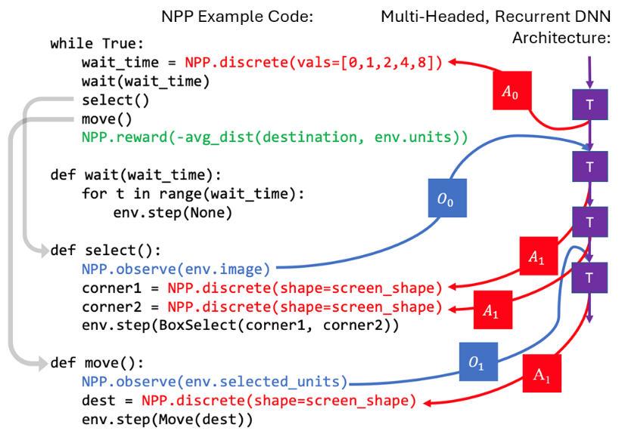
Neural Program Policies (NPPs) – Moving Past Traditional DRL Challenges by Introducing Policies that Overcome Multi-Domain & Multi-Task Problems
The NPP Domain Specific Language (DSL) is used to produce Policy Programs (PPs). With this DSL, AI developers can incorporate domain knowledge into a policy via the implementation of 4 instructions:
How an agent should interface with the simulation environment (OBSERVE)
Specifying action spaces given environment observations (ACT)
Specifying reward signals given observation/action pairs (REWARD)
Specifying terminal state conditions (DONE)
Under the hood, PPs automatically generate appropriate Recurrent Deep Neural Network (DNN) architecture for observation and action spaces specified by program
Automatically handles varying input observation & action dimensions.
New model head dynamically added for new observation/action tensor dimension encountered
Receptive to multi-domain and multi-task policy specifications
Simple NPP example used to select and move units in SC2.
All boxes are neural networks.
Purple: Transition model (temporal component)
Blue: Parts of Observation model
Red: Parts of Action model
Green: Agent Rewards
Notes:
To solve these challenges and experiment with a new class of AI-planning support capability, we introduce Neural Program Policies of NPPs. NPPs are a neuro-symbolic AI approach invented by Charles River Analytics that combines human knowledge with DNNs to move past traditional DRL challenges I described in the problem overview. NPPs apply PP’s to overcome scaling problems found in multi-domain and mult-tasks application areas.
Quickly explain OBSERVE and ACT, mentioning NPPs are critical to improving DRL with them. And super-quickly mention REWARD and DONE are the same in standard RL. (need to save time by not getting into the details here)
After explaining the two major bullets, very quickly explain the diagram:
Small succinct NPP expresses learning for selecting SC2 units and moving them across an dynamic, adversary contested area
The NPP weaves in actions, observations and rewards
Under the hood, the PP instantiates a corresponding DNN with multiple NNs for learning, shown as boxes
The purple boxes serve as a spine for learning over time,
And it hold ACT NNs of different types (or shaped), this NPP DNNs includes two ACT NN shapes, as notated by A0 and A1. Similarly with OBSERVE NNs.
This instantiation decomposes the complex problem into much more learnable subcomponents, specifically learning the characteristics of what to observe and what to action
After explaining the diagram, say:
With NPPs, developers can focus agent learning on salient factors
Notes from orig slide, but there is not time to discuss:
i.e. strictly enforce that agents employ certain behaviors that would otherwise need to be learned over many episodes
e.g., in StarCraft 2, one could write subroutines so that the agent pursues strategy A when encountering enemy entities on land and pursues strategy B when confronting enemies in the air

Slide 8
Evaluation and Results
Evaluated NPPs applied to two problem categories:
Control problem benchmarks provided by OpenAI gym and
Multi-domain reasoning using StarCraft II simulation extended with sea, undersea, and novel support functions.
New NPP approach achieved significant technical performance with respect to state-of-the-art:
Fast. Trains with a surrogate model ~10,000x faster than real time (FTRT)
Accurate. Predicts StarCraft II outcomes with ~1% relative error, using surrogate model within 1 day of training on 1x NVDIA A100,
High-fidelity. Learns a vastly reduced action space for complex, interconnect multi-domain simulations with cost-effective training,
Scales to large, long-duration scenarios,
High-Quality. Generates COA traces that defeat human COAs, and
Explainable. Enables the interpretation of AI-generated COA traces
Can AI Support More Real-World Planning?
Achieve expert level creative play for days/weeks-long games
<$1K
Take hours to train at expert level
Handle massive action space from more, interconnected domains
Explain what it knows to support human planning
8
Notes:
Rather than stating the specifics/reading the bullets under the 2nd bullet, just say, “It’s fast, accurate, high-fidelity, scales to large, long-duration scenarios, and produced COAs the defeat human expert created COAs, and provides an HMI for explaining the traces.” <this will save time, because the next slides go into the details. This summary is here for people who are reviewing the slides after the presentation>

Slide 9
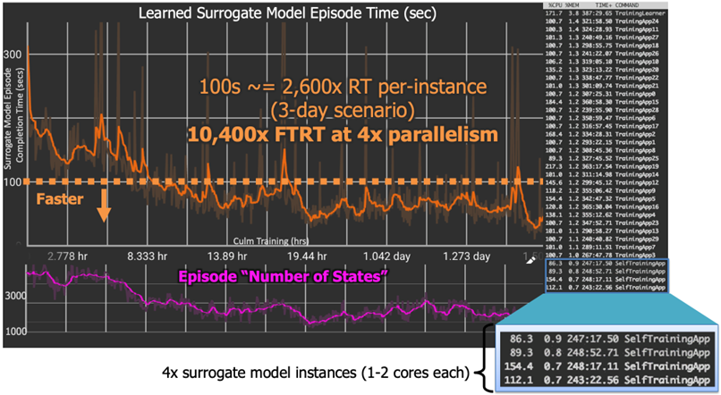
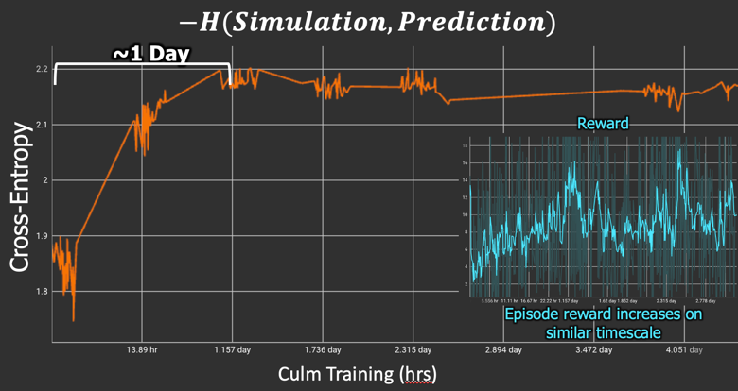
Results for Training Speed Enhancement
Take hours to train at expert level
Surrogate model enabled the evaluation of 1,000x more COA traces compared to evaluating with our expanded StarCraft II scenario directly, which takes hours per episode
This is ~10,000x faster than our estimate for real-time (FTRT) equivalent engagement.
In one training day, our surrogate model accurately predicts StarCraft II outcomes with ~1% relative error, shown via cross-entropy between true simulation observables and predicted distribution of observables
Notes:
Explain that the NPP DRL architecture contains a surrogate model, which, similar to other related architectures provides a simulation abstraction.
Make sure to emphasize the 1 day of training, “In one training day, our surrogate model accurately predicts StarCraft II outcomes with ~1% relative error…”

Slide 10
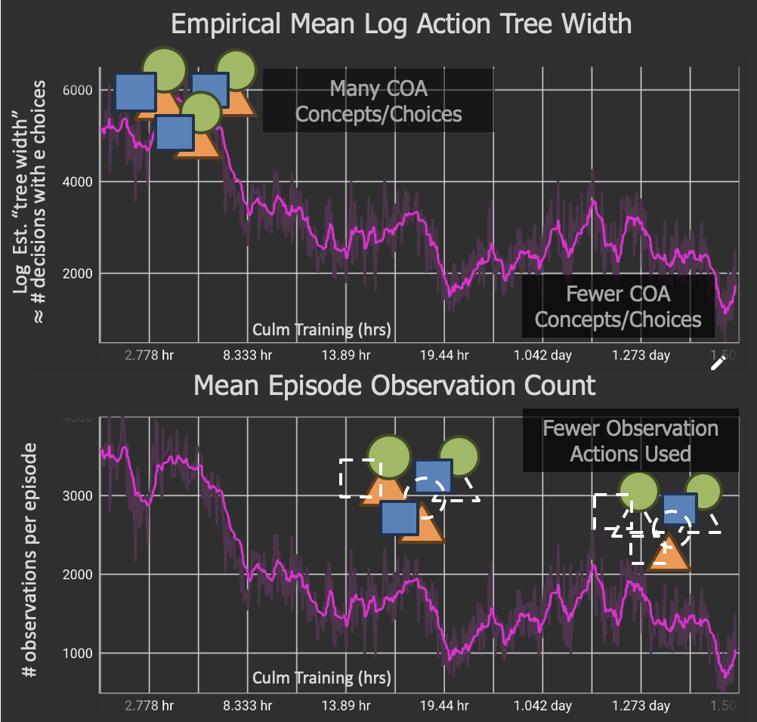
Results for Efficient Learning of Large-Scale Scenarios
Handle massive action space from more, interconnected domains
Unique State-Action World States:
Go boardgame
<
StarCraft II
<
Heavily Modified StarCraft II
10¹⁷⁰
10^{1,685}
10^{5,500+}
(361 pieces x 361 squares x 1-6 hours)
(100s units x 10s choices/unit x 15-20 min)
(1,000s units x 100 choices/unit x 1+ days)
The NPP-agent learns to reduce the number of observations to make, which reduces actions needed.
The NPP-agent vastly reduces the action space to a small and meaningful set that it learns to decrease further with training.
Notes:
https://en.wikipedia.org/wiki/Go_(game)
Reinforcement Learning: The Ancient game of Go – Humans vs. AI
https://www.lancaster.ac.uk/stor-i-student-sites/jordan-j-hood/2021/04/18/reinforcement-learning-the-end-game/
AlphaStar
How AlphaStar Became a StarCraft Grandmaster | AI and Games #48
https://www.youtube.com/watch?v=lPERfjRaZug
Some extra resources: The StarCraft Survey Research Paper that estimates 10^1685 states http://www.cs.mun.ca/~dchurchill/pdf/...
A Survey of Real-Time Strategy Game AI Research and Competition in StarCraft [2013] S. Ontanon, G. Synnaeve, A. Uriarte, F. Richoux, D. Churchill, and M. Preuss TCIAIG (August 2013)
SC2++ state space (600mi x600mi) x 1,000-6,000 units.

Slide 11
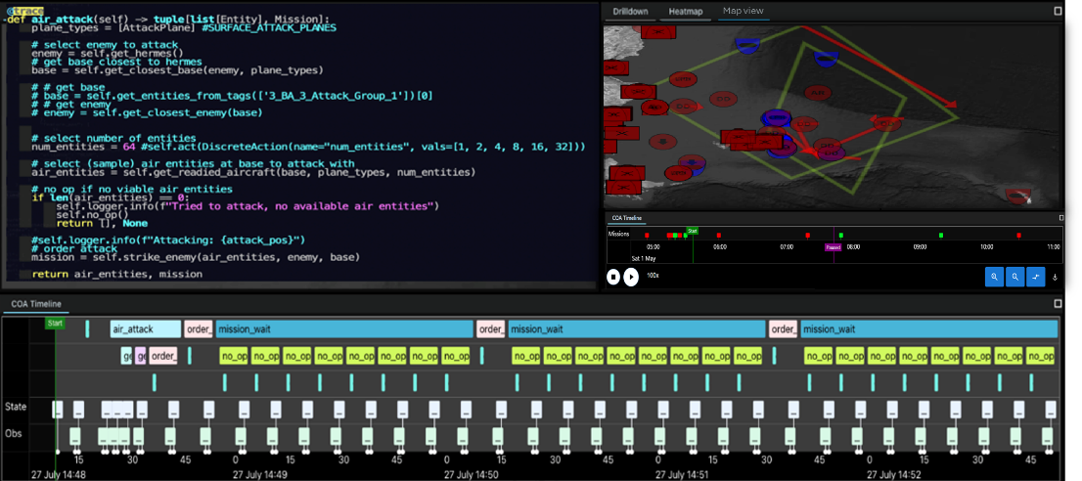
Results for Generating & Explaining Multi-Domain COA Traces
Explain what AI knows to support human planning
Presentation of Human-Understandable Winning Insights
Interactive Human Machine Interface (HMI)
Maps
Timelines
Drill downs into unit status, battles
Inspection of AI-assigned missions
The NPP-agent generated 24+ high-quality COA traces that defeated the human-expert-designed Blue COA. These contained 5 unique strategies which provided material insights to planning staff experts.
Achieve expert level creative play for days/weeks-long games

Slide 12
Contribution Summary
Designed and implemented a NPP DSL that allows AI developers to describe structured policy and generalized COA templates
Incorporates SME knowledge to express key domain concepts
Decomposes decision problem into learnable constructs
Developed an NPP-based adaptive deep neural network (DNN) architecture
Uses the DSL-encoded knowledge to generate useful and creative COA traces
Learns functional approximations required to describe policies, predictions, and other needed outputs for the DSL-defined problem
Ran a series of experiments applying NPPs two problem categories:
Demonstrates effectiveness for simple control tasks,
Generates high-quality COA traces based on a heavily modified version of StarCraft II with new physical domains and support functions (e.g., resource management, communications, and sensors)
State-of-the-Art Results for AI Supporting More Real-World Planning
Achieves expert level creative play for days/weeks-long games
<$1K
Takes hours to train at expert level
Handles massive actions space from more, interconnected domains
Explains what AI knows to support human planning
Fast: 10,000X FTRT
Large-Scale: Multi-domain
High-Quality & Creative COAs: Novel COAs that enable human insights
Accurate: ~1% relative error
High-fidelity: Comms+Sensing
Cost-Effective: Training <1 day
Explainable: Interactive HMI
Notes:
<last click> Bottom-line the resulting system supports a human-AI team paradigm to increase the number and quality of multi-domain plans considered. It is Fast, Accurate, Cost-effective, Handles large-scale domains & scenarios– with hi-fi comms and sensing model, and ultimately produces High-Quality Creative COA that provide human planning staff with valuable insights, which are explained via an interactive HMI.
STOP on this slide for Questions. It is a good summary for people to absorb the highlights of the entire talk.
Flip to the next slide towards the end of the last question, to be sure to invite people who are interested in collaboration talk to us. Encourage them to take a picture and email, call, or find us.

Slide 13


Please Contact Us For Follow-up Questions or Collaboration
Key Contacts at I/ITSEC:
Kevin Golan, Scientist II Human-Centered AI Charles River Analytics Inc. kgolan@cra.com 617.234.1562
Rob Hyland, Principal Scientist Director of Program Transition Charles River Analytics Inc. rhyland@cra.com 617.234.5088
Peter Weyhrauch, PhD Vice President, Human-Centered AI Charles River Analytics Inc. pweyhrauch@cra.com 617.234.5052
+
Notes:
Invite people who are interested in collaboration talk to us. Encourage them to take a picture and email, call, or find us.

