Slide 1
M&S as a Service Composability Lessons from NATO
Tom van den Berg, TNO Applied Physics Laboratory, NLD
Scott Gallant, Effective Applications, USA
Rob Kewley, simlytics.cloud, USA
Chris McGroarty, Jeremiah Long, and Christopher J. Metevier, U.S. Army Combat Capabilities Development Command – Soldier Center (DEVCOM SC), USA
APPROVAL NUMBER: PR2024-1657
APPROVED FOR PUBLIC RELEASE

Slide 2
Agenda
North Atlantic Treaty Organization (NATO) Modeling and Simulation (M&S) as a Service (MSaaS) Overview
MSaaS Composability Overview
MSaaS Technical Reference Architecture
MSaaS Building Blocks
Composability Information Model
MSaaS Engineering Process
NATO Coalition Warrior Interoperability Exploration, Experimentation, Examination Exercise (CWIX 2024) MSaaS Artificial Intelligence (AI) Composition
Conclusion

Slide 3
NATO M&S as a Service Operational Concept

Slide 4
Composability Lexicon
Composability is the capability to select and assemble simulation components in various combinations into valid simulation systems to satisfy specific user requirements (Petty and Weisel, 2003).
Composability is prior to run time.
Interoperability is at run time. Interoperability is necessary but not sufficient for composability.
MSaaS Composability is the capability to select and assemble Simulation Services in various combinations into valid Composition.
MSaaS Conceptual Composability is the ability to meaningfully compose Simulation Services into a valid Composition. It is analogous to semantic composability.
MSaaS Engineering Composability is the ability to select and configure the services of a Composition so that it may be automatically deployed and executed. It is analogous to syntactic composability.

Slide 5
NATO MSG-195 Composability Tiger Team
Meetings
Portsmouth
Rome
Orlando
Virtual
Adelaide
Orlando
Virtual
Hamburg
Los Angeles
Madrid
1
2
3
4
5
6
7
8
9
10
DEC ‘22
DEC ‘23
DEC ‘24
Objectives
Technical Reference
Architecture Update
Engineering Process
Information Model
Identity/document MSaaS Conceptual Composability requirements
MSaaS Conceptual Composability
Concepts
MSaaS Conceptual Composability
Information Model
MSaaS Conceptual Composability
Development
Identity/document MSaaS Engineering Composability requirements
MSaaS Engineering Composability Concepts
MSaaS Engineering Composability Information Model
MSaaS Engineering Composability Development
Build conceptual composition with MSaaS Composition Services
Build engineering composition with MSaaS Composition Services
CWIX
MSaaS Composability
Experiment
Identify data model changes to support service discovery/composability
Experimentation
Report

Slide 6
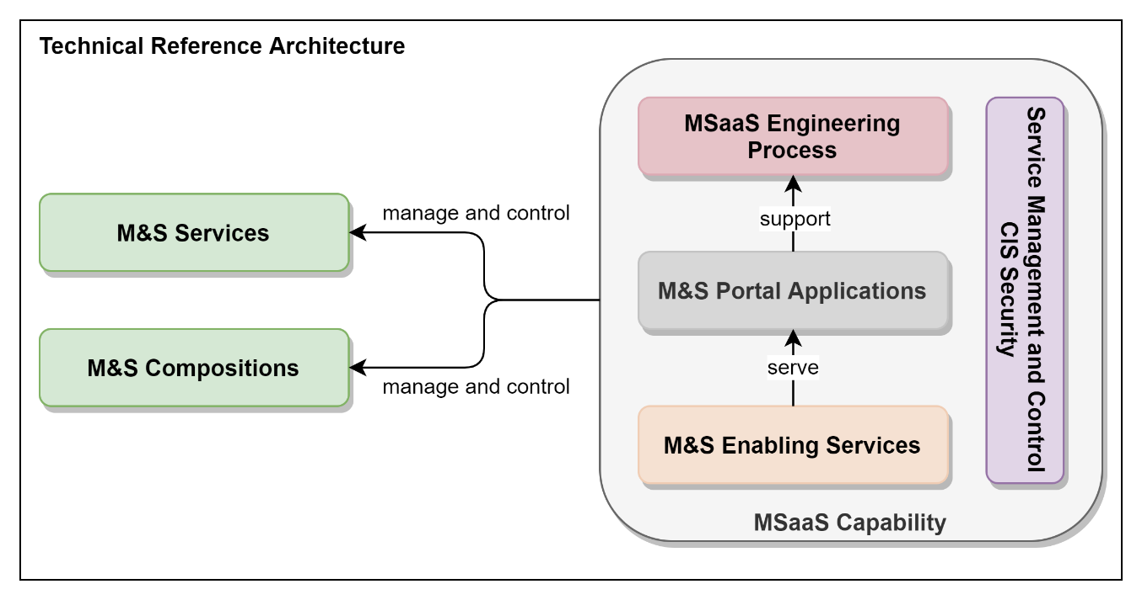
MSaaS Technical Reference Architecture: Building Blocks

Slide 7
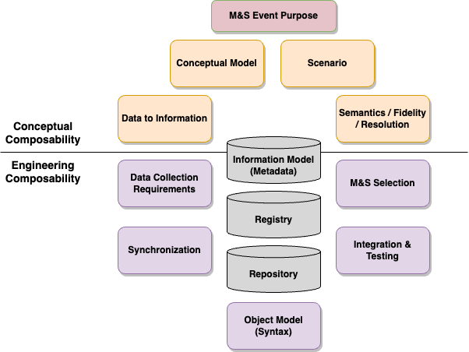
MSaaS Technical Reference Architecture: Composability

Slide 8

MSaaS Technical Reference Architecture: Information Model
Category | Description
Core | M&S resource at the foundational level including the unique identifier, name, description, point of contact, etc.
Syntactic | Syntax including protocol(s) and structure(s), publish/subscribes, and any other details required.
Semantic | Meaning and the dynamics of the data, fidelity (accuracy), resolution (level of detail), synthetic environment, etc.
Synchronization | Methods for communication such as time management, dead reckoning, as well as data specific elements.
Functional / Scenario | How to configure simulation resources based on the functions required, scenario used, deployment chosen
Deployment | Deployment details including networking, security, and hardware details.
Business | Financial and usage terms

Slide 9
MSaaS Technical Reference Architecture: Engineering Process
Mirrors IEEE Recommended Practice for Distributed Simulation Engineering and Execution Process (DSEEP)
Define Composition Objectives
Perform Conceptual Analysis
Design Composition
Develop Composition
Plan, Integrate, and Test Composition
Execute Composition
Analyze Data and Evaluate Results
IEEE: Institute of Electrical and Electronics Engineers

Slide 10

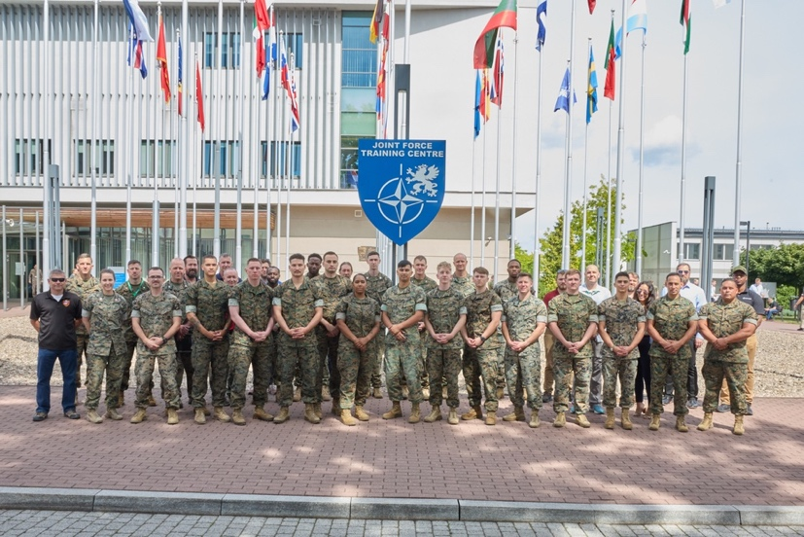

NATO M&S for Collective Training and Exercises
NATO Coalition Warrior Interoperability Exploration, Experimentation, Examination Exercise (CWIX ‘24)
3-21 June, NATO Joint Force Training Center, Bydgoszcz, Poland
The Very High Readiness Joint Task Force, as part of the NATO Response Force, conducts collective training to prepare units for a pending deployment
Training takes place on NATO Federated Mission Network
Unit commanders and staff interact with simulation through existing mission command systems
Free-thinking Opposing Forces (OPFOR) with realistic doctrine
Exercise control cell manages the exercise
Additional higher/adjacent headquarters interact with training audience
Observer/Controller/Trainers provide realistic feedback
Common standards for network, command and control, and simulation

Slide 11
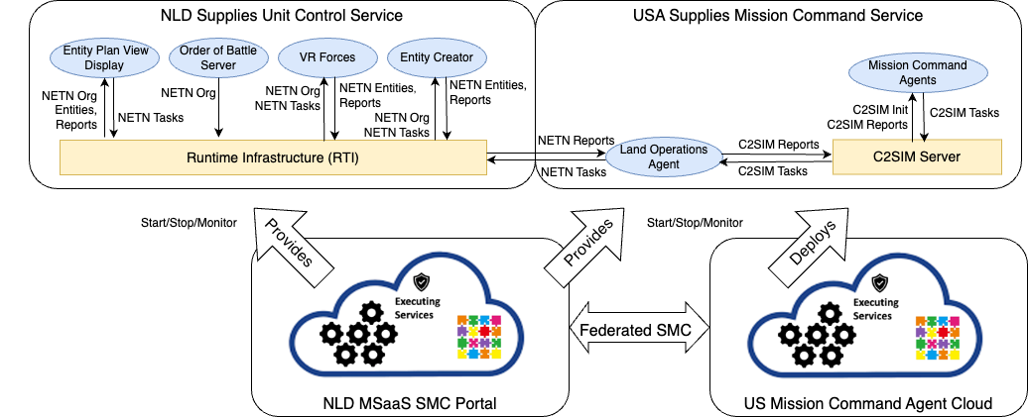
Common Challenge: Controlling Multiple Higher/Adjacent/OPFOR Units
EXCON cell must control many higher/adjacent/OPFOR units with limited resources.
Composing M&S and Command and Control services enables this capability
C2SIM: Command and Control - Simulation Interoperation
NETN: NATO Education and Training Network
NLD: Netherlands
SMC: Service Management and Control
VR: Virtual Reality
US: United States of America
Mission Command Service Objective Architecture
EXCON: Exercise Control

Slide 12
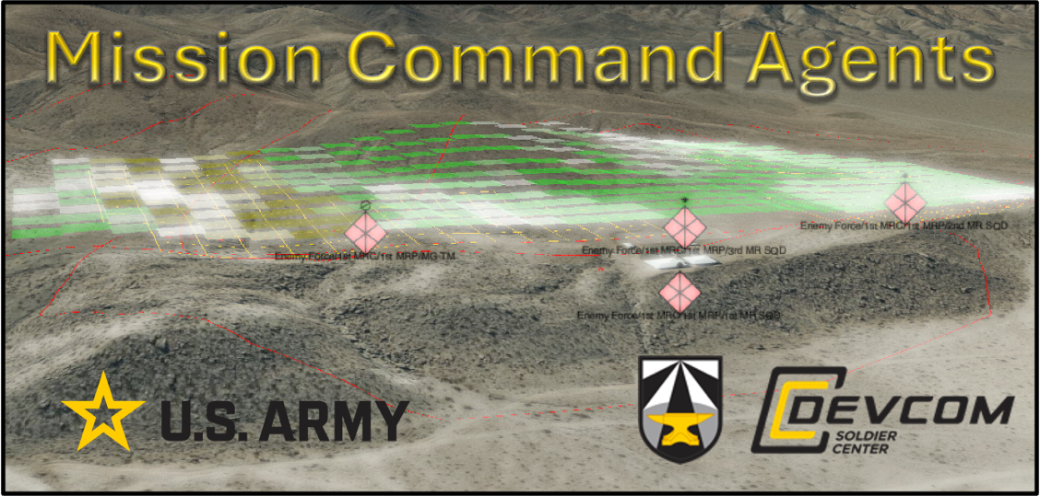
Engineering Process Define Composition Objectives
Exercise Purpose
Explore Command and Control (C2)-Simulation interoperability requirements in the support of Mission Rehearsal and Collective Training
Mission Command Service
Control higher, adjacent, opposing forces
Reduce need for human controllers
Behave according to doctrine
Exhibit terrain awareness
React to changing conditions

Slide 13
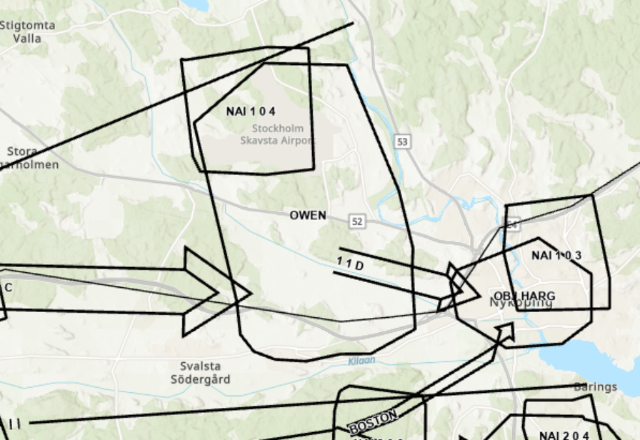
Engineering Process Perform Conceptual Analysis
1-1 Battalion Attack Operational Graphic
1-1 Battalion Attack C2SIM via Sketch-thru-plan

Slide 14
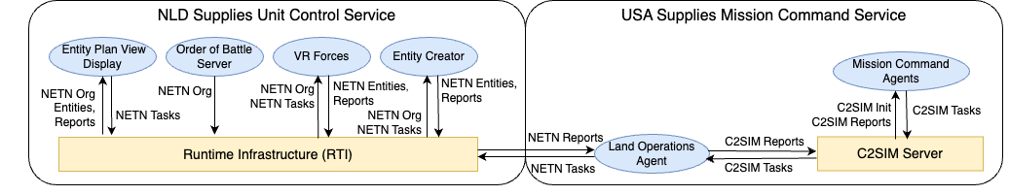
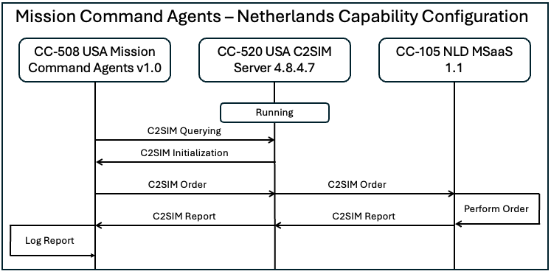
Engineering Process Design Composition
CWIX CC-105
CWIX CC-508
CWIX Test Case via CWIX Wiki

Slide 15
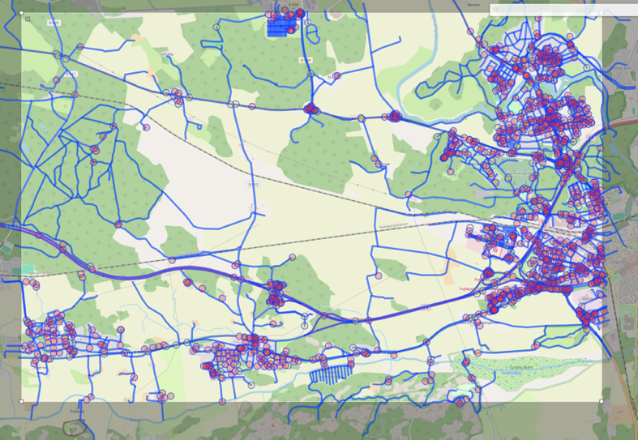
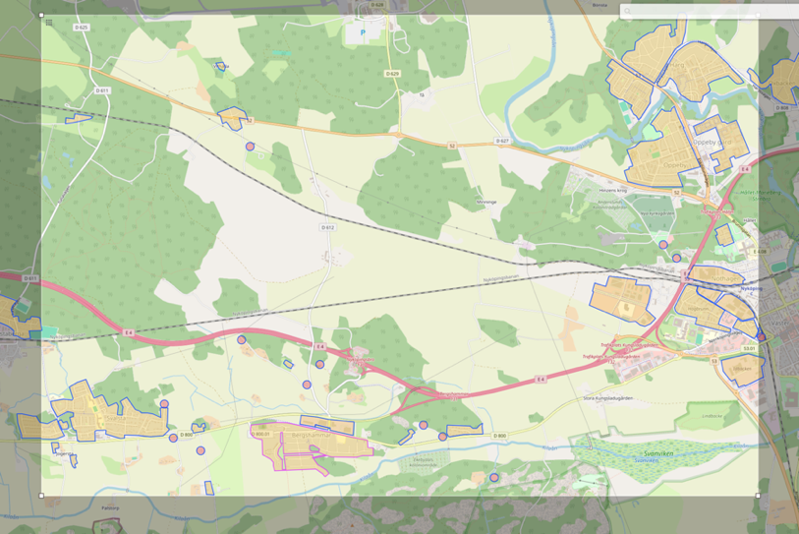
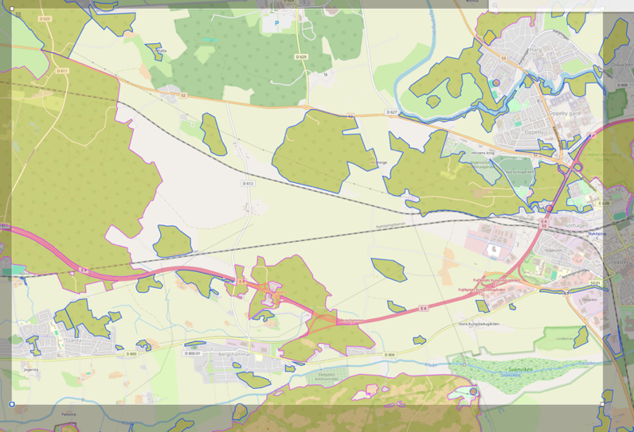
Engineering Process Develop Composition
Highways
Built up areas
Forests
Query OpenMaps Overpass API for data
Load GeoJSON to environment database
Pull into Mission Command Agents terrain model
Query any point for geometric relationships to any feature
API: Application Programming Interface
JSON: JavaScript Object Notation

Slide 16
Engineering Process Plan, Integrate, and Test Composition
Mission Command Agents (MCA) passed C2SIM orders to three different NATO simulations with mostly successes and some lessons identified

Slide 17
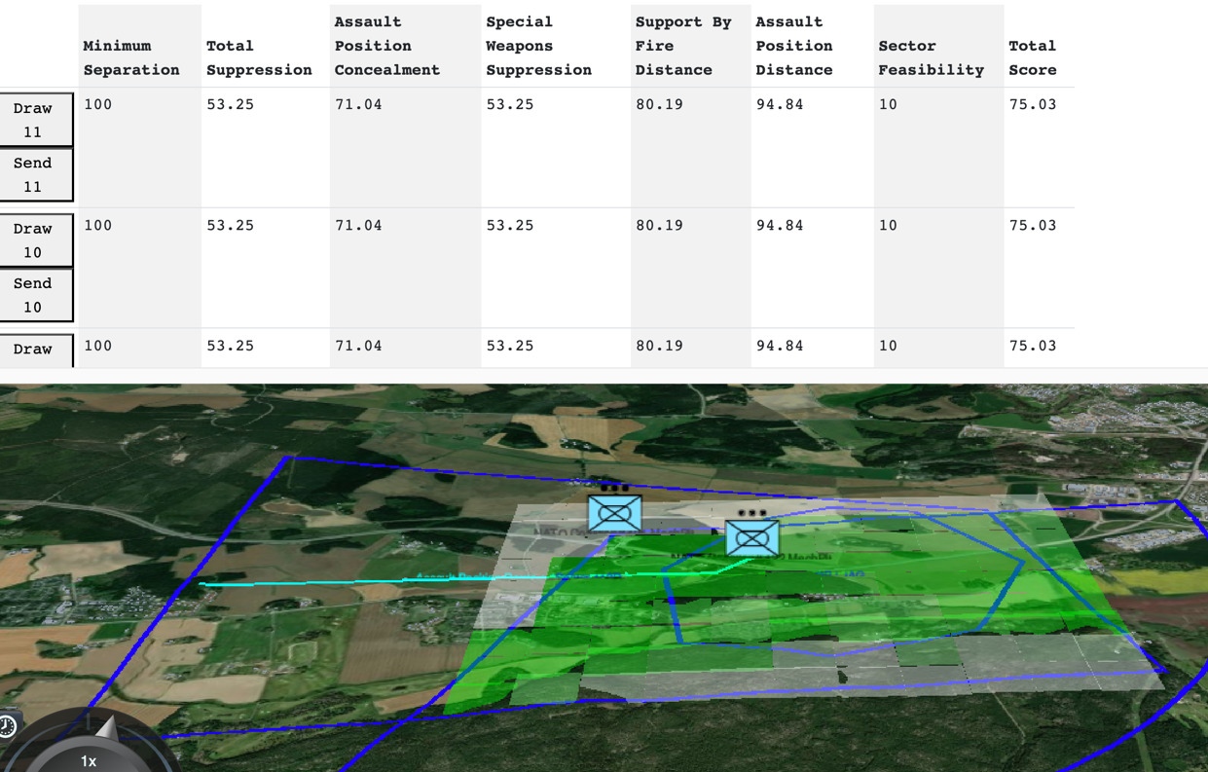
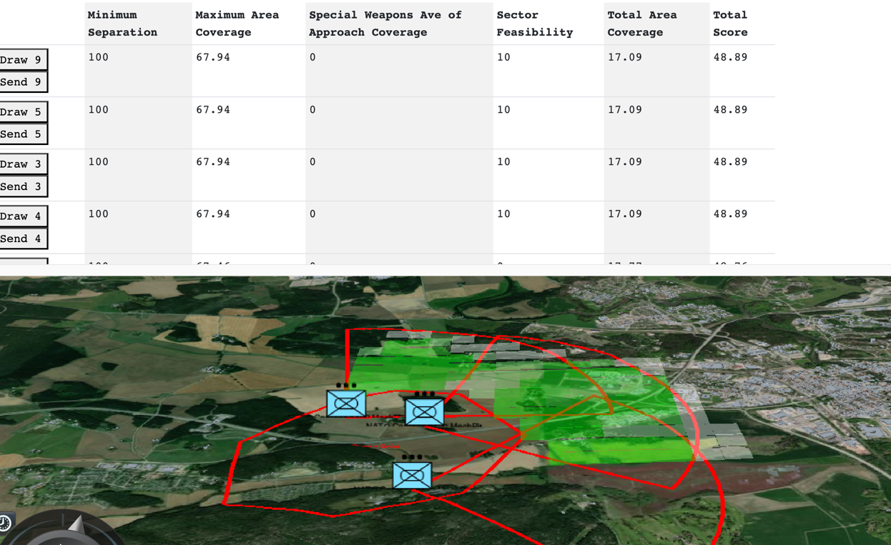
Engineering Process Execute Composition
Blue Attack
Blue Defense

Slide 18
Engineering Process Analyze Data and Evaluate Results
Positive outcomes:
Validated baseline interoperability with three different simulation systems and two different C2 systems via C2SIM. Also, validated baseline interoperability with the Netherlands via Web Live, Virtual, Constructive (WebLVC) standard.
Strong interest across the M&S Focus Group and CWIX general audience about the capability of mission command agents to support not only collective training, but also decision support.
Validated that Mission Command Agents were able to provide a reasonably realistic surrogate for a human simulation operator in conducting attack and support by fire missions for one company.
Lessons identified:
Route planning needs to consider water obstacles and road network in more detail.
Mission Command Agents need to figure out a way to automatically, or with additional AI, create a planning scenario from minimal user inputs and the information already available.
Mission Command Agents need to be more dynamic in the developing scenario. Enemy actions and friendly changes in mission or plan should be handled quickly and automatically.
Think of mission command agents as a service with a well specified API that could be consumed by any C2 system. This gives multiple C2 systems the option to build an interface to Mission Command Agents.

Slide 19
Conclusions
Demonstrated delivery of training capabilities
Composability research results
Definitions
Current state-of-the-art
Products
Technical Reference Architecture
Building Blocks
Information Model
Engineering Process
Follow-on NATO activity: NATO M&S Group - 232 “Establishing an M&S Ecosystem to support Multi-Domain Operations (MDO)”

Slide 20
Questions/Comments/Discussion

