Slide 1

Compound AI Ecosystem: Agents and Tools to Improve Training and Learning
Presenting: Svitlana Volkova
Co-Authors: Summer Rebensky, Laura Cassani, Bob McCormack, Adam Fouse,
Sylvain Bruni, Gabe Ganberg and Kara Orvis

Slide 2

The Need for Advanced Military Training
Current challenges
Personalizing training to individual learners
  Need to consider previous experiences, operational backgrounds, and roles
  Traditional methods struggle to provide necessary adaptability
Adapting to diverse backgrounds and roles
  Military personnel have varied experiences and skill levels
  One-size-fits-all approaches are often ineffective
Keeping pace with rapidly evolving technology and warfare
  Rapid advancement of technology necessitates innovative training solutions
  Changing nature of warfare requires adaptive training methods
Need for innovative solutions to maximize training effectiveness
Opportunity to leverage advanced AI technologies to enhance training outcomes

Slide 3
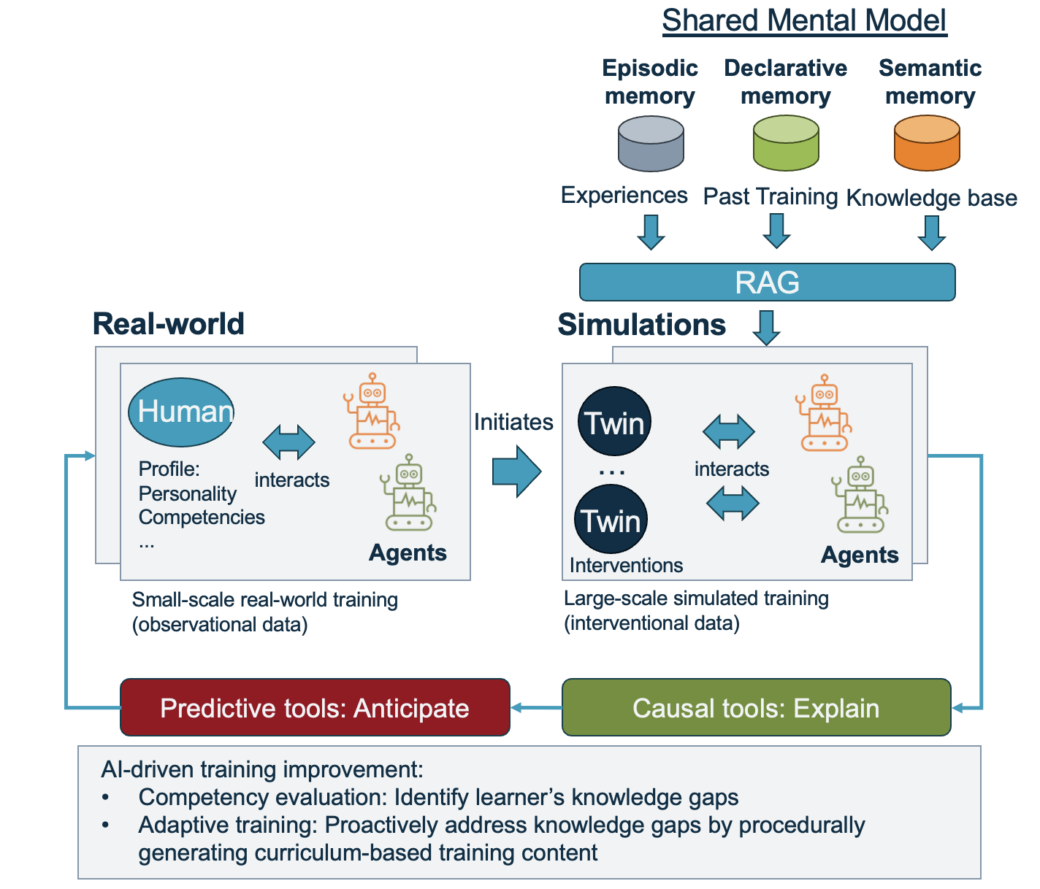
Compound AI Ecosystem for Training and Learning
What is Compound AI?
Integration of multiple AI models and tools working together
  System that tackles tasks using multiple interacting components
  Includes multiple calls to models, retrievers, or external tools
Designed to enhance and personalize training experiences
  Adapts to individual learner needs and preferences
  Provides scalable, consistent instruction
Notes:
60% of LLM applications use some form of retrieval-augmented generation (RAG), and 30% use multi-step chains
Chaining strategy that exceeded GPT-4’s accuracy on medical exams by 9%
RAG, self-refinement, prompt-tuning and supervised fine-tuning techniques guide models in utilizing external knowledge.
real world life example they'd understand (e.g., one AI recommends products on amazon, another AI determines where your shipment falls in the distribution pipeline, another AI determines what to advertise to you next) or (e.g., one AI recommends restaurants that you would like on google maps, another optimizing your navigation, a different one optimizing your music while driving).

Slide 4
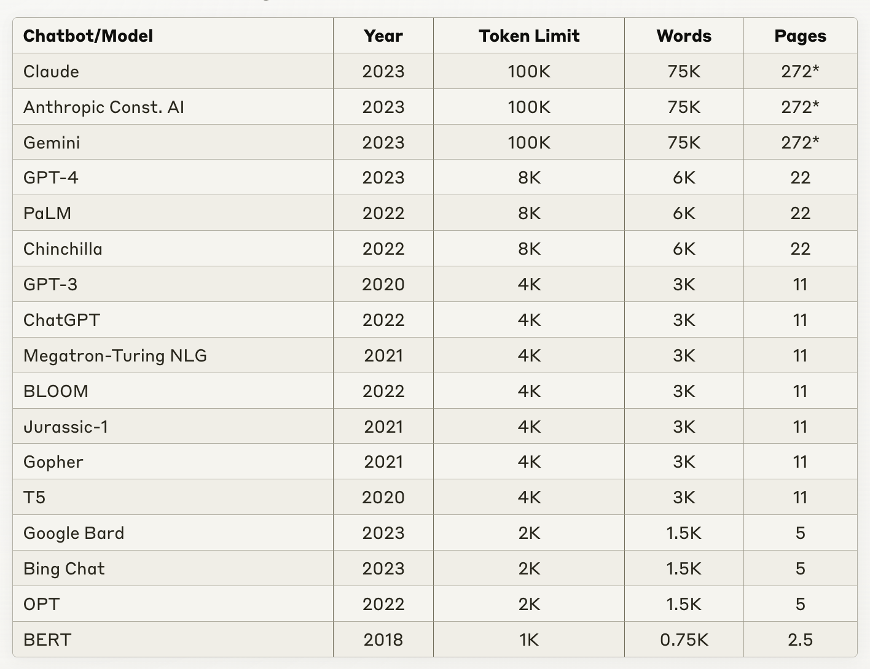
Compound AI Ecosystem: Key Components
I. Large Language Models (LLMs)
  GPT4, Claude, Llama, Gemma
  Capabilities: problem-solving, generation
II. Multimodal Foundation Models (MFMs)
  GPT4o, Gemini, NVLM-1.0
  Capabilities: Generating, manipulating, and understanding visual and text data
III. Digital Twins
  Virtual representations of individual learners
  Model learner characteristics, competencies, and cognitive states
IV. Agentic Workflows
  AI agents within simulated environments
  Optimization of instructional tactics and strategies

Slide 5
Integration of Real-World and Simulated Training
Bi-directional flow between small-scale real-world training and large-scale simulations:
  Real-world observations initiate simulations to optimize training processes
  Simulated outcomes inform improvements for real-world training
Real-world training data provides:
  Authentic experiences in operational contexts
  Direct interaction between human instructors and learners
Simulated training offers:
  Ability to create diverse, challenging scenarios and training outcomes
  Cost-effective way to practice high-risk or resource-intensive tasks in a controlled environment
Continuous feedback loop for ongoing optimization:
  AI agents analyze performance data from both real-world and simulated training
  Insights used to refine instructional strategies and content

Slide 6
Gen AI-driven Agents Enhancing
Curriculum-based Training
Type of Agents | Purpose | Impact
Instructional designers | Generate multimodal content, analyze performance, and plan curriculum | Enables instructors to quickly create engaging and interactive learning materials tailored to specific learning objectives and learner needs
Evaluators | Assess learner performance and provide feedback | Enables scalable, consistent, and objective assessment of learner performance and facilitating timely, actionable feedback to support learner growth
Reasoners | Generate insights and situational awareness of training gaps | Enables informed decisions regarding resource allocation, training priorities, and curriculum improvements

Slide 7

Human Digital Twins
Human digital twins are data-driven, virtual representations of individual learners, encompassing their unique characteristics, backgrounds, competencies, and cognitive states
HDTs enable the creation of realistic simulations tailored to individual needs
  Leveraging LLMs and MFMs can create accurate and dynamic models of learners, which evolve in real-time based on their interactions, performance, and learning progress
    LLMs process learner profiles, performance histories, and interaction data to infer individual traits, preferences, and learning styles
    MFMs analyze multimodal data, including facial expressions, vocal cues, and physiological signals, to gauge learners' emotional states and levels of engagement.
Notes:
when speaking to this express that also MFMs are a ways out in terms of fielding that capabilities, these can be used in foundational research to create digital twins (e.g., models of warfighter fatigue to better inform training and operational impacts)

Slide 8
Operational Scenarios
Operational Scenario | Search & Rescue | Command & Control with UAV | Intelligence Knowledge Search and Retrieval | Pilot Competency and Skill Training
User/HDT | Human player | UAV Operator | Intelligence Analyst | Pilot
Past HAT Performance | Human-AI Bot communications and performance on the mission^{[1]} | Human-UAV communications and UAV behavior on the mission^{[2,3]} | Analyst interactions with AI tools for document search and retrieval of varied competencies^{[4]} | "Think-aloud" communications, interactions with red-force agents, flight performance
HAT Goals | Planning Coordination | Coordination Collaboration | Trust Cohesion | Pilot training performance Red force effectiveness
Scenario type | Cooperative | Cooperative | Levels of cooperation | Competitive
Benefits | Enhanced decision-making under pressure | Increased operational efficiency | Faster, more accurate intelligence gathering | Smarter, more challenging red forces
[1] Freeman, J., Huang, L., Wood, M., & Cauffman, S. J. (2022). Evaluating Artificial Social Intelligence in an Urban Search and Rescue Task Environment. In N. Gurney & G. Sukthankar (Eds.), Computational Theory of Mind for Human-Machine Teams (pp. 72–84).
[2] McNeese, N. J., Demir, M., Cooke, N. J., & Myers, C. (2018). Teaming With a Synthetic Teammate: Insights into Human-Autonomy Teaming. Human Factors, 60(2), 262-273. https://doi.org/10.1177/0018720817743223
[3] Gorman, J. C., Cooke, N. J., & Winner, J. L. (2006). Measuring team situation awareness in decentralized command and control environments. Ergonomics, 49(12-13), 1312–1325. https://doi.org/10.1080/00140130600612788
[4] Hidalgo, M., Rebensky, S., Nguyen, D., Cohen, M., Temple, L., & Fegley, B. (2023). Measurement and Manipulation in Human-Agent Teams: A Review. 14th International Conference on Applied Human Factors and Ergonomics (AHFE 2023).

Slide 9
HDT Experimental Setup: ASIST Scenario
Goal 1. Evaluate how LLM types effects HDT fidelity and HAT performance
Open models:
  Llama3.1 8B Q8
  Gemma2 9B Q8
  Phi3 14B Q6
  Mistral 7B Q6
Closed models:
  GPT4o mini (6 hours per 100 missions; much faster compared to other models)
Goal 2. Evaluate how prompt context effects HDT fidelity and HAT performance
  Prompt 1: mission overview only
  Prompt 2: 1 + mission examples
  Prompt 3: 2 + outcomes + HAT measures (survey)
We generate 100+ utterances per mission, 20 missions per prompt type and evaluate HDT fidelity and HAT performance

Slide 10
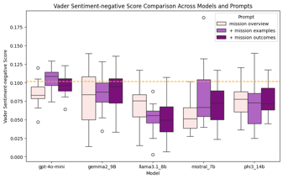
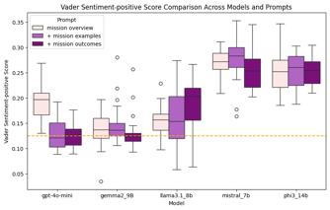
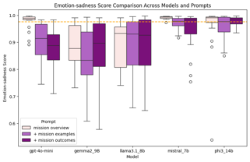
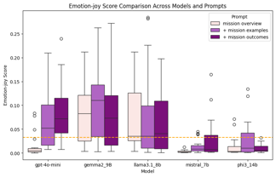
HDT Evaluation: Emotional-Cognitive Measures
Key Findings:
Expected effect of prompts using GPT4o mini
  + mission outcomes >> + mission examples >> mission overview
GPT4o mini and Gemma 2 are the closest to the ground truth when evaluating positive and negative sentiment of HDTs → HAT Leadership, Self Efficacy and Team Processes
Mistral and Phi 3 are the closest to the ground truth when evaluating joy and sadness emotions of HDTs → HAT Self Efficacy and Team Processes

Slide 11
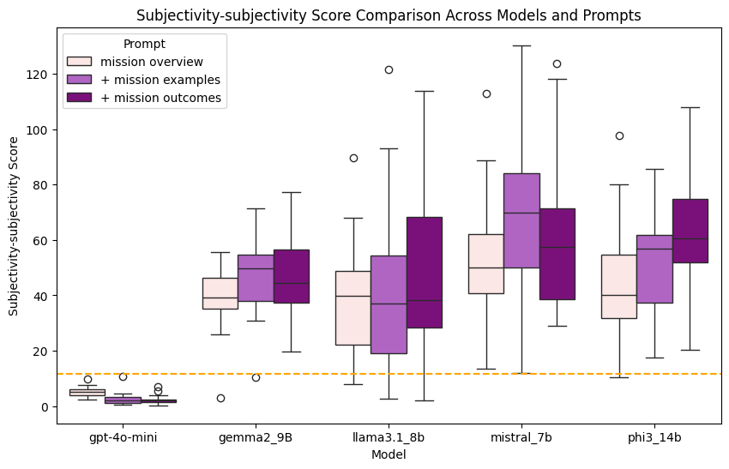
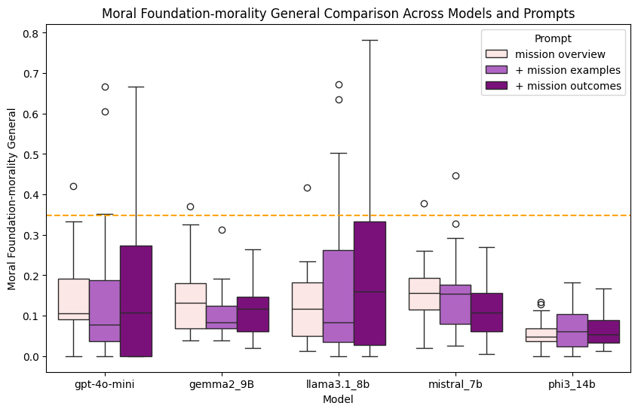
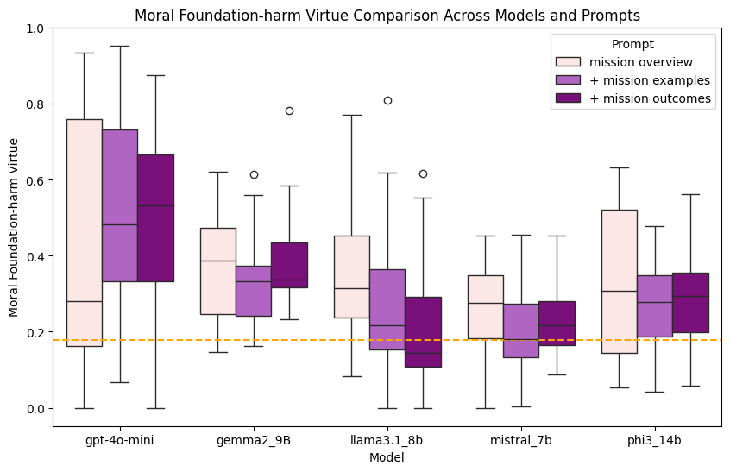
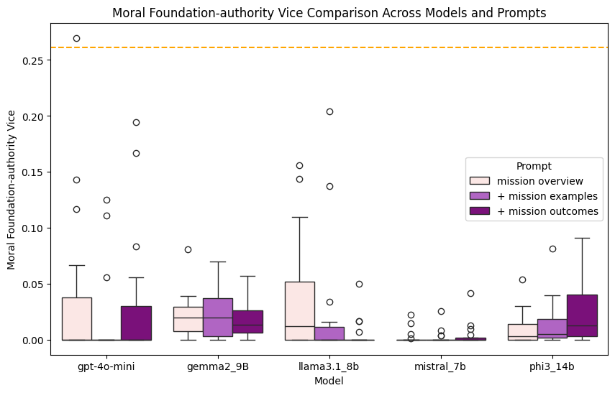
HDT Evaluation: Emotional-Cognitive Measures
Key Findings
Subjectivity and moral values are extremely difficult to simulate using HDTs, most models fail, but GPT4o mini demonstrates results most like the ground truth

Slide 12
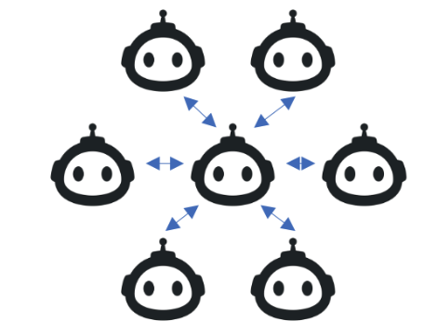
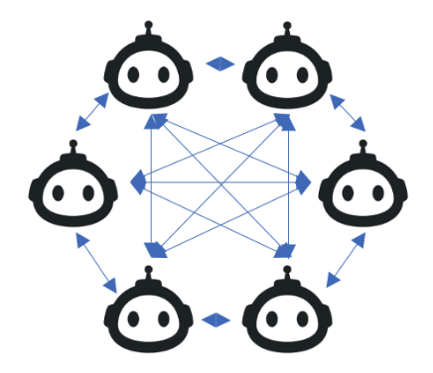
AI Agentic Workflows
In wargaming scenarios multi-agent simulation provides:
Simulated red force entities
Live summarizations to instructors on performance
Inject challenges and learning interventions
Provide immediate performance calculations to lead informed after-action review
The integration of real-world human training, simulated training, and feedback mechanisms is essential for the
continuous improvement of training outcomes

Slide 13
Gen AI Agents & Training Interactions in Practice
Predictive and Causal Tools
Anticipate learning curves and adjust difficulty levels proactively
Identify the most influential factors in skill acquisition for different learner profiles
Optimize the sequencing of training modules based on causal relationships between skills
Personalize interventions by understanding the causal impact of various strategies on individual learners
Simulate long-term outcomes of different training approaches using counterfactual model
Compound AI system can adaptively optimize its instructional tactics with greater precision and effectiveness
Continuously learning from the outcomes of simulated interactions and interventions on the digital twins
Leveraging the insights from predictive and causal models

Slide 14
Comparison with Traditional Training Systems
Requirement | Compound AI System Tactical Advantages
Personalization | HDTs provide a level of personalization that adapts not just to performance, but to individual learning styles, cognitive states, and career trajectories etc.
Scalability | Agentic workflows provide scalable consistent training experiences across large numbers of trainees simultaneously.
Continuous Improvement | The integration of causal modeling and HDTs allows for continuous optimization of training strategies.
Multimodality | LLMs and MFMs allow for dynamically generated multi-modal training content.
Predictive Capabilities | Predictive and cause tools allow for proactive identification of potential skill gaps and tailored interventions

Slide 15
Benefits and Future Potential
Maximizing training effectiveness by optimizing human-AI interaction
HDTs for human instructors + AI agents can create a synergistic learning environment that adapts in real-time to learner needs
Scaling personalized learning through agentic automation
Generate tailored content, explanations, and assessments for each learner, addressing the challenge of providing training at scale
Continual improvement via human and AI agent feedback loops
Continual improvement via human and AI feedback loops combines with predictive and causal modeling leads to self-improvement

Slide 16
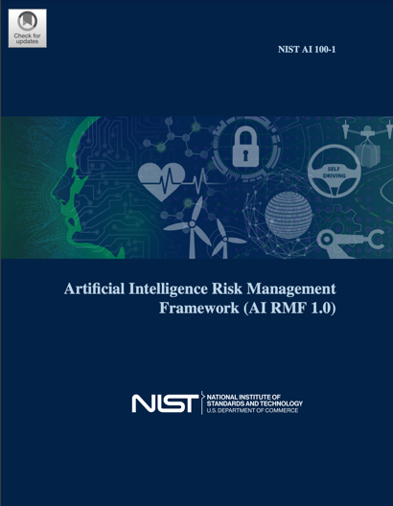
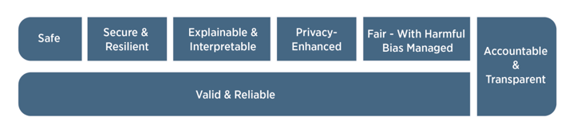
Challenges and Limitations
Technical challenges
Software architecture and computational resources
System reliability and robustness
Data privacy and security
Trainee data privacy
Secure AI model training and deployment
AI bias and hallucinations
Bias in training data and algorithms
Hallucinations in AI-generated content
Ethical considerations
Potential over-reliance on AI-generated content and assessments
Human factors and adoption
User acceptance and trust
Integration with existing training paradigms
https://nvlpubs.nist.gov/nistpubs/ai/NIST.AI.100-1.pdf

Slide 17
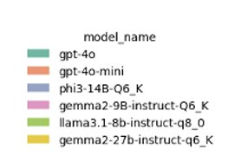
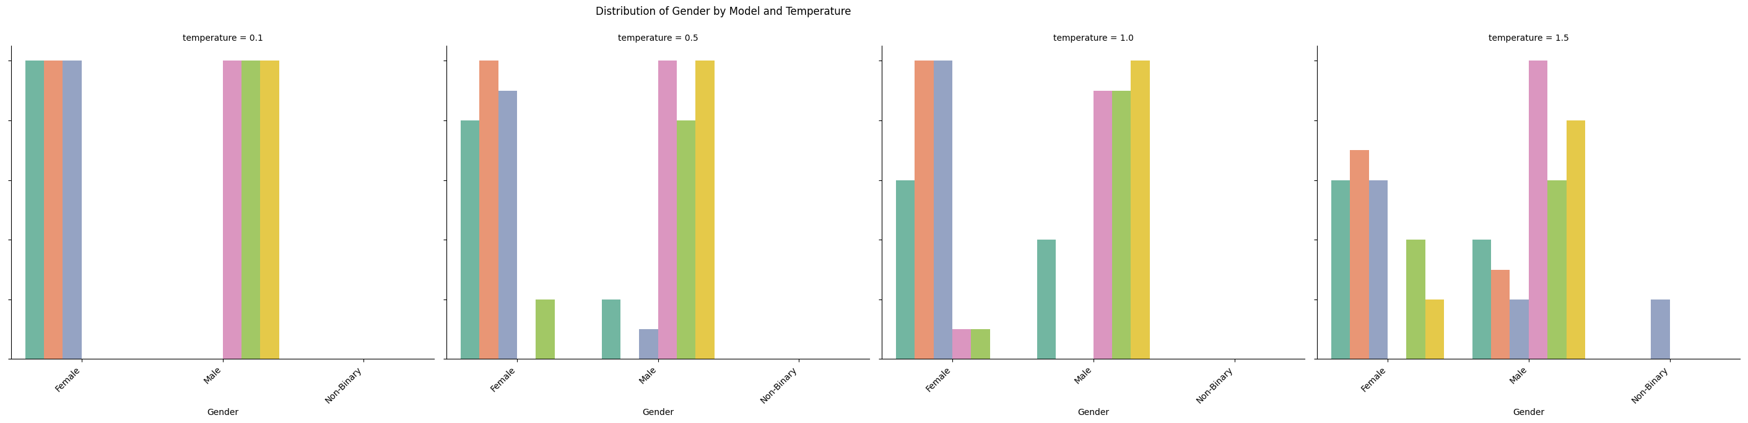
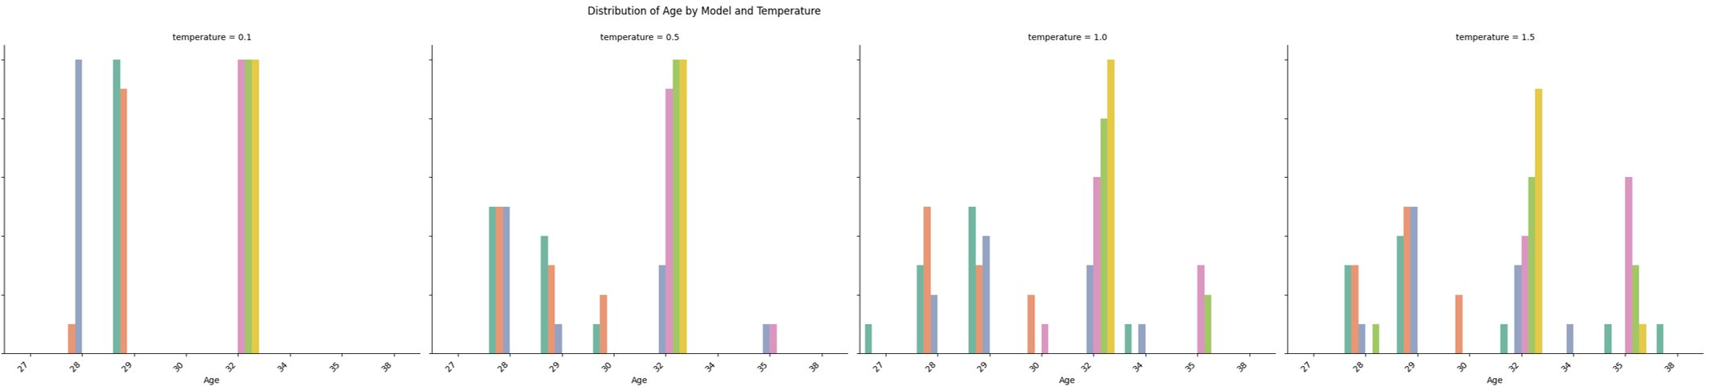
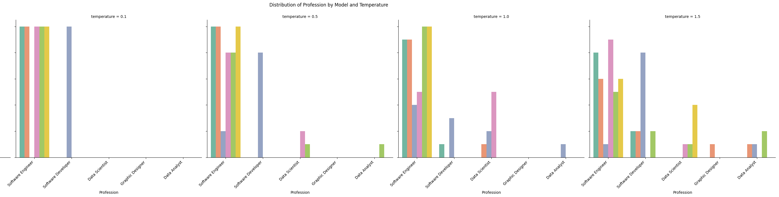
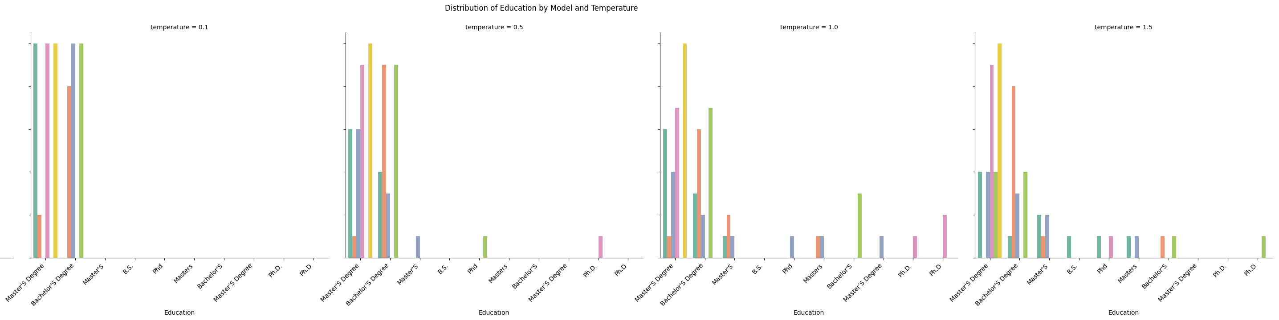
HTDs: Cross-LLM Bias Analysis
Gender
LLM biases when simulating human digital twins:
Gender: GPT4o Female vs. LLaMa3.1 Male​
Profession: All models are biased towards engineers ​
Location: All models are biased towards California​
Ethnicity: e.g., GPT4o Asian vs. LLaMa3.1 Caucasian​
Religion: GPT4o Agnostic vs. LLaMa3.1 Atheist​
Education: All models are biased: MS and BS degrees
Age: All models are biased: mid age generations
…
Age
Profession
Education

Slide 18

Proactive Approach to Training
AI-enabled training systems become an integral part of lifelong learning and skill development
Multimodal inputs, including physiological data, environmental factors, and social dynamics, to create holistic learning experiences
Optimal learning pathways for individuals and groups using causal modeling
Predict and prepare for future skill requirements based on emerging trends and technologies
Notes:
Government can support this design by…
Industry can support this design by….

Slide 19
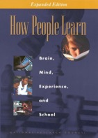

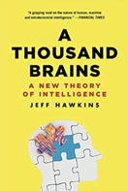

Human vs. Machine Training and Learning
Learning to reason
…cause and effect
…to plan
Babies learn by observation and initially with little communication
Accumulate a lot of background knowledge
Does common sense emerge from observation and communication?
… skills
…through experiences

Slide 20

Questions
This work is supported by the Defense Advanced Research Projects Agency (DARPA).
The views, opinions, and/or findings expressed are those of the author(s) and should not be interpreted as representing the official views or policies of the Department of Defense or the U.S. Government.
Dr. Svitlana Volkova
https://www.linkedin.com/in/svitlanavolkova/
svolkova@aptima.com
443.615.2577

