Slide 1
A Statistical Method for Non-Laser Based Force-on-Force Training Solutions
Travis Hillyer, DEVCOM SC

Slide 2
Outline
Background
The Geo-Pairing Problem
Preliminary Design
Model Setup
Analysis Methodology
Results
Discussion
Conclusion
Future Work

Slide 3
Background – Current State
Existing Force-on-Force (a.k.a. Live) training devices for simulating direct fire weapons are essentially laser tag systems
These systems fail to accurately replicate actual weapon performance and don’t replicate many types of weapons
The US Army is replacing existing systems with innovative approaches that mitigate the above limitations
Notes:
I could spend the entire time just explaining the live training environment, but instead, I’ll just gloss over it in a few seconds.
Limitations include:
1) Inability to lead moving targets
2) Inability to shoot through obscurants (fog or smoke) and concealment (light vegetation or cover)
3) Unrealistic lethality ranges
4) Unrealistic casualty assessment and damage models

Slide 4
Background – Geo-Pairing
One such approach is referred to as Geo-Pairing, which measures weapon orientation and position to inform realistic ballistic simulations
Target position and digital terrain are fused with a ballistic solution based on shooter position and weapon orientation to decide whether the shooter successfully shot the target
The performance of geo-pairing solutions are highly impacted by a position and orientation solutions’ abilities to maintain accuracy throughout long, rigorous training exercises in challenging environments.

Slide 5
Background – This Paper
Previous analysis¹ suggested that there is no practical set of sensors that would successfully enable realistic geo-pairing, i.e. we may not be able to achieve the required measurement accuracy in a size, weight, or power budget appropriate for direct fire small arms weapons
If that’s the case, what can we do?
¹Alombro, M. N. (2018). Small Arms Weapons Orientation and Position Estimation Through Scenario-Based Simulations. Wright-Patterson Air Force Base: Department of the Army.

Slide 6
Background – This Paper
Statistical methods can give insights on processes in the face of uncertain or unknown data
Monte Carlo simulations enable faster/cheaper experimentation than live fire events. Using one, can we:
Understand the relationship different sensor errors have on our likelihood of measuring data that would allow us to calculate a hit? In other words, given a set of sensors, what is the probability of measuring a hit (P_hit)?
Use those relationships to determine what sensor accuracy is required to enable realistic training results?
Develop an acceptable probabilistic approach that will enable realistic training while reducing the need for highly accurate sensors?
To find out, we must first define the problem

Slide 7
The Geo-Pairing Challenge
Here we have a shooter (green star) and a target (green triangle) at some position in the real world.

Slide 8
The Geo-Pairing Challenge
Due to GNSS error, for example, there is uncertainty in our ability to measure their exact positions (dashed ovals).

Slide 9
The Geo-Pairing Challenge
Therefore, out measured position of the shooter (red star) and target (red triangle) are offset from their real-world position by some random error.

Slide 10
The Geo-Pairing Challenge
Similarly, our shooter is aiming a weapon at the target (green dotted line).

Slide 11
The Geo-Pairing Challenge
Once again, our ability to measure the shooter’s exact weapon orientation is limited due to sensor error (black dashed line).
(Note: the error is likely not centered around the actual point of aim either. The nominal value could technically be any number between 0 and 360 degrees.)

Slide 12
The Geo-Pairing Challenge
On top of that, because our measured position is offset from the actual position, the orientation error shares that same offset.

Slide 13
The Geo-Pairing Challenge
The measured weapon orientation (solid red line) is somewhere in this range of error.

Slide 14
The Geo-Pairing Challenge
Finally, we calculate our engagement solution based on measured data. The calculated impact point (red ‘X’) completely misses the measured target (and the real one).
X
Notes:
Note: the position of red X along the red line depends on the elevation of the weapon, weapon ballistics, and terrain. Realistically, the red X can be anywhere along that red line for the purposes of this top-down simplified illustration.

Slide 15
The Geo-Pairing Challenge
The Final Picture
Range of possible shooter positions based on GNSS error
Range of possible weapon orientations based on orientation error
Calculated point of impact based on measured data
Measured shooter position
Calculated result
X
Actual shooter position
Expected result
Actual target position
Measured target position
Range of possible target positions based on GNSS error

Slide 16
The Geo-Pairing Challenge
The Final Picture
Range of possible shooter positions based on GNSS error
Range of possible weapon orientations based on orientation error
Calculated point of impact based on measured data
Important Note: errors in weapon orientation result in shot adjudication errors that increase linearly with distance.
Small orientation errors can equal large adjudication errors at long distances!
Measured shooter position
Calculated result
X
Actual shooter position
Actual (expected) result
Actual target position
Measured target position
Range of possible target positions based on GNSS error

Slide 17
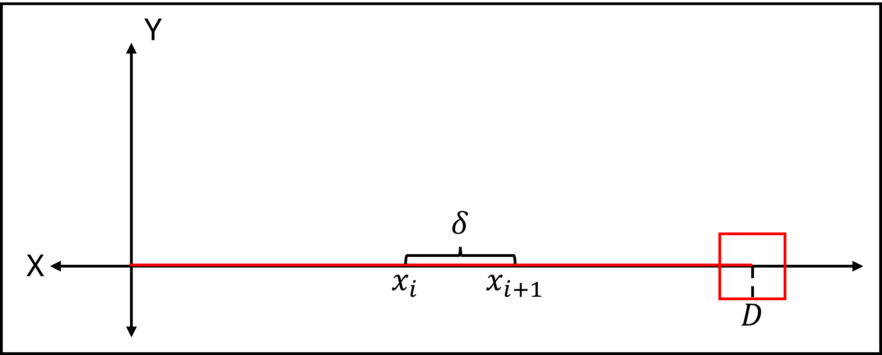
Model Setup
With the problem defined, a mathematical model is required to run an effective Monte Carlo simulation
Simplify the problem by looking at the shooting event from the top down (ignore weapon elevation and gravity)
Randomly generate position and orientation errors to perturb the ideal scenario
Calculate the bullet position in two dimensions and determine if it ever intercepts the target
Record the hit or miss and repeat the process (a lot)
Target centered at position (D,0) with size T
Shooter at position (0,0) aiming along y=0
The Ideal Scenario

Slide 18
Model Setup - Assumptions
Errors are independent from each other (i.e. position error does not affect orientation error; x-position error does not affect y-position error)
Errors are uniformly distributed (i.e. given a nominal value and some error, the sensor has an equal probability to return any number within the error range)
The shooter is always aiming at the target (i.e. if all errors are zero, the result will always be a hit)

Slide 19
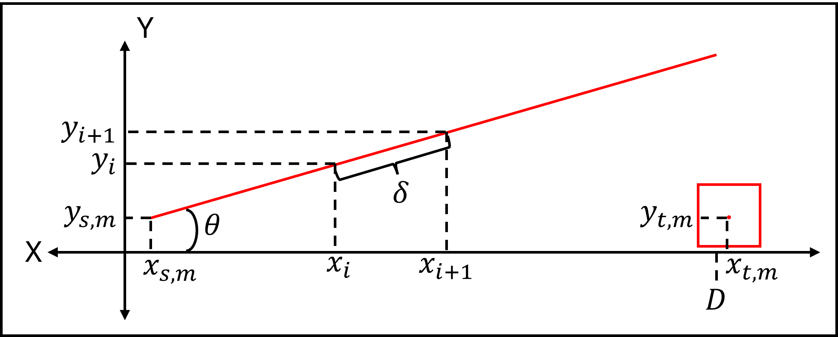
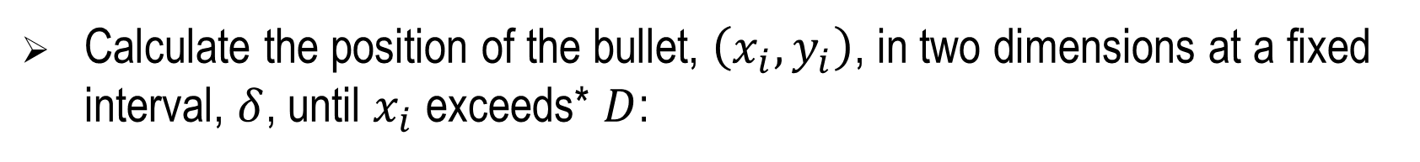
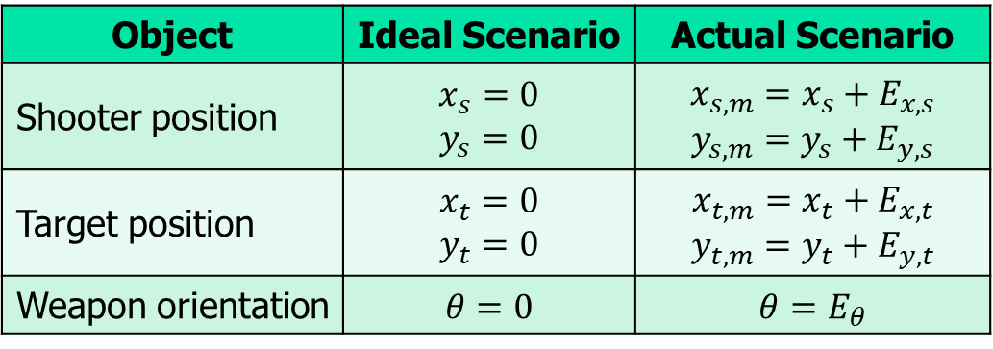
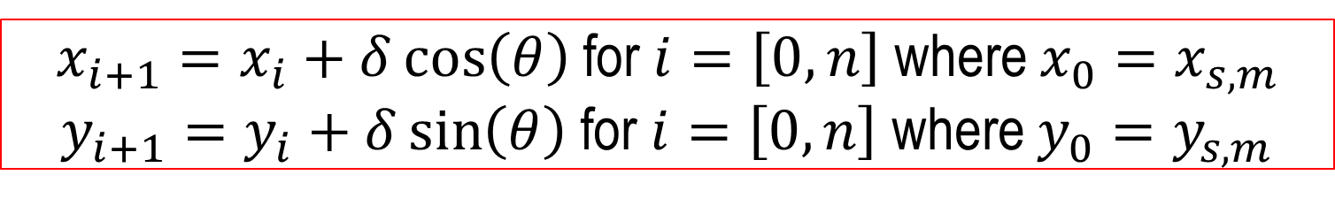
Model Setup
Object | Ideal Scenario | Actual Scenario
Shooter position | $$x_{s}=0$$ $$y_{s}=0$$ | $$x_{s,m}=x_{s}+E_{x,s}$$ $$y_{s,m}=y_{s}+E_{y,s}$$
Target position | $$x_{t}=0$$ $$y_{t}=0$$ | $$x_{t,m}=x_{t}+E_{x,t}$$ $$y_{t,m}=y_{t}+E_{y,t}$$
Weapon orientation | $$θ=0$$ | $$θ=E_{θ}$$
Calculate the position of the bullet, $\left(x_{i},y_{i}\right)$, in two dimensions at a fixed interval, $δ$, until $x_{i}$ exceeds* $D$:
$x_{i+1}=x_{i}+δ\cos\left(θ\right)$ for $i=\left[0,n\right]$ where $x_{0}=x_{s,m}$
$y_{i+1}=y_{i}+δ\sin\left(θ\right)$ for $i=\left[0,n\right]$ where $y_{0}=y_{s,m}$
*In the final algorithm, we choose to exceed D by two times the position error. This ensures we have sufficient distance to intersect the target, if it would have intersected at all. That is, $n=\frac{\left(D+2\left[\$PositionError\right]\right)}{δ}$.
Notes:
We exceed D just to make sure that we calculate far enough out that our line reaches from the shooter to the target position even at extreme position errors.

Slide 20
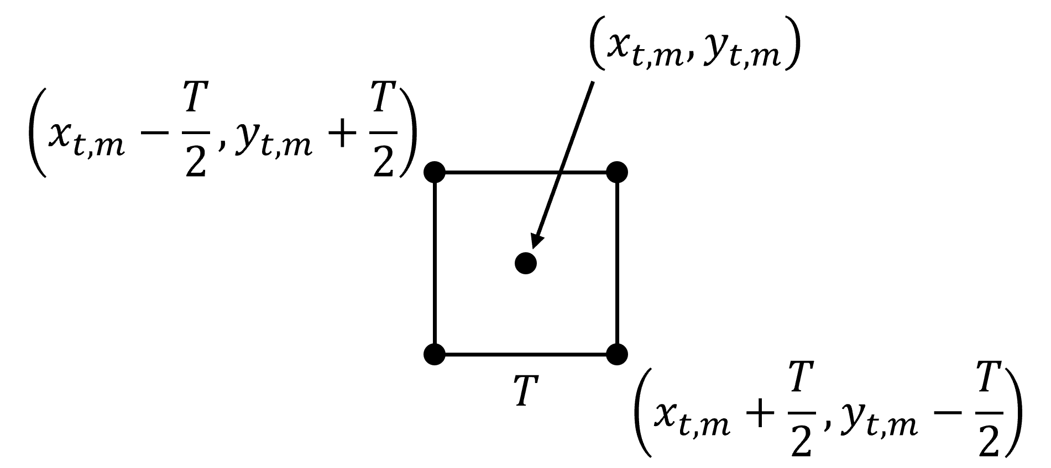
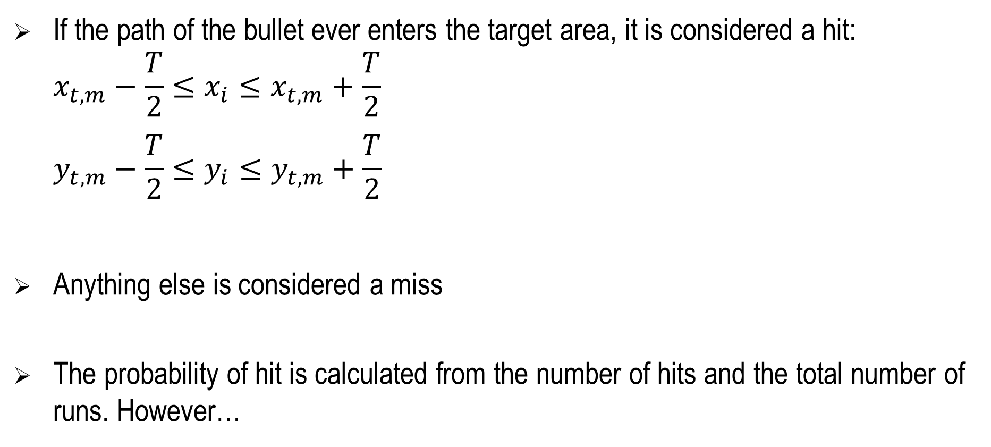
Model Setup
If the path of the bullet ever enters the target area, it is considered a hit:
$$x_{t,m}−\frac{T}{2}≤x_{i}≤x_{t,m}+\frac{T}{2}$$
$$y_{t,m}−\frac{T}{2}≤y_{i}≤y_{t,m}+\frac{T}{2}$$
Anything else is considered a miss
The probability of hit is calculated from the number of hits and the total number of runs. However…

Slide 21
Model Setup
An important note about probability of hit:
There are two ways to calculate probability of hit from the simulation
Individual, or per-run, probability of hit: record the result of each simulated bullet and divide the total number of hits by the total number of runs.
E.g. what is the probability bullet one hits target one, and so on?
This is the most realistic method since it matches what we would expect to measure if the simulation was replaced by a live fire event.
Total, or per-simulation, probability of hit: record the number of simulated bullets that would have hit any of the random targets and divide that number by the total number of runs
E.g. what is the probability any bullet hits any target?
This is less realistic but may provide an interesting way to manipulate results within a training scenario
It’s easy enough to calculate both, so we shall

Slide 22
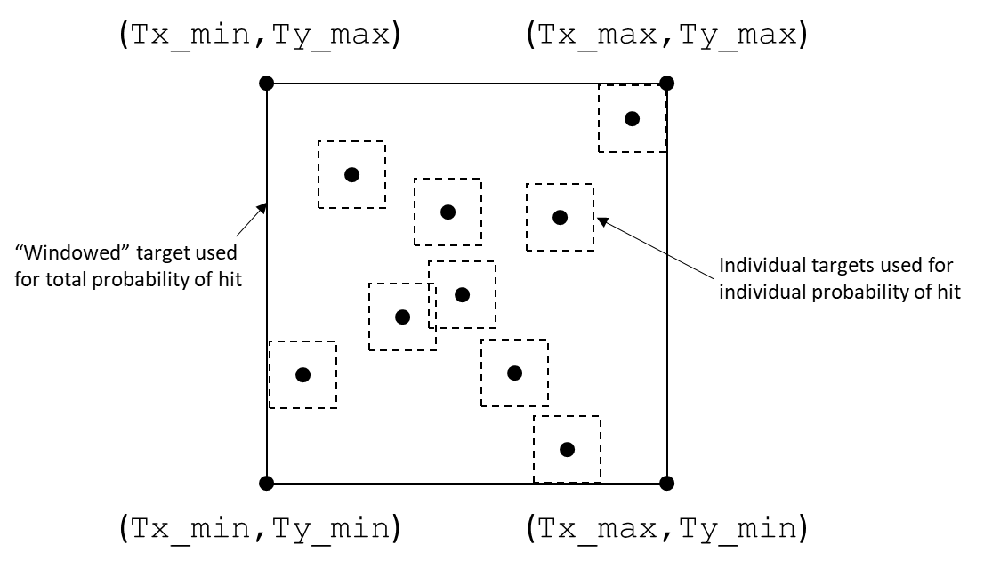
Model Setup

Slide 23
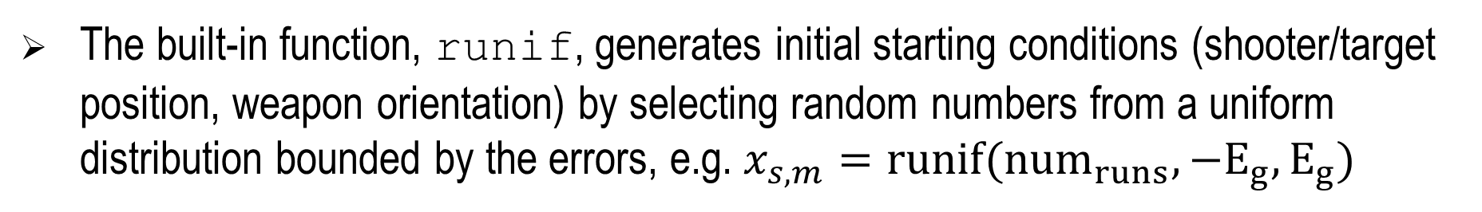
Model Setup
The above steps were programmed into an R function* to enable rapid simulation. The function has the following inputs and outputs both options for probability of hit
Input Variable | Description | Default Value
E_g | The absolute value of the position error | 0.614m
E_m | The absolute value of the orientation error | 0.875°
num_runs | The number of shots to simulate | 10
step | The interval used to calculate the bullet path | 0.1m
t_size | The size of the square target | 0.5m
D_max | The maximum distance to compute the bullet path | 500m + 2*E_g
The built-in function, runif, generates initial starting conditions (shooter/target position, weapon orientation) by selecting random numbers from a uniform distribution bounded by the errors, e.g. $x_{s,m}=runif({num}_{runs},−E_{g},E_{g})$
* Source code may be made available upon request

Slide 24
Analysis Methodology
As stated, the model outputs two probabilities of hit (total and individual)
By itself, that information is not very useful—it doesn’t indicate anything about the relationships between sensor error
An Analysis of Variance (ANOVA), however, can help show important interactions between different factors
In this case, a three-factor, two level experiment with repetition is appropriate. Our factors are:
Factor | - | +
Factor A: GPS Error (meters) | 0.614 | 2.21
Factor B: Orientation Error (degrees) | 0.875 | 11.5
Factor C: Target Size (meters) | 0.25 | 0.75

Slide 25
Analysis Methodolgy
The final ANOVA experiment setup looks like this.
The actual analysis was done using R’s built in ANOVA function
 |  | Factors |  |  | Results (Probability of Hit)
Run |  | A | B | C | 1 | 2 | 3 | 4
1 | (1) | - | - | - | ### | ### | ### | ###
2 | a | + | - | - | ### | ### | ### | ###
3 | b | - | + | - | ### | ### | ### | ###
4 | ab | + | + | - | ### | ### | ### | ###
5 | c | - | - | + | ### | ### | ### | ###
6 | ac | + | - | + | ### | ### | ### | ###
7 | bc | - | + | + | ### | ### | ### | ###
8 | abc | + | + | + | ### | ### | ### | ###

Slide 26
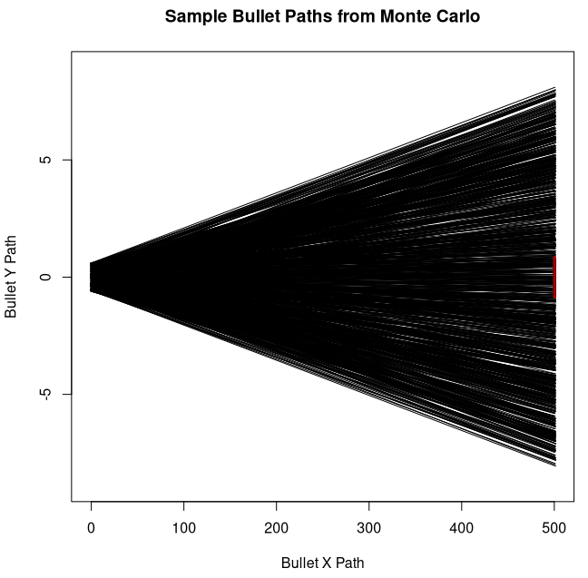
Results
The Monte Carlo simulation was run five times (5 simulations * 1,000 runs/simulation = 5,000 total runs)
Input Variables:
E_g = 0.614m
E_m = 0.875
step = 0.1m
t_size = 0.5m
D = 500m
Num_runs = 1000
Results:
Trial Number | Individual P_hit (%) | Total P_hit (%)
Trial 1 | 3.4 | 11.2
Trial 2 | 3.3 | 11.8
Trial 3 | 3.0 | 9.3
Trial 4 | 2.9 | 11.0
Trial 5 | 3.4 | 12.9
Average | 3.2 | 11.2
A sample plot from one of the simulations. The total target area is indicated in red.

Slide 27
Results
Results from the ANOVA analysis
Trial |  | Factors |  |  | Results |  |  |  | ANOVA
Run | Purpose | E_g | E_m | t_size | 1 | 2 | 3 | 4 | P Value
1 | Control | 0 | 0 | 0.5 | 1.000 | 1.000 | 1.000 | 1.000 | N/A
2 | Default System | 0.614 | 0.875 | 0.5 | 0.031 | 0.032 | 0.032 | 0.029 | N/A
3 | DOE (-1) | 0.614 | 0.875 | 0.25 | 0.010 | 0.014 | 0.020 | 0.015 | N/A
4 | DOE (a) | 2.21 | 0.875 | 0.25 | 0.017 | 0.013 | 0.015 | 0.014 | 0.552
5 | DOE (b) | 0.614 | 11.5 | 0.25 | 0.001 | 0.000 | 0.004 | 0.001 | 2.2E-16*
6 | DOE (ab) | 2.21 | 11.5 | 0.25 | 0.001 | 0.001 | 0.000 | 0.000 | 0.663
7 | DOE (c) | 0.614 | 0.875 | 0.75 | 0.048 | 0.043 | 0.061 | 0.049 | 6.18E-12*
8 | DOE (ac) | 2.21 | 0.875 | 0.75 | 0.046 | 0.064 | 0.049 | 0.055 | 0.365
9 | DOE (bc) | 0.614 | 11.5 | 0.75 | 0.005 | 0.002 | 0.000 | 0.000 | 3.29E-11*
10 | DOE (abc) | 2.21 | 11.5 | 0.75 | 0.004 | 0.001 | 0.002 | 0.006 | 0.905
Orientation error, target size, and the interaction between them have the greatest impact on probability of hit.

Slide 28
Discussion
Probabilities of hit paint a bleak picture—such low values are likely insufficient to provide training realism
ANOVA suggests that orientation error and target size play the biggest role in achieving good results, but why doesn’t position matter as much?
Spoiler: the ANOVA experiment did not adequately cover a wide enough range for each error
To find out why, it’s useful to plot individual probability of hit as a function of each factor

Slide 29
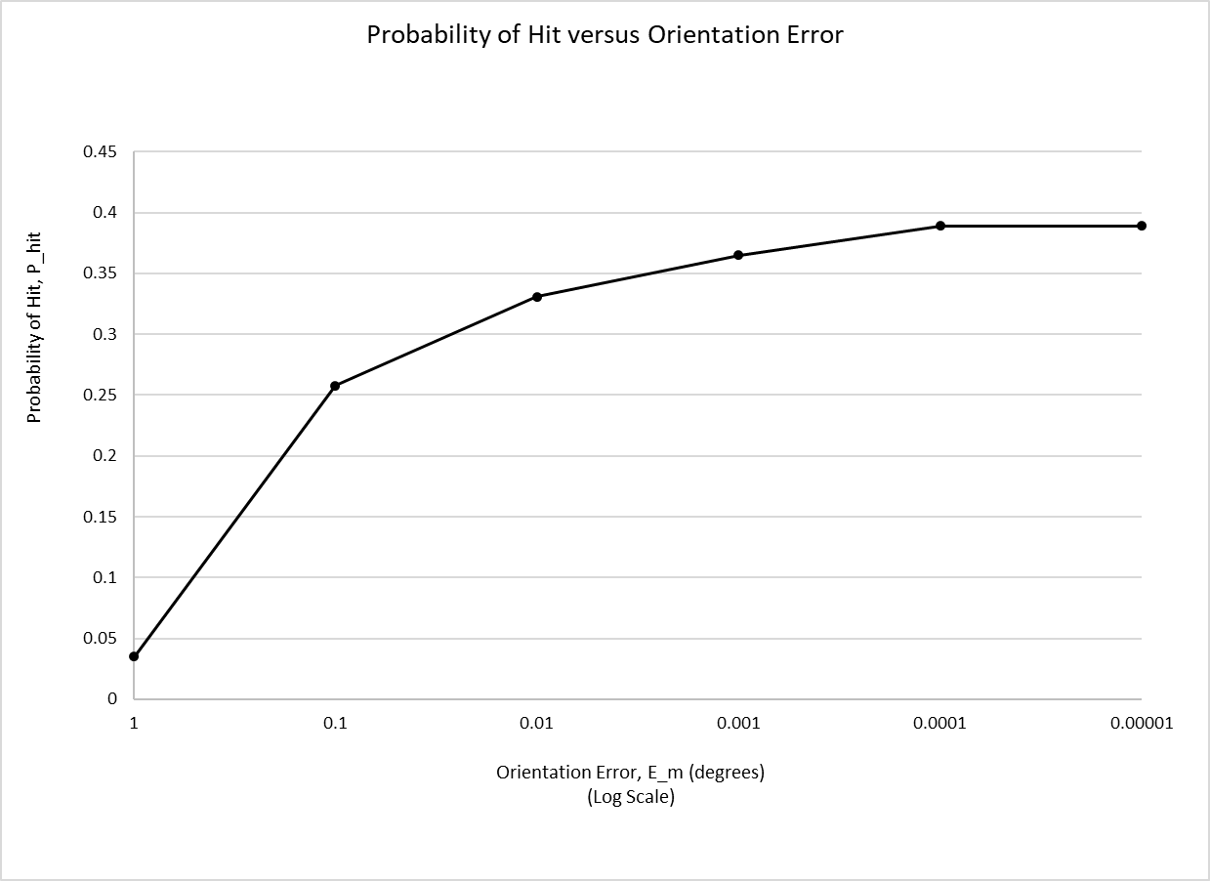
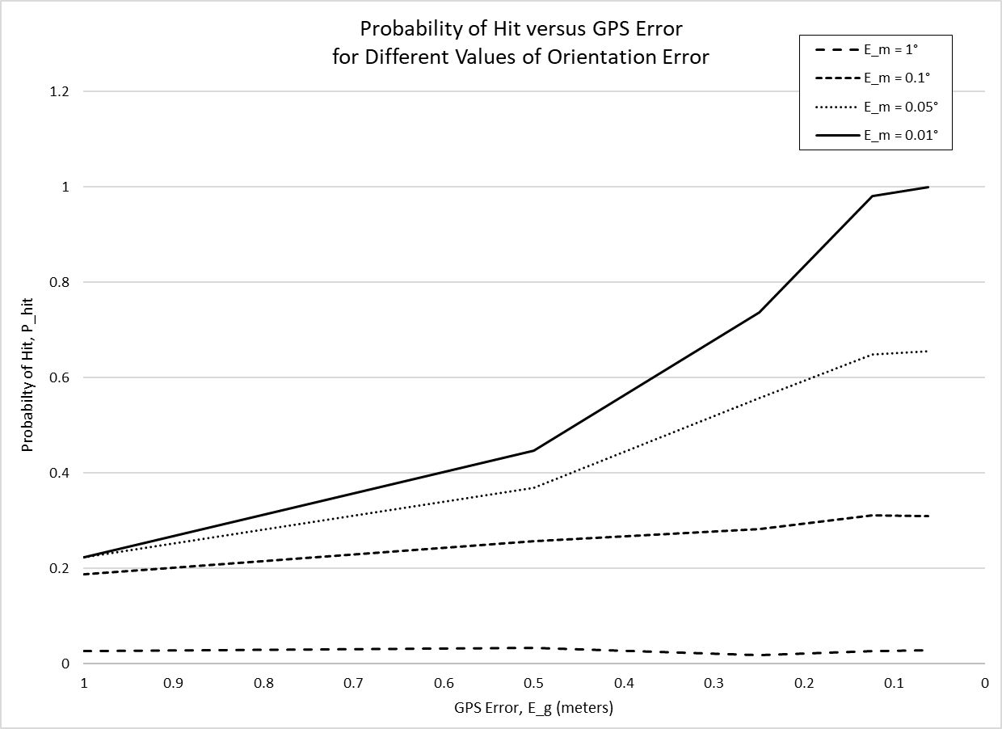
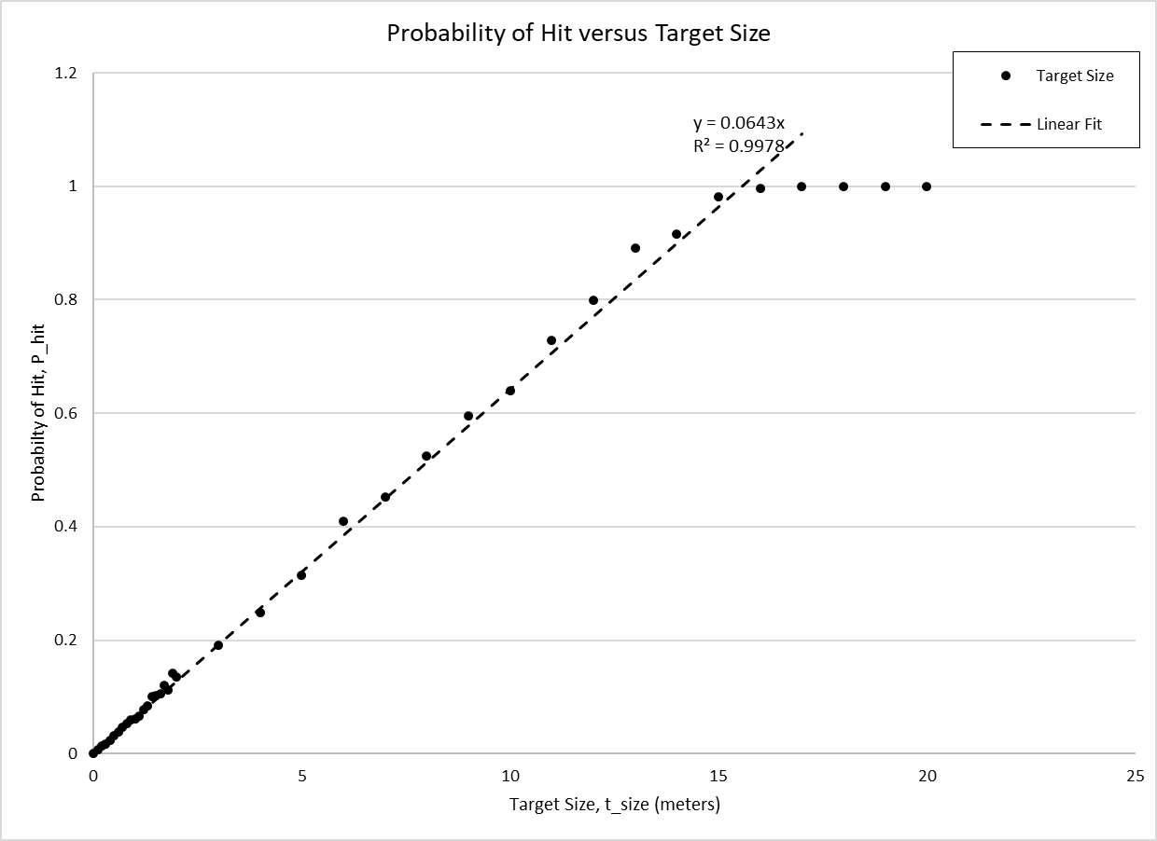
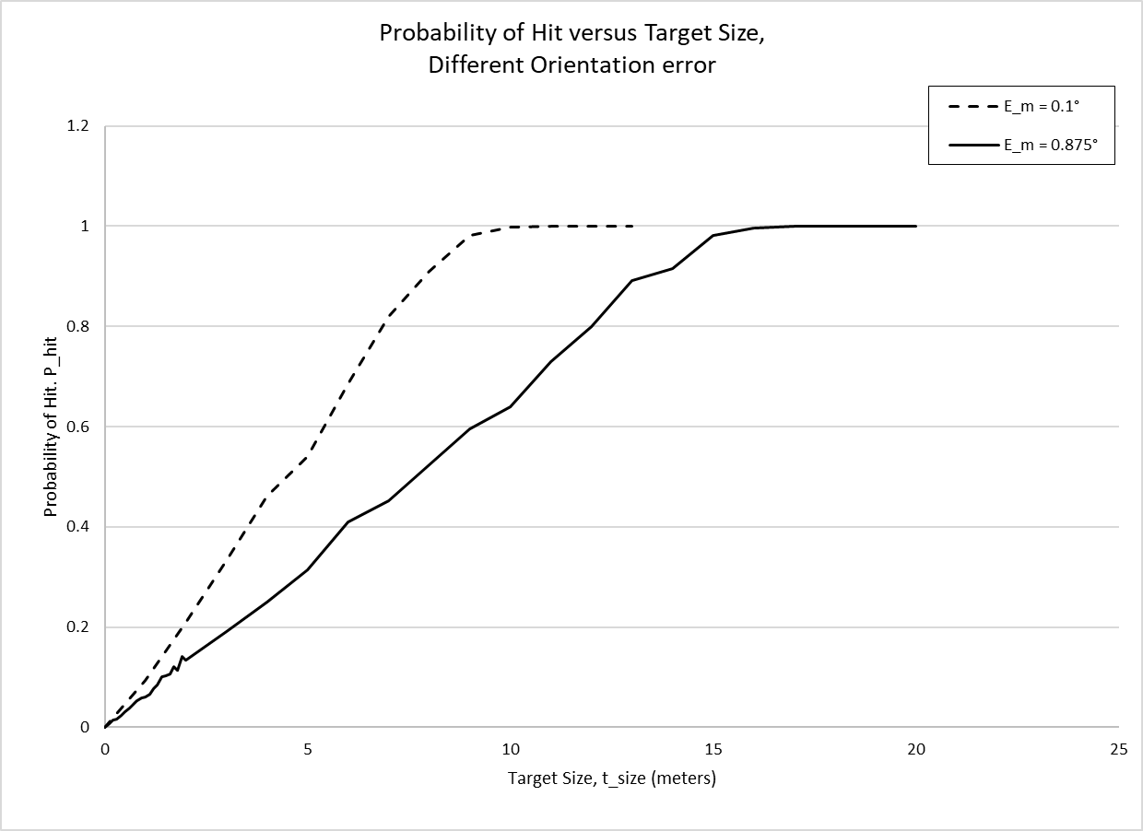
Discussion
Orientation error initially has a big impact on P_hit but levels out over time
To achieve higher levels of P_hit, position accuracy must be improved
Target size (perhaps obviously) has a linear impact on P_hit until the target size is bigger than the orientation error cone, at which point a hit is guaranteed

Slide 30
Discussion
This plot is particularly useful
It shows the probability of hit as a function of GPS error
By plotting results from systems with different orientation errors on the same chart, we can start to see how entire systems might behave

Slide 31
Discussion
Use it as a tool to inform system design:
How accurate does a system need to be to achieve a desired probability of hit?

Slide 32
Discussion
In a training system, use the plot to determine an expected probability of hit given system reported errors (e.g. from a Kalman filter or GNSS fix) and (hopefully) improve system realism:
As part of an integration algorithm for a hybrid system where multiple methods for determining hit are present
“The expected probability of hit based on reported error is < XX% so do not prefer the geo-pairing solution over other methods.”
As part of an algorithm to intelligently adjudicate targets in a multiple target scenario
“Given the errors of all targets in an area and the errors of the shooting system, target X has the highest probability of hit.”

Slide 33
Discussion
In a training system (continued):
Together with the Monte Carlo simulation, use as part of an algorithm to intelligently adjudicate against single targets
Use measured positions and weapon orientation to estimate a shooter-target pair.
Use reported errors to run a Monte Carlo simulation and determine a total probability of hit (since the real target could be in any of the random positions at any given time)
Use the Monte Carlo result to adjudicate the engagement
“Based on a Monte Carlo simulation probability of hit greater than XX%, with the known system errors, adjudicate the engagement as a kill.”

Slide 34
Discussion
Combined with any of the above use cases, the manipulation of target size could provide a straightforward means to intelligently raise or lower the difficulty of a training exercise.
Somewhat obviously, smaller targets are harder to hit than larger targets
The benefit to combining this with a probabilistic model is that it can be an adaptive response, rather than a fixed configuration
“The training scenario should be at a constant difficulty; the probability of hit should always be XX%. Adjust the target size based on system reported errors to maintain that probability of hit.”
Note: there is a practical limit to this. Disproportionately large targets are nonsensical and even slightly larger than real targets may cause issues in multiple target scenarios when targets start to overlap.

Slide 35
Conclusion
Given current limitations on sensor performance, a geo-pairing only live training system is likely insufficient to provide realistic training, but all is not lost:
There are multiple was to incorporate probabilistic methods into live training adjudication algorithms to improve their outcomes
Focused research on improving weapon orientation measurement capabilities can greatly improve system performance
Probabilistic methods can also enable intelligent manipulation of training scenario difficulty

Slide 36
Future Work
Explore the impact of different error distributions (e.g. normal vs. uniform) on the results. Ideally, measure common sensors in a realistic training environment to get an understanding of real error distributions
Expand the scope of the model to include other factors such as terrain accuracy, real ballistics, and soldier performance/skill data
Incorporate size/weight/power/cost considerations to provide a means to optimize a system design for different considerations
Develop proposed probabilistic methods into useful training system algorithms and incorporate into training systems for evaluation
Notes:
The third bullet might be immediately useful for weapons other than direct fire

Slide 37
Thank You!
Any questions?
Contact Information:
Travis Hillyer
travis.r.hillyer2.civ@army.mil

