Slide 1
Data Mesh Contextualized
Policies Supporting the Mesh
Erica Dretzka, DoD OSD CDAO CTO
Jordan Gottlieb, DoD OSD CIO ZT PfMO

Slide 2
Agenda
Mesh Intro
Mesh Actors
Use Cases
Next Steps

Slide 3


Mission-Infrastructure Capabilities
Data
Data
AI
Inefficient Manual Interoperability
AI
Access Controls
Mission Sets
Access Controls
Mission Sets
Data Exchange
Data Exchange
Isolated environments with similar profiles, tech stacks, users, and data
Modeling and Simulation (M&S) &
Artificial Intelligence (AI)
Digital Engineering (DE) & Test & Evaluation (T&E)
Training & Education, Digital Twins (DT), Cyber-Physical Systems [CPS],
Internet of Things [IoT]
Local Mission
Tools
Shared Mission
Live Fires, Effectively Maintain Equipment, Engage Adversary, Cybersecurity
Operational Effectiveness, Real-Time Interoperability, CJADC2

Slide 4





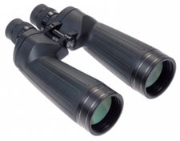




Mesh Actors Driving Infrastructure Agility
Inflexible Standards & Infrastructures
Flexible Patterns & Decomposability
Systems Engineer
Policy Analyst
Practitioner | Utilizes the secured, governed, and trusted interoperated mesh environment for mission use cases
Systems Engineer | Develops transparent, composable system
Policy | Supports functionality through policies surrounding responsibility, use cases, DoDI/DoDMs, etc
Practitioner

Slide 5
Moving beyond theory to implementation
Theory
Growth in Book and Paper publications
Implementation via Modularization
Creating Reference Designs and Prototypes
Theory
Systems Engineer
 | Proposed (Micro)Service
1 | UID
2 | Semantic Services
3 | Data Catalog
4 | Data and Metadata Profiles ([x]BOMs)
5 | Policy Access Control
6 | Digital Policy Administration
7 | Data Exchange Management
8 | Data Product Search
9 | Data Pub/Sub
10 | Mesh Performance Analytics
11 | Data Product Life Cycle Management
12 | Data Security Classification
13 | Quality Management Services
14 | Mediation Hub Services
15 | Mesh instrumentation Tools
Digital Systems
Human Systems
Physical Systems
Able to monitor, analyze, and control at the sub-unit level in real time, visualize operations at both the system & ecosystem level.
Policy Analyst
Create a machine-readable “fabric of policies” to achieve structure & longevity of the modular parts.

Slide 6
Focus: Policy Actor
Data, AI, ML, Data Science, Dashboarding
Digital Engineering and Modeling and Simulation (DEM&S)

Slide 7
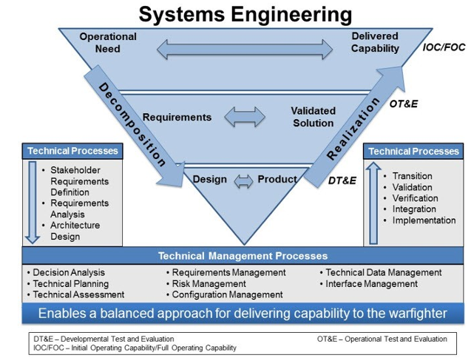
Focus: Systems Engineer & Security Actor
Orchestrate composable elements across environments, use cases, user bases, etc.
Accounts for change cases to engineer longitudinal maturation and adaptability
Security Practitioners incorporate cybersecurity and access management

Slide 8

Focus: Policy Actor Enablement
Make the data mesh components usable and relevant for use cases
1 | UID
2 | Semantic Services
3 | Data Catalog
4 | Data and Metadata Profiles ([x]BOMs)
5 | Policy Access Control
6 | Digital Policy Administration
7 | Data Exchange Management
8 | Data Product Search
9 | Data Pub/Sub
10 | Mesh Performance Analytics
11 | Data Product Life Cycle Management
12 | Data Security Classification
13 | Quality Management Services
14 | Mediation Hub Services
15 | Mesh instrumentation Tools

Slide 9
Why Mission Practitioners Care

Slide 10
MX ENG Use Case

Slide 11
Mission Use Cases
Use of Education in AI is growing
CJADC2 uses the data mesh

Slide 12
Next Steps
Reference Designs kickoff
DMRA & UDRA Issued
Prototype kickoff
3/24
Q1 25
2025
It is expected that each implementation will be unique based on their mission set and socio-technical infrastructure
The end state will be a constellation of technology, cognitive processes, and information
Zero Trust-compatible modularity achieves interoperability among the different implementations

Slide 13
Erica L. Dretzka Chief Digital and AI Office (CDAO), Chief Technology Office (CTO) Washington, DC erica.l.dretzka.civ@mail.mil | Mr. Jordan Gottlieb Chief Information Office (CIO), Zero Trust Portfolio Management Office (ZT PfMO) Systems Engineer Technical Advisor (SETA) Washington, DC jordan.gottlieb.ctr@mail.mil

Slide 14


Title Slide
I/ITSEC 2024
Your organization’s logo, which may appear on the title slide and nowhere else. Don’t try to buffalo us and sneak it in again.
Oh, good, because we hate it when our presenters are whisked off to jail. Omit unless your organization requires it.
Unclassified

