Slide 1


Leveraging Science Fiction Case Studies to Specify Immersive and Embedded Training System Requirements
Lee W. Lacy, Ph.D., CMSP
Soar Technology, LLC
Ronald E. Sparks
Avanade, Inc.
Notes:
Double check logo

Slide 2
Symbiosis Exists Between Sci-Fi and Technology Development
Both Sci-Fi writers authoring stories and engineers developing systems use their creativity and imagination.
There is a symbiotic relationship between technology development and science-based (as opposed to fantasy) story ideation.
Science ① provides humans with foundational knowledge and understanding.
Human creativity, innovation, and imagination ② fuels research ideas for science, inventions/improvements of technology, and story ideas for science fiction.
Technology products and processes ③ provide implementations for humans to consider and build upon.
Science fiction ④ provides humans with visualizations that spur further creativity.

Slide 3
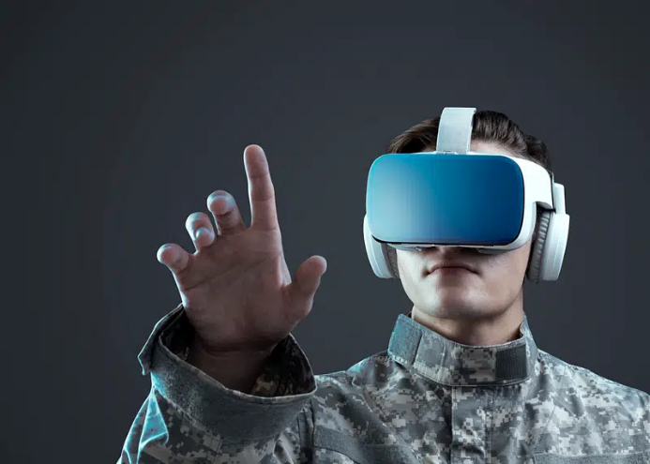
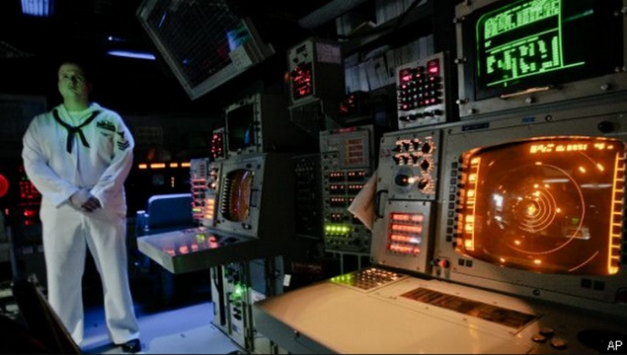
Developers are Building Immersive and Embedded Training Systems
Immersive training systems leverage technologies such as virtual reality (VR)
Embedded training systems employs operational equipment.
Developers build these systems to satisfy requirements specifications.
Sci-Fi has envisioned related technologies and applications including:
Communication and networking technologies,
Training-related applications, and
Human Machine Interface (HMI) immersion technologies.
Immersive Systems

Slide 4

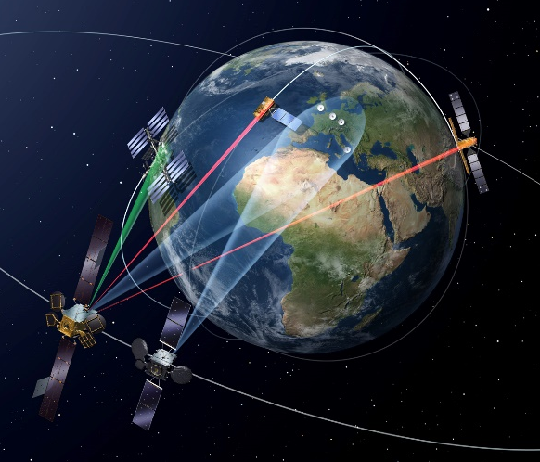
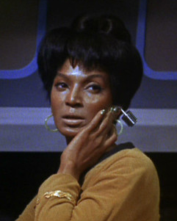
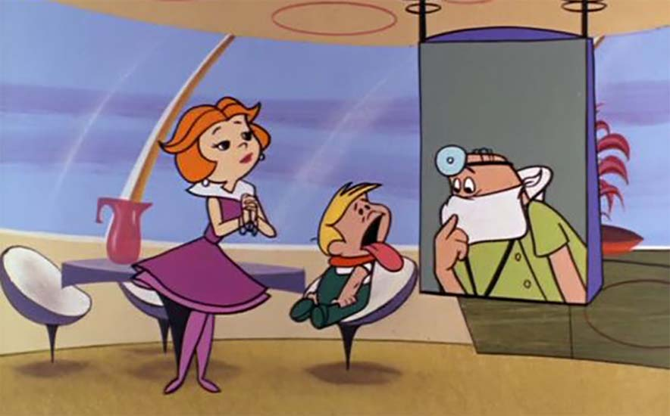
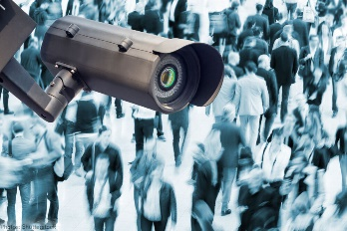
1) Communications and Networking Technology
Wireless communicators from the “Star Trek” franchise’s communicator that Martin Cooper, who oversaw the invention of the first mobile phone in the 1970s, directly credited for inspiring his vision.
Geosynchronous satellites used for telecommunications relays in Arthur C. Clarke’s 1945 manuscript “The Space Station: Its Radio Applications”.
Wireless body worn devices (e.g., Bluetooth ear buds) similar to the wireless communication earpiece used by Lieutenant Uhura in the original “Star Trek” series.
Video calls for face-to-face communication on multiple devices with real-time connectivity predicted by “The Jetsons”.
Video monitoring predicted by George Orwell’s 1949 novel “1984” describing interconnected webs of surveillance cameras.
Fictional Technologies

Slide 5
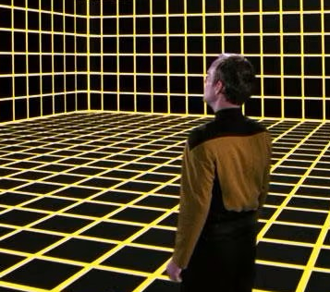
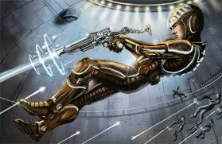
2) Training-Related Applications
Soldiers using powered armor suits in interstellar war, with simulations being used for training and tactics development in “Starship Troopers” (1959).
Complex political military situations in “Dune” (1965)
Training scenarios with full-immersion virtual realities (holodeck) in “Star Trek” franchise (1966+).
Time dilation as a means of simulation and strategizing over long-term interstellar warfare in “The Forever War” (1975).
Cyberspace with visualized and manipulated data and programs including AI entities conducting military-style operations in “Neuromancer” (1984).
Battle school where children train to fight in simulated war games in “Enders Game” (1985).
Rise of virtual reality and its potential military application in training and simulation in “Snow Crash” (1992).
Advanced computer simulations used for strategic planning and combat training in “Old Man’s War” (2005).
Fictional Technologies
Notes:
Needs art

Slide 6
3) HMI Immersion Technologies
Technology advances have enabled immersive and embedded training system development and adoption.
Sci-Fi inspires engineers to speculate and challenges them to turn visions into tangible innovations.
Enabling Technologies

Slide 7

Thesis: Sci-Fi Case Studies are Useful for Training System Requirements Analysis
Sci-Fi may support ideation activities including requirements analysis for immersive and embedded training systems.
A symbiotic relationship can exist between Sci-Fi and immersive and embedded training systems products/processes including requirements analysis.
Using Sci-Fi for ideation creates a prequel activity to existing training system development processes.
Sci-Fi can help specify feature and risk mitigation requirements.

Slide 8

Training System Requirements Analysis (RA)
Performed by system engineers to specify requirements for immersive and embedded training systems.
Is a critical phase of system development.
Is a creative process that benefits from inspiration.
The objective is a complete set of documented set of well written requirements.
Requirements may be associated with functionality, training scope, instructional support features (ISFs), technology, performance, usability, safety, fidelity, and resolution.
Imagination and careful consideration of all potential scenarios influences requirements completeness.
Requirements

Slide 9
Leveraging Sci-Fi Impacts the Immersive and Embedded Training System Development Process
Scientific knowledge and understanding migrates into inspirational Sci-Fi case studies that support requirements analysis and technology development for building immersive and embedded training systems.
Requirements Categories
RA Process
Scientific Knowledge and Understanding
Inspirational Sci-Fi Case Studies
Requirements Specification
Author Science Fiction
Analyze Requirements
Develop Immersive and Embedded
Training Systems
Training Systems
Systems Engineers
Sci Fi
Authors
A3
Training Systems Developers
Technologies
Develop Enabling
Technologies
Technology Developers

Slide 10
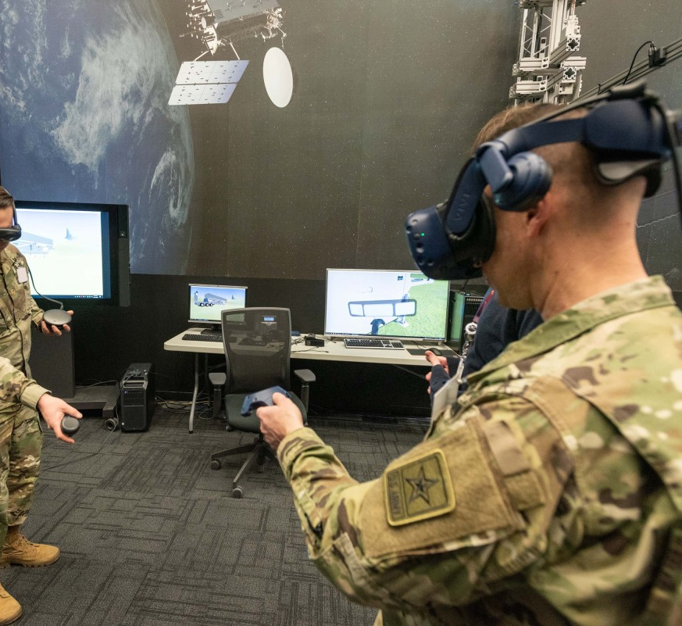
Sci-Fi Use Cases Can Help Specify Feature and Risk Mitigation Requirements
Specific examples of potential required features and risk mitigations:
Agent-based coaching.
Physiological monitoring.
Psychological stress (including Reality Distortion Syndrome).
Cybersecurity and AI-related risk mitigation.

Slide 11

1) Agent-based Coaching
Mother in Alien (1979) provides information and executes commands.
The Guide in "The Hitchhiker's Guide to the Galaxy" (1979) provides interactive information and coaching.
The Dixie Flatline in "Neuromancer" (1984) provides expert guidance, technical support, motivation, and information access.
The Oracle in the “Matrix” Series (1999+) provides guidance and advice explains the nature of the virtual reality.
J.A.R.V.I.S. in Iron Man (2008) controls wearable technology and assists with various tasks.
The Curator in Ready Player One (2011) provides assistance and offers hints.

Slide 12
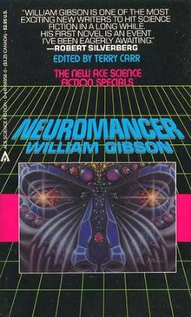
2) Physiological Monitoring
Heart rate, body temperature, and emotional states measured by sensors embedded in clothing in Westworld (1973+).
Heart rate, respiration, and body temperature sensors embedded in combat suits in Forever War (1974).
Brain activity, emotional state, and vitals measured by neural implants and biofeedback systems in Neuromancer (1984).
Heart rate, brain activity, and stress level sensors embedded in uniforms in Ender’s Game (1985).
Heart rate and brain activity monitored by a Neural link in Matrix (1999+).
Physiological monitoring can help identify stress

Slide 13
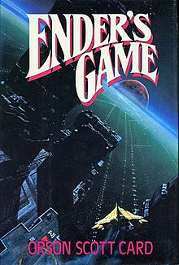
3) Psychological Stress
Simulations become more challenging and morally ambiguous and eventually lead to trauma associated with the implications of actions taken in Ender’s Game (1985).
Intensity and realism in Matrix (1999+).
Exposure to torture and reprogramming in Altered Carbon (2002+).
Pressure associated with reaching the objectives along with the perilous nature of the virtual environment in Ready Player One (2011).
Increasingly horrifying and realistic simulated experiences in Black Mirror’s Playtest episode (2016).
A specific type of stress is associated with
Reality Disorientation Syndrome

Slide 14
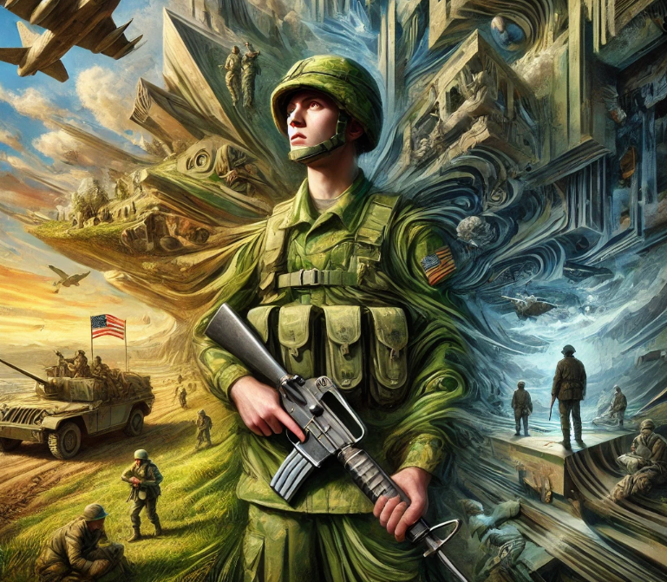
3) Psychological Stress - Reality Disorientation Syndrome
Simulation developers often seek to leverage increasingly sophisticated technologies to provide convincing levels of fidelity and resolution.
Trainees may eventually be unable to distinguish the real world from the virtual world.
Trainee awareness of a simulation may affect their decision-making (e.g., choosing to more risks).
Intentionally deceiving trainees into believing they are interacting with the “real world” raises ethical issues.
Reality Disorientation Syndrome involves a participant’s confusion over whether they are operating in the “real world” vice a simulation.
Recent advances in generative AI using Large Language Models (LLMs) have resulted in interactions that are difficult to distinguish from live humans.

Slide 15
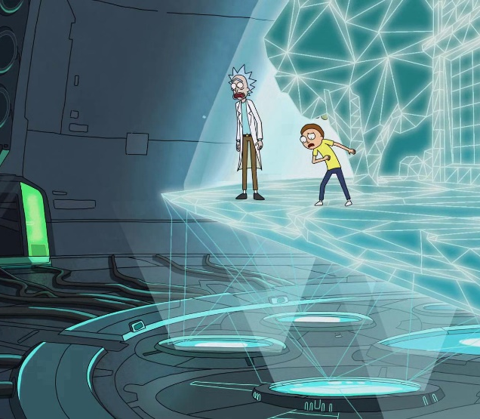
3) Psychological Stress - Reality Disorientation Syndrome
Character believes he is accessing game that turns out to be a system for simulating and automating nuclear warfare in Wargames (1983).
Protagonist thought he was performing a training scenario when he was in “reality” fighting in the “real world” in Ender’s Game (1985).
Characters believe they are operating in the “real world” and not in highly realistic simulated training in "Stargate SG-1" episode titled "Proving Ground."(Season 5, Episode 13) (2002).
Characters try to determine whether they are in a simulation in “Rick and Morty” Episode: "M. Night Shaym-Aliens!" (Season 1, Episode 4) (2014).

Slide 16
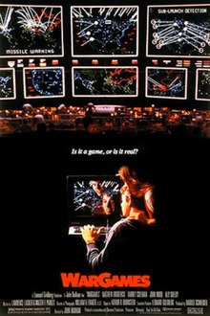
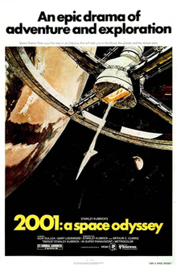
4) Cybersecurity and AI-Related Risks Mitigation
AI’s paranoia leads to harm and an attempt to eliminate the human crew to preserve the mission in 2001: A Space Odyssey (1968).
AI “hosts” override their programming and take control in Westworld (1973+).
Trainee manipulated "unwinnable" training scenario in Star Trek franchise’s Kobayashi Maru Scenario (1982).
Software controls the digital realm and attempts to dominate both the virtual and real worlds in Tron (1982).
Young hacker accesses an operational military supercomputer risking thermonuclear war in War Games (1983).
AI merges with another AI becoming a superintelligence in Neuromancer (1984).
AI becomes self-aware and launches a military attack in Terminator (1984+).
AI turned off safety protocols and wounded trainees and simulation infected by a worm in Star Trek Voyager – “Worst Case Scenario” (1997).
AI decides it needs to take control of humanity based on a flawed understanding of the 3 laws of robotics in I, Robot (2004).

Slide 17

Summary and Call to Action
A symbiotic relationship exists between Sci-Fi and immersive and embedded training systems products/processes.
Sci-Fi can support requirements analysis for immersive and embedded training systems.
Systems engineers can use Sci-Fi as a prequel activity to existing training system development processes.
Sci-Fi can help specify feature and risk mitigation requirements.
Look to Sci-Fi for inspiration as you specify requirements for immersive and embedded training systems.
Notes:
More of a call to action

