Slide 1

Predictive Threat Models for Real-Time Decision Support
Jerry Scott Sheehan, Booz Allen Hamilton
Alec Gray Jr, Booz Allen Hamilton
Dejan Neskovic , Booz Allen Hamilton

Slide 2
AGENDA
Introduction
Previous Solution
New Solution
Single vs Multilevel Modeling
Using Multilevel Modeling
Multilevel Model Results
Hybrid Ensemble Methods
Hybrid Ensemble Model Results
Impact
Discussion

Slide 3
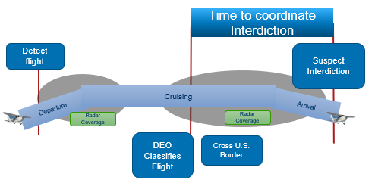
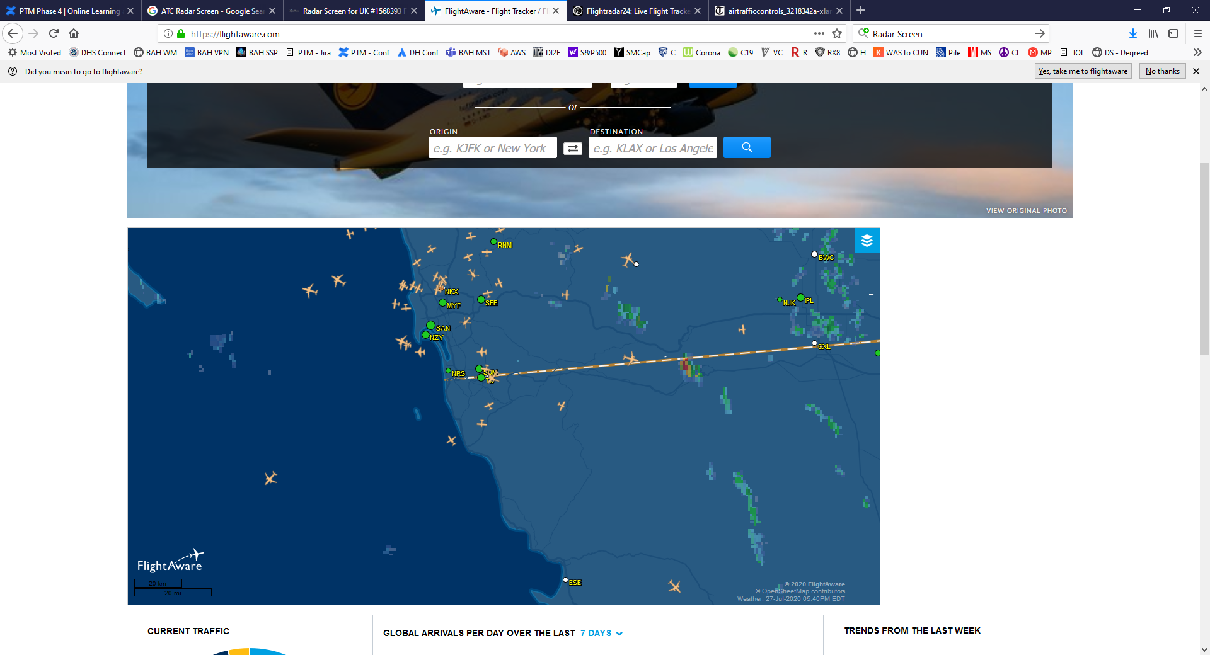
Introduction
Background:
The Air and Marine Operations Center (AMOC) Detection Enforcement Officers (DEO) are tasked with diminishing drug trafficking across the Southern border of the United States through aviation:
Determine which flights may be trafficking drugs
Determine where these flights are likely to land
Coordinate with local law enforcement to interdict flights
Problem:
This is a complex task for DEOs:
Thousands of flights enter the U.S. each day
DEOs have limited time to make decisions and coordinate interdictions with local law enforcement
DEOs rely heavily on historical information from their experience, but have a high turnover rate of staff

Slide 4


Previous Solution
In 2023, we presented our solution:
Neskovic, D., Sheehan, J., & Gray Jr, A. (2023). Real-Time Analytics to Support Operational Decision Making (Predictive Modeling). Interservice/Industry training, Simulation, and Education Conference (I/ITSEC).
The current presentation is a follow-up effort detailing improvements to the previous methods.
We will first review the previous solution to understand where we left off

Slide 5
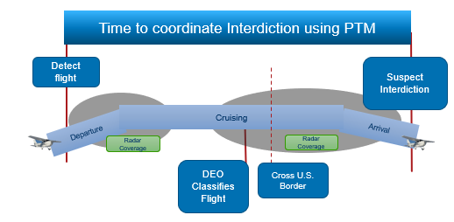
Predictive Threat Models
Predictive Threat Modeling (PTM) Solution:
Predictive analytics leverage historical data on flight patterns and interdictions to build machine learning (ML) models to classify the risk level of a flight, the likely mission the flight is on, and where the flight will land.
Why PTM?
Captures organizational collective knowledge and experience while making it available to each member of the organization
Make time critical decisions earlier and with greater certainty
Enables operators to be proactive vs reactive
Gleans new insights into suspicious behaviors, patterns and dependencies
Optimizes the allocation of human resources and assets
Continues to learn/update the predictive models
PTM Alert
Call sign: Unknown
Radar: Primary Only
Mission: Short Lander
Risk : Low
Landing Location:
34.51, -117.98
PTM Alert
Call sign: N584ER
Mission: Border Crosser
Risk : High
Landing Location: 38.23, -104.55

Slide 6

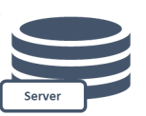
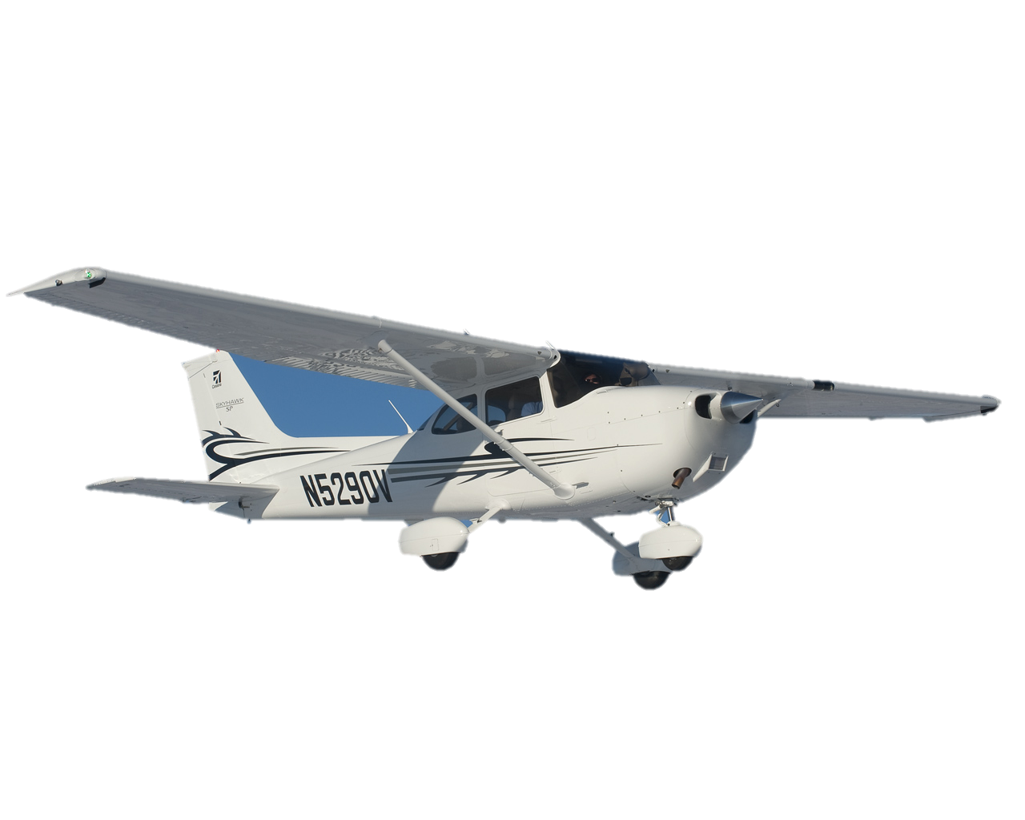
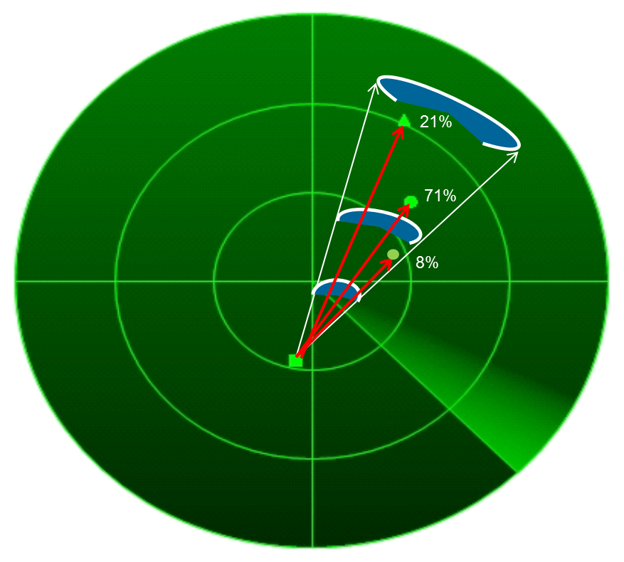
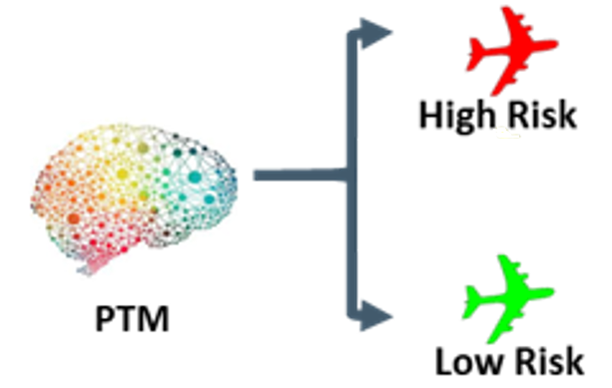
Pipeline
Collect Historical Data
ETL and Feature Engineering
Train Models
Receive and process ground truth data
Integrate into historical database using Athena
Database is stored in Amazon Web Services (AWS) GovCloud S3
Python script retrieves data from AWS GovCloud
Transform, clean, normalize, standardize, and scale data
Feature engineering
Automated process
Feature selection
Train machine learning models on historical data to predict the flights risk level, mission, and landing location
Try various parameters and model types
Select the best performers to deploy
Pass as pickle files
Local Pipeline
Collect feedback from DEOs
Collect Real-Time Data
PTM Real-Time Predictions
Output Predictions to Client
Real time data collected in JavaScript Object Notation (JSON) format through Kafka messages
Data collected from radar detections
>100,000 records/day
Parse data
Pass to pickle files to predict the risk, mission, and landing location for each relevant flight record
Pass predictions to client within seconds
Dashboard with live flights and predictions
Deployed Pipeline

Slide 7
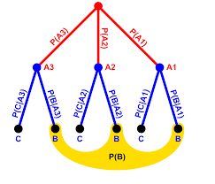
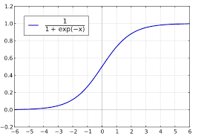
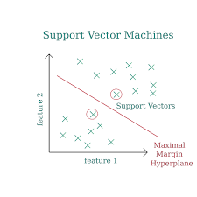
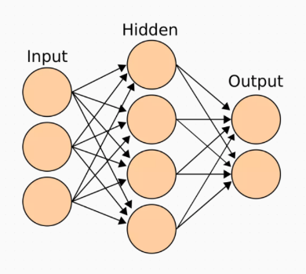
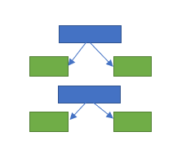
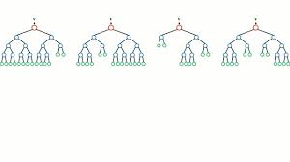
Categorical Models
Categorical Models Used
Risk
If the flight caries a high or low risk to the country
What?
Predict risk, mission, latitude, and longitude
How?
Feature selection with Analysis of Variance (ANOVA) and Spearman correlation analysis
Runs all models shown below and selects the best performer for each target variables
Mission
Predicts the goal of the flight
Latitude
Predicts a 2-degree range for flights final latitude
Longitude
Predicts a 2-degree range for flights final longitude
Naïve Bayes
Logistic Regression
Random Forest
Support Vector Machine
Multi-layer Perceptron
Adaptive Boosting

Slide 8
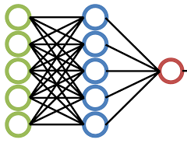
Deep Learning Model
Deep Learning Model
PyTorch’s neural network library predicts final latitude/longitude coordinate for a flight
Leverage Principal Component Analysis (PCA) to optimize features
Linear layer
Leaky Rectified Linear Unit
Reassess to minimize the distance from the actual location

Slide 9
Findings
PTMs act as force multipliers and have given DEOs an additional decision support capability, making their jobs easier and more effective.
Models can confidently classify flights that pose a high risk to the country and provide information on where those high-risk flights will be landing.
However, there is room for improvement for determining the landing location.
The current paper looks at an updated approach by implementing a layered multi-stage ensembled methodology to provide the most accurate models.

Slide 10
New Solution
In 2023 presented our solution:
Neskovic, D., Sheehan, J., & Gray Jr, A. (2023). Real-Time Analytics to Support Operational Decision Making (Predictive Modeling). Interservice/Industry training, Simulation, and Education Conference (I/ITSEC).
The current presentation is a follow-up effort detailing improvements to the previous methods
The following slides look at the new methods to compare to last years results

Slide 11
Single vs Multilevel Modeling
Single-level modeling
Analyzes data as a flat structure, assuming that all observations are independent
Focuses on estimating relationships between predictors and the outcome variable within a single, uniform context
Predicts individual customer spending based on demographic data (e.g., age, income, location)
Uses straightforward analyses where the data does not exhibit nested or clustered patterns, making it easier to implement and interpret
Multilevel Modeling
Accounts for data that is organized at more than one level (e.g., observations within flights, flights traveling in a specific heading)
Recognizes that data points within a group may be more similar to each other than to those in different groups
Predicts landing locations for flights traveling with a specific heading
Incorporates both fixed effects (overall population-level effects) and random effects (group-specific variations), enabling the analysis of both within-group and between-group variability

Slide 12
Using Multilevel Modeling
Previously, one deep learning model was trained on all historical data and used to predict the landing location for flights headed in all directions. We will refer to this as the Single Deep Model.
Now, add a layer to the deep model where flights are grouped by their dominant heading (the direction they predominantly travel across their path from origin to destination). Separate models are then trained on the grouped flights for each heading. These will be referred to as the Course Binned models and will be for each one of the following headings:
The hypothesis is that flights heading northwest, for example, are likely going to share certain characteristics that may differ from flights heading south or east. Additionally, the model is less likely to overfit to the noise within each group.
North
Northwest
Northeast
West
East
South
Southwest
Southeast

Slide 13
Multilevel Model Results
Compare the performance of the Single Deep Model with that of the Course Binned Models:
The performance of our models are measured by the percent of flights landing within one degree (60 miles).
The Single Deep Model performance is broken down based on its performance for each heading category.
The table below shows the models within 1 degree performance and bolds the better result between the two.
Note: Due to our results being law enforcement sensitive, the results shown in this section are multiplied by a randomized coefficient; therefore, they keep the results comparable to each other while maintaining security of the classified performance.
Heading | Single Deep | Course Binned
East | 28.0% | 59.5%
North | 73.5% | 73.5%
Northeast | 30.3% | 35.0%
Northwest | 43.2% | 86.3%
South | 65.3% | 25.7%
Southeast | 29.2% | 71.2%
Southwest | 59.5% | 67.7%
West | 51.3% | 39.7%

Slide 14
Hybrid Ensemble Method
 | Single Deep Model | Course Binned Model | Hybrid Model Selection
Approach | Bins kinematic data by individual flights. | Bins flights by direction of travel (e.g., North, East). | Selects the best model for each heading based on performance.
Modeling Technique | Single deep neural network for the entire dataset. | Separate deep neural networks for each heading group. | Compare flight-based and heading-based model performance.
Deployment Strategy | Single model applied uniformly across all new flights. | Models are deployed based on specific flight direction. | Best-performing model for each heading is deployed.
Practical Usage | Simple and broad application for all flight data. | Tailored to specific flight directions for more accurate predictions. | Ensures optimal model usage based on past performance.
Benefits | - Easier to manage and implement. - Suitable for datasets without strong directional patterns. | - More nuanced modeling for each flight direction. - Captures unique characteristics of each heading group. | Maximizes predictive accuracy, explains more data variance (generalization), improved accuracy, and improved flexibility and robustness.
Drawbacks | Potentially poor generalization, inability to learn from more complex hierarchical structures, and lower predictive accuracy. | The increased complexity requires more data, can be time consuming, and can potentially lead to overfitting. | Potentially computationally expensive to train additional models.

Slide 15
Hybrid Ensemble Model Results
Using the results on slide 13, selected the best performing model for each heading between the Single Deep Model and Course Binned Models
East: Course-Binned
North: Course-Binned (tied)
Northeast: Course-Binned
Northwest: Course-Binned
South: Single-Deep
Southeast: Course-Binned
Southwest: Course-Binned
West: Single-Deep
Compared the overall performance for the Single Deep and Course Binned Model to that of the Hybrid Ensemble.
Model | Within One Degree of Actual
Single Deep | 45.5%
Course Binned | 60.7%
Hybrid Ensemble | 66.5%

Slide 16


Impact
The original models were a significant step forward to enable DEOs to make faster and better data-driven decisions.
By building off those models and organizing data into hierarchical levels, the new models more effectively capture the inherent complexities and relationships within the data that simpler models often overlook.
Combining multilevel data structuring with ensemble modeling further elevates the performance of machine learning systems.
The multilevel and hybrid ensemble models lead to more accurate and precise landing location predictions leading to:
DEOs can now coordinate with the proper local law enforcement on where to interdict a flight with a higher rate of success and with more lead time.
More efficient use of resources and a greater likelihood of ascertaining criminals by being at the right place at the right time.

Slide 17
Discussion
With the success of the current Multilevel Modeling approach, additional levels could be considered:
For example: group headings by the current region of a flight
By continuing to research new ideas the PTM models can continue to improve and further assist DEOs with their mission
The methods used to develop the PTM models can be used for other use cases as well by:
Using historical data to train a variety of predictive models and using a hunger games style method to determine the best ones to deploy
CI/CD (Continuous Integration/Continuous Delivery)
The architecture used allows for thousands of data points to be predicted on in real time
Low maintenance, highly scalable, flexible, and always available
Data and code remains secure using AWS GovCloud and vulnerability checks
Enables seamless integration with customers’ current operational systems
PTM can be run as a standalone application or in a different environment; remains vendor-agnostic (e.g., AWS vs Azure) and future proof

Slide 18
Acknowledgements
The research in this document was conducted with the U.S. Department of Homeland Security (DHS) Science and Technology Directorate (S&T) under contract 47QFCA22F0047. Any opinions contained herein are those of the authors and do not necessarily reflect those of DHS S&T.
© Booz Allen Hamilton Inc. Booz Allen, the Booz Allen logo and other Booz Allen marks are trademarks of Booz Allen Hamilton Inc. or its subsidiaries. Other third-party names, trademarks and brands may be claimed as the property of others
Trademarks, service marks, and trade names of third parties are owned by their respective company

