Slide 1

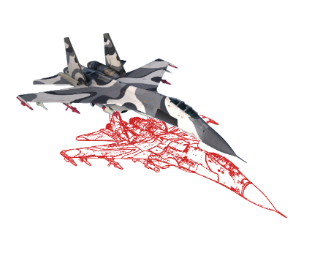

Computer-Generated Forces Team Behavior within Air Combat Simulations
Concept and Agent Structure
Data & Dynamics
V&V
AI
Philippe Ruther, Luca Winkler
CGF - Red Forces

Slide 2

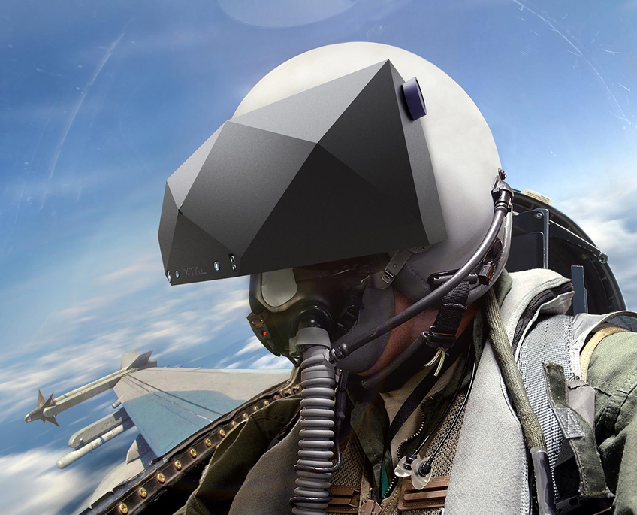
Motivation
Competitive Simulations require valid Opponents
  Data & Dynamics: sensors, flight model
  AI: situationally adaptive, coordinated team behavior
  Verification & Validation: establish trust, valuable results
Red Forces Simulation Frame
Data & Dynamics
V&V
AI
Use Case 1
Goals:
Training
Behavior Validation
Tactics Validation
CGF
versus
VR-Sim
Evaluation of
Use Case 2
Goals:
Evaluation of AI-Methods
Generate AI-Framework
Tactics Validation
CGF
versus
CGF

Slide 3

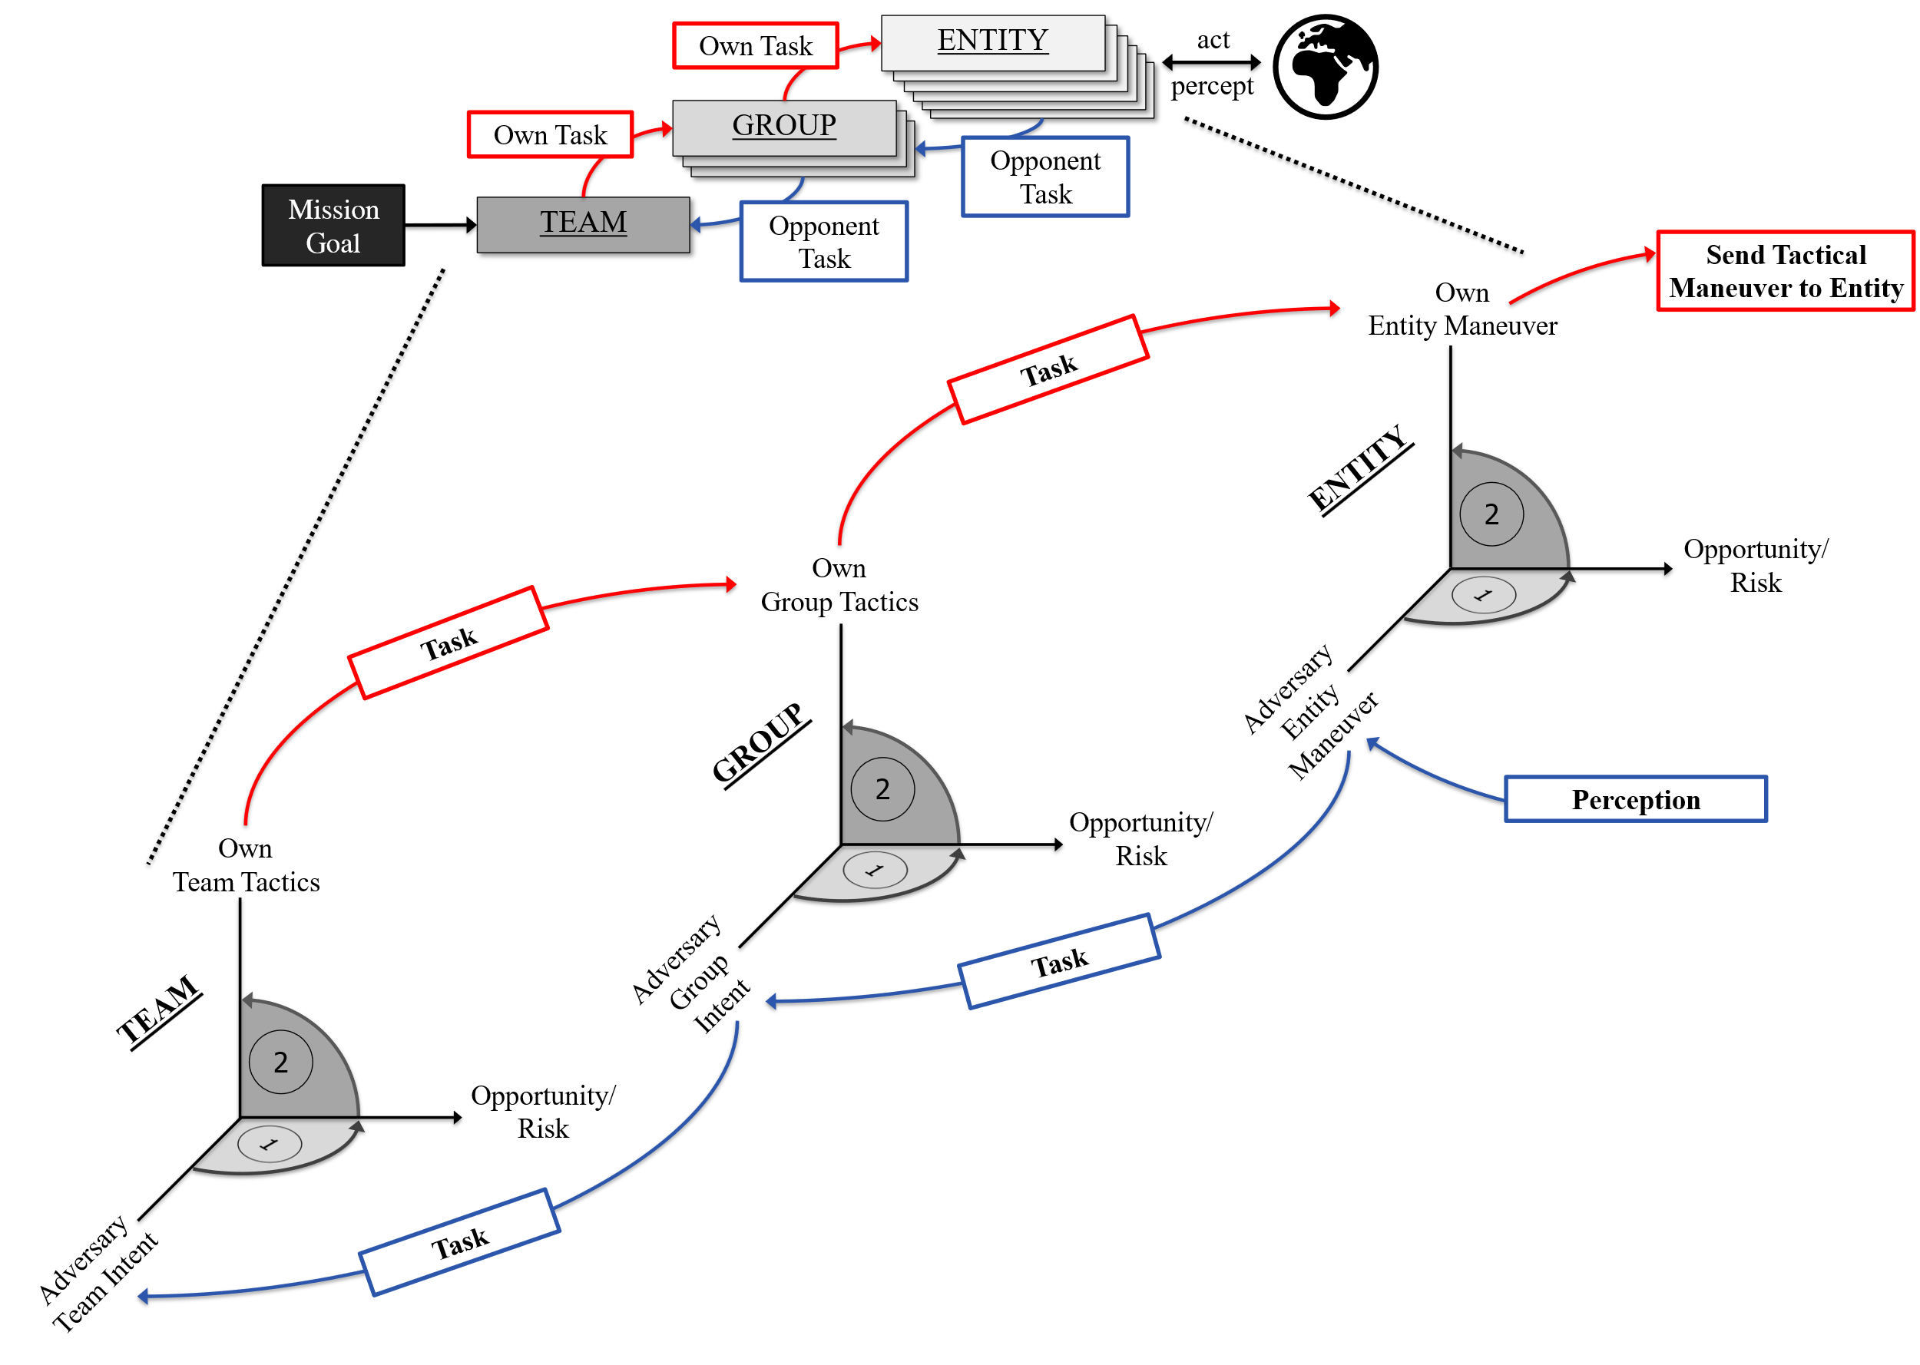
Team Behavior
Own Task
ENTITY
act
OWN Entity
OWN Entity
OWN Entity
OWN Entity
percept
OWN Entity
GROUP
Own Task
OWN GROUP
OWN GROUP
Opponent Task
Mission Goal
TEAM
Opponent Task
Send Tactical Maneuver to Entity
Own
Entity Maneuver
Task
ENTITY
2
Opportunity/Risk
Own
Group Tactics
1
Task
Adversary Entity
Maneuver
GROUP
2
Perception
Opportunity/Risk
Own
Team Tactics
1
Adversary Group Intent
Task
TEAM
2
Opportunity/Risk
1
Adversary Team Intent
Task
1
1

Slide 4
Team Behavior

Slide 5
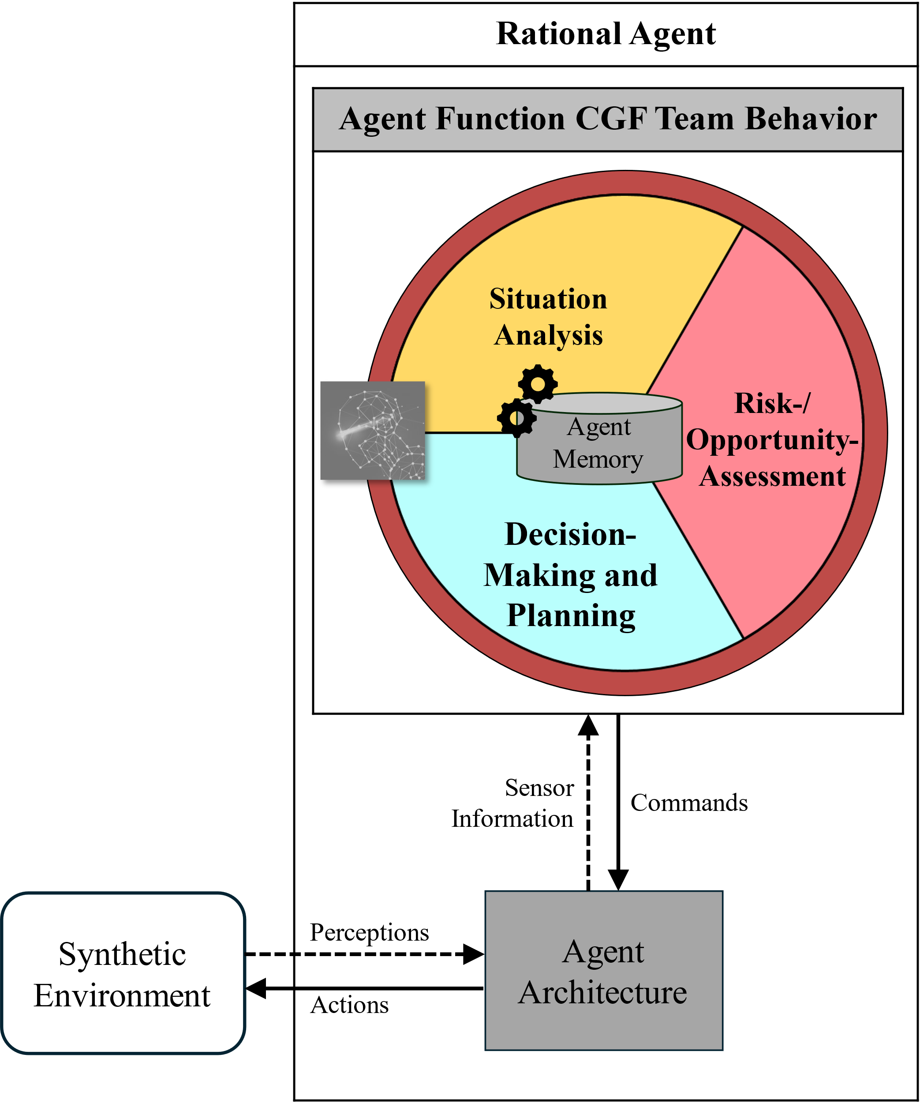
Team Behavior

Slide 6
Team Behavior

Slide 7
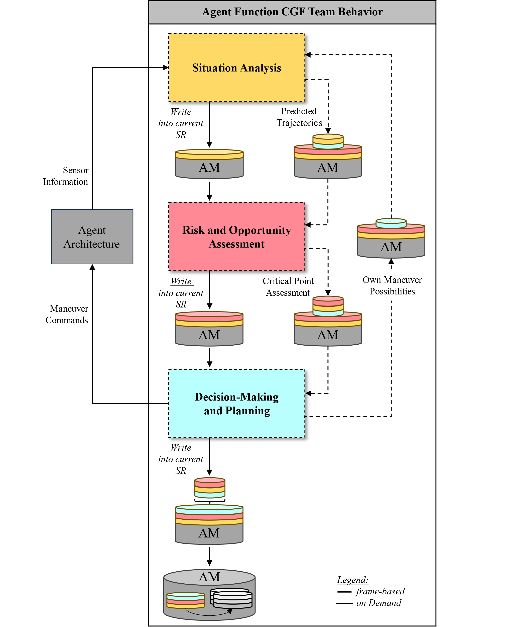
Agent Structure

Slide 8

Agent Structure
Notes:
Box & One defense
From left to right (attack): Point Guard, Shooting Guard, Center, Power Forward, Small Forward

Slide 9
Agent Structure
Notes:
Defence decided on: Box & One defense

Slide 10

Agent Structure
Notes:
CGF Team on Offence
From left to right (attack): Point Guard, Shooting Guard, Center, Power Forward, Small Forward
At the end of their run up, they found themselves in this situation with the ball with the PG
Players as a representation of AA

Slide 11
Agent Structure
Notes:
In the very beggining of the Situation (and even during the run up), the PG percieves the Situation:
He observes the position of the home team and compares it to the positions of his own team to draw conclusions on the intent (Guard/Movement)

Slide 12
Agent Structure
Notes:
In the very beggining of the Situation (and even during the run up), the PG percieves the Situation:
He observes the position of the home team and compares it to the positions of his own team to draw conclusions on the intent (Guard/Movement)

Slide 13
Agent Structure
+
+
-/+
Notes:
The Percieved Situation is then evaluated with regards to team and individual perspectives

Slide 14
Agent Structure
+
+
-/+
Notes:
At that Point, a decision on future actions can be made.
Since currently, no plan exist, a team (?) tactic has to be decided on

Slide 15
Agent Structure
3
+
+
2
1
-/+
Notes:
At that Point, a decision on future actions can be made.
Since currently, no plan exist, a tactic/maneuver has to be decided on
3 Options have been identified:
Shoot, move, pass

Slide 16
Agent Structure
2
Notes:
At that Point, a decision on future actions can be made.
Since currently, no plan exist, a tactic/maneuver has to be decided on
The identified options now have to be evaluated. To do this, the resulting situations have to be extrapolated.
Option 2 serves an example for this
Power Forward moves

Slide 17
Agent Structure
2
Notes:
At that Point, a decision on future actions can be made.
Since currently, no plan exist, a tactic/maneuver has to be decided on
The identified options now have to be evaluated. To do this, the resulting situations have to be extrapolated.
Option 2 serves an example for this
Power Forward moves

Slide 18
Agent Structure
Notes:
Assuming the Identified intent of the home team stays the same, their trajectory can be extrapolated in relation to the movement of our movement (Guard Power FW)

Slide 19
Agent Structure
Notes:
Giving space to our PG to go for the basket. (Such a coordinated tactic would previously have to be defined within the AM)

Slide 20
Agent Structure
Notes:
However, the Risks and Opportunities of the trajectory have to be evaluated
a critical Point has been identified. ->
PG enters the Area of a defender
The results of the evaluation consider the risk here to outweigh the opportunity and mark this point for DMP as a point in time where replanning will be necessary.
This process allows us to continue expanding the evaluation with another set of maneuver Possibilities (assuming Computing Power is irrelevant)

Slide 21
Agent Structure
3
2
1
Notes:
Based on the evaluation and CPA of the 3 possibilities, a decision is made for one

Slide 22
Agent Structure
1
Notes:
Based on the evaluation and CPA of the 3 possibilities, a decision is made for one
The critical Aspect of the Function is controlling the Amount/Timing of replanning triggers
Tactics do not provide value if they are not exected fully

Slide 23





Agent Structure
Entity Task:
Act to enable Tactics B
Own
Entity Maneuver
Own
Entity Maneuver
ENTITY
2
Opportunity/Risk
1
Adversary
Entity Maneuver
Adversary Entity Maneuver
Notes:
To Bridge this gap, we consider quantified state spaces to provide a good approach.

Slide 24
Agent Structure
Entity Task:
Act to enable Tactics B
Own
Entity Maneuver
Own
Entity Maneuver
ENTITY
Maneuver X
2
Opportunity/Risk
Maneuver Y
1
Adversary
Entity Maneuver
Recognizing Group Intent
Adversary Entity Maneuver
Perception
Notes:
To Bridge this gap, we consider quantified state spaces to provide a good approach.

Slide 25
Agent Structure
Entity Task:
Act to enable Tactics B
Own
Entity Maneuver
Own
Entity Maneuver
ENTITY
Min. Opportunities
Max.
Risk
Maneuver X
2
Opportunity/Risk
Maneuver Y
1
Adversary
Entity Maneuver
Recognizing Group Intent
Adversary Entity Maneuver
Perception
Notes:
To Bridge this gap, we consider quantified state spaces to provide a good approach.

Slide 26
Agent Structure
Entity Task:
Act to enable Tactics B
Send Tactical Maneuver to Aircraft
Own
Entity Maneuver
Own
Entity Maneuver
ENTITY
Maneuver I
Entity
Solution
Space
Maneuver J
Min. Opportunities
Max.
Risk
Maneuver X
2
Opportunity/Risk
Maneuver Y
1
Adversary
Entity Maneuver
Recognizing Group Intent
Adversary Entity Maneuver
Perception
Notes:
To Bridge this gap, we consider quantified state spaces to provide a good approach.

Slide 27
Agent Structure
Group Task:
Act to enable Tactics B
Entity Task:
Act to enable Tactics B Vers. X
Own
Group Tactics
GROUP
Tactics B
Version Y
Own
Group Tactics
Adversary
Group Intent
Tactics B
Version X
Min. Opportunities
Max.
Risk
2
Sub-Tactics D
Opportunity/Risk
Sub-Tactics C
1
Group
Solution
Space
Recognizing Team Intent
Adversary Group Intent
Adversary Entity Maneuvers
Notes:
To Bridge this gap, we consider quantified state spaces to provide a good approach.

Slide 28
Agent Structure
Group Task:
Act to enable Tactics B
Mission Goal
Own
Team Tactics
TEAM
Tactics B
Own
Team Tactics
Adversary
Team Intent
Team
Solution
Space
ATO
Mission Risk Level
Tactics A
Min. Opportunities
Max.
Risk
2
Tactics A
Opportunity/Risk
Tactics B
1
Adversary Team Intent
Adversary Group Intent
Notes:
To Bridge this gap, we consider quantified state spaces to provide a good approach.

Slide 29

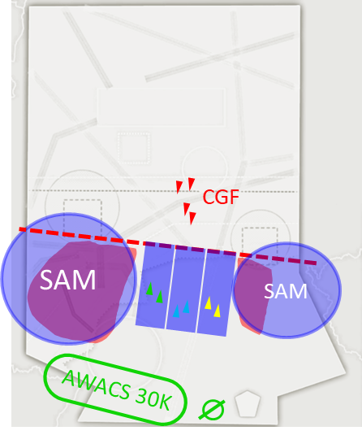
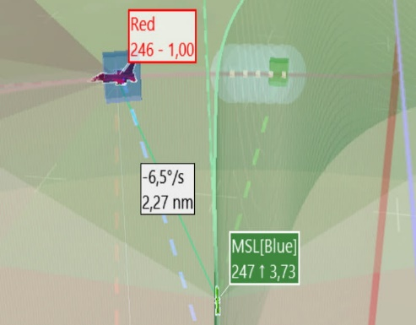


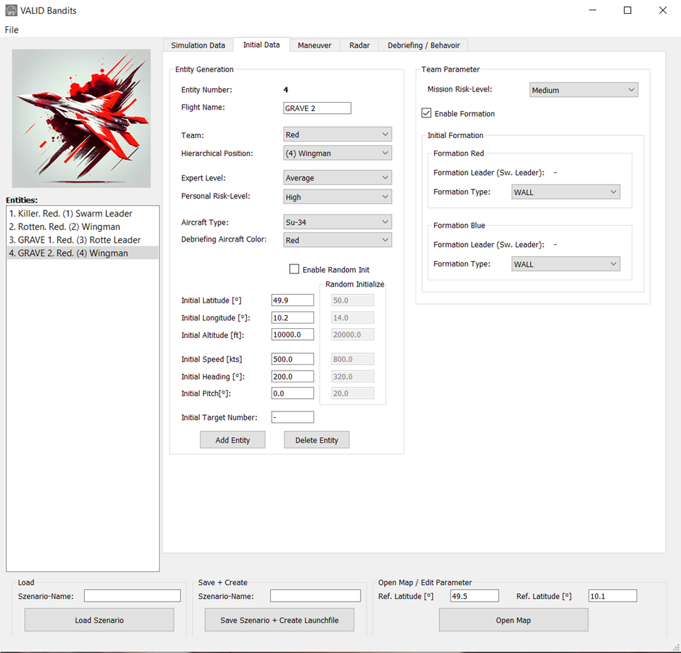

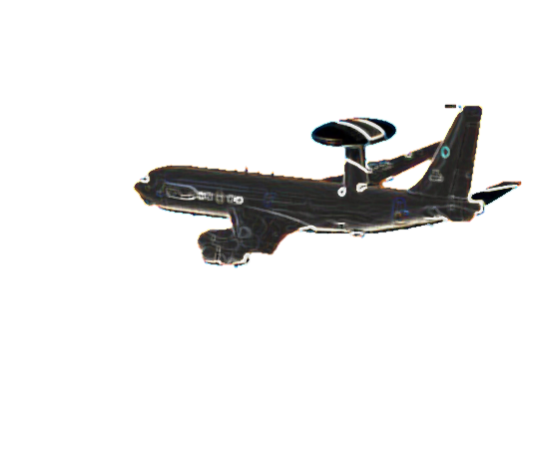
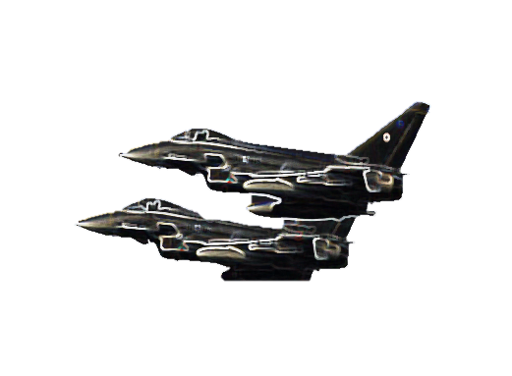
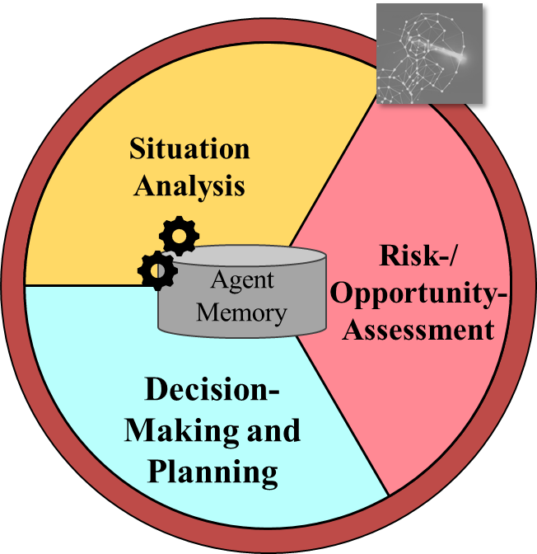
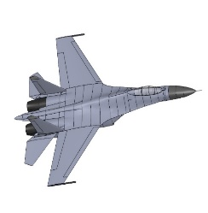

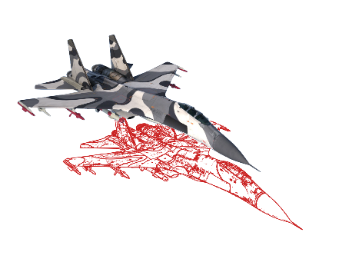
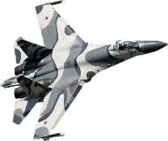
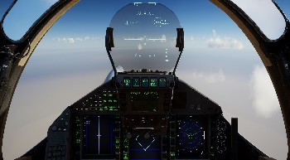
Results and Future Work
Threat-
Initialization
Debriefing
C&C - AWACS
Explainable Behavior!
Airspace Structure ACO
Mission Task ATO
DIS
Tactical Datalink (Link16)
Red Forces - Simulation Frame
VR-Simulators (Pilots)
CGF-Control
CGF-Dynamic & Data
CGF-Dynamic & Data
V&V
CGF-Dynamic & Data
DIS
Behavior Model
CGF-Dynamic
& Data
Autopilot
Autopilot
Autopilot
Autopilot
V&V
Notes:
GIF of running animation TODO
Included Logo to show that we already have an operating CGF system at the Uni
Currently running on BTs, but working on replacing with described concept

Slide 30
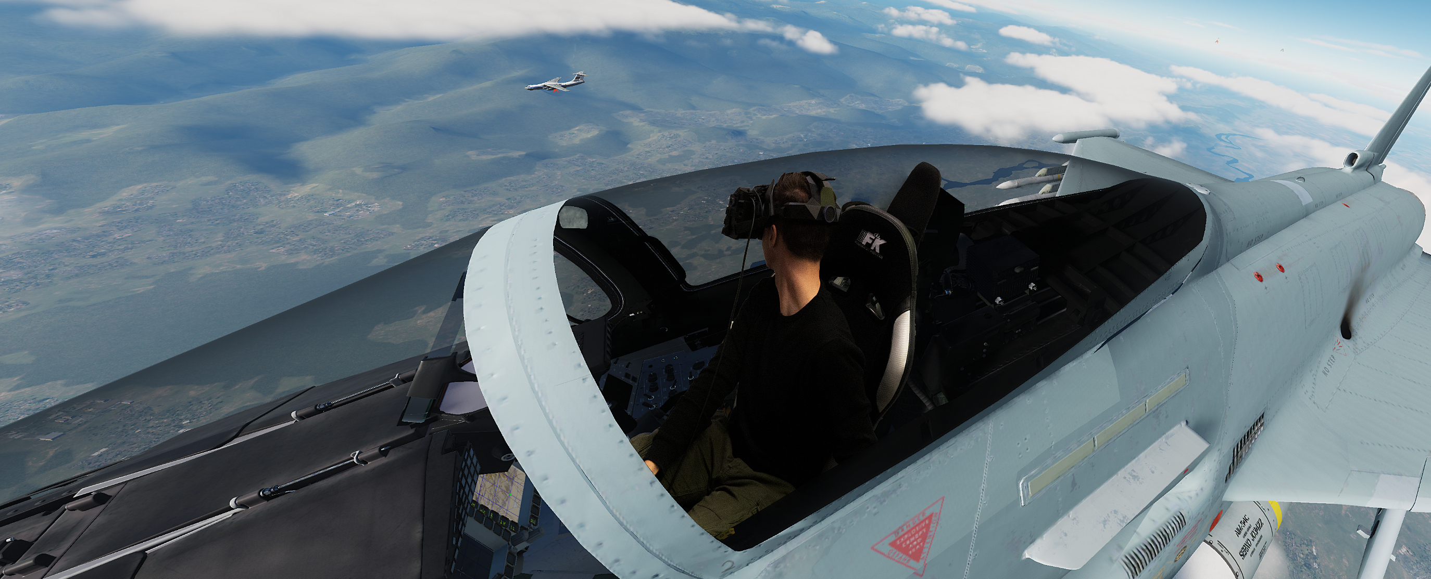
Philippe Ruther UniBwM
Philippe.Ruther@unibw.de
Professur für Luftfahrttechnik — IFS (unibw.de)
Fabian Reinisch UniBwM
fabian.reinisch@unibw.de
Professur für Luftfahrttechnik — IFS (unibw.de)
Luca Winkler UniBwM
luca.winkler@unibw.de
Professur für Luftfahrttechnik — IFS (unibw.de)
Questions?
Michael Strohal UniBwM
michael.strohal@unibw.de
Professur für Luftfahrttechnik — IFS (unibw.de)
Peter Stütz UniBwM
peter.stuetz@unibw.de
Professur für Luftfahrttechnik — IFS (unibw.de)

