Slide 1
Converting One World Terrain Geospatial Content to CDB
Presenter: Jordan Dauble, SimBlocks.io
Co-Author: William Aycock, Joint Staff J7
Co-Author: Thomas Kozma, Maxar Technologies

Slide 2
Introduction
Overview
Purpose
Geospatial Standards
CDB (formerly Common Database)
3D Tiles
Well-Formed Format (WFF)
Conclusion
Q&A

Slide 3
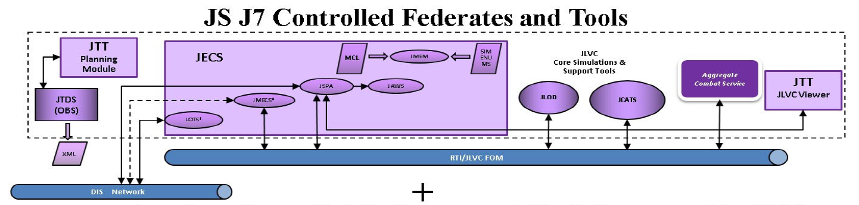
WFF to CDB Purpose
Develop a standalone tool to convert the content of a Synthetic Training Environment (STE) One World Terrain (OWT) 3D Terrain Pack in the Well-Formed Format (WFF) to Open Geospatial Consortium (OGC) Common Database (CDB).
WFF will be version 1.6
CDB will be version 1.2
Generated CDB terrains will be imported into existing Joint Live-Virtual-Constructive simulation applications and tools.

Slide 4
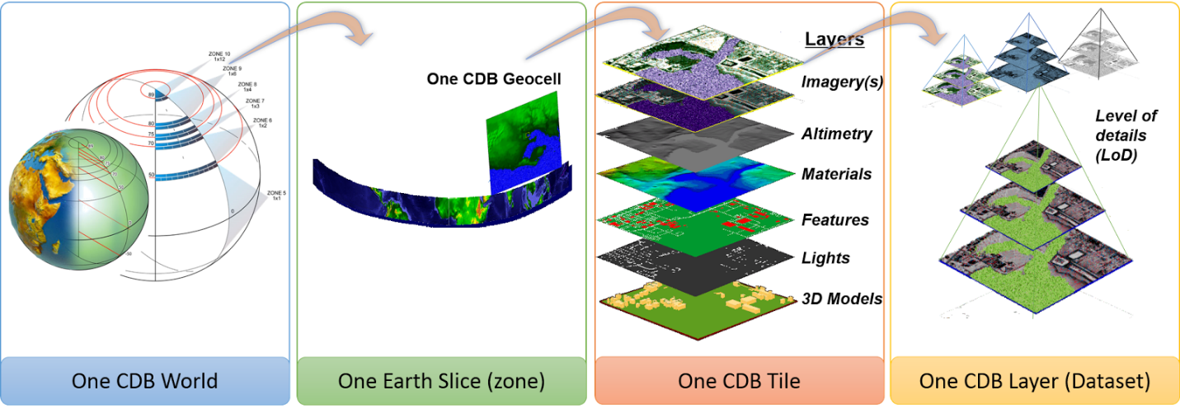
CDB
Figure 2. CDB data organization structure
Volume 11: OGC CDB Core Standard Conceptual Model

Slide 5
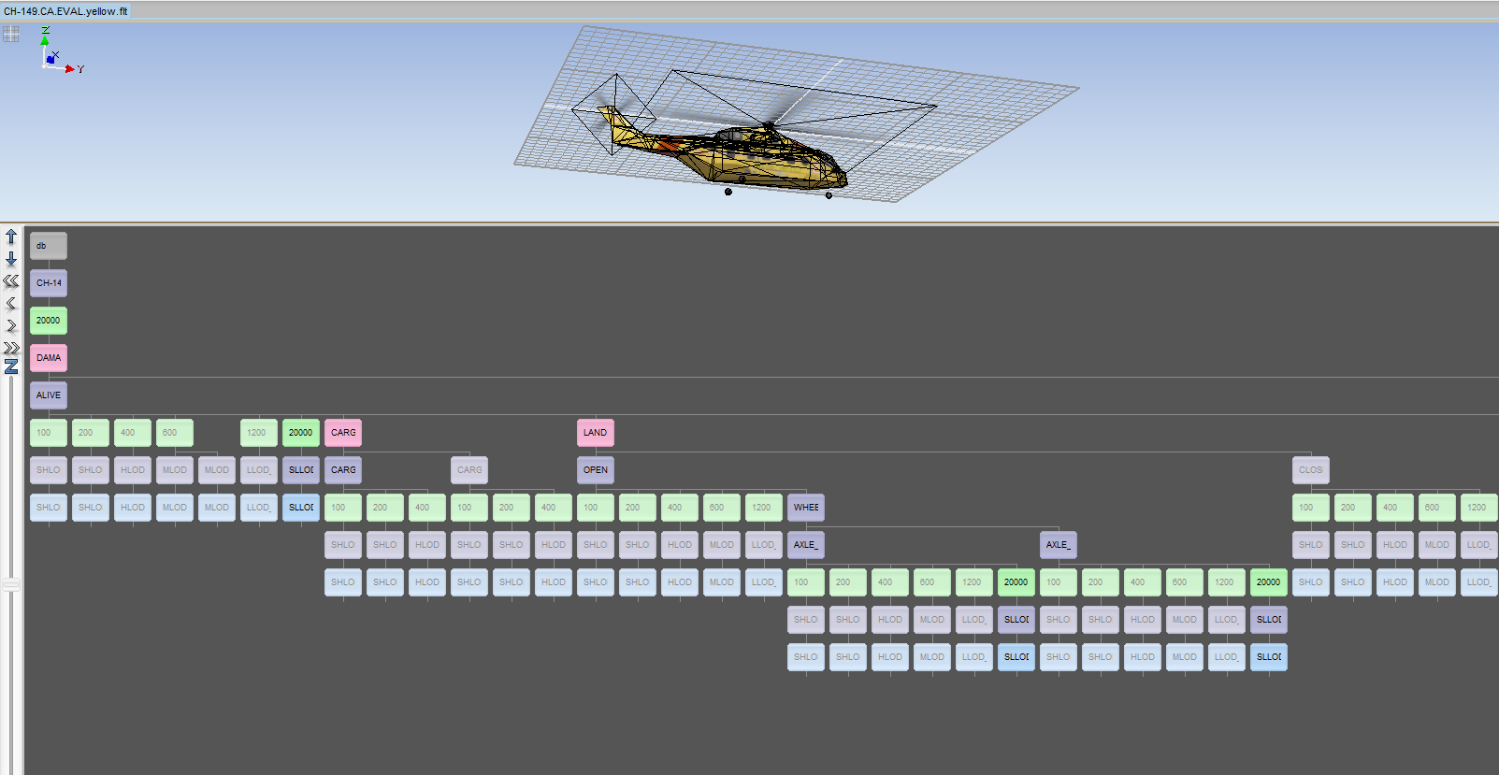





OpenFlight
OpenFlight model in Remograph Remo3D

Slide 6

GeoPackage
"An Open Format for Geospatial Information
GeoPackage is an open, standards-based, platform-independent, portable, self-describing, compact format for transferring geospatial information."
https://www.geopackage.org/
Used to store vector layers in CDB
Optional alternative to ShapeFiles

Slide 7
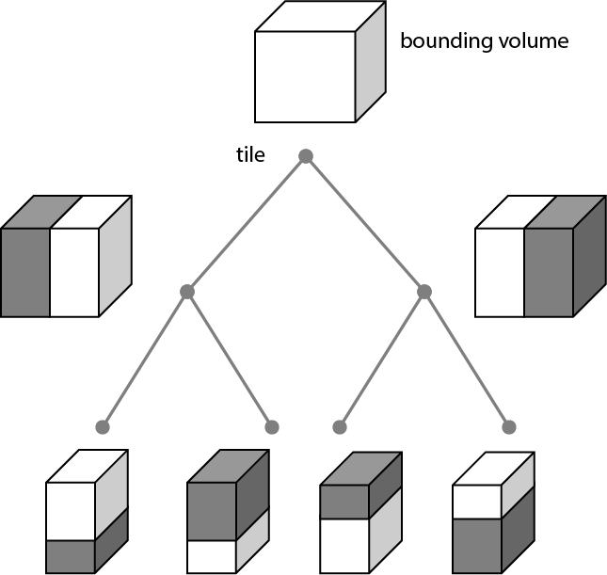
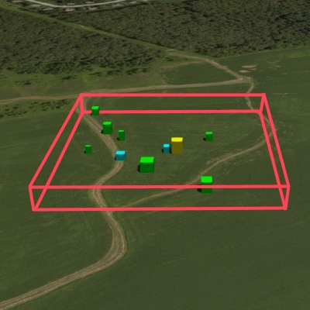
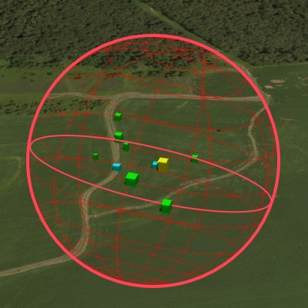
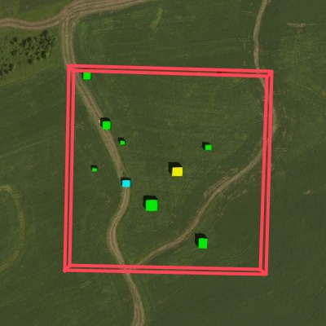
3D Tiles
Stores geospatial data in flexible tiles
Good for streaming
Models stored as glTF files
Figure 1 — A tree of tiles
3D Tiles Specification, 22-025r4
Table 4 — Different bounding volume types for a tile

Slide 8
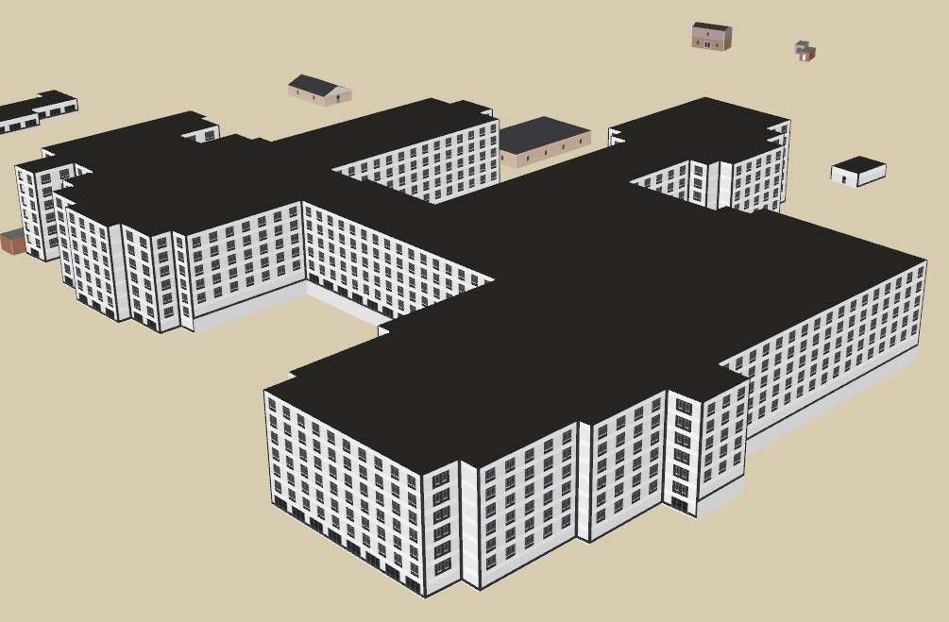
glTF
glTF is a file format for storing model data.
glTF is the primary model format used in 3D Tiles.
glTF stores data in a compressed binary format.
Geometry nodes store mesh data.
Light nodes describe light sources.

Slide 9
3D Tiles vs CDB
Category | 3D Tiles | CDB
Standardization | Open Geospatial Consortium | Open Geospatial Consortium
Optimizations | Streaming and rendering 3D geospatial content | Storing and versioning 3D content using common formats
Tools | Cesium | Various simulation vendors
Data Structure | Tiles, Hierarchical Level of Detail | Rigid Tiles, Layers, LODs
Adoption | Rapid adoption across segments | Military simulation & aviation
3D Models | glTF, Batched 3D Models (b3dm) | OpenFlight
Imagery | Polygon Mesh | JPEG2000
Elevation | Polygon Mesh | GeoTIFF
Bathymetry | Polygon Mesh | GeoTIFF
Raster Materials | Polygon Mesh | GeoTIFF

Slide 10
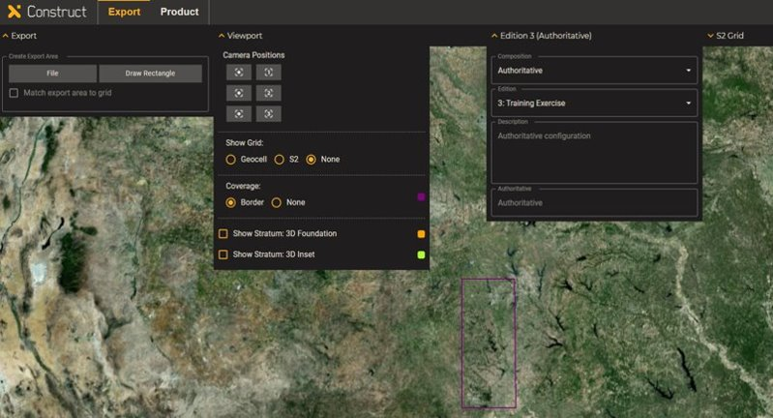
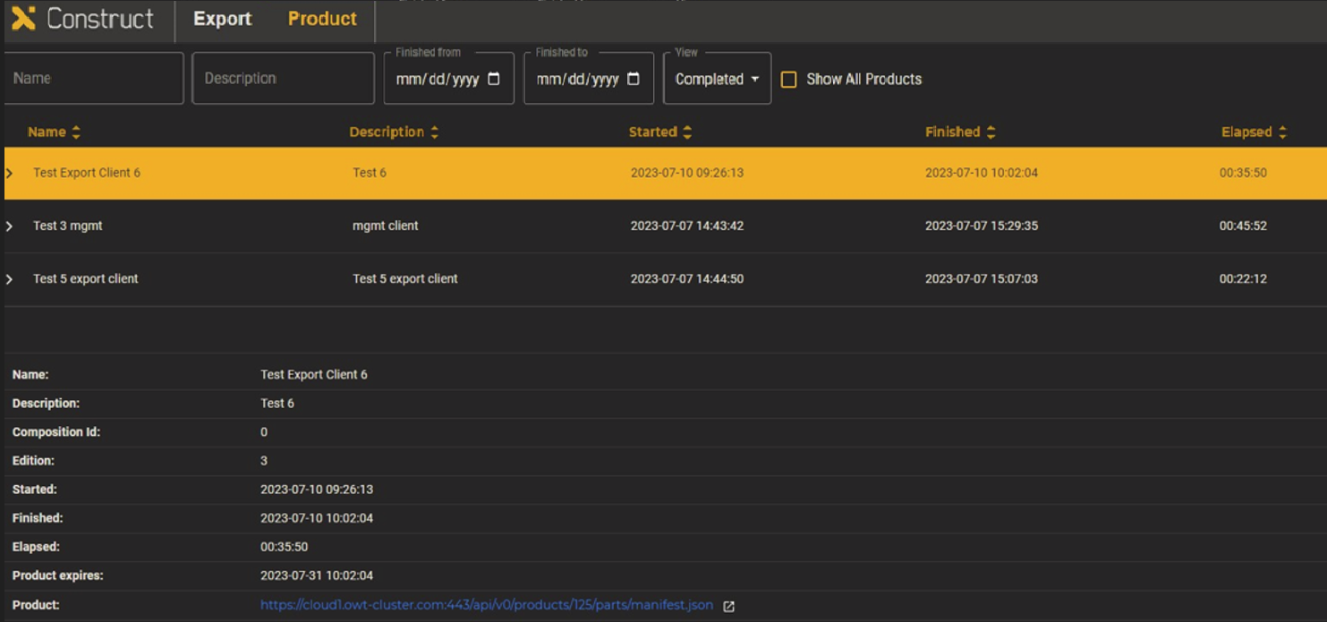
One World Terrain
3D geospatial database of the entire globe.
Provides realistic and highly detailed terrain data.
WGS-84 compatible synthetic representation of the Earth.
Simulation clients retrieve terrain packs for specific areas of interest.
Terrain data can be used to enhance training and mission planning.
Extends the OGC 3D Tiles specification.

Slide 11
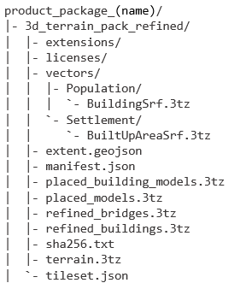
WFF Terrain Pack
Terrain Packs are made up of WFF Tiles
The data in a WFF Tile is split into data layers.
Data layers may include:
Digital Terrain Model (DTM)
Models for the terrain (hills, mountains, etc.)
Digital Surface Model (DSM)
Models for buildings, bridges, etc.
Network Layers, Vector Data

Slide 12
WFF 3tz Container
3tz zip archives are used to store asset files
3tz files are organized using S2 implicit tiling
This is stored as a node tree of JSON files
There are several types of asset files:
JSON Metadata
glTF Terrain
glTF Models
GeoJSON Features
JSON
Level 0
JSON
JSON
Level 1
JSON
JSON
Level 2
…
JSON
glTF
glTF
glTF
Level 12

Slide 13
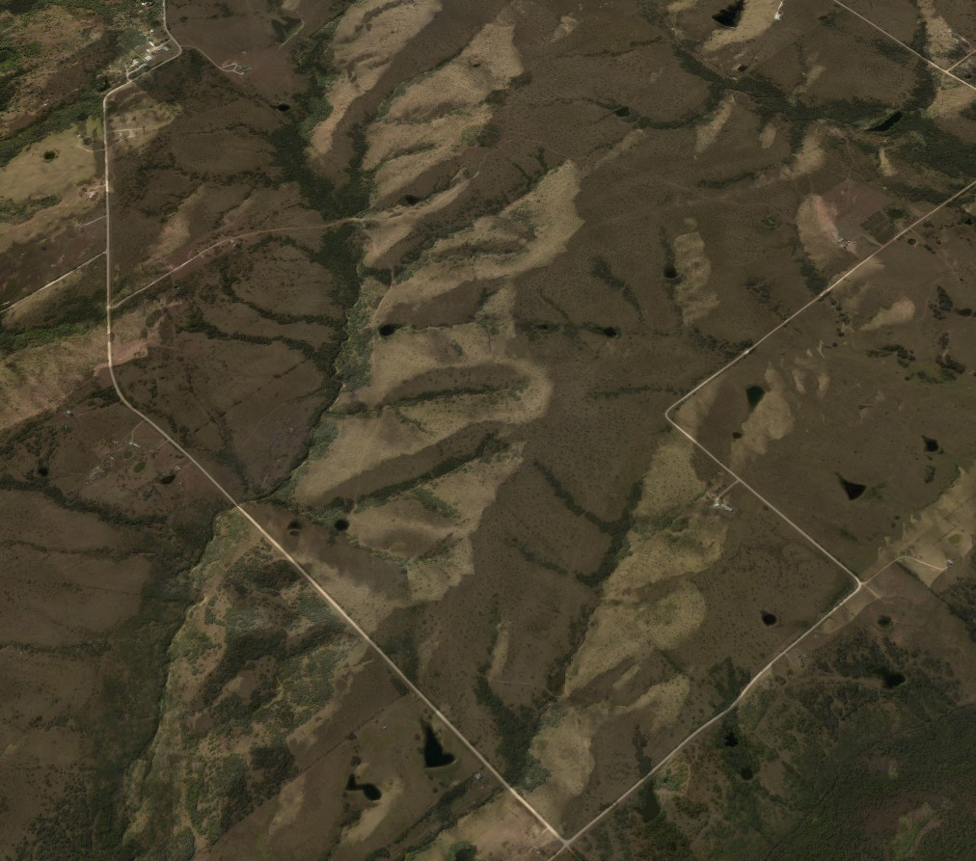
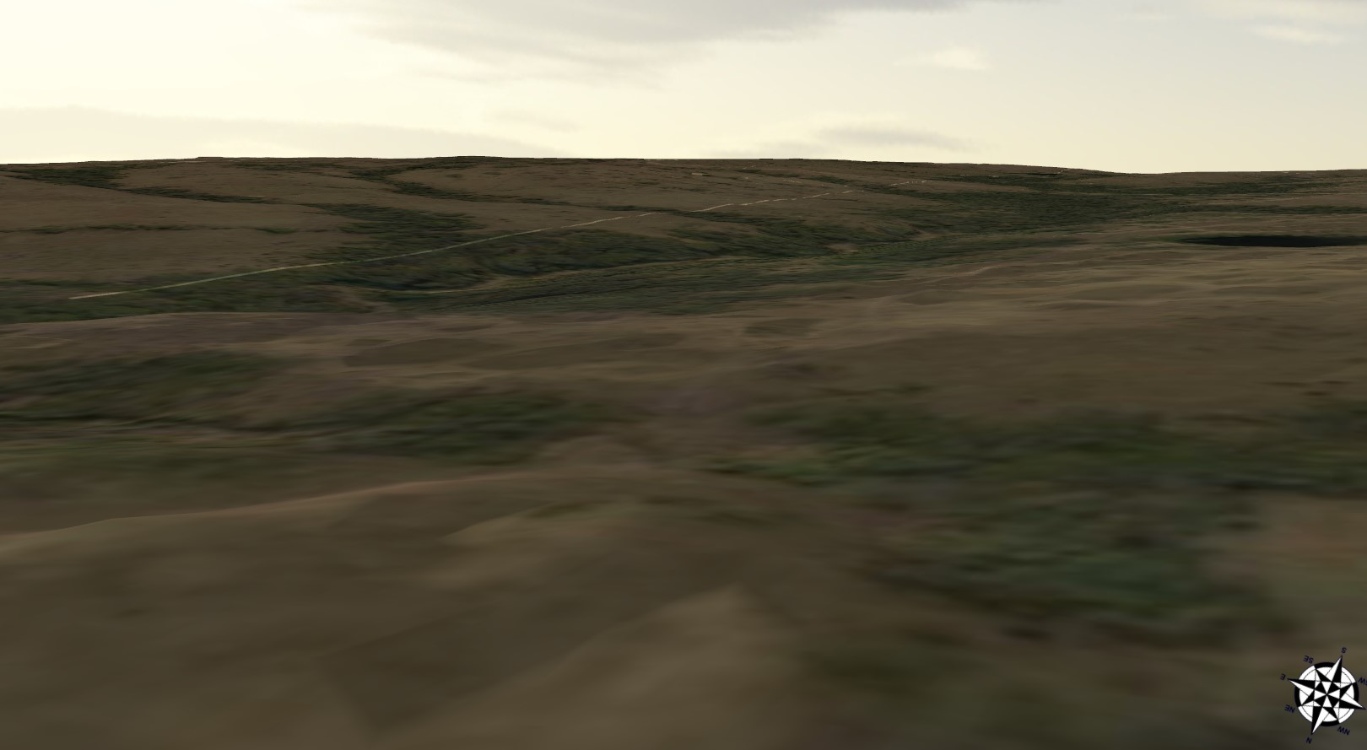
WFF Terrain
The terrain data is stored in terrain.3tz files
WFF Terrain is a 3D Polygon Mesh, split up into thousands of glTF models
Higher Levels of Detail are made up of smaller, more detailed models

Slide 14
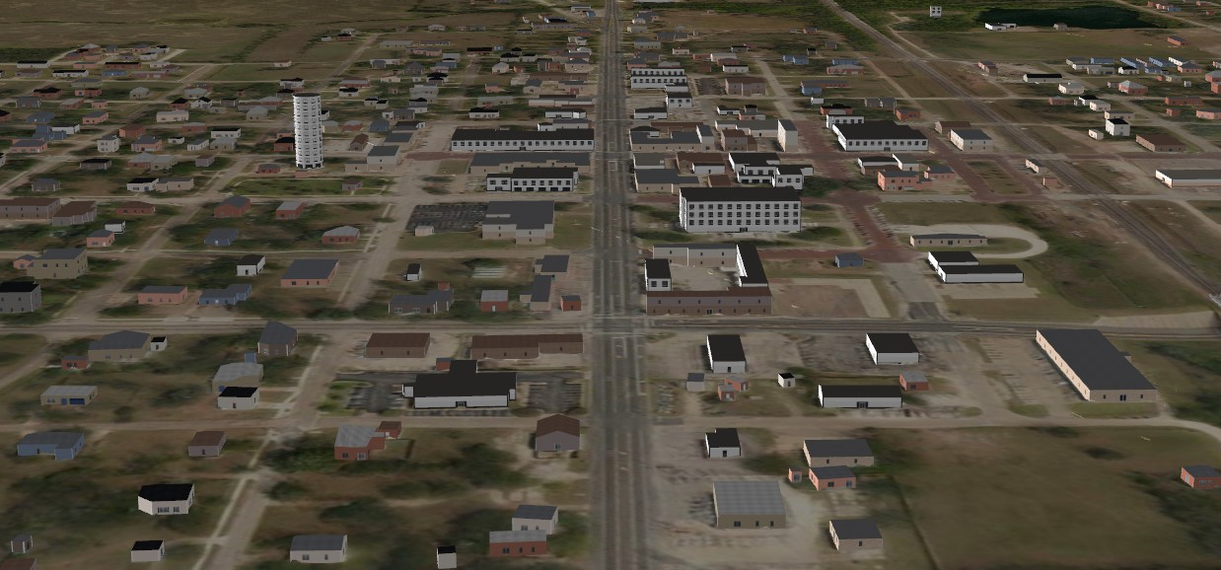
WFF 3D Models
WFF Models are geometry that is not part of the terrain
There are different types of models (buildings, bridges, trees, etc.)
Models can have Levels of Detail

Slide 15
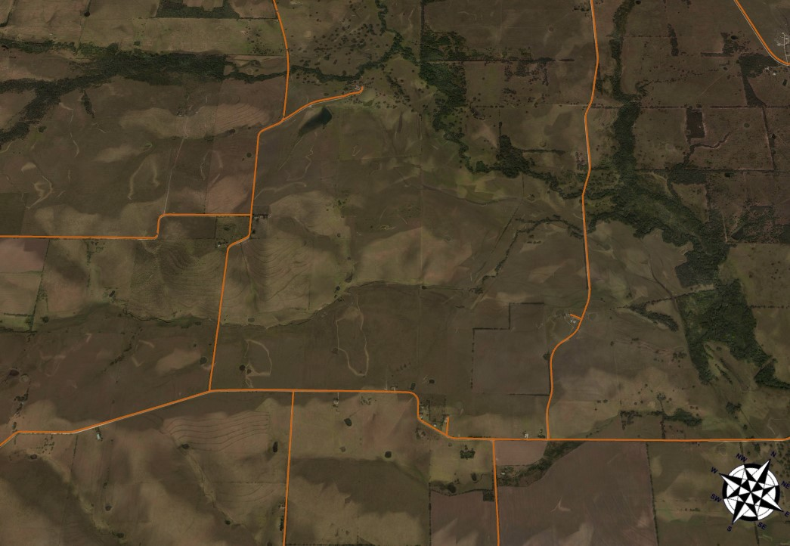
WFF Features
WFF Features are stored in GeoJSON files.
They can be made up of 3 types of vectors:
Points (street lights, trees, etc.)
Lines (roads, rivers, power lines, etc.)
Surfaces / Areas (zoning, parks, etc.)
Other info is stored as JSON metadata
Names, IDs, feature codes, etc.

Slide 16
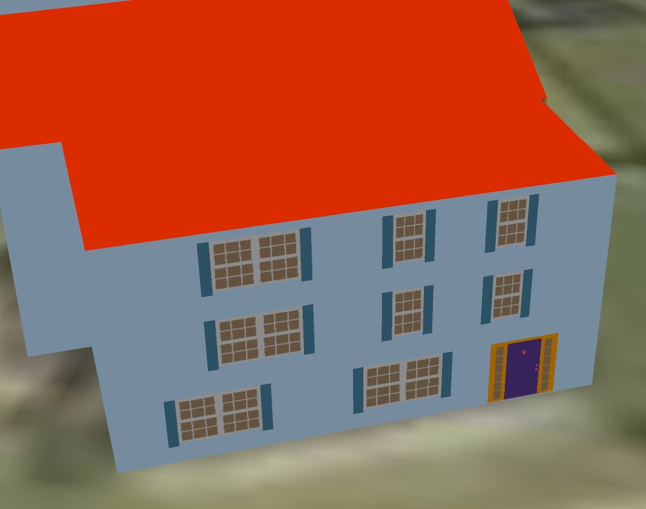
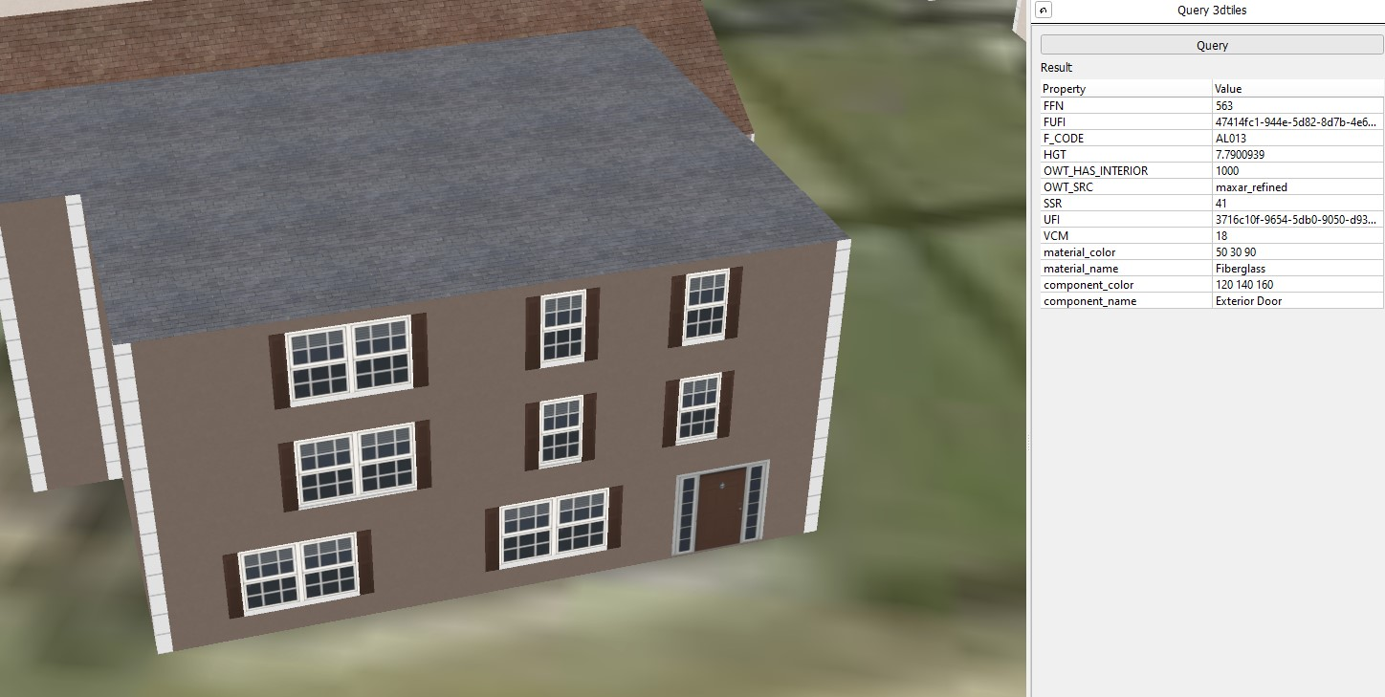
Material Codes
WFF data viewed using Precision 3D Explorer

Slide 17
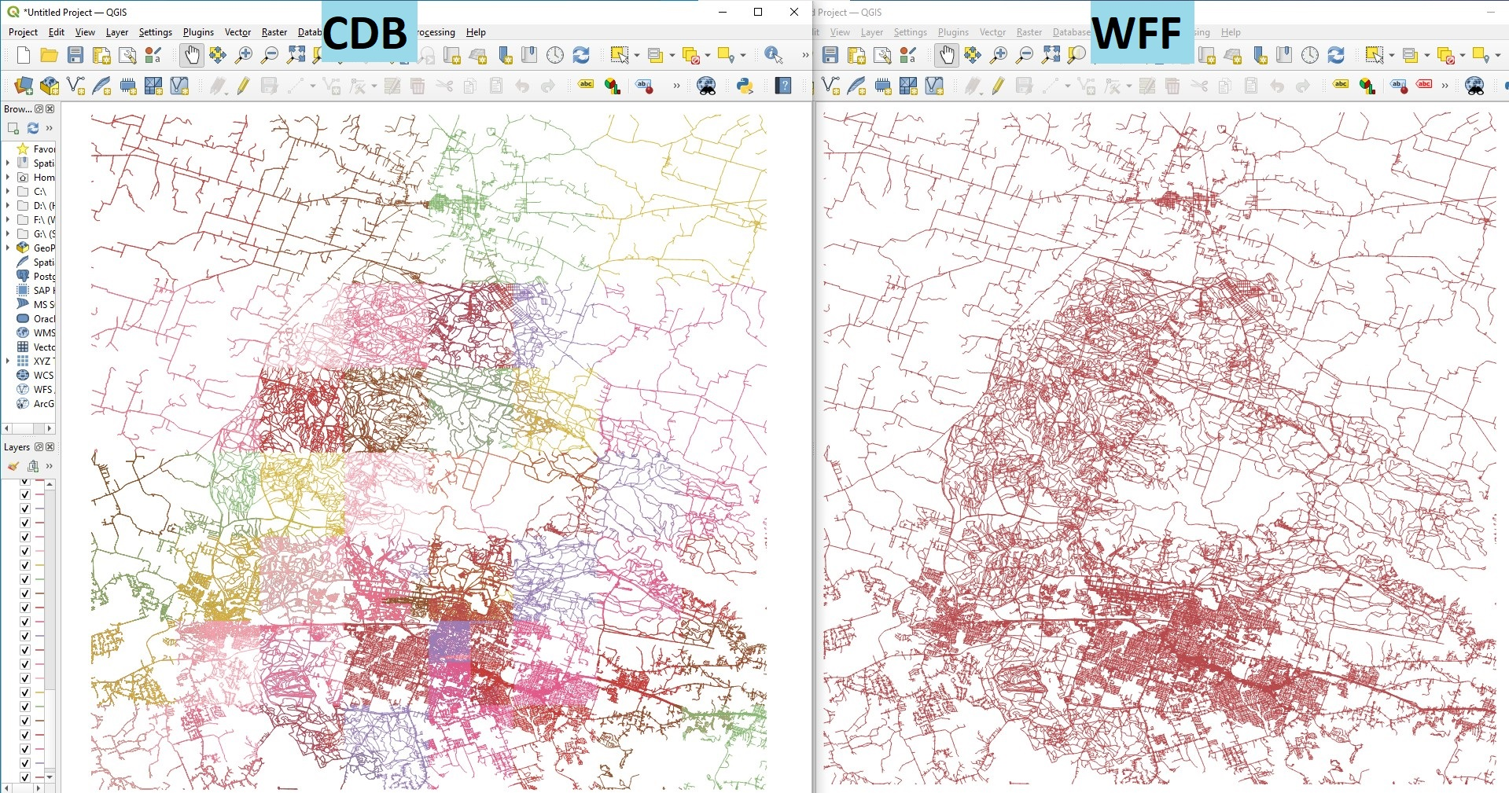
Roads

Slide 18
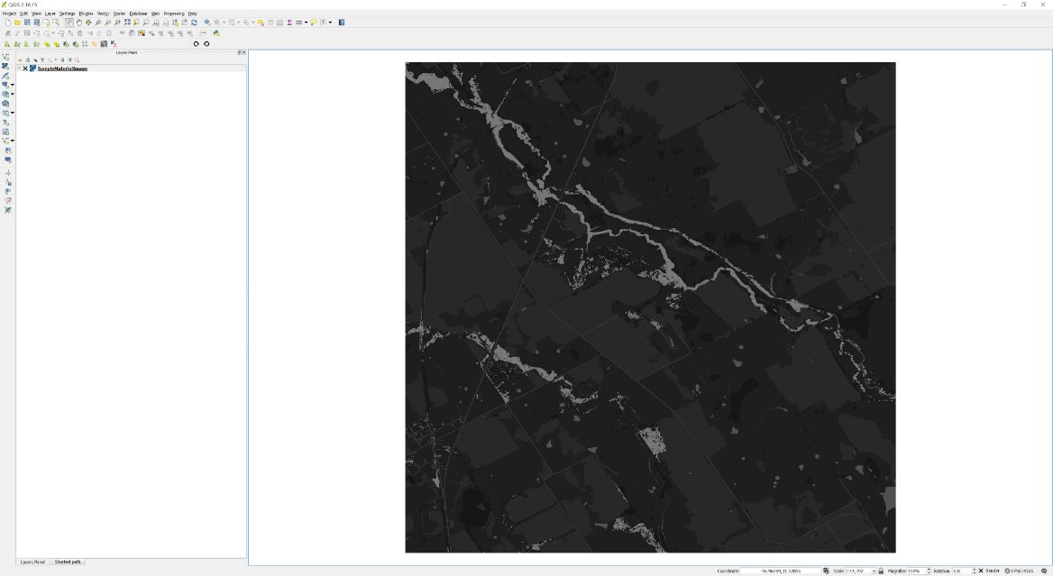
Raster Materials

Slide 19
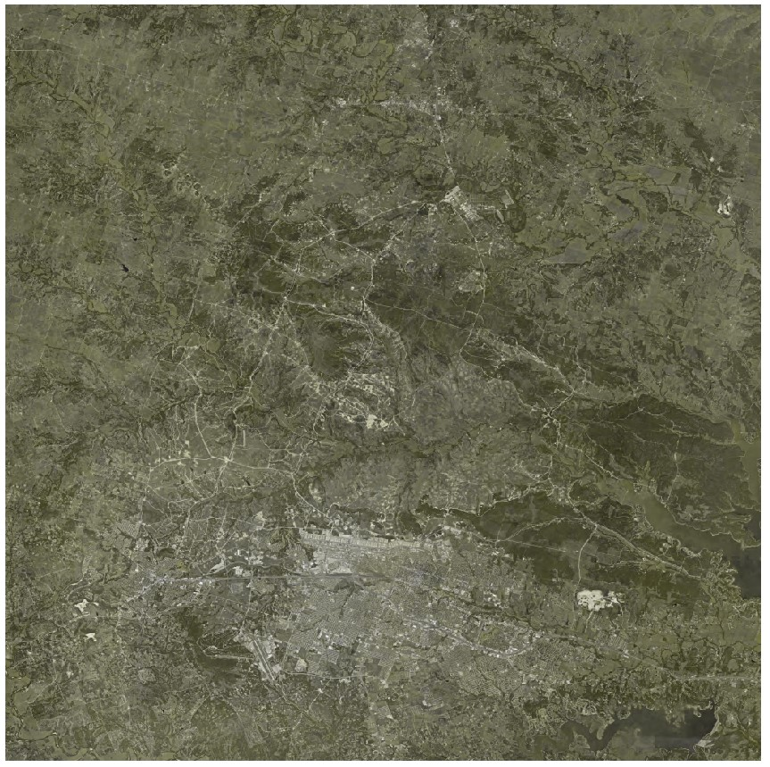
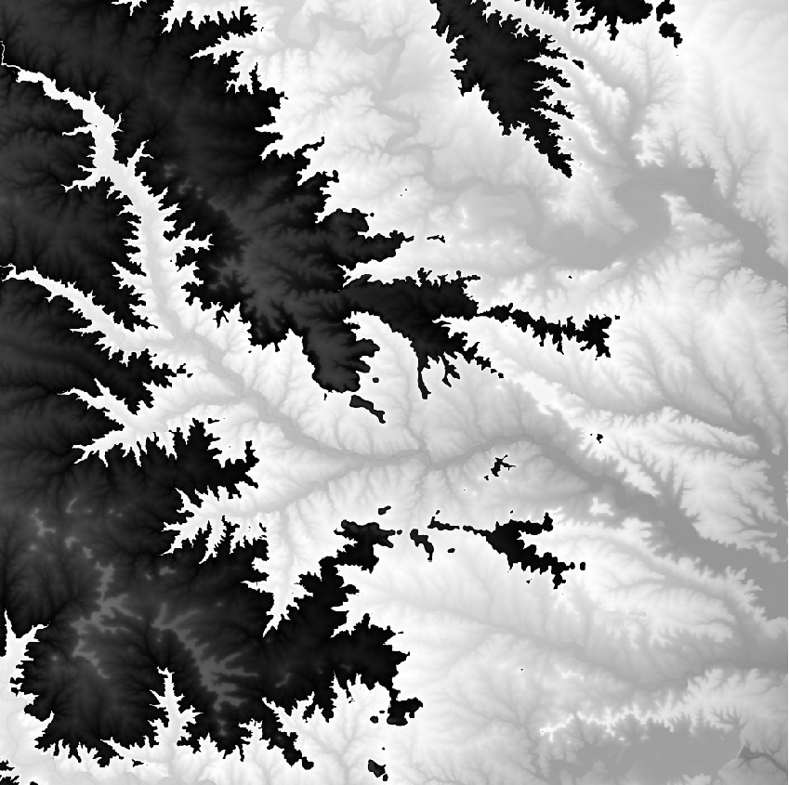
Imagery and Elevation

Slide 20
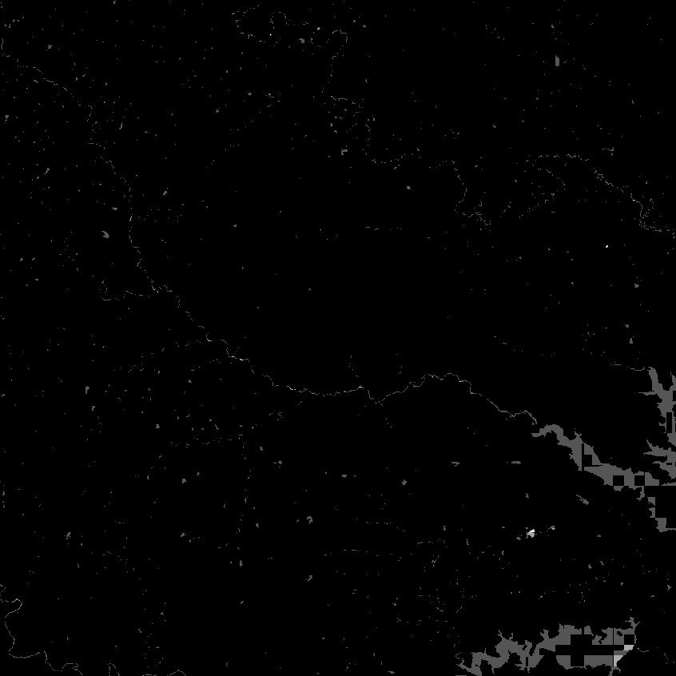
Imagery and Bathymetry

Slide 21
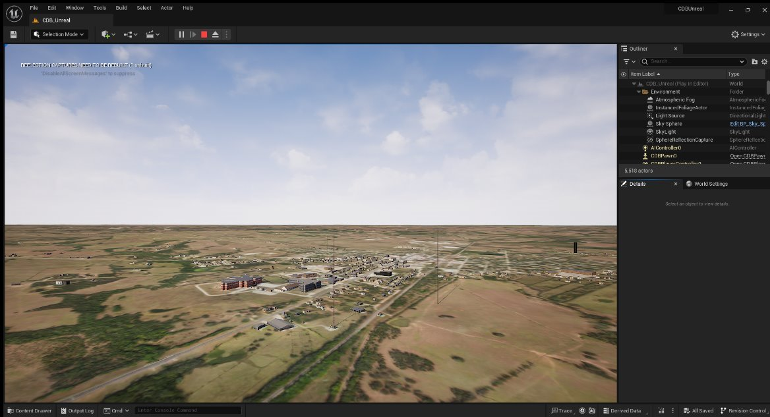
CDB in Unreal

