Slide 1
Supplementing Instructor-Led Training with AI: Developing a Virtual SME
Nelson Hurst, Integration Innovation Inc. (i3)
John Thornton, Integration Innovation Inc. (i3)
Notes:
Welcome, everyone. Today, we'll be discussing our research on supplementing instructor-led training with AI, specifically focusing on the development of a virtual Subject Matter Expert. I’m Nelson Hurst from i3, here with John Thornton and I'm excited to share our findings with you.

Slide 2


Speakers
Nelson Hurst
John Thornton
Senior Principal Software Engineer at i3
Experience in software engineering, developing IMI courseware solutions, web-based and desktop applications.
Over 25 years of professional experience in the Industry.
Department Manager at i3
Experience in software engineering, web, mobile & XR application development.
B.Eng. in Software Engineering from Auburn University
Notes:
Small Introduction about who we are.

Slide 3

Introduction
Background:
  Interactive Multimedia Instruction (IMI) improves learner outcomes
  Instructor-led IMI provides valuable feedback and guidance
Challenges:
  Finite instructor time
  The retirement of experienced instructors.
  Limited scalability of human-led instruction
Need for innovative solutions to maintain training quality and reach
Notes:
Interactive Multimedia Instruction, or IMI, has revolutionized training by improving learner outcomes through increased interactivity and immersion. Instructor-led IMI, where human experts guide students through digital courses, has been particularly effective. However, we're facing significant challenges. Instructor time is limited, and we're seeing qualified instructors retiring of training programs. This limits our ability to scale up training and reach more students. It's clear that we need innovative solutions to maintain the quality of our training while expanding its reach.

Slide 4
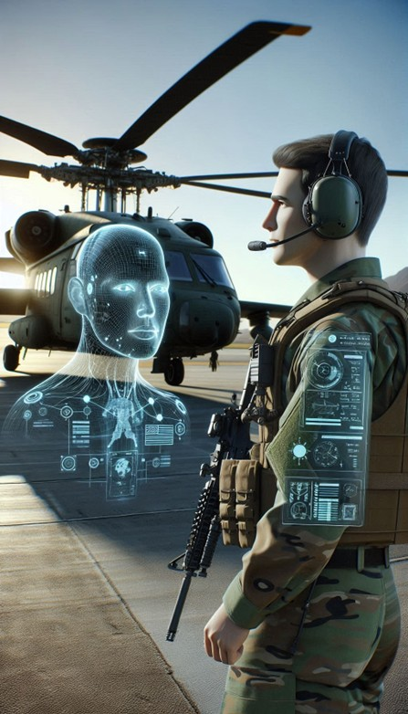
Proposed Solution
AI-driven virtual Subject Matter Expert (SME)
  Augments human instructors
  Available 24/7 for self-paced learning
Leverages cutting-edge AI technologies:
  Large Language Models (LLMs)
  Speech recognition and synthesis
  3D avatars for immersive experience
Goals: Enhance training accessibility and effectiveness
Notes:
To address these challenges, we've developed an AI-driven virtual Subject Matter Expert, or SME. This virtual SME is designed to augment human instructors, not replace them. It's available 24/7 for self-paced learning, leveraging cutting-edge AI technologies such as large language models, speech recognition, and 3D avatars. Our goal is to enhance training accessibility and effectiveness, allowing us to train more students without compromising on quality.

Slide 5
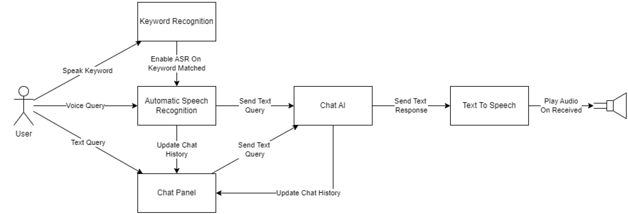
System Architecture
Notes:
Our system architecture is built on two main components. The frontend uses the Unity Engine, which provides 3D rendering for immersive environments and handles user interactions. The backend utilizes a large language model for natural language processing, which we've deployed locally for data privacy and reduced latency. We've integrated speech recognition for user input and text-to-speech for SME responses, allowing for natural, context-aware interactions within the 3D environment.

Slide 6

Key Components
Keyword Recognition:
  Unity's built-in implementation
  Triggers speech recording
Automatic Speech Recognition:
  Whisper Large v3 model
  Converts user speech to text
Text-to-Speech Synthesis:
  Tortoise model for natural-sounding output
4. Local LLM Deployment:
  llama.cpp library for efficient inference
Retrieval-Augmented Generation (RAG):
  Enhances responses with specific domain knowledge
Notes:
Let's break down the key components of our system. We use Unity's built-in keyword recognition to trigger speech recording. For speech recognition, we've implemented the Whisper Large v3 model to convert user speech to text. Our text-to-speech synthesis uses the Tortoise model for natural-sounding output. The large language model is deployed locally using the llama.cpp library for efficient inference. Finally, we use Retrieval-Augmented Generation, or RAG, to enhance responses with specific domain knowledge.

Slide 7
Technical Approach
Unity application:
  Handles user interactions (text/voice)
  Renders 3D avatar and environment
Web requests to LLM interface:
  Sends user queries and context
  Receives generated responses
RAG server:
  Retrieves relevant information from knowledge base
3D avatar interactions:
  Responds to LLM commands
  Points to or highlights relevant 3D components
Notes:
Our technical approach centers around the Unity application, which handles user interactions and renders the 3D avatar and environment. When a user interacts with the system, either through text or voice, the application sends web requests to the LLM interface. These requests include the user's query and relevant context. The LLM, enhanced by our RAG server, generates appropriate responses. These responses can include commands for the 3D avatar, allowing it to point to or highlight relevant components in the virtual environment.

Slide 8

LLM Evaluation
Benchmarking process:
  Custom Knowledge and Skills Assessment (KSA) tests
  25 questions testing reasoning and problem-solving
Evaluation metrics:
  Logic, Math A, Math B, Instruction following
  Reflection capability
Results:
  Mixtral-8x7B-Instruct-v0.1 performed best overall
  Significant performance drop when all questions asked simultaneously
Notes:
To ensure the effectiveness of our virtual SME, we conducted rigorous evaluations of various large language models. We developed custom Knowledge and Skills Assessment tests, consisting of 25 questions that test reasoning and problem-solving abilities. We evaluated the models on metrics including logic, basic and advanced math, instruction following, and reflection capability. The Mixtral-8x7B-Instruct-v0.1 model performed best overall in our tests. Interestingly, we observed a significant performance drop when all questions were asked simultaneously, highlighting the importance of context management in these models.

Slide 9
LLM Evaluation Results
Large Language Models Details |  |  |  | Test 1 |  |  |  |  |  | Test 2
Context | TPS | Params | Name | Logic | Math A | Math B | Instruct | Reflect | Total | Total
16k/32k | 50 | 46.7B | Mixtral-8x7B-Instruct-v0.1.IQ3_XXS | 13 | 6 | 2 | 3 | y | 24 | 16
4k | 45 | 10.7B | Nous-Hermes-2-SOLAR-10.7B.Q8_0 | 12 | 6 | 2 | 3 | y | 23 | 11
16k/32k | 45 | 46.7B | Nous-Hermes-2-Mixtral-8x7B-DPO.Q3 | 12 | 6 | 2 | 3 | y | 23 | 14
16k/32k | 45 | 46.7B | dolphin-2.7-mixtral-8x7b.Q3_K_S | 12 | 6 | 1 | 3 | y | 22 | 13
8K/200k | 21 | 34B | dolphin-2.2-yi-34b-200k.Q4_K_M | 13 | 6 | 2 | 1 | y | 22 | 10
16k/200k | 25 | 34B | Smaug-Yi-34B.Q3_K_M | 13 | 6 | 1 | 2 | y | 22 | 10
32k | 67 | 7B | WestLake-7B-v2.Q8_0 | 12 | 5 | 2 | 3 | n | 22 | 6
8k/200K | 20 | 60B | Mixtral_34Bx2_MoE_60B.IQ2_XS | 13 | 6 | 0 | 2 | n | 21 | 12
32k | 67 | 7B | OmniBeagle-7B.Q8_0 | 11 | 6 | 2 | 2 | n | 21 | 8
32k | 67 | 7B | OpenHermes-2.5-Mistral-7B.Q8_0 | 8 | 3 | 1 | 2 | y | 14 | 9
32k | 67 | 7B | Mistral-7B-Instruct-v0.2.Q8_0 | 13 | 0 | 0 | 2 | n | 15 | 10
8K/200k | 30 | 34B | Nous-Capybara-34B.Q4_K_S | 12 | 3 | 1 | 0 | n | 16 | 5
Maximum Score |  |  |  | 14 | 6 | 2 | 3 | y/n | 25 | 25
Notes:
He is a table several of the results from the evaluation. As you can see here, as stated earlier, Mixtral is one of the best models. Many of the other models here are merges and derivatives of existing models such as Meta’s Llama 2.
Note – since the time of Testing these Models, the latest models will nearly ace these tests.

Slide 10

LLM Limitations
Computational requirements:
  High-end hardware needed for local deployment
Counting and enumeration issues
Contextual understanding challenges:
  Misinterpretation of sarcasm or cultural nuances
Potential for generating misinformation
Lack of true creativity
Common-sense reasoning deficits:
  Struggle with basic physical concepts
  Difficulty with temporal and causal reasoning
Notes:
While powerful, large language models do have limitations that we need to be aware of. They require significant computational resources, which can be challenging for local deployment. We've also observed issues with counting and enumeration tasks, as well as challenges in contextual understanding, particularly with sarcasm or cultural nuances. There's also a potential for generating misinformation if not properly constrained. These models lack true creativity and often struggle with common-sense reasoning, such as understanding basic physical concepts or temporal and causal relationships.

Slide 11

Local Deployment
llama.cpp library for efficient inference
Hardware requirements:
  64-128GB RAM
  High-performance GPU (e.g., NVIDIA GeForce RTX 4090)
Benefits:
  Enhanced data privacy
  Reduced latency for real-time interactions
  Rapid iteration and development
  Control over model and data
Notes:
We chose to deploy our LLM locally using the llama.cpp library. This approach requires substantial hardware - we recommend at least 64GB of RAM and a high-performance GPU like the NVIDIA GeForce RTX 4090. While demanding, local deployment offers several benefits. It enhances data privacy, reduces latency for real-time interactions, allows for rapid iteration during development, and gives us full control over the model and data.

Slide 12
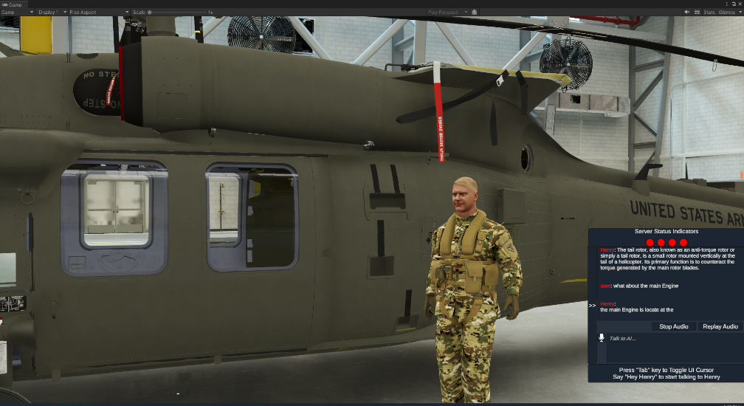
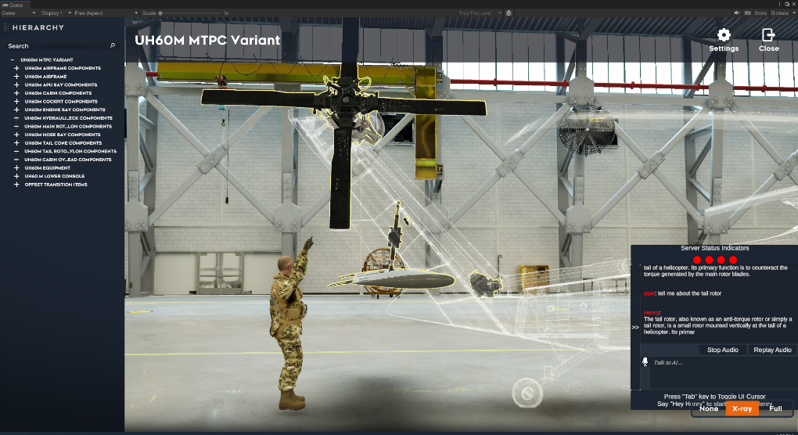
User Experience
Natural interaction:
  Voice input with keyword activation
  Text input option
3D avatar representation:
  Enhances immersion and engagement
Integration with existing IMI content:
  SME can reference and interact with course materials
Contextual awareness:
  SME understands user's progress in the course
Notes:
We've designed the user experience to be as natural and intuitive as possible. Users can interact with the virtual SME through voice input, activated by a keyword, or through text input. The SME is represented by a 3D avatar, enhancing immersion and engagement. Importantly, our virtual SME integrates seamlessly with existing IMI content, able to reference and interact with course materials. It's also contextually aware, understanding the user's progress in the course and tailoring its responses accordingly.

Slide 13
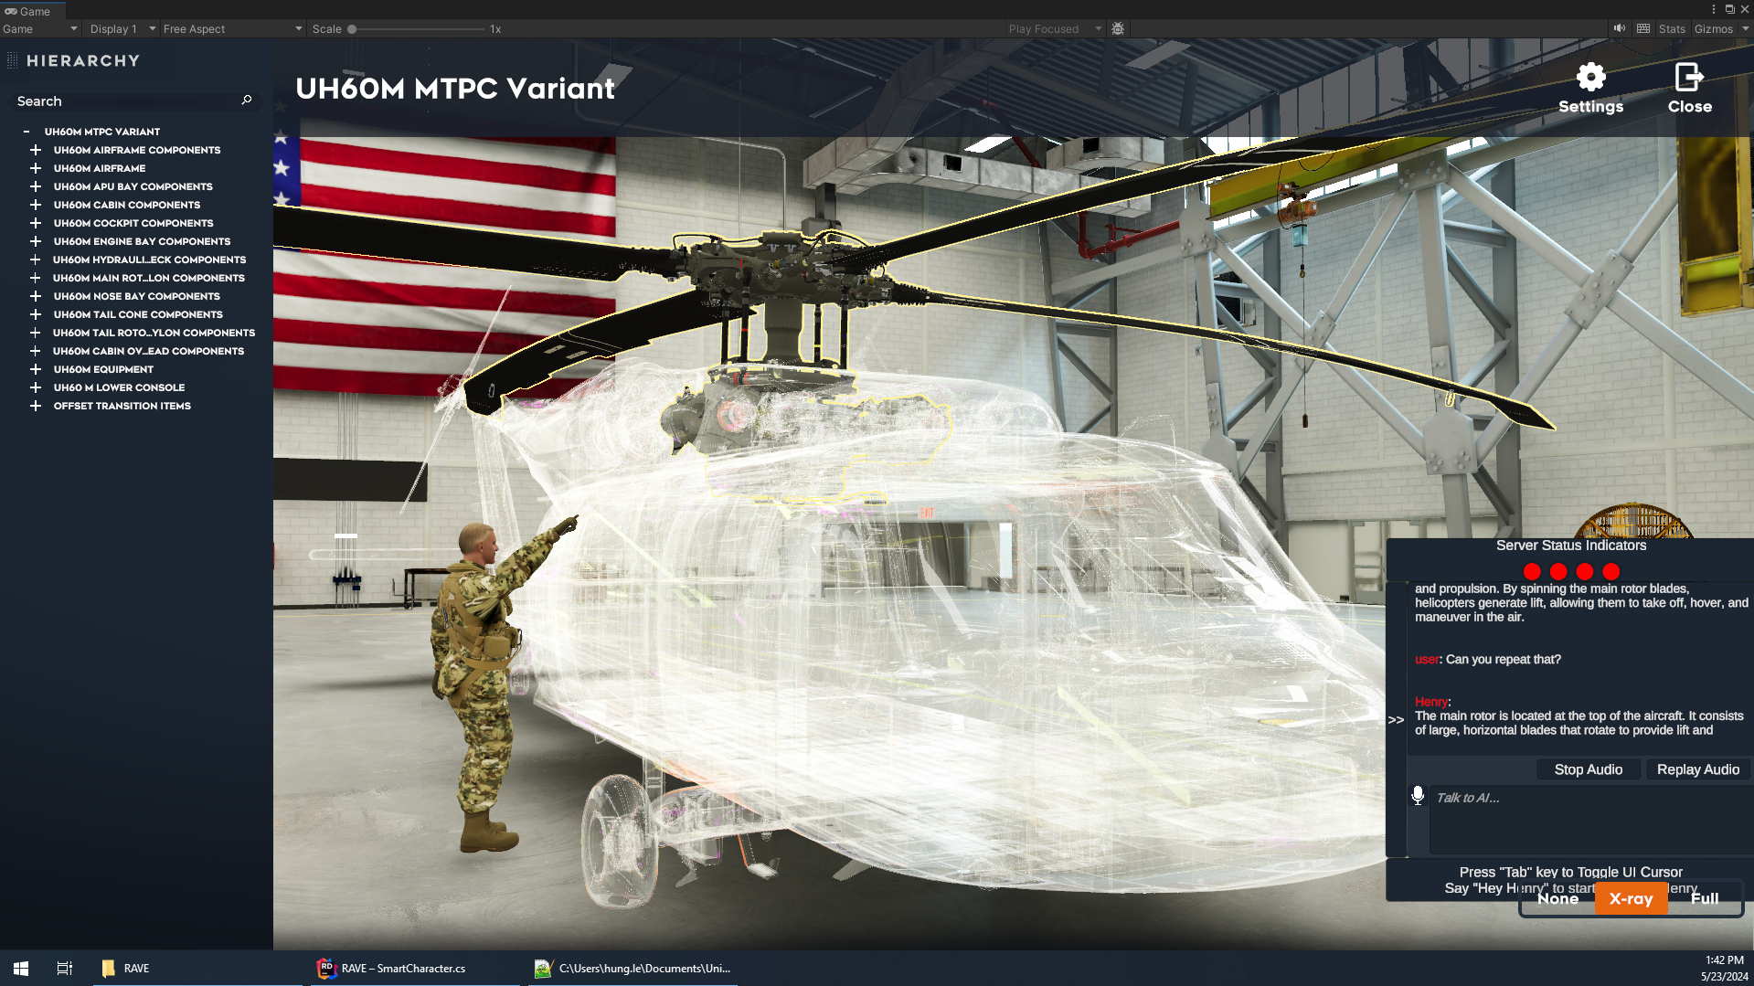
Practical Application
Notes:
The Application example shown here is demonstrating how our Virtual Instructor is showing the user where the Main rotor is located. (possibly explain more in depth)

Slide 14
Challenges and Solutions
Speech recognition in noisy environments:
  Implemented bandpass filtering and ambient noise calibration
Text-to-speech for technical content:
  Custom dictionary for handling abbreviations
  Sentence tokenization for improved readability
Balancing model size and performance:
  Explored quantization techniques
  Optimized for specific hardware configurations
Notes:
Throughout development, we encountered several challenges. Speech recognition in noisy environments was addressed by implementing bandpass filtering and ambient noise calibration. For text-to-speech synthesis of technical content, we developed a custom dictionary for handling abbreviations and implemented sentence tokenization for improved readability. Balancing model size and performance was achieved through quantization techniques and optimization for specific hardware configurations.

Slide 15

Future Research
Expanding knowledge base:
  Continuous refinement of RAG data sets
  Implement reinforcement learning from expert feedback
Improving environmental interactions:
  Enhanced 3D model awareness
  Direct LLM commands to agent for course content interaction
Enhancing user experience:
  Conduct UX studies for data-driven improvements
  Explore AI-driven procedural character animations
Exploring deployment options:
  Investigate cloud infrastructure capabilities
  Develop specialized local server solutions for secure deployments
Notes:
Looking ahead, we've identified several areas for future research. We plan to continually expand our knowledge base through refinement of RAG datasets and implementation of reinforcement learning from expert feedback. We aim to improve environmental interactions by enhancing 3D model awareness and enabling direct LLM commands to the agent for course content interaction. User experience enhancements will be driven by UX studies, and we're exploring AI-driven procedural character animations. We're also investigating various deployment options, including cloud infrastructure and specialized local server solutions for secure deployments.

Slide 16
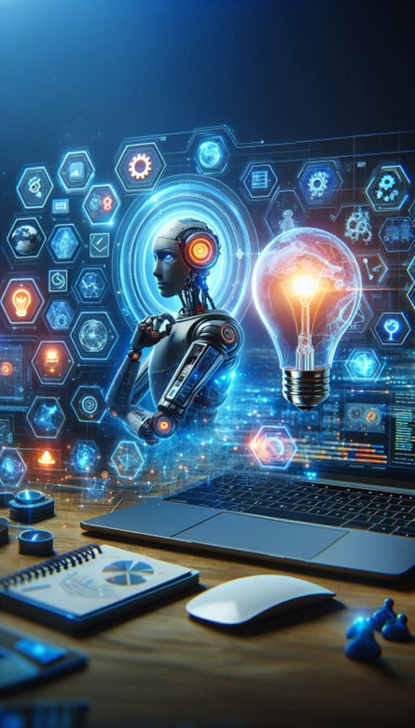
Potential Applications
Self-paced learning environments:
  24/7 availability of virtual SME
  Personalized learning paths
Supplementing live instruction:
  Virtual SME as teaching assistant
  Handling routine queries to free up instructor time
Training in areas with instructor shortages:
  Maintaining training quality and consistency
  Scaling up training capacity without additional human resources
Notes:
The potential applications for our virtual SME are extensive. In self-paced learning environments, it offers 24/7 availability and can facilitate personalized learning paths. As a supplement to live instruction, the virtual SME can act as a teaching assistant, handling routine queries and freeing up instructor time for more complex tasks. Perhaps most importantly, in areas facing instructor shortages, our system can help maintain training quality and consistency while scaling up training capacity without additional human resources.

Slide 17

Conclusion
Virtual SME as augmentation, not replacement:
  Enhances, rather than eliminates, human instruction
Potential for significantly enhancing IMI effectiveness:
  Increased engagement and interactivity
  Personalized learning experiences
Next steps:
  Further development and refinement of the prototype
  Pilot testing in real training environments
  Continuous improvement based on user feedback and technological advancements
Notes:
In conclusion, we see our virtual SME not as a replacement for human instructors, but as a powerful augmentation. It has the potential to significantly enhance the effectiveness of Interactive Multimedia Instruction by increasing engagement, interactivity, and personalization. Our next steps include further development and refinement of the prototype, pilot testing in real training environments, and continuous improvement based on user feedback and technological advancements. We believe this technology has the potential to transform how we approach training and education in the digital age.

Slide 18

Q&A
Contact information:
  Nelson Hurst: nelson.hurst@i3-corps.com
  John Thornton: john.thornton@i3-corps.com
  Hung Le: hung.le@i3-corps.com
Notes:
Thank you for your attention. We're now open for questions. If you'd like to discuss this further or request access to our full white paper, please don't hesitate to contact us. Our email addresses are displayed on the screen. We're excited about the potential of this technology and look forward to your insights and feedback.

