Slide 1




Development of Team Dynamic Measurement Framework for Adaptive Teams
Kamala Avancha, Arizona State University
Parkhi Malhotra, Arizona State University
Jamie C. Gorman, Arizona State University
Vipin Verma, Arizona State University
Randall Spain, US Army DEVCOM Soldier Center
Benjamin Goldberg, US Army DEVCOM Soldier Center
Scotty D. Craig, Arizona State University

Slide 2
Agenda
Project Overview
Team Training
Training Transition
Initial Scenario
Synthetic Training Environment
Team Dynamics Metrics
Design & Review process

Slide 3
Project Overview
Develop a virtual reality training experience to monitor team dynamics for TC3 simulation.
Partnership between Arizona State University and US Army Soldier Center Simulation and Training Technology Center (STTC).
Sponsored by the US Army DEVCOM, Soldier Center under cooperative agreement W912CG-23-2-0002.
Goal is to assess and improve team members’ ability to recover and reorganize from unexpected but significant disturbance events.
Team Dynamics Measurement framework assesses team resilience, adaptation, and recovery.
Supported by GIFT to monitor team dynamics during training.
Notes:
Generalized Intelligent Framework for Tutoring (GIFT)

Slide 4
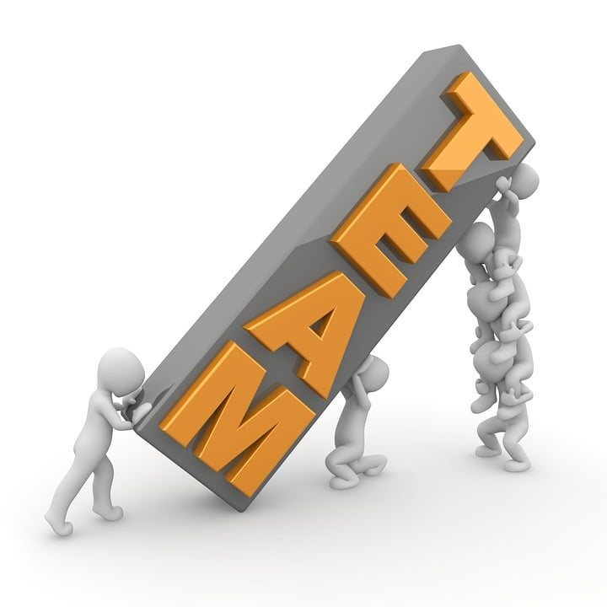
Team Training
Team (Salas et al., 1992)
diverse roles (e.g., heterogeneous knowledge, skillsets across roles)
Interdependent and
work together to accomplish shared goals
Training in teamwork, monitoring, and feedback to team members
Dynamic and individual feedback during task execution could have negative consequences (Walton et al., 2014)
Higher levels of role experience (Ouverson et al., 2021)
Task experience (Ouverson et al., 2021)
Team training that incorporates real world complexities(perturbations).
Notes:
Higher levels of role and task experience show significant effects on communication performance.

Slide 5
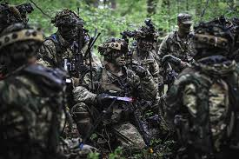
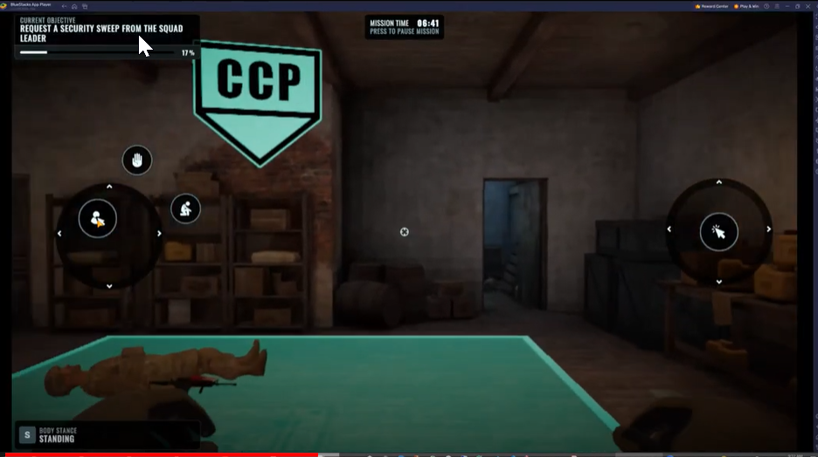
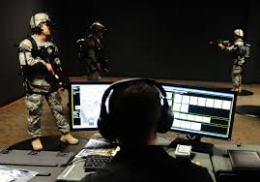
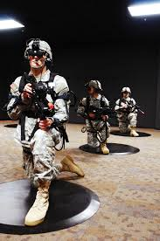
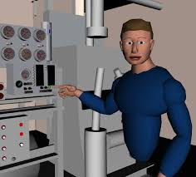
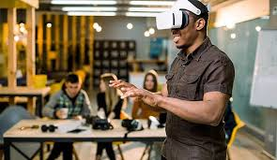
Training Transition

Slide 6
Initial Scenario
There are three CLS (Level 2 medical support) trainees partaking in a Virtual Reality (VR) training that is divided into two 15-minute consecutive sessions with a 10-minute break between sessions to debrief and avoid VR fatigue. At the end of the training, the trainees will have a 10-minute reflection session on the overall learning. The debrief sessions will require trainees to transition to GIFT outside VR platform.
The trainees will be real life characters in this setting. The characters are involved in a Casualty Collection Point (CCP) Scenario with several Non-Playable Characters (NPCs) - seven are Patients/ Casualties, one Lieutenant, three Sergeants, and one Medic (Sergeant) that transitions between the two CCPs. The scenario is in an urban setting with buildings where two CCPs are established in close proximity to each other. The CCPs are divided into four separate areas each (Immediate, Delayed Care, Minimal, Expectant) and the atmosphere is charged with the sounds of battle and gunfire.
Challenge
The challenge in this scenario is for the trainees to effectively handle a charged, urgent situation in a Casualty Collection Point (CCP) by triaging, treating, and coordinating the transition of casualties while overcoming perturbations to team coordination. They must quickly assess and prioritize casualties, administer immediate care, manage casualty flow, and maintain communication, requiring them to work as an adaptive and cohesive team under pressure.

Slide 7
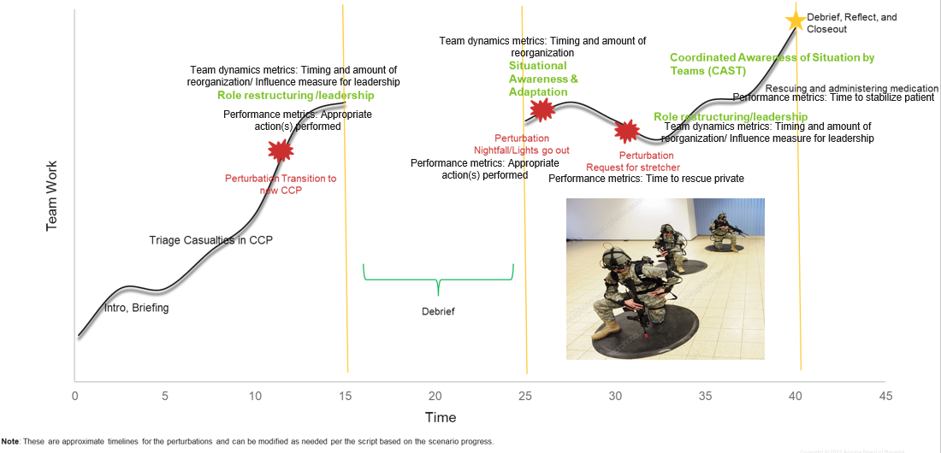
Initial Scenario
Expectant - Not expected to survive
Apply bandages, etc. (Stabilizer, Supplier)
Provide comfort (Stabilizer, Supplier)
Relieve pain (Stabilizer, Supplier)
Prioritization (All)
Immediate - Gunshot wound, no exit
Oxygen (Stabilizer, Supplier)
Control bleeding (Stabilizer, Supplier)
Administer medication (Stabilizer, Supplier)
Apply bandages, etc. (Stabilizer, Supplier)
Prioritize (All)
Delayed - Not a critical organ (e.g., leg injury)
Control bleeding (Stabilizer, Supplier)
Administer pain medication (Stabilizer, Supplier)
Apply bandages, etc. (Stabilizer, Supplier)
Prioritize (All)
Minimal
May require medications (Stabilizer, Supplier)
May require bandages (Stabilizer, Supplier)
Can help move other patients
Prioritization (All)
Immediate (Watson), Expectant, Minimal
Delayed, Immediate, Expectant, Minimal
Team roles: Medical supplier–administers and keeps track of medical resources in the CCP; Prioritizer–keeps track of each patient in the CCP; Stabilizer–actively monitors and stabilizes patients in the CCP

Slide 8
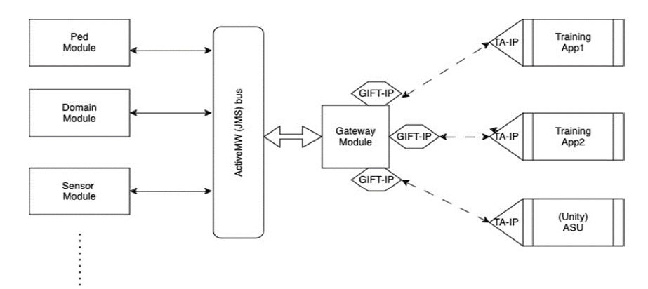
Synthetic Training Environment
Multi-user system.
Central server for game state management.
Wireless tethered headsets.
Vicon tracking system to track trainee movement.
Inverse kinematics to estimate full body skeletons of trainees.
Learner events sent to GIFT.
Perturbations controlled by GIFT.

Slide 9
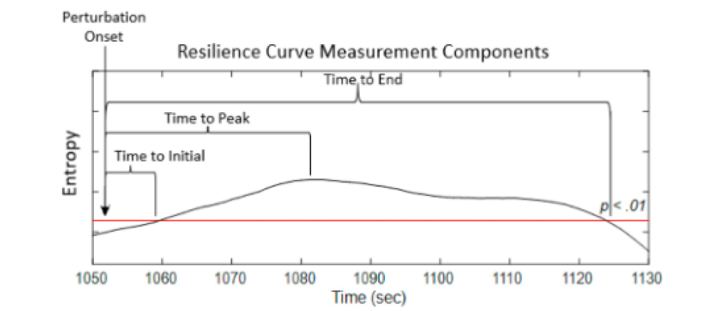
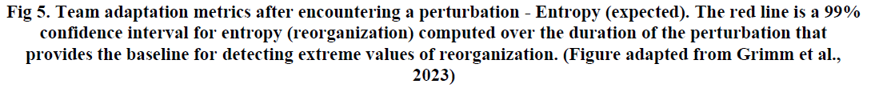
Team Dynamics Metrics
Layered dynamics to calculate:
System entropy as time series (Reorganization)
Relaxation Time
Enaction (Initial)
Adaptation (Peak)
Resilience (End)
Percent determinism (Repetitiveness)
Frequency (Amount of interaction)
Average Mutual Information (Influence)
*These metrics are calculated to assess dynamic team competencies as teams adapt to and recover from perturbations.

Slide 10
Design & Review process
Scenario Task Overview
Event Flow
Interaction requirements
Perturbation design
SME reviews
Team metrics
Hybrid Cognitive Task Analysis used for
Scenario Task Overview
Event Flow diagram
Interaction requirements
Perturbations design
Iterative SME reviews for improving
Scenarios
Team interaction design
Perturbations

Slide 11
Questions?
Email: kamala.rangaraju@asu.edu
Email: scotty.craig@asu.edu ASU ADL Partnership LAB: ADL.ASU.EDU

Slide 12
References
Craig, S. D., Gary, K., Gorman, J. C., Verma, V., & LiKamWa, R. (2024). A Synthetic Training Environment for Assessing Changes in Team Dynamics with the Generalized Intelligent Framework for Tutoring. In A. M. Sinatra (Ed.). Proceedings of the 12th Annual Generalized Intelligent Framework for Tutoring (GIFT) Users Symposium (GIFTSym12) (p. 97-104). US Army Combat Capabilities Development Command–Soldier Center.
Gerhardt, R. T., Mabry, R. L., De Lorenzo, R. A., & Butler, F. K. Fundamentals of Combat Casualty Care (Chapter 3).
Gorman, J. C., Grimm, D. A., Stevens, R. H., Galloway, T., Willemsen-Dunlap, A. M., & Halpin, D. J. (2020). Measuring Real-Time Team Cognition During Team Training. Human Factors, 62(5), 825-860. https://doi.org/10.1177/0018720819852791
Grimm, D. A. P., Gorman, J. C., Cooke, N. J., Demir, M., & McNeese, N. J. (2023). Dynamical Measurement of Team Resilience. Journal of Cognitive Engineering and Decision Making, 17(4), 351-382. https://doi.org/10.1177/15553434231199729
Marlow, S. L., Bedwell, W. L., Zajac, S., Reyes, D. L., LaMar, M., Khan, S., Lopreiato, J. L., & Salas, E. (2018). Multiple Patient Casualty Scenarios: A Measurement Tool for Teamwork. Simulation in Healthcare, 13(6), 394–403.
Milham, L. M., Phillips, H. L., Ross, W. A., Townsend, L. N., Riddle, D. L., Smith, K. M., Butler, P. V., Wolf, R. J., Irizarry, D. J., Hackett, M. G., & Johnston, J. H. (2017). Squad-level training for Tactical Combat Casualty Care: Instructional approach and technology assessment. The Journal of Defense Modeling and Simulation: Applications, Methodology, Technology, 14(4), 345–360. https://doi.org/10.1177/1548512916649075
Ouverson, K. M., Ostrander, A. G., Walton, J., Kohl, A., Gilbert, S. B., Dorneich, M. C., Winer, E., & Sinatra, A. M. (2021). Analysis of communication, team situational awareness, and feedback in a Three-Person Intelligent Team tutoring system. Frontiers in Psychology, 12. https://doi.org/10.3389/fpsyg.2021.553015
Salas, E., Dickinson, T. L., Converse, S. A., & Tannenbaum, S. I. (1992). Toward an understanding of team performance and training. In R. W. Swezey & E. Salas (Eds.), Teams: Their training and performance (pp. 3–29). Ablex Publishing.
Walton, J., Dorneich, M. C., Gilbert, S., Bonner, D., Winer, E., & Ray, C. (2014). Modality and timing of team feedback: Implications for GIFT. In Proceedings of the Second Annual GIFT User Symposium (pp. 190-198).

