Slide 1




Airway Skill Assessment with Spatiotemporal Attention Mechanisms Using Human Gaze
Jean-Paul Ainam, Rahul, Rensselaer Polytechnic Institute
Lora Cavuoto, University at Buffalo
Jack Norfleet, Matthew Hackett US Army Combat Capabilities Development Center (CCDC SC)
Suvranu De, Florida State University

Slide 2
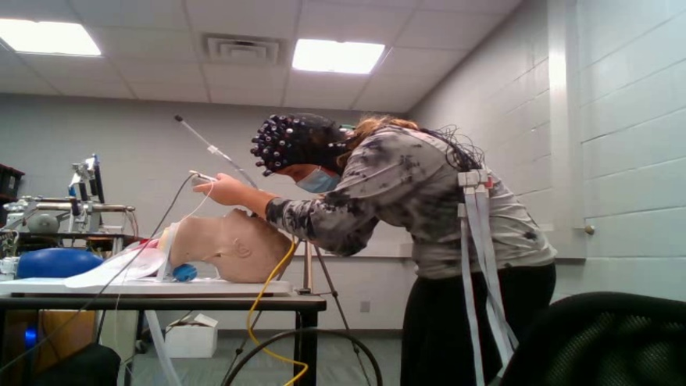
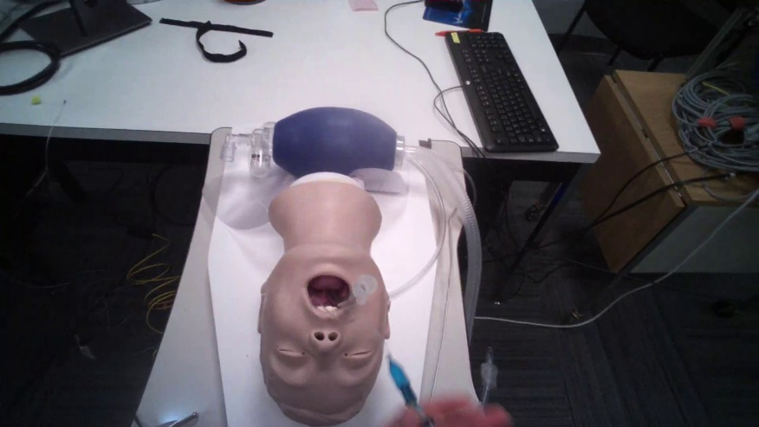
Objective
Assess airway management skills, specifically endotracheal intubation (ETI), using a machine learning approach.
Integrate gaze and video-data to improve the assessment.
Problem
Traditional assessments rely on subjective evaluation.
They fail to measure competency in high-stress, real-world scenarios accurately.

Slide 3
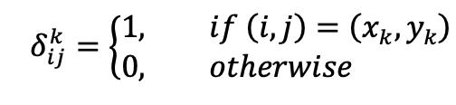
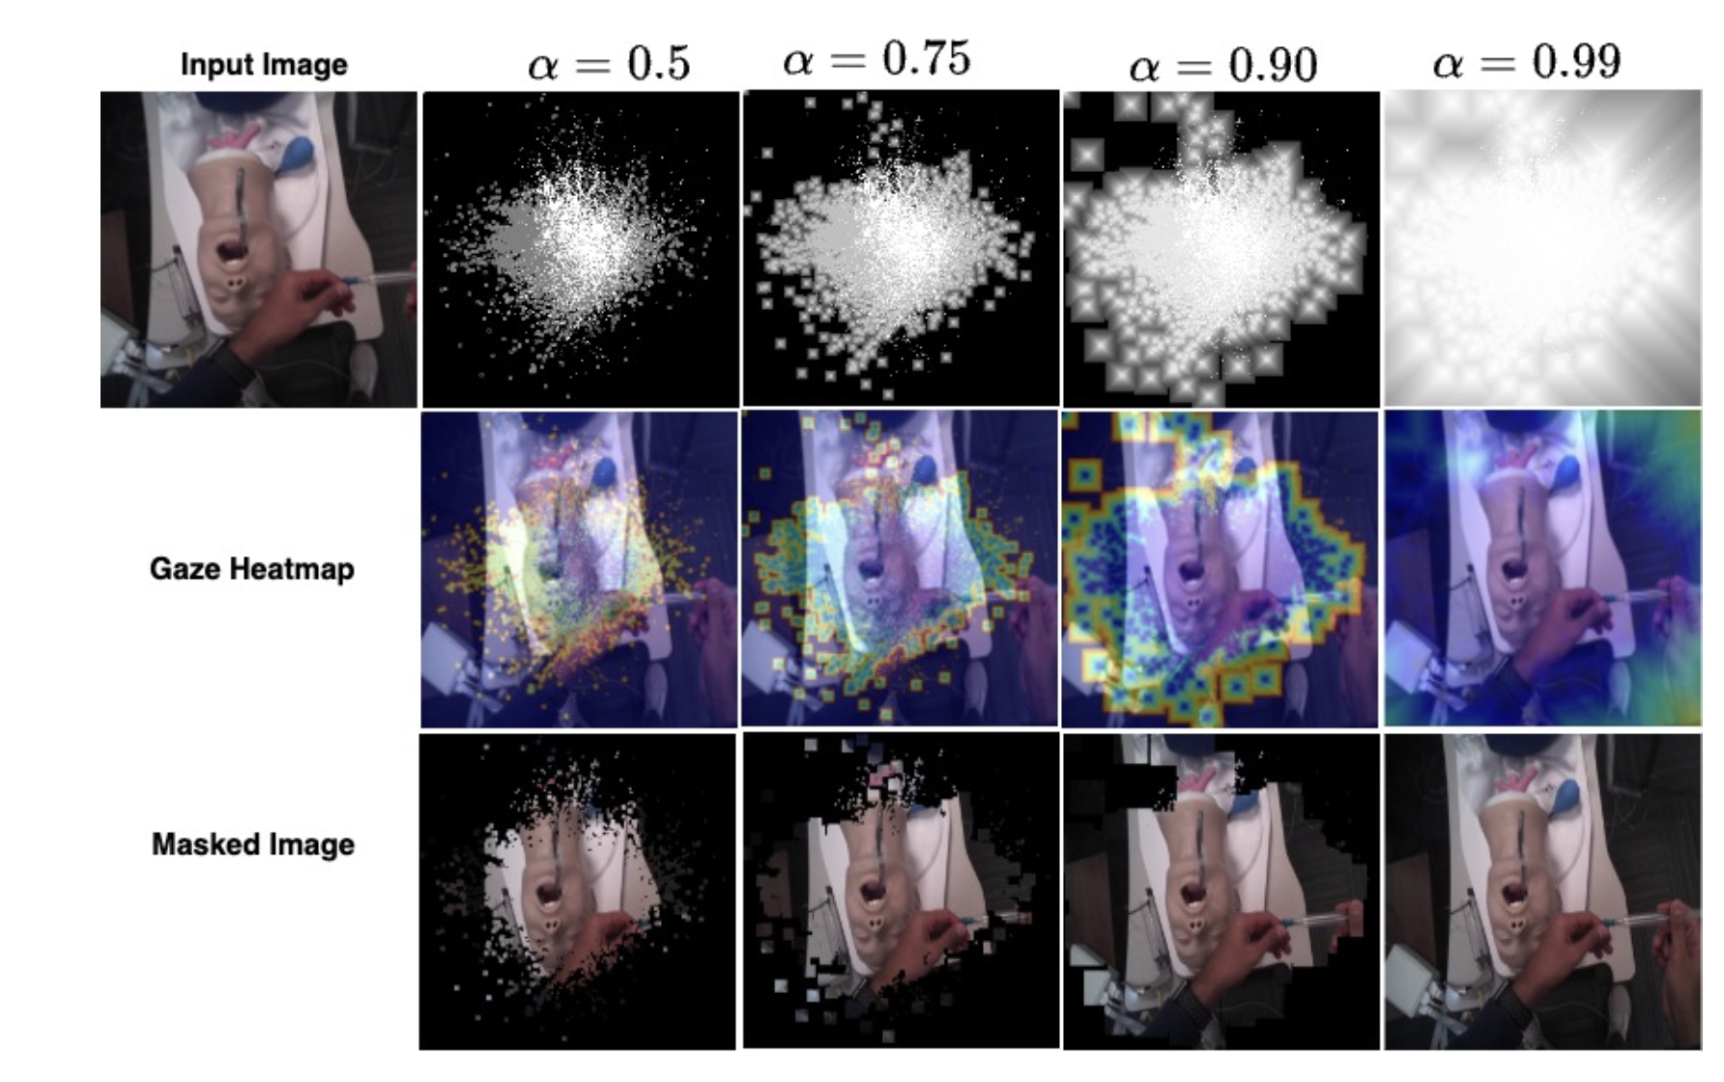

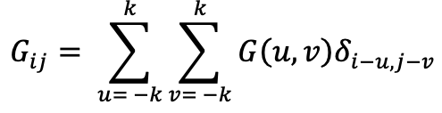
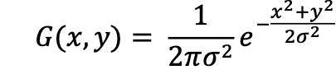
Visual Mask
Create a binary mask using a Kronecker delta function.
  Function:
Masking ETI Procedure with the Human Gaze
Pixel propagation to reduce sparsity.
  Based on the Euclidian distance D.
  Use a decay function to reduce the influence of D.
  Use a threshold.
  Function:
Apply Gaussian convolution to reduce errors introduced by gaze measurements.
  Functions:

Slide 4
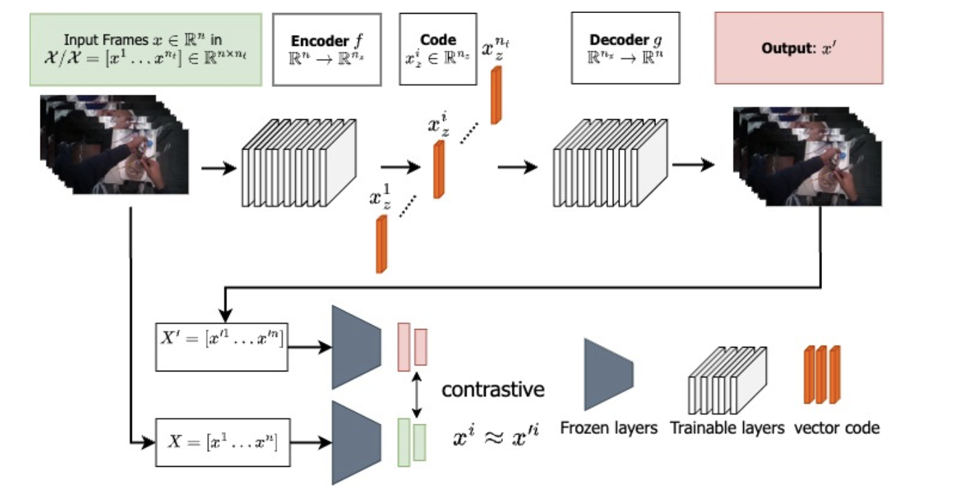
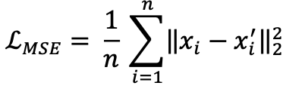
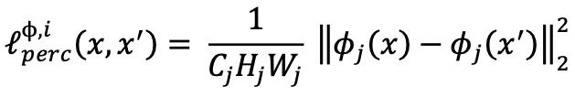
Framework - Autoencoder
Autoencoder (AE): Learns to encode the input into a compressed latent space.
Enhanced with a perceptual loss.
Function to minimize pixel loss:
Function to measure perceptual loss:
Autoencoder Framework

Slide 5
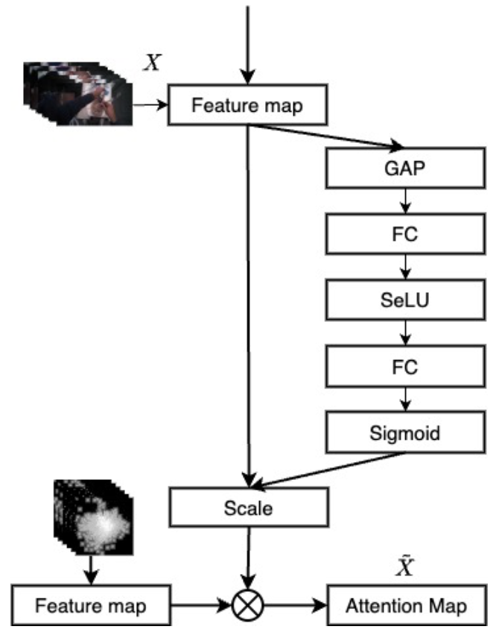
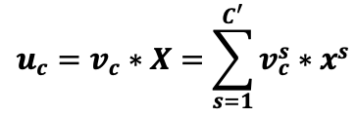
Framework – Attention Module
Attention module leverages autoencoder features.
Cross attention with the visual mask.
Output of the Squeeze-and-Excitation block:
Attention Module

Slide 6
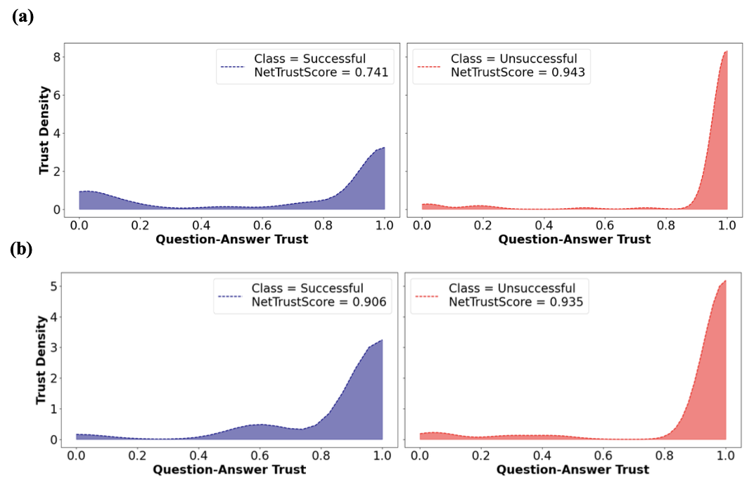
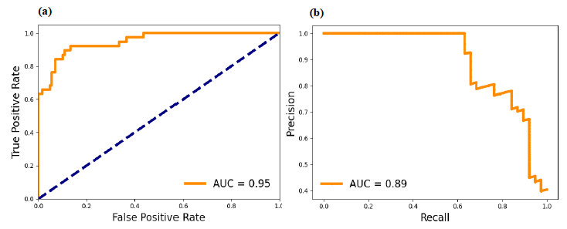
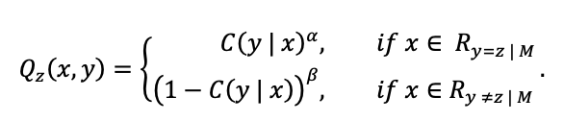
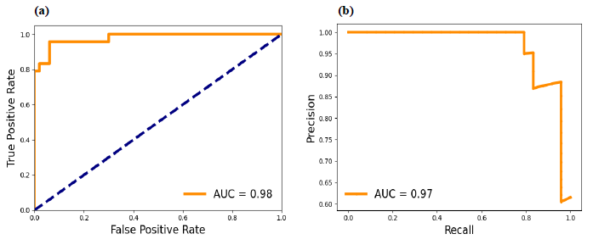
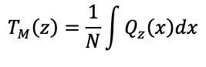

Results & Analysis
Metrics | Baseline | w/ Gaze
Acc. | 89.8 | 93.2
MCC | 70.3 | 85.4
F1 Score | 76.7 | 90.2
Specificity | 94.5 | 92.0
Sensitivity | 73.7 | 95.8
Dataset
Successful | 325
Unsuccessful | 129
TOTAL | 454
Trustworthiness: without Gaze (a), with gaze(b)
ROC (a) and PR (b) Curves for w/o Gaze method
ROC (a) and PR (b) Curves for with Gaze method

Slide 7
Conclusion
Relevance to Combat Medicine: Designed to improve life-saving ETI procedures in military and emergency contexts, where rapid response is critical.
Objective Evaluation Tool: Provides an automated, objective method to assess psychomotor skills in high-stress environments.
Potential Benefits: Increased mission readiness, better patient outcomes, and improved clinical training efficiency.

