Slide 1

How to Make Military Training STICK:
Superior Task Implementation of Core Knowledge
Rich Arnold, Arnold Performance Training Group
Anthony Jones, Tidewater Community College

Slide 2



Training Costs…
2023 civilian workplace training:
$101.8 billion
Military training:
A wide range of systems
  Higher education and career schools
  Resident specialty schools and courses
  Operational programs
  On The Job / Qualification training
  Unit and Organization training and exercises
  = $ Billions…
Notes:
Training Costs
Here’s what we spend on training per year. Are we getting a good return on that investment?
What’s our ROI?
Is training always designed to WORK? If so…how is success measured

Slide 3

Does Training Yield Reliable Performance After Completion?
Training is good at fostering initial comprehension
Focus on Short-Term memory leads to lack of retention: Up to 90% loss in a month
“One-Off” training is not enough to sustain new habits
Problem: Erosion + Lack of Reinforcement
Notes:
Does training yield high reliability?
Training by itself does not….we need to retain what we learn, apply what we learn and develop that application environment. Common problem in training outcomes is that graduates leave having completed the performance objectives BUT the research shows significant erosion of that new skill and knowledge without reinforcement and repetition.
What is the purpose of your training programs?
What results do you expect from them?

Slide 4
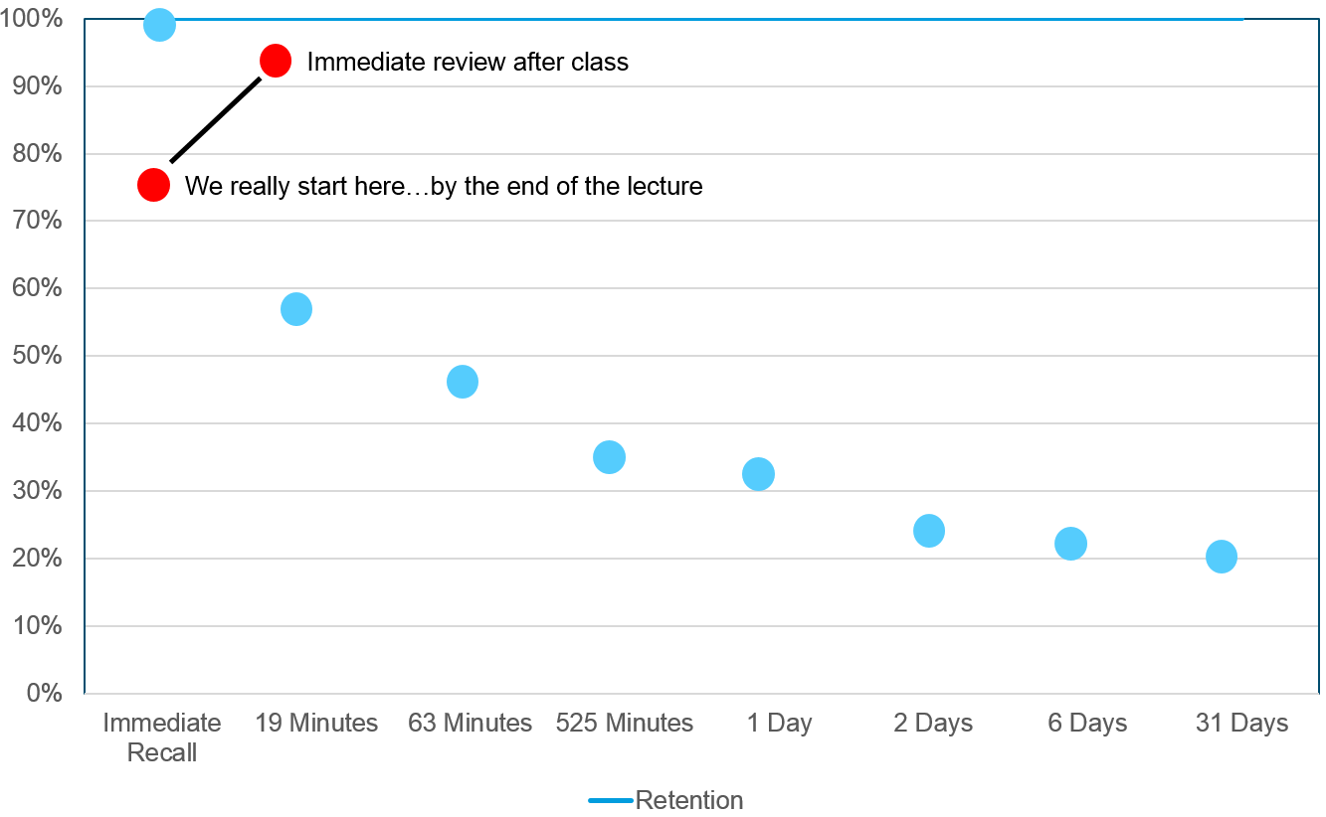
What Happens After Training: The Forgetting Curve
Skill-knowledge is developed
Training may not result in new habits or long-term retention unless immediately applied
Retention typically via application, on the job / refresher training, and policy / process reinforcement
Most loss occurs in the first day with 50% within 1 hour
Loss rate flattens over time
Notes:
The Forgetting curve
Let’s look at what this forgetting process actually looks like…forgetting curve, 20% loss on exist from the actual sessions…forgetting as we are learning. One day is UP TO 70% loss.
Dr. John Wittman, Ca State University Stanislaus
https://www.csustan.edu/sites/default/files/groups/Writing%20Program/forgetting_curve.pdf

Slide 5

Erosion’s Impact After Completing Initial Training
Long-term memory requires more repetition, application, and reinforcement
Training tied to infrequently performed tasks may rapidly erode after initial completion
Post-Training reinforcement impedances:
  Work loads
  Available instructional and practice systems
  Available instructors
Notes:
Defining the Gap.
How do you break this erosion…fill in the gap? Is it ad hoc, formal, combo?
Are these methods efficient, effective, what is the success rate?
Is a gap between what we learn and what we remember just considered a given?

Slide 6

Repetition and Reinforcement
Post-training
  Reinforcement boosts knowledge and skill retention
  Repetition can help form and sustain application habits
Repetition and Reinforcement
  Challenge / Questioning effect
  Start right after initial training
  Provide over a spaced period
  Short and focused
  Not distracting
  Tie to completion requirements
Notes:
Time and spacing is key
Select key objectives and content as part of the initial training program design
Space regular reinforcement and repetition via SHORT and TARGETED events/checks built into daily workflow
NOT a refresher, coaching, mentoring or OJT event.

Slide 7
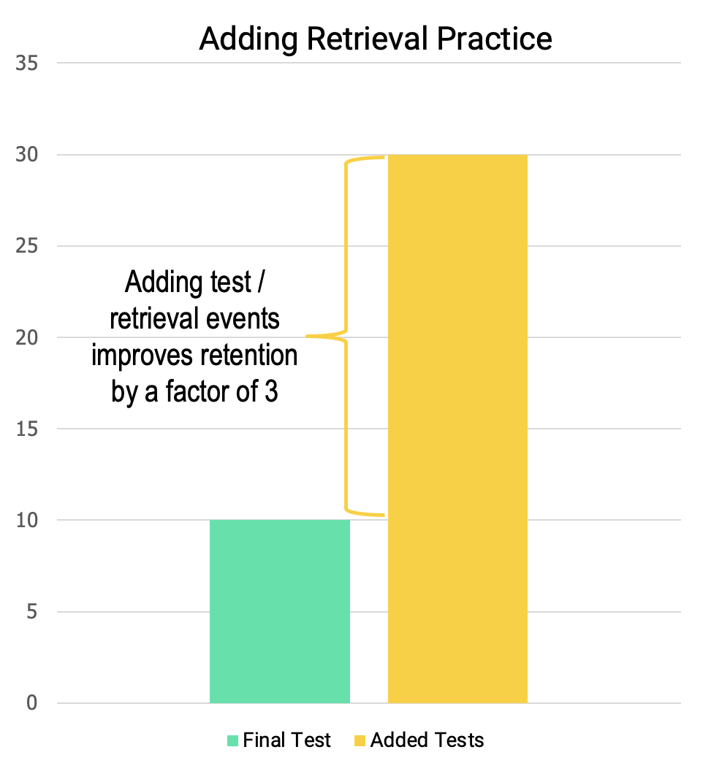
Retrieval Practice is Key
Retrieval Practice: An event or test causes you to remember what you learned
Start just after training
Multiple retrieval / test events yield better results than a single final test or event
Notes:
Retrieval Practice is Key. Asking the brain to remember information previously learned is called retrieval practice. This is where current learning design can fall flat. To make training shorter in the ever increasing speed of business, it is common not to repeat key information frequently, and to limit practice to one or two instances. With a simple assessment question at the end of training, the assumption is learners will go back to the job ready to perform with the new knowledge, skill, or information. Studies show (as in Figure 34) that simply having learners recall information by taking a test right after training is less effective than asking them to recall information over time by taking multiple tests. Retrieval practice is what helps move information from short term memory to long term memory.
3 Ebbinghaus, Hermann. Memory; A Contribution to Experimental Psychology. New York city: Teachers College, Columbia University, 1913. 4 Glover, John, A. (1989). The “testing” phenomenon: Not Gone but Nearly Forgotten, Journal of Educational Psychology, 8. 392-399. 5 Arthur, W., Jr., Day, E.A., Villado, A.J., Boatman, P.R., Kowollik, V., Bennett, W., & Bhupatkar, A. (2010). The Effect of Distributed Practice on Immediate Post-training, and Long-Term Performance on a Complex Command-and-Control Simulation Task. Human Performance, 23(5), 428-445.

Slide 8
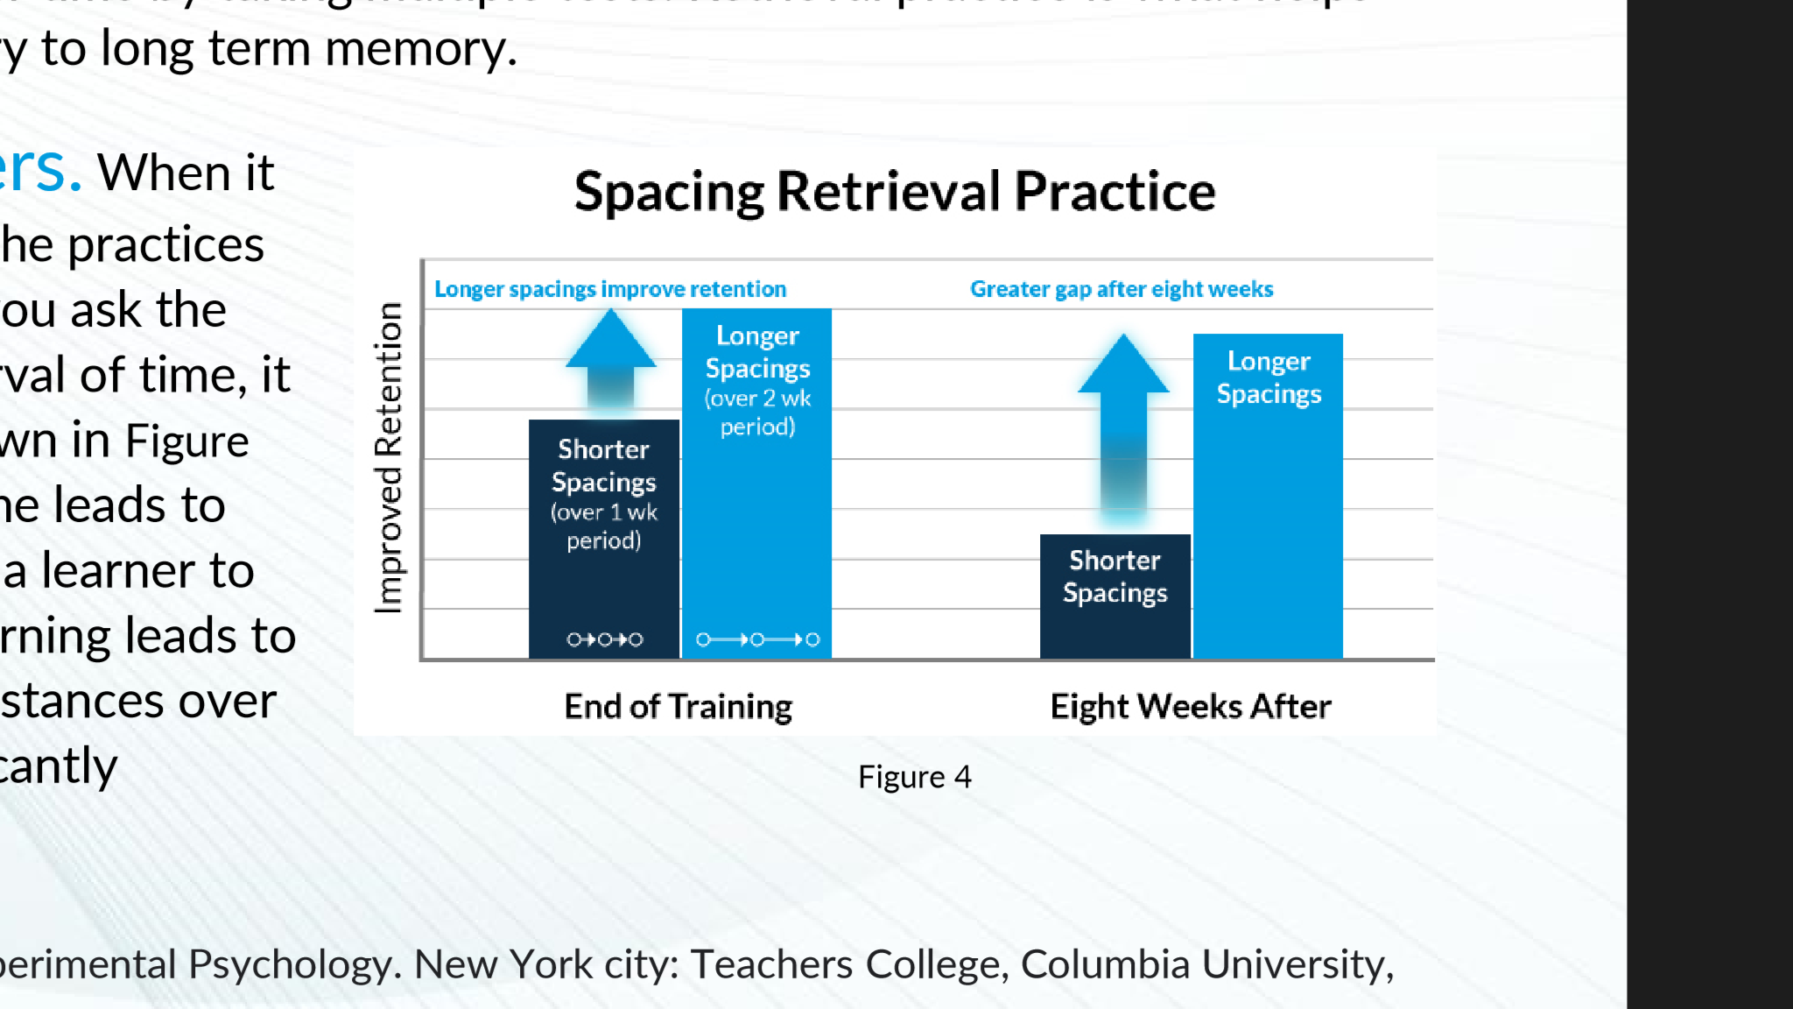
Spacing Retrieval Practice
Retrieving information over time also increases retention
More practice over longer spaces of time yields better results than practice over a short period
Notes:
Spacing of Repetitions Matters. When it comes to retrieval practice, the timing of the practices also matters. Research shows that when you ask the brain to retrieve information after an interval of time, it improves learner retention. The figure depicts this result: More practice over longer spaces of time leads to improved learner retention. While asking a learner to recall information one time after initial learning leads to memory improvement, spacing multiple instances over extended periods of time results in significantly improved memory recall.

Slide 9
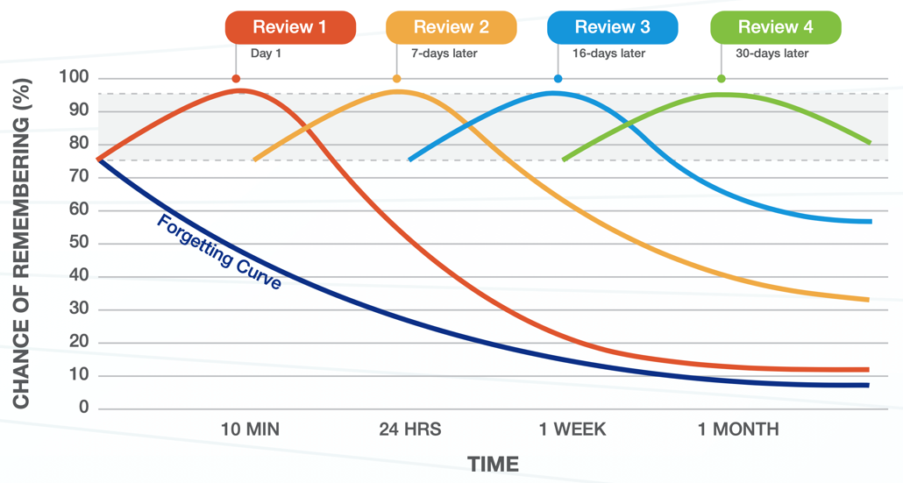
Putting Them Together: The Power Of Spaced Repetition
Course | Pre-Test (Correct) | Post-Test (Correct) | Remarks
USDA Instructor Development Courses | 81 & 76 % | 94 & 91% | Pre-Test: All students were above the passing threshold. Post-Test: All students were at or above the 80% level
Tidewater Community College, Norfolk Naval Shipyard Apprentices Science in the Workplace | 76% | 87% | Pre-Test: 5 of 21 students at or below passing, with most testing at 80% Post-Test: No students below passing, most at 90% or above.
Notes:
The Forgetting Curve.
No magic fairy dust…some forgetting will always occur. BUT, the spaced repetition and reinforcement can greatly flatten that curve…starting RIGHT after training can prevent that drop from the initial 80% down to the 30%.

Slide 10
Practical Working Examples:
Voluntary engagement at
83-86% of participants
NO erosion
Increase in tested retention
Apprentice Training, Science in the Workplace:
  Pre-Campaign: 5 of 21 students at or below passing after training
  Post-Campaign: ALL at passing or above, most at 90%
94
91
87
81
76
76
Notes:
NOT showing you this as a marketing probe but as a practical example of applying this concept. You could use email, a manual system, etc. but that would be pretty labor intensive. Key elements in a systematic approach:
Automate within a cohesive and coherent structure.
Direct to the person…
Tied to the core performance objectives of the underlying program…not pushing new stuff unless delivered as original microlearning.
SIMPLE, EASY and RAPID to complete…don’t irritate people who already “completed” their program.
13 of 17 (76%) participated in the pre-test, post-test and at least 3 Hermann sets
Of these 13, the average score on the pre-test was 76% and the average score on the post-test was 91% (+19.5%)
I excluded Fatou from these results b/c she only took 2 sets
If she is included, the average score on the Post-test is still 91%, versus 74% on the pre-test (+22.4%), and engagement increases to

Slide 11
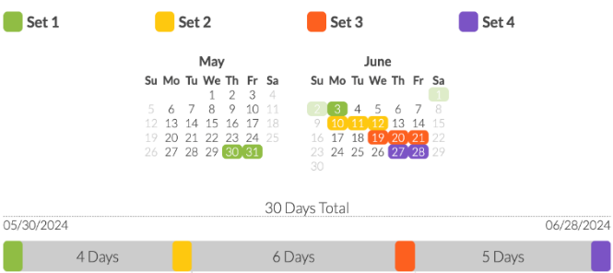
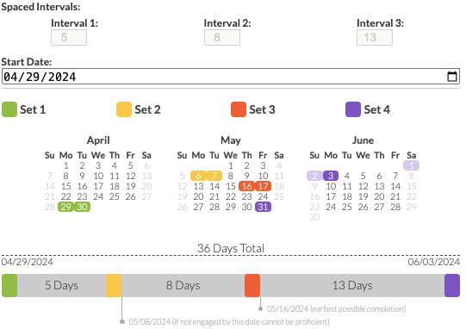


Spaced Repetition “Campaign”
Repetition / Reinforcement events (4 sets) tied to key objectives
Starts immediately after initial training
Spacing intervals increase over time
Challenge events take less than 5 minutes
Performance feedback for the learner and sponsors
Science in the Workplace
Instructor Development Course
6-12 Days
6-10 Days
7-8 Days
Notes:
Continue the example… PLACE EVENTS WITHIN A CAMPAIGN (repetition and spacing)
Campaign is a holistic construct of linking the reinforcement events across the objectives…building up that retention pattern over time. Ideally it also coincides with the person APPLYINHG what they’ve learned within their job-tasks.
Start IMMEDIATELY after training…within a day. This is key to check the initial drop in the forgetting curve.
Spacing increases over time…typically within a 5-6 week period for a campaign.

Slide 12




Application Methodology and Processes
Tie to (not replace) courses and training as a process element.
Question-based approach
Leverage media: video, data displays, job aids, infographics, policy and process links
Responsive design
Short events: Approx. 5 minutes
Not Disruptive: Place In the workflow / real-life setting
Spread over time (4 weeks)
SPACED REPETITION
MICRO-LEARNING
Knowledge check questions & interactive scenarios, spaced over time, to support long-term retention
Brief case studies, updates, lessons learned, current events, & role-specific content to support formal training
EXAMPLES OF REMEDIATION OPTIONS
SUPER SHORT VIDEO
INFOGRAPHIC
DATA DISPLAYS
ONE-PAGE PDF
POLICY LINK
AI BASED Q&A
Notes:
A unified Approach
Align Content in Context of the job, task, situation, etc…context is important for the internal analysis we perform to see how we can apply and use what we learn. Make sure new learning is presented, practiced, and tested in real life situations. This is most often done via scenarios and simulations.
Practice and Feedback. Retrieval practice asks the learner to take new content and use it in other situations that require them to think and apply. Feedback is key to this practice and is the mechanism critical for learning. Comparing their answer (correct or incorrect) to the intended response and adding content as reinforcement helps ensure learning.
SPACED REPETITION: Another very effective way to enhance long-term retention is to use spaced repetition over time. Pushing out knowledge checks or test questions, interactive scenarios, and bite-sized refreshers throughout the year can keep the information fresh in learners’ minds and help the organization measure the effectiveness of the training. Scenarios could include a blend of issues from different compliance courses, to help employees decompartmentalize the information and see how it applies across functions in the context of the business.
MICROLEARNING: Building on the spaced repetition recommendation, pushing out small bits of information can help to reinforce the learning throughout the year. Examples include brief case studies demonstrating the importance of the information, any policy or regulatory updates, lessons learned related to particular risk areas, and role/function-specific content. This content should be driven by business performance data (metrics), current events or risks, pulse survey results, and changes to policies, processes, or regulations.

Slide 13
AI Close Instance with Neural Vector Database and Reference
Add a question: What are the benefits of Spaced Repetition and Reinforcement?
Question Details / Correct Examples
Correct / Incorrect Answer Examples
Spacing_Learning_Over_Time_March2009v1.pdf – Spacing repetitions over time boosts long-term remembering. It enables learners to store information in memory in a manner that makes information more resistant to forgetting than non-spaced repetitions. – P.8
Spacing_Learning_Over_Time_March2009v1.pdf – Spaced repetitions may bring learning events closer to the time they are applied on the job. The more time that passes between learning and application, the more our learners experience forgetting. As soon as learning events end, forgetting begins. By adding subsequent spaced repetitions, we essentially extend learning and lessen forgetting. – P.9
Spacing_Learning_Over_Time_March2009v1.pdf – Repetitions can create other effects besides just better memory. Research has shown that repetitions can make ideas more persuasive (Cacioppo & Petty, 1989; 1979; Claypool, Mackie, Garcia-Marques, McIntosh, Udal, 2004; Maslow, 1937) and products more desirable (Nordhielm, 2002; Cox & Cox, 2002). – P. 46
Enter correct examples (comma-separated)
Spaced Repetition and Reinforcement benefits include: 1) Improved long-term memory retention, 2) Increased resistance to forgetting, 3) Better learning results compared to non-spaced repetitions, 4) Can make ideas more persuasive and desirable, 5) Extend learning / reduce forgetting, 6) Bringing learning events closer to job application, 7) Deeper engagement with learning materials, 8) Can increase positivity of learning information.
Enter incorrect examples (comma-separated)
Spaced repetition only improves short-term memory recall, The main benefit of spaced repetition is faster initial learning, Spaced repetition is less effective than cramming for long-term retention.
Enter Large Language Model (LLM) evaluation instructions
When evaluating the answer: 1) Look for mentions of improved long-term memory retention and resistance to forgetting as key benefits. 2) Check if the answer compares spaced repetition favorably to non-spaced learning methods. 3) Consider additional benefits beyond memory, such as increased persuasiveness of ideas or deeper engagement with materials.

Slide 14
Benefits and Challenges
Benefits
Significant positive training ROI
Potential to reduce failure rates
Enhance transfer of performance-based learning from school to field
Reinforce infrequently used skills and knowledge
Support microlearning anywhere/any time
Low ISD costs – Rapidly create campaigns by using extant course content
Challenges
Post-course engagement if participation is voluntary
Training system integration
Security considerations depending on access systems and locations
Identification of courses and work fields with the most applicability
Culture Change!
Notes:
Potential participation issues after course completion. In a typical course, a student completes their training, is evaluated, and receives a certificate or graduation credit—they are done with the course. Even though a graduate may receive follow-on qualification training, localized training connected to their job, or follow-on advanced training, they tend to view the underlying course as completed. This method asks them to remain connected to the course over the spaced repetition interval even though they finished the underlying training and are no longer under the control of the school or course sponsor. This can adversely impact timely participation and campaign completion. Our initial discussions with participants and sponsors indicate the need to support implementation with associated administrative functions. For example, actual course credit may be assigned after completing the campaign instead of immediately after graduation. Although the time demands for refresher events are very low (typically less than 5 minutes), they still occur within the participant’s daily post-course work-life environment. Our tests indicate the need to look at system and individual incentives to ensure full and active participation.
Modification to the instructional design requirements. The instructional design load is very low to use this method. Our campaign development required about 5-10% of the initial development time. Campaign developers reused content, media, and materials from the source course within the campaign. However, this small instructional design burden is predicated on the campaign sponsor accessing the source content and the cost-effective ability to leverage / reuse that content within the spaced repetition and reinforcement campaign. This should not be a problem for courses where the organization owns or has rights to the content but could pose additional costs or accessibility issues for content that is procured solely for the source course.
Security vs. Accessibility. The system we used for the test has an authority to operate (ATO) within government networks. However, security considerations may preclude participants from accessing campaigns via the tools they use in their daily lives (e.g., cell phones, tablets, and personal computers). Security considerations should be baked in during the initial design and development process including how students will access the campaign.
Analytical processes to identify courses appropriate for spaced repetition and reinforcement. The research indicates that spaced repetition can reinforce objectives across cognitive, affective, and kinesthetic domains (Fahl, 2023) and (Scarf, 2017). However, systematic use and implementation of the method across a broader enterprise indicates the need to consider the content during the initial analytical and design stages of course development. Asking questions such as: “What are the key performance objectives that require reinforcement?” and “Where is skill and knowledge erosion adversely impacting field performance?” will focus methodology implementation on tasks that yield the most benefit to the organization. A campaign is not necessary to support tasks that are immediately performed after graduation while tasks that are not immediately performed but are critically important may be ripe for a campaign.

Slide 15

Summary
Don’t accept the paradigm of skill and knowledge erosion: “Use it or Lose It”
Boost retention and positive habit formation by using spaced repetition and reinforcement
Use a systematic spaced repetition and approach to make training STICK
  RichArnold1982@gmail.com
  703.932.6319

