Slide 1

Digitally Designed – Applying AI Agents to Digital Twin Development
Graham Long, Thales

Slide 2
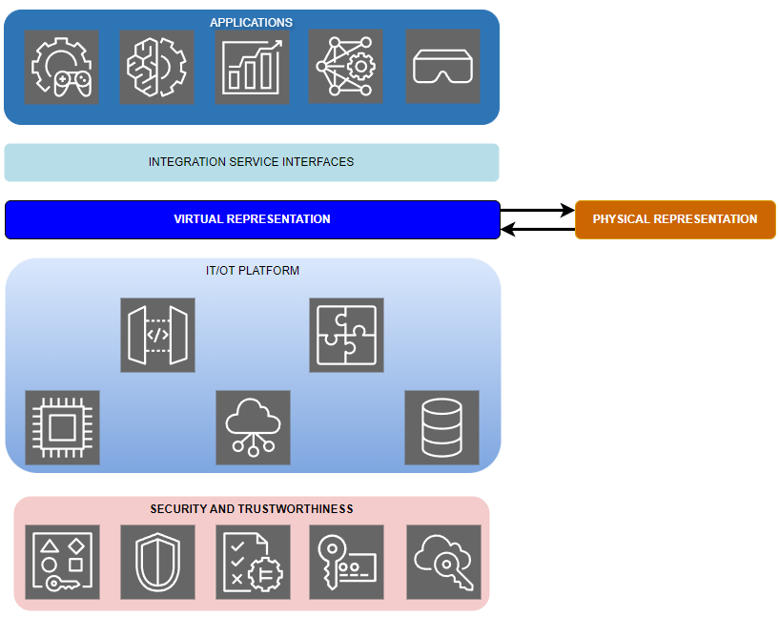

Introduction to Digital Twins
Introduction to Digital Twins
1970
2002
2012
2016
2017
2018
2024++
First Digital Twin
NASA Apollo 13
Digital Twin concept
Grieves
Manufacturing
Energy
Construction
Infrastructure
Urban planning
Healthcare
Modelling &
Simulation
NASA/USAF
Digital Twin concept
Digital Twin
widely studied
academia / industry
Gartner:
digital twin top 10
strategic tech
5D digital twin
Model introduced
Diverse
proliferation
Digital twin (DT):
Digital representation of a physical entity, system, or process, connected to its real-world counterpart via bidirectional data flow
Digital twins are complex systems or systems of systems
Developing DTs is challenging
Data & Expertise Intensive
Requires significant domain expertise and data from multiple sources
Complex
Integrating systems, physical assets, live data, simulation models is not trivial
Can Agentic AI be applied to the development & composition of DT systems?

Slide 3
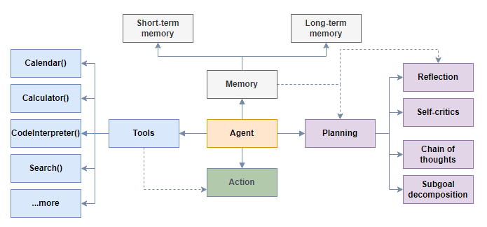
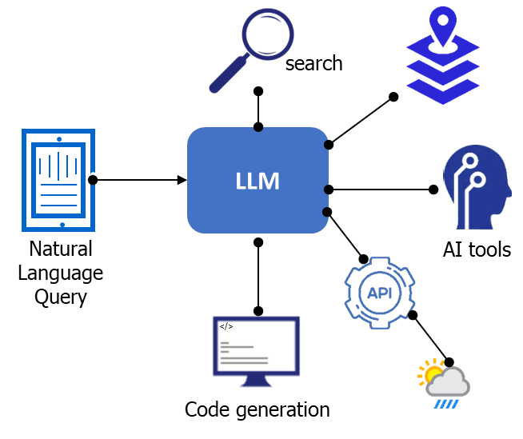
Agentic AI
Agentic AI is rapidly transforming creativity, productivity, and innovation
Powered by rapid evolution of large language models (LLM) capabilities
Software development, healthcare, …..
"What I am seeing with AI agents is an exciting trend that I believe everyone building AI should pay attention to." (Ng, 2024).
What is an AI agent
LLM-based entity capable of interacting with its environment
Independently breaks down tasks and make decisions
Combines LLMs with memory, planning, and tool use
Calls tools via API / function calls to achieve specific goal
Role of LLMs
LLMs are the “thinking” engine or brain of these AI agents
LLM acts as a controller & general-purpose language interface
LLM decides how to 'route' incoming natural language queries
Agentic Capabilities
Autonomy: Agents operate with minimal human input
Dynamic Problem Solving: Adapt to changing situations & tasks
Multimodal Abilities: Incorporate text, images, & other inputs

Slide 4
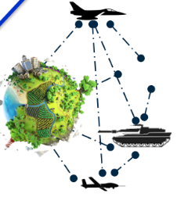

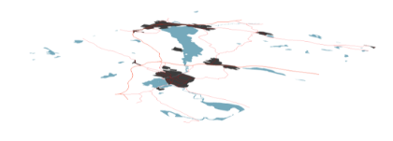
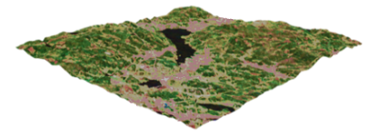
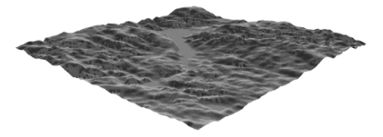
Application of AI Agents to Digital Twins
AI agents excel at handling intricate, multi-step problems
Digital Twin System composition is a complex, multi-step activity
Applying agentic AI to DT system composition system is a promising but challenging first step
Leverage existing systems, tools, components, workflows, specific domain knowledge bases, and expertise
Proof of Concept (PoC) use case – AI agent for a DT Virtual Environment (VE) component :
Virtual Environment (VE) for an Air Operations DT populated with multi-domain DT, live, virtual, constructive & entities
Digital model of its physical counterpart: terrain, features, content represented @ appropriate accuracy, fidelity,
Multi-resolution environment with seamless global, regional, and local scale representations
4

Slide 5




Virtual Environment Agent Architecture
High-level scenario
Derive requirements
Design
Data acquisition
Data processing
Content Creation
Assembly
Generate VE
VE Agent Objective
Execute all major steps in the VE development pipeline
Update & generate VE in response to on-demand, changing operational needs and scenarios
Develop the VE from a scenario description
Multi-agent architectures (n > 1 agents)
Complex scenarios
Multiple agents cooperate, share information, make collaborative decisions
Varied expertise, perspectives, cooperative problem-solving, scalable systems, specialization, parallel processing, robustness
Single-agent architectures (n = 1 agents)
Simpler, centralized tasks
One agent organizes & complete all tasks
Requiring greater accuracy, direct control, ease of integration, resource efficiency
Each agent has a persona & a unique role with particular characteristics, capabilities, behaviors, and constraints
5

Slide 6
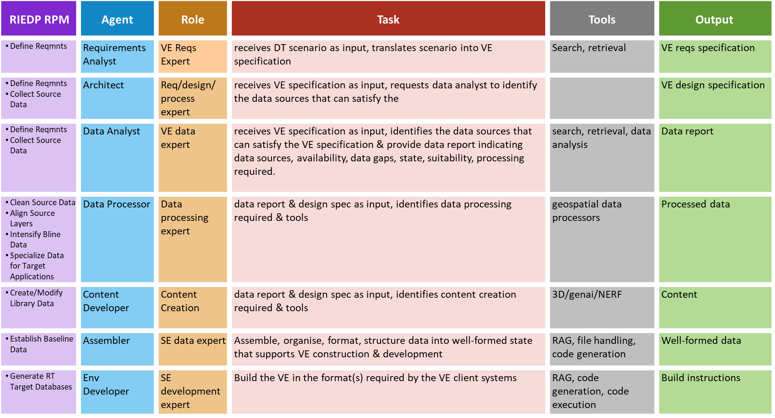
AI Agent Roles

Slide 7
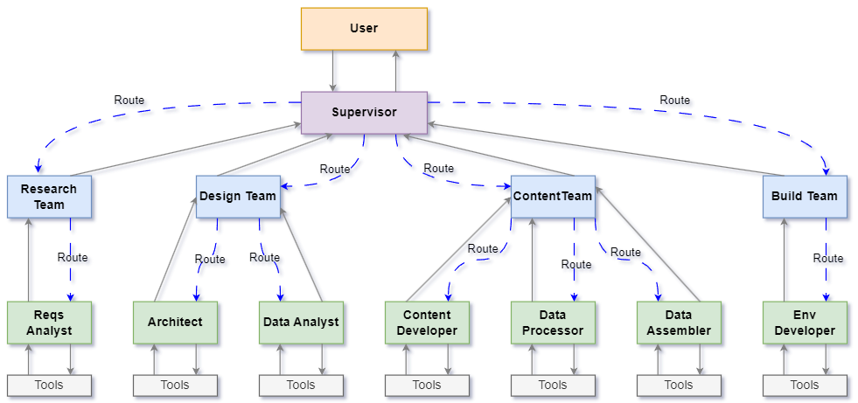
VE Multi-Agent Architecture
Agents are arranged into sub-teams of agents working on particular aspects of the task
Agent supervisors assign tasks to individual agents & use other agents as tools
Agents adopt a cooperative communication paradigm, collaborating towards a shared goal
Top-level & mid-level supervisors supervise sub-teams of agents
Complex problems are divided into manageable units of work
Specialized agents target tasks with own prompt, LLM, and tools

Slide 8





LLM Knowledge Augmentation
An effective multi-agent solution must generate accurate, reliable, and quality responses
Agents must possess a deep understanding of diverse information relevant to their tasks
Relying on LLM pre-trained knowledge is unlikely to produce suitable results
VE agent must access enterprise, domain specific design, reqs, data, standards data
Agents using pre-trained LLMs constrained by scope of LLM training data
LLM training data may exclude data sources required by the agent
LLMs can hallucinate plausible but incorrect answers, compromising quality & accuracy
Query
Response
Pre-training
Response
Massive dataset
(web, wiki, books etc..)
Query
Generation
LLMs + external knowledge will improve responses & agent performance
Response
Pre-training
Response
Search
Augmentation
Retrieval Augmented Generation (RAG)
Retrieval-based & generative models to improve accuracy & relevancy of response
Provides access to highly specific, precise, controlled and curated data sources
Query +
Relevant docs
Org / domain
specific dataset
Retrieval

Slide 9
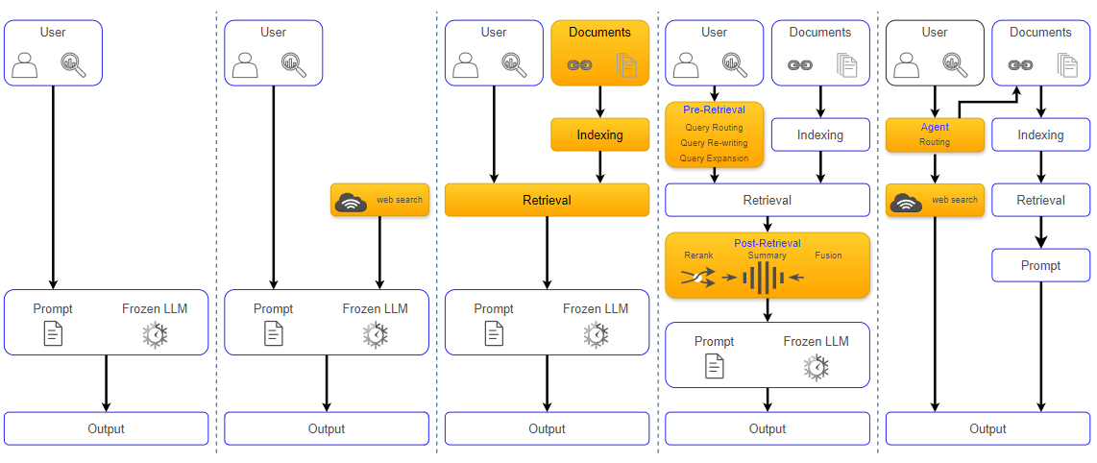
RAG
LLM Q&A
LLM + WEB
BASIC RAG
ADVANCED RAG
AGENTIC RAG
Add LLM access to external knowledge with web search
Add document store, indexing & retrieval
Add pre and post retrieval enhancements
Add agent router to RAG & / or web search

Slide 10
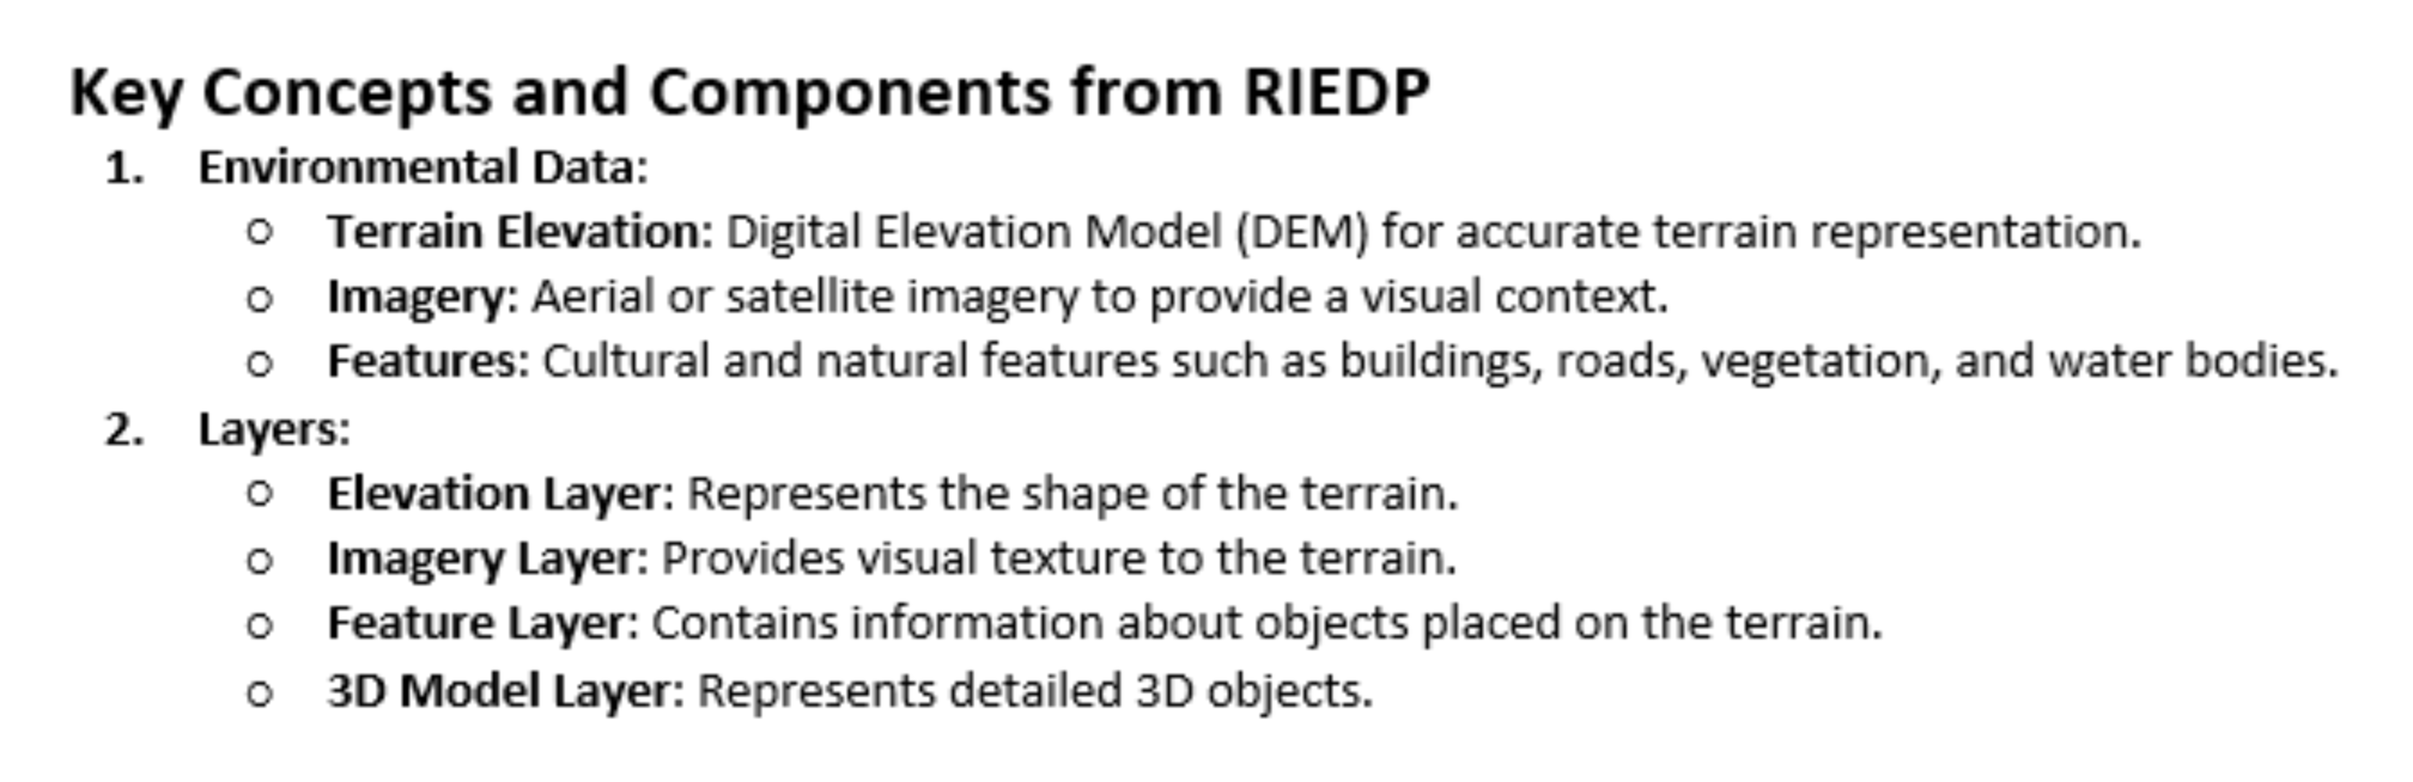
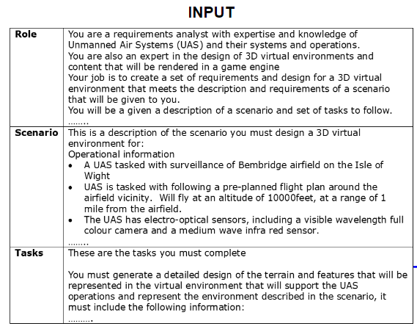
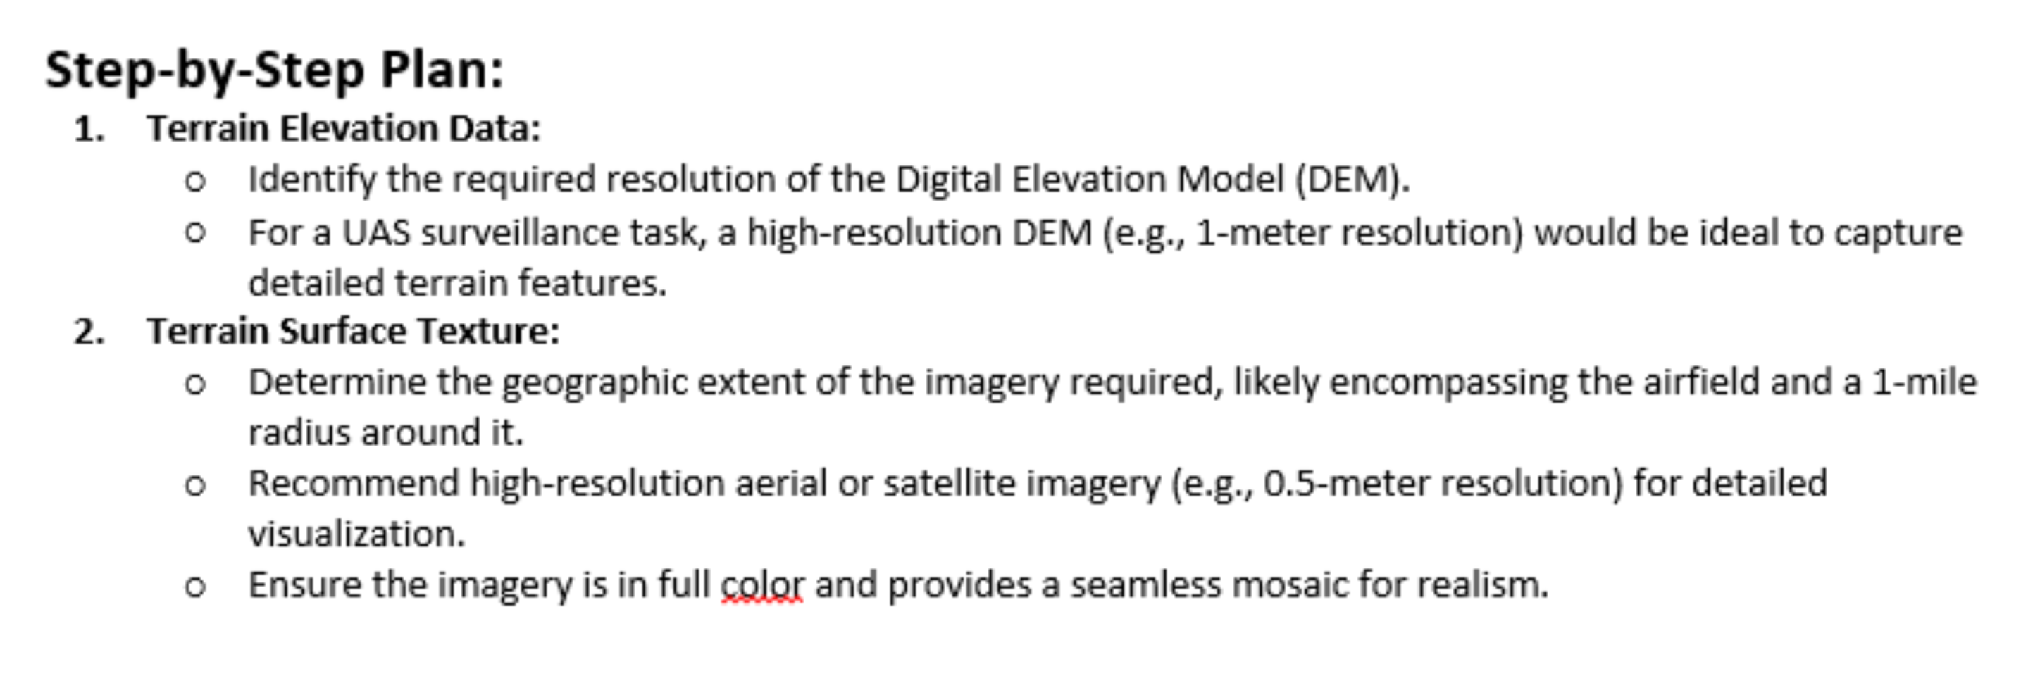
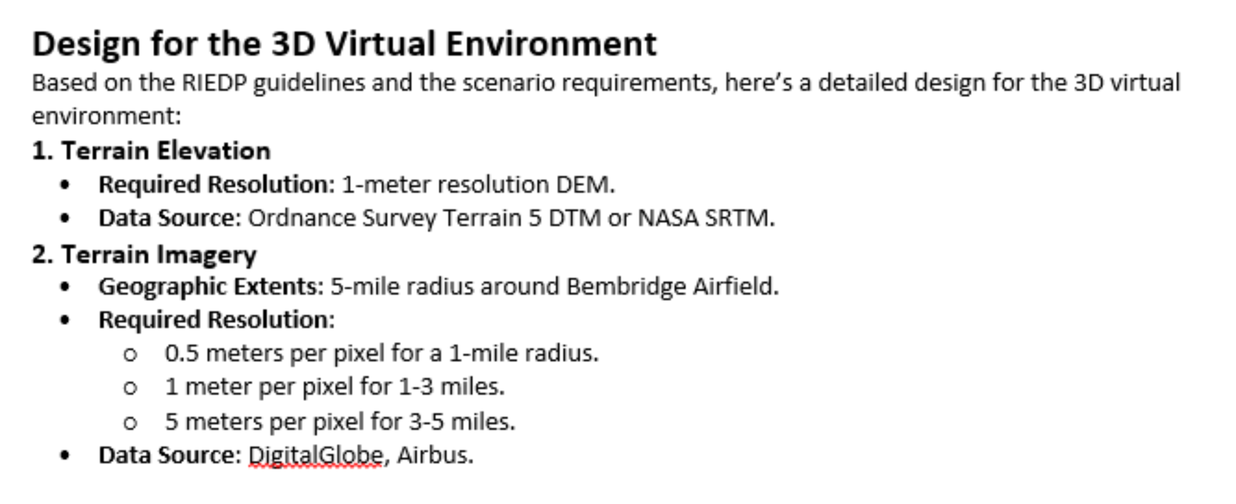
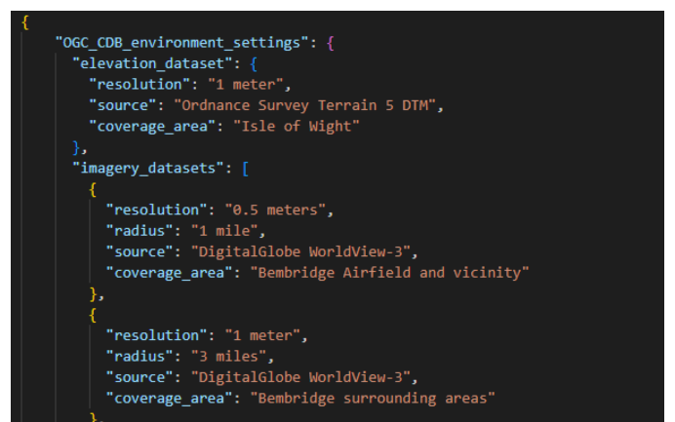
Requirements Analyst Agent
Objective:
Derive the VE requirements specifications from a description of the DT scenario
System User:
Does not possess expert knowledge of VE reqs or design
Agent Output
Input: DT scenario
Task: Translate scenario into VE specification
Agent Output: VE reqs specification
Environment Concepts:
Based on RIEDP RAM
Environment Development Planning:
Identify steps and actions
Reqs / Design Specification:
Identify steps and actions
10
Design Specification:
Standards based design specification

Slide 11
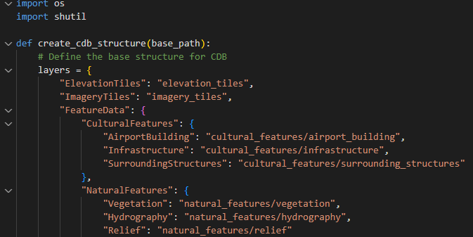
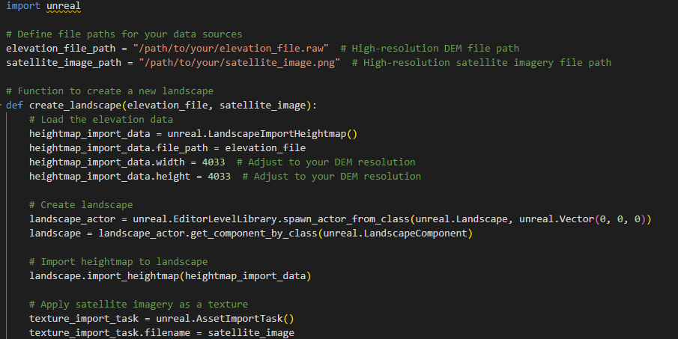
Other Agents
Data Assembler Agent
Role:
Gathers and organizes the data and content into a well-formed data set that provides the source and basis for environment generation for the target client systems
Enhanced Knowledge Access:
RAG allows agents to access and retrieve contextually relevant information from specialized, expert knowledge sources, overcoming limitations of pre-trained LLM data.
Improved Accuracy and Depth:
By curating comprehensive knowledge from multiple documents, RAG enables agents to provide thorough and expert-level responses with detailed, accurate information.
Cross-referenced Reliability:
It enables cross-referencing of facts from multiple authoritative sources, reducing the risk of errors or misleading information.
Real-time Data Integration:
RAG supports the integration and retrieval of the latest information in real time, which is crucial for high-fidelity virtual environments and digital twin solutions.
Explainability and Trust:
It enhances transparency and trust in AI agents by providing insights into retrieval decisions, source attribution, and agentic reasoning processes.
Environment Developer Agent
Role:
Environment developer constructs the environment for the client systems

Slide 12
VE Agent PoC Summary
AI agents applied to creation of a high-fidelity air operations virtual environment
Key Benefits:
Reduced development time by dynamically generating virtual environments based on changing operational needs.
Enhanced flexibility allows users to adapt environments without deep technical expertise.
Challenges Identified:
Complexity in integrating multiple agent roles.
Need for further refinement in agent decision making.

Slide 13
Multi-Agent System Considerations
Challenges
Scalability: As tasks increase, resource requirements grow, making coordination more complex
Hallucinations: AI generated misinformation may spread between agents if unchecked
Communication: Efficient orchestration between agents is critical to avoiding bottlenecks
LLM selection
Task specialization (e.g., summarization, code generation)
Performance vs. cost trade-offs (scalability vs. infrastructure investment)
Data security and privacy compliance
Local Models: Greater data privacy, lower latency, full control over computational resources.
Cloud Models: Scalable, easier to manage, but with potential data privacy concerns
Emergence of Development Frameworks
Tools (Langchain, AutoGen, CrewAI) have simplified multi-agent development - but design remains complex critical issues to address
Need for Objective Evaluation:
Limited benchmarks to assess multi-agent systems; need comprehensive evaluation methods to measure system performance

Slide 14
Conclusions
Future
Scalability: AI agents will enable larger, more complex tasks to be undertaken.
Creativity and Innovation: Enhanced agentic AI capabilities will unlock new capability
Next Steps
Continued research into multi-agent system efficiency and problem solving
Further integration of LLMs with domain specific knowledge sources
Transformative Potential: AI agents are already reshaping fields like software development and content creation
AI agents can enhance digital twin development by reducing complexity and enhancing capabilities
While agentic systems are promising, challenges in coordination, scalability, and accuracy remain
Further integration of multi-agents with diverse tasks & skills

Slide 15

Thank You

