Slide 1

Whole Earth Fraternal Twin Content
for Flight Simulation
Daniel Lowe
Simulation and Training Solutions
Collins Aerospace
Notes:
Goal: Lowering cost of simulation content while maintaining realism

Slide 2
Agenda
Current state of Database Creation
Industry goal: Digital Twin
Propose a novel idea: Fraternal Twin
Building a Fraternal Twin

Slide 3
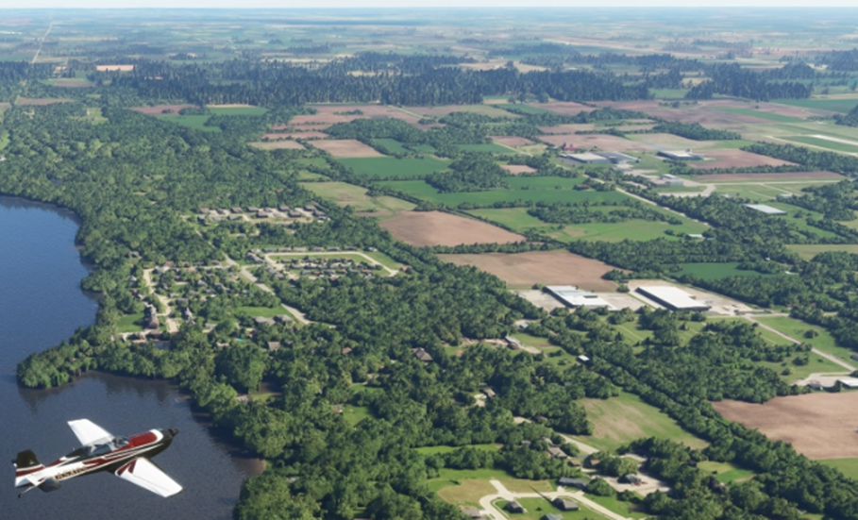

Introduction
Microsoft Flight Simulator Digital Twin
Notes:
Discuss the “Current State” of simulation content creation.
What does the industry want?
How can we improve the realism and lower the cost of content?
Microsoft uses AI to extract 3D objects from photo.
Whole Earth Photo Imagery is cost prohibitive - need lots of customers.
Hard to update photo content. (issues: color matching, clouds, time of day)
Why build a database for the Whole Earth?
Developing one process on a global dataset allows the development effort to be scaled over a larger area thus lowering costs
Spreads the development costs across more customers
Automation saves effort
We now have datasets that cover the whole earth.

Slide 4
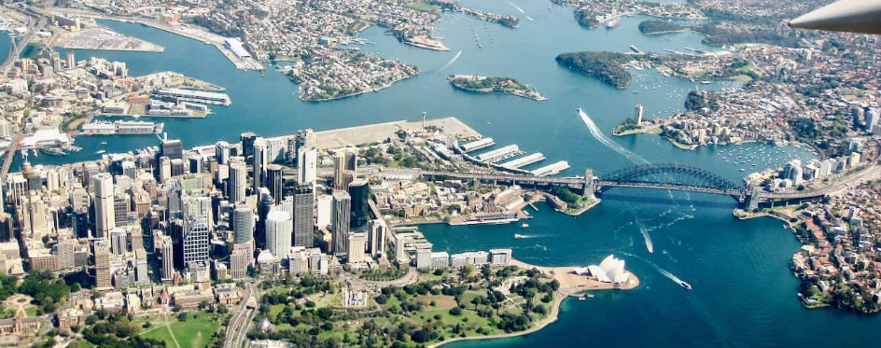
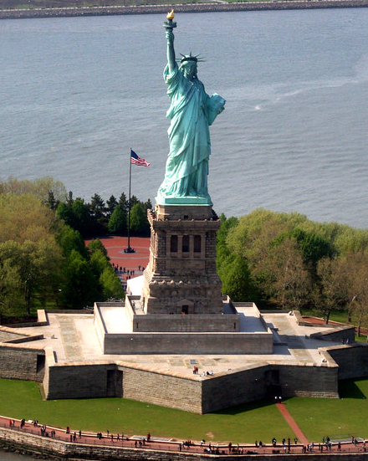
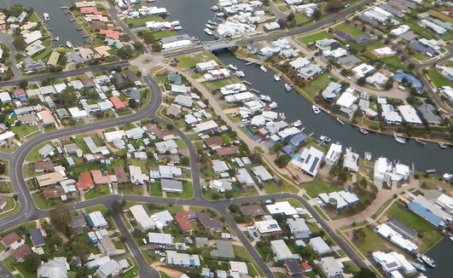
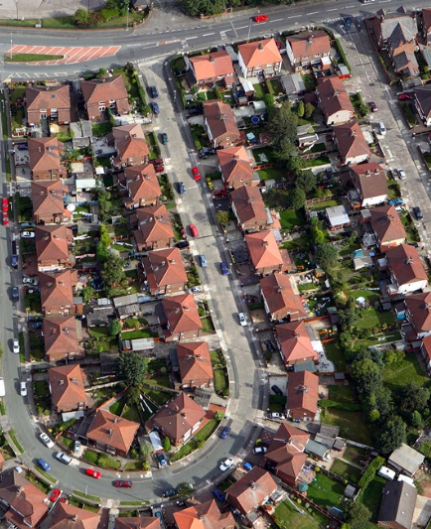
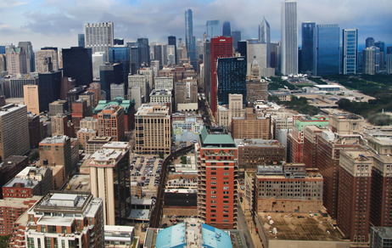
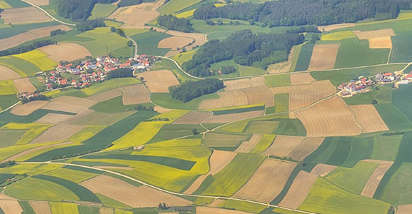
Digital Twin or Fraternal Twin
Notes:
Digital Twin is an exact copy of the real thing.
Typical View vs Actual View
How much content can change and a pilot would never notice?
A fraternal twin can substitute for a digital twin.
Water/Land boundaries, Road networks, Landmark Features, type/style of buildings
Next >> What technologies do we need?

Slide 5
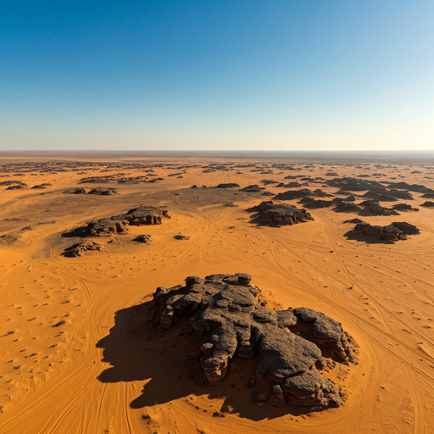
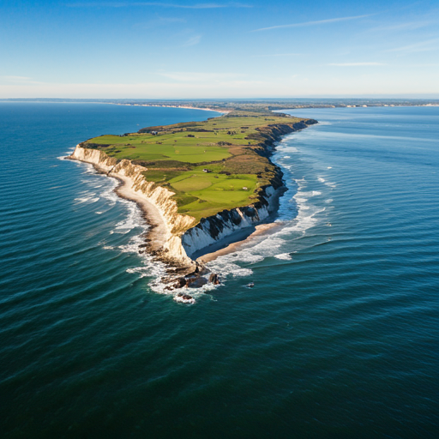
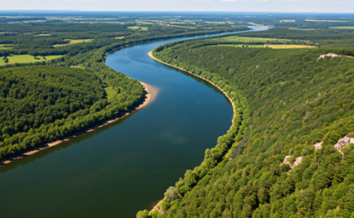
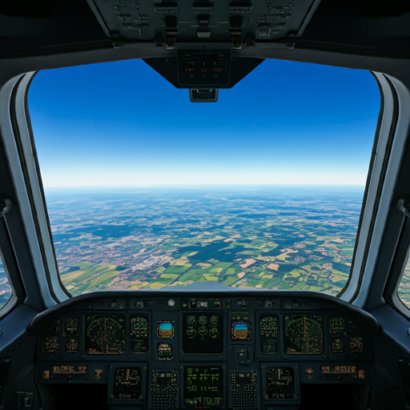
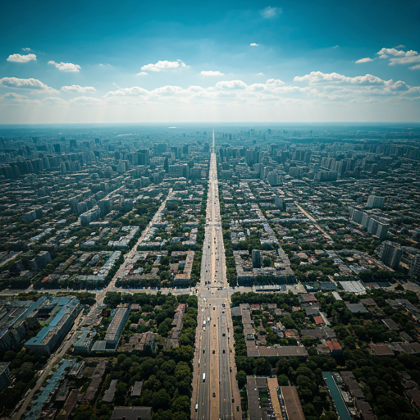
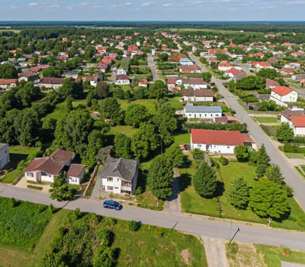
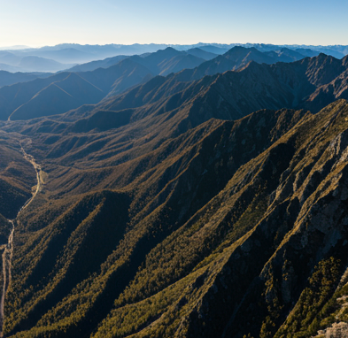
AI Image Generators
gemini.google.com
Notes:
Pros of Generating imagery
Photo-realistic
No repeating pattern at any altitude
Geo-specific road network and water for whole Earth
SPADE vs Stable Diffusion

Slide 6
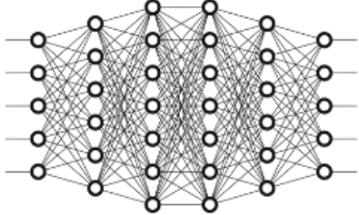
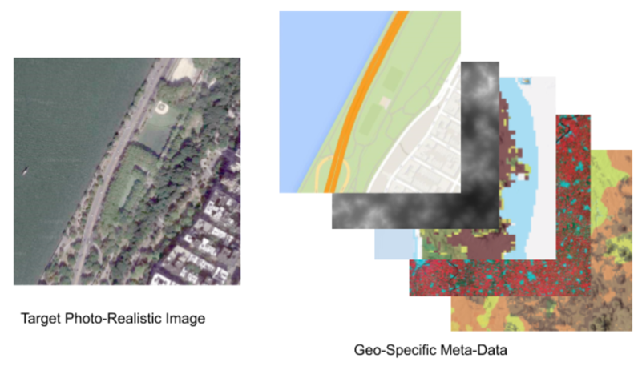
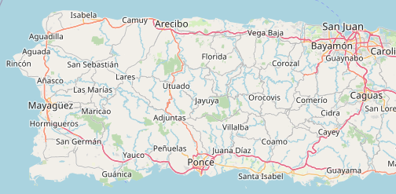
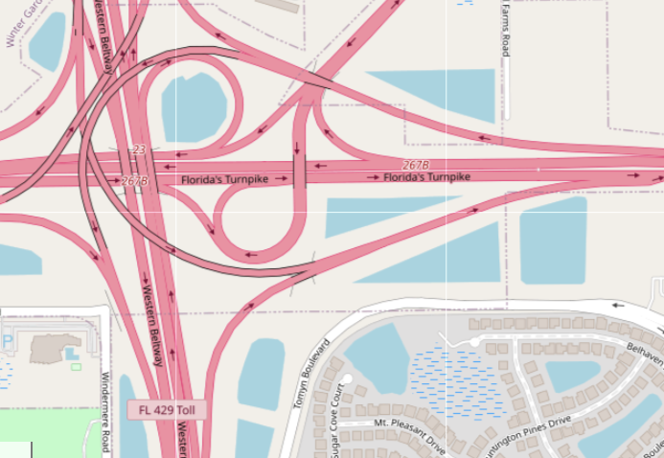
Semantic Image Synthesis
AI Image Generators
+
Whole Earth metadata
Semantic Image Synthesis
gemini.google.com
Notes:
Geographical (roads, waterways, building footprints, etc.)
Elevation (terrain slope)
Ecological (what type of land - desert, mountain, forrest, etc.)
Next> Whole Earth Biomes and Seasons

Slide 7
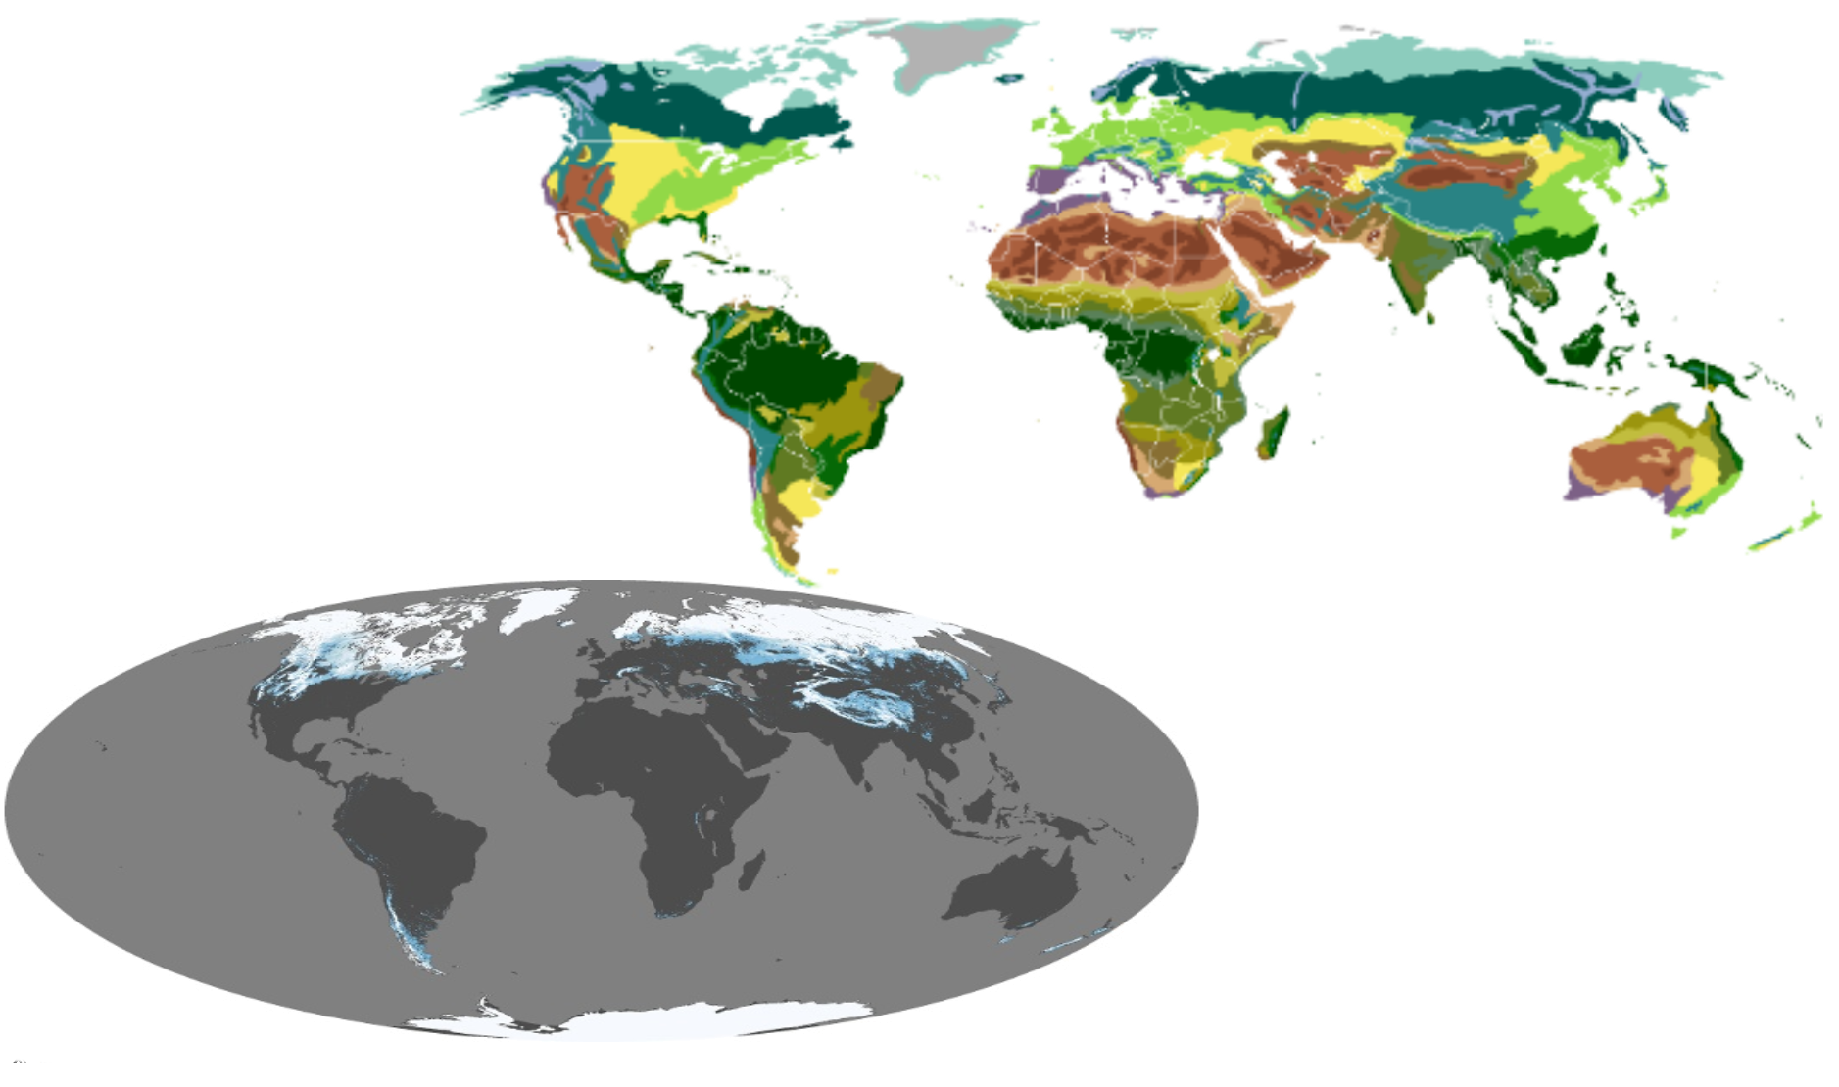
More Whole Earth Metadata
Biomes
Winter Snow
Notes:
Biomes - each biome represents a unique training area. Once a biome is trained it can be used throughout the world.
Seasons - where to find snow

Slide 8
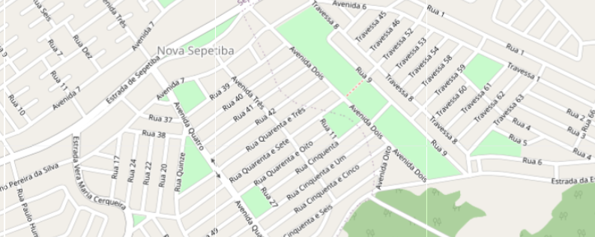
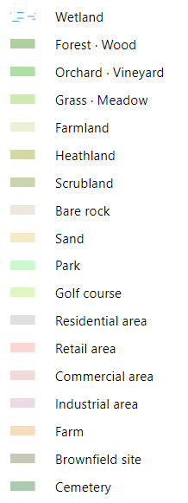
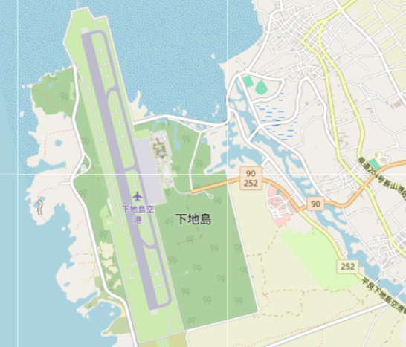
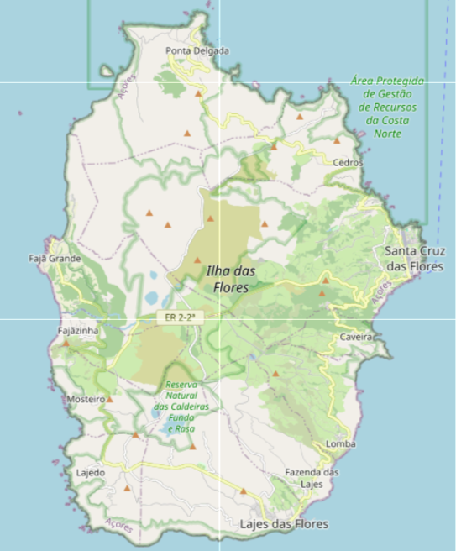
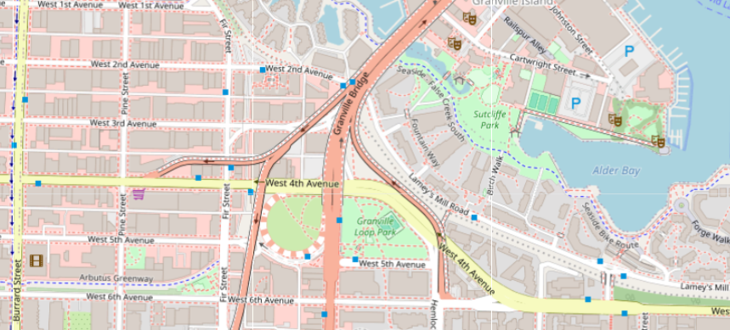
Semantic Data for the Whole Earth
Open Street Maps
Notes:
Open Street Maps (OSM) for the Whole Earth
Roads, waterways, landuse, powerlines

Slide 9
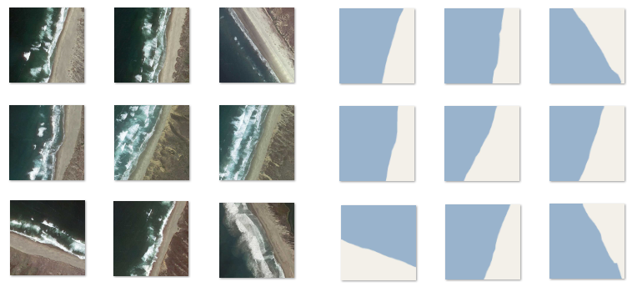
Shoreline Training Data
Real Imagery Semantic Data
Notes:
Did not need lots of imagery for training

Slide 10
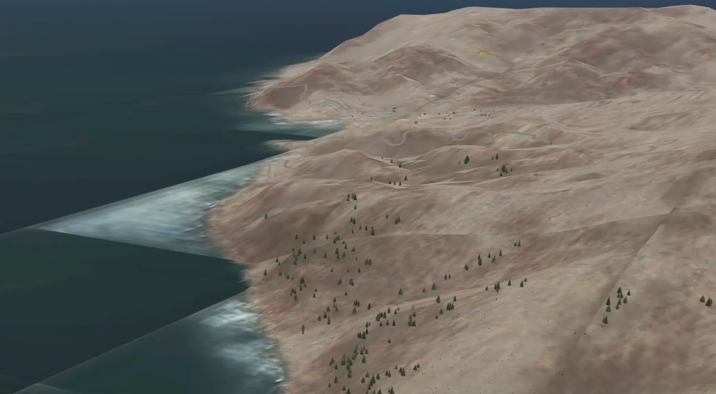
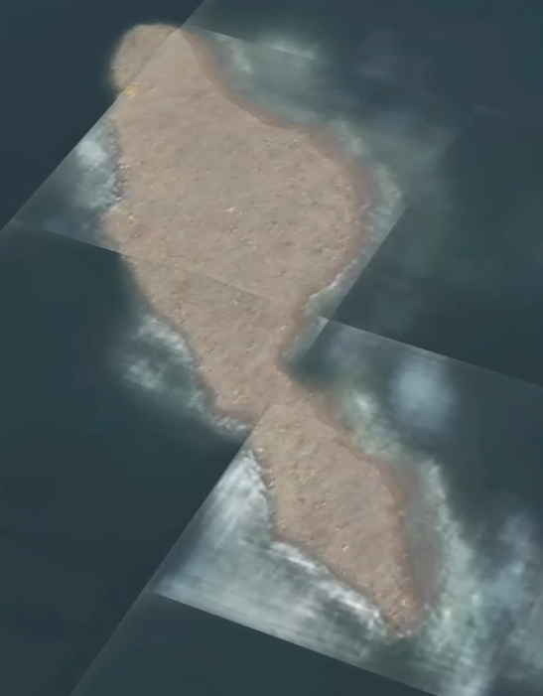
Generated Imagery at Run-time
Notes:
Run-time generation.
Demonstrated Shoreline continuity
Need to solve cohesion
Next>> What about other land types

Slide 11
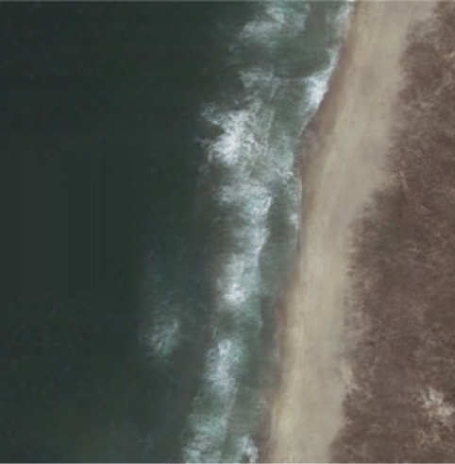
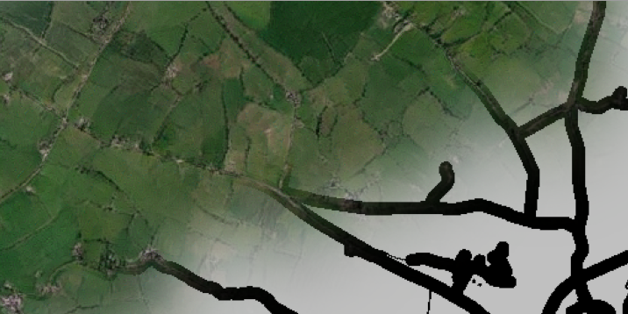
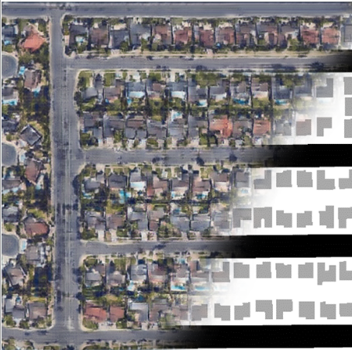
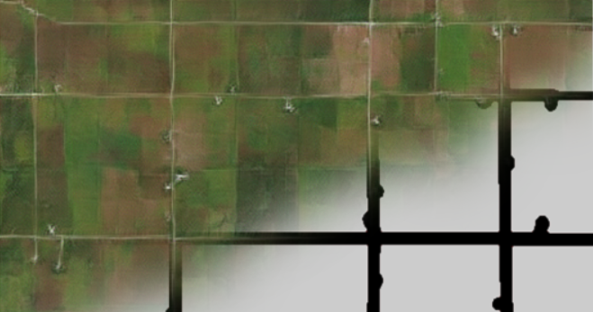
Generated Terrain
Shoreline Farmland CA Suburbs
Notes:
Generated Imagery from 3 small training datasets
Next>> But what about cohesion?

Slide 12
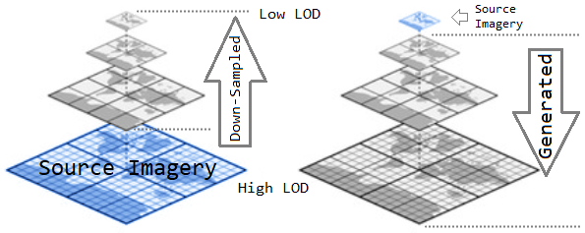
Imagery Generation
Down Sampled Imagery (Traditional Approach)
Generated Imagery (Fraternal Twin)
Notes:
Traditional Approach
Petabytes
Next>> Base Image

Slide 13
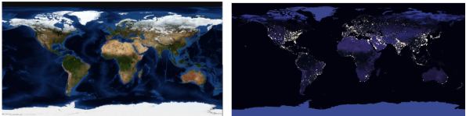
Base Image
Day
Night
Notes:
Base Imagery for day
Base Imagery for night
Next>> Spatial Coherence

Slide 14
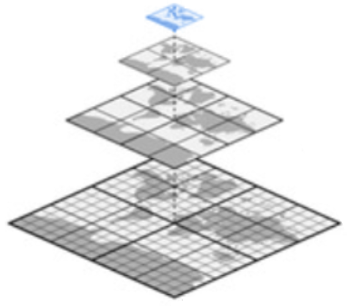
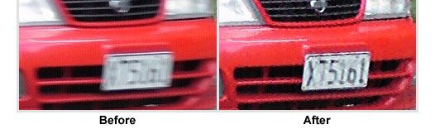

Spatial Coherence
Base Image
Notes:
Across tile boundaries
Between Levels of Detail (LOD)
Licence place may not have the right letter/number but it will be readable as a letter/number
Next>> building footprints

Slide 15
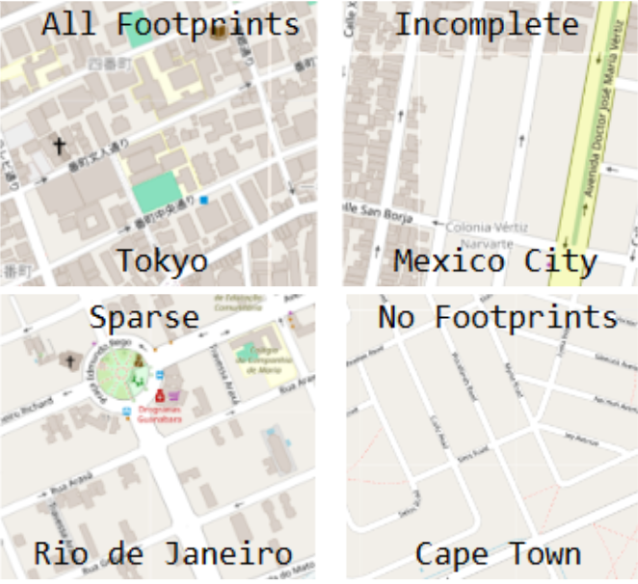
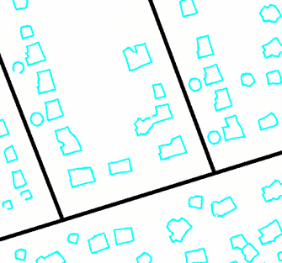

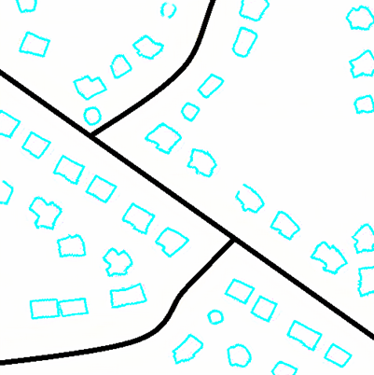

3D Models Footprints
OSM Building Footprints
Generated Building Footprints
Notes:
OSM Building Footprint Completeness
Demonstrated that missing OSM building footprints can be synthetically generated.
Building footprints are aligned with roads.
Next>> Back to sub-centimeter imagery

Slide 16





Sub-centimeter Texel Imagery
Notes:
Don’t need to be limited to satellite resolution for highest LOD.
Imagery can be trained to generate sub-centimeter imagery.
Only generated as needed and where needed.
This avoids the problem of storing lots of imagery.
Next>> airports

Slide 17
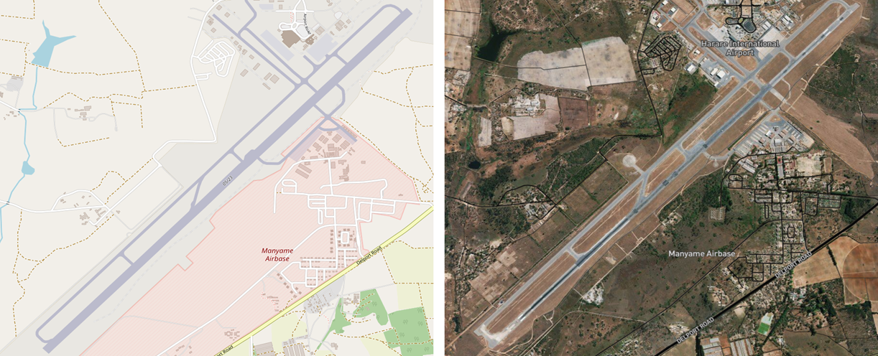
Airports
OSM Airport Data
Real Airport Image
Notes:
OSM contains practically all the world’s airports. This information can be used for a less expensive solution to populate the world’s airports.
https://www.openstreetmap.org/#map=15/-17.9320/31.0943

Slide 18
Summary
 | Digital Twin | Fraternal Twin
Realistic | Looks real | Looks real
Customizable | Fixed | Parameterizable
Geographic Scope | Usually Localized | Whole World
Cost | $$$$ | $$
Sensorization | difficult | easier
Content Updates | hard | easier
Shadows | baked in | not an issue
Database Size | Petabytes | Megabytes
A Whole Earth Fraternal Twin is:
more cost effective than a Digital Twin
sufficiently realistic for training
Notes:
better technology

Slide 19
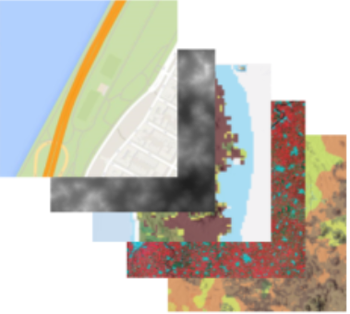

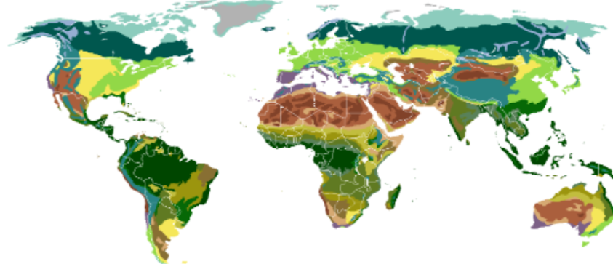

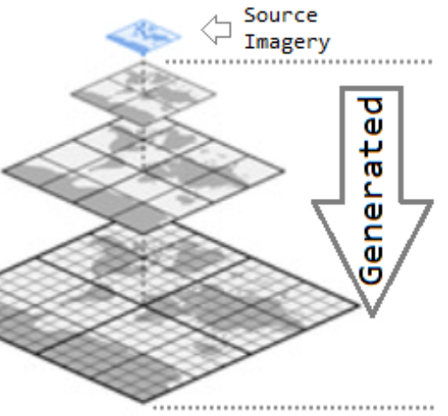
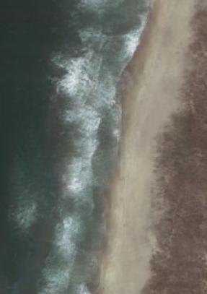
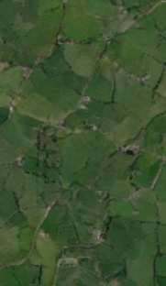
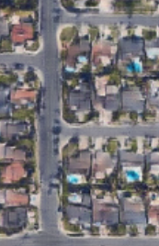

Questions
Whole Earth Fraternal Twin Content
for Flight Simulation

