Slide 1
See Like a Satellite:
Adapting Human Vision to Complex Sensing Technologies with Adaptive Synthetic Aperture Radar Image Recognition Training (ASIRT)
Presented by:
Kimberly Pollard, DEVCOM Army Research Laboratory
Spencer Lin, USC Institute for Creative Technologies, MxR Lab
Kimberly A. Pollard, Benjamin T. Files, Brent Lance
DEVCOM Army Research Laboratory
David Nelson, Ben Nye, Rhys Yahata, Spencer Lin
USC Institute for Creative Technologies
UNCLASSIFIED

Slide 2
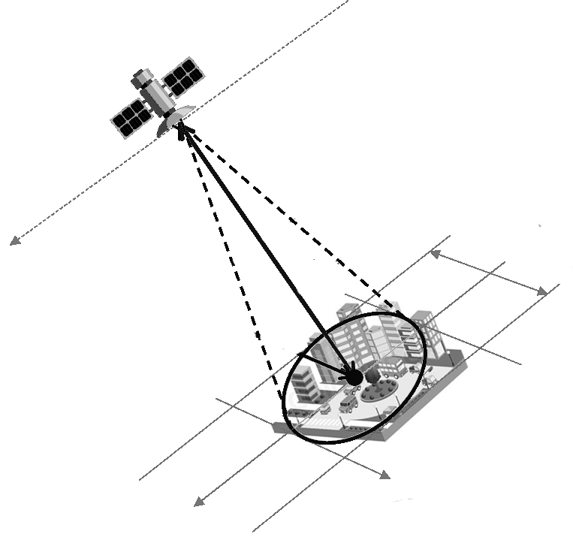
Synthetic Aperture Radar (SAR)
SAR Remote Sensing Technology
Powerful
Works at night
Sees through clouds, rain, even fabric!
Works at great distances
Indispensable for understanding who, what,
where, when
Challenging
Images are difficult for humans
Images violate natural visual expectations
Too many images for people to ever view
UNCLASSIFIED

Slide 3
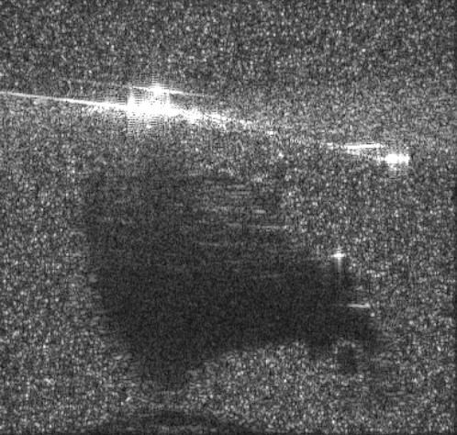
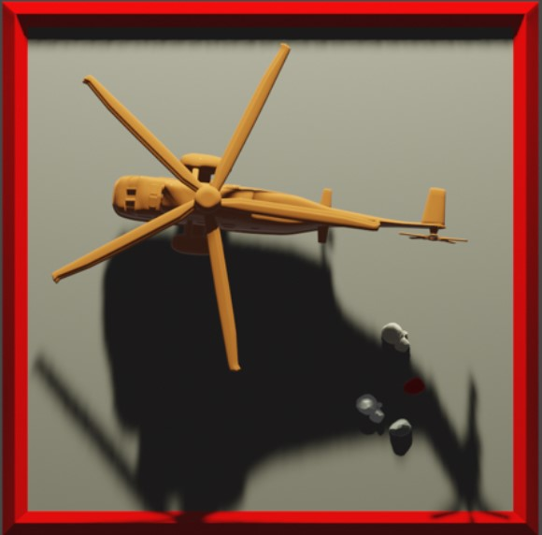
The JOYS of SAR
UNCLASSIFIED

Slide 4
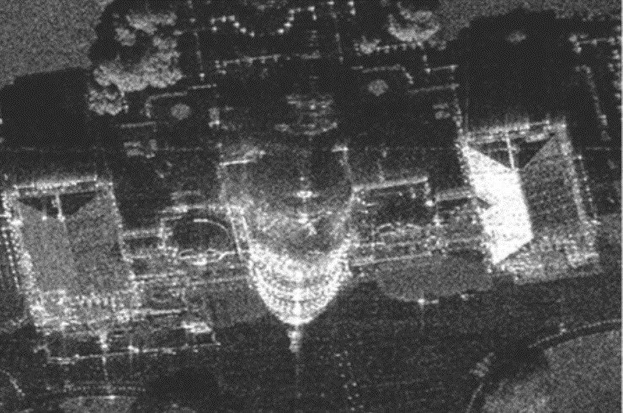
SAR’S Peculiar PROPERTIES
SAR images differ from visual light images ^{5-7,11}
  Shadows point away from sensor
  Geometric distortions
  Layover, where tall objects look closer
  Multipath reflections add repeats and ghosts
  Microwaves interact with materials differently than visible light
  Differences in resolution based on ground slope
  And more!
Why can’t AI already do this?
  Not enough labeled training data
Image courtesy Sandia National Labs
Layover
Multipath
UNCLASSIFIED
Notes:
Sensor angle changes appearance
Stars from trihedrals

Slide 5


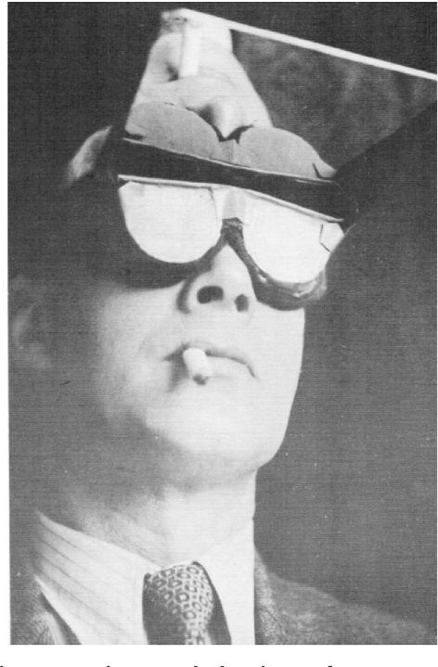
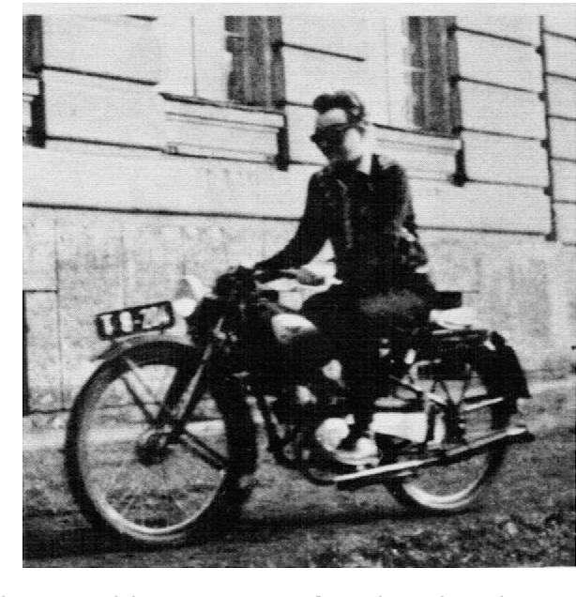

How do we quickly train humans to label SAR?
Current approach:
  Currently training methods are somewhat limited ⁸⁻¹⁰
  Training is largely knowledge-based.
Our approach:
  Combine adaptive learning methods
  with a perceptual learning
  (perceptual adaptation) approach
Current training for SAR labelers
PHYSICS
Sachse, P., Beermann, U., Martini, M., Maran, T., Domeier, M., & Furtner, M. R. (2017). “The world is upside down”–The Innsbruck goggle experiments of Theodor Erismann (1883–1961) and Ivo Kohler (1915–1985). Cortex, 92, 222-232.
UNCLASSIFIED

Slide 6
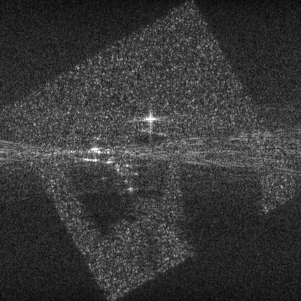
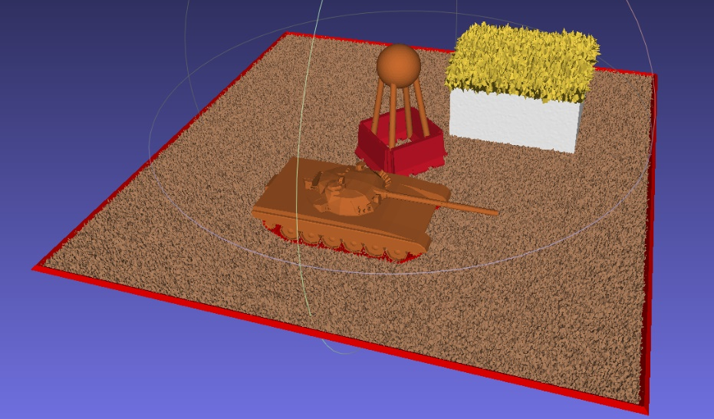
Using Perceptual Learning for SAR
Human visual system - 3D perspective over time (temporal Association) to learn objects ¹²⁻¹⁶
SAR in augmented reality!
Immersive, interactive training systems - perceive objects through the “eyes” of the sensor
Develop an intuitive understanding of SAR images
First: formal user study to assess effectiveness and inform AR design
Original renders of publicly available models using F/OSS software
UNCLASSIFIED
Notes:
Human visual system uses 3D perspective over time (temporal association) to learn objects ¹²⁻¹⁶
Let’s do that with SAR in augmented reality!
Develop immersive, interactive training system to allow humans to perceive objects as if through the “eyes” of SAR
Develop an intuitive understanding of SAR images
Before we make the jump to augmented reality, we did a user study to assess effectiveness and help inform design

Slide 7
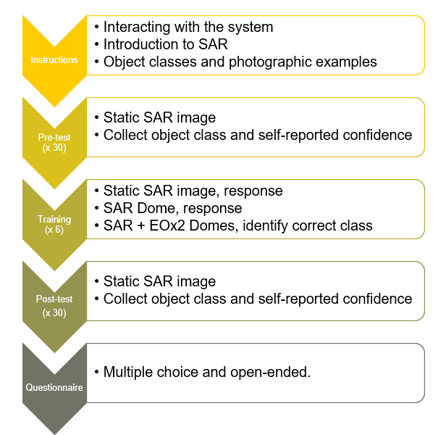
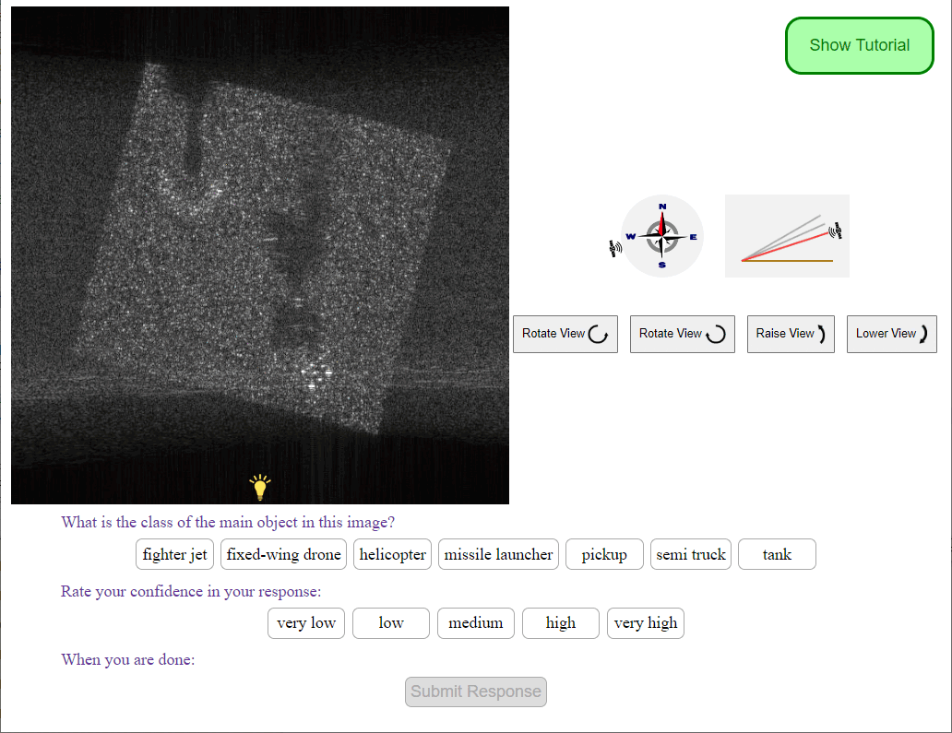
User Study
UNCLASSIFIED

Slide 8
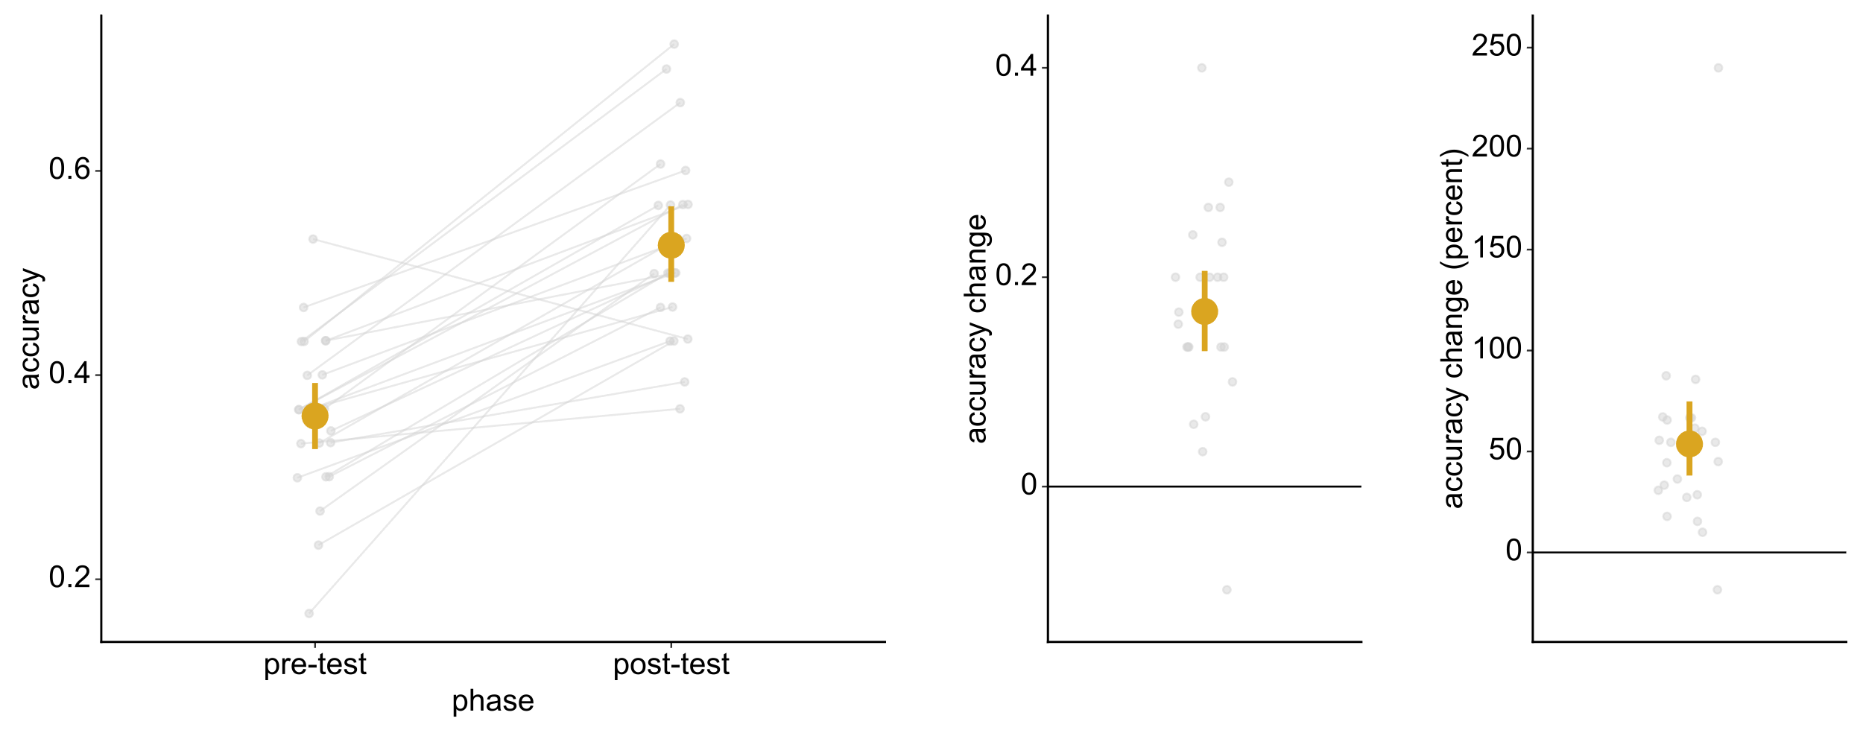
Overall Performance improves after training
UNCLASSIFIED

Slide 9
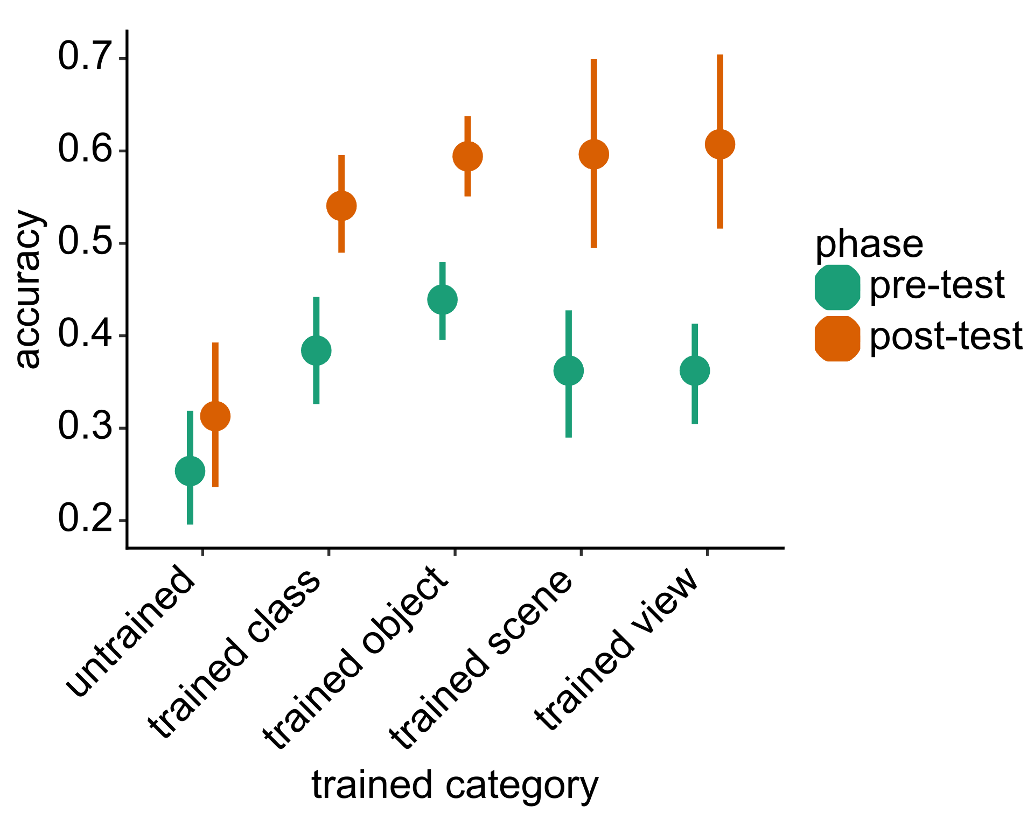
Accuracy improvement varies by relationship of test to training
UNCLASSIFIED

Slide 10
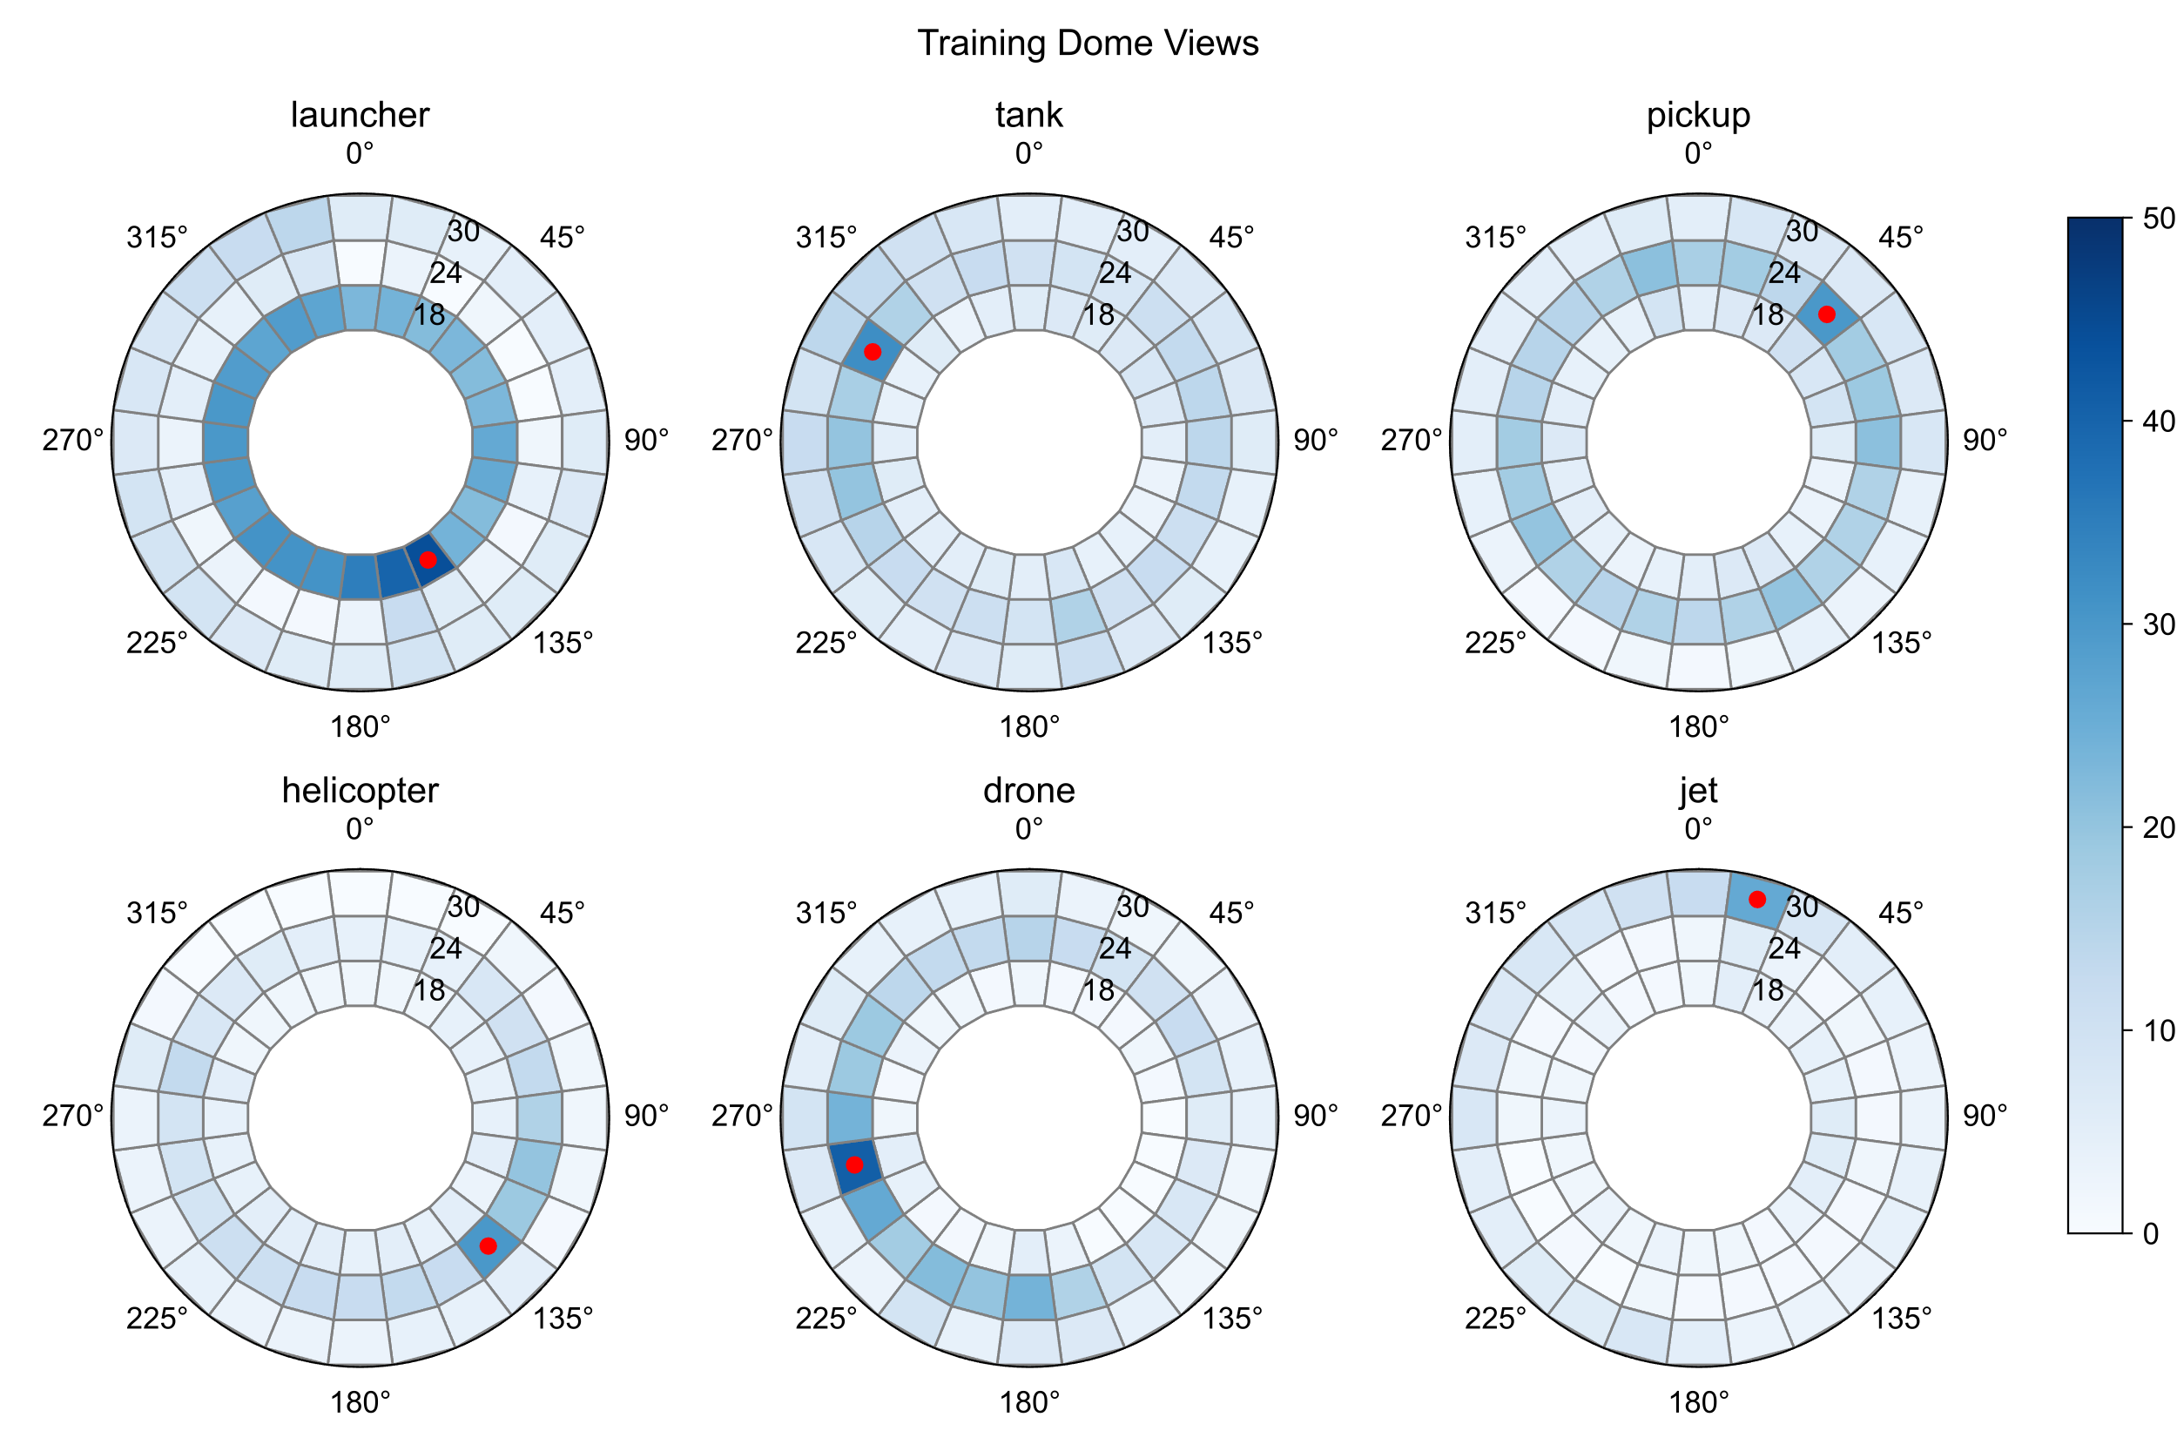
Participants explored SAR Domes
UNCLASSIFIED

Slide 11
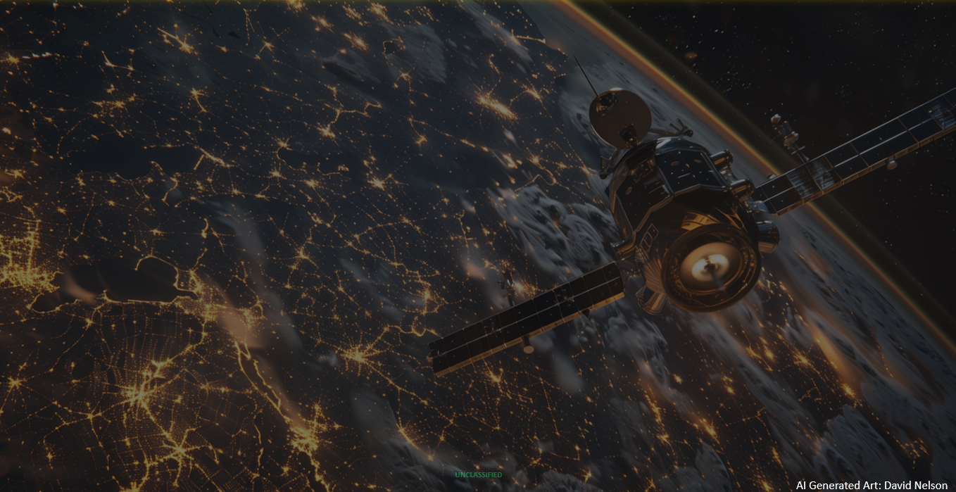
SAR-AR
Next Steps
A mobile-based Augmented Reality (AR) application to sharpen the acumen of SAR interpreters.

Slide 12
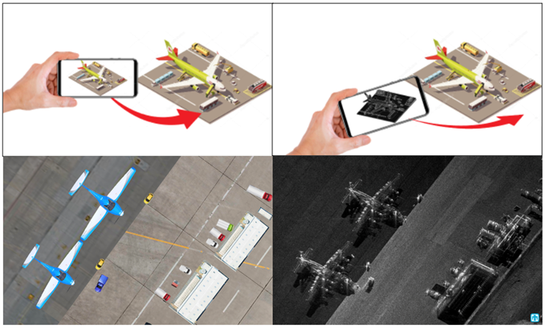
SAR-AR
Smartphone/Tablet-based augmented reality interaction for use in future user-study.
UNCLASSIFIED
Notes:
This training application will be used in the design of a comparable study to the one already conducted. We will investigate whether immersive/interactive engagements like this one can even more greatly improve SAR image identification.

Slide 13
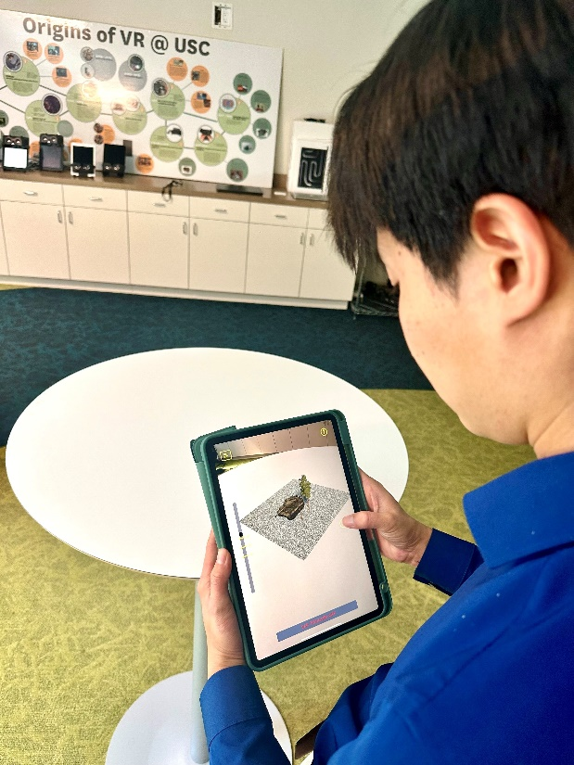
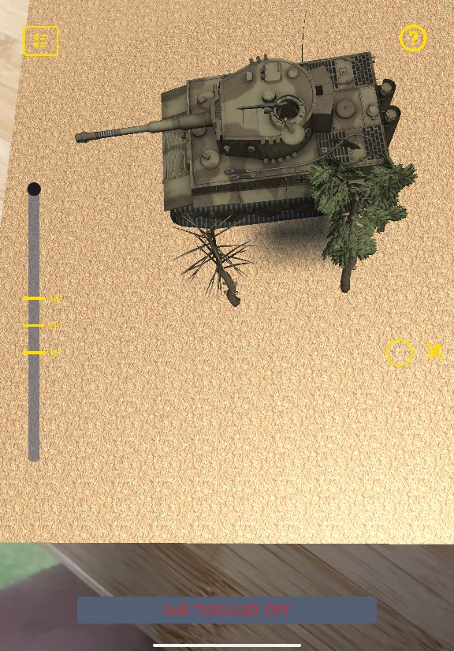
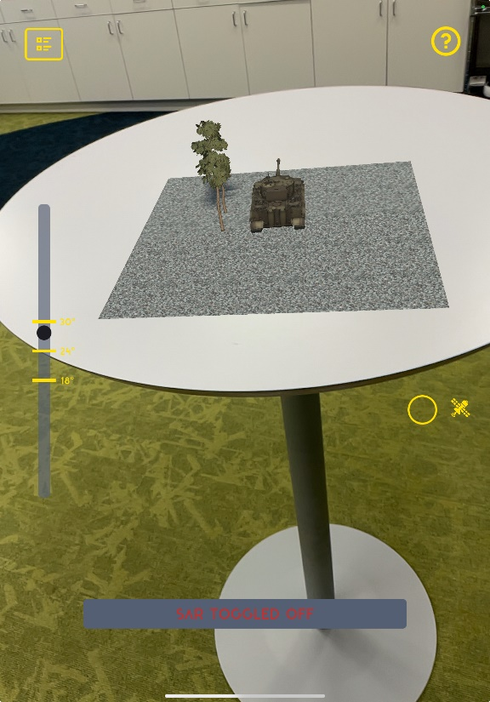
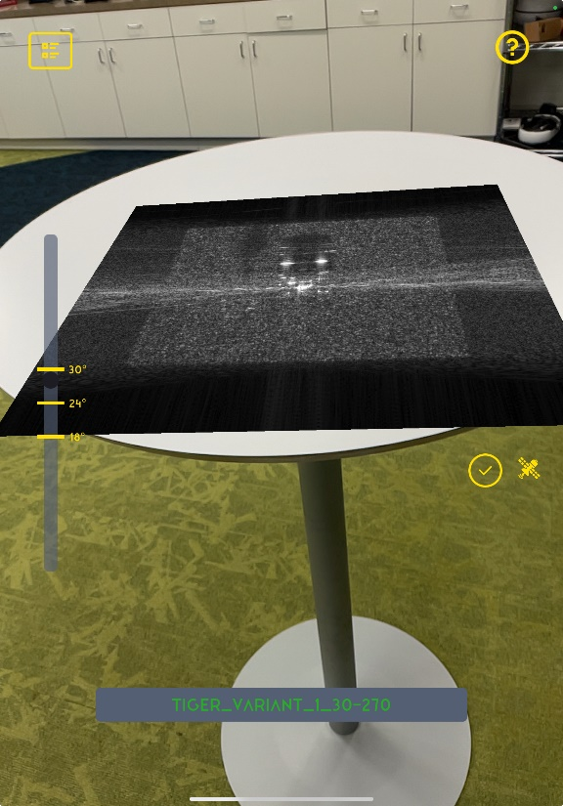
SAR-AR
Handheld smart device allows user to engage with augmented reality view of the scene.
User can toggle between SAR and optical views and can walk around the scene to see different angles.
UNCLASSIFIED
Notes:
This training application will be used in the design of a comparable study to the one already conducted. We will investigate whether immersive/interactive engagements like this one can even more greatly improve SAR image identification.

Slide 14
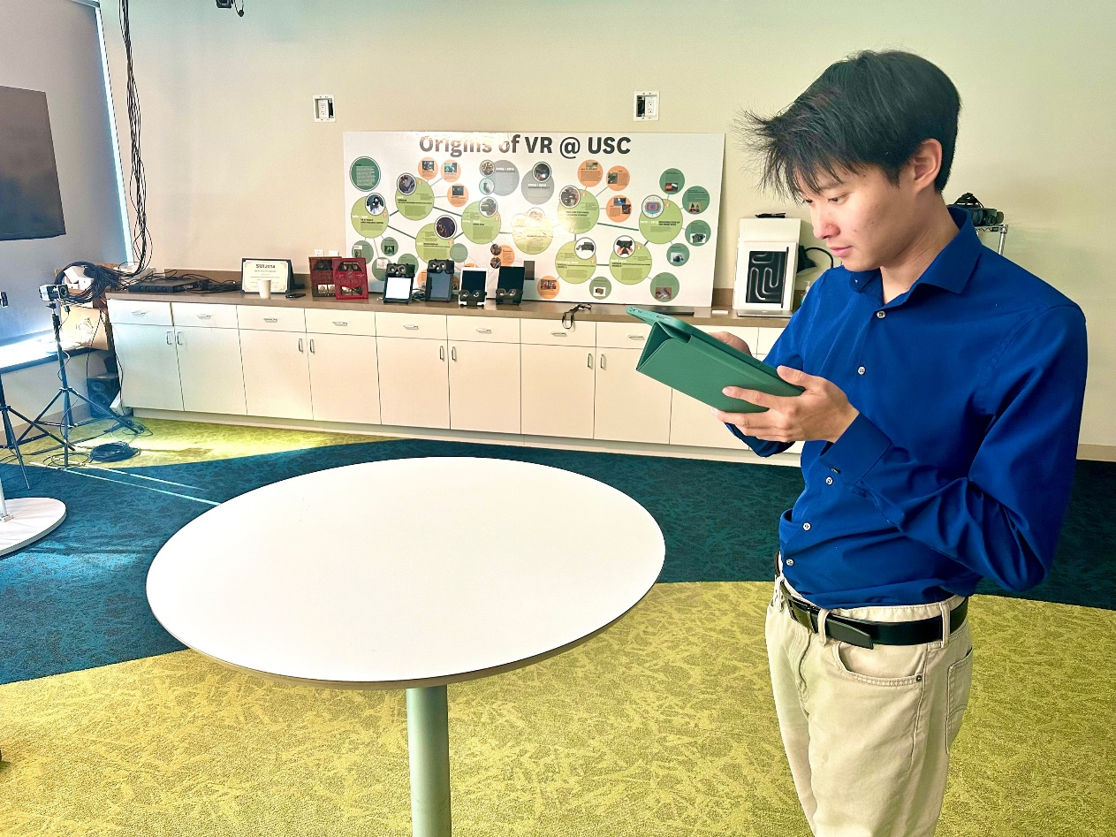
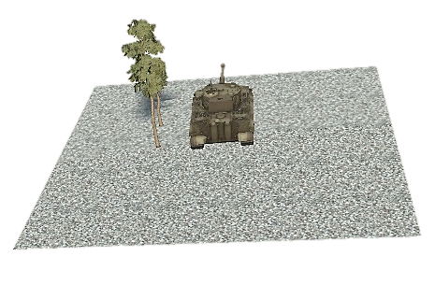
Value-Added
Spatially orient users to build intuition of how SAR technologies work
Interactive way of learning the properties of SAR imaging
Mobile platform is easy to distribute and vastly portable
More engaging AR-based user interface lowers the friction of learning
UNCLASSIFIED
Notes:
Spatially orient users to build intuition of how SAR technologies work
Interactive way of learning the properties of SAR imaging
Mobile platform is easy to distribute and vastly portable
More engaging AR-based user interface lowers the friction of learning

Slide 15

Future Work
Conduct a formal user study to compare the efficacy of SAR-AR with traditional desktop-based trainers
Design an interactive module to engage users and strengthen knowledge absorption and retention
Upgrade textures of models to be more realistic
AI Generated Art: David Nelson
AI Generated Art: David Nelson
UNCLASSIFIED

Slide 16
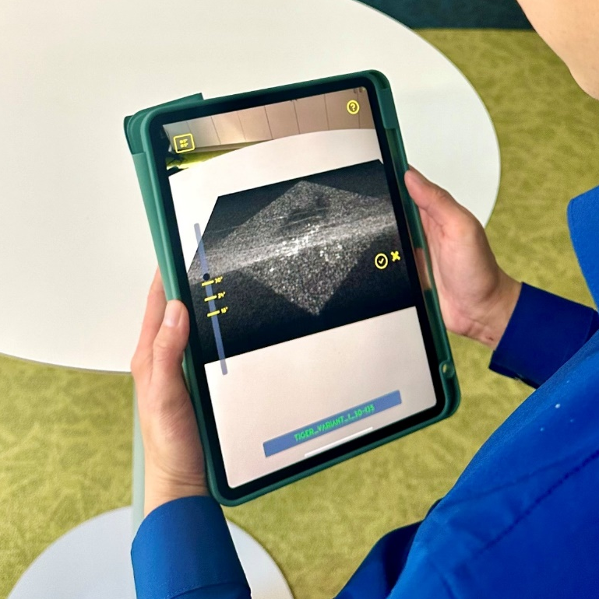

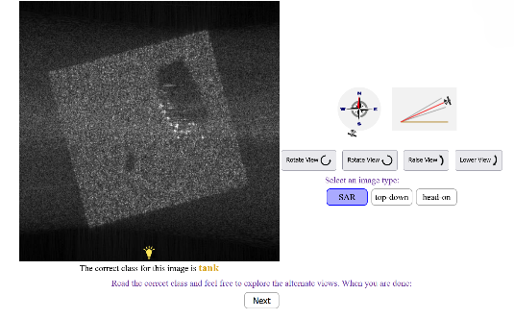
See Like A Satellite
Thanks! Visit us in the demonstration hall to interact with the SAR-AR training system!
Try the hands-on SAR-AR
training system!
Try the online trainer used
in the experiment!
Contacts:
Kimberly Pollard:
kimberly.a.pollard.civ@army.mil
Ben Files:
benjamin.t.files.civ@army.mil
David Nelson:
dnelson@ict.usc.edu
Ben Nye:
nye@ict.usc.edu
Spencer Lin:
slin@ict.usc.edu
https://sar-training.pages.sitcore.net/sarTrainer/prolific.html
UNCLASSIFIED
Notes:
This training application will be used in the design of a comparable study to the one already conducted. We will investigate whether immersive/interactive engagements like this one can even more greatly improve SAR image identification.

Slide 17
Backup slides
UNCLASSIFIED

Slide 18
References
  1. Seitz, A. R. Perceptual learning. Current Biology 27, R631–R636 (2017).
  2. Fiorentini, A. & Berardi, N. Perceptual learning specific for orientation and spatial frequency. Nature 287, 43–44 (1980).
  3. Ball, K. & Sekuler, R. Adaptive Processing of Visual Motion. Journal of Experimental Psychology: Human Perception and Performance 7, 780–794 (1981).
  4. Sagi, D. Perceptual learning in Vision Research. Vision Research 51, 1552–1566 (2011).
  5. van Zyl, J. & Kim, Y. Synthetic Aperture Radar Polarimetry. (John Wiley & Sons, Inc., 2011). doi:10.1002/9781118116104.
  6. Doerry, A. W. & Dickey, F. M. Synthetic Aperture Radar. Optics & Photonics News 15, 28 (2004).
  7. Stone, J. V., Kerrigan, I. S. & Porrill, J. Where is the light? Bayesian perceptual priors for lighting direction. Proc. R. Soc. B. 276, 1797–1804 (2009).
  8. Conway, E. D. An introduction to satellite image interpretation. (Johns Hopkins University Press, 1997).
  9. Johnston, I. A. et al. Perceptual Learning of Appendicitis Diagnosis in Radiological Images. Journal of Vision 20, 16 (2020).
  10. Chen, W., HolcDorf, D., McCusker, M. W., Gaillard, F. & Howe, P. D. L. Perceptual training to improve hip fracture identification in conventional radiographs. PLoS ONE 12, e0189192 (2017).
  11. Hogan, D. & Brown, J. SAR 101: An Introduction to Synthetic Aperture Radar. Capella Space https://www.capellaspace.com/sar-101-an-introduction-to-synthetic-aperture-radar/ (2020).
  12. Li, N., & DiCarlo, J. J. (2010). Unsupervised natural visual experience rapidly reshapes size-invariant object representation in inferior temporal cortex. Neuron, 67(6), 1062-1075.
  13. DiCarlo, J. J. & Cox, D. D. Untangling invariant object recognition. Trends in Cognitive Sciences 11, 333–341 (2007).
  14. Rolls, E. T. Learning Invariant Object and Spatial View Representations in the Brain Using Slow Unsupervised Learning. Front. Comput. Neurosci. 15, 686239 (2021).
  15. Wiskott, L. & Sejnowski, T. J. Slow Feature Analysis: Unsupervised Learning of Invariances. Neural Computation 14, 715–770 (2002).
  16. Peters, B. & Kriegeskorte, N. Capturing the objects of vision with neural networks. Nature Human Behavior 5, 1127–1144 (2021).
UNCLASSIFIED

Slide 19
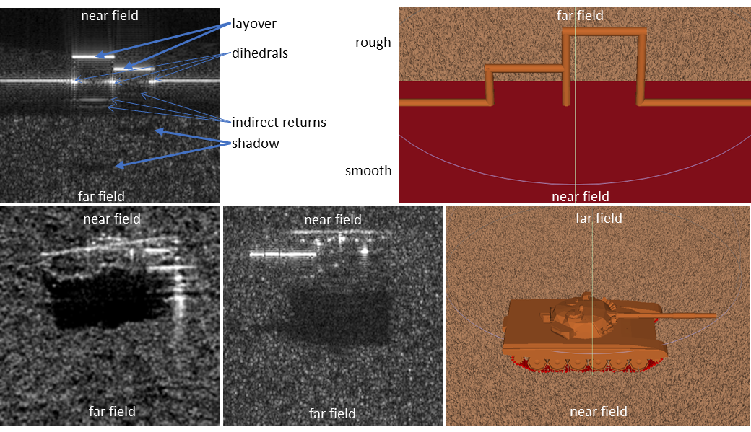
Simulating SAR images
UNCLASSIFIED

Slide 20
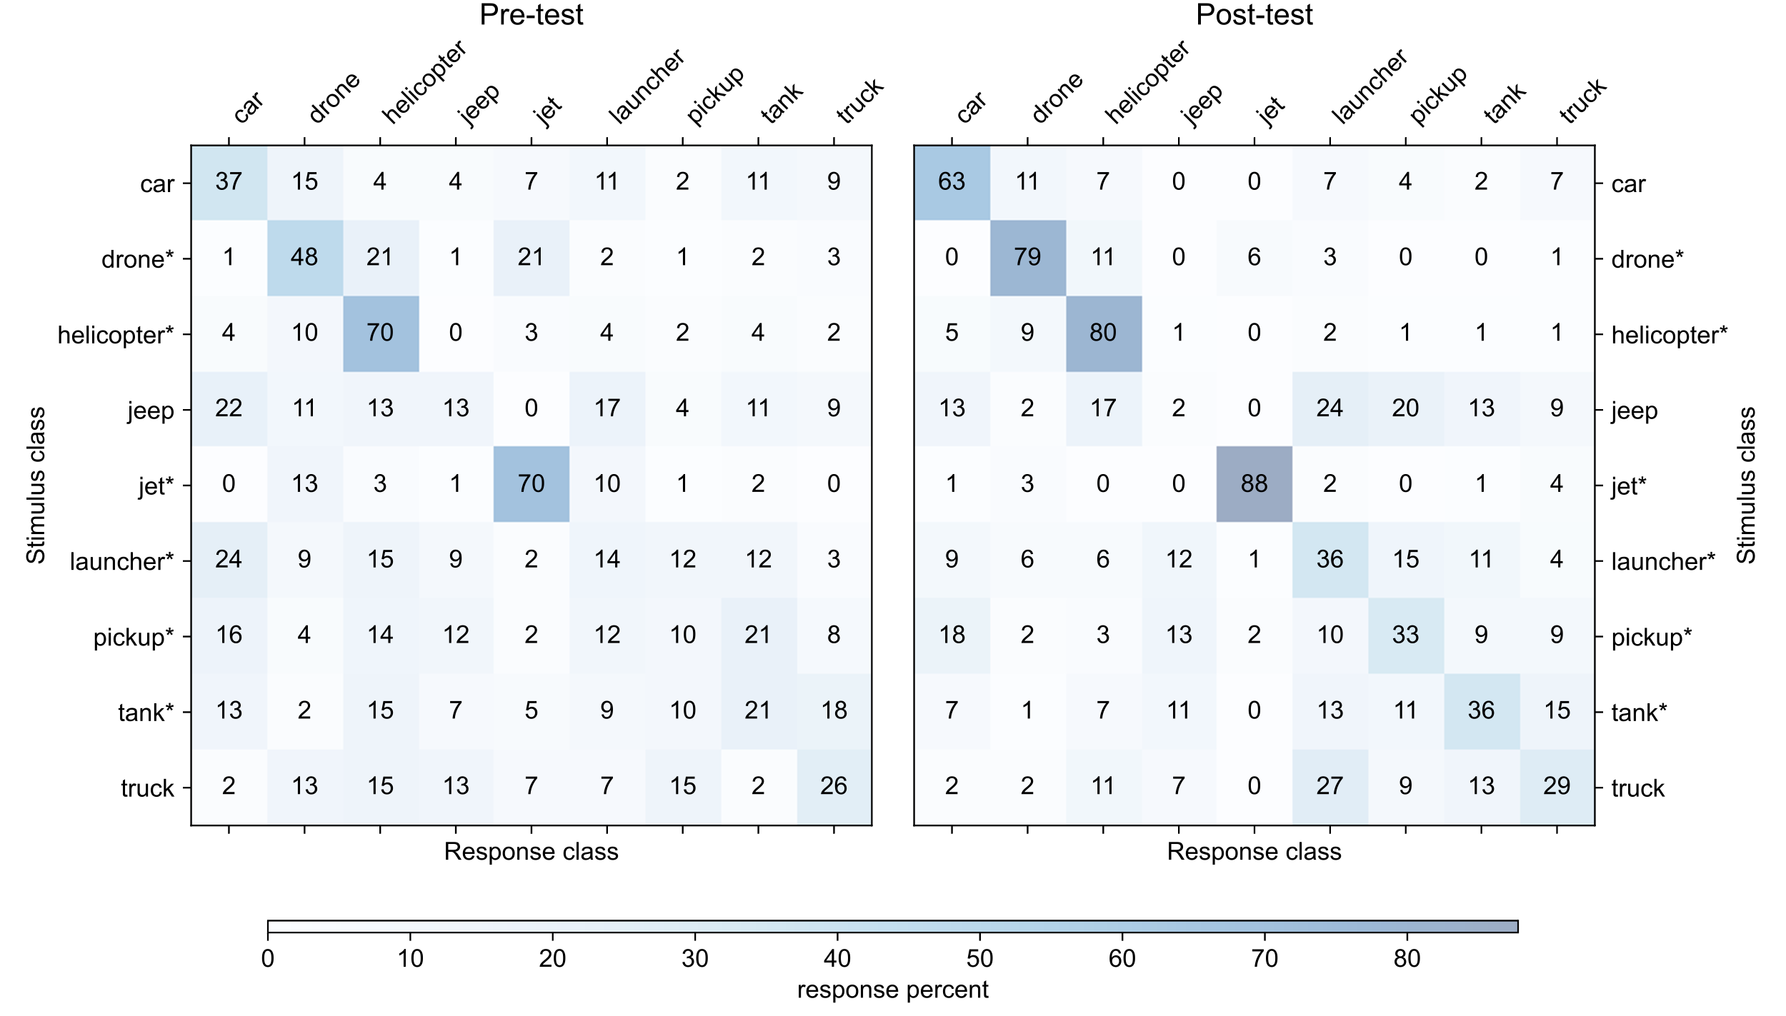
More accurate for trained classes
(and untrained: Car)
UNCLASSIFIED

Slide 21
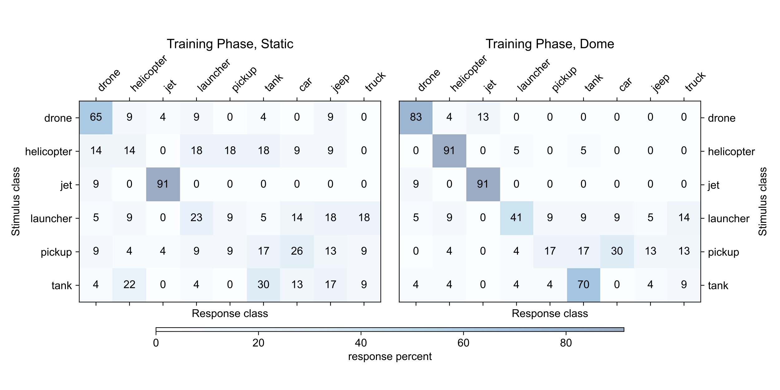
Fewer Confusions after Dome Viewing
UNCLASSIFIED

Slide 22

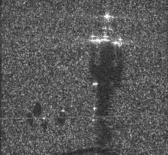

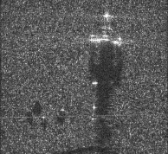

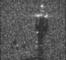

Enabling a different kind of human/AI teaming
Q: Why can’t AI already do this?
Better Training
Faster, more accurate image labeling
helicopter
More labeled data
Improved AI
nnnn
helicopter
nnnn
nnnn
helicopter
helicopter
helicopter
helicopter
helicopter
Better understanding of the world around us
UNCLASSIFIED
Notes:
Mention the crowd source thing
And how we’ll still need labelers after this
To combat adversarial stuff, to handle new objects, etc.

Slide 23
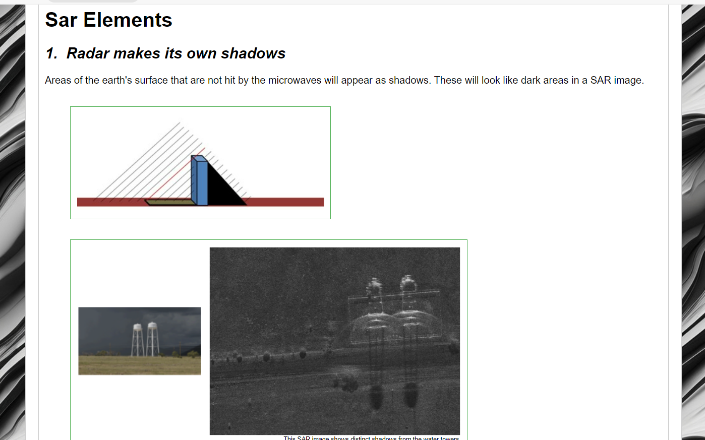
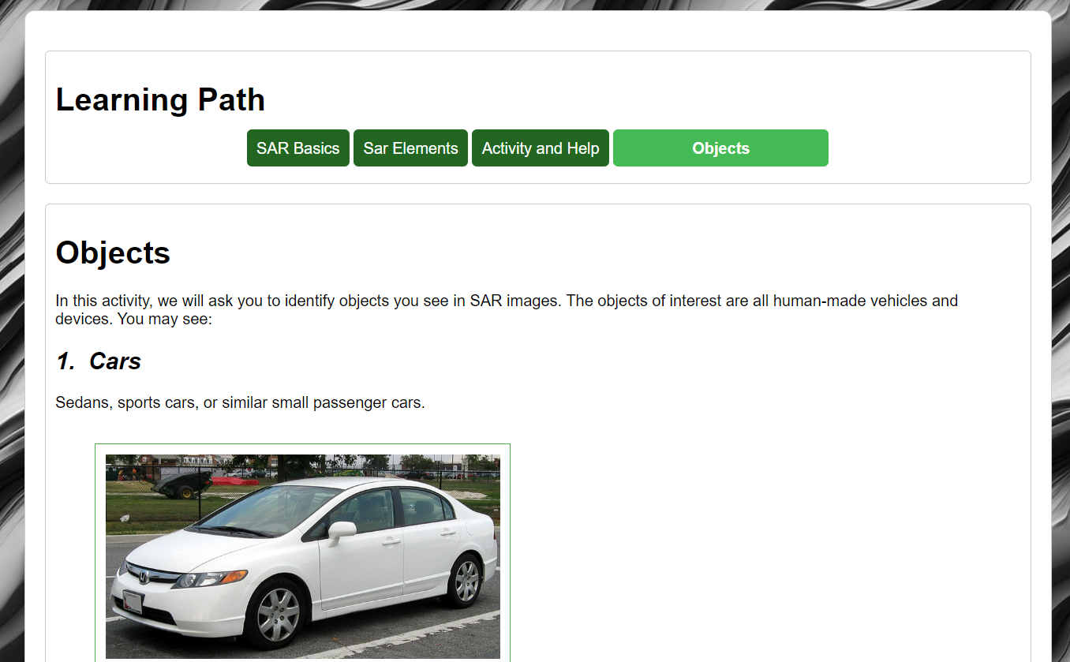
User Study
Instructions
Interacting with the system
Introduction to SAR
Pre-test
(x 30)
Static SAR image
Collect object class and self-reported confidence
Training
(x 6)
Static SAR image, response
SAR + EOx2 Domes, identify correct class
Post-test
(x 30)
Questionnaire
Object classes and photographic examples
Static SAR image
Multiple choice and open-ended.
SAR Dome, response
Collect object class and self-reported confidence
https://sar-training.pages.sitcore.net/sarTrainer/prolific.html
UNCLASSIFIED
Notes:
23 participants
Recruited from the general population
using Prolific
Web-based experiment

Slide 24
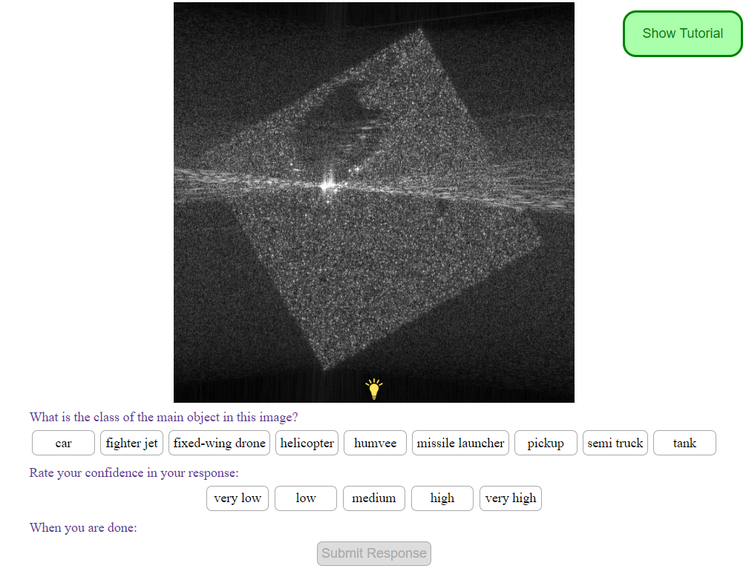
User Study
Instructions
Interacting with the system
Introduction to SAR
Pre-test
(x 30)
Static SAR image
Collect object class and self-reported confidence
Training
(x 6)
Static SAR image, response
SAR + EOx2 Domes, identify correct class
Post-test
(x 30)
Questionnaire
Object classes and photographic examples
Static SAR image
Multiple choice and open-ended.
SAR Dome, response
Collect object class and self-reported confidence
UNCLASSIFIED

Slide 25
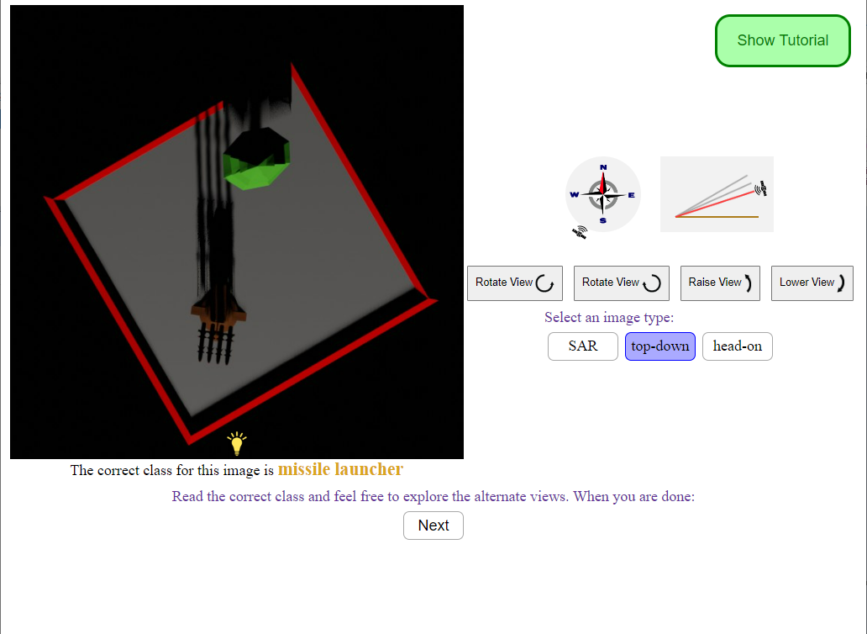
User Study
Instructions
Interacting with the system
Introduction to SAR
Pre-test
(x 30)
Static SAR image
Collect object class and self-reported confidence
Training
(x 6)
Static SAR image, response
SAR + EOx2 Domes, identify correct class
Post-test
(x 30)
Questionnaire
Object classes and photographic examples
Static SAR image
Multiple choice and open-ended.
SAR Dome, response
Collect object class and self-reported confidence
UNCLASSIFIED

Slide 26
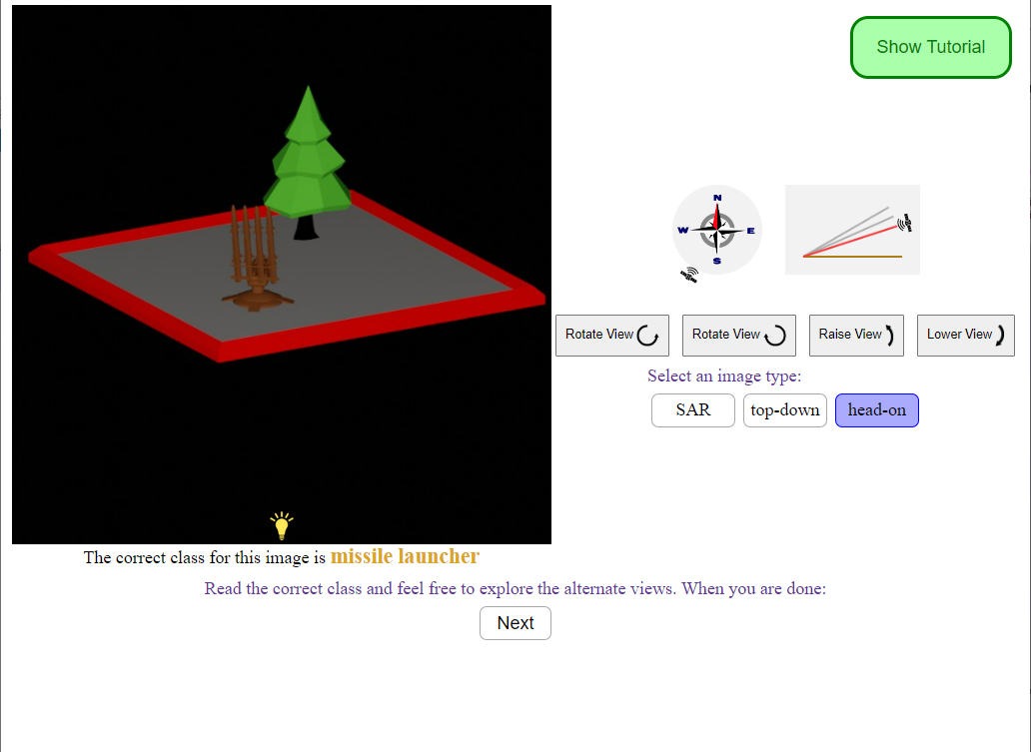
User Study
Instructions
Interacting with the system
Introduction to SAR
Pre-test
(x 30)
Static SAR image
Collect object class and self-reported confidence
Training
(x 6)
Static SAR image, response
SAR + EOx2 Domes, identify correct class
Post-test
(x 30)
Questionnaire
Object classes and photographic examples
Static SAR image
Multiple choice and open-ended.
SAR Dome, response
Collect object class and self-reported confidence
UNCLASSIFIED

Slide 27
User Study
Instructions
Interacting with the system
Introduction to SAR
Pre-test
(x 30)
Static SAR image
Collect object class and self-reported confidence
Training
(x 6)
Static SAR image, response
SAR + EOx2 Domes, identify correct class
Post-test
(x 30)
Questionnaire
Object classes and photographic examples
Static SAR image
Multiple choice and open-ended.
SAR Dome, response
Collect object class and self-reported confidence
UNCLASSIFIED

Slide 28
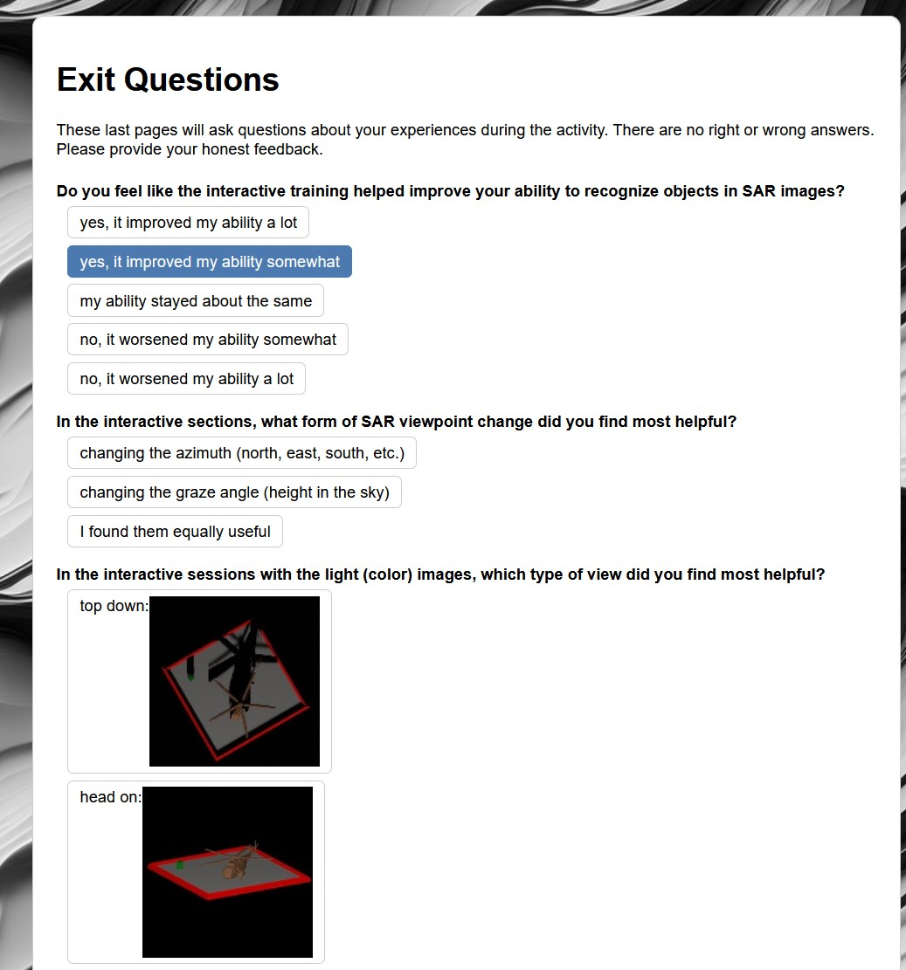
User Study
Instructions
Interacting with the system
Introduction to SAR
Pre-test
(x 30)
Static SAR image
Collect object class and self-reported confidence
Training
(x 6)
Static SAR image, response
SAR + EOx2 Domes, identify correct class
Post-test
(x 30)
Questionnaire
Object classes and photographic examples
Static SAR image
Multiple choice and open-ended.
SAR Dome, response
Collect object class and self-reported confidence
UNCLASSIFIED

Slide 29
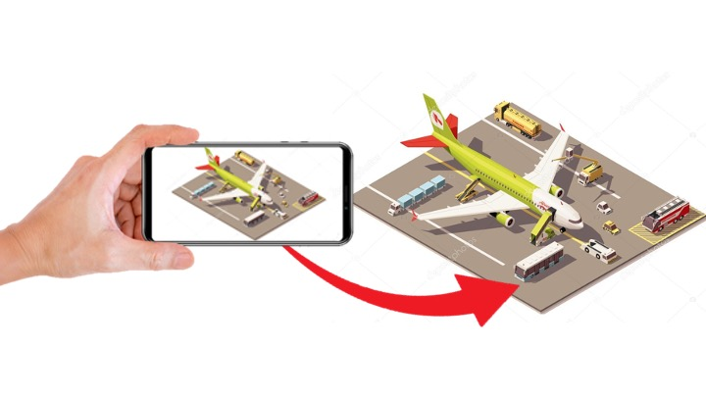
SAR-AR
Smartphone/Tablet-based augmented reality interaction developed for follow on user-study.
UNCLASSIFIED
Notes:
USC-ICT in collaboration with ARL developed an innovative prototype designed to leverage immersive 3D interactive training material to enhance the ability of analysts-in-training to identify and analyze SAR images.
USC-ICT is in the process of developing a more immersive, interactive training engagement that leverages phone/tablet based augmented reality. Where the trainee will use the tablet/phone as a representative SAR sensor, hovering over a virtual scene anchored to a surface in the room. They’ll be able to move around the scene to see it from different vantage points…

Slide 30

You too can …
See Like A
UNCLASSIFIED
Notes:
This training application will be used in the design of a comparable study to the one already conducted. We will investigate whether immersive/interactive engagements like this one can even more greatly improve SAR image identification.

Slide 31

SAR-AR: Adapting Human Vision to Complex Sensing Technologies with Adaptive Synthetic Aperture Radar Image Recognition Training (ASIRT)
04 December 2024
Kimberly A. Pollard, Benjamin T. Files, Brent Lance
DEVCOM Army Research Laboratory
David Nelson, Ben Nye, Rhys Yahata, Spencer Lin
USC Institute for Creative Technologies
UNCLASSIFIED

