Slide 1


Enhancing Operational Decision-Making
with Adaptive Head-Mounted Display Interfaces
Authors
David Nelson, Deniz Marti, Rhys Yahata, David Cobbins,
Raymond New, Rajay Kumar, Mark Core
Steven Thurman
Russell Cohen Hoffing
Presenter:
Deniz Marti, Research Associate, MxR Lab, USC’s Institute for Creative Technologies
David Nelson, Director MxR Lab, USC’s Institute for Creative Technologies

Slide 2

Research Project: Adaptive Head Mounted Display Interfaces
Prototype Interactions
  Future adaptive HMD user interfaces
Command Center Use-case
  Displaying, processing and integrating information on 3D terrain
    providing essential information
    minimizing visual clutter.
Create Conceptual Framework
  Enhancing decision-making
  Informing future modernization priorities
Increased Cognitive Load
  increases with multiple information sources presented simultaneously.
Increased Eye Strain
  constant switching between different visual contexts and focal depths.
Notes:
On this applied research effort the MxR Lab is developing prototype interactions investigating future adaptive user interfaces in head-mounted displays focusing on models to improve user experience and efficacy.
We’re utilizing a Command Center use-case, as we seek to address the challenge of displaying data spatially on 3D terrain, aiming to find a balance between providing essential information and minimizing visual clutter
The goal is to create a conceptual framework for an adaptive interface tailored to warfighter needs, enhancing sense–making and decision-making and informing the Army’s future modernization priorities for head-mounted displays.
This effort was informed greatly by research being conducted at ARL-West addressing a real world problem that can also be found in the use of head mounted displays.
This is the cognitive and physiological cost of frequent context and focal depth shifting when consuming and processing multi-modal information streams.

Slide 3
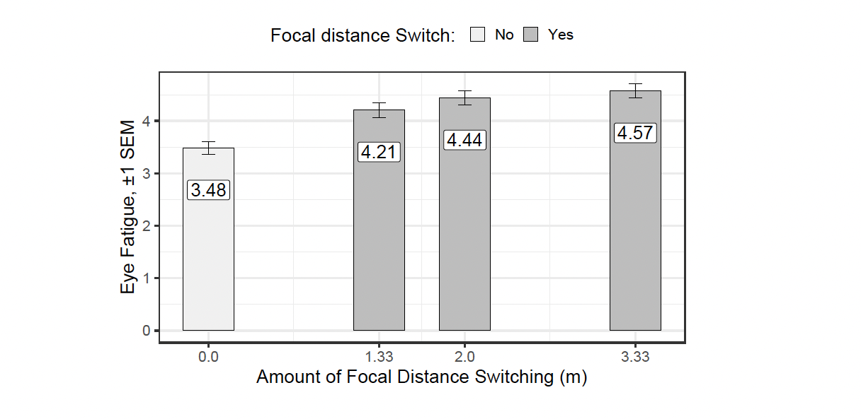
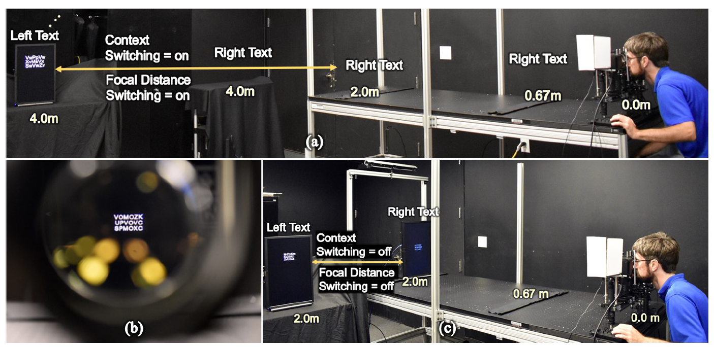
ARL-W Basic Research Studies
Arefin (2020) in their master thesis showed that the focal distance switching condition, participants perform fewer tasks and exhibit lower accuracy across all three distances.
Participants also experience higher levels of eye fatigue when there is a significant amount of focal distance switching.
As the amount of focal distance switching increases, participants' eye fatigue gradually increases.
Notes:
In a controlled laboratory experiment that involved participants searching for specific letters in two blocks of text, one on the left and one on the right. Participants first identified a target letter in the left text, and then counted how many times that target letter appeared in the right text. They had to complete this task multiple times, with varying conditions: some tasks required switching between an augmented reality (AR) display and real-world text, while others involved switching focus between different distances. Performance was measured by how many tasks participants completed accurately, their error rates, and how much eye fatigue they reported.
Researcher Mohammed Arefin found that when user’s had to switch focus between different distances, they completed fewer tasks, made more mistakes, and experienced more eye strain, with eye fatigue getting worse the more they had to switch focus.
This experiment measured how a user’s eye's vergence angle (EVA) changes when focusing on objects at different depths in real, augmented reality (AR), and virtual reality (VR) environments. Using a head-mounted display (HoloLens 2) with eye trackers, the study found that eye vergence angle varies with object depth and differs between real-world and XR environments, highlighting the challenge of eye strain and perceptual distortions in AR and VR. These findings are important for improving XR display designs to reduce eye strain and performance quality.

Slide 4
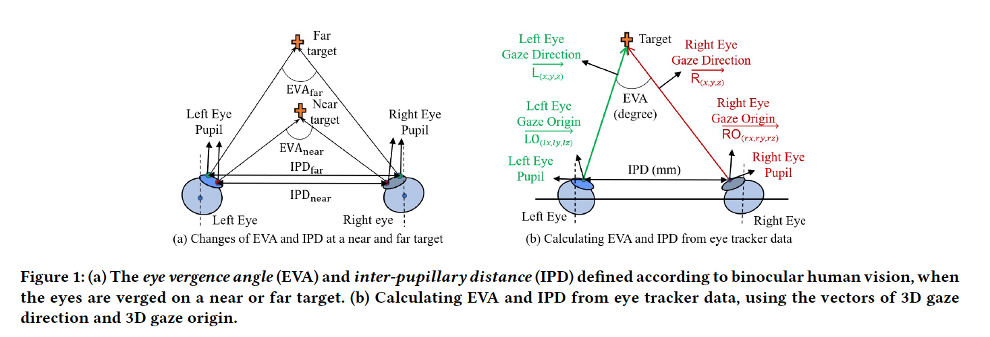
ARL-W Basic Research Studies
  Thurman and Cohen-Hoffing demonstrated that they could utilize eye tracking in an HMD to track perceptual depth changes.
Notes:
Using eye vergence angle (EVA) and interpupillary distance measurements Dr. Thurman and Dr. Cohen-Hoffing’s findings indicated that it is possible, in principle, to predict perceptual depth changes with an eye tracker enabled HMD display.
Most current commercial optical see-through augmented reality displays present content at a fixed focal distance, while real-world stimuli can occur at a variety of focal distances.

Slide 5
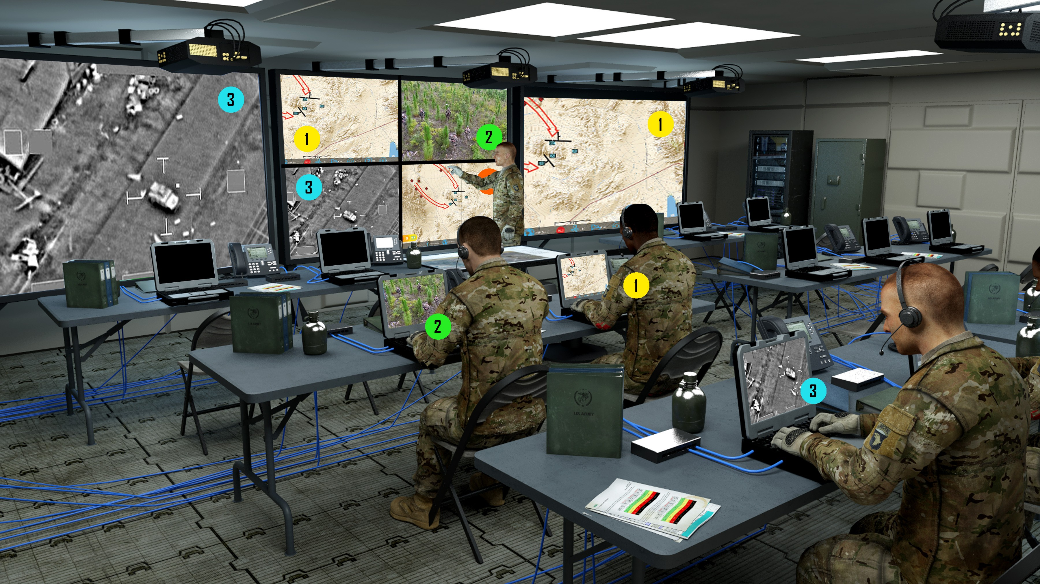
Use Case: Command Center Environment
Context Overload & Depth Shifting
  Command Centers face constant data overload and frequent context switching
Information Integration
  Multiple Fixed Monitors, 2D Maps
Notes:
We saw significant alignment with the basic research efforts of ARL-W and the Mixed Reality Lab’s applied research in adaptive HMDs, and were inspired to apply the ideas in a real world use-case.
Why:
Command Centers intrinsically deal with an overwhelming amount of data that requires frequent context and focal depth switching in the processing and integration of information.

Slide 6
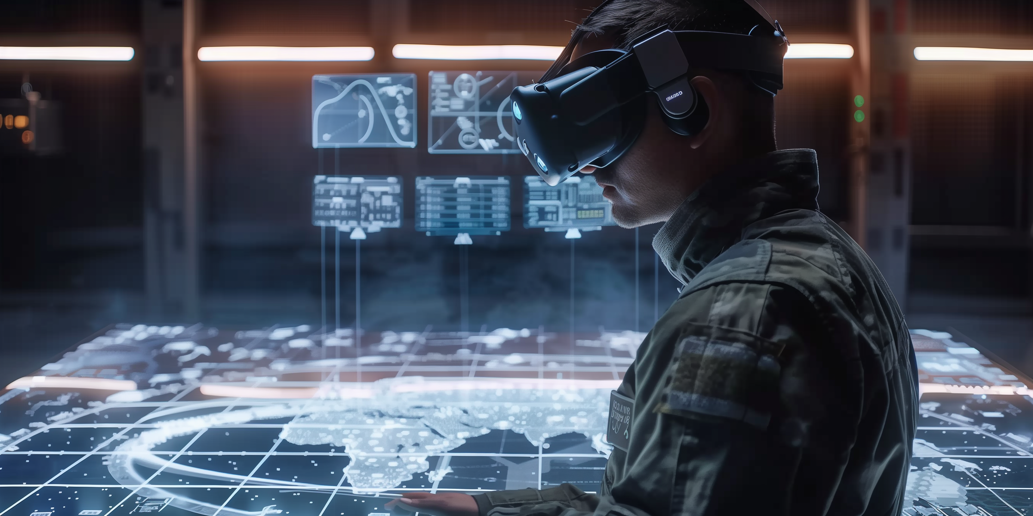
Use Case: Command Center Environment
Leveraging affordances of immersive hardware:
C2 NEXT
  Distributed Command and Control
  Mission Planning
Increased use of MR hardware
  BVI
  XR COP
Unique Capabilities
  3D Maps/Spatial Computing
  Infinite Monitors
Context & Focal Depth Shifting
  Problem not solved.
Notes:
Furthermore, the future vision of C2 seeks to leverage the affordances of XR technologies in mission-critical environments:
To facilitate remote/distributed Command Centers, enhanced mission planning,
display 3D-maps and immersive spatialized data
But the issue of the cognitive and physiological costs of context and depth switching still need to be addressed.
This highlights the need for research in the user-interfaces and user-experiences utilizing these mediums.
Our approach was to use the HMD’s eye-tracking to track users' focus and adaptively display relevant information based on the user’s gaze and perceived perceptual depth. To bring the information to the user at their point of attention and focus.
And to investigate the potential of adaptive user interfaces in XR environments to reduce the cognitive cost of context and depth shifts and improve decision-making in a future tactical command center environment.

Slide 7




Approach
Adaptive HMD Interfaces
  Eye-tracking: Utilize state-of-the-art eye-tracking.
  Dynamic information presentation: Adaptively present information within the user’s point of attention.
  Enhanced decision-making: UI/UX design for quicker and more accurate decisions.
Notes:
Our approach was to use the HMD’s eye-tracking to track users' focus and adaptively display relevant information based on the user’s gaze and perceived perceptual depth. To bring the information to the user at their point of attention and focus.
And to investigate the potential of adaptive user interfaces in XR environments to reduce the cognitive cost of context and depth shifts and improve decision-making in a future tactical command center environment.

Slide 8


Hypotheses
H1: Adaptive interfaces will facilitate user information integration by enabling more frequent gaze switching between the map and screens due to the accessibility (closer spatial proximity) of the screens to the real-time gaze point and the relative ease of information retrieval.
H2: As a result of more information integration, decision-making quality will be higher and decision-making times faster in the adaptive interface condition than in the non-adaptive condition.
Notes:
In short:
H1: Adaptive interface techniques will enable users to switch their gaze between the map and screens more easily by rendering the screens at the depth where they are looking.
H2: More switching will enable better information integration so users will make better and faster decisions with adaptive interfaces compared to non-adaptive ones.

Slide 9




Research Methods
Research Question: To what extent do eye-gazed-based adaptive interfaces improve eye behavior, quality and decision-making speed?
Research Method: experimental design to assess the effectiveness of adaptive and non-adaptive (fixed) HMD interfaces in a decision-making scenario using a 3D map in a Command Center style use-case.
Research Scenario: Substitute Military Operations for a Family Vacation Planning scenario
  Resource management: manage time and money to ensure relatives reach the airport within a six-hour window.
  Dynamic challenges: blocked roads, unexpected demands, and equipment malfunctions.
COMMAND & CONTROL
Notes:
Analogous to command center tasks: Mirrors decision-making challenges in large-scale operations like TOCs
To accommodate a lay population with no military experience:
Your Command and Control scenario became a Family Vacation
Your Tank Platoon became your spouse and children in their respective vehicles.

Slide 10
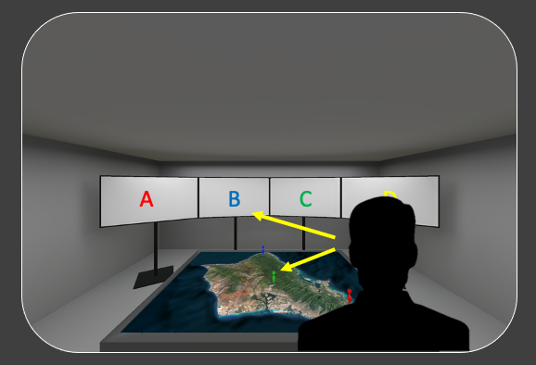



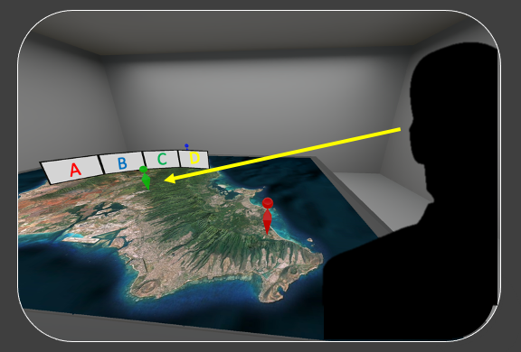

Experimental Design
Sample size of 60:
  31 assigned to adaptive condition & 29 to control condition
Eye behavior variables
  Tracked gaze patterns, fixation times, and switches between map and screens
Decision behavior variables
  9 key decision-making events involving navigation and resource management
  Binary outcomes: good decisions (1) and poor decisions (0)
Time analysis
  Logged decision-making time from information display to decision entry
Control condition
Experimental condition
Notes:
Control condition:
Non-adaptive interface with fixed monitors
Experimental condition:
Adaptive interface data feeds appear at point-of-attention

Slide 11
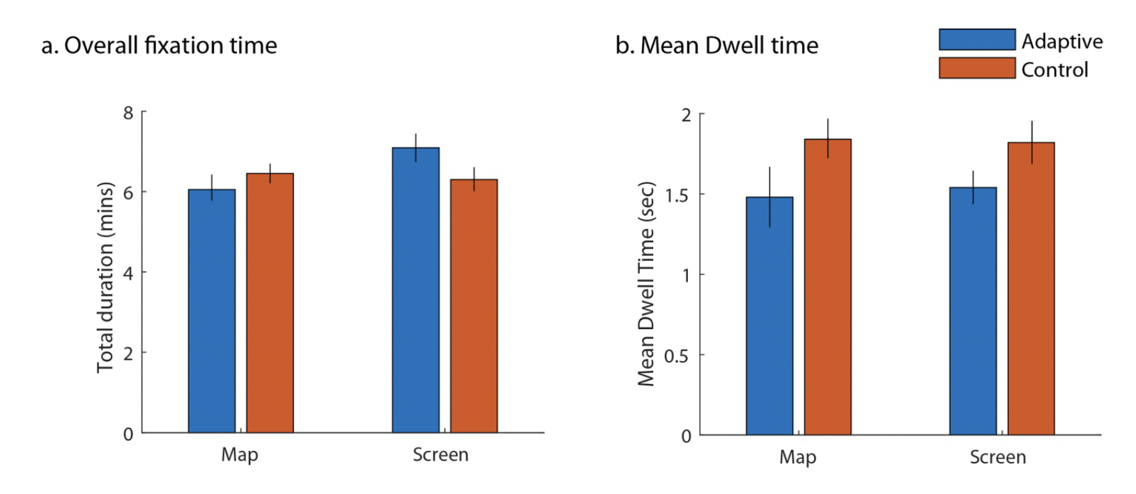
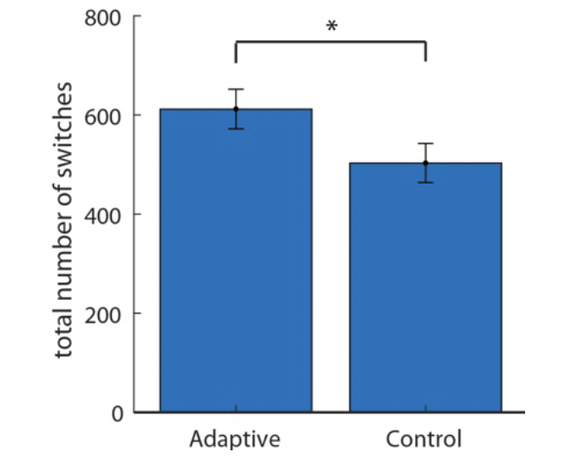
Eye Behavior Results
Higher switching frequency
Participants in the adaptive condition switched more frequently between screens and maps.
Reduced dwell time
The adaptive group spent less time dwelling their attention on screens and maps.
Notes:
We can divide fixation into two: map or screens (one of the screens)
interaction effect, the amount of the time, they spent less time in the adaptive overall fixated in the map, more time on the screens, whereas in the control condition, they looked ~ equally, which indicates that adaptive more time looking on the screen less time on the map.
Next, we examined average fixation dwell time as an indicator of user’s allocation of attention (Figure 5b).
For each fixation on the map or screen, we determined the amount of time spent on average before the user
switched fixation to a different object. In the control condition, average participant dwell time on the map
was 1.84 sec (SD=0.69) and dwell time on a screen was 1.82 sec (SD=0.72). In the adaptive condition, average
participant dwell time was 1.48 sec (SD=1.05) on the map and 1.54 sec (SD=0.58) on a screen. An ANOVA
comparing Condition (adaptive vs control) x Object (screen vs. map) revealed a main effect of Condition (
F(1,104) = 4.44 , p = 0.038 ) but non-significant effect of Object ( F(1,104) = 0.02 , p = 0.890 ) and interaction (
F(1,104) = 0.08 , p = 0.778 ). The main effect of condition suggests that participants in the adaptive condition
deployed their attention more efficiently by leveraging shorter duration fixations onto the map and the
screens to achieve the same level of performance as the control condition, likely aided by the closer proximity
of screens to gaze position in the adaptive condition.

Slide 12
Eye Behavior Results
Increased screen time
Participants in the adaptive condition spent more time processing screen information compared to the control group.
Notes:
We can divide fixation into two: map or screens (one of the screens)
interaction effect, the amount of the time, they spent less time in the adaptive overall fixated in the map, more time on the screens, whereas in the control condition, they looked ~ equally, which indicates that adaptive more time looking on the screen less time on the map.
Next, we examined average fixation dwell time as an indicator of user’s allocation of attention (Figure 5b).
For each fixation on the map or screen, we determined the amount of time spent on average before the user
switched fixation to a different object. In the control condition, average participant dwell time on the map
was 1.84 sec (SD=0.69) and dwell time on a screen was 1.82 sec (SD=0.72). In the adaptive condition, average
participant dwell time was 1.48 sec (SD=1.05) on the map and 1.54 sec (SD=0.58) on a screen. An ANOVA
comparing Condition (adaptive vs control) x Object (screen vs. map) revealed a main effect of Condition (
F(1,104) = 4.44 , p = 0.038 ) but non-significant effect of Object ( F(1,104) = 0.02 , p = 0.890 ) and interaction (
F(1,104) = 0.08 , p = 0.778 ). The main effect of condition suggests that participants in the adaptive condition
deployed their attention more efficiently by leveraging shorter duration fixations onto the map and the
screens to achieve the same level of performance as the control condition, likely aided by the closer proximity
of screens to gaze position in the adaptive condition.

Slide 13
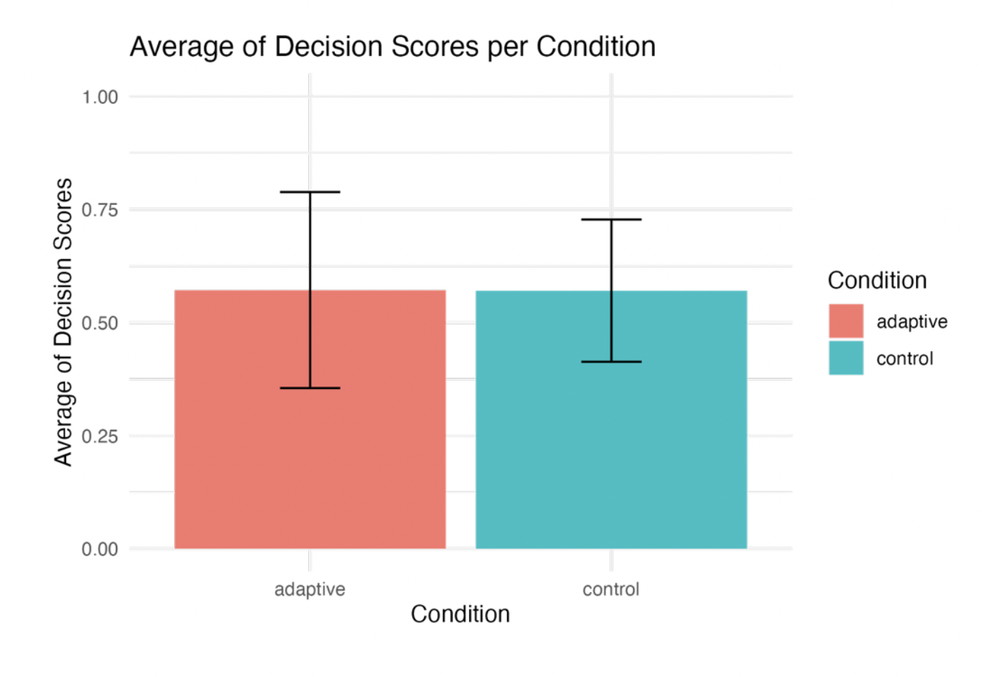
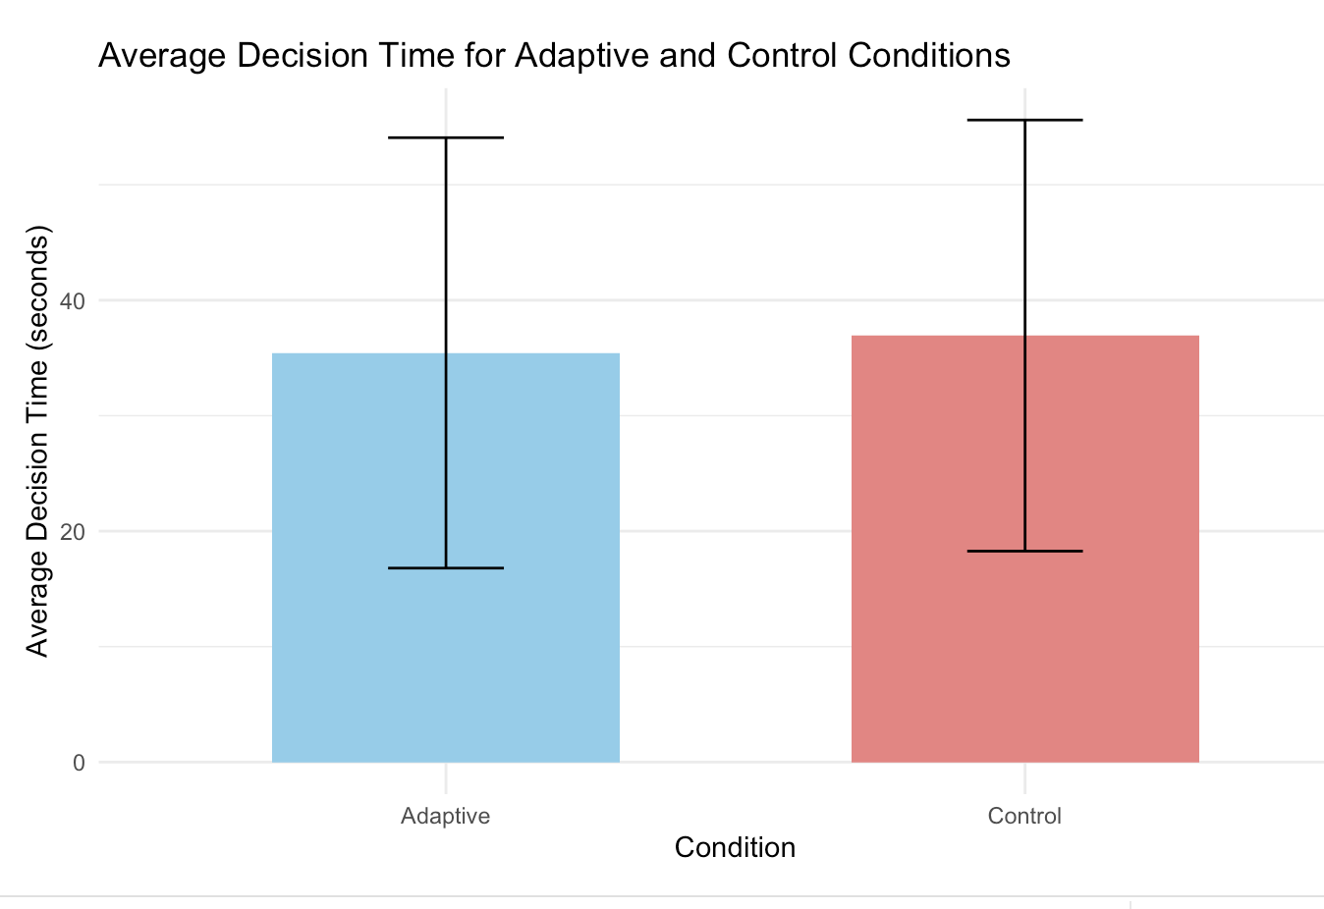
Decision Quality Results
No significant difference in decision-making quality and speed between the control and adaptive conditions.
Notes:
Fig 3. The box plot for average decision scores for both adaptive and control groups.
Participants’ decision-making time was measured by the average interval from the onset of
event-related information display to the point when the participant verbally communicated their
decision. The average decision time was M=35.44 seconds (SD = 18.64) for the adaptive
condition and M=36.94 seconds for the control condition (SD = 18.67). A Welch Two Sample ttest
indicated no statistically significant difference in the time spent making decisions between
the adaptive and control conditions, t(56.78)= −0.65 , p=.51 (with 95% CI [−10.64 , 5.42]).
The average decision time was M=35.44 seconds (SD = 18.64) for the adaptive condition and M=36.94 seconds for the control condition (SD = 18.67).
A Welch Two Sample test indicated no statistically significant difference in the time spent making decisions between
the adaptive and control conditions, t(56.78)= −0.65 , p=.51 (with 95% CI [−10.64 , 5.42]).

Slide 14
Key Conclusions
Increased screen time leads to more engagement with the available information despite shorter time spent on each object.
Higher switching frequency & reduced dwell time
  The adaptive group spent less time dwelling their attention on screens and maps.
  Frequent switches between the map and screens made it easier to integrate important information into the map without affecting decision-making performance.
No significant difference in decision-making quality and speed across both the adaptive and control groups.
Why?
  Sample Size – Relatively small, lay population
  Task Complexity/Engagement: Tasks were fairly simple.
  Incentive: Participants might need more motivation to strive for better performance
  Adaptive ≠ Adaptable: Participants did not have a choice to apply the technique.
Notes:
Participants in the adaptive condition spent more time processing screen information compared to the control group.
Participants in the adaptive condition switched more frequently between screens and maps.
The higher frequency of switches in the adaptive group suggests more integration of map and screen data, though this did not correlate with a significant change in performance.
control Condition
Participants increased fixation dwell time and switched less frequently, likely increasing working memory load due to higher locomotive cost of switching gaze.
Adaptive Condition
Lower locomotive effort allowed participants to reduce working memory load by offloading memory with each screen fixation.
Dwell time– integration, synthesis

Slide 15
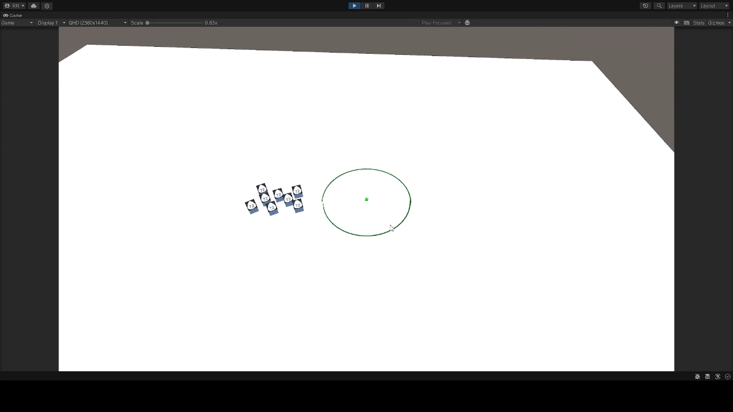
Key Findings/Insights
Key Finding:
  Information Integration:
    Frequent display switching
    More total screen time
    Focus on critical info
Insight:
  Alternative Conditions:
    Frequent context/depth shifts
    Info at point of attention
    Complex, high-stakes decisions
    Future Research:
  Adaptive vs Adaptable:
    User choice in display methods
    Improved decision speed and quality
Notes:
Using eye-tracking as an interface to initiate a decluttering technique, offering user a choice to accept or deny.
Adaptable: User decides when to deploy the adaptive technique.
Adaptive: System automatically “decides” the adaptive technique based on conditions.
urrently conducted a new/similar user study, introducing a new adaptation technique we call FAN (Filter and note) to decrease clutter and provide more dynamic information working on a 3D Map in an immersive command center environment.
We look forward to sharing those results with you soon.
Key Finding:
Information Integration: Although users switched between displays more frequently and spent less time focusing on each individual display, this led to spending more overall time on the screen they did spend more time on integrating the most critical information (screen)
Insight:
Alternative Conditions: We can extrapolate that the enabling users to context and depth shift more frequently by providing information at the user’s point of attention might still mitigate the associated cognitive and physiological costs while provide better information integration when applied in more complex and dynamic scenarios where higher stakes decision making is involved.
Adaptive vs Adaptable: Offering user’s the ability to choose display modalities and techniques may improve information processing and decision making speed and quality.

Slide 16
Q & A
Contact email: dnelson@ict.usc.edu

