Slide 1


Development of closed-loop military simulation software:
Challenges, best practices, and lessons learned
Erkin Çilden¹, İsmail Çağlar Çetintaş¹, Denizcan Demirok¹,
Büşra Toraman¹, Levent Hakkı Şenyürek¹, Fatih Narman¹,
Merve Çağlar Erdemir¹, Ahmet Sezer¹, Halit Oğuztüzün²
¹ STM Defense Technologies Engineering and Trade Inc.
Ankara, TÜRKİYE
² Middle East Technical University, Department of Computer Engineering
Ankara, TÜRKİYE
Notes:
- Greetings
- Talk about self (STM, Turkey)

Slide 2
Outline
Introduction
GEMED Project Experience
Perspectives
Modelling Perspective
User and Analysis Perspective
User Experience and User Interface Design(UX / UI)
Engineering and Management Perspective
Discussion and Conclusion
Notes:
These are the key points to mention in outline:

Slide 3
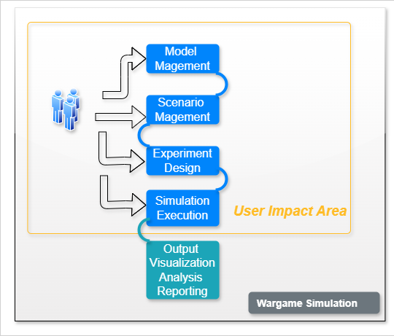
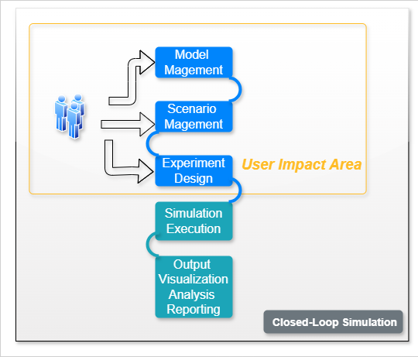
Introduction
Wargame
In the military context, the simulation of a military operation (Ministry of Defence UK, 2017; NATO, 2019, 2023)
A multi-user software incorporated in a multiplayer game setting
Usually equipped with real-time models with appropriate levels of fidelity and aggregation
Tools required to manage the execution
Features to support the evaluation and improvement of the players’ real-time decision capabilities
Closed-loop Simulation
A term used for this category is closed-loop simulation (Hodický et al., 2020; Turnitsa et al., 2022), or less frequently automated constructive simulation (ACS) (Hodicky et al., 2019; Nohel et al., 2022)
The players are not in-the-loop during the simulation execution
A predefined scenario script is followed from the beginning to the end without interruption
Notes:
As a common understanding, a computer-assisted wargame simulation is:
BULLETS
Closed-loop simulation in this paper means:
Computer simulation model executes without user intervention
Serves for military purposes such as training, tactics evaluation and technical effective analysis.
In this paper we summarized some challenges we faced, best practices and lessons learned from our experience on a closed-loop military simulation software development project.
We told our experiences from following perspectives:
Model Engineering
Software Engineering
Project Management

Slide 4
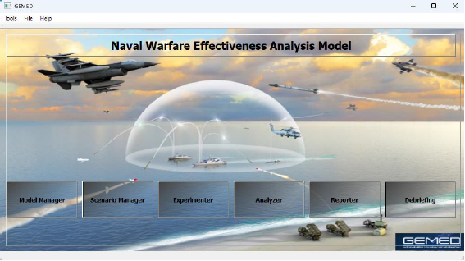
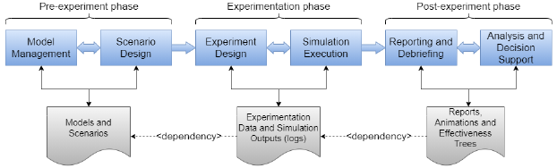
GEMED Project Experience
Closed-loop military simulation
Multi agent based design
Mix of discrete-event and variable time advance mechanisms
Multi-level analysis simulation system
Design of Experiments:
• Controlled variations and randomness sources
• Multiple runs: Factors and Trials
~90 generic system models, by a consortium of 4 contractors:
Naval and Air Platforms
RF/IR/Acoustic Sensors
Weapon Systems
Missiles
Command Control Systems
Notes:
GEMED: Naval Warfare Effectiveness Analysis Model
Six modules: model management, scenarion management, DOE-and-execution, reporting, debriefing and effectiveness analysis.
DoE: Points of interest are chosen such as maximum radar range, initial ship position change and experimented upon using full factorial design.
Dependency through data. Each modüle is an application of sorts itself and only data flow is shared between them.
A research and development project developed between 2018-2023 to analyse tactical/operational scenarios via scientific methods through simulation outputs of batch runs and experimentation.

Slide 5
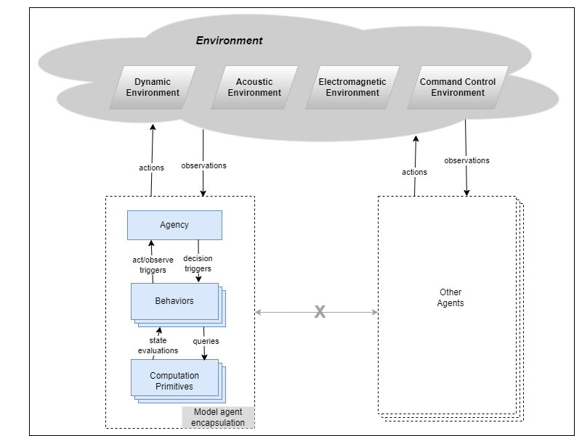
Perspectives - Modelling
Model Development and Implementation Aspect
Multiagent Based Design
Managing the modeling complexity of the target domain is easier
An effective way to understand the emergent behavior of the complex phenomenon
Agent encapsulation makes it easier to isolate agents
On the other hand,
Certain model design mindset, certain autonomy of models, model developers’ experiences. (Design challenge)
Requires a careful design of the “environments” since agents only interact through them(Invisible environments)
An acceptable level of agent autonomy
Higher levels of autonomy difficult to interpret analytically
Notes:
A bottom-up approach is chosen where each run-time entity is an agent.
Agent-to-agent communication is only allowed through environments and events. These environments are:
Newton physics
Hydro-acoustics
Electromagnetic spectrum
C2 (tactical picture related data)
Additionally, events (Explode, Start Moving, Turn On etc.) are utilized.

Slide 6
Perspectives - Modelling
Model Development and Implementation Aspect
Multi Fidelity Alignment
A requirement or a constraint for a closed-loop military simulation
MABS principles usage
Multiple stakeholders’ contribution
Early integration using mock models
On the other hand,
Careful consideration of multiple-aspects with multiple stakeholders
Multiple-fidelity modeling has potential adverse effects on consistency:
Repeatability
Reliable emergent behavior
Smooth user experience
Notes:
Most challenging task of developing a closed loop simulation; Decide what level of fidelity is sufficient for the requirements at hand.
Performance and complexity is key concerns. Will it run fast enough? Can user find the required data to create an object from the model?
With Multi Agent Based Simulation each model can be implemented with a higher amount of freedom. Define agent’s data needs, outputs and environment interactions clearly and you are mostly done.
Validation of model is easier with such an approach where the focus is on one single model.
Although some models require other models to behave «correctly» to some degree for validation to be acceptable

Slide 7
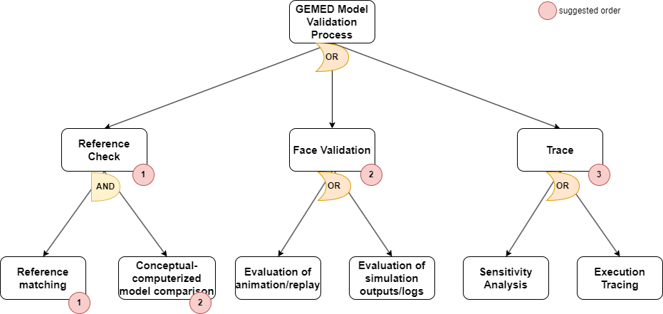
Perspectives - Modelling
Model Validation and Verification Aspect
Feature Driven V&V Process
Repeatable process steps
Easy measurement of the progress of the V&V activities
Common ground for the whole discussion and negotiation
Enabling automated V&V at the feature level
On the other hand,
Consensus of all stakeholders at the beginning of the project
Not be always easy to achieve
Automation tools to keep track of progress, and test repeatability
Notes:
Feature-driven approach is chosen. Features and related test scenarios are derived from models and a baseline for V&V process is created.
Scenario-driven acceptance tests for verification.
Repeatable processing steps: repetitions are not avoidable. Define a process that may be run again and again.
Easy measurement of the progress of the V&V activities: Which feature is tested, which feature failed etc.
Common ground for the whole discussion and negotiation: There are defined processes and metrics. Stakeholders can discuss about them.
Enabling automated V&V at the feature level: When scenario are defined and ready, scenario runs may be automated. This frees resources to be used elsewhere.
Consensus of all stakeholders at the beginning of the Project: Features should be agreed upon. It is not always possible.
Automation tools: Tools like Squish, Selenium etc. may increase cost.

Slide 8
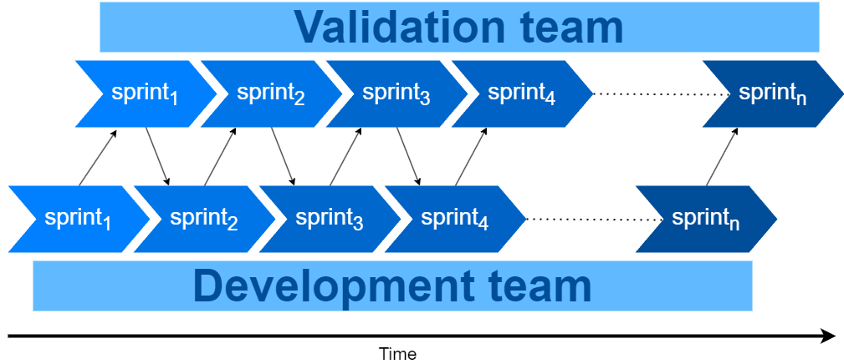
Perspectives - Modelling
Model Validation and Verification Aspect
Continuous Regression
Ensures that earlier achievements of the validation activities are still intact
Significantly elevates stakeholder confidence
Additionally,
Should be supported by automation tools
GUI testing tools
Project specific scripts
Would better be practiced by dedicated personnel
Difficulty of prediction and planning in advance of work package for the amount of resources
Notes:
Change to a model may mean significant change to overall emergent behavior i.e. a butterfly effect.
Therefore, change management is an important aspect of model V&V process.
Automated tests and correct regression analysis to model behavior is a required strategy.

Slide 9
Perspectives - User and Analysis
Data Management and Simulation Output Analysis Aspect
Simulation Big Data
Database management:
NoSQL databases
Ontology driven design (Hofmann et al., 2011),
May require the user to select a subset of the simulation outputs to reduce the data repository workload
However,
Calibrating the data management solution for conflicting database operations is not straightforward
Requirement of significant effort of database indexing for optimal performance
Possibly cannot be finalized until the late stages of development
Notes:
Hundreds of batch runs with a couple levels mean massive amount of output data/simulation log.
Best-effort run requirements means that simulations should run as fast as possible. Output writes should not create a bottleneck during simulation run.
After simulation runs, analysis requires read operations to be as fast as possible.
MongoDB with Logstash; Write to log files during simulation run and let logstash handle the burden of writing to database as a independent process. MongoDB was suitable to collect different kinds of log data.
Indexing; optimizing indices was challenging. Even now more optimization is required.

Slide 10
Perspectives - User and Analysis
Data Management and Simulation Output Analysis Aspect
Inspection of Simulation Outputs
Usage of 3rd party data inspection software
Supporting at least a few popular/required software for data inspection
Selection of target tools and development of export libraries will probably pay back
No silver bullet to handle every need regarding simulation output interpretation tools. Support for a handful of tools/software might be good idea.
On the other hand,
Licenses for third-party software libraries should be used with caution
Requirement of a meta-data derivation layer for advanced analysis, before export
Graphical analysis data is crucial for understanding complex phenomena
Run-by-run comparable attribute value change rate
Hypothesis analysis on select model attributes
Time series etc.
Notes:
The main purpose of closed-loop simulation software is analysis. A lot of data should be presented to user in a comprehensible, clear way. Some visual representation of scenario flow, namely 3D debriefing, some reports and analysis options should be present in the simulation software..
To address this in GEMED, we did not invent the whole tool stack again and applied 3rd party tools and solutions to our software such as SIMDIS for debriefing/3D display and R and Python scripts and libraries for reports, graphs and analysis tools. We also implemented Unity based 3D viewing solution to be able to change SIMDES based tools in case of licensing problems and other customer requirements.

Slide 11
Perspectives - User Experience and User Interface Design (UX / UI)
Closed Loop Scenario Definition Challenge
Defining a set of rules that would cover the whole automated scenario flow
Visual programming environment
Pre-run mechanism for the target scenario to properly build-up
Suitable to use as a base for further altered trials
Usage of widely accepted model and process definition standards and languages
BPML, UML, SysML
On the other hand;
Close negotiations with the end-user to understand their needs
Frequent interim releases the tool might help
The proposed solution may be tightly coupled with the underlying model design
Important to set an appropriate model abstraction level to build it on
Notes:
In a wargaming simulation scenario consists of initial states of players a small set of planned injections during simulation. Computer assisted simulation entities may require additional programming to mimic desired unit behavior. On the other hand, closed-loop simulations use scenario as its base state and its execution flow meaning it includes starting positions, complete unit behavior and conditional inputs. Should we have a scripting language for this task? Will user be able to use this scripting language? Could sufficient training be provided to every new user? Hard to know when you don’t know the whole user base.
Instead hiding the language behind a simple GUI and minimal training to use that GUI seems like a better alternative. To that end, we implemented a visual scripting tool inspired by Business Process Modeling practices. With this tool, the user can create plans by using pre-defined tasks (like “Follow the waypoint”, “Search in the area”) concurrently and sequentially and by utilizing conditional transitions between such tasks.

Slide 12
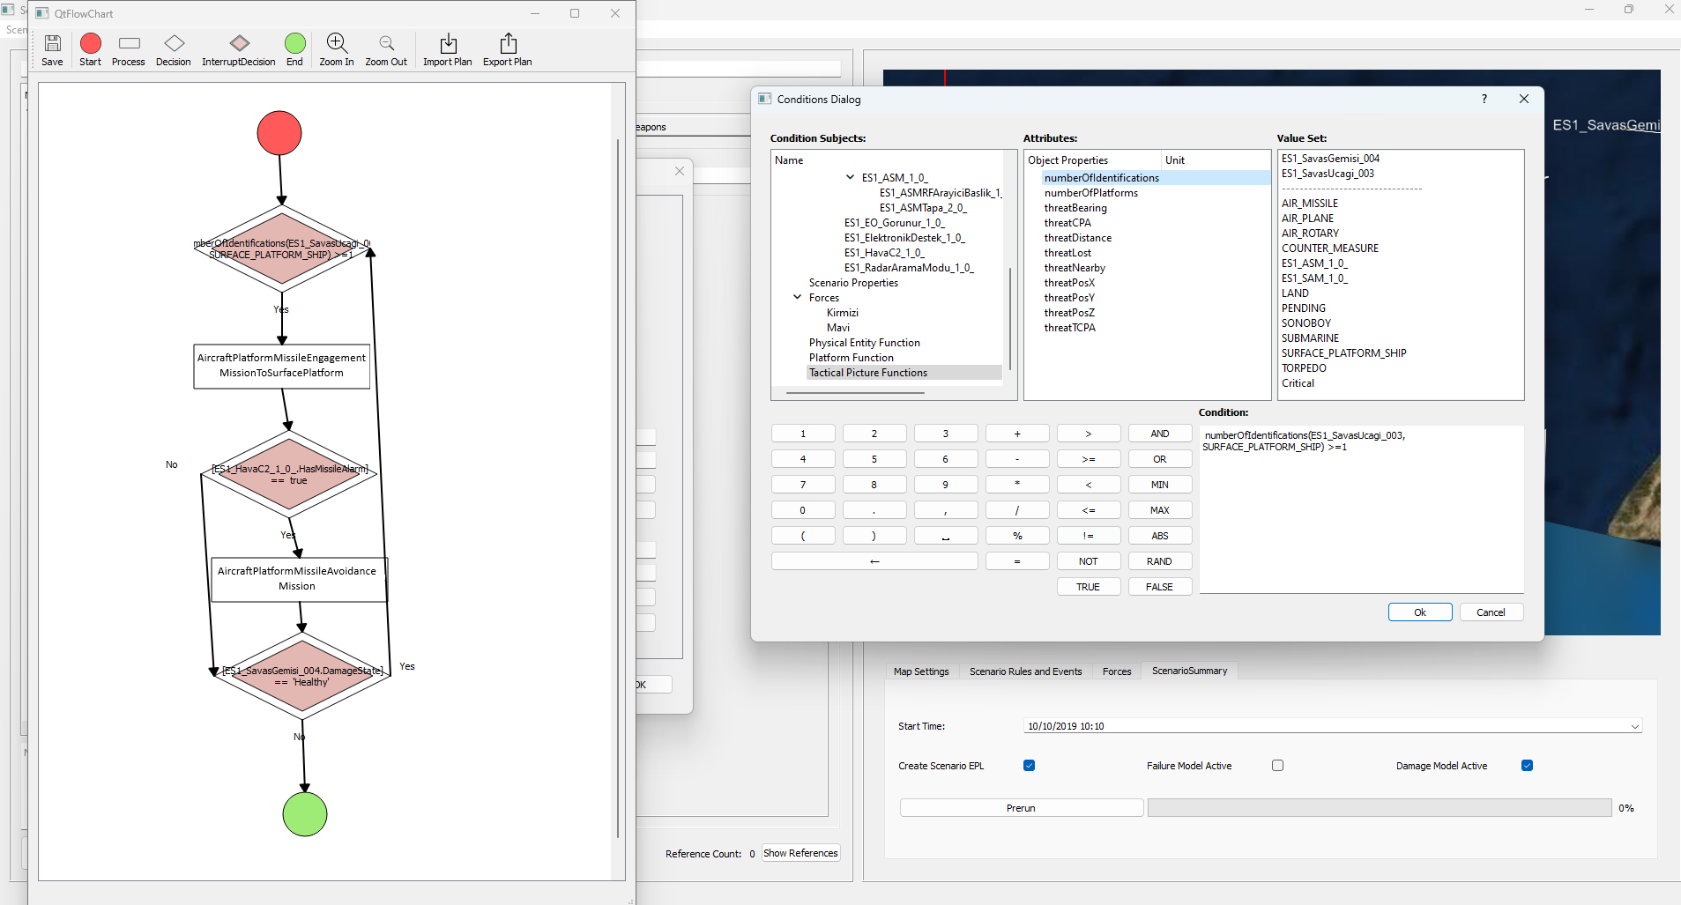
Perspectives - User Experience and User Interface Design (UX / UI)
Closed Loop Scenario Definition Challenge
Notes:
In a wargaming simulation scenario consists of initial states of players a small set of planned injections during simulation. Computer assisted simulation entities may require additional programming to mimic desired unit behavior. On the other hand, closed-loop simulations use scenario as its base state and its execution flow meaning it includes starting positions, complete unit behavior and conditional inputs. Should we have a scripting language for this task? Will user be able to use this scripting language? Could sufficient training be provided to every new user? Hard to know when you don’t know the whole user base.
Instead hiding the language behind a simple GUI and minimal training to use that GUI seems like a better alternative. To that end, we implemented a visual scripting tool inspired by Business Process Modeling practices. With this tool, the user can create plans by using pre-defined tasks (like “Follow the waypoint”, “Search in the area”) concurrently and sequentially and by utilizing conditional transitions between such tasks.

Slide 13
Perspectives - User Experience and User Interface Design (UX / UI)
Scenario Variations Management
Tools for easily alter the scenario and to manage the scenario variations
Closely dependent on the ontology
A careful ontology management can enable smooth batch management at the data layer
Allow a fluent and practical control flow of simulation software for the user
However,
The user should be informed and/or trained about the meaning of the batch run methods presented by the tool
Statistical impact on the expected output, which may require additional interpretation
Blocking much of the computing resources for a long time
A good practice to design the simulation software non-blocking for other processes of the host computer
Notes:
Experiment design is generally a requirement for closed-loop simulations
After a base scenario created, alterations to the scenario definitions may be applied such as random walks, Monte Carlo simulations and DOE.
Manually running each variation is cumbersome! Batch runs of experiment via an UI is much more helpful.
Association of variation with the base scenario in automated batch run technique is easier when it comes to analysis phase.
In GEMED, user can define levels, factors and random variation on scenario or model attributes. After that the software take cares of the rest and automatically dispatches runs to CPU threads.

Slide 14
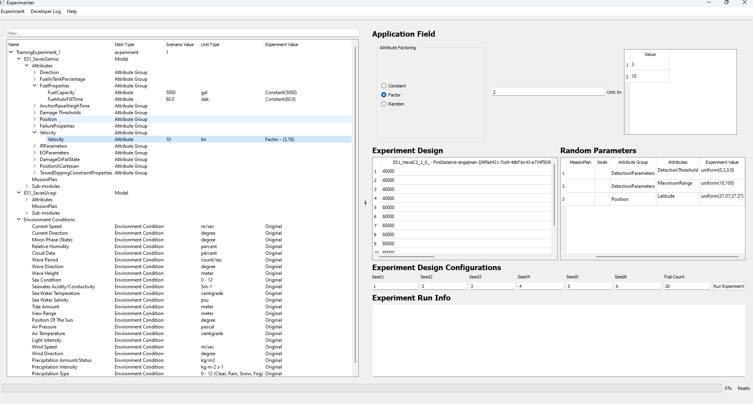
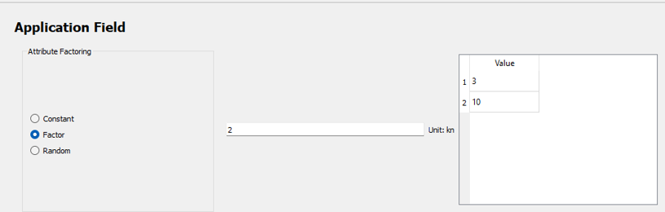
Perspectives - User Experience and User Interface Design (UX / UI)
Scenario Variations Management
Notes:
Experiment design is generally a requirement for closed-loop simulations
After a base scenario created, alterations to the scenario definitions may be applied such as random walks, Monte Carlo simulations and DOE.
Manually running each variation is cumbersome! Batch runs of experiment via an UI is much more helpful.
Association of variation with the base scenario in automated batch run technique is easier when it comes to analysis phase.
In GEMED, user can define levels, factors and random variation on scenario or model attributes. After that the software take cares of the rest and automatically dispatches runs to CPU threads.

Slide 15
Perspectives - Engineering and Management
Software Engineering Aspect
The Simulation Engine
Design of engine;
Usually tightly depends on performance and model fidelity requirements
Critical technical path of the software development plan
Multiple modeling approaches to achieve targeted software quality attributes, depending on the intended use
However,
May require careful planning and incremental prototyping of the simulation engine
Impact on shape the design and development practices for models
Trade-off between decentralization of the simulation engine with repeatability and overall execution performance
The selection or design of the engine should consider the autonomous execution principles of the intended simulation models, since they determine the techniques (events, time advance functions, state transitions etc.) required to serve the models throughout their execution.
Notes:
Developed an in-house engine since COTS solutions didn’t address both flexibility of autonomous model development and performance/parallel processing concerns.
A mix of discrete event and variable time simulation approach is followed. Different models worked best with different approaches.
Multi-agent based simulation approach. Each system/sub-system is modelled as an autonomous agent and interactions are only possible through various environments.

Slide 16
Perspectives - Engineering and Management
Software Engineering Aspect
Utilizing Computational Resource
Would be necessary most of the time, which differentiates it from most other simulation systems
Can be achieved simply by distribution or parallelization of each trial
Trade-off problem where several factors should be considered, including
Computation complexities of trials,
Inter-process communication
Network connection latencies
Network topology
Hardware specifications
On the other hand,
Distributing simulation models/entities over computing resources would not be straightforward to implement, while trying to maintain common target attributes of a closed-loop simulation such as repeatability, faster than real-time execution, etc.; instead, distribution of trials may be a more practical design choice,
Addressing pseudo-randomness may require special handling in case of parallel executions
Notes:
We needed batch runs to complete as fast as possible. Logical path is to utilize parallel processing and distributed computing. Due to user requirements and hardware limitations of that requirements (close site, single desktop application etc.) parallel processing by utilizing all available CPU threads was the answer.

Slide 17
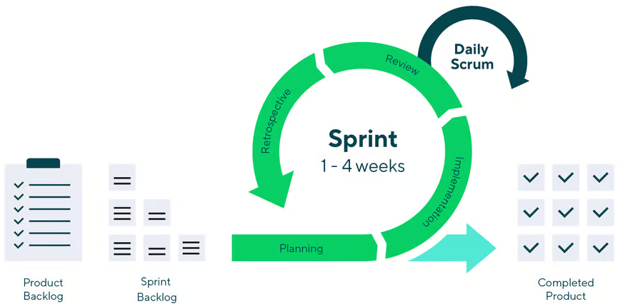
Perspectives - Engineering and Management
Project Management Aspect
Significant Difficulty in Effort Estimations
Practice of iterative and incremental development (such as Agile methods)
Easier to collect effort history of the team and update future estimations accordingly
Early integration and frequent delivery speed up error reduction
Identifying issues sooner and clarifying user expectations quickly
Initiate model validation activities starting from the requirements analysis phase, at the conceptual level
Additionally;
No generic solution for accurate effort estimation for development of complex simulation software
Additional effort may be required to find tailored solutions specific to the project
Image from Wrike Agile Guide, URL: https://www.wrike.com/agile-guide/agile-development-life-cycle/
Notes:
Effort estimation and planning was one of the most difficult challenges for GEMED. Primary reasons that we identified during development are:
Model development with additional layers of autonomy are challenging
Emergent behavior in a scenario of multiple models under development requires constant calibration
Different models may end up with different levels of fidelity. Alignment of fidelity effort may be unpredictable
Model coupling (for instance between seeker and its parent missile)
Started with Kanban. At the start of development constant changes and prototyping meant no sprint to complete with usable feature. Once first set of models and their interactions are coherent enough and milestones are established, we switched to Agile to complete tasks in productive meaningful manner.

Slide 18
Perspectives - Engineering and Management
Project Management Aspect
Adverse Effects of Multiple Intended Use
Requirements elicitation phase should be carefully handled, frequently reviewing the intended use(s) until the early prototypes
A higher-level authority for aligning the stakeholders around a single intended use may be assigned
On the other hand;
Frequent delivery or early prototyping may fail to demonstrate the conflicting intended uses
Focusing more on lower-level software and model features compared to a conceptual intended use, which may delay the identification of the problem
Notes:
When customer requirements have ambiguous multiple intended uses, it is a technical challenge to design a software and/or conceptual model space, in such a way that it covers every intended use of the resulting software. For instance, missile-target engagement, hit and destruction calculations (which requires high precision calculations with a time resolution of milliseconds) vs. force-on-force analysis of combatant platforms (which are engagements that may span days or even weeks )might be an example of conflicting intended uses.
In the case of conflicting intended uses and customer needs, the solution may even become an implementation of different modes of simulation software (which results in higher development effort than intended) or a mixing of different model fidelities in same scenario environment (which makes simulation results barely usable)
To combat such cases:
- Requirements elicitation phase should be carefully handled, frequently reviewing the intended use(s) until the early prototypes that demonstrates different intended use cases.
- A higher-level authority for aligning the stakeholders around a single intended use may be assigned and invited to technical meetings between stakeholders
But…
- Frequent delivery or early prototyping may fail to demonstrate the conflicting intended uses since they focus more on lower-level software and model features compared to a conceptual intended use, which may delay the identification of the problem.

Slide 19
Conclusion and Discussions
Three critical areas while developing a closed-loop simulation:
Simulation models pose design, development and credibility challenges, even in the conceptual phase. “Intent/Purpose” should be considered carefully.
Big data management, output analysis and user interface design require unique solutions.
Trade-off between clashing decisions should be carefully managed.
Future Discussions and Improvements:
V&V and testing effort through GUI test automation. Regression testing of model changes can be handled much faster.
Generic, ontology-driven, end-to-end simulation software design. New simulation software implementation cost would be reduced significantly.
Common design framework (requirements management and ontology) for stakeholders to collaborate on.

Slide 20
Questions
QUESTIONS?
ACKNOWLEDGEMENTS
This work is supported by the Scientific and Technological Research Council of Türkiye (TÜBİTAK) under Grant No. 115A044.
Notes:
That’s all from me on the subject of developing GEMED. Thanks for listening. Any questions?

